Slide 1
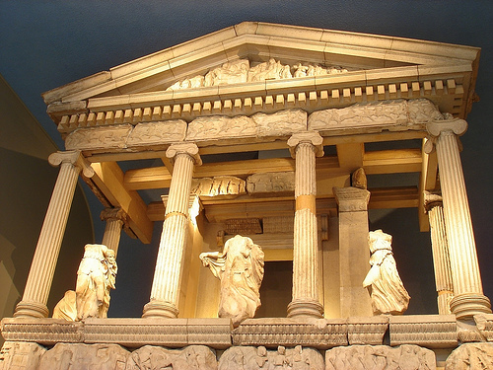
SWEN-755: Software architecture Quality Requirements
Viktoria Koscinski

Slide 2
Architecturally Significant Requirements (ASRs)
Architecturally Significant Requirements
Architecturally significant requirements (ASRs) are those requirements that play an important role in determining the architecture of the system.
Technically challenging.
Technically constraining.
Central to the system's purpose.
If a requirement affects the making of a critical architectural design decision, it is by definition an ASR.
Identifying and communicating this subset of requirements will help others understand their potential implications.
Notes:
ASRs tend to be technically challenging, technically constraining, and central to the system’s purpose.
Can ASRs be functional requirements, non-functional requirements, or both? Both! There will be more non-functional ASRs than functional.

Slide 3
Architecturally Significant Requirements (ASRs)
Is it architecturally significant?
Reminder – we talk about 3 main types of requirements:
Functional: satisfied by including appropriate set of responsibilities within the design.
Functionality does not determine architecture (and many architectures can satisfy one functionality), but functionality interacts with and constrains other qualities.
Quality Attribute (QA): satisfied by structures and behaviors of the architecture.
Constraints: design decisions that are already made.
Notes:
Functional: we care about how the functionality affects and interacts with our qualities
QAs: security, availability, modifiability, etc.
Constraints: we care about how to design the system around them
What is another name for QA requirements? Non-functional requirements.
Can we change the constraints or compromise on them? No!

Slide 4
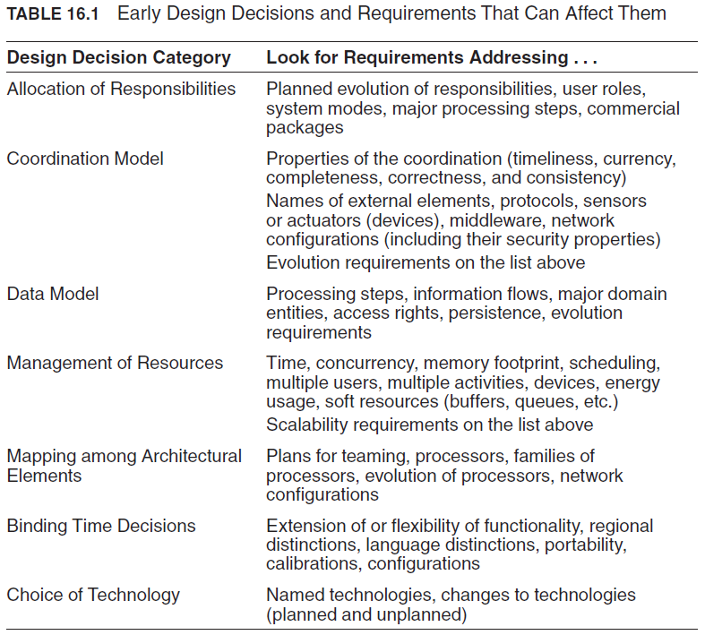
Architecturally Significant Requirements (ASRs)
Is it architecturally significant?
Software Architecture In Practice, 3rd edition
Notes:
Left side: categories of architectural design decisions
Right side: requirements that might affect that kind of decision

Slide 5
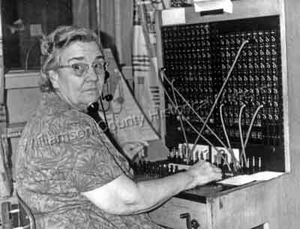
Architecturally Significant Requirements (ASRs)
Example: ASRs
Imagine that a telephone switch manufacturer is creating a new switch.
That system must be able to route calls, generate tones, generate billing information and so forth.
But if it is to be successful, it must do so within strict performance, availability, modifiability, and cost parameters.
The architecture is the key to achieving — or failing to achieve —these goals.
Notes:
route calls, generate tones, generate billing information and so forth – What is this? Functionality!
performance, availability, modifiability, and cost parameters. – What is this? Qualities!

Slide 6
Architecturally Significant Requirements (ASRs)
Good examples
The following are good examples of Architecturally Significant Requirements:
The system must record every modification to customer records for audit purposes.
The system must respond within 5 seconds.
The system must deploy on Microsoft Windows XP and Linux.
The system must encrypt all network traffic.
The ATM system must dispense cash on demand to validated account holders with sufficient cleared funds.
Notes:
Security
Performance
Cost, Modifiability, Availability
Security
Performance, Security
They all allow for quality attributes!!!

Slide 7
Quality Attributes
Functionality vs. Quality
Quality concern
Quality concern
Quality concern
Within complex systems, quality attributes can never be achieved in isolation.
The achievement of any one will have an effect on the achievement of others.
Sometimes the effect is positive and sometimes negative.
Notes:
Functionality can also affect quality attributes

Slide 8
Quality Attributes
Usability
Security
Functionality vs. Quality
Security
Cost
Modifiability
Performance
Notes:
How do each of these tradeoffs work? Possibly: 1. Better security -> less usability
2. bigger security -> bigger cost
3. Better performance -> less modifiability

Slide 9
Quality Attributes
Quality Attribute Scenarios
Artifact
1
2
Stimulus
Response
3
4
Source of stimulus
Environment
Response measure
Quality attribute characterizations answer the following questions about each attribute:
What are the stimuli to which the architecture must respond?
What is the measurable or observable manifestation of the quality attribute by which its achievement is judged?
What are the key architectural decisions that impact achieving the attribute requirement?
Notes:
QAS: used to specify quality attribute requirements!
This is a general scenario. It is general because it doesn’t have any specific characterizations (source of stimulus, stimulus, artifact, environment, and so on…).
These are also sometimes called “generic scenarios.”
A scenario with specific characterizations for a specific quality attribute is called a concrete [quality attribute] scenario.
A scenario without specific characterizations but still aimed for a specific quality attribute is called a general [quality attribute] scenario.
For example, in the next few slides, we will see a general availability scenario, as well as a concrete availability scenario.

Slide 10
Quality Attributes
Quality Attribute Scenarios
Source of stimulus: Some entity that generated the stimulus (human, computer system, etc.).
Stimulus: A condition that requires a response when it arrives at the system.
Environment: The conditions surrounding the stimulus (normal operation, a state/mode).
Artifact: Some artifact is stimulated (the portion of the system to which the requirement applies).
Response: What happens as a result of the stimulus?
Response measure: Is the response satisfactory? How is the response measured?
Notes:
6 pieces of information that we need.
Artifact: data store vs entire system, vs metadata store, etc.
Response measure: latency, throughput (performance), clock time, labor (modifiability)

Slide 11
Quality Attributes
Quality Attribute Scenarios
A useful “cheat sheet” for quality attribute scenarios is located in the “Additional Reading” module on MyCourses, titled “Quality Attribute Generic Scenarios.”
Notes:
6 pieces of information that we need.
Artifact: data store vs entire system, vs metadata store, etc.
Response measure: latency, throughput (performance), clock time, labor (modifiability)

Slide 12
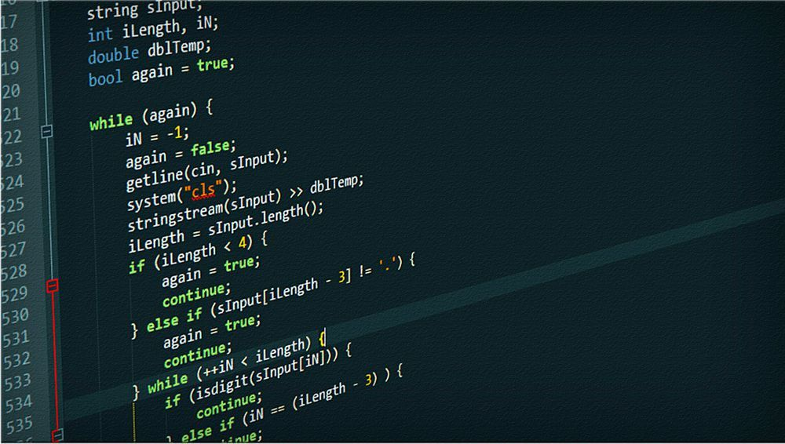
Quality Attributes

Slide 13
Availability
Availability
“The ability of a system to mask or repair faults so that the cumulative service outage period does not exceed a required value over a specified time interval.”
From an architectural perspective we need to consider:
What kinds of things are likely to fail?
How is system failure detected?
How frequently is it likely to occur?
What happens when a failure occurs?
How long is a system allowed to be out of operation?
When can failures occur safely?
How can failures be prevented?
What kind of notifications are required?

Slide 14
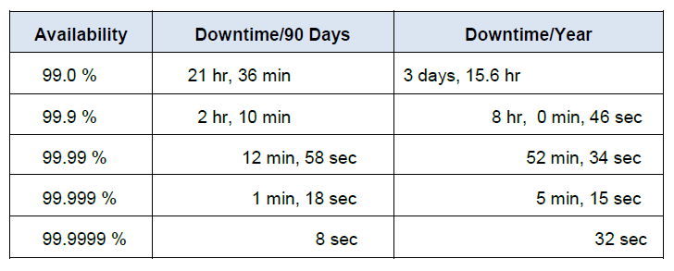
AVAILABILITY
Availability

Slide 15
Availability
Availability General Scenario
Artifact Process, Storage, processor, Communication
1
2
Stimulus: Omission, Crash, Timing, Response
Response: Record (i.e. log), Notify, Disable, Continue (normal/ degraded), be unavailable (during repair)
3
4
Source: Internal,
External
Environment: Normal, Degraded operation
Response measure: repair time,
Availability %, Available/Degraded Time interval
System-specific scenarios can be derived from the general scenarios by instantiating the six parts (or some of the six parts).
Notes:
Stimulus: this is the fault that caused a loss in availability
omission: failure to respond to input
Crash: repeated omission faults
Timing: early/late response
Response: incorrect value
Environment: if not normal, maybe a shut down is good to get the system back up, but if otherwise normal operation, maybe it is better to just degrade some function

Slide 16
Availability
Availability: Concrete Scenario 1
Artifact Obstacle Detection Module
1
2
Stimulus: causes a failure
Response: Detect the failure, Switch to back up process
3
4
Source: A random event
Environment: while the robot is in normal mode, moving
Response measure: Failure detected in 2 seconds, and Lunar robot continues the operation with no down time
A random event causes a failure of the obstacle detection module during normal operation while the robot is moving. The module detects the failure within 2 seconds, switches to the backup process, and continues to operate with no downtime.
Example taken from Lunar Robot
Notes:
[next] Notice how the concrete scenario does not need to be specified using only a single answer

Slide 17
Availability
Availability: Concrete Scenario 2
Artifact ...to the communications network…
1
2
Stimulus: …causes a failure…
Response: What can mitigate this issue?
3
Response: All displays must start showing the scheduled arrival time for all buses…
4
Source: A random event…
Environment: …during normal operations.
Response measure: …within 30 seconds of the failure
Example taken from a bus tracker system: Busses will all carry GPS technology (i.e. GPS receiver, radio transmitter, supporting hardware, and software), accurate within 100 meters. This will be used to compute estimated arrival time at each major bus stop.
A random event causes a failure to the communications network during normal operations. All displays must start showing the scheduled arrival time for all busses within 30 seconds of the failure.

Slide 18
Availability
Availability: Concrete Scenario 3
Artifact process
1
2
Stimulus: Unanticipated signal data
?
Response: Inform operator and continue to operate
3
4
?
?
Source: External
Environment: Normal operation
Response measure: No downtime
Internal or external?
State?
?
An unanticipated external message is received by a process during normal operation. The process informs the operator of the receipt of the message and continues to operate with no downtime.
Notes:
Artifact
Source
Stimulus
Environment
Response
Measure

Slide 19
MODIFIABILITY
Modifiability
Refers to the cost of a change.
Four questions:
What can change? Functions, platform, environment, qualities, capacity…
When is the change made and by whom? In the code (programmers), at compile time (switching components), at build time (different libraries), at execution time (different parameters)…
What is the cost of the change?
What is the likelihood of the change?

Slide 20
MODIFIABILITY
Modifiability General Scenario
Artifact System, user interface
1
2
Stimulus: Wishes to add/delete/modify/vary functionality, quality attribute, capacity
Response: Make modification, Test modification, Deploy modification
3
4
Source: End user, Developer, system administrator
Environment: Runtime, Compile time, Build time, Initiation time, Design time,
Response measure: Cost in effort, Cost in money, Cost in time, Cost in number, size, complexity of affected artifacts, Extent affects other system functions or qualities, New defects introduced
System specific scenarios can be derived from the general scenarios by instantiating the six parts (or some of the six parts).

Slide 21
MODIFIABILITY
Modifiability: Concrete Scenario 1
Artifact: Code
1
2
Stimulus: Wishes to change the UI
???
Response: Modification is made with no side effects
3
4
???
???
Source: Developer
Environment: At design time
Response measure: In three hours
???
???
???
A developer wishes to change the user interface to rearrange widgets on a data entry screen. This change will be made to the code at design time. It will take less than three hours to make and test the change and no side effect changes will occur in the behavior.
Notes:
Source
Stimulus
Artifact
Environment
Response
Response measure

Slide 22
MODIFIABILITY
Modifiability: Concrete Scenario 2
Artifact: Bus tracker system
1
2
Stimulus: requests that a new display be made operational
Response: The new display starts displaying estimated arrival times for buses relevant to it
3
4
Source: Operations manager
Environment: outside of the peak traffic period
Response measure: within 5 minutes of the request
Bus tracker system: A new display must be able to be brought online without affecting the rest of the system, but it will initially be brought online during an off-peak period.
Architectural concerns?
Notes:
First, who can come up with a sentence or two describing this concrete scenario? “The operations manager requests that a new display of the bus tracker system be made operational outside the peak traffic period.” The new display should start displaying estimated arrival times for relevant busses within 5 minutes of each request.”
Now let’s think about these scenarios in terms of architectural concerns.
What might be a design decision you make based off of this?
Old and new system running in parallel.

Slide 23
MODIFIABILITY
Modifiability: Concrete Scenario 3
Artifact: Bus tracker system
1
2
Stimulus: requests that a new display be made operational
Response: The new system is available to start displaying estimated arrival times for buses
3
4
Source: Operations manager
Environment: System is offline
Response measure: within 4 hours
Bus tracker system: Same as previous scenario, except it is agreed that the system can be shut-down and restarted when new features are to be made operational.
Architectural concerns?
Notes:
What might be a design decision you make based off of this?
Backup in case system doesn’t go up.

Slide 24
More general scenarios
Artifact
1
2
Stimulus
Response
3
4
Source of stimulus
Environment
Response measure

Slide 25
Usability
Usability General Scenario
Artifact System
1
2
Stimulus: Wants to
learn system features; use system efficiently; minimize impact of errors; adapt system; feel comfortable
Response:
to support; learn system features; use system efficiently; minimize impact of errors; adapt system; feel comfortable
3
4
Environment: At runtime or configure time
Response measure: Task time, number of errors, number of problems solved, user satisfaction, gain of user knowledge, ratio of successful operations to total operations, amount of time/data lost
Source: End user

Slide 26
Performance
Performance General Scenario
Artifact System
1
2
Stimulus: Periodic events arrive; sporadic events arrive; stochastic events arrive
Response:
Processes stimuli; changes level of service
3
4
Source: One of a number of independent sources, possibly from within system
Environment: Normal mode; overload mode
Response measure: Latency, deadline, throughput, jitter, miss rate, data loss

Slide 27
Security
Security General Scenario
Artifact System services;
data within system
1
2
Response:
Authenticates user; hides identity of the user; blocks access to data/services; allows access to data/services; grants/withdraws permission to access data/services; records access/modifications or attempts to access/modify data/services by identity; stores data in an unreadable format; recognizes an unexplainable high demand for services and informs a user/system, restricts availability of services
3
Stimulus: Tries to
display data, change/delete data, access system services, reduce availability to system services
4
Source: Individual or system that is (in)correctly identified, of unknown identity who is internal, external, (not) authorized with access to limited resources, vast resources
Response measure: Time/effort/resources required to circumvent security measures with probability of success; probability of detecting attack; probability of identifying individual responsible for attack or access/modification of data/services; percentage of services still available under denial-of-services attack; restore data/services; extent to which data/services damaged or legitimate access denied
Environment: online or offline, connected or disconnected, firewalled or open

Slide 28
Testability
Testability General Scenario
Artifact Piece of design, piece of code, complete application
1
2
Stimulus: Analysis, architecture, design, class, subsystem integration completed; system delivered
Response:
Provides access to state values; provides computed values; prepares test environment
3
4
Source: Unit developer;
increment integrator;
system verifier;
client acceptance tester;
system user
Environment: At design time, at development time, at compile time, at deployment time
Response measure: Percent executable statements executed;
Probability of failure if fault exists;
Time to perform tests;
Length of longest dependency chain in a test;
Length of time to prepare test environment;

Slide 29
Class Activity
What qualities are important?
It depends!!!
Different software systems have different quality concerns.
We need to discover which qualities are of importance for a particular system.

Slide 30
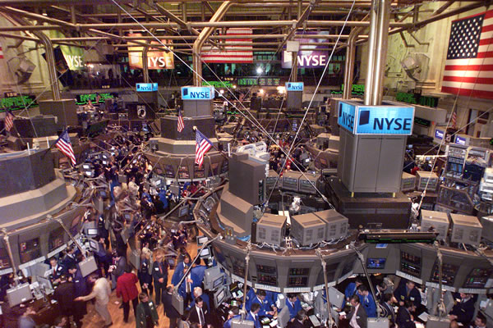
Class Activity
Daytime Trading System
Quality Attributes:
Availability
Modifiability
Usability
Performance
Security
Testability
Quality concerns?
Quality attribute scenario?
Artifact
1
2
Stimulus
Response
3
4
Source of stimulus
Environment
Response measure
Notes:
What quality attributes are we concerned about?
Why?
What is a quality attribute scenario example for one of these quality concerns?

Slide 31
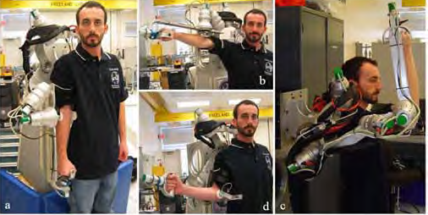
Class Activity
Upper limb rehabilitation device
Quality Attributes:
Availability
Modifiability
Usability
Performance
Security
Testability
Quality concerns?
Quality attribute scenario?
Artifact
1
2
Stimulus
Response
3
4
Source of stimulus
Environment
Response measure
Notes:
What quality attributes are we concerned about?
Why?
What is a quality attribute scenario example for one of these quality concerns?

Slide 32

Class Activity
House Arrest: Ankle Bracelet + Tracking
Quality Attributes:
Availability
Modifiability
Usability
Performance
Security
Testability
Quality concerns?
Quality attribute scenario?
Artifact
1
2
Stimulus
Response
3
4
Source of stimulus
Environment
Response measure
Notes:
What quality attributes are we concerned about?
Why?
What is a quality attribute scenario example for one of these quality concerns?

