Slide 1

SWEN 755: Software Architecture
Achieving Qualities
Viktoria Koscinski
All rights reserved (Mehdi Mirakhorli, Viktoria Koscinski)

Slide 2
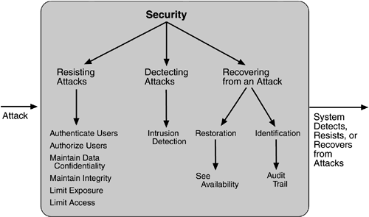
Security Tactics
Security Tactics
More than hundreds variances of tactics

Slide 3
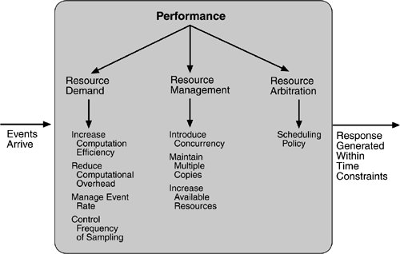
Performance Tactics
Performance Tactics

Slide 4
Performance
Performance Tactics
Increase computational efficiency.
One step in the processing of an event or a message is applying some algorithm. Improving the algorithms used in critical areas will decrease latency.
Sometimes one resource can be traded for another. For example, intermediate data may be kept in a repository, or it may be regenerated depending on time and space resource availability. This tactic is usually applied to the processor but is also effective when applied to other resources such as a disk.

Slide 5
Performance
Performance Tactics
Reduce computational overhead.
If there is no request for a resource, processing needs are reduced. In Chapter 17 (Software Architecture in Practice, 2nd edition), you will see an example of using Java classes rather than Remote Method Invocation (RMI) because the former reduces communication requirements.
The use of intermediaries (so important for modifiability) increases the resources consumed in processing an event stream, and so removing them improves latency. This is a classic modifiability/performance tradeoff.

Slide 6
Performance
Performance Tactics
Manage event rate.
If it is possible to reduce the sampling frequency at which environmental variables are monitored, demand can be reduced. Sometimes this is possible if the system was over-engineered. Other times an unnecessarily high sampling rate is used to establish harmonic periods between multiple streams. That is, some stream or streams of events are oversampled so that they can be synchronized.
Control frequency of sampling.
If there is no control over the arrival of externally generated events, queued requests can be sampled at a lower frequency, possibly resulting in the loss of requests.

Slide 7
Performance
Performance Tactics
Bound execution times.
Place a limit on how much execution time is used to respond to an event. Sometimes this makes sense and sometimes it does not. For iterative, data-dependent algorithms, limiting the number of iterations is a method for bounding execution times.
Bound queue sizes.
This controls the maximum number of queued arrivals and consequently the resources used to process the arrivals.

Slide 8
Performance
Performance Tactics
Introduce concurrency.
If requests can be processed in parallel, the blocked time can be reduced. Concurrency can be introduced by processing different streams of events on different threads or by creating additional threads to process different sets of activities. Once concurrency has been introduced, appropriately allocating the threads to resources (load balancing) is important in order to maximally exploit the concurrency.
Maintain multiple copies of either data or computations.
Clients in a client-server pattern are replicas of the computation. The purpose of replicas is to reduce the contention that would occur if all computations took place on a central server. Caching is a tactic in which data is replicated, either on different speed repositories or on separate repositories, to reduce contention.

Slide 9
Performance
Performance Tactics
Increase available resources.
Faster processors, additional processors, additional memory, and faster networks all have the potential for reducing latency. Cost is usually a consideration in the choice of resources, but increasing the resources is definitely a tactic to reduce latency.
Scheduling.
Whenever there is contention for a resource, the resource must be scheduled. Processors are scheduled, buffers are scheduled, and networks are scheduled. The architect's goal is to understand the characteristics of each resource's use and choose the scheduling strategy that is compatible with it.

Slide 10
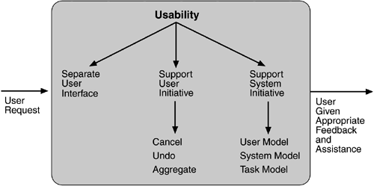
Usability Tactics
Usability Tactics
Ease of Use
Ease of learning
Efficient
Error Tolerant

Slide 11
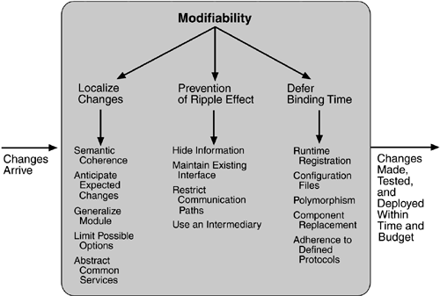
Modifiability Tactics
Modifiability Tactics

Slide 12
Modifiability
Modifiability Tactics
Localize changes: Tactics to reduce the number of modules directly affected by a change.
Prevent ripple effects: Tactics to limit modifications to localized modules.
Defer binding time: Tactics that defer binding time in order control deployment time and cost.

Slide 13
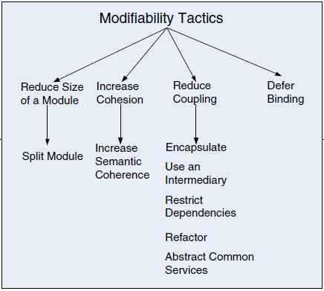
Modifiability
Modifiability Tactics
Localize changes: Tactics to reduce the number of modules directly affected by a change.
Prevent ripple effects: Tactics to limit modifications to localized modules.
Defer binding time: Tactics that defer binding time in order control deployment time and cost.
Software Architecture In Practice, 3rd edition (from fig. 7.3)
Notes:
More recently, there is a discussion on coupling and cohesion in terms of modifiability. We will talk about it more on the following slides.

Slide 14
Modifiability
Modifiability Tactics
Three important contexts for understanding modifiability tactics:
Coupling and cohesion
Coupling: The probability that a modification to one module will propagate to the other (measure of the strength of the association established by a connection from one module to another).
Cohesion: The measure of the relationship among responsibilities within a specific module.
Patterns
Techniques for achieving modifiability
Notes:
High coupling is an enemy of modifiability
Cohesion measures a module’s “unity of purpose.” High cohesion is good, low is bad.

Slide 15
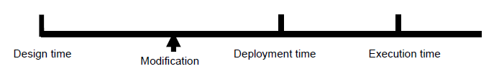
Modifiability
Modifiability Tactics
Goal is to control the time and cost to implement, test, and deploy changes.
Who makes the change? (Architect/Developer)
When is the change made?
What can change? (Which parts of the system need to be more modifiable than others?)
How is the cost of change measured? (Must include specification, design, implementation, testing, and deployment).

Slide 16
Modifiability
Modification Costs
A ‘responsibility’ is an action, knowledge to be maintained, or a decision to be carried out by a software system or an element of that system.
Modification costs include the cost of modifying a single responsibility + the cost of modifying other responsibilities affected by the original change (ripple effect).
Important parameters for modifiability:
Average cost of modifying a single responsibility
Reducing coupling between responsibilities.
Cohesion - collocate responsibilities with higher coupling.
Life cycle time of modification – prepare in advance for strategic late life cycle modifications.
Notes:
This is where coupling and cohesion come in again. We want modifications of one responsibility to not have too large of an affect on other responsibilities, and we also want responsibilities with a high coupling to be possibly grouped together in a single module.

Slide 17
Modifiability
Modifiability Tactics
Reduce the cost of modifying a single responsibility
Split a responsibility.
Increase Cohesion
Maintain semantic coherence.
Abstract common services.
Reduce coupling
Use Encapsulation
Use a wrapper
Raise the abstraction level
Use an intermediary
Restrict communication paths
Continued…..
Notes:
We have a few different modifiability tactics.
Increase semantic coherence. The goal of ensuring that a layer’s responsibilities
all work together without excessive reliance on other layers
is achieved by choosing responsibilities that have semantic coherence.
Doing so binds responsibilities that are likely to be affected by a change.
For example, responsibilities that deal with hardware should be allocated
to a hardware layer and not to an application layer; a hardware responsibility
typically does not have semantic coherence with the application
responsibilities.
■ Abstract common services. In the case where two modules provide notquite-
the-same but similar services, it may be cost-effective to implement
the services just once in a more general (abstract) form. Any modification
to the (common) service would then need to occur just in one place, reducing
modification costs.

Slide 18
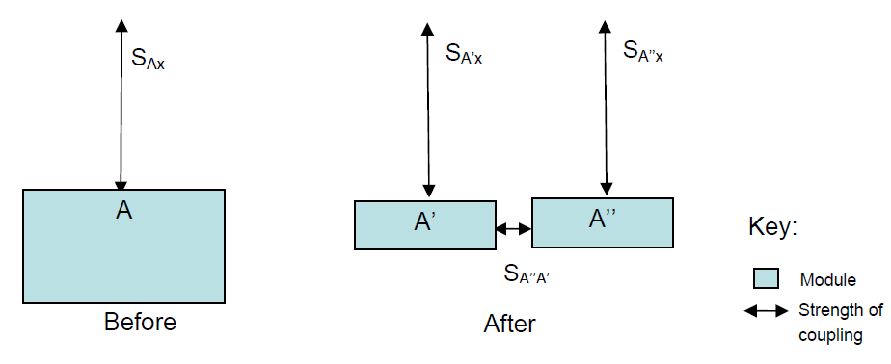
Modifiability: Split a Responsibility
(1) Split a Responsibility
Common criterion for splitting a responsibility is that children can be modified independently, as this splits the costs.
This splits (at least reduces) the cost of modification.
Notes:
Responsibility in a single module, being split into two smaller modules.
We have to keep in mind what the coupling ends up being between the two new responsibilities. Maybe now the cost of just modifying one of the smaller split modules is smaller. However, this will depend on that coupling.

Slide 19
Modifiability: Split a Responsibility
(1) Split a Responsibility
Splitting can support deferred bindings.
Partition 1: Manages primary activity.
Partition 2: Manages runtime activities to support a request for modification.
Examples:
Aspect-Oriented Programming (AOP)
Polymorphism
Component replacement

Slide 20
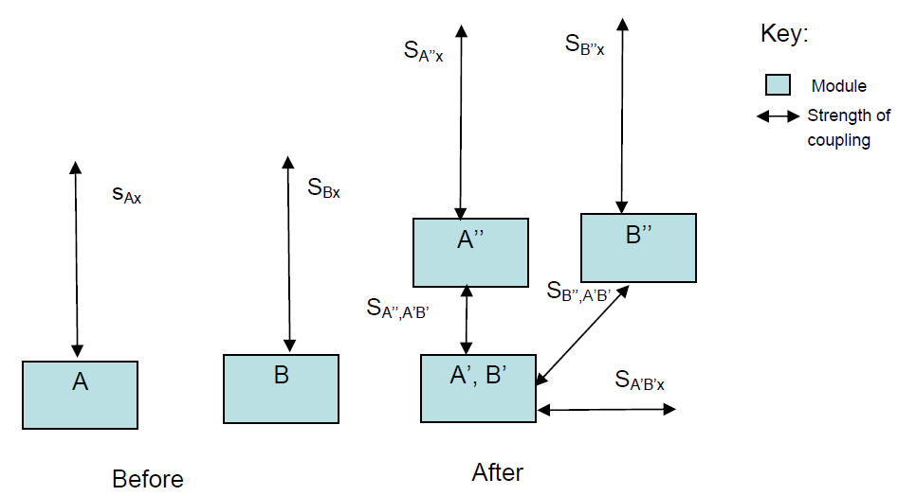
Modifiability: Increasing Cohesion
(2) Increasing Cohesion
A and B are both split (A’,A’’)(B’,B”)
A’ and B’ – are co-located because they tend to be affected by the same modification.
Notes:
Here, we are taking a portion of A and a portion of B that are both affected by a certain modification and we are grouping those together into one module (A prime and B prime), while the portions that stay separate are still separate modules (A double prime, B double prime).
You have to keep in mind that now you have more modules but this may be worth it, again based on the costs of modification.

Slide 21
Modifiability: Increasing Cohesion
2a. Maintain Semantic Coherence.
A’ and B’ – are portions of A and B simultaneously affected by expected modifications.
Discovered through:
Historical knowledge
Future ‘knowledge’
Logical coherence of responsibilities
Makes sense if:
Cost of modifying A’,B’ is less than that of A,B
A” and B” are unaffected by the modification

Slide 22
Modifiability: Increasing Cohesion
2b. Abstract Common Services.
If A’ and B’ represent similar services, then A’ provides a variant of the service to A”, and B’ provides a variant to B”.
Abstract out A’ and B’ and implement once in a slightly more general form.
Often achieved through refactoring.

Slide 23
Modifiability: Reduce Coupling
3. Reduce Coupling
Four tactics:
Use encapsulation
Use a wrapper
Raise the abstraction level
Use an intermediary and restrict communication paths
Notes:
We will talk about each of these four in the next slides.

Slide 24
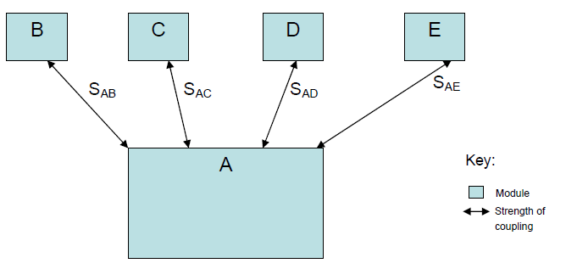
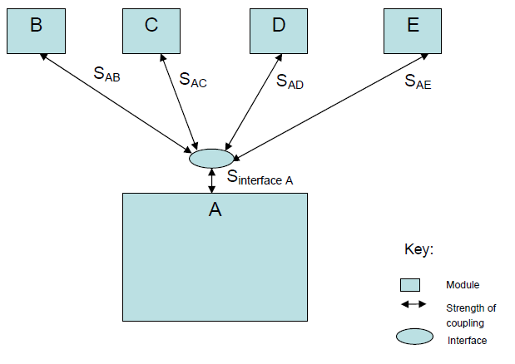
Modifiability: Reduce Coupling
3a. Encapsulation
Reduce the probability that a change to one module propagates to other modules by introducing an explicit interface.
Before
After
Asymmetrical coupling A → I(A) strong, I(A)→A weak.
Explicit interface added with its own responsibilities such as “transform input parameter to internal representation.”
Notes:
Strengths of coupling now go to interface.

Slide 25
Modifiability: Reduce Coupling
3b. Use a Wrapper
A wrapper is a form of encapsulation which transforms the data or control information for a module.
A wrapper can prevent outside modifications from propagating into a module.
Cost of changing the wrapper is less than cost of changing A.
Use a wrapper tactic involves:
Add a new interface to a module “wrapper for A” W(A)
Couplings are moved from A to W(A)
W(A) has high coupling to A.
A has low coupling to W(A)
Notes:
Strengths of coupling now go to interface.

Slide 26
Modifiability: Reduce Coupling
3c. Raise the abstraction level
Raising the responsibility for a module involves parametrizing its activities.
Example: Java Generics, allow you to create classes and methods that work in the same way on different types of objects.
A’ has responsibility to interpret parameters and A” has the responsibility to implement activity.
(Note: Same diagram as Split)
Notes:
Strengths of coupling now go to interface.

Slide 27
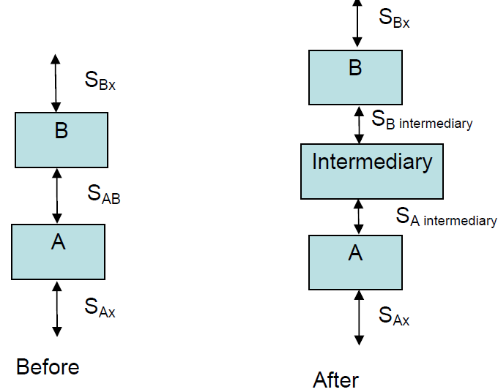
Modifiability: Reduce Coupling
3d. Use Intermediary / Restrict Communication Paths
An intermediary breaks a dependency.
Example: If A is a producer and B is a consumer, then publisher-subscriber intermediary removes A’s knowledge of B. It also can remove partial knowledge of B for A.
Notes:
Strengths of coupling now go to interface.

