Slide 1

SWEN 755: Software Architecture
Achieving Qualities
Viktoria Koscinski
Reading: Chapters 8, 13 – Software Architecture in Practice, 3rd edition
All rights reserved

Slide 2
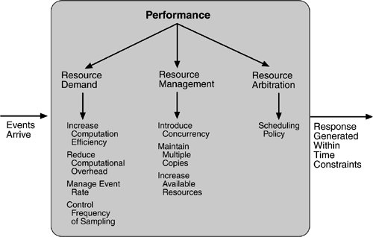
Class Activity
Performance Tactics
Tactics are generic design principles.
Find an example of one or more of performance tactics being used in the real (non-software) world.
Example: the design of roads and traffic systems.
Throughput: how many people per hour get from location X to location Y?
Average-case latency: How long, on average, does it take to get from location X to location Y?
How is each tactic implemented?
Notes:
Talk with partner for some time, then present in class.
Tactics may be implemented in this case by users or by the designers.
Throughput = “how many people per hour get from location X to location Y?”
Average-case latency = “how long does it take on average, to get from location X to location Y?”
Increase efficiency – Users may find quicker/shorter routes to their destination. Designers may offer multiple routes.
Reduce overhead – Users may carpool to get more people to the place they are going (carpool lanes may be included in design). Using pre-programmed traffic lights vs complex sensor systems can help literally reduce computational overhead.
Manage event rate – Lights can limit the number of cars entering a specific road at a time.
Control frequency of sampling – Sensors might be frequently monitored in high-traffic zones, but less so or not used in low-traffic zones. For example, changing speed of highway in NJ based on traffic flow.
Introduce concurrency – Multiple lanes, parallel roads, carpooling.
Maintain multiple copies – Adding lanes or parallel routes. Redundant power source for lights in high-traffic areas.
Increase available resources – More lanes, more routes.
Scheduling policy – Fixed priority scheduling policy for ambulances/police/emergency vehicles with lights/sirens. Carpool/bus lanes also apply here. So do synced traffic lights.
Emphasis on tactics being generic design principles which are used in the real world to achieve quality attributes – not just used in software design and architecture.
RIT cares about modifiability – modifying spaces in buildings, adding on.
RIT cares about security – ID card swipes.
RIT cares about usability – provides projectors, whiteboards in classroom.

Slide 3
Class Activity
Performance Tactics
Resource Demand:
Increase computational efficiency
Reduce computational overhead
Manage event rate
Control frequency of sampling
Resource Management:
Introduce concurrency
Maintain multiple copies
Increase available resources
Resource Arbitration:
Scheduling policy
Notes:
Talk with partner for some time, then present in class.
Tactics may be implemented in this case by users or by the designers.
Throughput = “how many people per hour get from location X to location Y?”
Average-case latency = “how long does it take on average, to get from location X to location Y?”
Increase efficiency – Users may find quicker/shorter routes to their destination. Designers may offer multiple routes.
Reduce overhead – Users may carpool to get more people to the place they are going (carpool lanes may be included in design). Using pre-programmed traffic lights vs complex sensor systems can help literally reduce computational overhead.
Manage event rate – Lights can limit the number of cars entering a specific road at a time.
Control frequency of sampling – Sensors might be frequently monitored in high-traffic zones, but less so or not used in low-traffic zones. For example, changing speed of highway in NJ based on traffic flow.
Introduce concurrency – Multiple lanes, parallel roads, carpooling.
Maintain multiple copies – Adding lanes or parallel routes. Redundant power source for lights in high-traffic areas.
Increase available resources – More lanes, more routes.
Scheduling policy – Fixed priority scheduling policy for ambulances/police/emergency vehicles with lights/sirens. Carpool/bus lanes also apply here. So do synced traffic lights.
Emphasis on tactics being generic design principles which are used in the real world to achieve quality attributes – not just used in software design and architecture.
RIT cares about modifiability – modifying spaces in buildings, adding on.
RIT cares about security – ID card swipes.
RIT cares about usability – provides projectors, whiteboards in classroom.

Slide 4
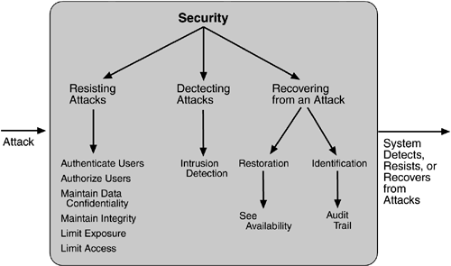
Security Tactics
Security Tactics

Slide 5
security
Security Tactics
Authenticate Users
Aim: Verify that a user is the person they claim to be.
Description: One step to ensuring that access is only granted to authorized people is to ensure identity, so that nobody can claim to be another person. Realizations range from knowledge (username and password) and ownership (smart cards) to physical properties (biometric data: fingerprints, etc.).
Applicability: Some of these realizations require special hardware (fingerprint scanners, etc.). Another constraint is that all possible identities must be known to the system.

Slide 6
security
Security Tactics
Authorize Users
Aim: Specify which rights which users have.
Description: Allow only persons (authenticated users) to access or modify data if they are allowed to. Authorization can be done for single users or groups of users.
Applicability: Use this tactic always when there are (groups of) users who should have different rights. Authorization is not necessary if everybody has the same rights. Note that giving everybody the maximum rights is not secure if it’s not necessary because this would not prevent unauthorized access (as unprivileged persons could use features not intended for them).

Slide 7
security
Security Tactics
Limit Exposure
Aim: Limit the possibilities for vulnerabilities.
Description: Attacks often use single vulnerabilities in systems, so decreasing the number of services decreases the likelihood of a vulnerability on this host. There are fewer possibilities for placing an attack.
Applicability: Some services are necessary, so removing them is not always an option. This tactic is especially useful at system boundaries, as attacks often come from the environment and not from within the system. On the other hand, applying this tactic on inner components too is also sensible, as an attacker already could have used a vulnerability at the system boundary to get into the system, and it is also possible for an attack to come from within the system, as a less privileged person who has limited access to the system could try to gain access to confidential data.

Slide 8
security
Security Tactics
Detecting Attacks
As there is no such thing as 100% security, it is impossible to prevent all attacks in advance. Still, it can be helpful to detect an ongoing attack in order to be able to react or even to detect a successful attack in order to mitigate the consequences. Intrusion detection is a way to do that.
Recovering From Attacks
Successful attacks typically have an impact on confidentiality, integrity, and/or availability (CIA). Be proactive if possible!
Confidentiality and integrity – Detect and mitigate if possible. Inform users.
Availability – See availability tactics.

Slide 9
security
Security Tactics
Maintain data confidentiality
Aim: Protecting data from unauthorized access.
Description: Confidentiality is usually achieved by applying some form of encryption to data and communication links. Encryption provides extra protection to persistently maintained data beyond that available from authorization. Communication links, on the other hand, typically do not have authorization controls. Encryption is the only protection for passing data over publicly accessible communication links.
Applicability: The link can be implemented by a virtual private network (VPN) or by a Secure Sockets Layer (SSL) for a web-based link. Encryption can be symmetric (both parties use the same key) or asymmetric (public and private keys).

Slide 10
security
Security Tactics
Maintain integrity
Aim: Data should be delivered as intended.
Description: Data can have redundant information encoded in it, such as checksums or hash results, which can be encrypted either along with or independently from the original data.
Applicability: Can be used for the data that is transferred between the subsystem or across the internet/network, or stored in the database.

Slide 11
Security Activity
Class Activity
In a particular programming environment, find a framework or list of frameworks to cover all the security tactics. For each tactic discuss the features provided by the framework that implements the tactic. In other words, describe why the framework covers that security tactic.
Authenticate users
Authorize users
Limit exposure
Detect attacks
Recover from attacks
Maintain data confidentiality
Maintain data integrity
Notes:
Quiz soon on security?

