Slide 1
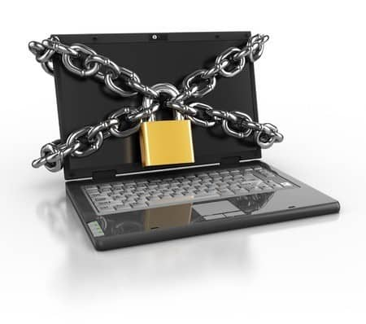
Secure By Design
SWEN 755
Viktoria Koscinski and Betsy Visconti

Slide 2
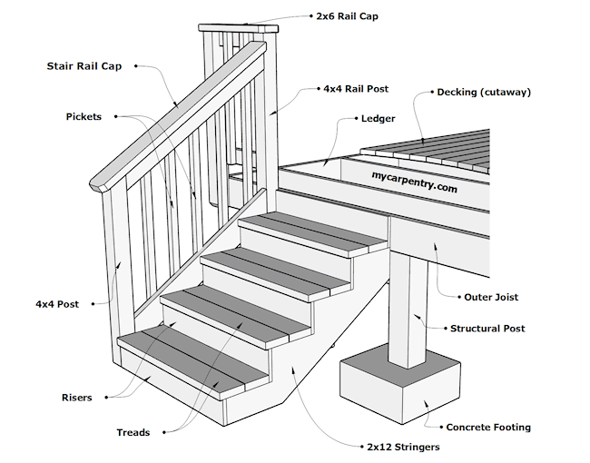
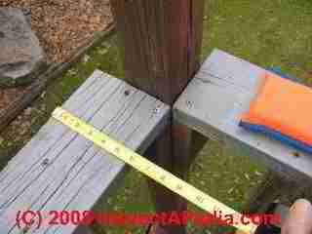
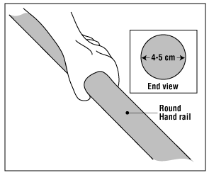
Secure By Design - Stairs
Design the product from the beginning to be secure
Stair heights - similar sizes
Stair depth - similar sizes
Stair height (4” - 7”)
Stair handrails must be certain sizes (4” - 5.25” if rectangular, 1.25”-2” diameter if round)
Notes:
In the physical world, many “secure by design” principles exist
Often enforced by regulations
For example, stairs must be safe to use

Slide 3
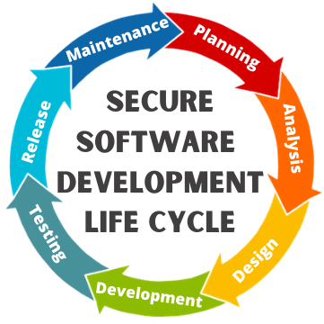
Secure By Design - Software Engineering
Security is overlooked
Many times, security is often not well-specified during the early stages of the software development lifecycle
Applying security after the fact can be:
Time-consuming
Expensive
Risky
Notes:
In the software world, “secure by design” principles are more likely to be overlooked

Slide 4
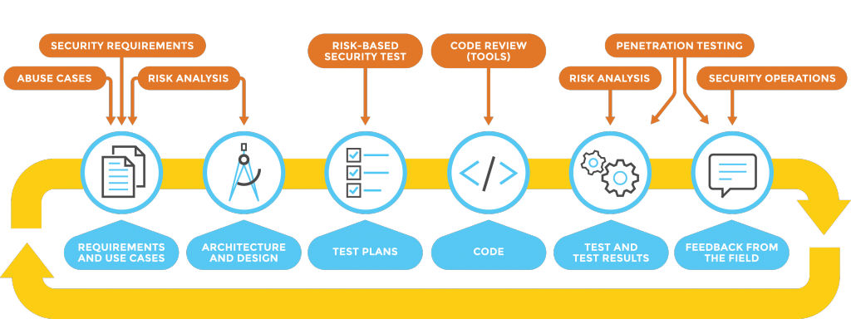
Secure By Design - Software Engineering
Including security in software in the early architecture and design stages can help ensure that it’s not overlooked in a later stage. 2 techniques we will focus on:
Security requirements
Misuse and abuse cases

Slide 5
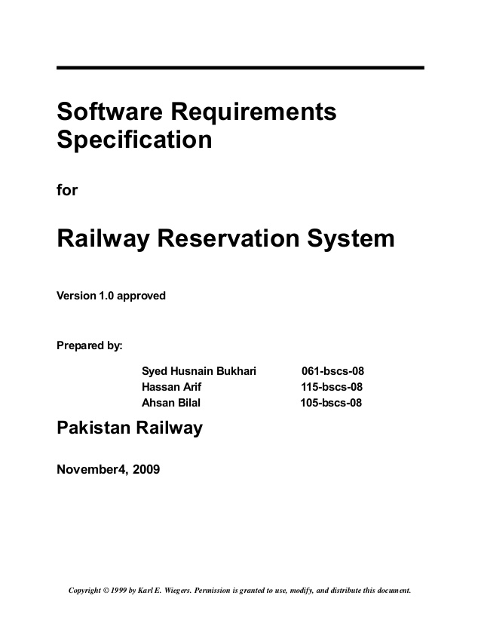
System Requirement Specification
Reminder: a system requirement specification is a structured collection of information that contain the requirements of a system
Software requirements specifications have to do with only the software portions of the system
Security Requirements are often left out or poorly specified, especially if the focus is heavily on functional requirements
Security requirments are non-functional (quality attribute) requirements
Notes:
Functional requirements can also sometimes drive security requirements.
For example, “The system shall display a loading screen after the user enters their credit card number.” Maybe we don’t have any requirements explicitly mentioning sensitive data, so this requirement would then inform us that the system handles some sort of sensitive data.
Ideally, this would prompt the requirements engineer to create requirements about dealing with sensitive data, but in the real world, this isn’t always the case and the requirements can be underspecified in this way. This is partially because requirements engineers aren’t necessarily security experts. The architect’s role here can be to help facilitate the conversation between the two to make sure those requirements are properly specified.

Slide 6
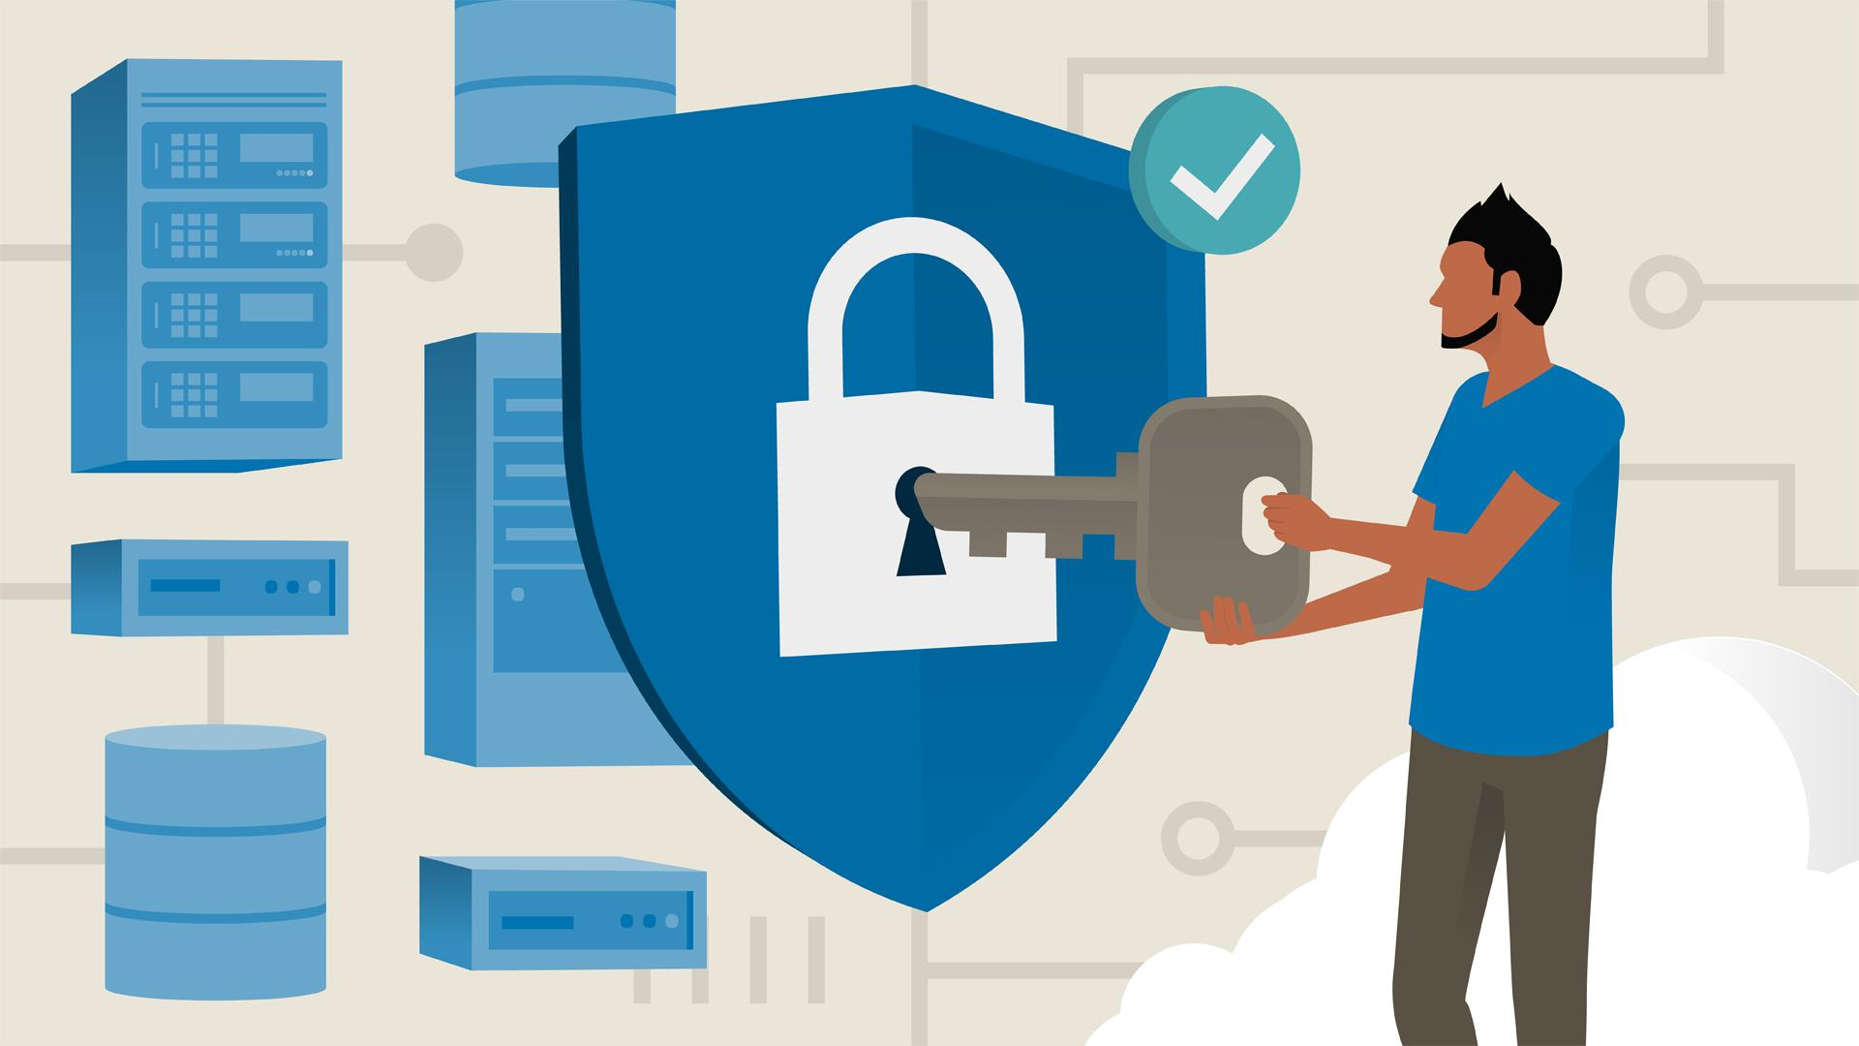
Security Requirements
Specify security measures that should be implemented in the software product
Created by using current best security practices (learned from known weaknesses)
Security requirements may be elicited using misuse/abuse cases, similar to how (non-security) requirements may be elicited using use cases
Like for “regular” requirements, good security requirements help create a design that supports security well

Slide 7

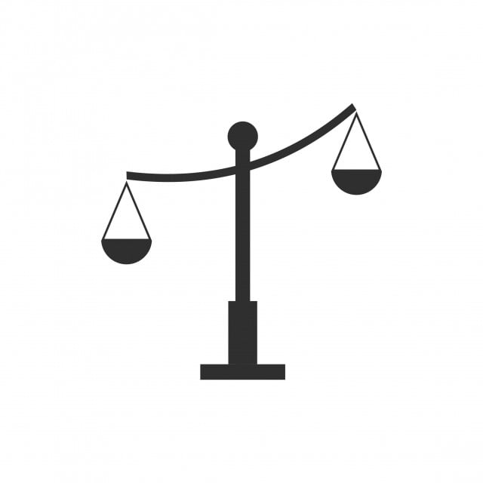
High Quality Requirements
Requirements should be:
Testable
‘System should be secure’
‘Encrypt all user-supplied data’
Measurable
‘Passwords shall have a minimum length’
‘Passwords shall be at least 8 characters long’
Complete
‘System shall maintain an audit trail of logins’
‘System shall maintain an audit trail of all user logins’

Slide 8
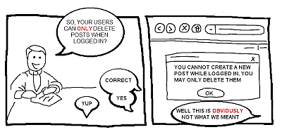
High Quality Requirements
Requirements should be:
Unambiguous
'Users can only delete posts when logged in’
'Users can delete posts only when logged in’
Consistent
Requirements should be consistent throughout a specifications document

Slide 9
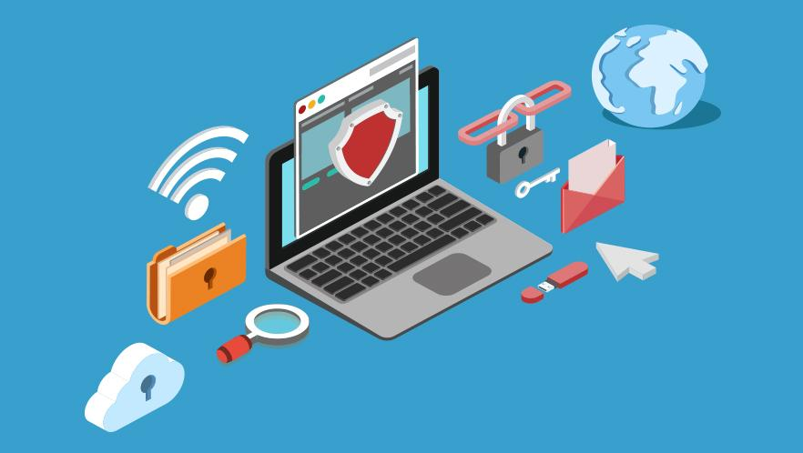
Security Requirement Types
Identification – who are you?
Authentication – are you who you say you are?
Authorization – do you have permission?
Immunity – preventing attacks
Integrity – preventing data corruption
Intrusion – detecting intrusions
Nonrepudiation – proof of interaction
Privacy – protect sensitive data
Security auditing – status and use of security mechanisms
Survivability – robustness to attacks, “if an attack occurs”
Physical protection – hardware, personnel, users
System maintenance – authorized modifications (updates) only
Read more here: https://www.jot.fm/issues/issue_2003_01/column6/
Donald Firesmith Engineering security requirements J Object Technol, 2 (1) (2003), pp. 53-68
Notes:
These requirements help with the implementation of their corresponding security tactics.

Slide 10
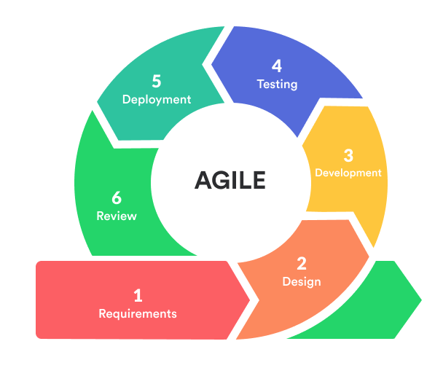
How can I improve my security requirements?
Elicit security requirements before starting system design and implementation
Use high quality requirements (unambiguous, measurable, etc.)
Going through a checklist of security types, such as that on the previous slide, can help ensure that all important/inteded aspects of the system’s security are considered
Notes:
You should consult a security expert if you can. If not, there are security standards documents available to help determine what requirements are needed for your system.

Slide 11
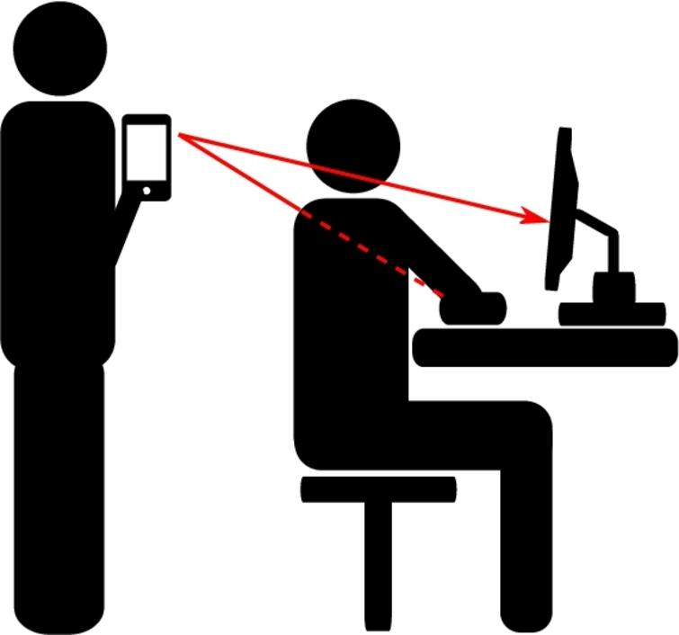
Building security into a system using abuse and misuse cases

Slide 12
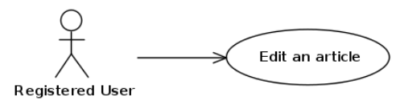
How do we elicit requirements?
Use cases, activity diagrams, entity relations diagrams
Describe the interaction of an actor with the system
Usually positive - What do we want to happen?
Then why do we overlook security?
Use cases tend to focus on functional requirements
We say what we want, but not what we don’t want
We need to ask ourselves how the system can be used in unintended ways
The obvious questions:
Do you want a hacker to figure out user’s passwords?
Do you want a user to accidentally change the price of your product?
Etc.
Sources:
Sindre, Guttorm, and Andreas L. Opdahl. "Eliciting security requirements with misuse cases." Requirements engineering 10.1 (2005): 34-44.
RE Magazine (https://re-magazine.ireb.org/articles/eliciting-security-requirements)

Slide 13
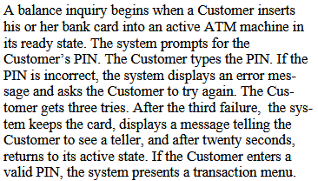
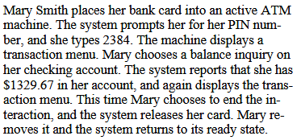

Example: Use Case
Source: McDermott, John, and Chris Fox. "Using abuse case models for security requirements analysis." Proceedings 15th Annual Computer Security Applications Conference (ACSAC'99). IEEE, 1999.
Notes:
Use cases are related to user stories

Slide 14
Misuse and Abuse Cases: An Overview
Similar to use cases (but from POV of malicious actor)
Not used as commonly but helpful in security requirements elicitation
A lot of similarities
Notation
Objective
Not the same, but differences not always well defined
Intentional vs unintentional
Harmful vs no harm done
Notation, diagram elements and style (includes uses cases or not)
Level of detail
Who can be an actor

Slide 15
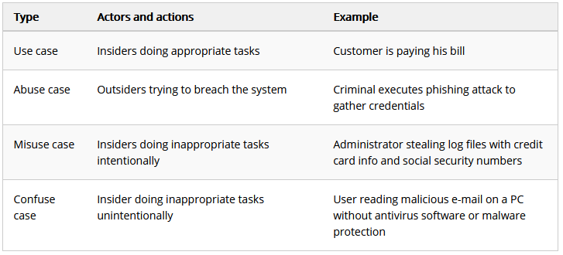
Source: RE Magazine (https://re-magazine.ireb.org/articles/eliciting-security-requirements)
Notes:
Which of these you happen to be using is not as important as the fact that you are using them to help build more secure systems!

Slide 16
Misuse Cases
Defined as:
“Use cases with hostile intent”
“Behaviors not wanted in the system”
“Threaten use cases with failure”
Level of detail depends on purpose
Formats:
Diagram
Table/template
Description
Diagram can have both use and misuse cases
Helps elicit security requirements

Slide 17
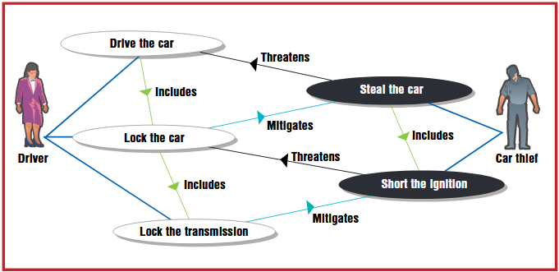
Example: Misuse Case Diagram
Source: Alexander, Ian. "Misuse cases: Use cases with hostile intent." IEEE software 20.1 (2003): 58-66.
Notes:
What is one way to mitigate a car thief trying to steal the car? Locking the car.
How would a car thief circumvent that mitigation? Shorting the ignition.
How would the driver try to mitigate the thief shorting the ignition? Locking the transmission.
In this case, the use/misuse case diagram can be used to brainstorm potential attacks and mitigation techniques.
Can be done until you go through “all” feasible scenarios.

Slide 18
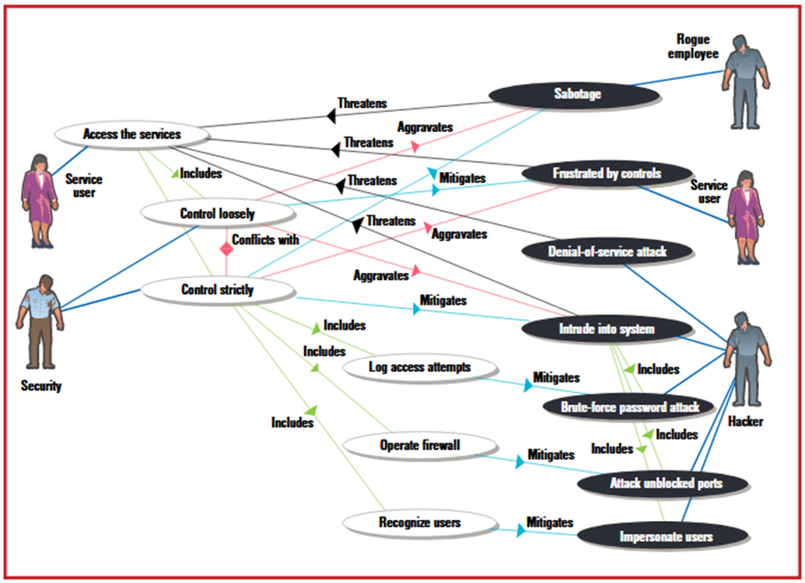
Source: Alexander, Ian. "Misuse cases: Use cases with hostile intent." IEEE software 20.1 (2003): 58-66.
Notes:
Misuse case diagrams can also shine light on possible conflicts and tradeoffs you will need to make in your system’s design.
Here, we have a user being frustrated by strict controls, which can be mitigated by looser controls, but a hacker intruding into the system, which can be mitigated by stricter controls. Which is more important? Which will win? As much as we want to say ‘security’ (stricter controls), it will depend…
Similar example of 2-factor authentication being more annoying to use, but secure more. What is the tradeoff here? Security vs? Usability!

Slide 19
Misuse Case Templates
Name
Author and date
Summary
Basic Path
Alternative paths
Mitigation points
Preconditions
Mitigation guarantee
Misuser profile
Threats
...
Gives more details than what we would see on the diagram

Slide 20
Abuse Cases
Use cases adapted to describe misuse
In terms of harm to system (in terms of user’s domain)
Includes privilege level and actor’s skills, resources, and objectives
Similar formats to use cases
But should NOT include use cases
Can also use trees or DAGs
2 types:
Essential - abstract, generalized
Real/implementation - specific protocol/implementation details
Not meant to be 100% complete/sound
Notes:
DAG = directed acyclic graph
Not 100% complete/sound, but still useful

Slide 21
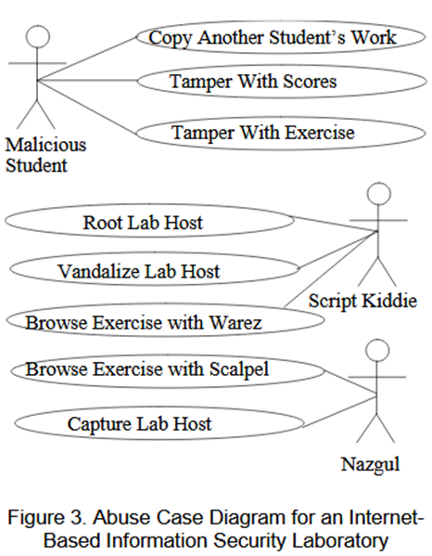
Example: Abuse Case
Actor descriptions
Resources
Skills
Objectives
Abuse case description
Harm
Privilege range
Abusive interaction
Source: McDermott, John, and Chris Fox. "Using abuse case models for security requirements analysis." Proceedings 15th Annual Computer Security Applications Conference (ACSAC'99). IEEE, 1999.
Notes:
Descriptions separate from diagrams. Both often used in conjunction

Slide 22

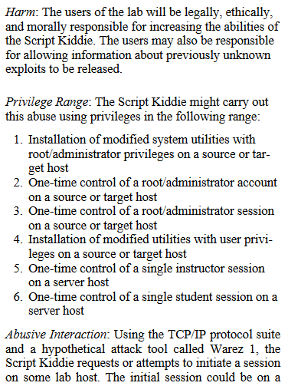
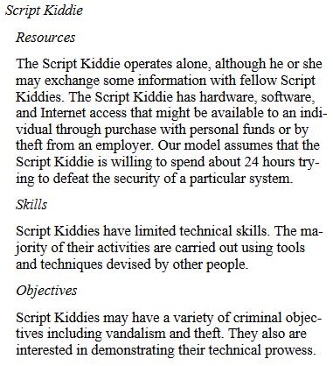
Example (Continued)

Slide 23
Modeling Abuse Cases
Identify actors
Identify abuse cases (diagrams)
Define abuse cases (trees, descriptions)
Check granularity
Possible but highly unlikely cases
Modeling with too much detail (too specific)
Not enough detail (too abstract)
Check completeness and minimality
Does it cause harm?
Is there another way to accomplish harmful goals?

Slide 24
Eliciting Security Requirements
Identify critical assets
Define security goals for each asset
Identify threats to each security goal
Can be represented as abuse/misuse cases
Identify and analyze risks for threats
Can also use abuse/misuse cases (especially expressed using trees)
Define security requirements
Can be defined as separate use cases when dealing with abuse cases, OR
Can be defined as mitigations to misuse cases
Source: Sindre, Guttorm, and Andreas L. Opdahl. "Eliciting security requirements with misuse cases." Requirements engineering 10.1 (2005): 34-44.

Slide 25
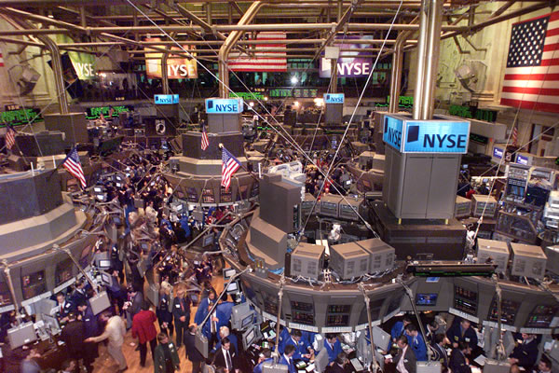
Class Activity: Eliciting Security Requirements
Identify one critical asset
Define a security goals for the asset
Identify a threat to the security goal
Represent this as an abuse/misuse case
Identify and analyze the risks
Define security requirements
Can be defined as separate use cases when dealing with abuse cases, OR
Can be defined as mitigations to misuse cases
Daytime trading system
Source: Sindre, Guttorm, and Andreas L. Opdahl. "Eliciting security requirements with misuse cases." Requirements engineering 10.1 (2005): 34-44.

