Slide 1
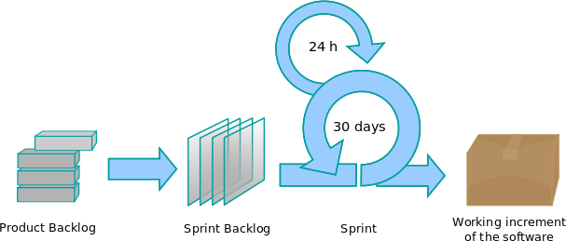

Appreciation for Software Development Process
By Lakeworks - Own work, GFDL, https://commons.wikimedia.org/w/index.php?curid=3526338
SWEN-610
Foundations of Software Engineering

Slide 2
What do you want in a Software Development Process?
A few questions to consider:
How does a software development process create value for the client?
How does a software development process support a team to be predictable and dependable?
How does a software development process improve software quality?

Slide 3
These are the principles software engineers follow.
Client-focused
A client representative must be on "the team"
The client validates each increment
The client defines and prioritizes the requirements
Use an iterative process
Build a working increment frequently
Demo the increment to the client and get feedback
Manage risk
Involve the client to validate and elaborate requirements
Work on architecturally-significant features early
Use an empirical process
Process is transparent to all stakeholders
The team inspects their own process each iteration
The team adjusts their process from lessons learned in the previous iteration

Slide 4
These are the core activities software engineers practice.
Communicate
Gather requirements to understand the client’s needs and goals.
Demonstrate each project increment for the client.
Plan
Plan each iteration (sprint) of work so the stakeholders know what is expected.
Conduct retrospectives to improve the process.
Model
Analyze the domain of the application for a deeper understanding of the requirements.
Design the system to meet the requirements.
Construct
Implement a working increment within each iteration.
Test the system to validate that it meets the requirements.
Maintain the system by fixing bugs and creating new features.
Deploy
Deploy software to the production environment.
Train users so they will succeed with the system.

Slide 5
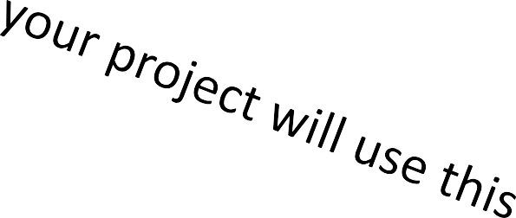
A defined process codifies the way in which a team will adhere to those principles and practices.
Traditional waterfall
Spiral methodology
Feature-driven development
Rapid Application Development
Extreme programming
Rational Unified Process
OpenUP

Slide 6
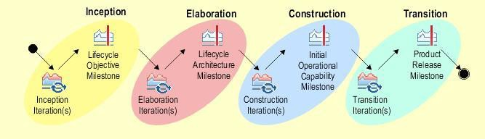
OpenUP describes project phases at the strategic level.
By The original uploader was GFLewis at English Wikipedia - Transferred from en.wikipedia to Commons by IngerAlHaosului using CommonsHelper., EPL, https://commons.wikimedia.org/w/index.php?curid=9030478
Inception
Manage requirements risks
Elaboration
Manage architectural risks
Construction
Build it out
Transition
Deploy it
Training users

Slide 7
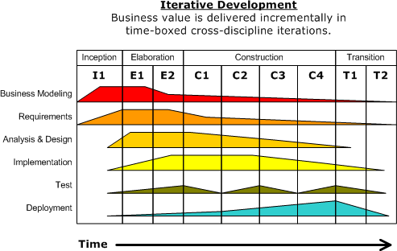



A team's effort in different activity areas varies by phase.
7
By Dutchguilder - Own work, Public Domain, https://commons.wikimedia.org/w/index.php?curid=37249677

Slide 8
You will use a Scrum process to define tactical activities.
By Lakeworks - Own work, GFDL, https://commons.wikimedia.org/w/index.php?curid=3526338
A Sprint is a single iteration of work that results in a working system that delivers identified value to the client.
Each Sprint has its own Sprint Backlog of features pulled from the Product Backlog.
Every day the team is working the Sprint Backlog to direct their development.

Slide 9
From Strategic to Tactical: OpenUP and Scrum
OpenUP (Strategic Level)
Inception: manage requirements & risks
Elaboration: manage architectural risks
Construction: build working software
Transition: deploy & train users
Scrum (Tactical Level)
Sprints deliver working increments
Product Backlog prioritized by customer value
Daily stand-ups keep the team aligned
Retrospectives for continuous improvement

Slide 10
Modern Extensions Beyond Agile
DevOps: CI/CD pipelines, automation, infrastructure as code
Lean Startup: Hypothesis-driven development, MVPs
Data-Driven SE: Use analytics, A/B testing, and telemetry
Socio-Technical Integration: Collaboration tools and practices

Slide 11
Questions you might consider in this class and beyond
When is Waterfall still appropriate?
What are the risks of 'Agile in name only'?
How can DevOps improve client satisfaction?
What ethical responsibilities do SE processes entail?
Where do research and practice diverge?

