Slide 1
[Git] Version Control

Slide 2
Motivation
Codebases are enormous and must handle constantly evolution
Google’s codebase is 2 billion lines of code
What if something breaks? What if we need to remember what changes we made? What if we want to analyze the past?
Version control is our answer

Slide 3
Version Control
Allows us to:
Try different algorithms or designs
Experiment with derivative ideas from the original project goal
Prototyping
Take back our mistakes
Find a way to blame other people for your problems
The usefulness of version control cannot be overstated. As growing software engineers, you should become very familiar with version control and use it -regularly-

Slide 4
Git
Version Control System we will use in class
Most-used version control system in the world to date
Distributed version control system: No need to constantly be in sync with a central repository; allows asynchronous changes.
Very nice for team-based projects-- so almost any non-trivial piece of software
There are other version control systems
Subversion (svn)
Concurrent Versions System (cvs)

Slide 5
Key Concepts
A remote repository is a designated disk location outside of your local machine.
A local repository is a local version of the remote repository. It may or may not be in sync with remote.
A workspace is the directory where you are doing your development activities
An index is a temporary cache where potential changes are kept/staged prior to being committed
A stash is a (hopefully) temporary storage for uncommitted changes, used when you want to save some changes but revert the state of the workspace

Slide 6
Git Commands
git add: ask git to begin tracking a file git clone: download a local copy of a remote repository git commit: save the current state git status: check the current repository status git pull: synchronize changes from the remote repository git push: synchronize local changes to the remote repository git merge: combine two different versions of the code
https://guides.github.com/introduction/git-handbook/

Slide 7
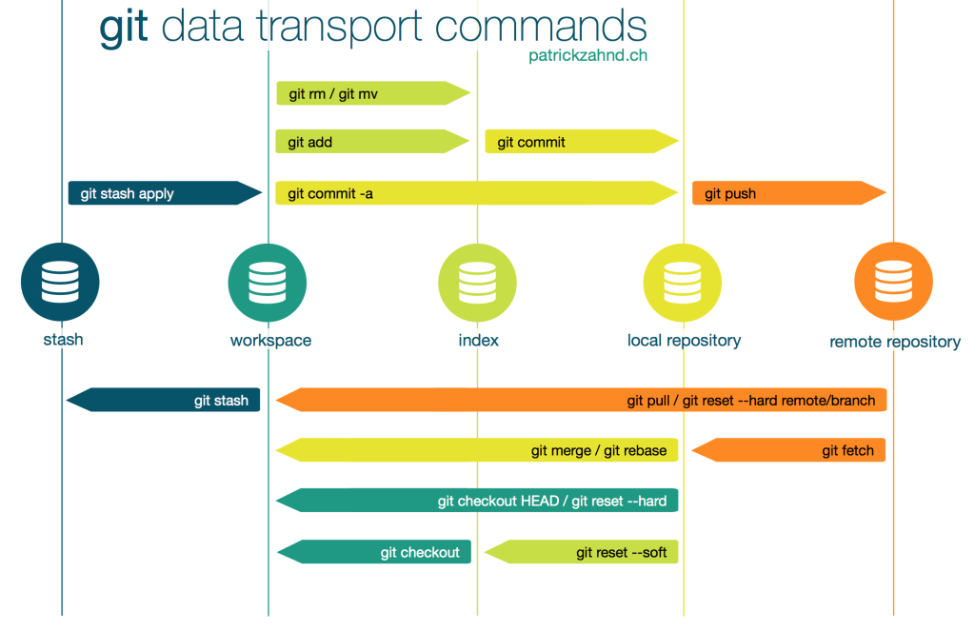

Slide 8
So what does Git look like in use?
Branches (asynchronous versions) of a repository used for various ends:
Fixing a bug, a release branch, a development branch, a feature branch
And a master main branch; one branch to rule them all; one ring-- er branch to find them, one branch to bring them all and in darkness… you get it.
Let’s look at an example

Slide 9
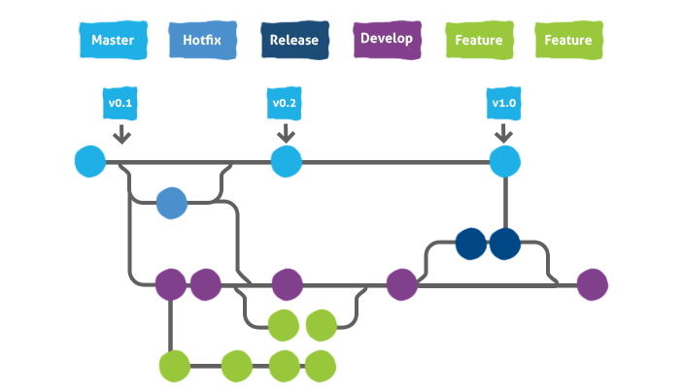
Main

Slide 10
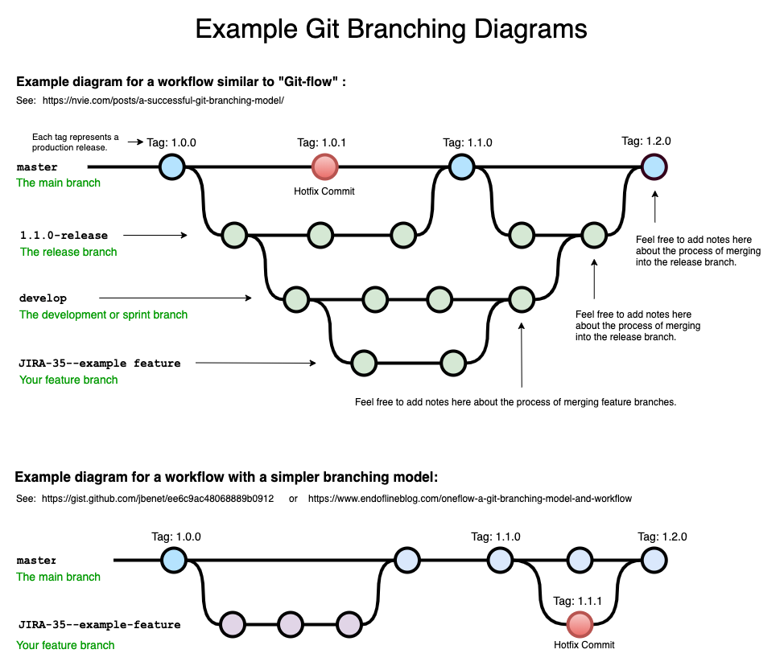

Slide 11
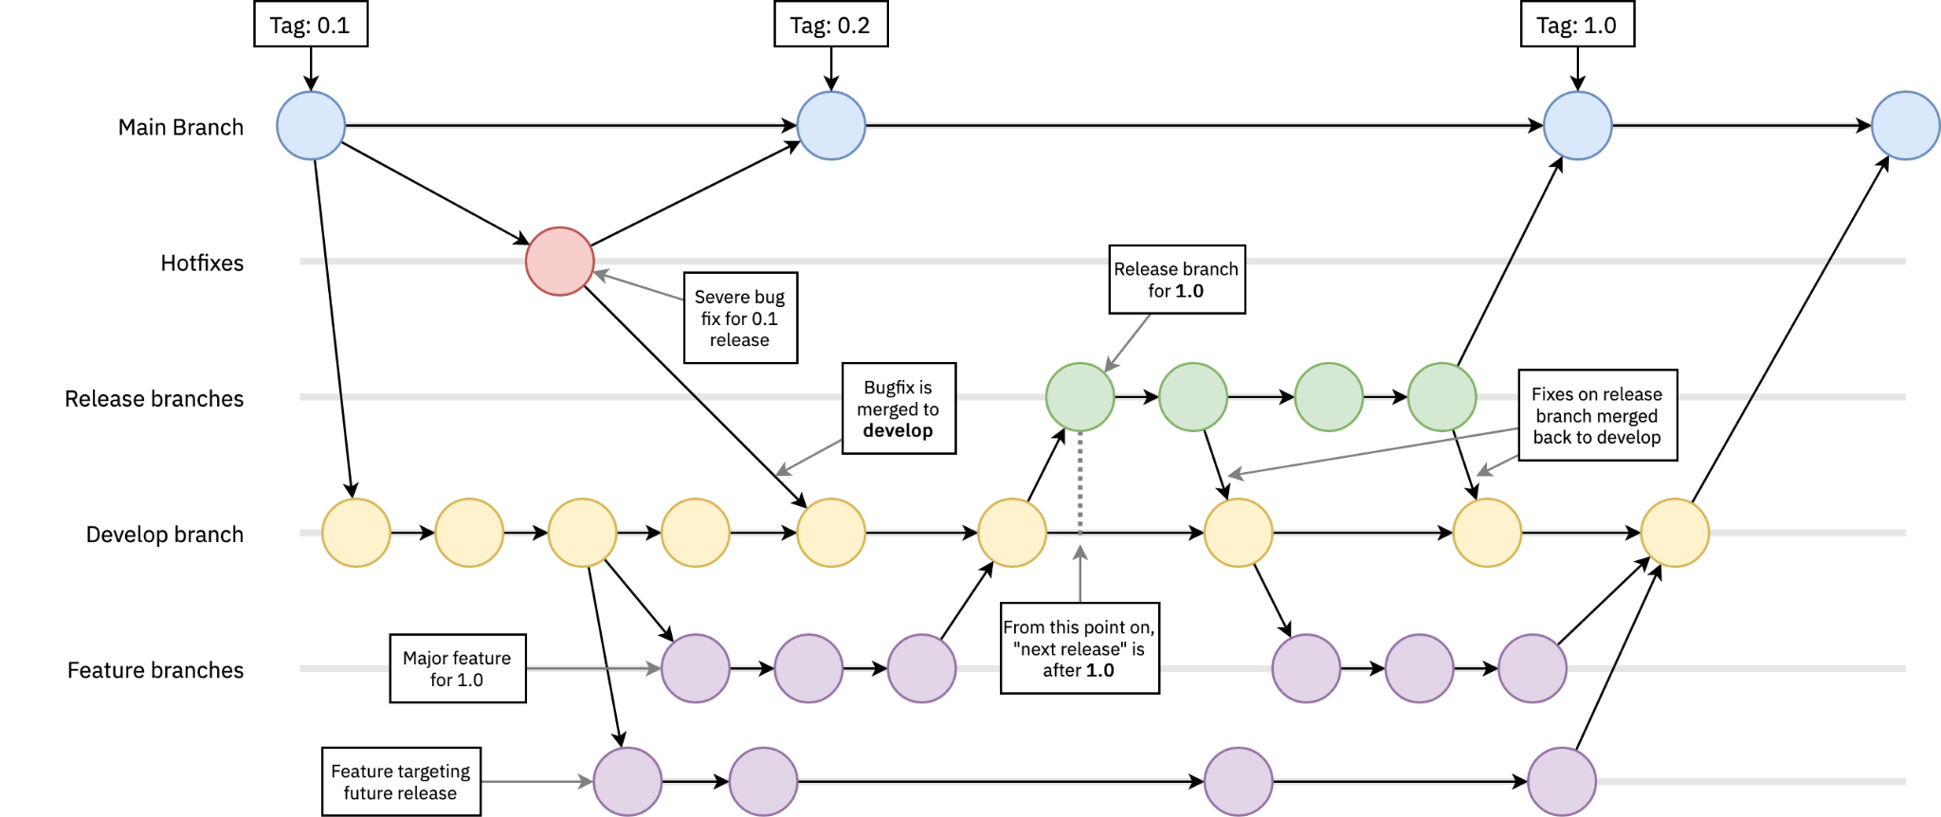

Slide 12
Git Branch
Git checkout –b <branch name>
Git branch <branch name>
Git checkout <branch name>
Many other ways

Slide 13
Conclusion
We will use Git to grade your assignments. This means you should become familiar with the git basics so that you can receive points for your work
Git adds to the already large number of commands being pushed on you. But if you commit to it, you’ll git it!

Slide 14
The C Programming Language
We will do a more thorough introduction to C next time. But you need to know a few things in order to do Fizzbuzz
C is a compiled language, meaning that you need to run C code through a compiler to generate an executable binary before you can run it
In Contrast to languages like Python, which are interpreted
We will go over how to compile C on Nitron

