Slide 1
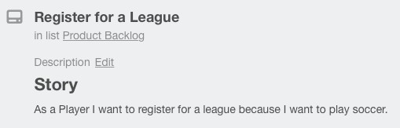

Defining Project Requirements
SWEN-610
Foundations of Software Engineering
Department of Software Engineering Rochester Institute of Technology

Slide 2
There are functional and non-functional requirements.
Functional requirements define the behavior of the application that achieve user goals.
Non-functional requirements define:
Systemic qualities such as response time, reliability and availability
Systemic constraints such as security or accessibility
Evolutionary qualities such as testability and extensibility

Slide 3
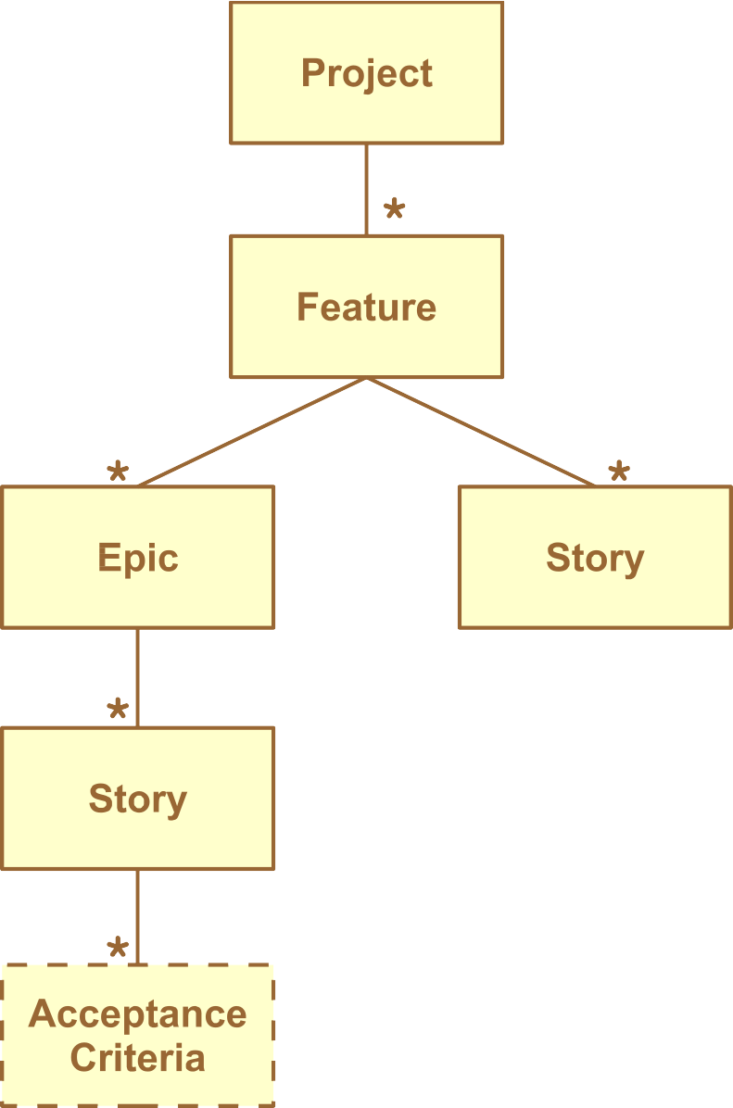
Functional requirements are in a hierarchy.
Most applications have many large-scale
features.
These are decomposed into epics and user stories.
Epics are further decomposed into additional stories.
As analysis progresses, stories will be further defined with acceptance criteria.

Slide 4
Features are large scale application behaviors.
Soccer league management application
The League Director manages a soccer league three seasons a year. Players need to register for a league. The Director selects a group of captains to form teams and the Director moderates the drafting of teams by captains. The Director must also schedule the games of the league across the whole season up to 15 weeks.
The Director must also be able to record game results and keep track of team rankings.

Slide 5
Defining requirements involves a continual discussion with the customer.
Eliciting requirements through:
Observation
Interviewing users and subject matter/domain experts
Brainstorming
There are many approaches for specifying requirements
Agile methods write user stories
This documentation forms a contract between the Product Owner and the Development Team.
The Product Owner will be involved with the definition of the user stories to ensure that the overall system will satisfy the business needs.

Slide 6
User stories express goals of users.
There are many ways to write a user story.
In class, you will use this notation:
"As a <ROLE>, I want <GOAL> so that <BENEFIT>."
Example:
As a Player, I want to register for a league so that I can play soccer.
The ROLE identifies the type of user to achieve the goal.
The GOAL is what the system will do for the user.
The BENEFIT is the value that the system provides the user.

Slide 7
More examples of user stories...
From the Soccer League application:
As a captain I want to enter the scores of my games so my team's rank can be
determined.
As a player I want to see my teams rank so I can gloat to my competitors.
As the director I want to create a tournament schedule so teams know when and who
to play.
From a Social Media application:
As a member I want to check-in that I'm having dinner with friends so my mom sees
me with my friends.
As an ad-bot I want to access user usage statistics so that I can create personalized ads.

Slide 8
You will want to avoid the characteristics of poorly written user stories.
Stories with no clearly defined user:
"I want to identify soccer league captains."
Or worse just: "identify soccer league captains"
Stories with no clear benefit:
What benefit does selecting captains provide?
Stories should not:
Over constrain the solution
Dictate user interface details

Slide 9
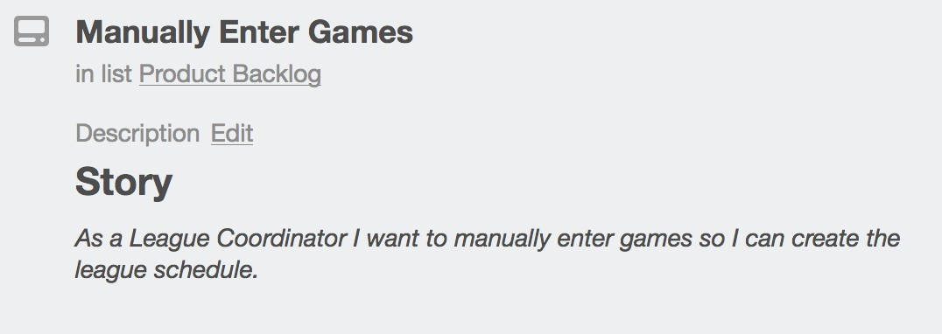
In Trello you create a new card for each User Story.
Your team will use Trello to record your project's requirements.
Every User Story will be captured in a Trello card, like this:

Slide 10
Story text is usually high-level, therefore you define acceptance criteria to provide refinement.
Acceptance criteria (AC) are detailed statements about how the system should behave.
Use this format:
GIVEN some condition WHEN some action occurs THEN system does something.
Example:
Given that I have not yet signed in when I see the Home page then I must see a means to sign-in.
A story typically has multiple AC
The AC should drive and constrain the design and development.
The AC are completed by the story's tester.

Slide 11
Writing User Stories for REST API and other services
REST APIs and other services should also be driven by requirements.
However, these requirements are different than the User or Product requirements we have discussed so far in that they may not come directly from a Product description.
It is typical that a team will start on backend services like a REST API before the development on the UI begins.
Therefore, the <role> for a REST API User Story is generally a developer or system integrator
User Story
AS A developer I WANT to submit a hero id to the API SO THAT I can retrieve the details of that hero
Acceptance Criteria
GIVEN I submit a hero id WHEN the hero exists for that id, THEN the system should return the hero
object and a status code of 200
GIVEN I submit a hero id WHEN the hero does not exist for that id THEN the system should return a status code of 404

Slide 12
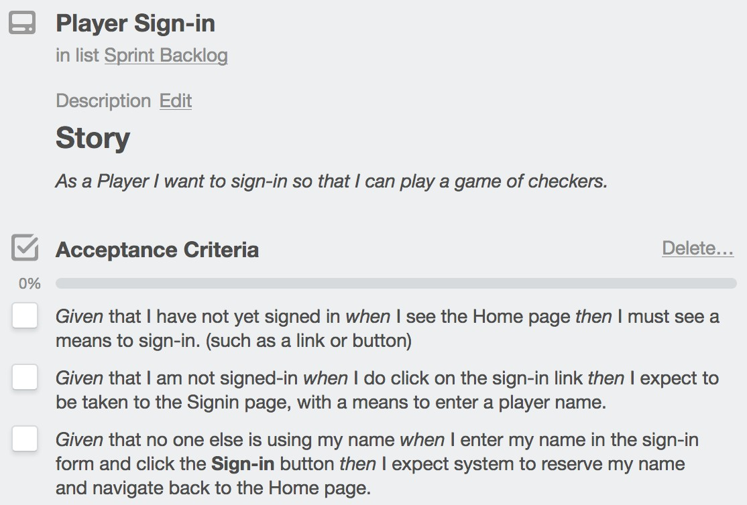
In Trello you add the Acceptance Criteria using a checklist.

Slide 13
Acceptance Tests
Concrete, executable tests that verify a User Story’s Acceptance Criteria have been met.
Source: Derived directly from the Acceptance Criteria (AC).
Form: Can be manual (scripted steps) or automated (e.g., UI, API, E2E).
Perspective: Validate behavior from the user’s or stakeholder’s viewpoint.
Traceability: Each acceptance test links to one or more AC; together they partially define “Done” for the story.
Outcome: Pass/fail evidence used for story acceptance by the Product Owner.

Slide 14
What are Solution Tasks?
Tasks describe how the team will implement a User Story
Internal to the development team (not visible to the customer)
Technical and detailed (classes, functions, database steps, UI elements)
Serve as the “to-do list” for developers during a sprint
Examples:
Create LoginController class
Add “Sign In” button to homepage template
Connect button to authentication service

Slide 15
Acceptance Criteria vs Solution Tasks
Acceptance Criteria (AC):
Define what must be true for the story to be considered 'done'
Written in customer language (user perspective)
Drive testing and validation
Example:
GIVEN I am not signed in, WHEN I view the homepage, THEN I see a 'Sign In' option
Acceptance Test is the implemented test/test plan for an Acceptance Criteria
Solution Tasks:
Describe how the team will implement the story
Internal to the team (not part of customer contract)
Examples:
Create LoginController class
Add 'Sign In' button
Connect to authentication service

Slide 16
Sometimes a story is too large and it must be broken into smaller stories that compose an Epic.
A story must be achievable within a single sprint.
For your project try to create stories that one student can code in a single week.
Break up a larger story into smaller stories.
Each sub-story must provide value but it can be a small step towards the epic goal.
Identify dependencies between sub-stories to produce a priority ordering of these stories.
An epic may be spread out over multiple sprints.
The acceptance criteria of an epic is the successful completion of its sub- stories.

Slide 17
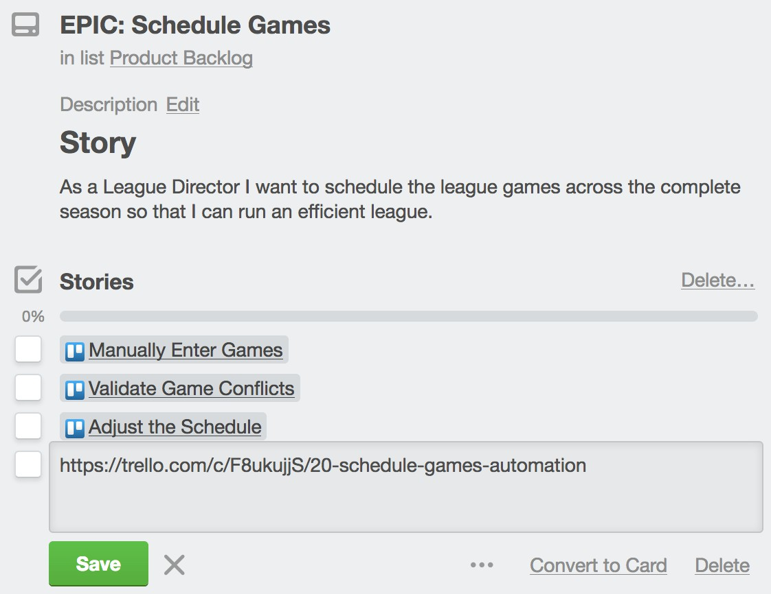

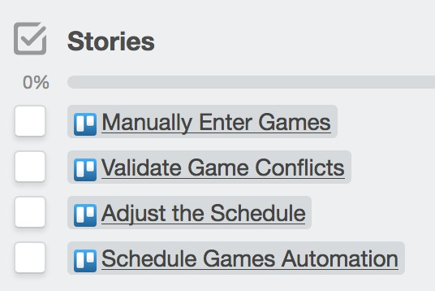
In Trello you can represent an Epic with a Checklist of links to Story cards.
Paste the Story card URL into the checklist item

Slide 18
Spikes help explore technology challenges.
A Spike is:
A story or task aimed at answering a question or gathering information, rather than at
producing shippable product.
(from ScrumAlliance.org)
Spikes are used for:
Learning new technologies or new techniques
Typically, just proof-of-concept coding; usually throw-away
Spikes are usually time-boxed to fit into a single sprint though there are occasionally epic spikes.

Slide 19
The Minimum Viable Product is all of the stories required to be in the first product release.
MVP is defined by the Product Owner.
It clearly identifies the set of stories that must be done before the product can be released.
These stories must be prioritized to be worked on first.

