Slide 1


Effective Team Communications
SWEN-610
Foundations of Software Engineering
Department of Software Engineering Rochester Institute of Technology

Slide 2
There are multiple stakeholders who have an interest in a software development project.
‘an individual, group, or organization, who may affect, be affected by, or perceive itself to be affected by a decision, activity, or outcome of a project’ (Project Management Institute, 2013)
Some of the project stakeholders include:
Product owner (customer/sponsor)
Product users
Project team members
Manager
Each stakeholder has a different set of interests and communication needs.

Slide 3
The Product Owner is mainly concerned that the project satisfies their needs.
Is the team building the right project?
Vision statement for features
Enumeration of epics and user stories
Priority of user stories
Is the team building the project right?
Acceptance tests for each story
Term project
Instructor is the Product Owner
Trello board for detailing epics and user stories with priority and acceptance criteria
If it is not in the Trello board, it is not in the project

Slide 4
The Product Users are concerned with the overall user experience.
What is the user experience?
User interface design
Workflow for using the product
Interface with other elements of the business processes
Project teams, unfortunately, often do not directly deal with the user or only do so through a proxy.
Term project
Instructor and course assistants as users
Other teams during cross-team testing

Slide 5

Project team members must communicate about the technical aspects of the project.
Requirements
User story creation with Product Owner (Trello board)
Design
Architectural design (UI – Application – Model)
Structural design (UML class structure diagrams)
Behavioral design (UML sequence and statechart diagrams, web application interface)
Design narratives (Design discussion)
Whiteboard designs
Code
Coding style guidelines (Google Java style)
Code reviews (GitHub pull requests)
Version control support (GitHub)
Elements in ()s are related to term project

Slide 6
Project team members must communicate about the process of doing the project.
Planning
Sprint planning and backlog refinement (Trello board)
Operational information
Stand-up meetings (in-person, Skype/Hangout, Slack)
Information exchange (Slack)
Information archive (Trello card)
Team coordination
Meeting scheduling (Doodle, When2Meet)
Information exchange (Slack)
Telling others about the project
(Demos and presentations)
Elements in ()s are related to term project

Slide 7
Your team must determine what communication can be virtual and what is better face-to-face.
Improved communication is the #1 item that teams say would help them be more effective
Most would agree that a face-to-face meeting is the best for communication.
The nature of modern software development often does not permit this.
An effective software development team balances
Virtual vs face-to-face meeting
Asynchronous vs synchronous communication
BUT…most work will be done asynchronously including coding

Slide 8
A Standup Meeting is a nearly daily form of team communication. Here's how it works…
A standup is a time-boxed meeting that relates progress and commitments across the team.
This is the Development Team's meeting to run
The Product Owner may be present
Each team member answers three questions:
What did I do yesterday?
What will I do today?
Are there any impediments to achieve my task?

Slide 9
What are some common gotchas running a Standup Meeting?
Examples:
A non-team-member is directing the meeting
Team lets the meeting run too long
People sit and get too comfortable
People digress on technical issues
People try to solve the impediment
People try to debate the merits of alternate solutions
Solutions?
Team must have discipline to cut-off rambling
And to take debates and solutions out of the meeting
Identify someone to help the person
And move on

Slide 10
The Manager is interested in progress and individual accountability.
Project progress and projections
Card flow through lists (Trello board)
Product backlog (Trello board)
Individual accountability
The Manager (your Instructor) needs to know who has done what work on the project.
Team members need visibility in artifacts
Trello card log
Slack channel presence with meaningful contributions
Code level contributions
Commits performed
Issues opened/closed
Pull requests issued/reviewed
Peer evaluations
Elements in ()s are related to term project

Slide 11
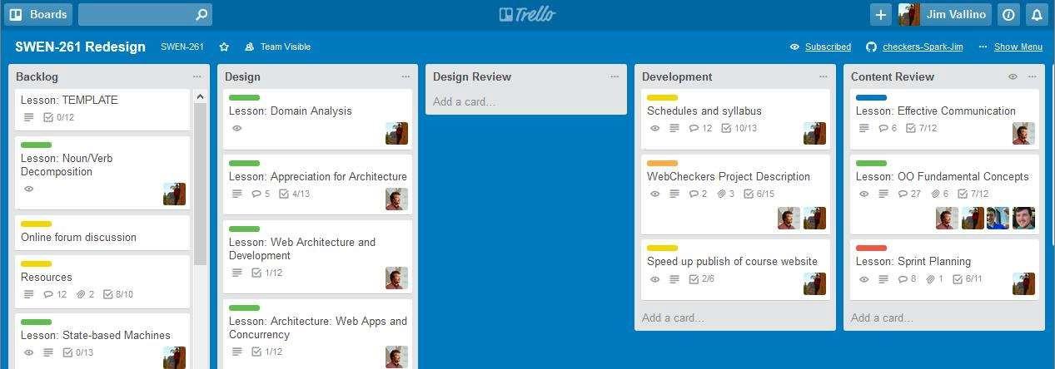
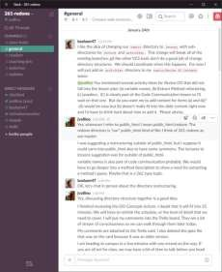
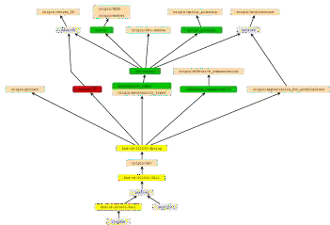
These same tools were used while developing the course and every term while it is taught.
Planning with Trello board
Communication and coordination
using Slack channels
Content development using Git with a feature branch for each topic

