Slide 1
Intro to Web Front Ends
SWEN-344 Web Engineering

Slide 2
Web front ends have a LOT of pieces
Highly subject to trends
Tons engineering challenges:
Usability
Compatibility
Performance
Accessibility
Key design concepts for web
Separation of style and substance
Reduce the user’s memory load
Semantic markup
Key pieces & vocab:
HTML: the initial structure of the page hypertext markup language
CSS: the style of page cascading stylesheets
JS: the logic of the page javascript
DOM: the current structure of the page document object model
The standards have evolved over time (since 1990s)
HTML is not a strictly defined syntax and browsers have accommodated many sloppy practices to avoid pages from ‘breaking’
There is so much legacy, attempts to clean up the syntax (e.g. XHTML) failed miserably!
Instead, there has been a consolidation over time of ‘winning’ browsers (although HTML 5 has also helped)

Slide 3
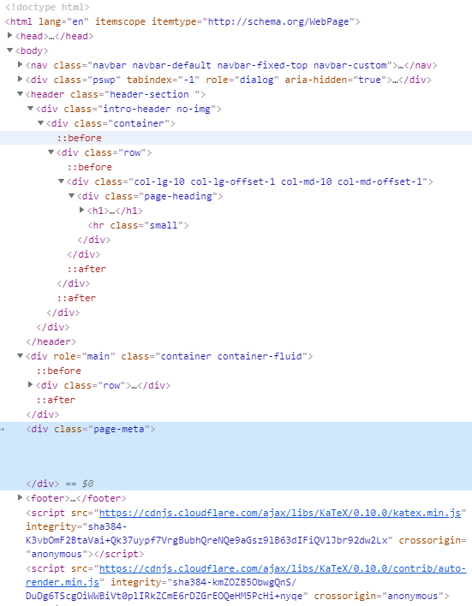
It’s all about the DOM
A webpage is a document. It’s content is a giant tree-like data structure
<foo bar=”baz”>content</foo>
Tags and Attributes
Tags are labels defining the type of data they enclose
<div></div> … just a placeholder. Division or divider
<input></input> … as it says, some type of ‘control’ that allows input
Many types: button, text, …
<table><row><column></column></row></table> … a grid (i.e. table)
NOTE: Tags have opening and closing marks
<input> (Open) </input> (close)
This provides structure and the ability for clients (like browsers) to parse the tree!
Tags have modifiers
<input type=“text”></input>
<div style=“border: 1px”></div>
https://developer.mozilla.org/en-US/docs/Web/HTML
https://www.w3schools.com/html/

Slide 4
It’s all about the DOM
Client
Client ( Browser) sends a request to retrieve (GET) a web page
Server handles the request, and the Browser receives HTTP response in HTML
HTML provides the initial structure of the DOM
Various things then concurrently modify DOM
<img src=”foo.png”> “go get (i.e. make HTTP GET request) for foo.png”
<script src=”foo.js”> “go get foo.js, then execute it”
<link rel=”stylesheet” href=”foo.css”>
go get foo.css and apply those styles to the DOM
Key: what order do these get executed in?
Usually… in document order, sort of …
CSS gets applied strictly in document order, JS not so much
HTTP Response ok (200)
<HTML> … </HTML>
GET http://server.com/index.html
Server

Slide 5
How big can the DOM be?
Pretty big.
Try this. Go to any website, open the Javascript console and run this: document.getElementsByTagName('*').length
Some examples
se.rit.edu/~swen-344 240 elements
nytimes.com 1,286
rit.edu 2,178
new.google.com 3,253
stackoverflow.com 3,460
reddit.com 4,423
coronavirus.jhu.edu/map.html 12,714
There are many, many (many) tags and properties
A major part of your education needs to be becoming comfortable with finding information in documentation
Two good resources are:
https://developer.mozilla.org/en-US/docs/Web/HTML
https://www.w3schools.com/html/

Slide 6
What is a web page?
Metadata tags to identify the page
It’s a text document (usually .htm or .html extension)
Content is in a ‘tagged’ language (sections are marked with specific characters)
<myTag></myTag> //Open and close tags
Browsers read/ parse the tags and build the DOM and then render (display) the information following the interpretation of the tags
<!doctype html>
<html lang="en">
<head>
<meta charset="utf-8">
<title>Web Assignment 1</title>
<meta name="description" content="First web assignment">
<meta name="author" content="Kal Rabb">
<link rel="stylesheet" href="custom.css">
</head>
<body>
</body>
</html>
Actual display content

Slide 7
Basic HTML building blocks
<html> <!-- Identifies the language e.g. not XML. PS This is a comment --> <head> <!-- CSS, fonts, metadata, js, etc. Typically stuff that isn’t displayed--> </head> <body> <!-- The actual content --> <img src=”foo.png”> <!-- vast majority of tags today are divs; allow placement and styling blocks --> <div>block of content</div> <p> Some text content with <span>inline styling</span> </p> </body> </html> <!-- Closing tag-->

Slide 8
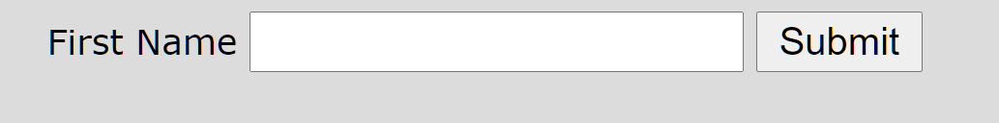
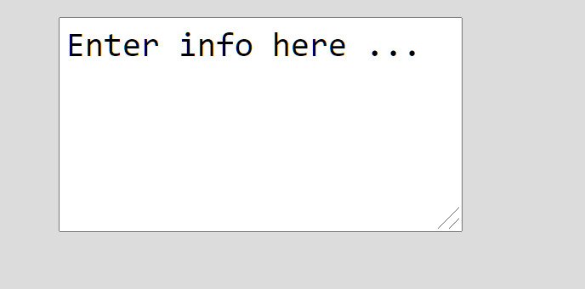

HTML Controls
<label>First Name</label>
<input type="text" name="firstname">
<input type="submit" name="send">
<textarea rows="5" columns="40" name="description">
Enter info here ...</textarea>
<input type="button" name="mybutton" value="clickme">

Slide 9
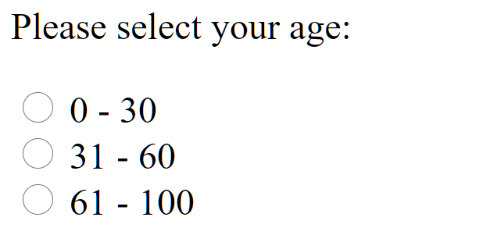
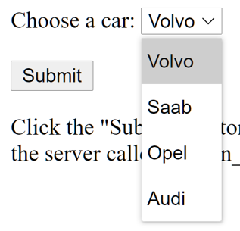
A few more …
<p>Please select your age:</p>
<input type="radio" id="age1" name="age" value="30">
<label for="age1">0 - 30</label><br>
<input type="radio" id="age2" name="age" value="60">
<label for="age2">31 - 60</label><br>
<input type="radio" id="age3" name="age" value="100">
<label for="age3">61 - 100</label><br><br>
<label for="cars">Choose a car:</label>
<select name="cars" id="cars">
<option value="volvo">Volvo</option>
<option value="saab">Saab</option>
<option value="mercedes">Mercedes</option>
<option value="audi">Audi</option>
</select>
https://www.w3schools.com/

Slide 10
Basic layout
‘display’ attribute (style=“display:<value>”)
There are two basic layouts defined with the display attribute
Block: A block-level element always starts on a new line, and the browsers automatically add some space (a margin) before and after the element. A block-level element always takes up the full width available (stretches out to the left and right as far as it can).
Two commonly used block elements are: <p> and <div>.
Inline: An inline element does not start on a new line. An inline element only takes up as much width as necessary.
<span>, <select>, <label> are common inline elements

Slide 11
Many types of display
display: block
display: inline
display: inline-block
Width and height are respected
Content gets pushed away
But still treated in the flow of text
display: inherit
Just use what the parent element is using (good for resetting a theme default)
display: flex
display: float (left, right …)
display: grid
display: table
i.e. <table>

Slide 12
JavaScript (JS)
Interpreted language,
Just-in-time compiled
Garbage collected
Multi-paradigm
Has some OO, but no inheritance or encapsulation
Has lots of C-style procedural syntax
Functional programming influence
Prototype-based programming
Add properties and methods at runtime to another object, e.g. empty object
You can create an object without first creating a class
First-class functions
A function can be treated like any other variable
E.g. sayHello()
No concept of input or output - just modifying the host environment
function sayHello() { return "Hello, "; } function greeting(helloCallback, name){ console.log(helloCallback() + name); }
greeting(sayHello, "world!");

Slide 13
Use JS Events to …
Respond to user actions
A button click (onClick)
A radio button selection (onChange or onClick)
A listbox selection (onChange or onClick)
And then do something …
function myEventHandler()
{
//get the object
//Figure out which attribute you want to change
//Change it
}

Slide 14
A javascript teaser …
Javascript allows dynamic behaviour (change html on the fly) within the browser
You can add Javascript code to the <head> tag; or elsewhere in the body; simple function declaration and object syntax
<script language="javascript“ type=“text/javascript”>
function setText(id1)
{
obj1 = document.getElementById(id1); //Get an element (in the DOM)
obj1.value = “Some value”; //Different DOM objects have different attributes you can set
}
</script>
Javascript called (for example) on DOM events; ids are unique within a given page
<div id=‘anotherId’ onClick=setText(‘someId’)></div>
Or .text; .innerHTML; class; …
Or another event (e.g. onchange …)
MDN (https://developer.mozilla.org) and w3schools (https://www.w3schools.com/) are great resources

