Slide 1
Intro to Web Front Ends
SWEN-344 Web Engineering

Slide 2
CSS

Slide 3
Style Sheets
All HTML tags can be ‘styled’. In other words, you can specify their visual attributes
Font
Color
Location
…
<div id=“styled_box"
style="border: 1px solid red; width:300px; height:200px;
padding: 5px; margin:10px"> </div>
However, this results in content and layout being intermingled. We want to separate those two functions
Stylesheets were introduced to help with separating content from layout
This allows you to develop all your content in your html page, and if you want to change the look and feel, you can just change the stylesheet without modifying the actual page
More or less, anyway. Sometimes one will affect the other …

Slide 4
Syntax
A CSS comprises of style rules that are interpreted by the browser and then applied to the corresponding elements in your document. A style rule is made of three parts −
Selector − A selector is an HTML tag at which a style will be applied. This could be any tag like <h1> or <table> etc.
Property − A property is a type of attribute of HTML tag. Put simply, all the HTML attributes are converted into CSS properties. They could be color, border etc.
Value − Values are assigned to properties. For example, color property can have value either red or #F1F1F1 etc.
You can put CSS Style Rule Syntax as follows −
selector { property: value }

Slide 5
Examples
Type Selectors:
table { border :1px solid #C00; }
h1 {
color: #36CFFF;
}
The Descendant Selectors:
Suppose you want to apply a style rule to a particular element only when it lies inside a particular element. As given in the following example, style rule will apply to <em> element only when it lies inside <ul> tag.
ul em {
color: #000000;
}
The Class Selectors
You can define style rules based on the class attribute of the elements. All the elements having that class will be formatted according to the defined rule. Class selectors are preceded by ‘.’
.black {
color: #000000;
}
This rule renders the content in black for every element with class attribute set to black in our document. You can make it a bit more particular. For example:
h1.black {
color: #000000;
}
This rule renders the content in black for only <h1> elements with class attribute set to black.

Slide 6
Examples
The ID Selectors
You can define style rules based on the id attribute of the elements. All the elements having that id will be formatted according to the defined rule. ID Selectors are preceded with ‘#’
#black {
color: #000000;
}
This rule renders the content in black for every element with id attribute set to black in our document. You can make it a bit more particular.
For example −
h1#black {
color: #000000;
}
This rule renders the content in black for only <h1> elements with id attribute set to black.

Slide 7
Multiple Style Rules
You may need to define multiple style rules for a single element. You can define these rules to combine multiple properties and corresponding values into a single block as defined in the following example (em is, iin this case, a unit of measurement, equivalent to one character (historically ‘m’)
h1 {
color: #36C;
font-weight: normal;
letter-spacing: .4em;
margin-bottom: 1em;
text-transform: lowercase;
}

Slide 8
Embedded styles ... Or External file
Embedded:
External CSS:
<!DOCTYPE html>
<html lang="en">
<head>
<style type='text/css'>
#top {
background-color: #ccc;
padding: 20px
}
.intro {
color: red;
font-weight: bold;
}
</style>
</head>
<body>
<div id="top">
<h1>SWEN-344</h1>
<p class="intro">This is the mantra for SWEN-344</p>
<p class="intro">Make sure you do assignments early!</p>
</div>
</body>
</html>
The <link> Element
The <link> element can be used to include an external stylesheet file in your HTML document.
An external style sheet is a separate text file with .css extension. You define all the Style rules within this text file and then you can include this file in any HTML document using <link> element. [Media refers to device (screen, print, speech …)]
Syntax:
<head>
<link type = "text/css" href = "..." media = "..." />
</head>
Style tag in <head>

Slide 9
In your HTML page …
#top {
background-color: #ccc;
padding: 20px
}
.intro {
color: red;
font-weight: bold;
}
<div id="top">
<h1>SWEN-344</h1>
<p class="intro">This is the mantra for SWEN-344</p>
<p class="intro">Make sure you do assignments early!</p>
</div>

Slide 10
Cascading Style Sheets
Cascade: if you use multiple in a row, the later ones override the older ones.
This applies to the order for sheets defined in HTML, e.g.
<head>
<!-- common pattern: reset defaults on everything across browsers -->
<link rel=”stylesheet” href=“reset.css”> <!-- First, these rules get applied -->
<link rel=”stylesheet” href=“theme.css”>
<!-- THEN these rules, overriding above if conflicting → <link rel=”stylesheet” href=“mysite.css”> </head>
And it applies within CSS too .song { font-size: 100pt } .song { font-size: 10pt } // overrides to 10pt
And it applies within an HTML element <div class=”song title”> <!-- title overrides song-->

Slide 11
Lots of references
https://www.freecodecamp.org/news/best-css-and-css3-tutorial/#:~:text=%20The%20Best%20CSS%20and,the%20right%20on...%20More
https://www.w3schools.com/Css/

Slide 12
Placeholder for a useful example …
https://www.w3resource.com/html-css-exercise/main-html-css-exercises.php

Slide 13
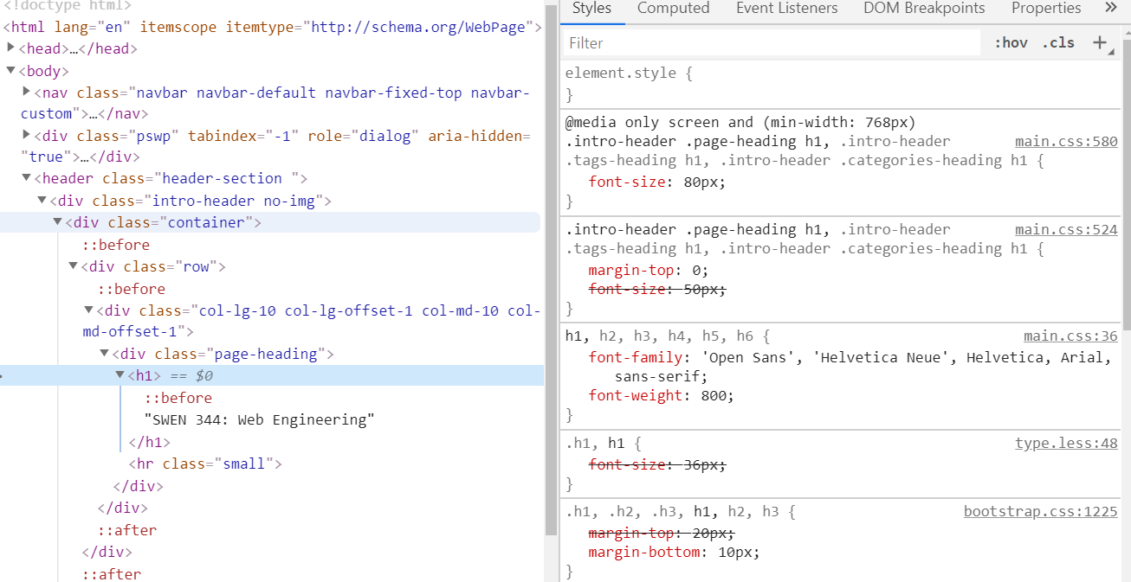
Confused? Use your Dev Tools!!

Slide 14
CSS DOM Selectors: id and class
Every DOM element has a class attribute and an id
Class stores a space-separated list of classes
Dot . selects classes, # selects IDs
E.g. HTML: <div id=”now-playing” class=”song title”>My Shot</div> CSS: .song { font-weight: bold; } .title { font-size: 1em; } #now-playing { font-family: Helvetica, Sans }
Conventions: id should be unique in the entire DOM, class not intended
Reality: browsers can handle non-unique ids, but are optimized for unique ids
Ideal: semantic markup
Classes and IDs should be readable to future developers
Lower the coupling! i.e. future developers should not have to edit BOTH the CSS and HTML very often

Slide 15
Tons more CSS Selectors
a {..} /* select all <a> tags */
a.foo {..} /* select all <a class="foo"> tags */
a#bar {..} /* select all <a id="bar"> tags */
.outer .inner {..} /* all .inner that are .outer elements, any level */
.parent > .child {..} /* .child must be direct child of a .parent */
span, div {..} /* all spans and divs */
p:nth-of-type(2n+1) {..} /* every other(odd) paragraphs */
a:hover {..} /* every link when the cursor hovers over it */
input[type="checkbox"]:checked {..} /* all checked checkboxes */
a + img {..} /* every <img> that comes immediately after an <a> */
* {..} /* everything */

Slide 16
Units in the DOM
Absolute
cm, mm, in → not typically used on screens, just print
px → 1 pixel… often used, but a bad idea to use today
pt → 1/72th of 1 inch… assuming 96px/in
Relative to font sizes
1em - parent element’s font size, (font size being the height)
1rem - the root element’s font size
Relative to viewport
<meta name="viewport" content="width=device-width, initial-scale=1">
vw, vh - 1% of the viewport's width, height e.g. 50vh
vmin, vmax - smaller/larger of width, height
Relative to the parent element: %
E.g. font-size: 85%, width: 50% or width: 100%
Good practice: use em and rem
Humans tend to scale the screen according to text they can read
Use em when you want the DOM element to change based on parent elements
Use rem when you are working with something global
Caveats
For a very long time, we could assume 96px to an inch. No more!
Retina screens changed all that
But not everyone HAS retina!
Also: phones and tablet are different distances from our faces than before.
So… you usually won’t use px as a unit
There are exceptions, of course… e.g. nudge by 1px

Slide 17
An example thus far
a { color: #0000FF; text-decoration: underline; } a:hover { color: #00FF00; font-weight: bold; }
h1, h2 { font-weight: bold; } h1 { font-size: 1.5em; text-align: center } h2 { font-size: 1.25em; } .subtitle { font-size: 2vh; text-align: left } h1 + .subtitle { text-align: center } p { font-size: 1rem } .welcome p { font-size: 125% }

Slide 18
Layout: box model
Great article: https://developer.mozilla.org/en-US/docs/Learn/CSS/Building_blocks/The_box_model
Everything has a bounding box around it e.g. text, images, divs
Block boxes
“Extend in the inline direction to fill the space available in its container”, e.g. width
width and height properties are respected
e.g. <h1> and <p> are block by default
Padding, margin, and border properties will cause the content to be pushed away from the box
Inline boxes
Won’t break on a new line
width and height are not respected
Dev tools can show you how the box is laid out
Notes:
https://developer.mozilla.org/en-US/docs/Learn/CSS/Building_blocks/The_box_model

Slide 19
Layout: Margin, Padding, Border
margin: the space around your box, i.e. outside
padding: the space inside your box
border: the way the border is treated
width is the content + padding + border (but NOT including margin)

Slide 20
Many types of display
display: block
display: inline
display: inline-block
Width and height are respected
Content gets pushed away
But still treated in the flow of text
display: inherit
Just use what the parent element is using (good for resetting a theme default)
display: flex
display: float (left, right …)
display: grid
display: table
i.e. <table>

Slide 21
Flexible display:
Flexboxes are best for linear layouts
All about just “goes with the flow”
Scales nicely with varying screen sizes or resizing within the UI
If you have:
a bunch of peers
that all need to be treated the same
with some block-like properties but still treated inline
...flexbox is your friend
Con: can’t always predict where a box will end up
https://css-tricks.com/snippets/css/a-guide-to-flexbox/

Slide 22
Container plus ‘items’
<div class="flex-container"> <div>1</div> <div>2</div> <div>3</div> </div>
1
2
3
.flex-container { display: flex; flex-direction: column; }
1
2
3
Many options: flex-wrap; wrap-reverse; row; row-reverse …

Slide 23
display: grid
Enormously expressive syntax around a grid
Similar to how cells work in a table or spreadsheet
...but designed with future-proofing in mind
Spanning grid boxes, start and end
Naming grid sections for better readability
Prevents a lot of “reflowing”
UI components won’t get shuffled around on screen changes - the grid just shrinks
More predictable than flexbox

Slide 24
More Layouts
CSS Grid
https://css-tricks.com/snippets/css/complete-guide-grid/
https://developer.mozilla.org/en-US/docs/Web/CSS/CSS_Grid_Layout/Line-based_Placement_with_CSS_Grid
Floats
float:left and float:right
Best for the “figure floating in the text”
Finicky, but useful in narrow situations
text-align: center
Lots of wysiwigs will do this for you. Don’t give in!
Sometimes what you really have is just text with some figures.

Slide 25
Media Queries
In CSS, what type of screen am I in?
Size? Aspect ratio?
Print, screen, or speech?
Color?
Prefers light or dark color scheme?
Am I mobile? Wrong question. Lines are blurry these days.
Use screen size and resolution
pointer: fine or coarse
hover: none
@media (min-width: 30em)
and (orientation: landscape)
{ ... } @media only screen
and (min-device-width: 768px)
and (max-device-width: 1024px)
and (-webkit-min-device-pixel-ratio: 1)
{ ... }

Slide 26
Responsive Design
Bootstrap
https://getbootstrap.com/
Foundation
https://get.foundation/sites/docs/
Basic concepts
12-column fluid grid
Wider than a breakpoint - left-to-right
Smaller than a breakpoint, stack vertically
Breakpoints at various screen sizes, using pixels
Internally: combination of flexbox and grid
Example: adding the TOC to our course website
//From Bootstrap docs
// Extra small devices (phones, less than 576px) // Small devices (landscape phones, 576px and up) @media (min-width: 576px) { ... } // Medium devices (tablets, 768px and up) @media (min-width: 768px) { ... } // Large devices (desktops, 992px and up) @media (min-width: 992px) { ... } // Extra large devices (large desktops, 1200px and up) @media (min-width: 1200px) { ... }
We’ll see more on a version of bootstrap during Reactjs

Slide 27
Review: avoid these HTML code traps
Overuse of <font>, <br>
Why: these break separation of substance and style
Alternative: use CSS for font/ text style. Use <div>, <p>
<div class=”blue”>Elvis</div>
Why: make tags semantic, what does the blue mean?
Alternative: “singer” or “first_name”
Laying out the page with a <table>
Why: Static placement, not flexible. Not what it was designed for (but widely used until alternatives were defined)
Alternative: use CSS grid, flexbox
https://developer.mozilla.org/en-US/docs/Web/HTML/Element/br

Slide 28
Client-Side Storage: Cookies
Cookies
Part of the HTTP protocol
The server response instructs the browser to set a “cookie”, or a key-value pair
Cookies are provided with every request to the server
Max size is ~4kb
Session cookies
Clear when the browser closes
Useful for authentication (although now replaced by sessionStorage… next slide)
Permanent cookies
Stays across browser sessions
Expire after a date
Third-party: can be read by ANY site you are visiting (tracking)
Javascript: document.cookie
HttpOnly cookies cannot be accessed via Javascript, useful for security

Slide 29
Client-Side Storage: sessionStorage & localStorage
Much larger storage capabilities beyond cookies
Not for tracking like third-party cookies
But personalization and client-side functionality
Still key-value storage
Session storage
For each “origin” you are visiting, a new storage is opened
Multiple tabs on the same website? One session storage.
Close all tabs for that origin, clear the session storage
Max size is ~5mb
Local storage
Same as session storage
...but does not clear when the browser closes
Bigger limits, usually ~10mb

Slide 30
Same-Origin Policy
Origin: protocol+host+port
e.g. https://store.example.com/foo/bar → “https”, “store.example.com”, 80
e.g. http://localhost:3000/foo/bar → “http”, “localhost”, 3000
Subdomains are different hosts
When parsing an HTTP response from origin X, only allow requests back to X
Huge exceptions to Same-Origin, however:
Links, redirects, form submission can go to a different origin (of course)
<script> tags are allowed to include code from a different origin
So don’t allow users to set <script> tags… XSS!
Error details are not available for cross-origin
<link rel=”stylesheet”> allowed for CSS
<img> tags for advertisements
Media from <video> and <audio>
Fonts in CSS
<iframe>, but if you want to disable that you can set the HTTP header X-Frame-Options
Conclusion: Weak security policy.
See also: CORS allows exceptions to this policy as well

