Slide 1
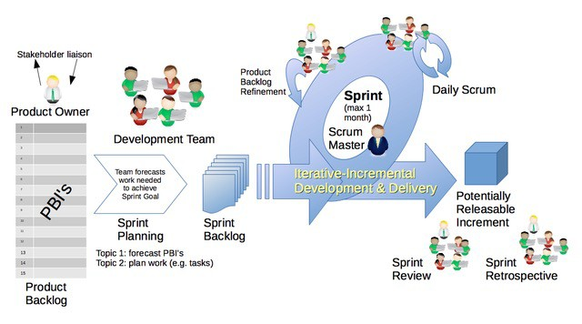

Backlog Refinement and Estimation
SWEN-610
Foundations of Software Engineering
Department of Software Engineering Rochester Institute of Technology
By Dr ian mitchell (Own work) [CC BY-SA 4.0 (http://creativecommons.org/licenses/by-sa/4.0) or CC0], via Wikimedia Commons

Slide 2
Before a story can be placed in the sprint backlog, it must be refined and given an effort estimate.
The user story statement alone provides no detail about what is required or how to implement it.
Backlog Refinement adds those details.
Acceptance criteria provide details of requirements
Solution tasks outline how to implement the story to satisfy the acceptance criteria
Based on the solution tasks, the developers can estimate story points using Planning Poker.
With enough stories having story points, sprint planning can fill the sprint backlog up to the team's velocity.

Slide 3
Acceptance criteria come from the Product Owner or user representatives.
Defining acceptance criteria can be done in brainstorming sessions with the product owner
The Product Owner leads the discussion and drives the exploration of the acceptance criteria.
The developers ask questions to further elaborate the acceptance criteria.
This can be done all together or in smaller groups discussing subsets of user stories.

Slide 4
Let's review:
What makes good acceptance criteria?
Like stories, focus on the what not the how.
Use a Given/When/Then format:
GIVEN some precondition WHEN I do some action THEN I expect some result
Given that I'm not signed-in when I visit the Home page then I expect to clearly see how to Sign-in.
Given that some other player has already signed-in with my name when I attempt to sign-in with my name then the system should reject the request with an error message
and re-render the Sign-in form.

Slide 5
With acceptance criteria defined, a developer then fleshes the solution tasks
Evolve the analysis models:
Explore new domain concepts
Alter existing domain model
Does the story alter the flow of the web interface or other application logic? If so, other diagrams (e.g. Sequence) may need to be modified
The design is very high-level:
Create or modify React Components/Services the UI tier
Create or modify REST API Services
Make other changes to how the objects are persisted in the Model Tier
Refactoring existing code to improve the overall design

Slide 6
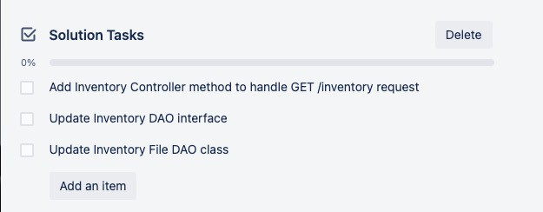
These descriptions become tasks in the story's Trello card.
Solution tasks are lower level that acceptance criteria, but not code level

Slide 7
During Sprint X you refine stories in preparation for the Sprint Planning meeting for Sprint X+1.
Product Backlog
Backlog Refinement
Sprint Planning
Sprint Backlog
Analyze story
Design solution
Review the next story on the backlog
Estimate using Planning Poker
Does story fit in sprint?
Yes: add to Sprint Backlog
No: keep on Product Backlog
Is Sprint full?
Yes: Done!
No: go to step 1 and repeat.

Slide 8
Planning poker is a technique devised by Mike Cohn.
It is a form of expert estimation in which every team member is an expert.
The points assigned are abstract; they do not relate to hours of effort.
A sprint's capacity is not in hours but "level of effort"
The point system provides relative levels of effort.
Small effort: 0, ½, 1, 2 or 3
Medium effort: 5, 8 or 13
Large effort: 20, 40 or 100
Unknown: ?

Slide 9
OK, but how do you estimate a story, really?
Create an estimate for each Solution Task in your story design.
Consider the type of component to build (or modify)
Consider the complexity of the feature
Consider how well you know the technology
Add up each task estimate and round up to the nearest Poker (Fibonacci) number.
Expert developers do this calculation implicitly based their large experience base.

Slide 10
Here is an example matrix of component estimation.
Architectural Tier | Component Type | Small / Low | Medium | Large / High
Client UI | React Component or Service | 2 | 3 | 5
REST API (Controller) | Service | 1-2 | 3 | 5
Persistence | Data Access Object | 1-2 | 3 | 4
Each team member can independently estimate a user story by:
For each class that will get touched/created when implementing the user story, identify its component type.
For each class, find its estimate in the chart based on your estimated level of development effort needed.
Add up all the class estimates to get your estimate for the user story.

Slide 11
Here's how Planning poker works.
The Product Owner reads the top story on the Product Backlog.
The team reviews the acceptance criteria and the suggested solution design.
To vote, each player picks the point card for his or her estimate.
Players reveal their cards all at once.
If there is consensus on one number, you're done.
Otherwise:
Have the outliers (high/low) explain their position
Team discusses
Vote again until consensus is reached

Slide 12
What should the team do if no consensus is found?
There are usually two issues that prevent consensus.
Product uncertainty:
The requirements (acceptance criteria) are too vague
Send the story back for further (analysis) refinement
Technical uncertainty:
Identify the uncertainty in the solution design
Create a spike story for this sprint to establish certainty
Send the story back for further (design) refinement
In either situation, the story should stay on the Product Backlog until the uncertainty is resolved.

