Slide 1
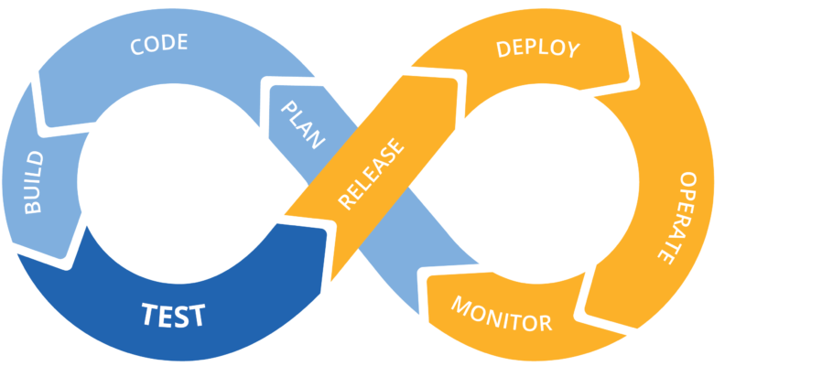

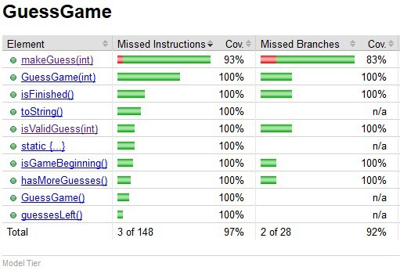

CI/CD Basics & Code Coverage
SWEN-610
Foundations of Software Engineering
Department of Software Engineering Rochester Institute of Technology

Slide 2
What is a CI/CD Pipeline?
Continuous Integration/Continuous Delivery (CI/CD) pipelines is a practice focused on improving software delivery using a DevOps approach.
It is a series of steps that must be performed in order to deliver a new version of software.
Version Control
Unit Test
Auto Test
Deploy to Production
Build
Deploy
Although it is possible to manually execute each of the steps of a CI/CD pipeline, the true value of CI/CD pipelines is realized through automation
2

Slide 3
What is a CI/CD Pipeline?
Continuous Integration is development practice where developers integrate all code into a shared repository, frequently.
Once code is merged, the automated build is ready to be verified and tested
Continuous Integration
Version Control
Unit Test
Auto Test
Deploy to Production
Build
Deploy
Continuous Delivery
Continuous Delivery executes after Continuous Integration steps have successfully completed
Application is built and deployed to a pre-production environment where additional automated testing and/or Acceptance Testing is conducted before deploying to production
3

Slide 4
How good is our Unit Testing?
We have been running our unit tests but how do we know how well they test all of our code?
Do the unit tests execute across a broad area of code or are they simply testing the same methods and ignoring others?
If we are using a CI/CD Pipeline, what if we wanted to impose a certain level of code coverage in our Continuous Integration before we run continue with Continuous Delivery?
We need a Code Coverage tool!

Slide 5
Code coverage analysis is measuring how well your unit tests exercise the production code.
Code coverage works like this:
Compile the project into some intermediate representation (IR)
Instrument the IR with "touch points"
Run the unit tests, which gathers coverage data
Generate a coverage report from the gathered data
We will recommend you use the Coverage module for python
Having this information is a double-edge sword.
It's mostly a positive thing; telling the team where to spend additional testing effort.
But don't be obsessed with the metrics; we'll talk more about this later.

Slide 6

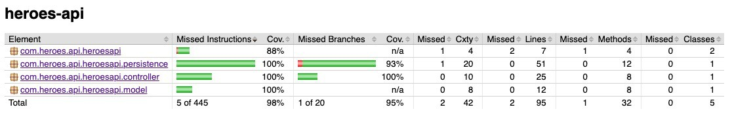

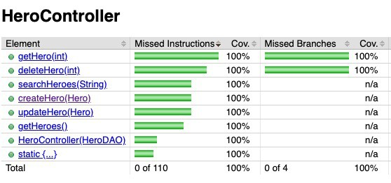

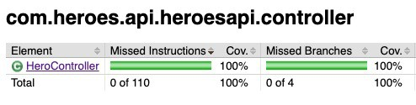
Coverage report is a simple HTML web site
The report is stored in /target/site/jacoco.
Missed Instructions provides information about the amount of code that has been executed or missed
Missed Branches indicates
branch coverage for
all if and switch statements
Top tier
Class-level
Controller tier

Slide 7

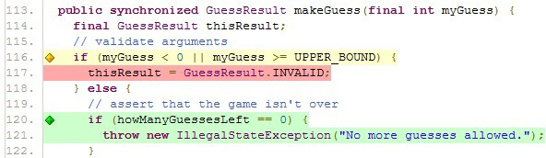
It's at the class-level where you can start a meaningful analysis.
This GuessGame code had 97% coverage. So, what do you do?
On the one hand:
That's REALLY good already.
The only missing test is a defensive check so maybe say "that's good
enough."
On the other hand:
This is a core Model tier class.
We want these to be "friendly" test dependencies.
So maybe the team agrees to make
this 100% covered.
What tests need to be added?
Color Legend Green ➔ covered
Yellow ➔ partially covered Red ➔ not covered

Slide 8
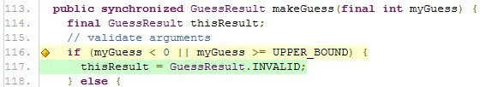
There needs to be a test to check making an invalid guess.
Here's a test:
@Test
public void make_an_invalid_guess() {
final GuessGame CuT = new GuessGame(); assertEquals(CuT.makeGuess(TOO_SMALL), GuessResult.INVALID); assertFalse(CuT.isFinished(), "Game is not finished");
}
Here's the updated analysis:
This line is tested but only through this part of the branch.
We need to test the second part of the branch.

Slide 9
Deciding what level of coverage depends upon several factors…
Some components (Model tier) are used across multiple other architectural tiers.
We recommend 95% or better for Model tier.
Others are only used by the REST API.
We recommend 90% or better in all other tiers.
Other factors:
Team and company culture
Application domain
Regulatory requirements may specify testing requirements.
Those defensive checks may be safety checks. You can not know if the system is safe if you do not test the checks.

Slide 10
Integrate Coverage into your CI pipeline
You should integrate code coverage into your CI
Why?
You should keep an eye on your coverage as your development continues
Integrate it into your database side first
How do we integrate it on the server side?
How do we integrate it for both?
You can choose to use another method for doing code coverage, as the Coverage module does have its weaknesses for our use case, but it can still work

