Slide 1
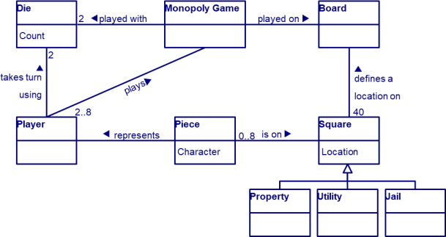
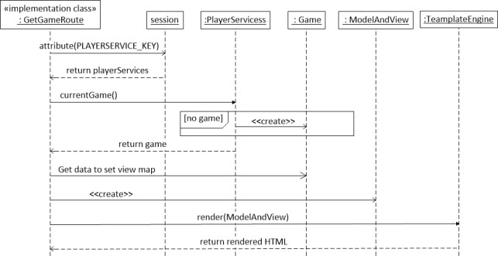
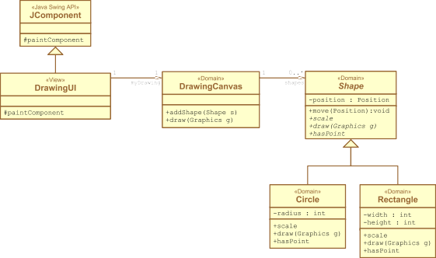

Design and Code Communication & Code Reviews
/**
Get the {@linkplain GuessGame game} for the current user.
The user is identified by a {@linkplain Session browser session}.
SWEN-610
Foundations of Software Engineering
Department of Software Engineering Rochester Institute of Technology
*
* @param session
* The HTTP {@link Session}, must not be null
*
* @return
* An existing or new {@link GuessGame}
*
@throws NullPointerException
when the session parameter is null
*/
public GuessGame get(final Session session)

Slide 2
How your code "reads" is critically important for the humans who will read it.
Code is read by humans as much as by machines.
Code must be readable and understandable by all team members.
Clear code communication includes:
A shared code style
Use of good, meaningful names
Component APIs are clearly documented
Algorithms are clarified using in-line comments
Indication of incomplete or broken code
Any fool can write code that a computer can understand. Good programmers write code that humans can understand.
Refactoring: Improving the Design of Existing Code
Martin Fowler, et. al (1999)

Slide 3
Follow “typical” naming conventions
How do you name a variable?
How do you choose the words to use?
How do you determine their order?
When do you abbreviate or expand?
What makes a variable name good?
What makes a variable name bad?
Lets talk about some research
https://github.com/SCANL/identifier_name_structure_catalogue
You don’t need to understand linguistics to write good variable names, but understanding something about linguistics can help

Slide 4
Make names reflect what they mean and do.
Dos:
Use names that reflect the purpose
Use class names from analysis and domain model
Use method names that are verbs in your analysis
Use method names that describe what it does not how it does it
Don'ts:
Don’t needlessly abbreviate; spell it out
pricePerUnit is better than pPU or worse just p
Don't use the same local variable for two purposes; create a new variable with an appropriate name
Try not to use negation in variable names
isValid is better than isNotValid.

Slide 5
A shared code style is good etiquette.
A code style includes:
Spaces vs tabs
Where to put curly-braces
Naming conventions
CamelCase for class names
UPPER_CASE for constants
lowerCamelCase for attribute and method names
And so on
Every team should choose a style and stick to it.
IDEs provide support for defining a code style
Pep8 - https://peps.python.org/pep-0008/

Slide 6
Document your API
In python, three quotes denotes a multi-line docstring
””” text here”””
Generally, these go just inside of the function (beneath the signature) and act as documentation for the function and its inputs
Python also has a module named pydoc
https://www.datacamp.com/tutorial/docstrings-python

Slide 7
Use in-line comments to communicate algorithms and intention.
Use in-line comments to describe an algorithm
Dos:
Use pseudo-code steps
Explain complex data structures
Don'ts:
Don't repeat the code in English
count++; // increment the count
Use comments to express issues and intentions
A TODO comment hints at a future feature
A FIX (or FIXME) comment points to a known bug that is low priority

Slide 8
A code review can improve the quality of the product and the quality of the team.
Increase product quality
Identify and fix design or coding violations
Identify and fix code communication issues
Analyze test coverage, identify new test scenarios
Increase overall team skill
Discuss code communication
Share coding and testing techniques
Discuss design principles & patterns, as appropriate

Slide 9
There are several situations that warrant a code review.
For new members of the team
Along with reading the Design documentation
Code review (walk-through) with a senior developer
For Spikes
To impart lessons from the Spike to the rest of the team
For User Stories
To improve the quality of the feature code
To share best practices with the rest of the team
Even trivial stories should have reviews

Slide 10
There are several code review techniques.
Individual
A senior developer sits with a junior developer
The review can be focused on a specific problem or for general understanding a subsystem
Synchronous
A team meets to review some code
Usually the most formal process
Disadvantage of needing to sync schedules
Asynchronous
A developer uses an online tool to create a review
Shows the diffs between two branches
Reviewers make comments in the tool
Hybrid approaches

Slide 11
A team will often have a checklist of things to look for during the code review.
Coding practices
Code communication
Defensive programming practices
Design practices
Adherence to architectural tiers
Adherence to core OO principles
Adherence to OO design principles
Testing practices
Are test suites comprehensive (enough)
Test code follows good code and design practices
Design documentation
Is the documentation being kept up-to-date

Slide 12
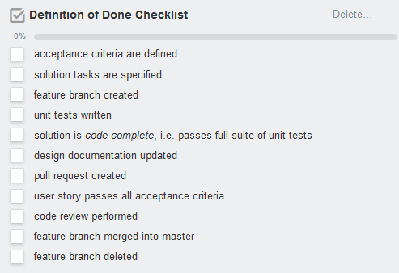
Issuing pull requests and performing code reviews will now be a part of your development workflow.
The Pull Request is made when the story moves to Ready for Test, i.e. after the user story is code complete, and the design documentation is updated.
Review should be done by a minimum of two team members other than the developer of the story.
Acceptance testing can be performed in parallel.

