Slide 1
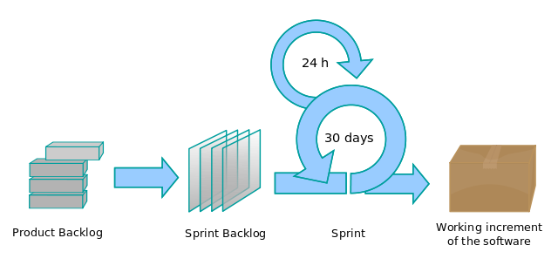
Sprint Planning
By Lakeworks - Own work, GFDL, https://commons.wikimedia.org/w/index.php?curid=3526338
SWEN-610
Introduction to Software Engineering
Department of Software Engineering
Rochester Institute of Technology
Notes:
1

Slide 2
A sprint plan is a plan to build a small, working increment of the product.
Each sprint is time-boxed; your sprints will be about three weeks long
Each sprint has a backlog of work to be done during the sprint
This is the team's commitment to the Product Owner
It is the sole focus on the team's effort during this sprint
The sprint planning meeting establishes the next sprint's backlog and launches the sprint
Let's first consider how a sprint flows...
Notes:
Bullet 1 – There are a few sprints that have a little less than three weeks.
B2-b2 – By "sole focus" I mean it. There is a temptation to design & build for future sprints. Don't do it! (YAGNI https://en.wikipedia.org/wiki/You_aren't_gonna_need_it) Just design and build what you need in this story. And at the larger scale, all effort should be directed to user stories that are in the minimum viable product (MVP) until that is complete. Teams will get at most 50% of 15 points in their final grade, if the final deliverable does not have a bugfree MVP. Make sure to highlight this multiple times through the term, and when you look at the user stories chosen for each sprint backlog.

Slide 3
So we start with a backlog for the new sprint.
During the Sprint Planning meeting, stories from the Product Backlog are put on the Sprint Backlog.
Let's assume that the team can do at most 25 points worth of work in a sprint.
Stories are in the product backlog in priority order and you select stories in priority order until you are near the sprint work limit.
Product Backlog
Sprint Backlog
S1 (5)
S2 (13)
S3 (21)
S9 would fit into the sprint but may have been left out because of a dependency on an unimplemented higher priority user story.
S4 (3)
S5 (3)
S6 (2)
S7 (13)
NOTE: In this illustration story points for each Story are provided. A future lesson will show you how to play planning poker so these numbers will come from the team.
S8 (5)
S9 (1)
S10 (3)
S11 (5)
Notes:
ANIMATION: This slide mimics the process of Sprint Planning; in its simplest form it's a matter of picking the top X stories off the Product Backlog that don't exceed the team's velocity.
They haven't been introduced to velocity so on this slide you don't necessarily have to mention it. All the students know is this team can only perform about 25 story points worth of work.
At the end of this lecture velocity is introduced but there won't be enough "working" sprints for them to accurately measure their team's velocity; so we won't spend much time on it.
Likewise, to make the sprint planning for Sprint 1 as simple as possible, the story points have all been specified for the two user stories that the teams will implement. There is a lesson on Planning Poker later in the term so don't spend too much time on this aspect of planning.

Slide 4
How does a story get from Backlog to Done?
When do you know that you're done with a story?
Product Backlog
Sprint Backlog
Done
S3 (21)
S1 (5)
S1 (5)
S6 (2)
S2 (13)
S7 (13)
S4 (3)
S8 (5)
S5 (3)
S9 (1)
S10 (3)
S11 (5)
Notes:
ANIMATION: When the slide opens ask the title question and within a second the "done" (gray) S1 card will move from left to right landing in the Done list.
Linger here and let the class offer suggested activities; hopefully someone will mention Developing and Testing. But there are many others that are also valid…
So then click the next animation to reveal the follow-up question: When are you really done?

Slide 5
The team must establish a Definition of Done.
Core activities:
Acceptance criteria are defined
Solution is designed
Solution is developed; aka "code complete"
Feature has been tested (manually)
Other activities we'll add throughout the course:
Feature branches (configuration management)
Unit testing
Code coverage analysis (goals)
Code reviews
Demo increment to stakeholders
Notes:
ANIMATION: The slide first shows our starting point for the Definition of Done. These are built into the template Trello board in the S1 story cards.
After talking about S1 you can click the animation to reveal these other activities that the course teaches throughout the next two sprints.

Slide 6
A story goes through five "gates" to get to Done.
A story goes through this gate when acceptance criteria and solution tasks are defined, it is estimated, and then selected to be worked on in the next sprint.
A story goes through this gate when it has been fully developed.
A story goes through this gate when it has been verified to pass all of the acceptance criteria and it is considered done.
Product Backlog
Sprint Backlog
Ready for Test
In Dev
In Test
Done
S3 (21)
S1 (5)
S6 (2)
S2 (13)
S7 (13)
S4 (3)
S8 (5)
S5 (3)
S9 (1)
S10 (3)
A story goes through this gate when a free developer starts implementing it.
A story goes through this gate when a team member starts testing it.
S11 (5)
Notes:
ANIMATION: This slide introduces the structure of the Trello board. Each list has a purpose and each transition can be seen as a "gate".
Each blue list contains activities for one or more team members. Analysis (Acceptance Criteria), design (Solution Tasks), and estimation (Planning Poker) in the Product Backlog list. The first two are somewhat background tasks done in preparation for the all-hands Planning Poker activity and picking the stories to put in the Sprint Backlog during Sprint Planning. Actual development/debugging takes place in the In Dev list where all the Solution Tasks are implemented and unit tests are passed. The final activity list is the In Test list where a team member, other than the developer, tests the user story against its Acceptance Criteria.
The black lists are where the stories wait for someone to take on the next phase of work: waiting for a developer in the Sprint Backlog list, and waiting for a tester in the Ready for Test list. The Done list is the permanent waiting list. ☺

Slide 7
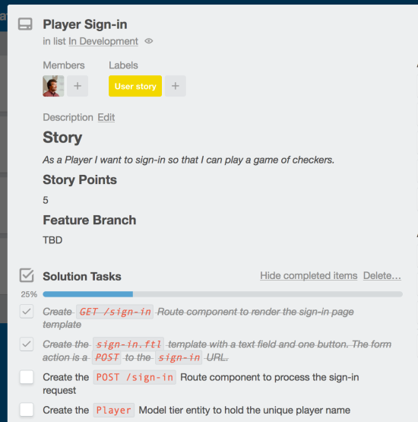
As solution tasks are completed, the person doing the work checks off the task as done.
Notes:
Check-off tasks during development.

Slide 8
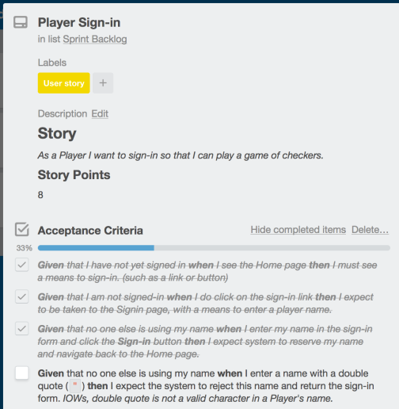
The tester checks off Acceptance Criteria as they validate the behavior of the system.
Notes:
Reinforce that only the tester checks-off ACs. I have seen teams check-off ACs during development but then had to uncheck them for testing. That makes the audit log more messy than it needs to be.

Slide 9
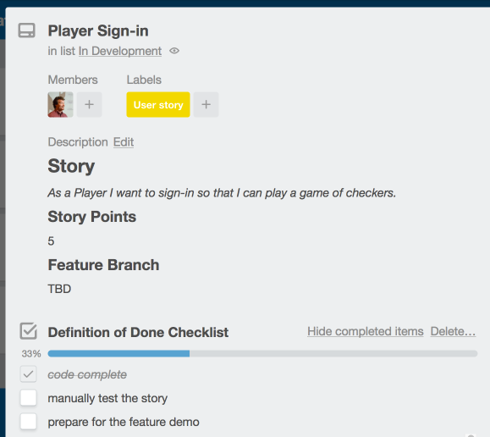
Check-off Definition of Done items as the work gets completed.
Notes:
Check-off DoD items as the card moves through each gate. The person doing the work should check-off these items. If multiple people were involved then just make sure to evenly distribute the activity by members across multiple stories. In the end, if everyone is doing work it will be clear in the long run across many stories.

Slide 10
A sprint holds a mini-waterfall of activities
Requirements
Design
Verification
adds details
Product Backlog
Sprint Backlog
Ready for Test
In Dev
In Test
Done
S3 (21)
S1 (5)
S6 (2)
S2 (13)
Implementation
S7 (13)
S4 (3)
S8 (5)
S5 (3)
Maintenance
S9 (1)
S10 (3)
S11 (5)
Notes:
ANIMATION: This slides reinforces the relationship between the five core activities (as mentioned in the Appreciation for Software Process lesson) and each Trello list.
Each of the five core activities are animated indicating another perspective of the flow of the development of a story; including the cyclic nature of testing and debugging/maintenance.
Don't spend much time on this slide.
The next four slides talk about the process of using Trello. It would be a more powerful lesson if you were to switch to performing a live demo of how to use Trello to coordinate story cards throughout the development process, assigning members, checking-off tasks, DoD activities and finally ACs during testing. Doing a demo replaces the need to "talk to" the next five slides.

Slide 11
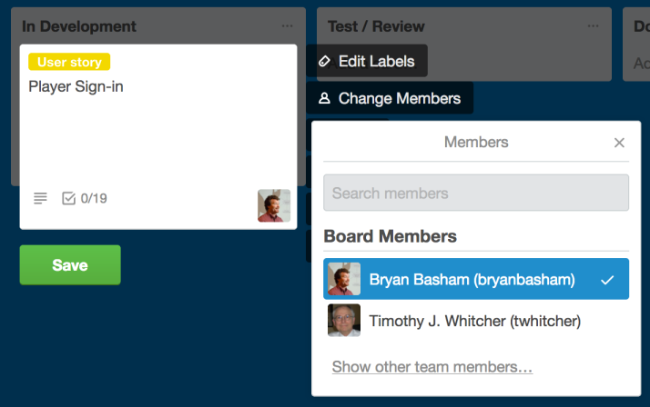
When members work on a Story they should be assigned to the card.
Notes:
Edit the card and click on the Change Member button then select each member working on the card for the next activity.

Slide 12
On any given day, the sprint board tells us the status of all sprint work.
Product Backlog
Sprint Backlog
Ready for Test
In Dev
In Test
Done
S3 (21)
S4 (3)
S2 (13)
S1 (5)
S6 (2)
S5 (3)
S7 (13)
S8 (5)
S9 (1)
S10 (3)
S11 (5)
Notes:
A well-used Trello board is a snapshot of the status of the sprint's work: what is done, what is being working (and by whom) and also what is waiting for someone to pickup.

Slide 13
At the end of a sprint, unfinished work gets put back onto the Product Backlog.
Product Backlog
Sprint Backlog
Ready for Test
In Dev
In Test
Done
S3 (21)
S4 (3)
S1 (5)
S6 (2)
S2 (13)
S7 (13)
S5 (3)
S8 (5)
S9 (1)
S10 (3)
S11 (5)
Notes:
ANIMATION: This slide represents what happens at the end of a sprint. Any work that is not done, i.e. all Definition of Done items are checked off, goes back to the Product Backlog. This gives the Product Owner the opportunity to rethink the priority of that story; for example, if the requirements weren't well understood or the team discovered it involved technology they needed to learn.
In practice however, usually the story just stays were it is on the board and is continued into the next sprint. Those points (all of them) are included in the next sprint's total; thus leading into the next slides discussion…

Slide 14
And the process starts all over again at the start of the next sprint.
Product Backlog
Sprint Backlog
Ready for Test
In Dev
In Test
Done
S4 (3)
The team has some flexibility in what they are willing to commit to the product owner for a sprint.
S3 (21)
S6 (2)
S7 (13)
S8 (5)
S9 (1)
S10 (3)
S11 (5)
Notes:
ANIMATION: this slides shows the process of picking Sprint Backlog stories but now we are including a story that is nearly done
That might raise two questions:
If I know that S4 is nearly done then the team might have a little more capacity to handle more that 25 pts (the static velocity measurement in these examples).
Or that if the team finishes the next sprint early they can pull in additional work (from the Product Backlog) when resources are available.
And hopefully, this might lead to a discussion about where that fixed number comes from… ah, the magic of velocity our next topic. You will ask the students where this number comes from with the animation on the next slide.

Slide 15
But how do you really know how many story points the team can accomplish in a sprint?
Velocity is measured from the average of the last three sprints.
Only use the completed stories.
This rolling average will change over time.
The average velocity is then used to cap the number of story points for the next sprint.
Example:
Sprint 7: 45 story points committed; 42 completed.
Sprint 8: 40 committed; 50 completed
Sprint 9: 48 committed; 47 completed
Velocity = (42 + 50 + 47) / 3 ~= 46.3333
Sprint 10 will be capped at 46 story points.
Notes:
ANIMATION: start with the question and if a student remembers see if they can guess how it is calculated
Then click to expose that information.
Then click again to show an example.

Slide 16
Velocity is specific to one team working on one project.
This assumes that sprint length and team membership remain consistent.
If either of these two change, then velocity measurement must start over with a new running average.
Velocity is only measured for a single project, single team.
Story points are level of effort estimates
Story points are determined by the team, for the team
Thus you cannot compare velocity's between teams
Management cannot set a team's velocity.
Notes:
Every team is unique and will have their own variations of estimating, skill level, etc that alters how velocity is measured.

Slide 17
Velocity is not the same as the team's overall capacity.
Velocity is only a measure of effort for working on user stories.
It does not include company meetings, email communication, small "outside" tasks
For class, it does not include most before- and after-class activities
What about these issues?
Holidays or vacations
Members given large, outside tasks
Normally these issues can be ignored being smoothed out by the averaging process.
In extreme cases, the team can make adjustments to the calculated velocity usually by lowering it.
Notes:
Other activities are not part of calculating velocity and shouldn't be tracked in story cards.

