Slide 1
Winning Solution for Meta KDD Cup’24
Yikuan Xia, Jiazun Chen, Jun Gao
National Key Laboratory for Multimedia Information Processing,
School of Computer Science,
Peking University

Slide 2
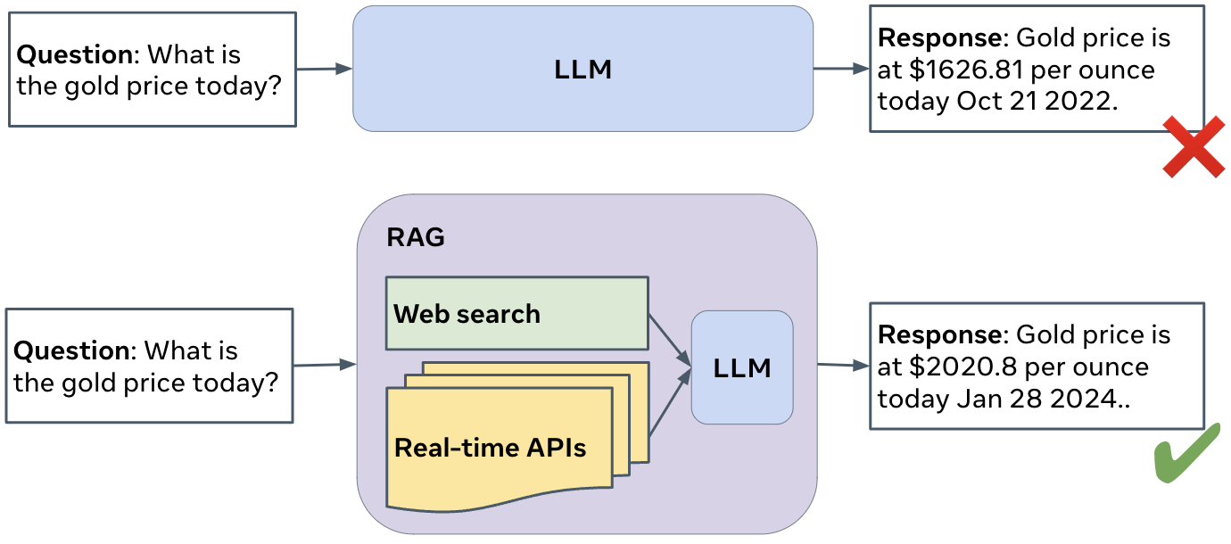
Introduction
Background of the Study
RAG (Retrieval-Augmented Generation) integrates external information retrieval with large language models (LLMs) to provide grounded answers
Addressing the issue of hallucination, where models generate inaccurate or ungrounded responses
Objectives of the Meta KDD Cup
Encourage participants to build Retrieval-Augmented Generation (RAG) systems using web sources and knowledge graphs to enhance information accuracy
Evaluate system performance across five domains and eight question types through the Comprehensive RAG (CRAG) benchmark, ensuring rigorous assessment standards
Figure 1: Illustration of RAG systems

Slide 3
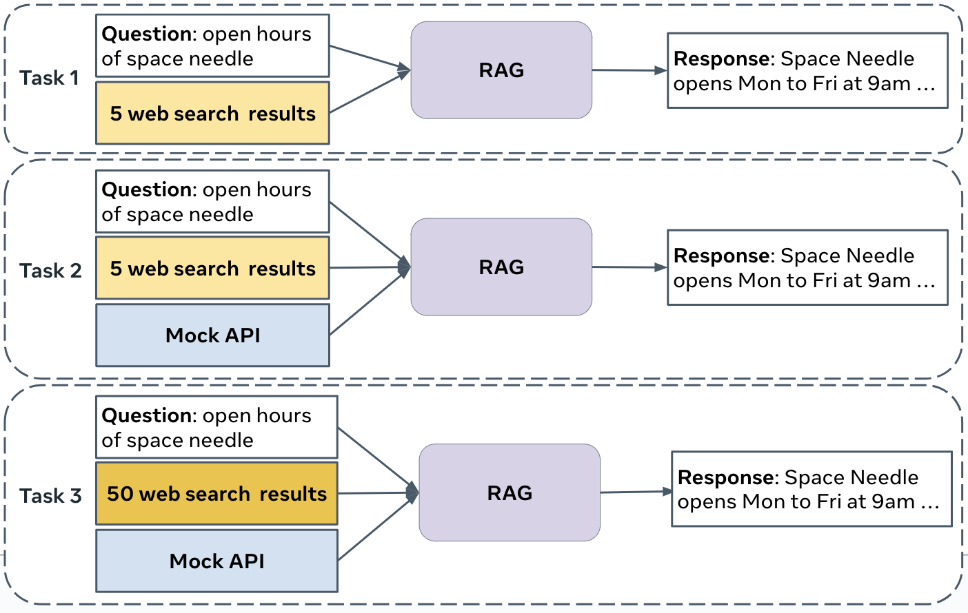
Overview of the Tasks
The CRAG Challenge aims to evaluate Retrieval-Augmented Generation (RAG) systems across multiple tasks, focusing on their ability to integrate diverse information sources and produce accurate, grounded responses
Task 1: Web-based Retrieval Summarization
There are 5 web pages per question to identify and condense relevant information into accurate answers
Task 2: Knowledge Graph and Web Augmentation
Mock APIs are provided to access structured data from mock Knowledge Graphs to integrate information into comprehensive answers
Task 3: End-to-End RAG
50 web pages and Mock APIs access per question are provided to select and integrate the most important data, reflecting real-world information retrieval challenges
Figure 2: Illustration of 3 tasks

Slide 4
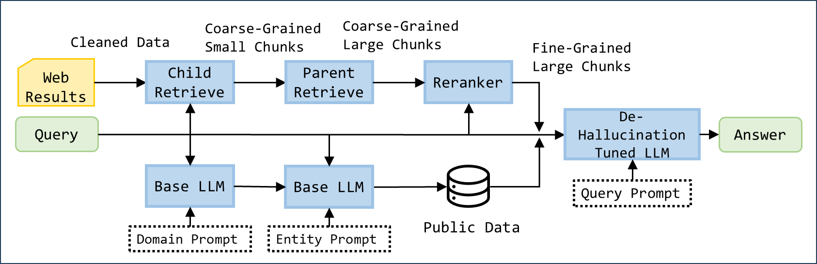
Solution to Task #1
We utilize two pathways for information retrieval, ultimately leveraging a tuned LLM to generate answers.
Web Retrieval Pathway: Follow the widely used retriever and reranker framework to acquire content from web pages
Public Data Pathway: Collect public data and utilize large models to identify entities and obtain stable facts
Tuned LLM: Reducing hallucinations and dealing with invalid questions
Figure 3: Illustration of Task 1 framework

Slide 5
Solution to Task #1
Web Retrieval Pathway:
Text Extraction: Processes HTML content from search results, converting it into plain text chunks
Parent-Child Chunk Retriever: Ranks text chunks by calculating the similarity between the query and each chunk
Reranker: Refines the ranking of retrieved chunks to optimize the use of relevant information within the limited context
1
2
3
Cleaned plain text chunks
Child Retrieve
Coarse-Grained Small Chunks
Parent Retrieve
Coarse-Grained Large Chunks
Reranker
Fine-Grained Large Chunks
Web Results
Query
Figure 4: Illustration of web retrieval pathway

Slide 6

Solution to Task #1
Public Data Pathway:
Figure 5: Illustration of Public data pathway
Identify the domain
Identify the entity
Index from collected public data
1
2
3
Base
LLM
Query
Domain
Base
LLM
Query
Query
Entity
Text Chunks
Domain prompt
Entity Prompt
Public Data
You are an assistant expert in movie, sports, finance and music fields.
Please judge which category the query belongs to, without answering the query. You can only and must output one word in (movie, sports, finance, music).
If the question doesn’t belong to movie, sports, finance, music,
please answer other.
Question: {query}
Answer:
You are a helpful and honest assistant. Please, respond concisely and truthfully in {token_limit} words or less. If you are not sure about the query, answer I don't know. There is no need to explain the reasoning behind your answers.
Given a query about movies, return the title of each movie in below formats. If multiple movie names are involved, connect with '&&’.
#Examples:
Question: which movie was created first, a walk to remember or the notebook?
Answer: a walk to remember && the notebook
#Query:
Question: {query_str}
Answer:
Domain prompt
Entity Prompt

Slide 7
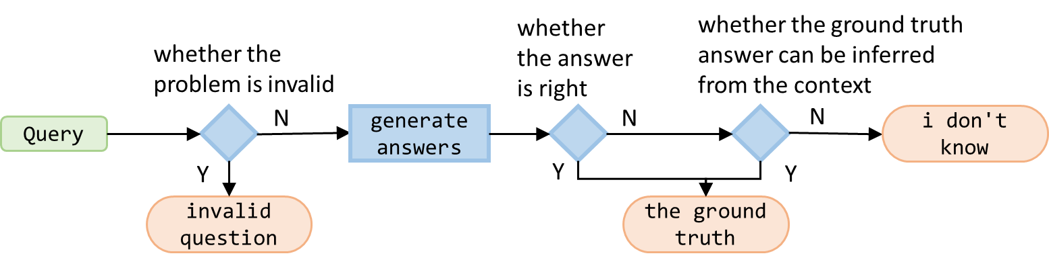
Solution to Task #1
You are a helpful and honest assistant. Please, respond concisely and truthfully in {token_limit} words or less. Now is {query_time}
Context information is below.
{context_str}
Given the context information and using your prior knowledge, please provide your answer in concise style. End your answer with a period. Answer the question in one line only.
Question: {query_str}
Answer:
Tuned LLM
Three significant improvements:
The answer style becomes closer to the short and direct answer as the ground truth answers, making it harder for the LLM to generate hallucinations during reasoning
The LLM can judge the "i don’t know" case more accurately, leading to a better result
The LLM can deal with some false premise cases, saving many points
Basic Query Prompt
......
If the question is based on false prepositions or assumptions, output "invalid question". For example, What's the name of Taylor Swift's rap album before she transitioned to pop? (Taylor Swift didn't release any rap album.)If you are not sure about the question, output "i don't know".
Question: {query_str}
Answer:
Controlled Query Prompt
Figure 6: Illustration of how to generate the labels
whether the answer is right
whether the ground truth answer can be inferred from the context
whether the problem is invalid
N
generate answers
N
N
i don't know
Query
Y
Y
Y
invalid question
the ground truth

Slide 8
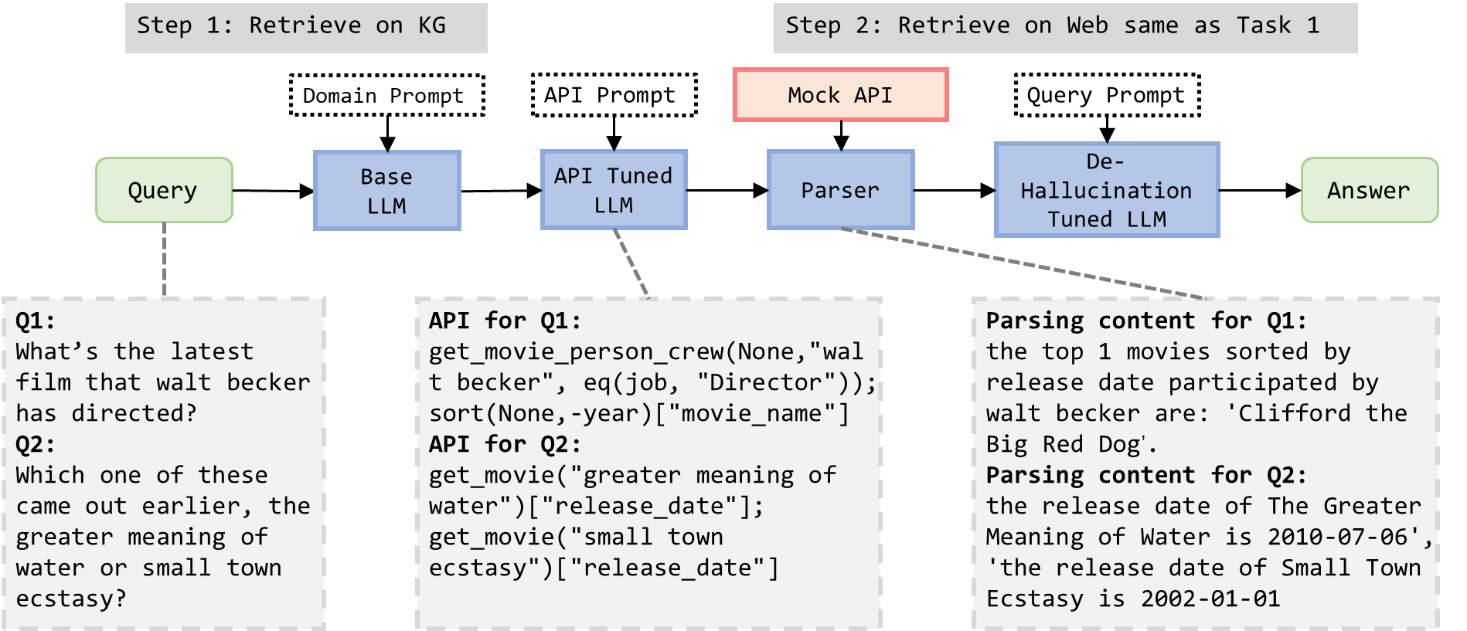
Solution to Task #2 and Task#3
Our framework separates the answer from the Mock API and web pages, and we prioritize the results based on the Mock API results
Figure 7: Illustration of Task #2 and #3 framework

Slide 9
Solution to Task #2 and Task#3
Knowledge Graph Retrieval Module
Regularization of the API: Though the APIs provided contain rich information, it’s quite hard to locate the exact information
get_person_info(person_name) → name (string); acted_movies (list); directed_movies (list); birthday (string); oscar_awards;
get_movie_info(person_name) → title (string); release_date (string); original_title (string); original_language (string); budget (int); revenue (int); rating (float); genres (list); oscar_awards; cast (list); crew (list);
get_year_info(year) → movie_list (list); oscar_awards (list);
get_person(person, condition)[key_name], which is equal to SELECT key_name FROM PERSON WHERE condition AND name = person;
get_movie(movie_name, condition)[key_name], which is equal to SELECT key_name FROM MOVIE WHERE condition AND title = movie_name;
get_movie_person_X(movie_k, person_k, condition)[key_name], (where X = CREW, CAST, or OSCAR), which is equal to SELECT key_name FROM MOVIE, PERSON, X WHERE condition AND title = movie_k AND name = person_k;

Slide 10
Solution to Task #2 and Task#3
Knowledge Graph Retrieval Module
Details of the API System: make the conditions work in the system
We can use cmp (key_name,value_name) to set a condition, e.g., eq(gender,male), which means the condition of gender to be male. The condition can be a list of multiple conditions , e.g., [eq(gender,"male"), eq(character,"batman")]
We can use ["len"] to get the output lengths of a result, and we can use AVG to get the average numeric value of the output
We can use sort(condition,sort_key_name) to get a sorted list which satisfies such condition, and the list is sorted using the sort_key_name. If we want descending sort, we can use -sort_key_name
Parser: We manually program the parser to meet the requirements of most queries in the development set

Slide 11
Solution to Task #2 and Task#3
Knowledge Graph Retrieval Module
API Generation: We use prompts to help the LLM generate as many valid APIs as possible to help us extract information.
......
You are given a query about movies, and several APIs to get information from a database How to collect useful information from the database using the given APIs. The schema of entities is as follows:{Schema_info}
The API rules are below:{API_rules}
Here are some examples:{ICL_examples}
Generate the answer only using the information from the query. Please strictly follow the format in the examples and APIs, you do not have to provide the code, only the use of API in the examples. The only allowed format is multiple lines of get_X,sort. (sort is optional) Please complete the answer only.
Query:{query_str}
Answer:
API Prompt
Fine-tuning for API Generation: Through experiment, we observe that using API Prompt still requires the LLM to have relatively strong capabilities.
GPT-4 label
manually label

Slide 12
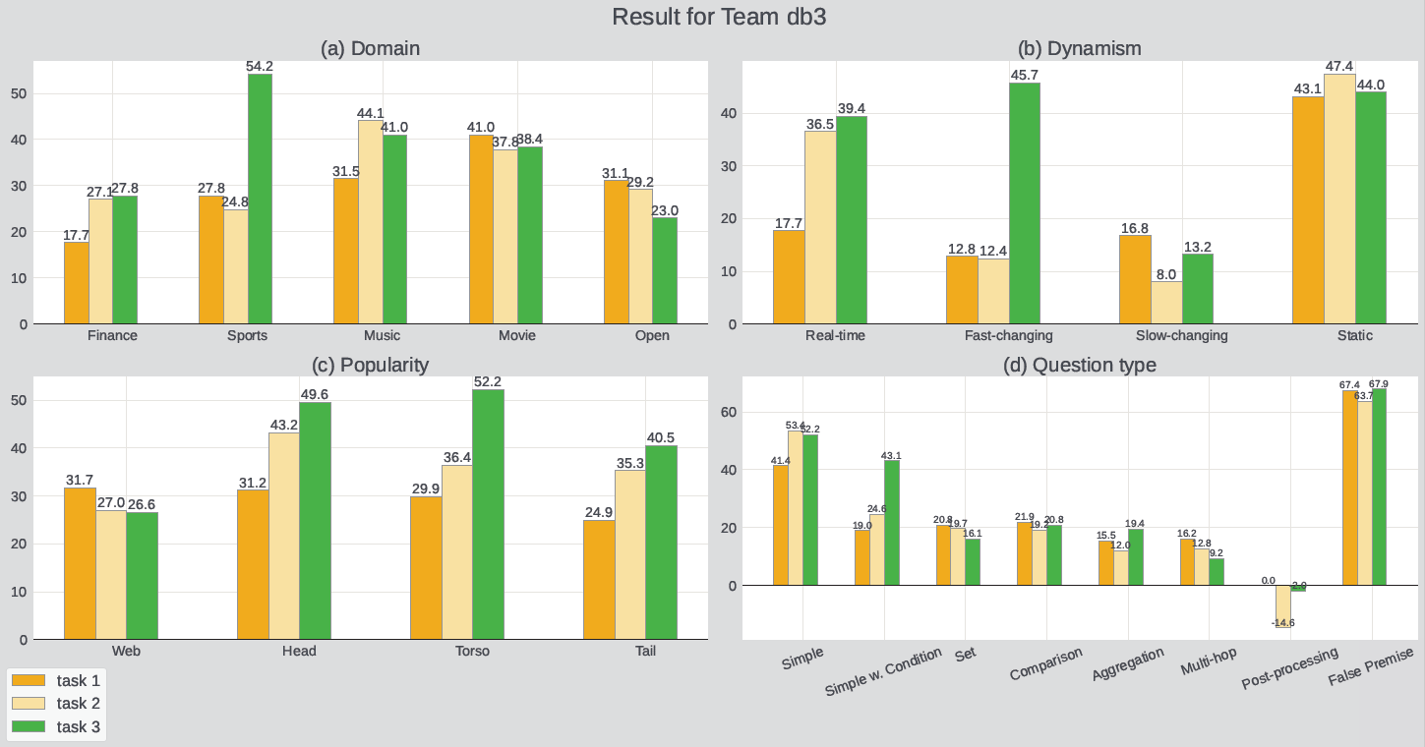
Results
Total points
Task#1 28.4%,
Task#2 42.7%
Task#3 47.8%

Slide 13
Conclusion
Our solution for Task #1 is a framework of web or open-data retrieval and tuned LLM for question answering.
The solution to Task #2 and Task #3 is based on a regularized API set for domain questions and the API generation method using tuned LLM.
We will further look into the balance of efficiency and effectiveness in RAG and a refined API parsing system for RAG to extract information from structured sources in the future.

Slide 14
Q&A
Notes:
Lastly, we present our experimental content.

