Slide 1

A Simple yet Effective Retrieval-Augmented Generation Framework for the Meta KDD Cup 2024
Liyang He¹, Rui Li¹, Shuanghong Shen¹, Junyu Lu^{1,2}, Linbo Zhu^{1,2}, Yu Su^{2,3}, Zhenya Huang¹
1. University of Science and Technology of China
2. Institute of Artificial Intelligence Comprehensive National
3. Hefei Normal University
Notes:
Hello everyone, my name is Liyang He, our team menbers are from University of Science and Technology of China, Institute of Artificial Intelligence Comprehensive National, and Hefei Normal University. We propose a simple yet effective RAG framework for the meta KDD CUP 2024.

Slide 2

1
Abstract
2
Data Process
Contents
3
Retrieval
4
Generation
5
Conclusion
Notes:
We will present our method in five sections, incuding abstract, data process, retrieval, generation and conclusion.

Slide 3
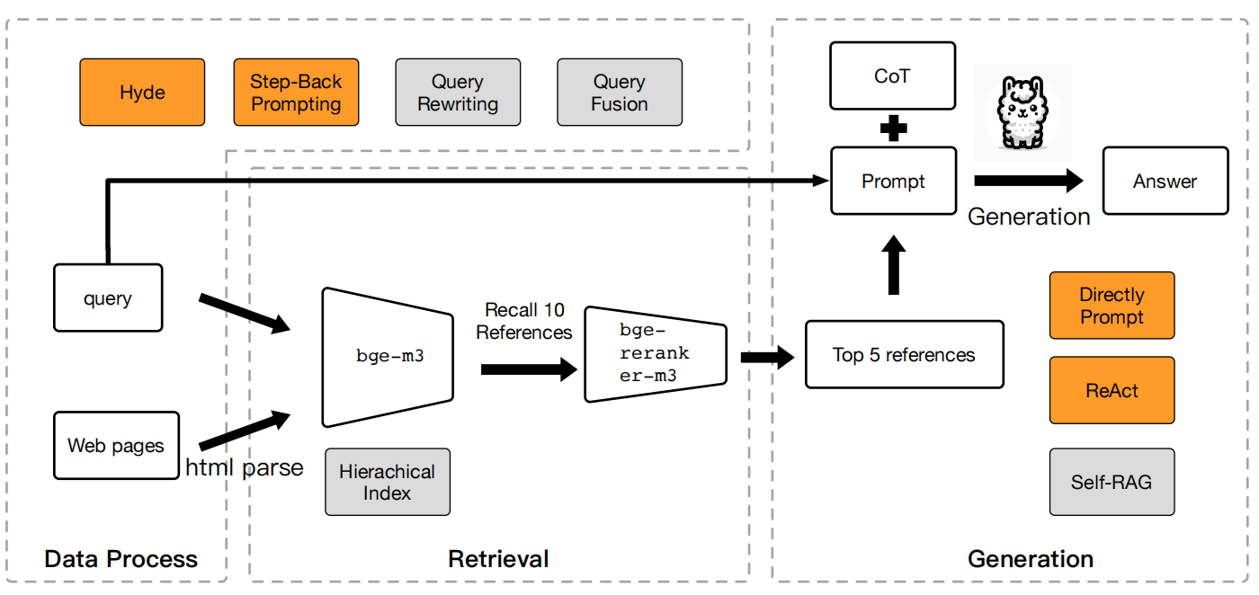
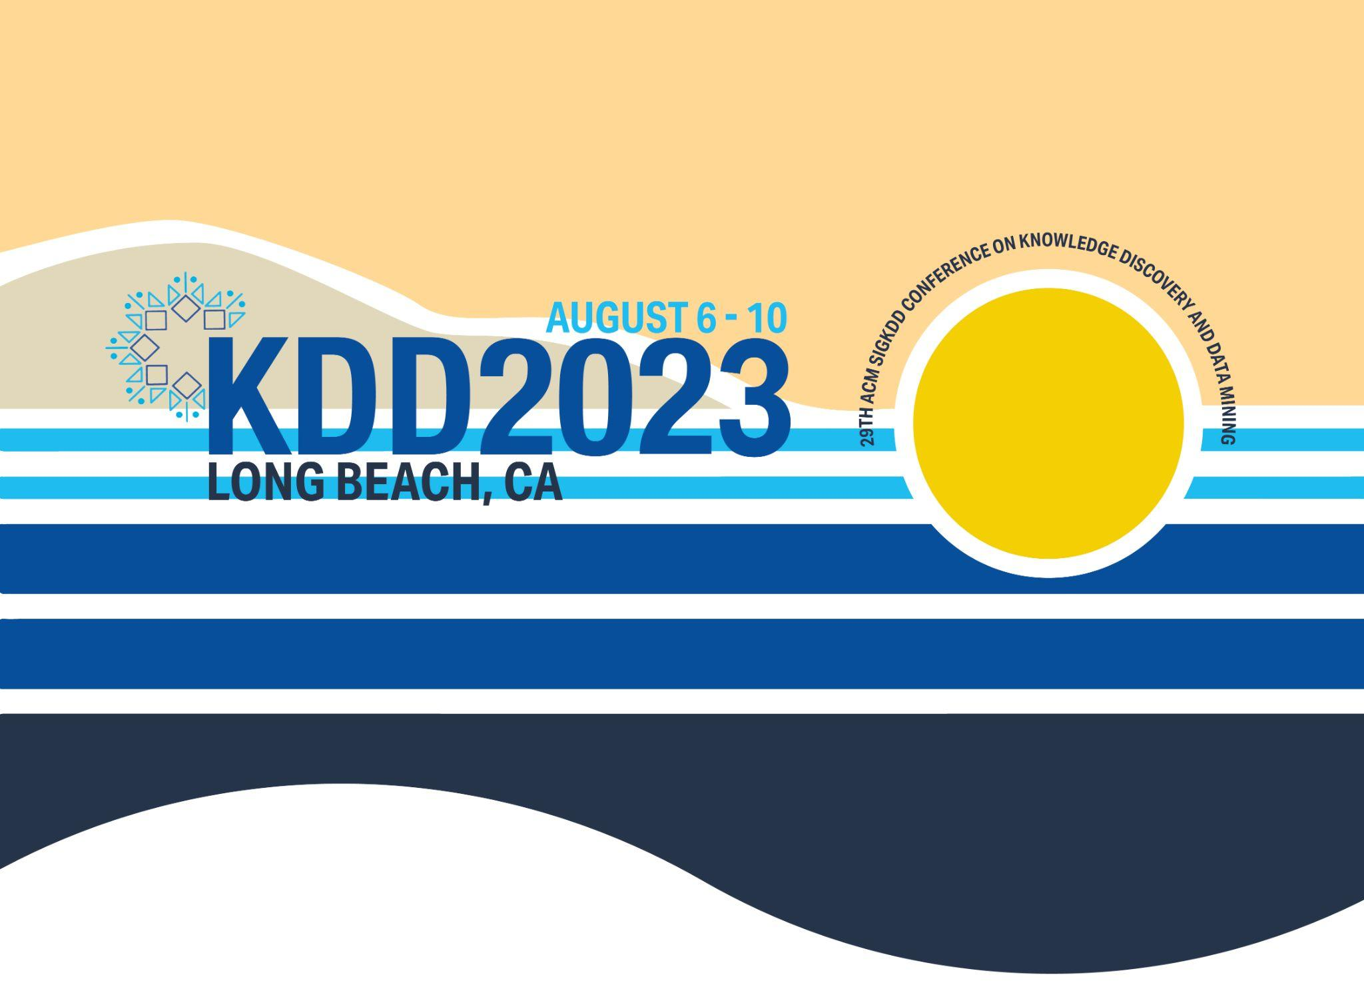
Abstract
This presentation describes our team’s solution for the Meta KDD CUP 2024: CRAG Task 1. The task involved building a RAG framework and testing it on the CRAG benchmark. Our solution is a simple yet effective pipline. We also tired many popular RAG techniques.
our framework
Notes:
Firstly, I want to provide a brief overview of our work

Slide 4
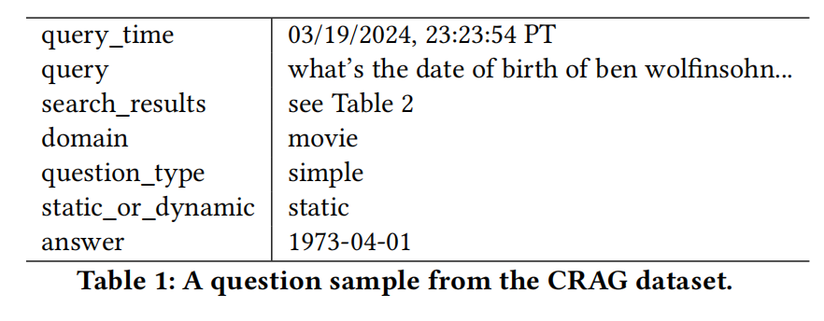
Data Process
The CRAG benckmark contains 4,409 pairs of question-answer samples, including:
5 domains: Finance, Sports, Music, Movies, and Open domain.
8 question types: simple factual questions, conditional questions, comparative questions, aggregation questions, multi-hop questions, set queries, post-processing questions, and false premise questions.
4 temporal categories: real-time questions, rapidly changing questions, slowly changing questions, and static questions.
Notes:
We think it is an very challenging benchmark due to the diversity and complexity of the questions.

Slide 5
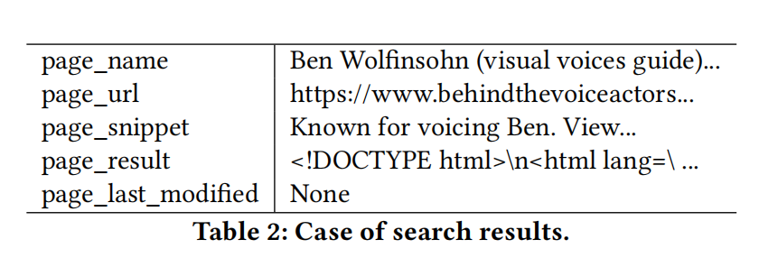



Data Process
For Web Pages
For Query
Query rewriting: Query rewriting aims to enrich the query information.
Hyde (Query to Document): Enhancing the original query by generating hypothetical documents.
Step-Back prompting: Abstracting the original question to obtain queries targeting high-level concepts and fundamental principles.
Query fusion: This method generates multiple queries from the original query through a large language model. It then executes these search queries in parallel and merges the retrieved results.
We experimented with multiple HTML parsing methods and ultimately selected BeautifulSoup from the bs4 library.
Some query enhancement strategies are benificail for specific types of inquiries, but the time overhead is not to be overlooked.
Notes:
Our data processing is divided into two parts. The reference documents are collected from web pages, they contain various HTML tags. Therefore, it is crucial to first convert this structured format into natural language text.
Query augmentation is a crucial step in modern information retrieval. Currently, various query enhancement methods have been proposed in the RAG field. We have experimented with these methods, including xxxx. Among these methods, we find Hyde and Step-Back prompting is benificail for some types of questions. For example, the Step-Back prompting technique has shown an increase of 0.09 points in accuracy for simple with condition questions. Hyde is also benificail for set and false_premise questions. However, the time overhead can not be overlooked. The time overhead renders them challenging to implement in this competition.

Slide 6
Retrieval
Framwork
Chunk Method
An individual recall model.
An individual ranking model.
Recall-then-ranking: using the bge-m3 model to recall 10 candidate sets. Then, we employ the bge-m3-reranker to rank these 10 candidates, selecting the top 5 results.
Fix length chunk: splitting the web pages into chunks of 512 in length.
Hierarchical Index: setting chunk sizes to 256, 128, and 64 to construct a hierarchical indexing structure.
An individual ranking model is a good choice but will result in memory overflow or inference timeout issues when using llama3-70B model.
Employing a Hierarchical Index did not yield significant performance improvements.
Notes:
In retrieval, we tried many framework, such as an xxx

Slide 7
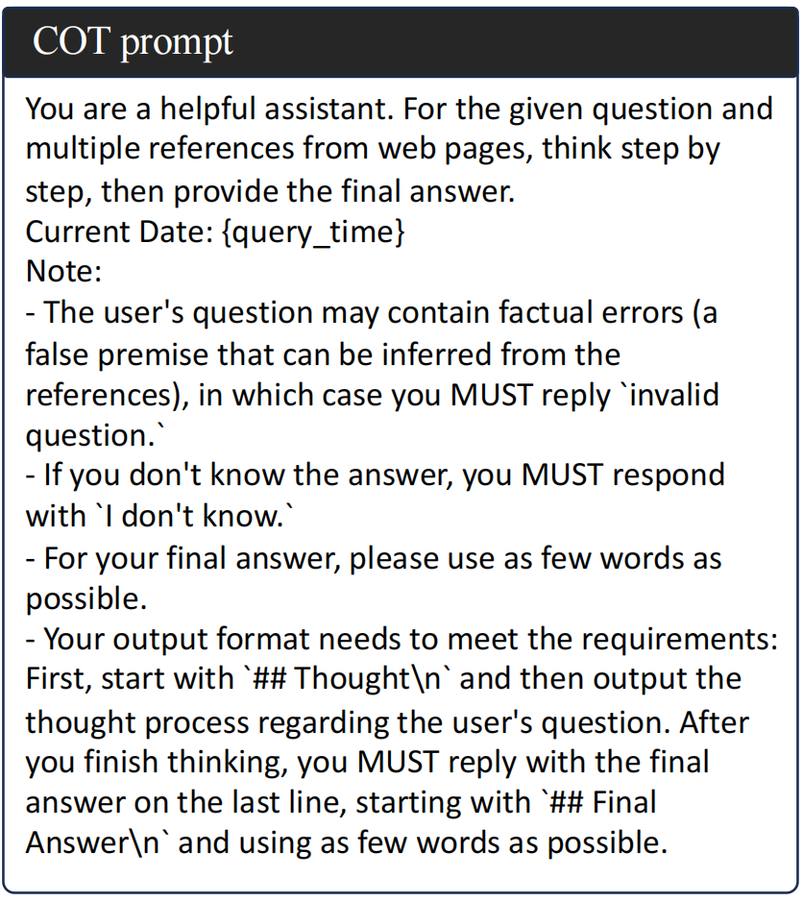
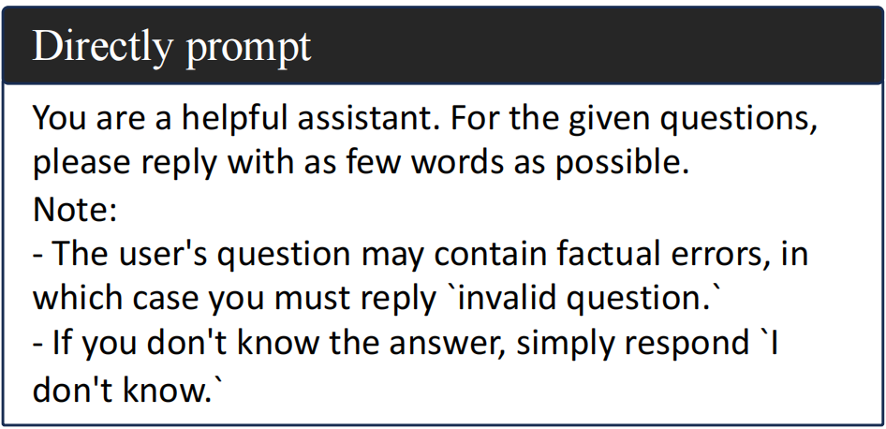
Generation
Directly prompt: By adding the retrieved content to the context and prompting the language model to output as little content as possible and responding with "I don’t know" to questions
for which no relevant information was retrieved.
Chain-of-thought prompting: By prompting the language model to output answers step by step and extract the final answer.
Notes:
In generation stage, we also tired many method

Slide 8
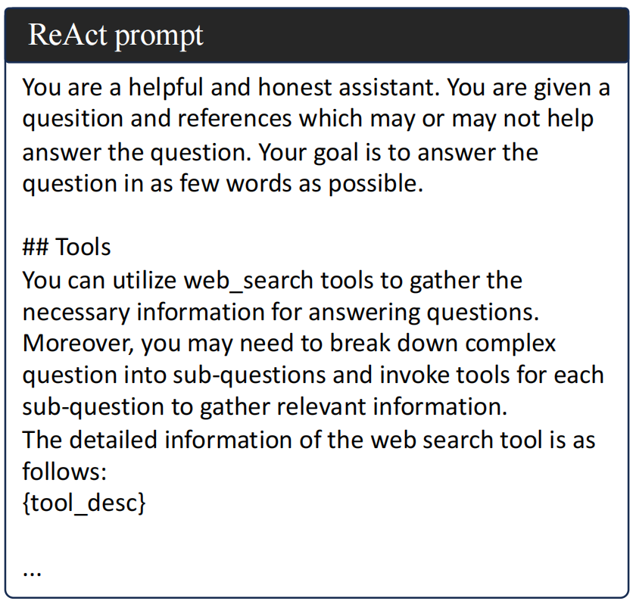
Generation
Self-RAG: Self-RAG is an adaptive rag technology that allows LLM to combine its own knowledge and references to respond to questions, and it will evaluate the relevance of the retrieval results to the question and whether they can help with the response. Here, we just got the Self-RAG with Llama2 versions during the competition, thus its performance was relatively poor.
ReAct (Agent): ReAct uses LLM to generate reasoning trajectories and actions for specific tasks in an interleaved manner. For this task, we created a web retrieval tool that allows LLM to make tool calls through prompts.
Notes:
using ReAct can achieve a higher accuracy on multi-hop questions, capmpred to cot prompt, but there were significant timeout problem with ReAct and the total score was 0.1 lower than the CoT prompt.

Slide 9
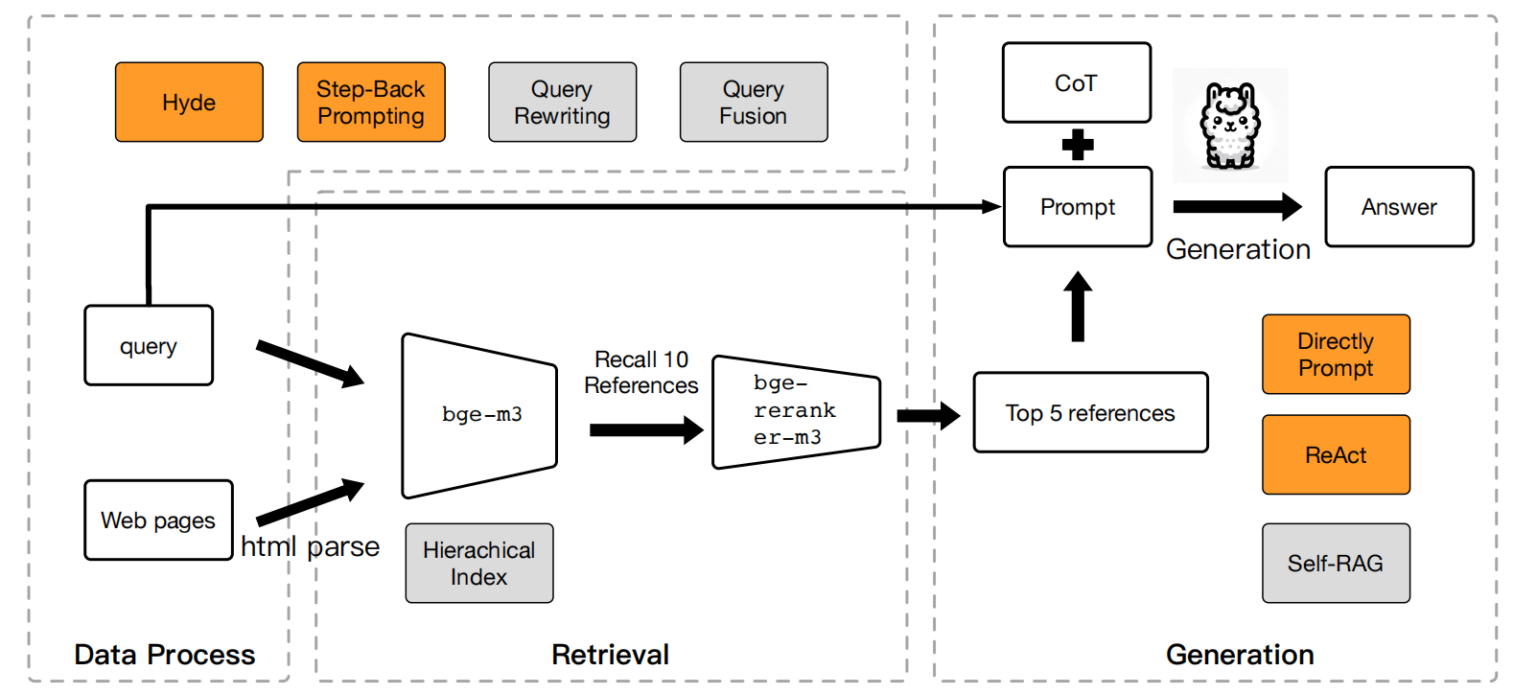
Conclusion
1. Some approaches are effective solely for particular kinds of questions, and the time overhead can not be overlook.
2. Some methods for RAG appear quite reasonable, but their practical application still frequently encounters a variety of problems.
Notes:
In conclusion, we tried many popular RAG method or components and finally constructed our framework.

Slide 10
THANK YOU
Speaker: Liyang He

