Slide 1
MARAGS: A Multi-Adapter System for Multi-Task Retrieval Augmented Generation Question Answering
Mitchell DeHaven

Slide 2
Outline
CRAG Dataset
MARAGS Overview
Document Processing
HTML
API JSON
Retrieval System
Experiments
Llama 3 Adapters
Dataset Creation
Training Setup
Experiments
Results
Future Work

Slide 3
CRAG Dataset
Question answering dataset meant to represent realistic RAG scenarios:
Web based and knowledge graph based information sources.
Multiple question genres: Finance, Sports, Music, Movie, Open
Dynamic Questions: Static, Slow-changing, Fast-changing, Real-time
Varied Topic popularity: Head, torso, tail
Primary Metric: CRAG Score
Score “correct”, “incorrect”, “missing” answers with 1, -1, 0 respectively.
Punishes hallucinations and encourages “i don’t know” answers

Slide 4
MARAGS Overview
Main idea is to build LoRa adapters for each individual task.
Tasks:
API Call Generation → API Adapter
Task 1 → Task 1 Adapter
Task 2 → Task 2 Adapter
Task 3 → Task 3 Adapter
Adapters can be rapidly swapped out, meaning a single Llama model with multiple adapters being swapped out.
M: Multi
A: Adapter
R: Retrieval
A: Augmentation
G: Generation
S: System

Slide 5
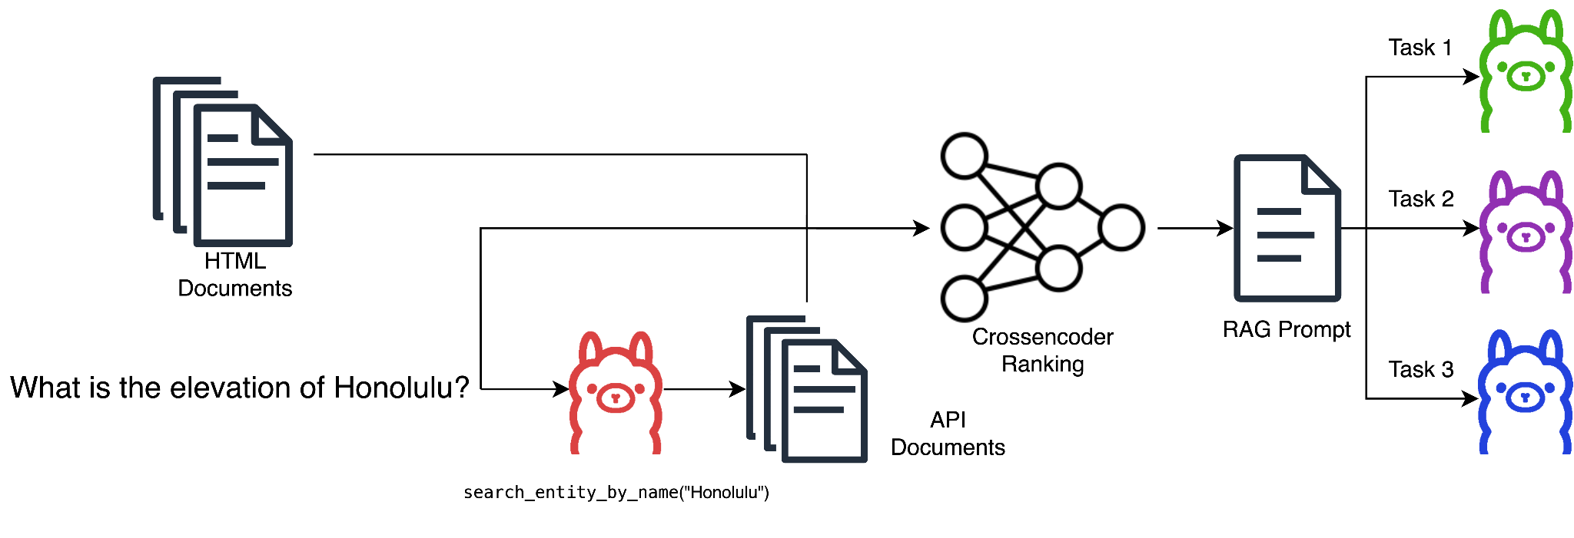
MARAGS Overview

Slide 6
Document Processing: HTML
Segmenting the HTML text into mostly self-contained passages can be a challenging problem unto itself:
Missing context
Coreference resolution
Our approach is relatively simplistic:
Utilize HTML structure to do segmentation
Traverse HTML tree:
If node’s text <= 2000 characters, treat as a segment
If node’s text > 2000 characters, traverse its children
If leaf node and text > 2000 characters, split text into <= 2000 character chunks
Include HTML title in each segment for additional context.

Slide 7
Document Processing: API JSON
Task 2 and Task 3 have access to additional information from a mock knowledge graph API in addition to the HTMLs.
For JSON, we process the it into a “natural language” representation.
Each API endpoint has an associated:
Python function representing API endpoint with docstring
Python function processing JSON into short English sentence segments

Slide 8
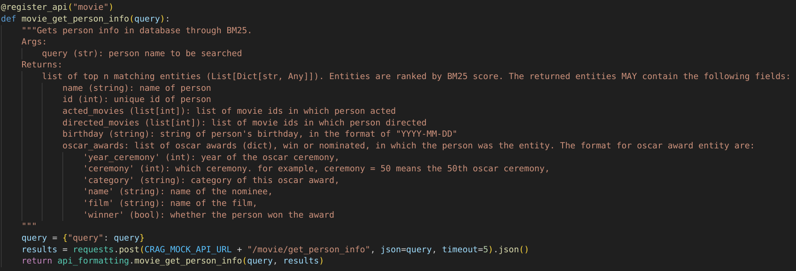
Document Processing: API JSON Example

Slide 9
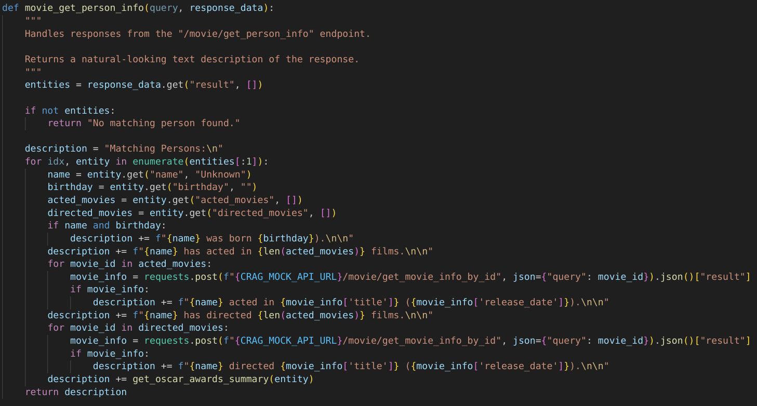
Document Processing: API JSON Example

Slide 10
Retrieval System: Cross-encoder
We experimented with 4 different retrieval setups:
TF-IDF (from Scikit-Learn)
Biencoder (from SentenceTransformers: multi-qa-MiniLM-L6-cos-v1)
Cross-encoder (from SentenceTransformers: ms-marco-MiniLM-L-6-v2)
Ensemble (using max rank)
Despite cross-encoder being most computational expensive of single approaches, performed fine on Task 3 w.r.t the 30s time limit.
Task 1:
Include top 10 HTML segment candidates in prompt for inference
Task 2&3:
Include top 10 HTML segment & top 10 API segment candidates

Slide 11
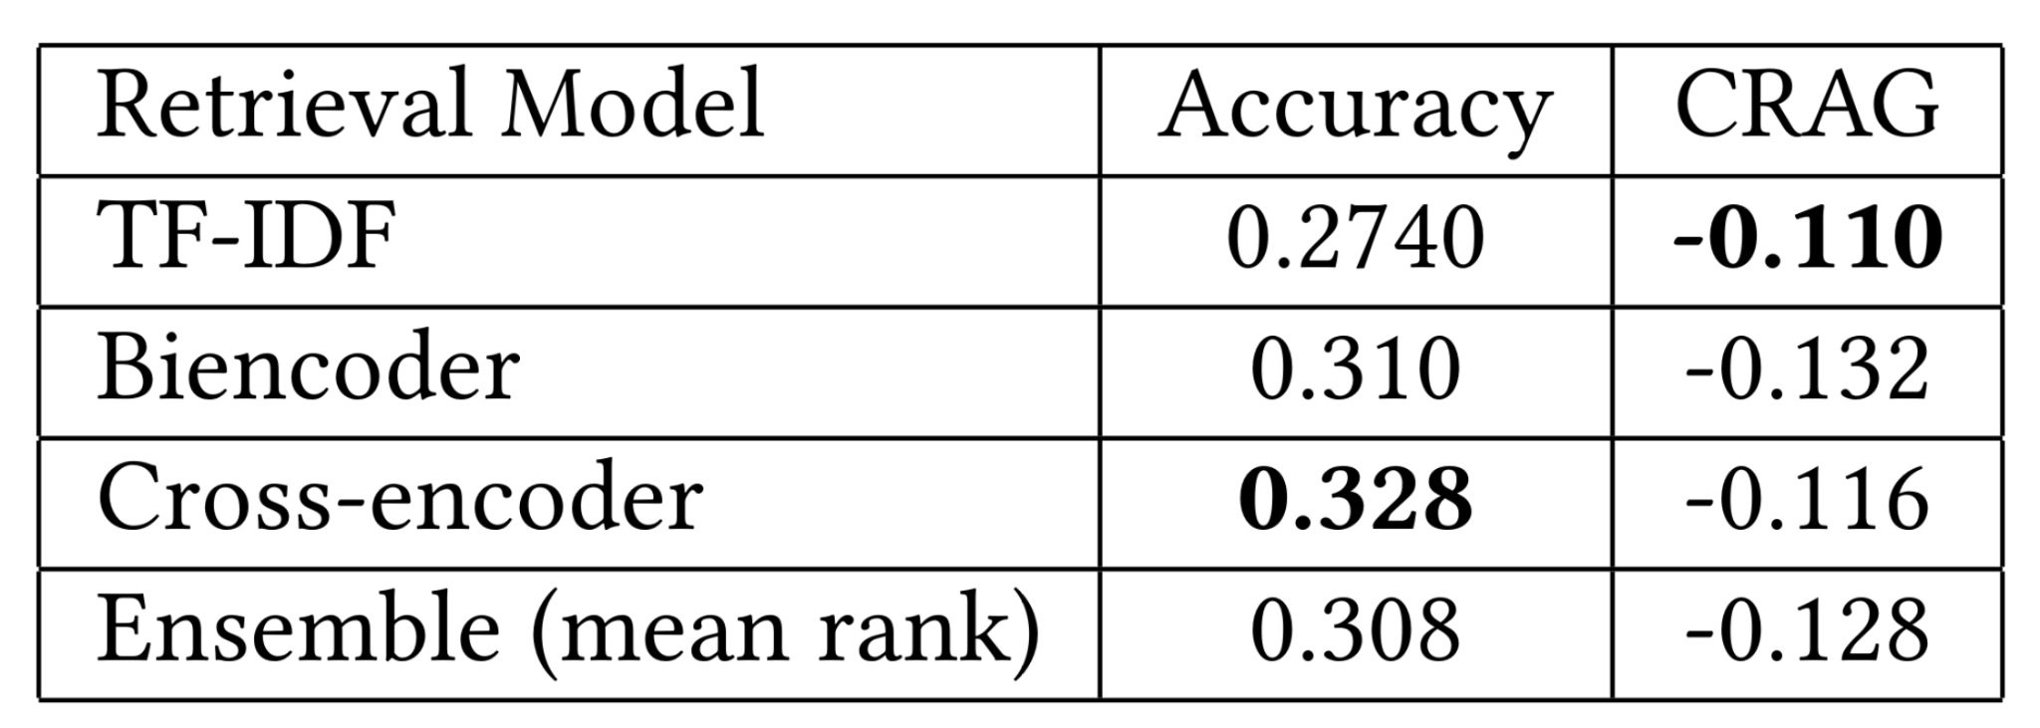
Retrieval System: Experiments
Use 500 random sample from dev set for testing on Task 1.
Since there are no labels for segments, use pipeline accuracy for metric.

Slide 12
Llama 3 Adapters: API Call Dataset
For creating targets for API calls, we do a “manual” annotation process.
To reduce the total amount of work, we generate a first pass with Llama 3 8B.
For each generated call:
If running `eval(<generated_called>)` within Python produces a valid response, keep as target
If non-valid response and possible, small edits were made to correct response
If small edits could not produce valid response, set target to “None”
This “manual” annotation used instead actual manual annotation due to time.
A better approach in retrospect:
Generate 10-20 candidate API calls using Llama
Evaluate JSON responses using Llama to determine best choice

Slide 13
Llama 3 Adapters: Question Answering Datasets
For each task, a task specific dataset is generated using “hittable” answers.
To determine which answers are“hittable”:
For each task:
Llama 3 base used to generate answer for each of the 4 retrieval approaches
Using GPT4-o to evaluate answer:
If answer correct with respect to provided gold answer, gold answer kept as target
If answer is incorrect with respect to provided gold, relabeled to “i don’t know”
If gold answer is “invalid question”, always retain it as target
We only retain “hittable” targets to reduce hallucinations.
“Hittable” % per task given our retrieval system:
Task 1: 41%
Task 2: 45%
Task 3: 51%

Slide 14
Llama 3 Adapters: Training Setup
We use the llama-recipes repository provided by Meta for training LoRa.
Use same 500 random samples from retrieval experiment as holdout set.
This leaves 2206 samples for training.
Use same hyper-parameters provided in repo with a few changes:
Epochs: 2
LoRa r: 8 → 256
Weight decay: 0.01 → 1.0
All experiments ran on a single NVIDIA 3090.

Slide 15
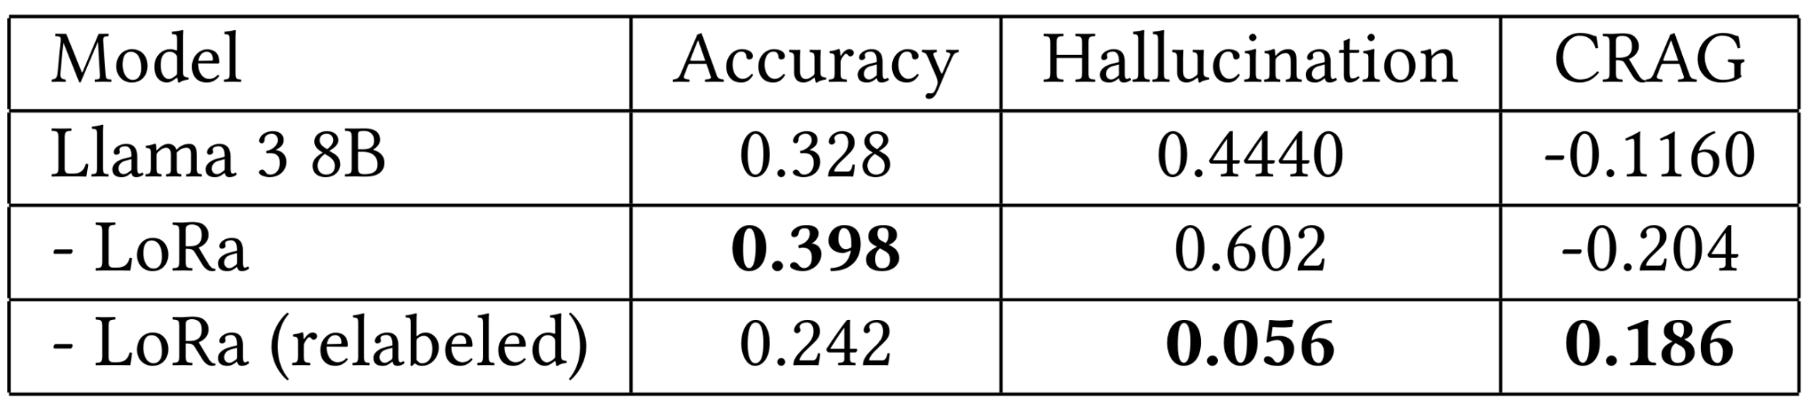
Llama 3 Adapters: Experiments
Looked at full pipeline Task 1 performance with 3 approaches:
Llama 3 8B (no adapter)
Llama 3 8B LoRa (original targets)
Llama 3 8B LoRa (relabeled targets)

Slide 16
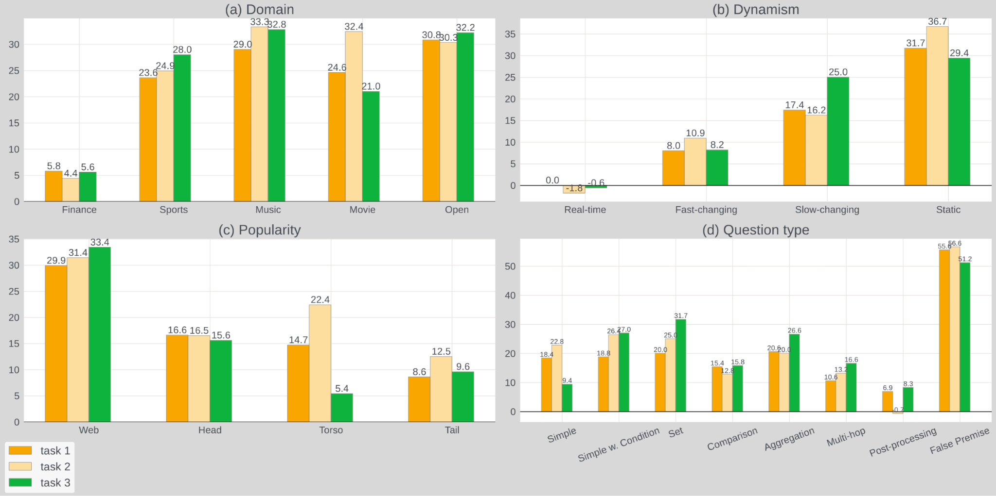
Results
MARAGS ranked 2nd on Task 1 and 3rd of Task 2 for the CRAG competition.

Slide 17
Future Work
Two CRAG questions that posed interesting problems for future work:
“Who has had a longer musical career, Sharika or Machine Gun Kelly?”
Llama 3 8B is capable of answering this question with no context.
LoRa, with relabeling, answers this with “i don’t know” consistently across runs.
Another adapter, operating without context?
“How many 3-point attempts did Steve Nash average per game in seasons he made the 50-40-90 club?”
Humans can answer this question with relative ease.
For a RAG system, likely rephasing into multiple questions is the best approach.
Another adapter for generating rephrasings?
Also looking at larger models, 70B for adapter base approaches.

