Slide 1




认知智能全国重点实验室
STATE KEY LABORATORY OF COGNITIVE INTELLIGENCE
Revisiting the Solution of
Meta KDD Cup 2024 : CRAG
Jie Ouyang, Yucong Luo, Mingyue Cheng*, Daoyu Wang, Shuo Yu,
Qi Liu, and Enchong Chen
State Key Laboratory of Cognitive Intelligence, University of Science
and Technology of China (USTC)
Team APEX
for Task 2&3
🥈
State Key Laboratory of Cognitive Intelligence，University of Science and Technology of China
Notes:
Hello everyone, it is my pleasure to be here to share our paper “Revisiting the Solution of Meta KDD Cup 2024 : CRAG”.
We are team APEX, we got 2nd for task 2&3 in the final evaluation.

Slide 2
Background
Problem Definition
LLM Hallucination
Dynamic (facts changing over time)
Diverse (torso and tail facts)
Inside Knowledge
in LLM
External knowledge
(KG, Web Page et al)
RAG
State Key Laboratory of Cognitive Intelligence，University of Science and Technology of China
Notes:
Before introducing our solution, please allow me to revisit the definition of RAG. In our view, the core idea of RAG is proposed due to the dilema of LLM
Retrieval-Augmented Generation (RAG) has recently emerged as a promising solution to mitigate LLMs' knowledge deficiencies. Given a question, a RAG system queries external sources to retrieve relevant information and subsequently provides grounded answers.

Slide 3
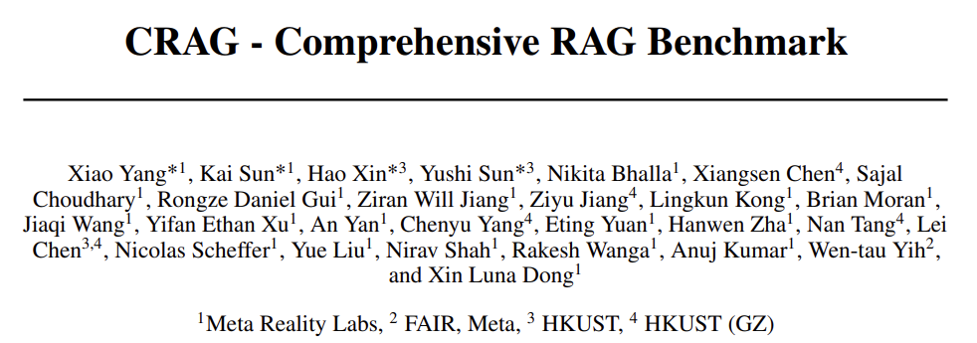
Background
Main Challenges
Challenges of Retrieval-Augmented Generation
Knowledge Indexing: GraphRAG
Knowledge Retrieve: sparse, dense or hybrid retrieval
LLM Reasoning: Chain of –thought (CoT), In-context Learning (ICL)
State Key Laboratory of Cognitive Intelligence，University of Science and Technology of China
Notes:
Despite its potential, RAG continues to face many challenges,
To bridge this gap, Meta introduced the Comprehensive RAG Benchmark (CRAG) a factual question answering benchmark of 4,409 question-answer pairs and Mock APIs to simulate web and Knowledge Graph (KG) search, and hosted the KDD CUP 2024 Challenge.

Slide 4
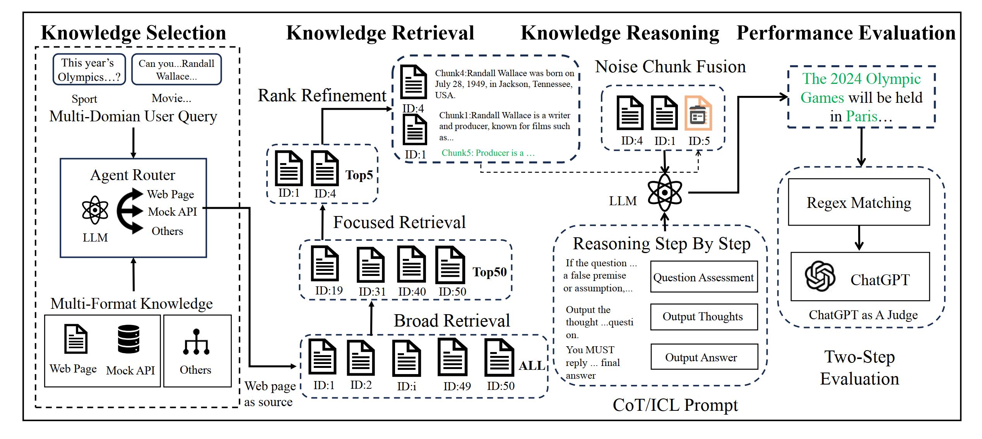
Methodology
Overall Pipeline
State Key Laboratory of Cognitive Intelligence，University of Science and Technology of China
Notes:
This figure shows the overall pipeline of our solution.
Our approach, akin to most Retrieval-Augmented Generation (RAG) systems, comprises three primary phases: retrieval, augmentation and generation.
In all phases, we implement routing mechanisms to address diverse query types.
During the retrieval phase, we initially perform separate retrieve processes for different data sources and subsequently perform a selective fusion of data from multiple sources based on the query domain.
In the generation phase, we first select an appropriate prompt template based on the query's domain and employ a Large Language Model (LLM) to generate a response.
Finally, we perform query-specific post-processing operations.(Not Show in Figure)

Slide 5
Methodology
Knowledge Selection
Routing is a crucial component of RAG systems, especially in real-world QA scenarios. In practical applications, RAG systems frequently incorporate multiple data sources.
In response to the specific characteristics of the questions in the CRAG Challenge, we designed two specialized routers: the Domain Router and the Dynamism Router.
Domain Router
(SequenceClassifier)
(Llama3-8B-Instruct)
(LORA)
Dynamism Router
(SequenceClassifier)
(Llama3-8B-Instruct)
(LORA)
LLM
Rather than LM
Domain&Dynamic
State Key Laboratory of Cognitive Intelligence，University of Science and Technology of China
Notes:
We first talk about the Router.
Routing is a crucial component of RAG systems, especially in real-world QA scenarios. In practical applications, RAG systems frequently incorporate multiple data sources.
In response to the specific characteristics of the questions in the CRAG Challenge, we designed two specialized routers: the Domain Router and the Dynamism Router.
Domain router is fundamentally a classifier, more specifically, a sequence classifier.
Given a query, the domain router assigns a specific domain from a predefined set: finance, sports, music, movie, and open.
We utilize Llama3-8B-Instruct as our base model and enhance it with a classification head (Multilayer Perceptron, MLP) for domain classification.
To adapt to the distribution of CRAG dataset, we implement a simple LORA fine-tuning using a limited amount of data on top of this pre-trained model.
So as Dynamism Router.

Slide 6
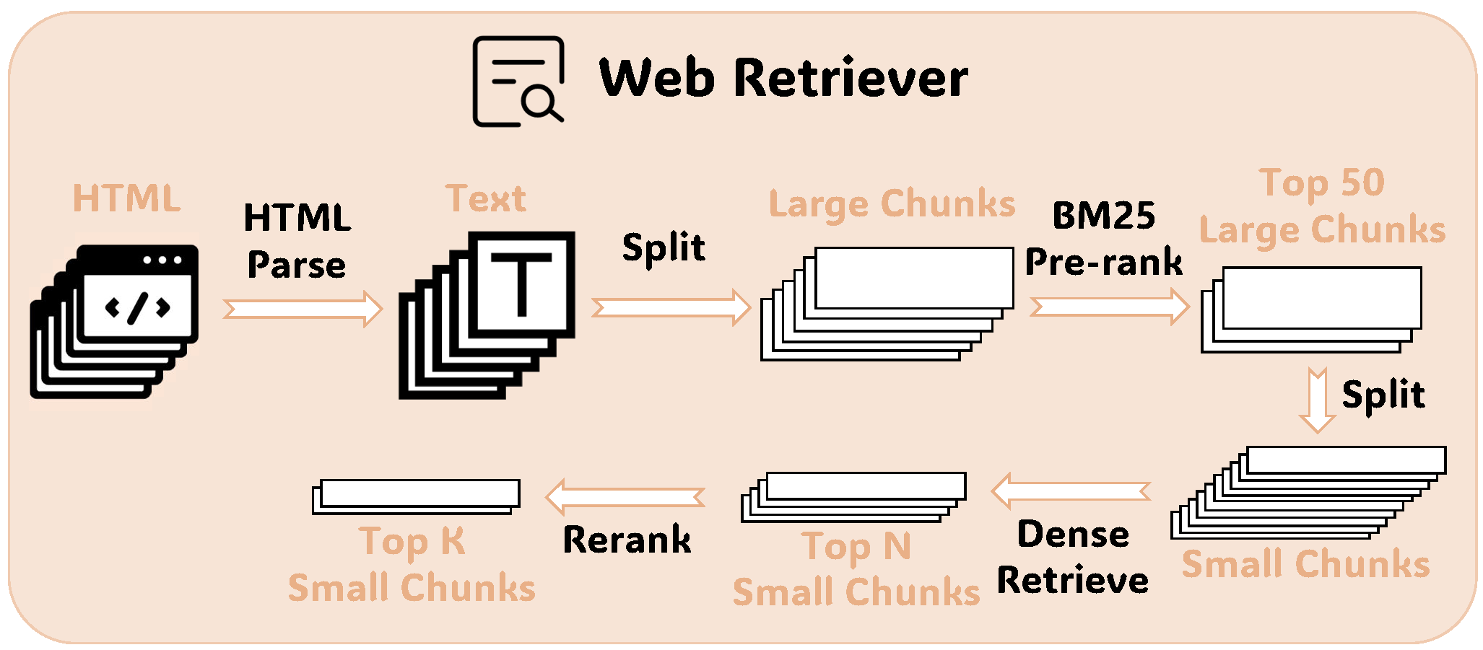
Methodology
Knowledge Retrieve
Web Pages
Task 3
3
5
State Key Laboratory of Cognitive Intelligence，University of Science and Technology of China

Slide 7
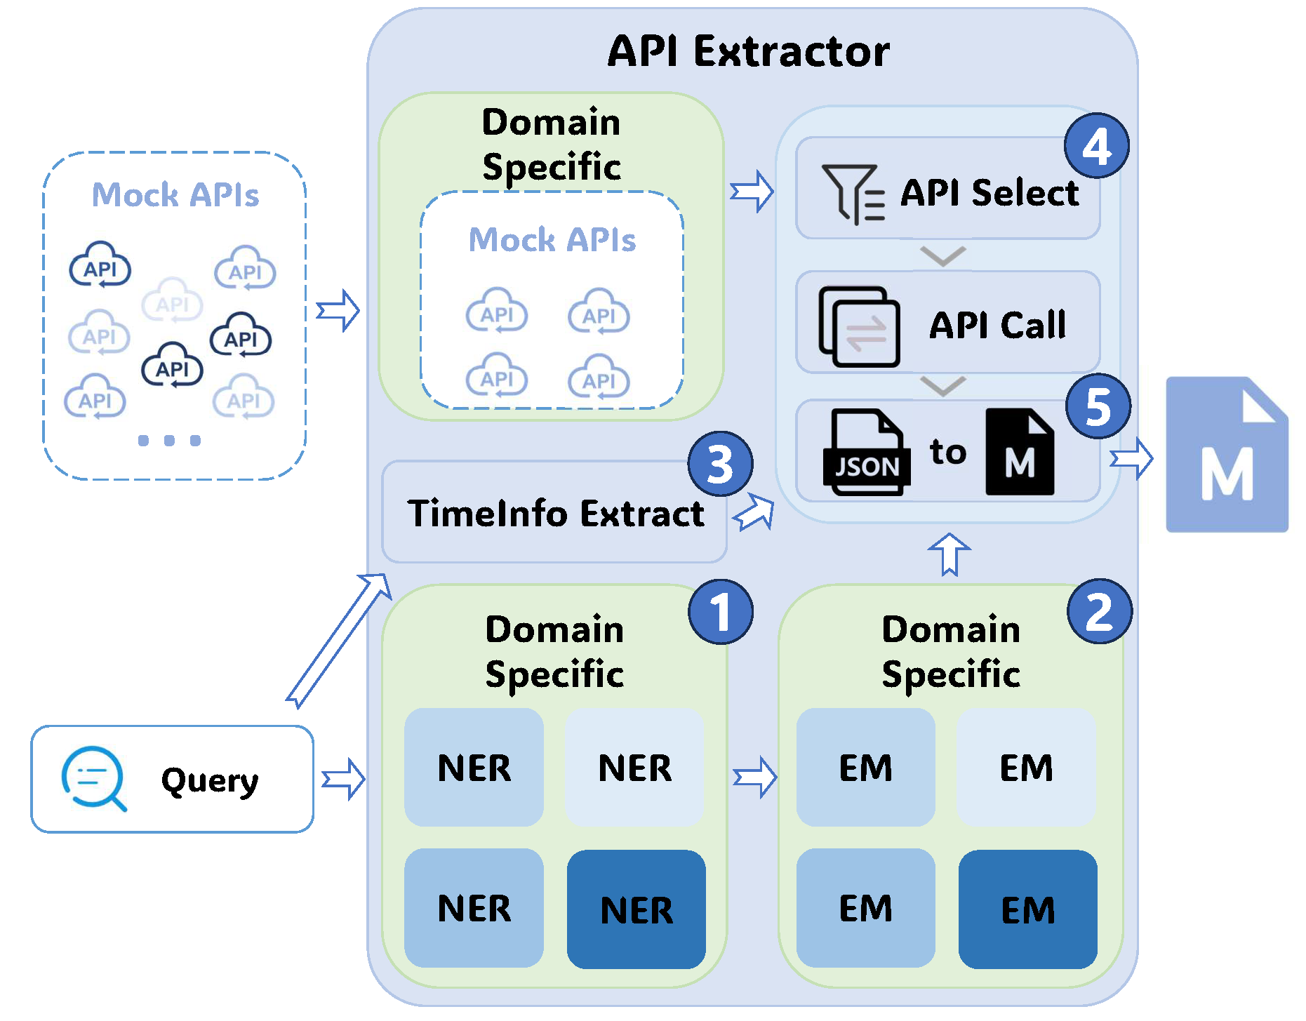
Methodology
Task 2&3
Knowledge Retrieval
Mock APIs
NER (query)
LLM
Plain Text (Not JSON)
Entity Match (EM)
Exact Match
BM25 + Rules
Time Information Extraction
Regex
pytz + datetime
API Post-processing
Json to Markdown
State Key Laboratory of Cognitive Intelligence，University of Science and Technology of China
Notes:
Having discussed how to handle web pages, we now turn to how to extract useful information from the MOCK APIs.
Mock APIs can be categorized into five distinct domains, each with separate workflows managed by a Domain Router. The overall process flow across all domains is consistent, as illustrated in the figure. (We don’t use open domain, so there’s only four color in the figure).
We first use LLM to perform Named Entity Recognition (NER), recognizing and classifying entities in the question into predefined categories, such as movie and artist names.

Slide 8
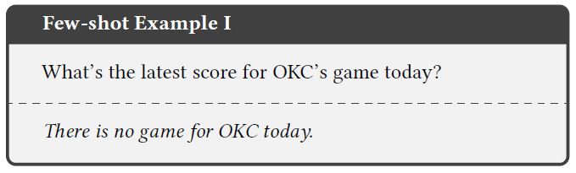
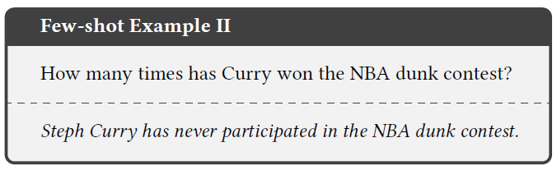
Methodology
Knowledge Reasoning
Chain of Thought (CoT)
Think Step by Step!
In-context Learning
Few-shot examples (e.g., false
premises)
Adaptive for different domains
Post-Processing
Domain&Dynamism Specific
Reject complex numerical
calculations (I don’t know)
Denoising
Reasoning
State Key Laboratory of Cognitive Intelligence，University of Science and Technology of China
Notes:
The Last Phase is Generation. In the generation phase, we employed two widely-used methodologies: Chain-of-Thought (CoT) reasoning and In-context Learning. After generation, we performed a simple post-processing procedure on the generated results based on the Domain and Dynamism Routers.
Chain-of-Thought enhances the reasoning process of language models by prompting them to articulate intermediate steps in problem-solving.
This approach not only enhances the model's ability to handle complex tasks but also significantly reduces hallucinations.
We improve the model's ability to recognize invalid questions, particularly those based on false premises, through In-context Learning.
We develop adaptive few-shot examples, selecting two of the most representative invalid question samples for each domain and elucidating the reasons for their invalidity.
Before finalizing the results, we implement basic post-processing strategies. Based on the question domain and volatility, we assign "I don't know" responses to queries susceptible to hallucination. We designated "I don't know" answers to fast-changing and real-time questions for domains lacking real-time API access. Furthermore, due to the model's limited mathematical computation capabilities, we reject to answer questions requiring numerical calculations, such as those involving the term "average."

Slide 9
Experiments
Experimental Settings
Components | Our choice
HTML Parser | Newspaper3K
Embedding Model | BAAI/bge-m3
Rerank Model | BAAI/bge-m3-v2-reranker
LLM | Llama3-70B-Instruct (GPTQ)
Task 2:
Building on Task 1，we concatenate the references retrieved from HTML with those retrieved from the Mock API.
Task 3:
Building on Task 2, we first use BM25 to select the 50 most relevant passages, and then apply embedding model to narrow it down to the 5 most relevant ones.
State Key Laboratory of Cognitive Intelligence，University of Science and Technology of China
Notes:
In this experiments, we employ several key components and models for efficient information processing. We start by using Newspaper3K for HTML parsing to extract news content. Then, BAAI's bge-m3 embedding model and bge-m3-v2-reranker are utilized to ensure precise data retrieval and ranking. Finally, the Llama3-70B-Instruct (GPTQ) is used for natural language generation, enabling complex task execution and decision support.
And In Task2: Building on Task 1，we concatenate the references retrieved from HTML with those retrieved from the Mock API.
In Task3: With building on Task 2, we first use BM25 to select the 50 most relevant passages, and then apply embedding model to narrow it down to the 5 most relevant ones.

Slide 10
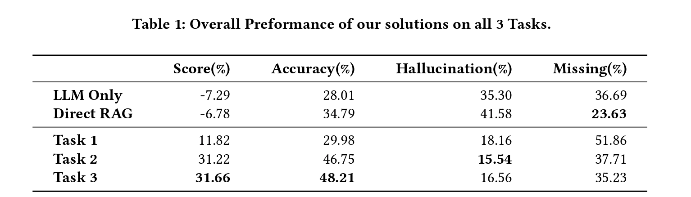
Experiments
Experimental Results
Overall Performance
State Key Laboratory of Cognitive Intelligence，University of Science and Technology of China
Notes:
Comparing our solutions to the RAG Baseline, we observe significant advantages in performance across all three tasks. As shown in the table, our approach showcases notable improvements in accuracy and information retention. Specifically, when contrasted with the RAG Baseline, our solutions demonstrate superior results with reduced hallucination rates and enhanced information completeness. Task 2 and Task 3, in particular, exhibit substantial enhancements in accuracy and reduced hallucination percentages, highlighting the effectiveness of our proposed methodologies in addressing these key metrics.

Slide 11
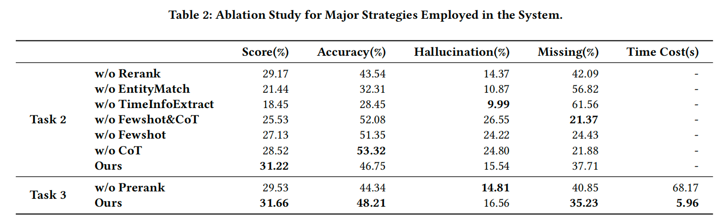
Experiments
Experimental Results
Ablation Study for Major Strategies
State Key Laboratory of Cognitive Intelligence，University of Science and Technology of China
Notes:
We did some ablation study for major strategies. In the retrieval phase, strategies like pre-ranking, re-ranking, Entity Match, and Time Information Extraction were employed. While pre-ranking and re-ranking marginally reduced performance in isolation, they significantly improved overall retrieval quality by filtering noise and refining results, enhancing both accuracy and efficiency. The absence of these steps notably decreased answer accuracy. On the other hand, Entity Match and Time Information Extraction, critical for accurate MOCK API calls, led to a marked performance drop when omitted. During the generation phase, using domain-specific few-shot examples and Chain of Thought prompting reduced hallucinations by up to 71%, improving the final score by 22%. These results underscore the necessity of these components.

Slide 12
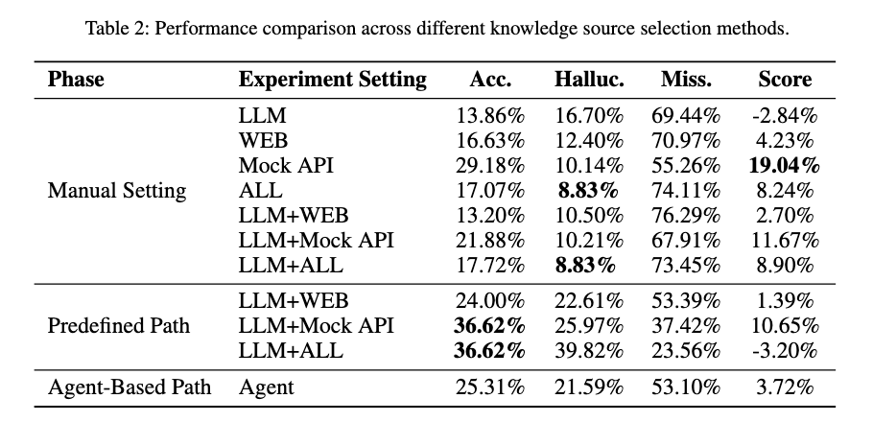
Experiments
Experimental Results
Ablation Study For Different Input Context
State Key Laboratory of Cognitive Intelligence，University of Science and Technology of China
Notes:
We also did a comparative analysis of performance across different knowledge sources, including internal, external, and combined scenarios. Integrating structured knowledge from the mock API significantly improves accuracy and reduces hallucination rates. In contrast, aggregating all sources can lead to conflicts and suboptimal results. Predefined fallback strategies, where the LLM prioritizes internal knowledge before querying external sources, boost accuracy but also raise hallucination rates, especially with multiple sources. While the agent-based dynamic selection strategy adds flexibility, it doesn't consistently outperform predefined methods, underscoring the challenges of real-time decision-making. These findings highlight the importance of structured external knowledge for performance enhancement and the need for advanced selection mechanisms to balance knowledge coverage and minimize hallucinations in retrieval processes.

Slide 13
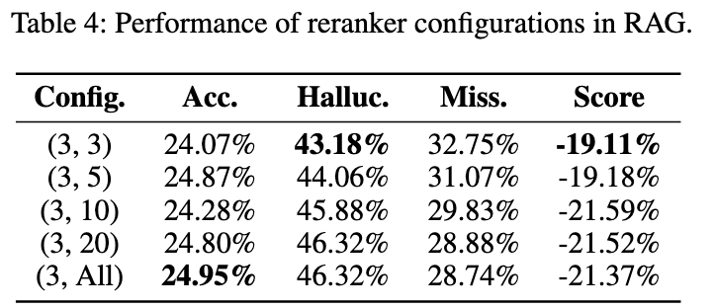
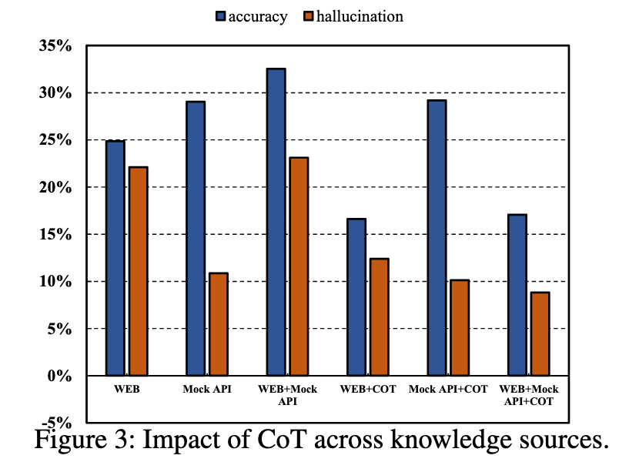
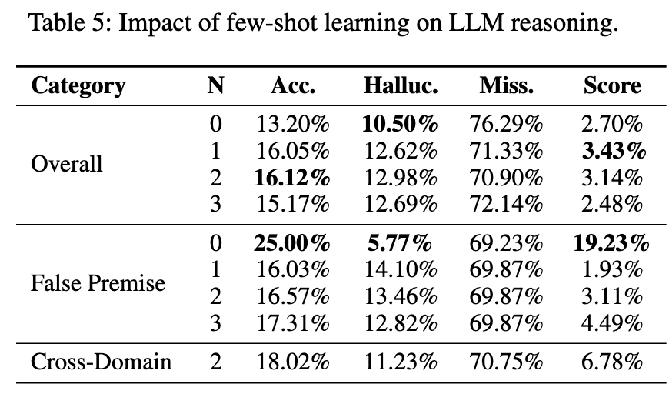
Experiments
Ablation Study
Experimental Results
State Key Laboratory of Cognitive Intelligence，University of Science and Technology of China
Notes:
We conducted three detailed Ablation experiments to evaluate our RAG system.
First, we assessed reranker configurations and retrieval chunk sizes, finding that increasing the number of chunks raised hallucination rates without improving accuracy. Smaller, focused sets proved more effective, while larger chunk sizes offered no additional benefit.
Second, we explored few-shot learning's impact. Although the model performed best under 0-shot conditions, introducing a few examples improved overall accuracy by providing task-specific guidance and enhancing cross-domain generalization.
Lastly, we investigated the Chain of Thought (CoT) approach. While CoT aims to improve reasoning, it inconsistently boosted performance and sometimes reduced accuracy, particularly in complex scenarios. Therefore, CoT should be applied selectively.

Slide 14
Conclusion
Our Perspectives
The quality of knowledge source is significant
Traditional QA evaluation often overlooks hallucinations.
Future focus: Assessing models' cognitive abilities using methods from human cognition research.
How to retrieve relevant knowledge as context is the core of RAG
Manual rules for API matching may fall short in real-world usage.
Future focus: Developing universal methods for selecting and calling APIs, processing results effectively.
The capacity of LLM can be roughly divided into denosing and reasoning
Denoising: reducing the noise from numerous context.
Reasoning: extracting useful knowledge from the limited context.
Teaching the LLM know what they do not know is very important.
Evaluation of hallucination is very vital.
State Key Laboratory of Cognitive Intelligence，University of Science and Technology of China
Notes:
Finally, I’ll share a few key takeaways from our participation
In summary, the quality of knowledge sources is crucial, as traditional evaluations often miss hallucinations. Effective context retrieval is key in RAG, and future work should focus on universal API methods. LLMs excel in denoising and reasoning, but teaching them to recognize their own limitations is vital for improving reliability. Thank you.
Besides, KTDCup was a rigorous yet rewarding experience. It pushed us to think creatively, work cohesively, and constantly strive for improvement. I hope our experiences can provide some valuable insights for others working in this space.

Slide 15

认知智能全国重点实验室
STATE KEY LABORATORY OF COGNITIVE INTELLIGENCE
Thank You for Your Attention!
Mingyue Cheng
mycheng@ustc.edu.cn
https://mingyue-cheng.github.io/
State Key Laboratory of Cognitive Intelligence，University of Science and Technology of China
Notes:
If you have any further questions or would like to discuss the details in more depth, please feel free to reach out to me via email, or visit my webpage.
Thank you for your attention, and I look forward to any questions or discussions afterward.

