Slide 1
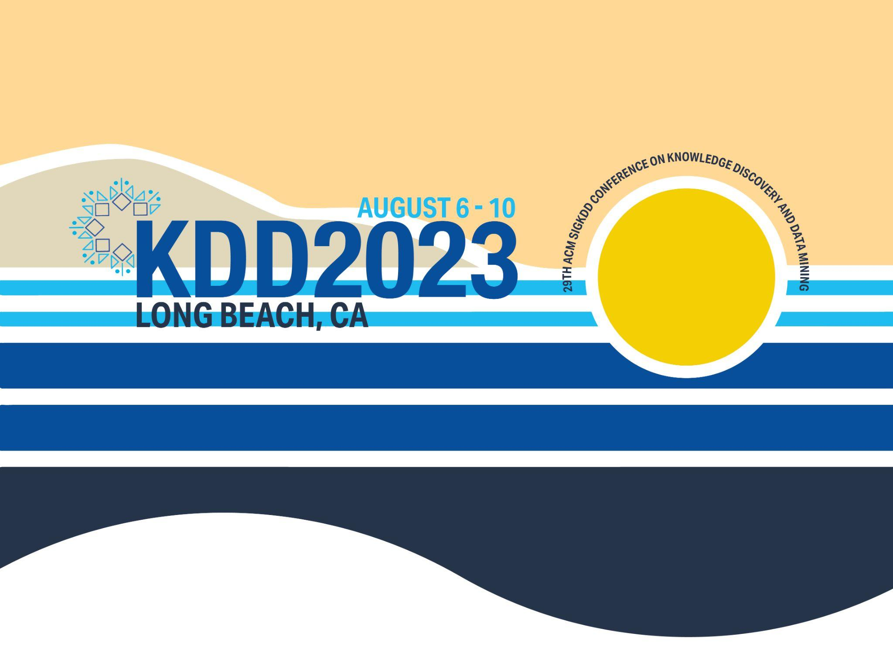

CLOSING

Slide 2
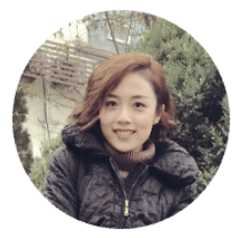
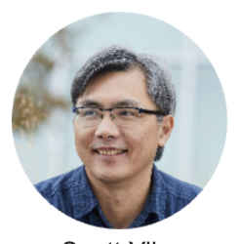
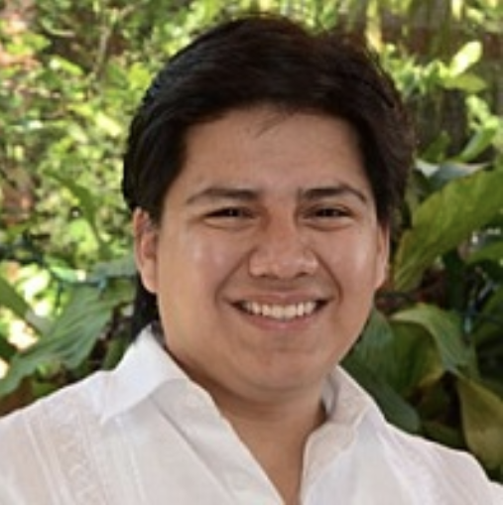
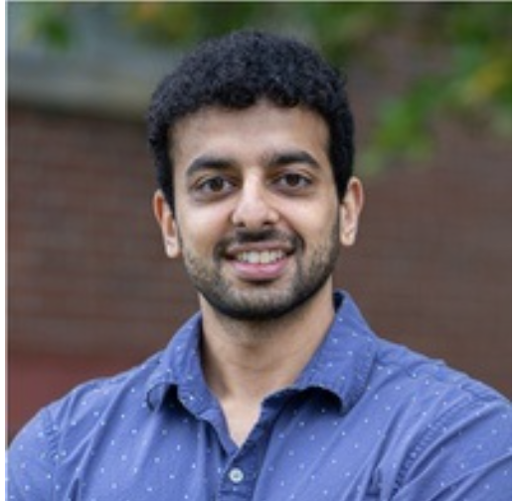
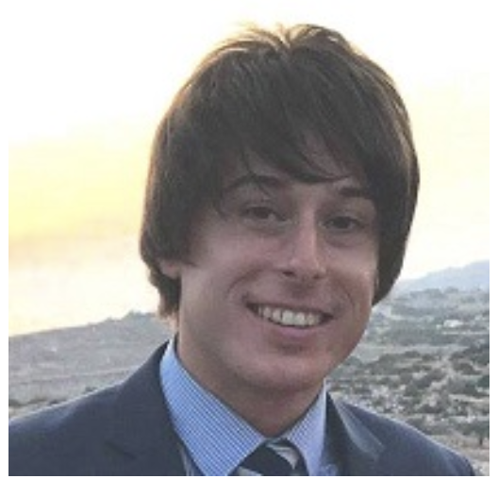
Workshop Recap
Opening talk
3 Keynotes
6 Winning team talks
Poster session: 16:00-16:30
Website: https://kddcup24.github.io/pages/keynotes.html

Slide 3

Where Are We in the RAG Journey?
SOTA Industry RAG (50%)
*Manual Eval
*Diff retrieval pool
Straightforward RAG (9-14%)
CRAG KDD Cups (36%)
*Manual Eval*
LLM-0nly
(3-20%)
Truthfulness
We call for continued efforts to leverage CRAG to improve RAG solutions!

Slide 4
What Are Next Steps for CRAG?
Multi-modal
CRAG
Multi-turn
Multi-lingual
We ask for your continued attention to CRAG 2.0!

Slide 5
THANK YOU

