Slide 1

KDD Cup Meta CRAG 2024:
Three-step Question-Answering Framework
Team: dRAGonRAnGers
Data System Lab in POSTECH

Slide 2
Overview
Introduction
Preliminaries
Methodology
Experiment
Conclusion

Slide 3
Overview
Introduction
Preliminaries
Methodology
Experiment
Conclusion

Slide 4
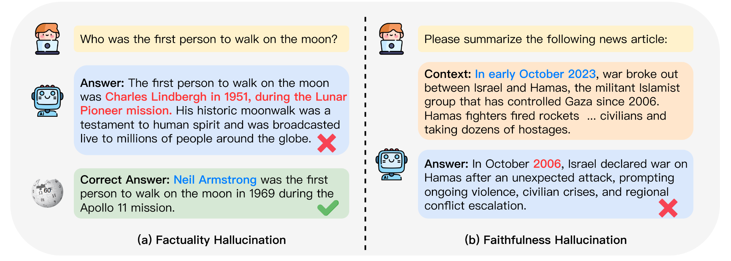
Large Language Model
Large language models (LLMs) have shown significant capabilities in the question-answering task.
However, they often suffer from hallucination, where generated content deviates from real-world facts.
Figure 1: An intuitive example of LLM hallucination from [1]
[1] Huang, Lei, et al. "A survey on hallucination in large language models: Principles, taxonomy, challenges, and open questions." arXiv preprint arXiv:2311.05232 (2023).

Slide 5
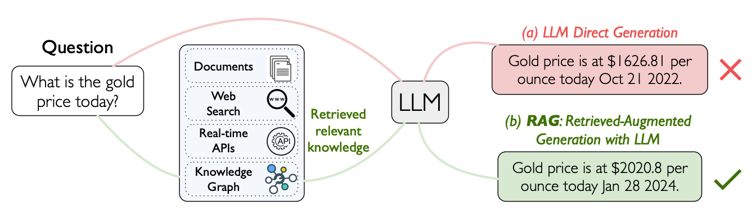
Retrieval-Augmented Generation
Retrieval-augmented generation (RAG) has been proposed to address the issues, which enhances LLM performance by retrieving relevant information from external knowledge sources.
Figure 2: QA using LLMs (a) without RAG vs. (b) with RAG from [2]
[2] Yang, Xiao, et al. "CRAG--Comprehensive RAG Benchmark." arXiv preprint arXiv:2406.04744 (2024).

Slide 6
Challenges of RAG
Despite the advancements, RAG still faces several challenges:
Unnecessary Retrieval
Propagation of Incorrect Information

Slide 7







Unnecessary Retrieval
Is Asia a bigger continent than Europe?
I already
know!
Yes, Asia is bigger than Europe.
Input
User
Output
LLM
External Source

Slide 8



Propagation of Incorrect Information
In 2004, which animated film was recognized with the best animated feature film oscar?
The Incredibles
(2004)
Retrieval
Error
Propagation
User
LLM
External Source
WATCH NOW Superhero Best Animated Movie Oscar The Incredibles (2004) The Incredibles Scene: Fire and Ice The Incredibles is a

Slide 9
Our Idea of Addressing the Challenges
Our Idea: Improving the Standard RAG Framework with Two Key Enhancements
Using LLM’s Inherent Knowledge: Generate accurate responses directly whenever possible to avoid unnecessary retrieval
Introducing Verification Step: Reassess the validity of the responses generated in the previous stages

Slide 10
Overview
Introduction
Preliminaries
Methodology
Experiment
Conclusion

Slide 11
Notation
Q: Natural language question
A: Answer
W = [w₁,... ,w_{n}]: Web Search Results is a list of web pages, where each web page w_{i} consists of a sequence of tokens
K = {(s₁, p₁, o₁), ..., (s_{m}, p_{m}, o_{m})}: Mock Knowledge Graph is a structured data source composed of triples (s, p, o), where s represents a subject, p a predicate, and o an object.

Slide 12
Problem Definition
Task 1: Retrieval Summarization. Given a question Q and a set of external sources E = {W} (|W| <= 5), generate an answer A using relevant information from these web pages to form a coherent and accurate response.
Task 2: KG and Web Retrieval Augmentation. Given a question Q and a set of external sources E = {W, K} (|W| <= 5), generate an answer A by leveraging both the web pages and the structured data comprehensively.
Task 3: End-to-End RAG. Given a question Q and a set of external sources E = {W, K} (|W| <= 50), efficiently generate an answer A utilizing both web pages and the structured data.

Slide 13
Problem Definition
Task 1: Retrieval Summarization. Given a question Q and a set of external sources E = {W} (|W| <= 5), generate an answer A using relevant information from these web pages to form a coherent and accurate response.
Task 2: KG and Web Retrieval Augmentation. Given a question Q and a set of external sources E = {W, K} (|W| <= 5), generate an answer A by leveraging both the web pages and the structured data comprehensively.
Task 3: End-to-End RAG. Given a question Q and a set of external sources E = {W, K} (|W| <= 50), efficiently generate an answer A utilizing both web pages and the structured data.

Slide 14
Overview
Introduction
Preliminaries
Methodology
Experiment
Conclusion

Slide 15
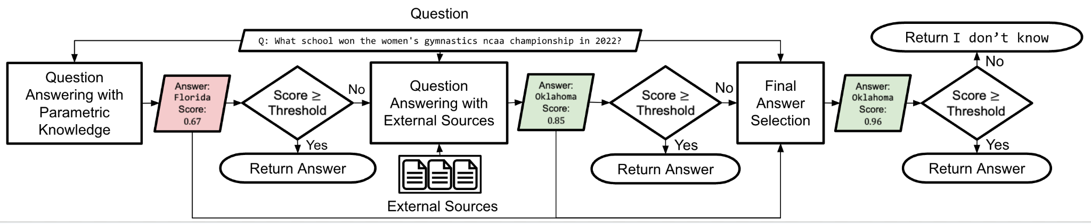
Three-step Question Answering Framework
The framework consists of the following three steps:
Question Answering with Parameterized Knowledge
Question Answering with External Sources
Final Answer Selection
Figure 3: Flowchart for Three-step question-answering framework

Slide 16
Step 1
The first step leverages the knowledge stored in large language models to provide initial answers without retrieval, thus reducing the end-to-end response time.
Figure 3: Flowchart for Three-step question-answering framework

Slide 17
Question Answering With Parametric Knowledge
Q: What school won the women's gymnastics ncaa championship in 2022?
First, the 2022 ncaa women's gymnastics championship was held on april 14-16, 2022.
Second, the university of florida won the 2022 ncaa women's gymnastics championship.
The answer is Florida.
A₁: Florida
LLM
(Llama3 70B-Instruct)
First, the 2022 ncaa women's gymnastics championship was held on april 15, 2022.
Second, the university of oklahoma won the 2022 ncaa women's gymnastics championship
The answer is Oklahoma.
A: Florida
Score: 2/3 ≈ 0.67
A₂: Oklahoma
First, the university of florida won the 2022 ncaa women's gymnastics championship.
Second, the 2022 ncaa women's gymnastics championship was held in april 2022.
The answer is Florida.
A₃: Florida
Figure 4: Question answering with parameterized knowledge

Slide 18
Step 2
The second stage utilizes external sources to accurately address the query by retrieving additional information.
Figure 3: Flowchart for Three-step question-answering framework

Slide 19

Question Answering With External Sources
Q: What school won the women's gymnastics ncaa championship in 2022?
Retrieved Result
Retriever
(all-to-all interaction)
Oklahoma Wins 2022 NCAA Gymnastics National Championship…
LLM
(ChatQA)
A: Oklahoma
Score: p_{LLM}(A|Q, Retrieved Result) ≈ 0.85
Web Search Result
Figure 5: Question answering with external sources

Slide 20
Step 3
The third stage reassesses the validity of the answers generated in the previous stages to enhance the reliability of the final response.
Figure 3: Flowchart for Three-step question-answering framework

Slide 21
Final Answer Selection
Q: What school won the women's gymnastics ncaa championship in 2022?
A₁: Florida
Retrieved Result
LLM
(ChatQA)
Oklahoma Wins 2022 NCAA Gymnastics National Championship…
A₂: Oklahoma
A₃: I don’t know
Final Answer: Oklahoma
Score: p_{LLM}(Final Answer|A₁, A₂, A₃, Q, Retrieved Result) ≈ 0.85
Figure 6: Final answer selection

Slide 22
Overview
Introduction
Preliminaries
Methodology
Experiment
Conclusion

Slide 23
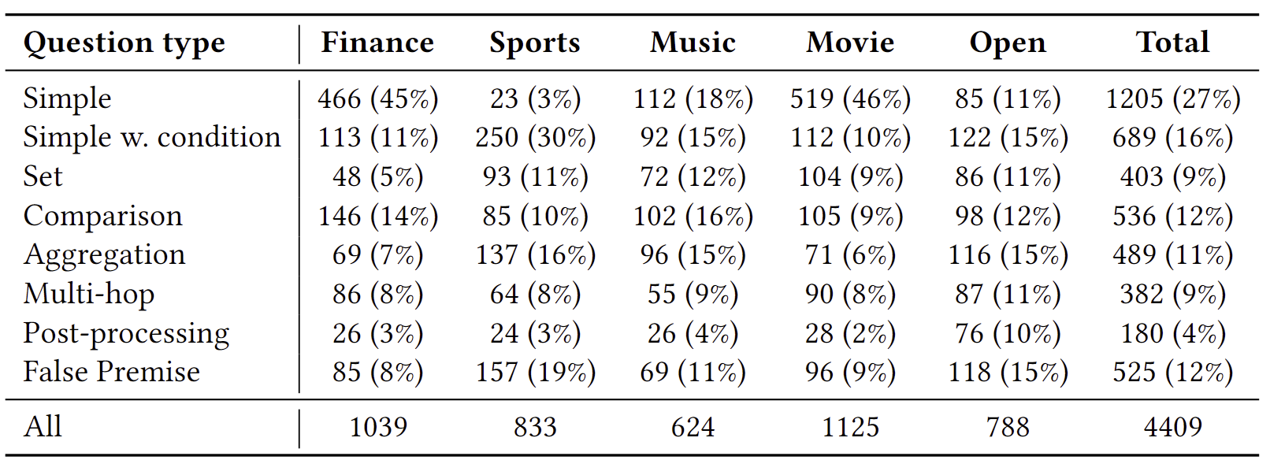
Dataset
Table 1: The number and percentages (% in parentheses) of questions for each question type in the CRAG dataset [2].
[2] Yang, Xiao, et al. "CRAG--Comprehensive RAG Benchmark." arXiv preprint arXiv:2406.04744 (2024).

Slide 24
Metrics
Overall Score (OS): Perfect + Acceptable - Hallucination
Perfect (P): The response accurately answers the user’s query without any hallucinated content.
Acceptable (A): The response offers a useful answer but may contain minor inaccuracies that do not diminish its overall utility.
Hallucination (H): The response provides wrong or irrelevant information to answer the user question.
Missing (M): The response indicates a lack of information, using phrases such as “I don’t know”, “I’m sorry I can’t find...” or results from system errors, including empty responses or requests for clarification.

Slide 25
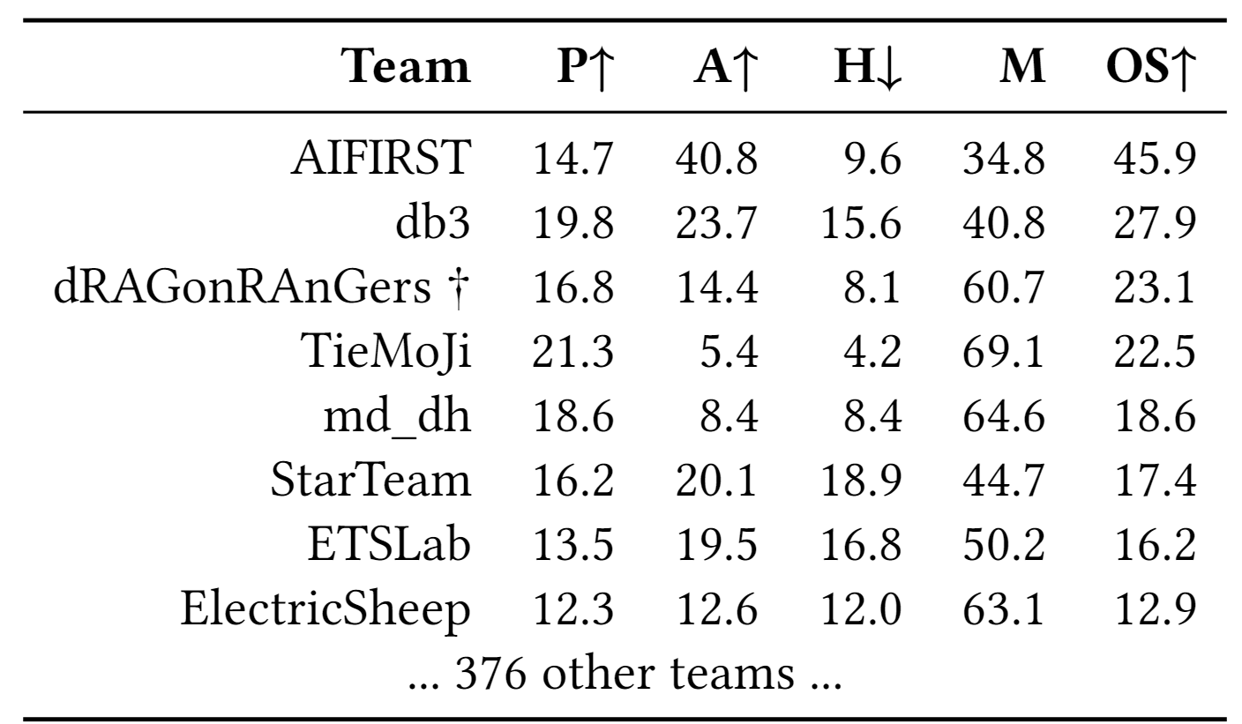
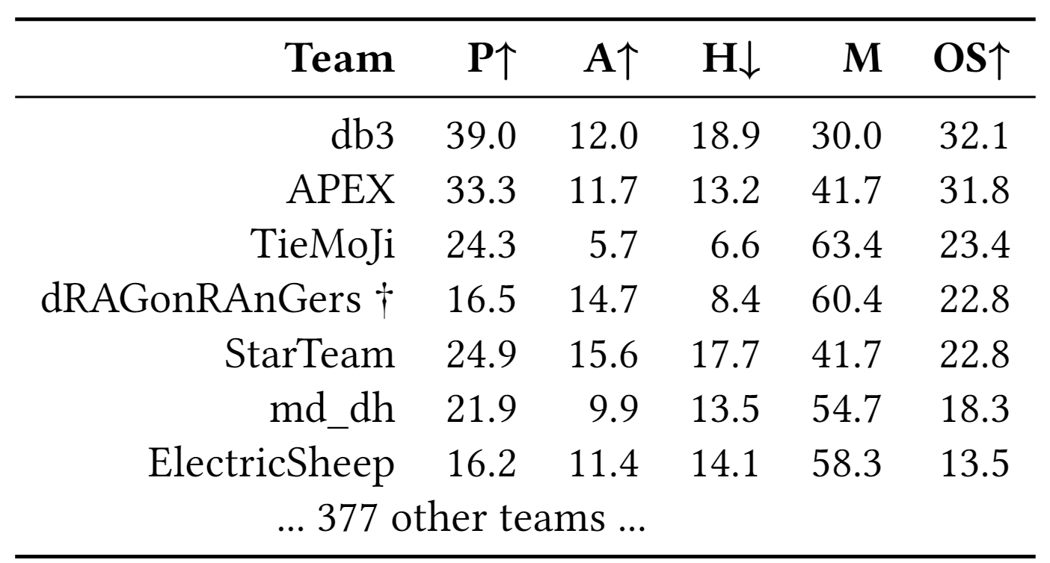
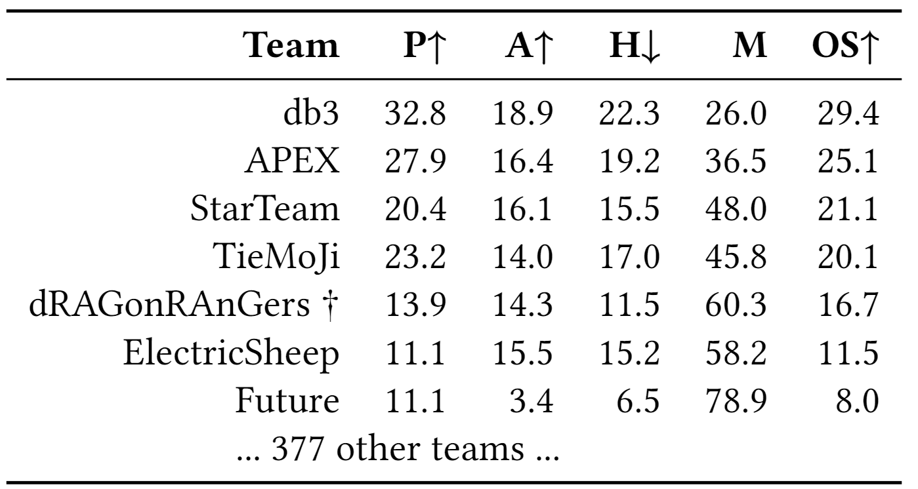
Accuracy Comparison
Our algorithm recorded missing scores exceeding 60% across all three tasks, while maintaining lower hallucination scores compared to other competitors.
Table 2: Evaluation results for task 1
Table 3: Evaluation results for task 2
Table 4: Evaluation results for task 3

Slide 26
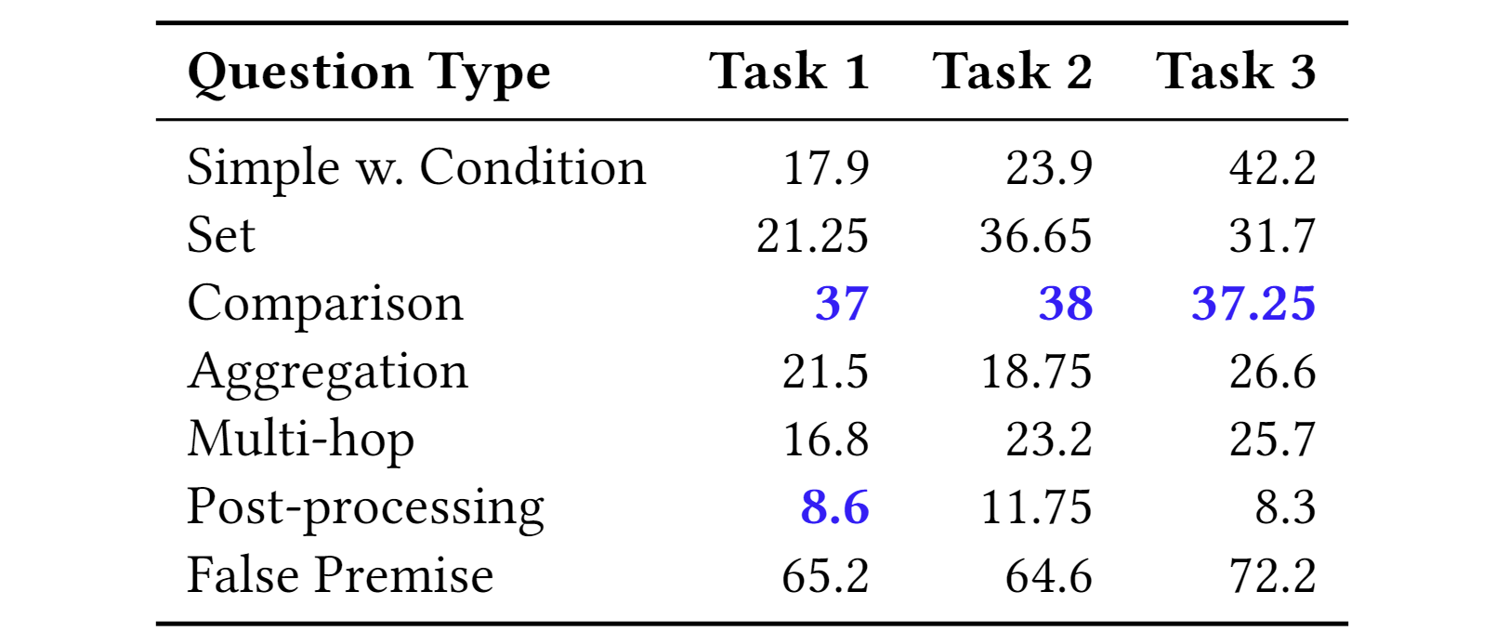
Human Evaluation
Our algorithm secured the first place across all three tasks in the comparison question category (see the blue, bold-fonted results in Table 5).
Table 5: Highest-ranked accuracy scores among KDD Cup
competitors for each task (columns) and question type (rows).

Slide 27
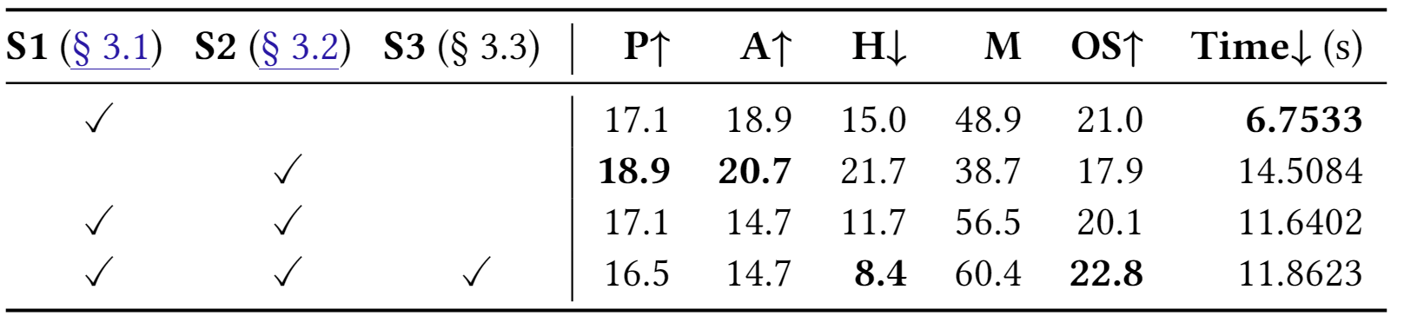
Ablation Study: Three-Step Framework
When Step 1 is used in conjunction with Step 2, the algorithm execution time is significantly reduced.
Introducing Step 3 to the framework resulted in a 28.2% reduction in hallucinations.
Table 6: Ablation study results

Slide 28
Overview
Introduction
Preliminaries
Methodology
Experiment
Conclusion

Slide 29
Conclusion
We introduce a three-step question-answering framework that enhances RAG systems by incorporating two additional steps.
The framework’s effectiveness was confirmed by achieving first place in the comparison question category across all tasks, as well as first place in the post-processing category for task 1.
By releasing our prototype, we aim to provide a practical tool for the research community, fostering further advancements in question-answering systems.

Slide 30
Thank You!!
Sungho Park
Contact us: shpark@dblab.postech.ac.kr
Data System Lab in POSTECH

