Slide 1


A Hybrid RAG System with Comprehensive Enhancement on Complex Reasoning
27/8/2024
Team ElectricSheep

Slide 2

A Hybrid RAG System with Comprehensive Enhancement on Complex Reasoning
KDD Cup RAG workshop
By: Team ElectricSheep
(Peking University)
Ye Yuan;
Chengwu Liu;
Jingyang Yuan;
Gongbo Sun;
Siqi Li;
Ming Zhang;

Slide 3


6 Key Components of Our System
1. Web page processing
2. Attribute predictor
3. Numerical calculator
4. LLM knowledge extractor
5. Knowledge graph module
6. Reasoning module

Slide 4
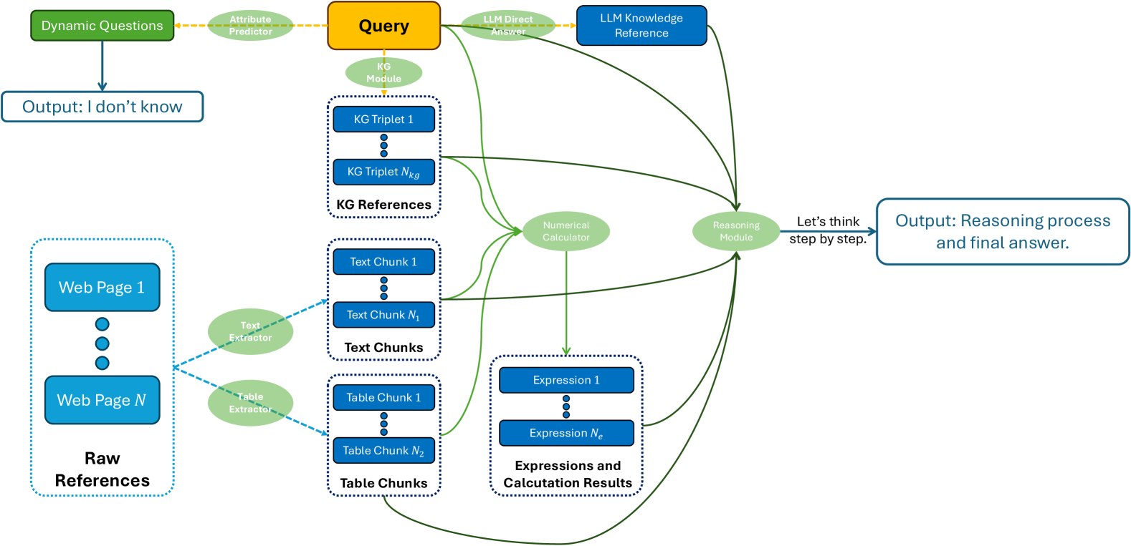
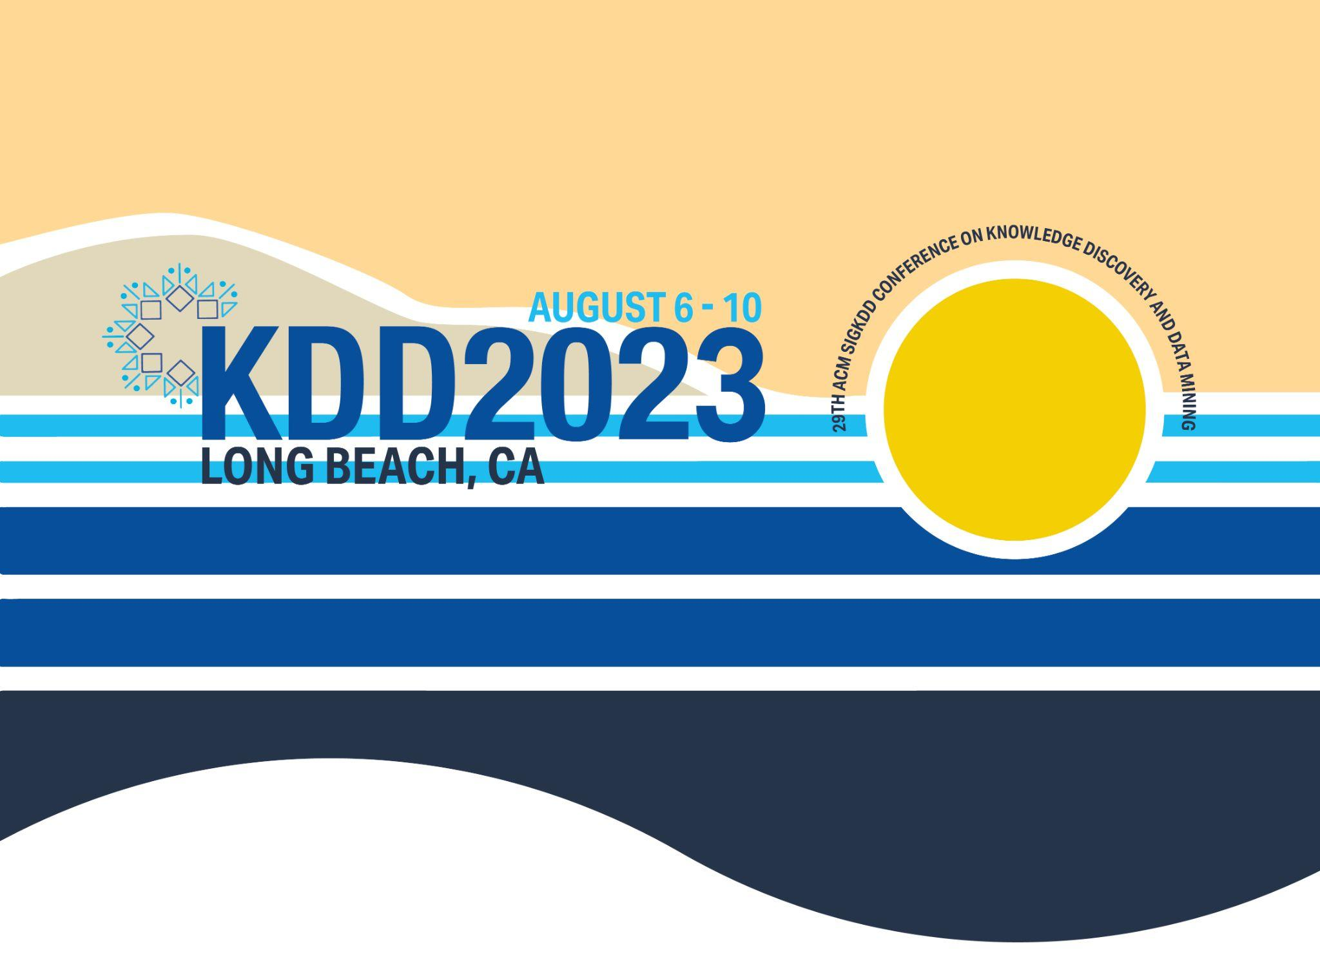
System Design

Slide 5
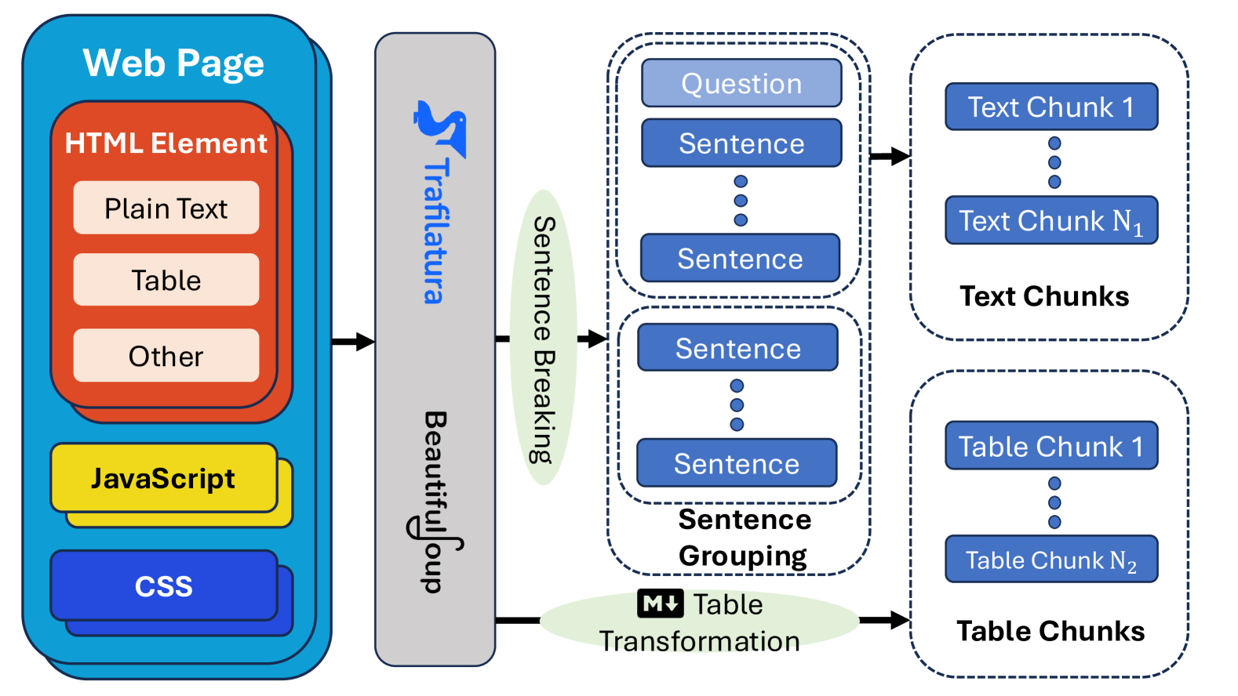
Web Page Processing

Slide 6
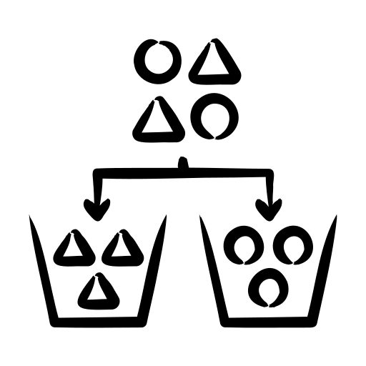
Attribute Predictor
Purpose: Identify question type and rate of fact change
Tactic: If a question is tricky, just leave it there!
“I don’t know!”
Classification Methods
In-context learning with large language models
SVM for speed and efficiency

Slide 7


Enhancing Numerical Calculation with a Calculator
Method: Let LLMs express answers as mathematical equations
Utilizes an external Python interpreter for accurate computation
Extra Technics: Multiple sampling

Slide 8
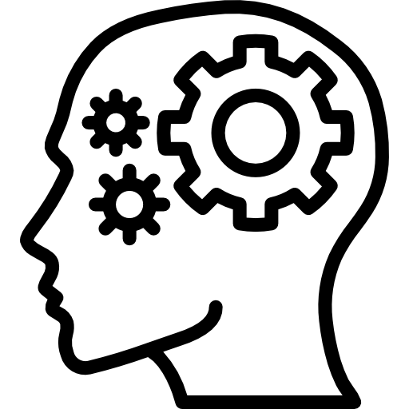

LLM Knowledge Extractor
Issue with Extra Documents:
Including outdated or irrelevant documents
Model Behavior:
Models often rely on included documents
Even if they LACK accurate information

Slide 9
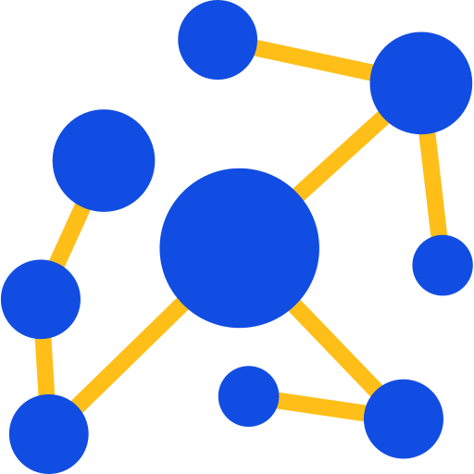
Crafting Effective Queries for KGs
Entity Extraction:
Trivial and naïve solution
Utilize LLM to identify and extract entities from user queries
Enhancement:
Develop queries based on predefined MANUAL RULES

Slide 10


Enhancing Reasoning with
Advanced Prompt Engineering
Data Integration:
Web Page Excerpts
Tables
KG query Results
Calculator Results
LLM’s Knowledge
Reasoning Technique: Implements zero-shot Chain of Thought

Slide 11
Handling Corner Cases
Detective Mode
Identifies and handles nonsensical questions before responding
Hallucination Reduction
Implements "I don't know" responses for uncertain questions
Format Correction
Introduces a backup summarization agent when parsing issues arise

Slide 12
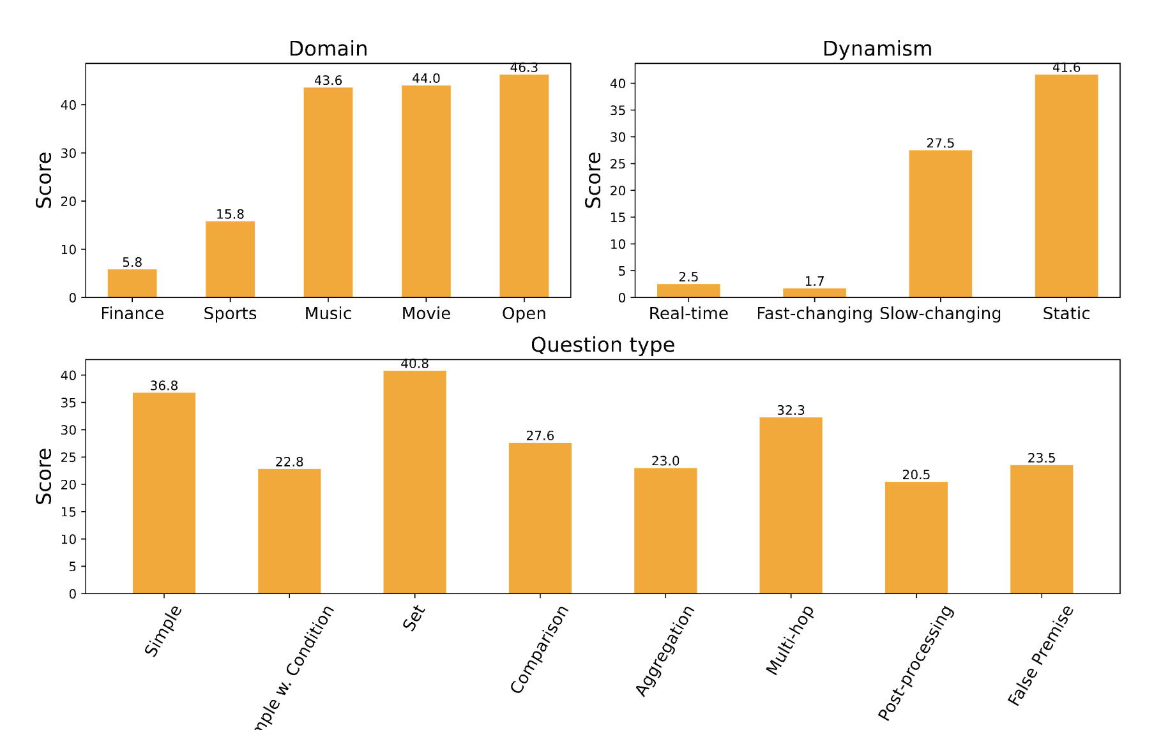
System Performance on Public Dataset

Slide 13
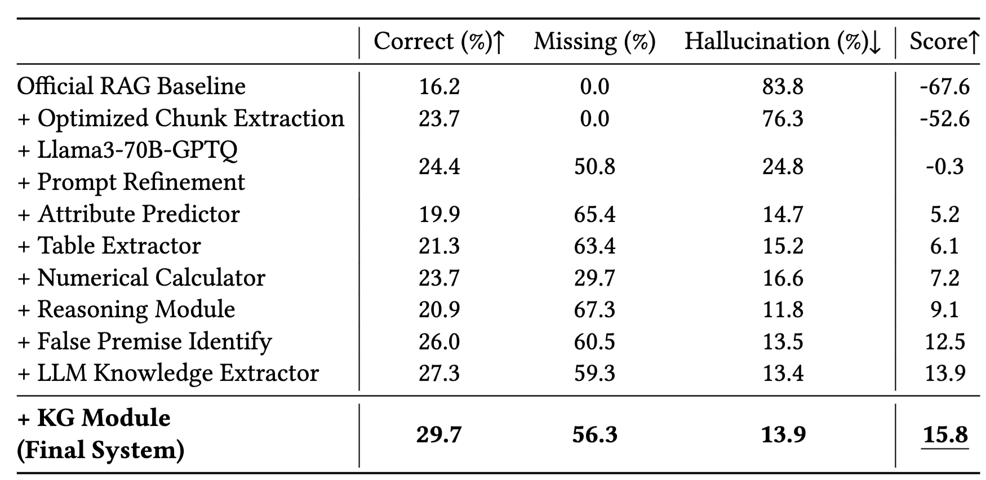
Ablation Study Results
Clear improvement in system score with every component added

Slide 14
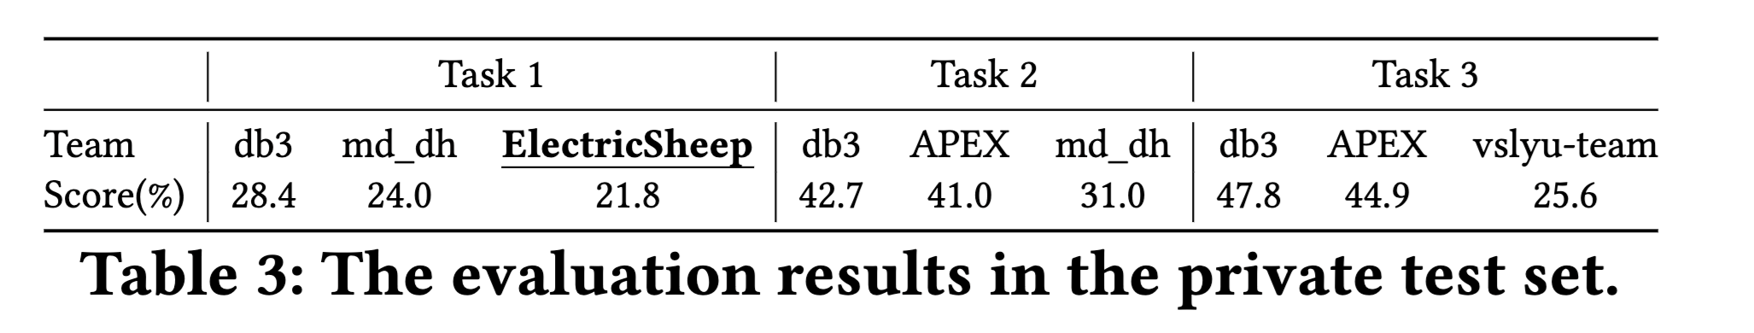
Performance under Different Tasks
Reason for Performance Gap between Task1 and Task2&3:
◦ Adopted a naïve knowledge graph query approach
◦ Underutilization of knowledge graph data

Slide 15
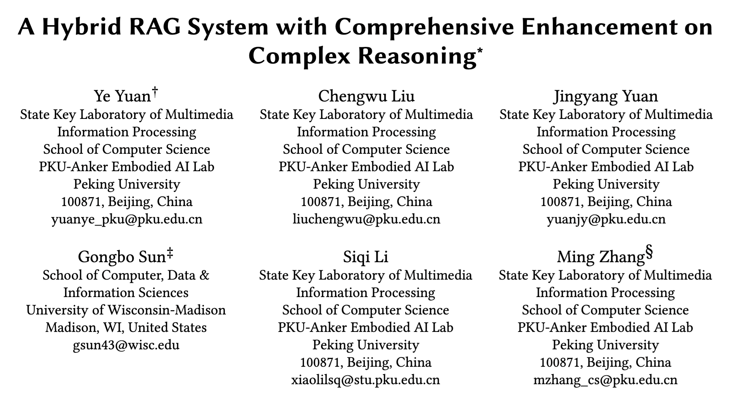

ArXiv: https://arxiv.org/pdf/2408.05141
Source Code: https://gitlab.aicrowd.com/shizueyy/crag-new

Slide 16
THANK YOU

