Slide 1
TEAM GGFC
Project ‘BE FIT’
Kaloyan Dinev, 10G
Stanislav Todorov, 10B

Slide 2
Implementation of the tasks:
Kaloyan Dinev – Back-End Developer
Stanislav Todorov – Front-End Developer

Slide 3







Technologies used:

Slide 4
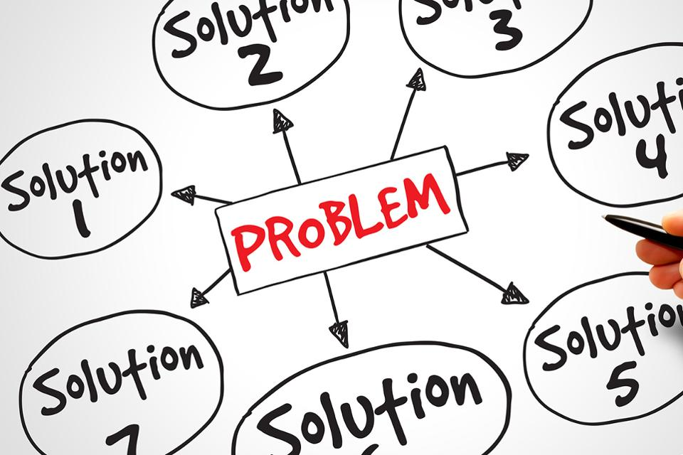

Slide 5

Future plans:
Add Fitness Schedule
Choose exercise by calculating your weight and height
Leaderboard
Footstep counter

Slide 6
Thank you for your attention!

