Slide 1

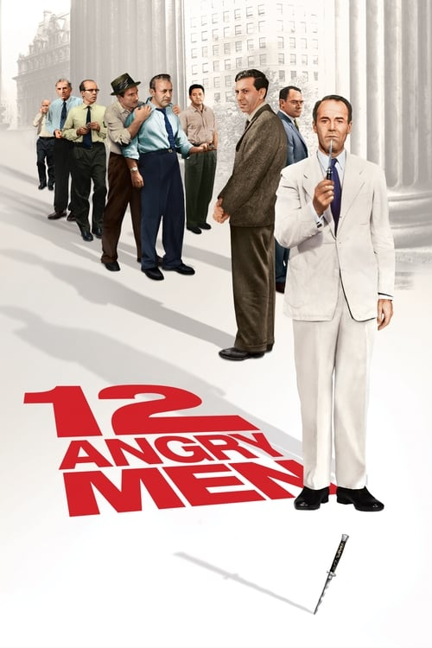



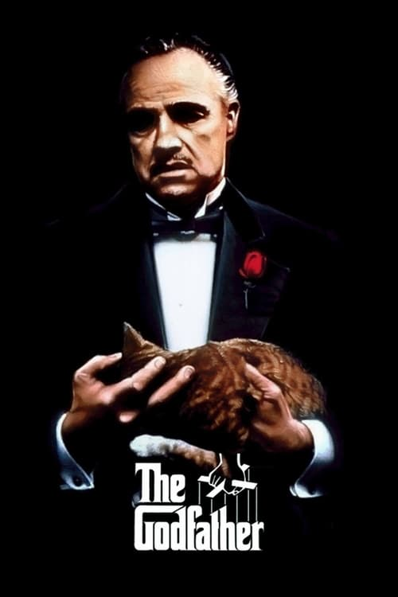
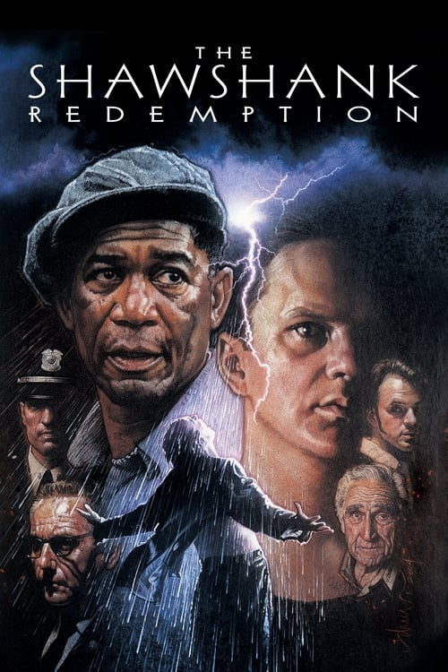

영화 검색하기…
검색
인기순
평점순
상영일순
정렬
카드 누르면 셰이딩 살짝 올라옴
The Godfather
1972
the Godfather is a 1972 American epic crime film[2] directed by Francis Ford Coppola, who co-wrote the screenplay with Mario Puzo, based on Puzo's best-selling 1969 novel of the same title. The film stars Marlon Brando, Al Pacino, James Caan, Richard Castellano, Robert Duvall, Sterling Hayden, John Marley, Richard Conte and Diane Keaton. It is the first
The Godfather
1972
the Godfather is a 1972 American epic crime film[2] directed by Francis Ford Coppola, who co-wrote the screenplay with Mario Puzo, based on Puzo's best-selling 1969 novel of the same title. The film stars Marlon Brando, Al Pacino, James Caan, Richard Castellano, Robert Duvall, Sterling Hayden, John Marley, Richard Conte and Diane Keaton. It is the first
The Godfather
1972
the Godfather is a 1972 American epic crime film[2] directed by Francis Ford Coppola, who co-wrote the screenplay with Mario Puzo, based on Puzo's best-selling 1969 novel of the same title. The film stars Marlon Brando, Al Pacino, James Caan, Richard Castellano, Robert Duvall, Sterling Hayden, John Marley, Richard Conte and Diane Keaton. It is the first
더보기
더보기
더보기
토글 기능

