Slide 1
프로그래밍 언어론
Lecture Note #01
조용주
ycho@smu.ac.kr

Slide 2
Introduction
Programming in Old Days
Earlier computers were monstrous devices
Filling several rooms
Consuming as much electricity as a good-size factory
Costing millions of 1940 dollars
Programmers were cheap
Programming in machine language
Machine language:
Sequence of bits that directly controls a processor(add, compare, move data from one place to another, and so on)
E.g. Calculating the greatest common divisor (GCD) of two integers using Euclid's algorithm (x86 instruction)
55 89 e5 53 83 ec 04 83 e4 f0 e8 31 00 00 00 89….

Slide 3
Introduction
The next step was writing in assembly language
Allow operations to be expressed with mnemonic abbreviations
E.g. GCD program in x86 assembly language
pushl %ebp
movl %esp, %ebp
pushl %ebx
subl $4, %esp
andl $-16, %esp
call getint
movel %eax, %ebx
call getint
cmpl %eax, %ebx
je C
A: cmpl %eax, %ebx
jle D
subl %eax, %ebx
B: cmpl %eax, %ebx
jne A
…

Slide 4
Introduction
Assembly language
One-to-one mapping between mnemonics and machine language instructions
Translation from mnemonics to machine language done by assembler
Assemblers eventually augmented with “macro expansion” to define parameterized abbreviations for common sequences of instructions
Easier than writing programs using machine language, but still difficult and machine-centered
System specific (not portable)

Slide 5
Introduction
People dreams about machine-neutral programming languages, specifically with numerical computations capability → Fortran
Catches up slowly, though
Human could write faster programs than compiled code
More high-level languages were introduced, such as Lisp and Algol
Translating from a high-level language to assembly or machine language is the job of a compiler
More complex than assemblers because of no 1:1 correspondence between source and target operations

Slide 6
Introduction
Performance gap was narrowed and reversed eventually
Need to economize the programmer effort
the original construction of programs
subsequent program maintenance – enhancement and correction
Labor costs now heavily outweight the cost of computing hardware

Slide 7
1.1 The Art of Language Design
Why are there so many programming languages?
Evolution – we’ve learned better ways of doing things over time
Constant development of accomplishing things
goto-based control flow (Fortran, Cobol, Basic)
Structured programming
Instead of goto, while loop or case(switch) statement-based control flow (Algol, Pascal, C, Ada)
Object oriented programming (Smalltalk, C++, Eiffel, Java, C#)
Scripting languages displace more traditional compiled languages, at least for rapid development (Python, Ruby)

Slide 8
1.1 The Art of Language Design
Special Purpose
Designed for a specific problem domain
Lisp dialects – symbolic data and complex data structures
Icon and Awk are good for manipulating character strings
C – low-level systems programming
Prolog – reasoning about logical relationships among data
Can be used for other generic work, but focus is on their specialty

Slide 9
1.1 The Art of Language Design
Personal Preference
Different people like different things
Some may like recursion, others prefer iteration
Some may like pointers; others prefer the implicit dereferencing of Lisp, Java, and ML
It would make unlikely that anyone will ever develop a universally acceptable programming language

Slide 10
1.1 The Art of Language Design
What makes a language successful?
Expressive power
Debate over one language is more “powerful” than another
Language features
have a huge impact on the programmer’s ability to write clear, concise, and maintainable code, especially for very large systems
Major focus of this book
Ease of use for the novice
Basic is a success
has very low "learning curve"
Pascal – in many introductory courses
compact and easy to learn

Slide 11
1.1 The Art of Language Design
Ease of implementation
Basic’s success also is due to that it can be implemented easily even on tiny machines, with limited resources
Forth and Squeak
Pascal
Niklaus Wirth developed a simple portable implementation of the language and shipped it free to universities all over the world
Java and Python took similar path (free for all)
Not anymore for Java (2018)

Slide 12
1.1 The Art of Language Design
Standardization
Almost every widely used language has an official international standard or a single canonical implementation, which is implemented using a standardized language.
the only truly effective way to ensure the portability of code across platforms
The standard for Pascal, which was missing several items that were essential to programmers,
Open Source
Most programming languages today have at least one open-source compiler or interpreter
C language and UNIX operating system
As of June 2015, C and its descendants account for well over half of a variety of language-related on-line content, including web page references, book sales, employment listings, and open-source repository updates

Slide 13
1.1 The Art of Language Design
Excellent Compilers
Fortran’s success is largely due to extremely good compilers
Common Lisp is successful in part because they have compilers and supporting tools that do an unusual good job of helping the programmer manage very large projects
Economics, Patronage, and Inertia
Factors other than technical merit influence success
The backing of a powerful sponsor
Cobol and PL/I by IBM, Ada by DoD
C# backed by Microsoft
Objective-C and Swift by iPhone and iPad
Some languages remain widely used because of base of installed software and programmer expertise (Cobol)

Slide 14
1.1 The Art of Language Design
No one factor determines whether a language is “good”
Need to consider issues from several points of view, specially both programmer and the language implementer
Sometimes, these points of view will be in harmony
the desire for execution speed
Conflicts and tradeoffs
The conceptual appeal of a feature is balanced against the cost of its implementation
The tradeoff becomes thorny when the implementation imposes costs not only on programs that use the feature but also on programs that do not

Slide 15
1.2 The Programming Language Spectrum
Many existing languages can be classified into families based on their model of computation
The top-level division of programming languages
declarative
The focus is on what the computer is to do
properties are declared, but no execution sequence is specified
higher level – more in tune with the programmer’s point of view, and less with the implementer's point of view
imperative
focus is on how the computer should do it
action oriented
computation is viewed as a sequence of actions
predominate mainly for performance reasons

Slide 16
1.2 The Programming Language Spectrum
Declarative
Imperative
subfamilies | programming languages
functional | Lisp/Scheme, ML, Haskell …
dataflow | Id, Va1
logic or constrained-based | Prolog, spreadsheets, SQL…
subfamilies | programming languages
von Neumann | C, Ada, Fortran, Pascal, Basic…
object-oriented | Smalltalk, Eiffel, C++, Java
scripting | Perl, Python, PHP

Slide 17
1.2 The Programming Language Spectrum
Functional languages
employ a computational model based on the recursive definition of functions
based on lambda calculus developed in 1930s
a program is considered a function from inputs to outputs, defined in terms of simpler functions through a process of refinement
Iteration is often accomplished through recursion
Lisp, ML, Haskell

Slide 18
1.2 The Programming Language Spectrum
Functional languages
employ a computational model based on the recursive definition of functions
based on lambda calculus developed in 1930s
a program is considered a function from inputs to outputs, defined in terms of simpler functions through a process of refinement
Iteration is often accomplished through recursion
Lisp, ML, Haskell

Slide 19
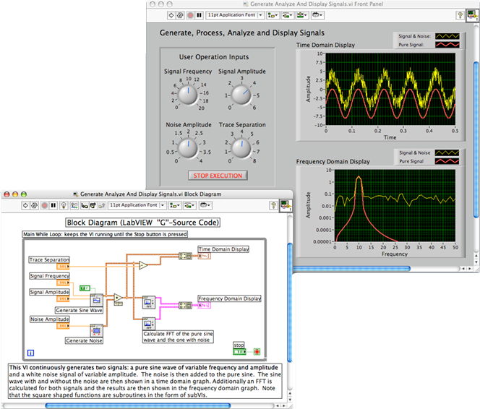
1.2 The Programming Language Spectrum
Dataflow languages
model computation as the flow of information (tokens) among primitive functional nodes
Conceptually or physically implements a directed graph of the data flowing between operations
nodes are triggered by the arrival of input tokens, and can operate concurrently
Id, Val, LabView

Slide 20
1.2 The Programming Language Spectrum
Logic or constraint-based language
model computation as an attempt to find values that satisfy certain specified relationships, using goal-directed search through a list of logical rules
Prolog – best-known logic language
The term is also sometimes applied to the SQL database languages, the XSLT scripting language, and programmable aspects of spredsheets

Slide 21
1.2 The Programming Language Spectrum
von Neumann languages
Probably the most familiar and widely used
Basic means of computation is the modification of variables whereas functional languages are based on expressions that have values
von Neumann languages are based on statements (assignments in particular) that influence subsequent computation via the side effect of changing the value of memory
Fortran, Pascal, Basic, C
Side effects (from Wikipedia)
A function or expression is said to produce a side effect if it modifies some state in addition to returning a value

Slide 22
1.2 The Programming Language Spectrum
Object-oriented languages
closely related to von Neumann languages but have a much more structured and distributed model of both memory and computation
Rather than picture computation as the operation of monolithic processor on a monolithic memory, object oriented languages picture computations as interactions among semi-independent objects, each of which has both its own internal state and executable functions to manage that state
Smalltalk (the purest), C++ and Java (most widely used)
CLOS and OCaml – object-oriented functional languages

Slide 23
1.2 The Programming Language Spectrum
Scripting Languages
A subset of the von Neumann languages
Distinguished by their emphasis on coordinating or “gluing together” components drawn from some surrounding context
Several scripting languages were developed for specific purposes
csh, bash – input language for job control
awk – text manipulation
PHP and JavaScript – intended for the generation of dynamic web content
Lua is widely used to control computer games
Python, Perl, Ruby, Tcl – more generic, rapid prototyping

Slide 24
1.2 The Programming Language Spectrum
GCD algorithms in different languages
The choice among von Neumann, functional, or logic programming for this problem influences how the programmer thinks
Imperative language
very imperative
int gcd(int a, int b) {
while (a != b) {
if (a > b) a = a – b;
else b = b – a;
}
return a;
}
To compute the gcd of a and b, check to see if a and b are equal. If so, print one of them and stop. Otherwise, replace the larger one by their difference and repeat.

Slide 25
1.2 The Programming Language Spectrum
Functional language
the emphasis is on the mathematical relationship of outputs to inputs
The gcd of a and b is defined to be (1) a when a and b are equal, (2) the gcd of b and a – b when a > b, and (3) the gcd of a and b – a when b > a. To compute the gcd of a given pair of numbers, expand and simplify this definition until it terminates.
let rec gcd a b = (* OCaml *)
if a = b then a
else if a > b then gcd b (a – b)
else gcd a (b – a)

Slide 26
1.2 The Programming Language Spectrum
Logic languages
The programmer specifies a set of axioms and proof rules that allows the system to find desired values
The proposition gcd(a, b, g) is true if (1) a, b, and g are all equal; (2) a is greater than b and there exists a number c such that c is a – b and gcd(c, b, g) is true; or (3) a is less than b and there exists a number c such that c is b – a and gcd(c, a, g) is true. To compute the gcd of a given pair of numbers, search for a number g (and various numbers c) for which these rules allow one to prove that gcd(a, b, g) is true.
gcd(A,B,G) :- A = B, G = A. % Prolog
gcd(A,B,G) :- A > B, C is A-B, gcd(C,B,G).
gcd(A,B,G) :- B > A, C is B-A, gcd(C,A,G).

Slide 27
1.2 The Programming Language Spectrum
The distinctions among language families are not clear-cut
The division between the von Neumann and object-oriented languages is fuzzy, and many scripting languages are also object-oriented
most of the functional and logic languages include some imperative features
several imperative languages have added functional features

Slide 28
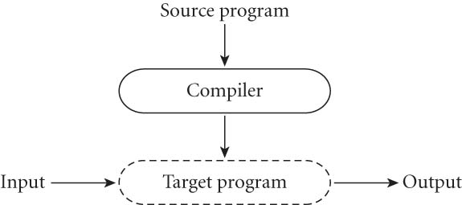
1.4 Compilation and Interpretation
Compilation vs. interpretation
not opposites
not a clear-cut distinction
Pure Compilation
The compiler translates the high-level source program into an equivalent target program (typically in machine language), and then goes away:
Some time later, the user tells the OS to run the target program

Slide 29

1.4 Compilation and Interpretation
Locus of control
compiler during compilation
the target program during its own execution
Compiler itself is a machine language program
When written to a file in a format understood by the OS, machine language is commonly known as object code
Pure Interpretation
Interpreter stays around for the execution of the program
Interpreter is the locus of control during execution

Slide 30
1.4 Compilation and Interpretation
An interpreter stays around for the execution of the application
the interpreter is the locus of control during that execution
Think of the Interpreter as a virtual machine whose "machine language" is the high-level programming language

Slide 31
Pure interpretation
Interpretation
Greater flexibility and better diagnostics (error messages)
Types and sizes may be decided upon the input data
Even names that refer to which variables
In Smalltalk, all type checking is delayed until run time. References to objects of arbitrary types (classes) can then be assigned into arbitrary named variables
Some language features are almost impossible to implement without interpretation
Lisp and Prolog write new pieces of itself and execute them on the fly

Slide 32
1.4 Compilation and Interpretation
Compilation
Better performance
The decision is made at compile-time
E.g. if the compiler can guarantee that variable x will always be at location 49378, it can generate machine language instructions that access this location whenever the source program refers to x

Slide 33
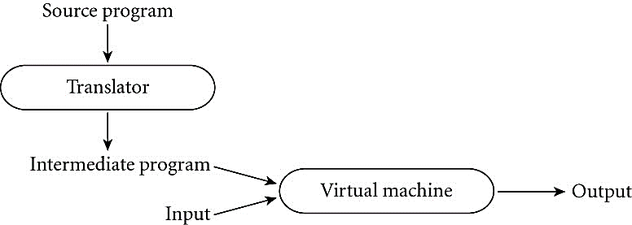
1.4 Compilation and Interpretation
Many language implementation include a mixture of both – compilation or simple pre-processing, followed by interpretation
Distinguishing compilation and interpretation is difficult
Two characteristics differentiating compilation from interpretation
Thorough analysis
Nontrivial transformation – no strong resemblance to the source

Slide 34
1.4 Compilation and Interpretation
Most interpreted languages employ an initial translator (a preprocessor)
removes comments and white spaces
groups characters together into tokens such as keywords, identifiers, numbers, and symbols
may expand abbreviations in the style of a macro assembler
may identify higher-level syntactic structures, such as loops and subroutines
to produce an intermediate form that mirrors the structure of the source, but can be interpreted more efficiently

Slide 35
1.4 Compilation and Interpretation
Early implementation of Basic, removing comments from a program was suggested in order to improve its performance
Pure interpreter was used; it would re-read the comments every time it executed a given part of the program
No initial translator

Slide 36
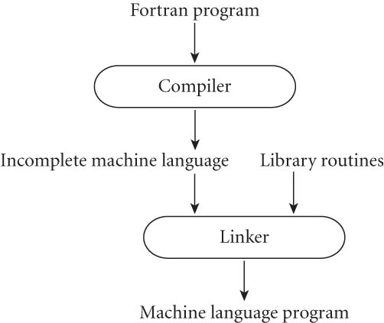
1.4 Compilation and Interpretation
Typical Fortran implementation comes close to pure compilation
the compiler translates Fortran source into some intermediate machine code (object code)
relies on the existence of a library of subroutines that are not part of the original program, such as, mathematical functions and I/O
linker merges the appropriate library into the final program
One can find interpretation in the Fortran
routines for formatted output
Another example is printf in C language

Slide 37
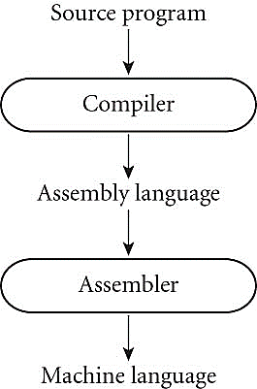
1.4 Compilation and Interpretation
Compilers may generate assembly language instead of machine language

Slide 38
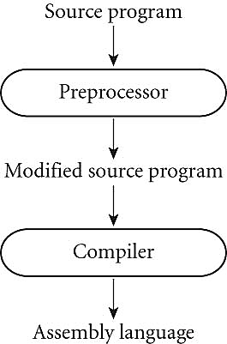
1.4 Compilation and Interpretation
Compilers for C language begin with a preprocessor that removes comments and expands macros. The preprocessor can also be instructed to delete portions of the code itself using conditional compilation facility

Slide 39

#ifdef … #endif: 정의되었다면
/* #define ADD 1 */
#define MIN 0
int main(void) {
int num1, num2;
printf("두 개의 정수 입력: ");
scanf("%d %d", &num1, &num2);
#ifdef ADD /* ADD가 정의되었다면 */
printf("%d + %d = %d\n", num1, num2, num1 + num2);
#endif
#ifdef MIN /* MIN이 정의되었다면 */
printf("%d - %d = %d\n", num1, num2, num1 - num2);
#endif
return 0;
}
ADD와 MIN의 정의 여부만 중요하다면 각각의 매크로에 값을 지정할 필요가 없음. 아래처럼 정의해도 됨
#define ADD
#define MIN
실행결과

Slide 40
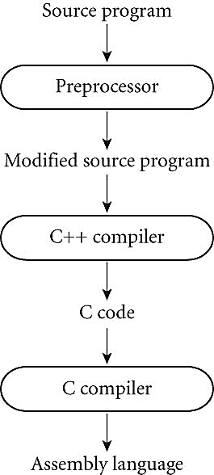
1.4 Compilation and Interpretation
Early C++ implementations (at the Bell lab in AT&T) generated an intermediate program in C
C++ compiler was a true compiler that performed a complete analysis of the syntax and semantics of the C++ source program

Slide 41
1.4 Compilation and Interpretation
Note that compilation does NOT have to produce machine language for some sort of hardware
Compilation is translation from one language into another, with full analysis of the meaning of the input
Compilation entails semantic understanding of what is being processed; pre-processing does not
Preprocessors perform transformations based on simple pattern matching, and may well produce output that will generate error messages when run through a subsequent stage of translation

Slide 42
1.4 Compilation and Interpretation
Many compilers are self-hosting : C compilers in C
Used a technique known as bootstrapping
Many early Pascal compilers were built around a set of tools distributed by Niklaus Wirth including
a Pascal compiler, written in Pascal, that would generate output in P-code, a simple stack-based language similar to bytecode of Java
the same compiler, already translated into P-code
a P-code interpreter, written in Pascal
To get Pascal up and running on a local machine,
the user of the tool set needed only to translate
the P-code interpreter (by hand) into an available language

Slide 43
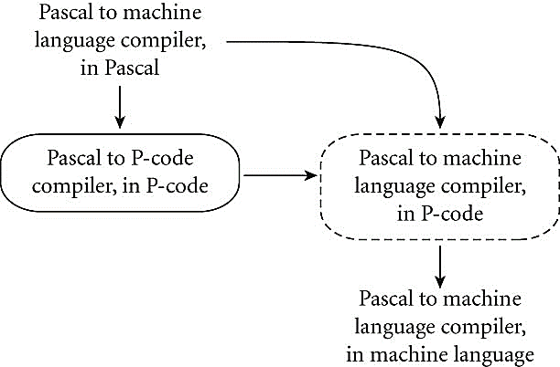
1.4 Compilation and Interpretation

Slide 44
1.4 Compilation and Interpretation
Compilation of Interpreted Languages
The compiler generates code that makes assumptions about decisions that won't be finalized until runtime. If these assumptions are valid, the code runs very fast. If not, a dynamic check will revert to the interpreter
Dynamic and Just-in-Time Compilation
In some cases a programming system may deliberately delay compilation until the last possible moment.
Lisp or Prolog invoke the compiler on the fly, to translate newly created source into machine language, or to optimize the code for a particular input set

Slide 45
1.4 Compilation and Interpretation
The Java language definition defines a machine-independent intermediate form known as byte code. The first Java implementation were based on byte-code interpreters, but more recent implementations employ a just-in-time compiler that translates bytecode into machine language immediately before each execution of the program
The main C# compiler produces .NET Common Intermediate Language (CIL), which is then translated into machine code immediately prior to execution, which is just-in-time translation

Slide 46
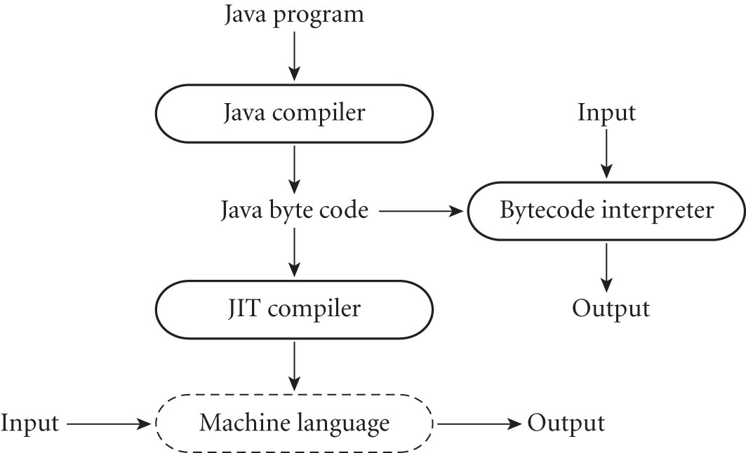
1.4 Compilation and Interpretation

Slide 47
1.4 Compilation and Interpretation
Microcode
On some machines (particularly designed before the mid-1980s, Assembly-level instruction set is not implemented in hardware; it runs on an interpreter
Interpreter is written in low-level instructions (microcode or firmware), which are stored in read-only memory and executed by the hardware
Unconventional compilers
text formatters (TeX, troff, Postscript)
silicon compilers
query language processors translate SQL into primitive operations on files

Slide 48
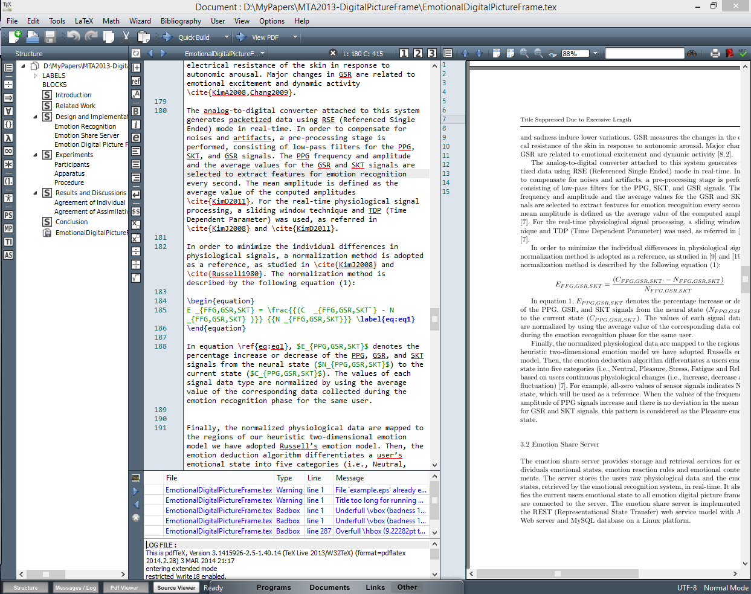

Slide 49
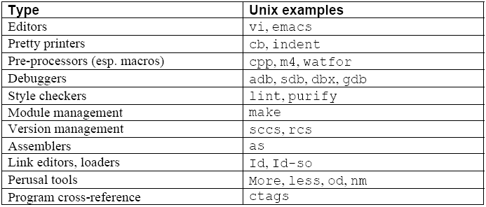
1.5 Programming Environments
Compilers and interpreters do not exist in isolation. Programmers are assisted in their work by a host of other tools
In old days, tools may be executed individually, but these days, an integrated development environment is often used

Slide 50
1.6 An Overview of Compilation
Typical compilation proceeds through a series of well-defined phases
Each phase discovers information of use to later phases, or transforms the program into a form that is more useful to the subsequent phase
First few steps (up through semantic analysis) serve to figure out the meaning of the source program → sometimes called front end
The last few phases serve to construct an equivalent target program → sometimes called back end
An interpreter shares the compiler's front-end structure, but "executes" (interprets) the intermediate form directly, rather than translating it into machine language

Slide 51
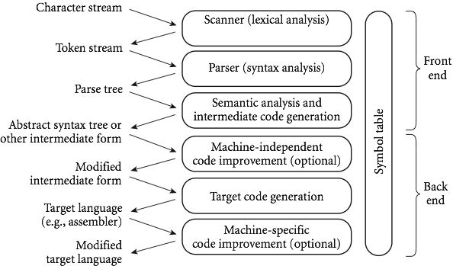
1.6 An Overview of Compilation
Phases of compilation

Slide 52
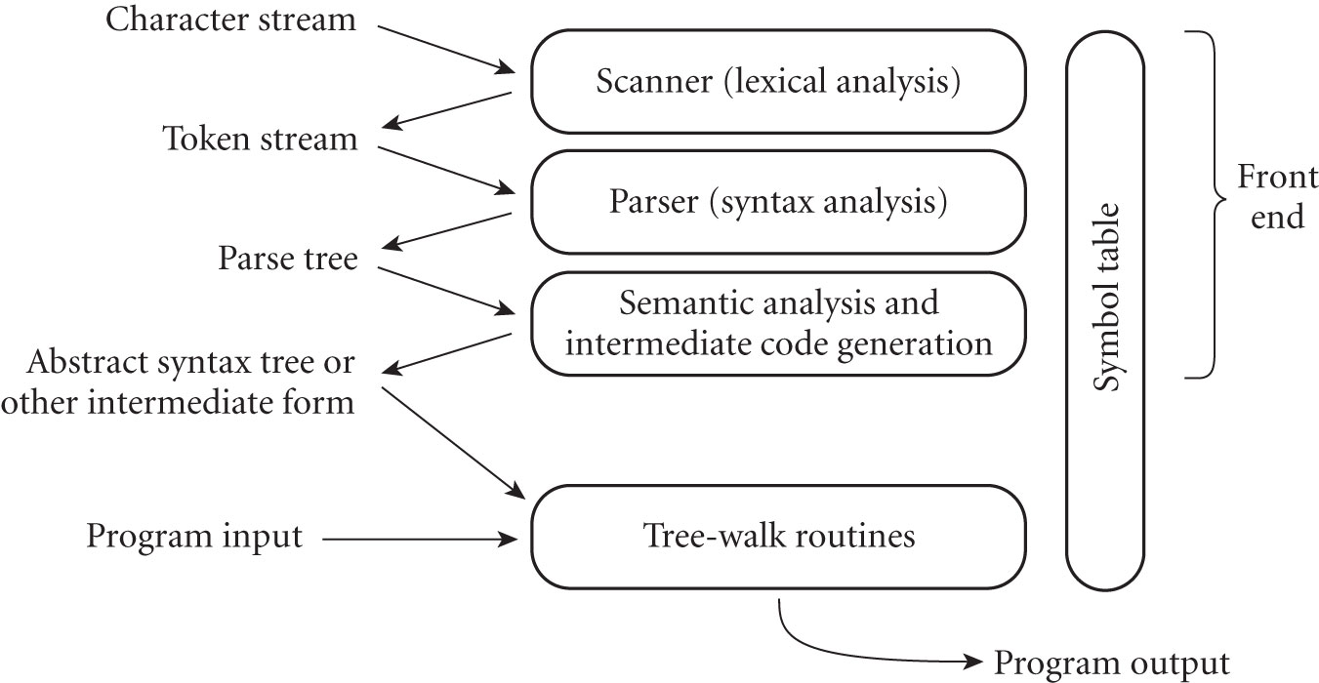
1.6 An Overview of Compilation
Phases of interpretation

Slide 53
1.6 An Overview of Compilation
A pass is a phase or set of phases that is serialized with respect to the rest of compilation:
a new pass is not started until the previous phases have completed
Two reasons of using passes in compilation
share the front end for more than one machine (target language)
the backend may be shared by compilers for more than one source language
compiles were also sometimes divided into passes to reduce the requirements of memory usage

Slide 54
1.6.1 Lexical and Syntax Analysis
Consider the greatest common divisor (GCD) problem
int main() {
int i = getint(), j = getint();
while (i != j) {
if (i > j) i = i – j;
else j = j – i;
}
putint(i);
}

Slide 55
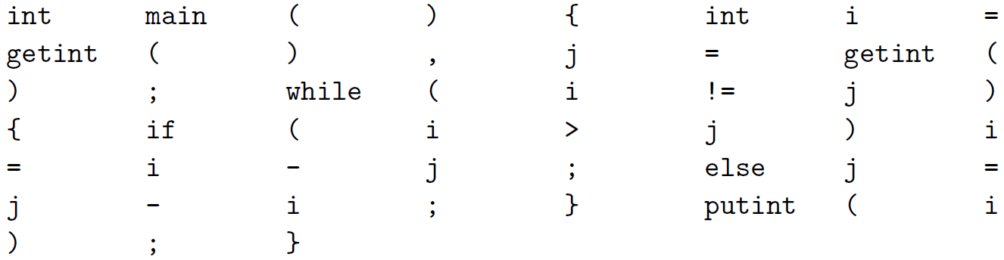
1.6.1 Lexical and Syntax Analysis
Scanning and parsing serve to recognize the structure of the program, without regard to its meaning
The scanner reads characters ('i','n','t',' ','m','a','i','n','(',')', …) and groups them into tokens, which are the smallest meaningful units of the program
tokens in the GCD program

Slide 56
1.6.1 Lexical and Syntax Analysis
Scanning is also known as lexical analysis
The principal purpose of the scanner
simplify the task of the parser, by reducing the size of the input
remove extraneous characters like white space
typically removes comments
tags tokens with line and column numbers, to make it easier to generate good diagnostics in later phases
The parser that takes characters instead of tokens as input would be awkward and slow

Slide 57
1.6.1 Lexical and Syntax Analysis
Parsing organizes tokens into a parse tree that represents higher-level constructs (statements, expressions, subroutines, and so on) in terms of their constituents
each construct is a node in the tree; its constituents are its children
the root of the tree is "program"; the leaves, from left to right, are the tokens received from the scanner
As a whole, the tree shows how the tokens fit together to make a valid program
The structure relies on a set of potentially recursive rules known as context-free grammar
each rule has an arrow sign (→) with the construct name on the left and a possible expansion on the right

Slide 58
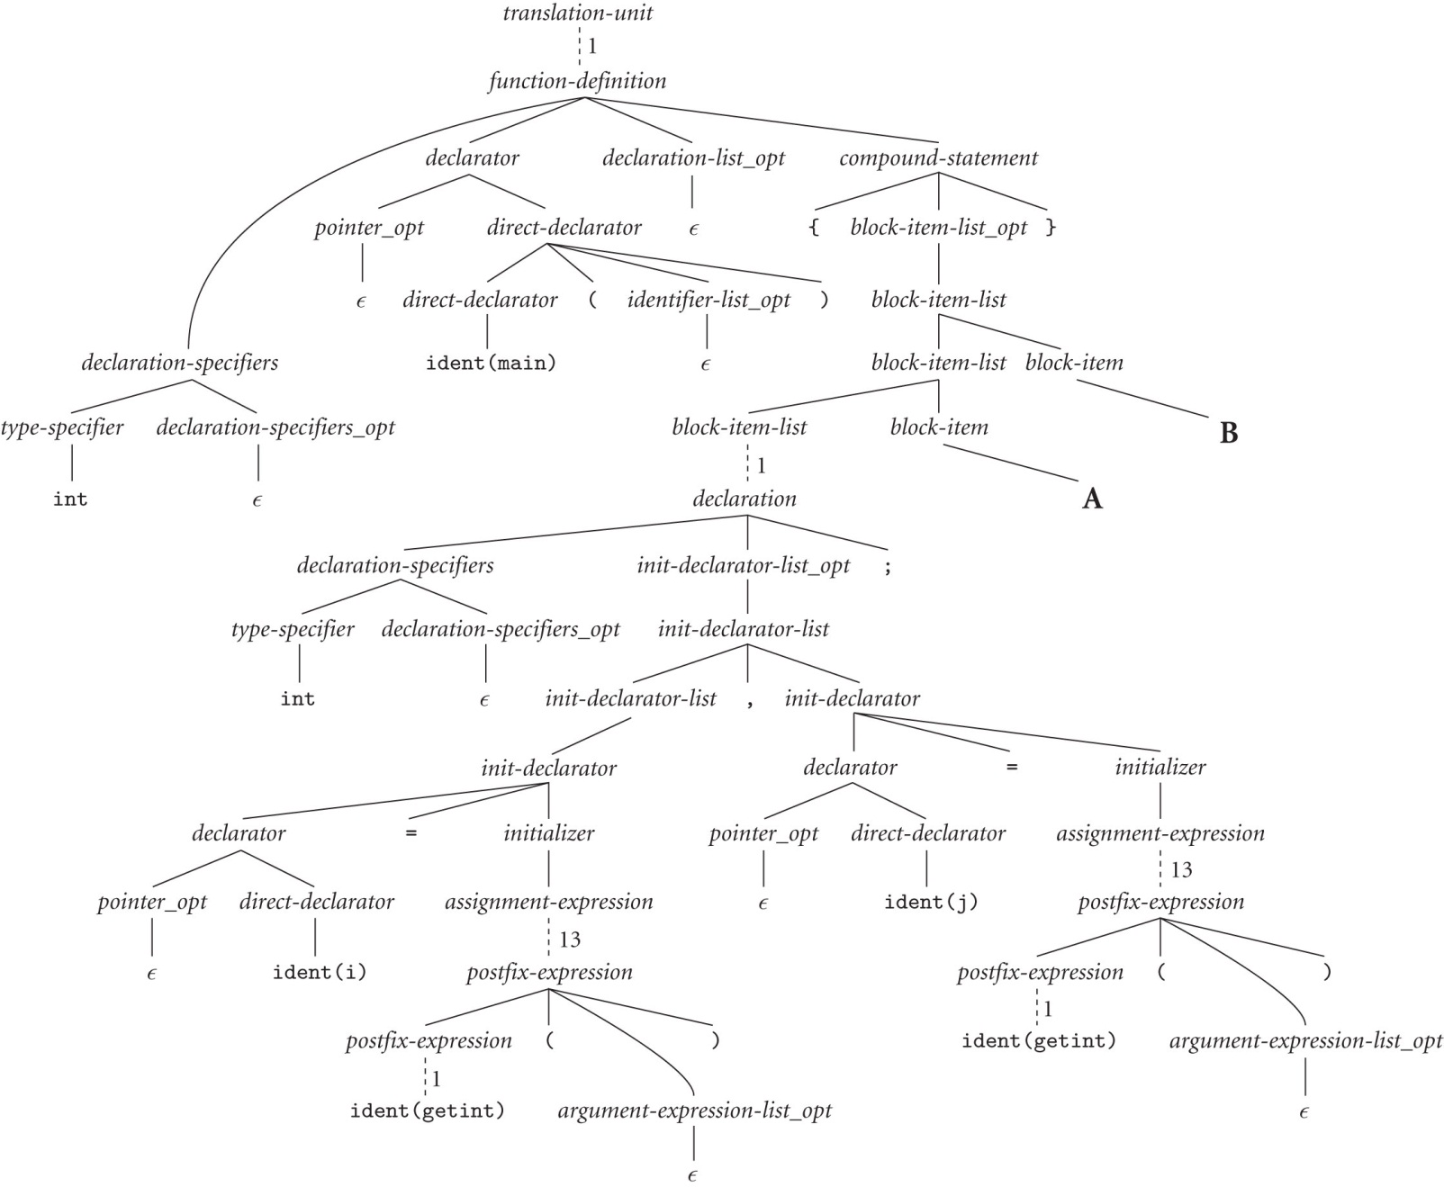
Parse tree of the GCD

Slide 59
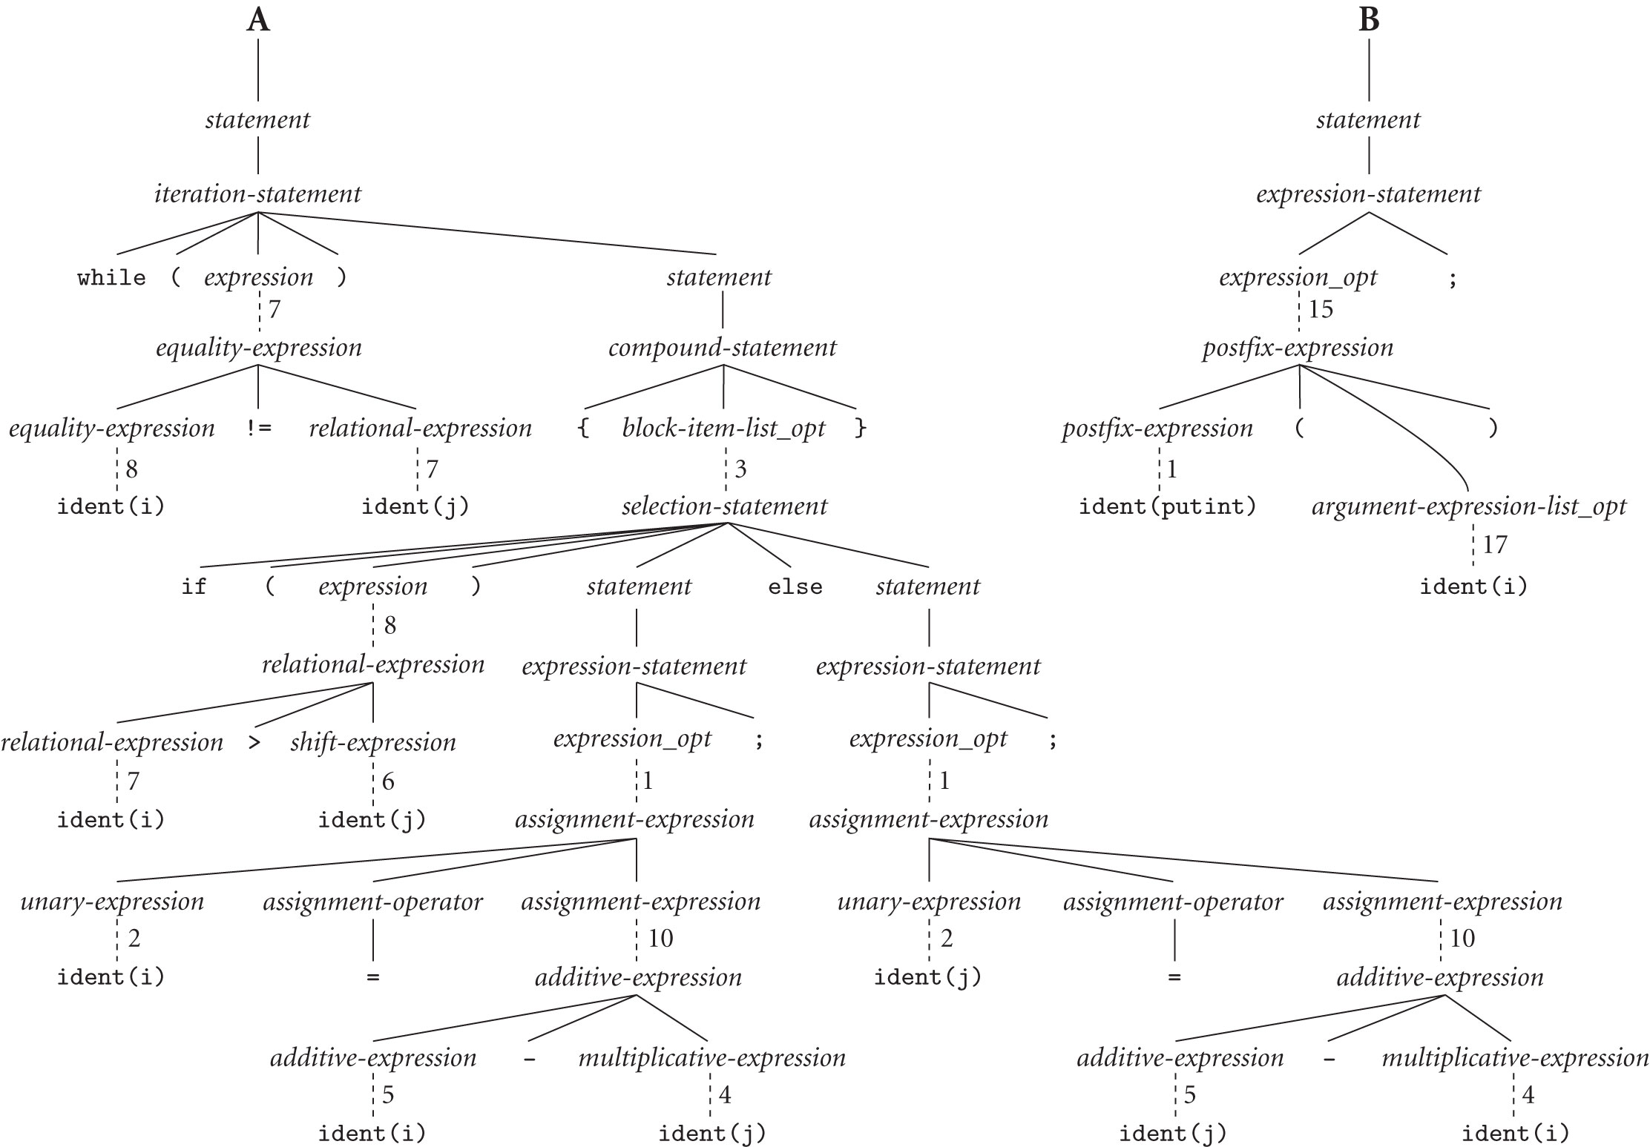
Parse tree of the GCD

Slide 60
1.6.1 Lexical and Syntax Analysis
while loop in C
ϵ means empty string
iteration-statement → while (expression) statement
statement → compound-statement
compounds-statement → { block-item-list_opt }
block-item-list_opt → block-item-list
block-item-list_opt → ϵ
block-item-list → block-item
block-item-list→ block-item-list block-item
block-item → declaration
block-item → statement

Slide 61
1.6.1 Lexical and Syntax Analysis
A context-free grammar defines the syntax of the language
Parsing is syntax analysis
In the parse tree,
each individual branching point represents the application of a single grammar rule
the resulting complexity is more a reflection of the grammar than it is of the input program
much of the bulk stems from
the use of such artificial "constructs" as block-item-list and block-item-list_opt
the use of equally artificial assignment-expression, additive-expression, multiplicative-expression, …

Slide 62
1.6.1 Lexical and Syntax Analysis
In the process of scanning and parsing, the compiler or interpreter checks to see
all of the program's tokens are well formed
the sequence of tokens conforms to the syntax defined by the context-free grammar
any malformed tokens (e.g., 123abc or $@foo in C) should cause scanner to produce an error message
any syntactically invalid token sequence (e.g., A = X Y Z in C) should lead to an error message from the parser

Slide 63
1.6.2 Semantic Analysis and Intermediate Code Generation
Semantic analysis discovers the meaning in a program
the semantic analyzer recognizes when multiple occurrences of the same identifier are meant to refer to the same program entity, and ensures that the uses are consistent
in most languages, the semantic analyzer also tracks the types of both identifiers and expressions
verify the consistent usage
guide the generation of code in the backend of a compiler

Slide 64
1.6.2 Semantic Analysis and Intermediate Code Generation
the semantic analyzer typically builds and maintains a symbol table data structure that maps each identifier to the information known about it
the identifier's type
internal structure (if any)
scope (the portion of the program in which it is valid)
using the symbol table, the semantic analyzer enforces a large variety of rules that are not captured by the context-free grammar and parse tree

Slide 65
1.6.2 Semantic Analysis and Intermediate Code Generation
in C, for example, it checks to make sure that
every identifier is declared before it is used
no identifier is used in an inappropriate context (calling an integer as a subroutine, adding a string to an integer, referencing a field of the wrong type of struct, etc.)
subroutine calls provide the correct number and types of arguments
labels on the arms of a switch statement are distinct constants
any function with a non-void return type returns a value explicitly

Slide 66
1.6.2 Semantic Analysis and Intermediate Code Generation
not all semantics rules can be checked at compile time
the compiler actually does what is called STATIC semantic analysis. That's the meaning that can be figured out at compile time
some things (e.g., array subscript out of bounds) can't be figured out until run time. Things like that are part of the program's DYNAMIC semantics
C has very little in the way of dynamic checks
examples of rules that other languages enforce at run time
variables are never used in an expression unless initialized
pointers are never dereferenced unless they refer to valid object
array subscript expression lie within the bounds
arithmetic operations do not overflow

Slide 67
1.6.2 Semantic Analysis and Intermediate Code Generation
The semantic analyzer typically transforms the parse tree into an abstract syntax tree (also known as AST or syntax tree) by removing most of the "artificial" nodes in the parse tree's interior
the semantic analyzer also annotates the remaining nodes with useful information, such as pointers from identifiers to their symbol table entries
the annotations attached to a particular node are known as its attributes

Slide 68
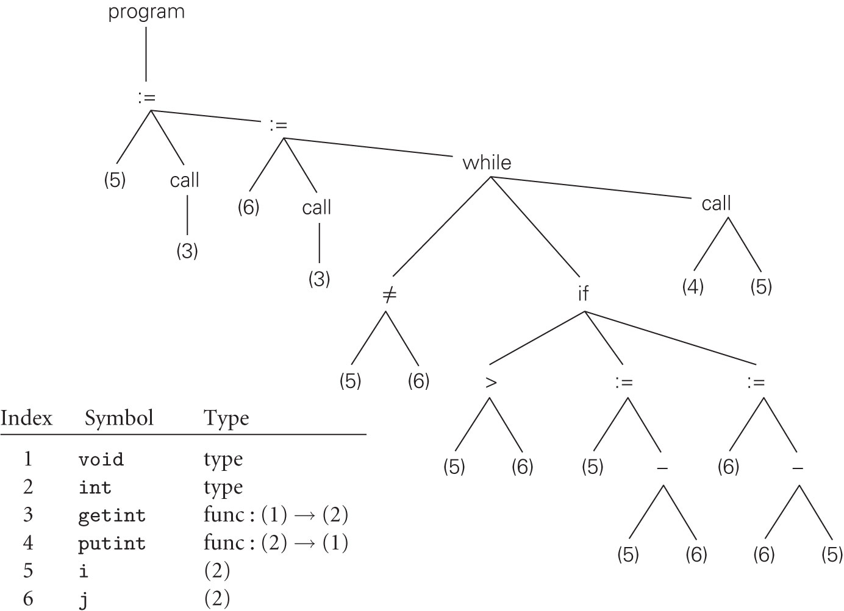
1.6.2 Semantic Analysis and Intermediate Code Generation
Abstract Syntax Tree for GCD

Slide 69
1.6.2 Semantic Analysis and Intermediate Code Generation
In many compilers, the annotated syntax tree constitutes the intermediate form that is passed from the front end to the back end
In other compiles, semantic analysis ends with a traversal of the tree (typically single pass) that generates some other intermediate form
One common such form consists of a control flow graph whose nodes resemble fragments of assembly language for a simple idealized machine
In a suite of related compilers, the front end for several languages and the back ends for several machines would share a common intermediate form

Slide 70
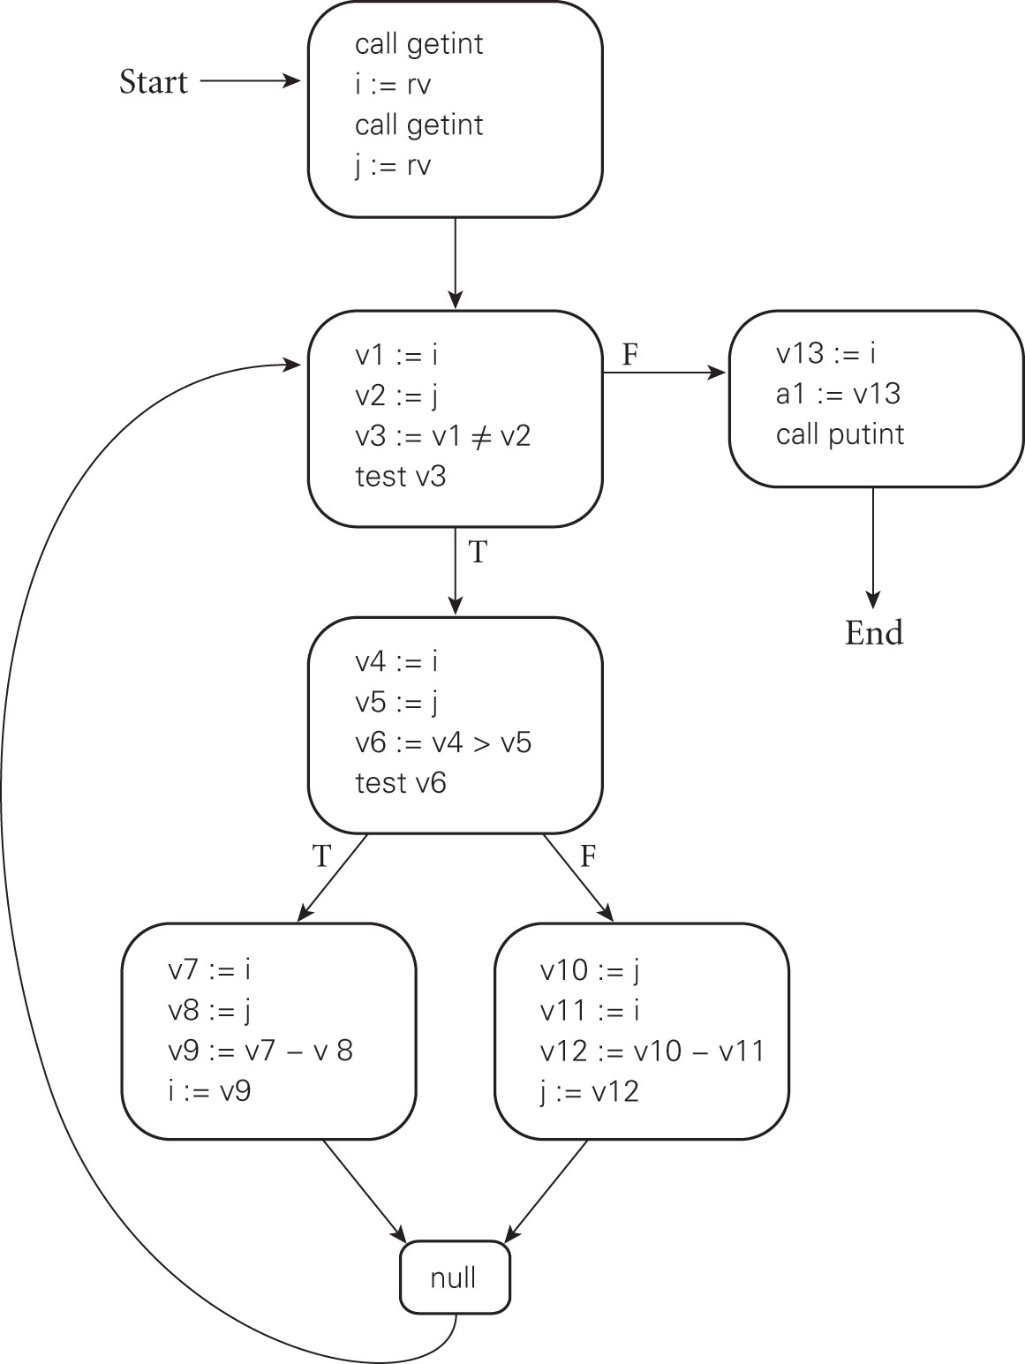
1.6.2 Semantic Analysis and Intermediate Code Generation
Control Flow Graph for GCD

Slide 71
1.6.3 Target Code Generation
The code generation phase of a compiler translates the intermediate form into the target language
To generate assembly or machine language, the code generator
traverses the symbol table to assign locations to variables
traverses the intermediate representation of the program
generating loads and stores for variable references
interspersed with appropriate arithmetic operations, tests and braches
Often a code generator will save the symbol table for later use by a symbolic debugger, by including it in a nonexecutable part of the target code

Slide 72
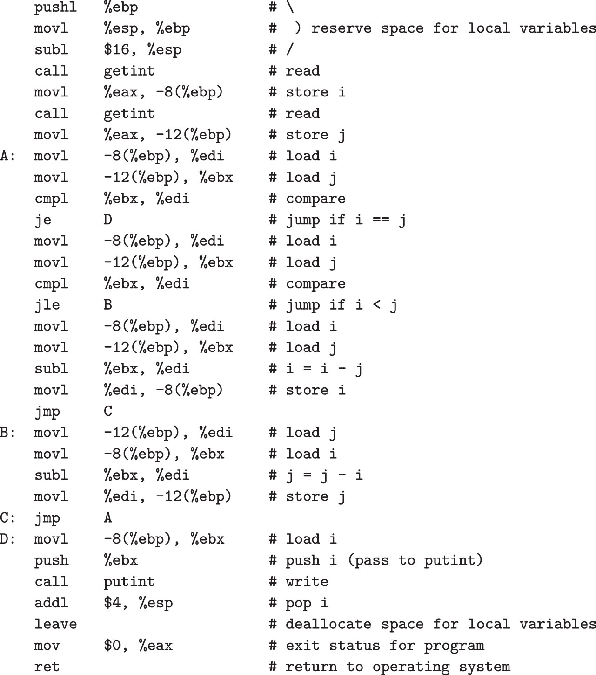
1.6.3 Target Code Generation
naïve x86 assembly language for
the GCD program

Slide 73
1.6.4 Code Improvement
Optimization – an optional phase of compilation whose goal is to transform a program into a new version that computes the same result more efficiently
Several optimization techniques have been studies
Store variables into registers
Reorder instructions to eliminate several of no-ops
Utilize multiple pipelines of newer processors

Slide 74
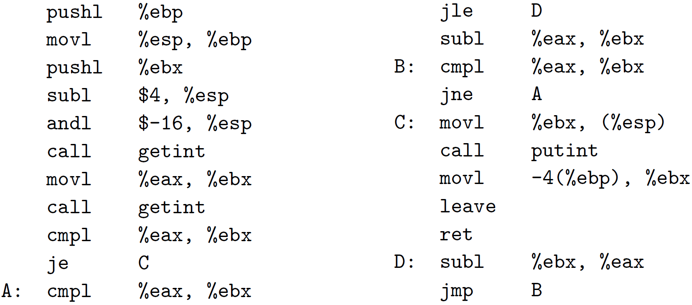
1.6.4 Code Improvement
Optimized version

