Slide 1
프로그래밍 언어론
Lecture Note #02
조용주
ycho@smu.ac.kr

Slide 2
Abstraction
Early languages such as Fortran, Algol, and Lisp were termed "high level" because their syntax and semantics were significantly more abstract – farther from the hardware – than those of assembly language
Abstraction achieved two complementary goals
    Machine independence
    Easier to understand and programming for humans
      primary reason to drive the design of modern languages

Slide 3
Abstraction
A name
  A mnemonic character string used to represent something else
Names
  in most languages are identifiers (alphanumeric tokens)
    symbols (like '+‘, “:=“) can also be names
  refer to variables, constants, operations, types, etc. using symbolic identifiers rather than low-level concepts like addresses
  essential in the context of a second meaning of the word abstraction

Slide 4
Abstraction
In this second meaning, abstraction is a process by which the programmer associates a name with a potentially complicated program fragment
  can be thought of in terms of its purpose or function, rather than in terms of how that function is achieved
  by hiding the irrelevant details, abstraction reduces conceptual complexity, making it possible for the programmer to focus on a manageable subset of the program text at any part

Slide 5
Abstraction
Abstraction
  Refers to the degree to which language features are separated from the details of any particular computer architecture
  Subroutine/function – Control abstractions
    hide arbitrarily complicated code behind a simple interface
  Class – Data abstractions
    hide data representation details behind a (comparatively) simple set of operations

Slide 6
3.1 The Notion of Binding Time
Binding
  An association between two things, such as a name and the thing it names
Binding time is the point at which a binding is created or, more generally, the point at which any implementation decision is made
  Language design time (in most languages)
    the control-flow constructs
    the set of fundamental (primitive) types
    constructors for creating complex types
    many other language semantics
Notes:
6

Slide 7
The Notion of Binding Time
  Language implementation time
    most language manuals leave a variety of issues to the discretion of the language implementer
    Typical examples
      Precision (number of bits) of the fundamental types – C/C++
      I/O to the operating system’s notion of files
      The organization and maximum sizes of stack and heap
  Program writing time
    Programmer choose
      algorithms
      data structures
      names
Notes:
7

Slide 8
Binding Time
  Compile time
    Choose the mapping of high-level constructs to machine code including the layout of statically defined data in memory
Notes:
8

Slide 9
Binding Time
  Link time
    Most compilers support separate compilation—compiling different modules of a program at different times—and depend on the availability of a library of standard subroutines, a program gets complete when the various modules are joined together by a linker
    The linker chooses
      layout of whole program in memory (virtual memory)
      Resolves inter-module references when separate compilation
    When a name in one module refers to an object in another module, the binding between the two is not finalized until link time
Notes:
9

Slide 10
Binding Time
  Load time
    The point at which the operating system loads the program into memory so that it can run
    In primitive OS, the choice of machine address for objects within the program was not finalized until load time
    Most modern OS distinguish between virtual and physical addresses
    Virtual address are chosen at link time
    Physical addresses may change at run-time
    The processor's memory management hardware translates virtual address into physical address
Notes:
10

Slide 11
Binding Time
  Run time
    a broad term that covers the entire span from the beginning to end of execution
    bindings of values to variables
    Run time subsumes
      program start-up time
      module entry time
      elaboration time (point a which a declaration is first "seen")
        Elaboration of a declaration refers to the storage allocation and binding process that takes place when the code containing the declaration is executed (Concepts of PL, Robert Sebesta)
      procedure entry time, block entry time
      expression evaluation and statement execution time
Notes:
11

Slide 12
Binding Time
Static and dynamic refer to things bound before run time and at run time
  Compiler-based language tend to be more efficient than interpreter-based implementations because they make earlier decisions
  A pure interpreter must analyze the declarations every time the program begins execution
    in the worst case, an interpreter may reanalyze the local declarations within a subroutine each time that subroutine is called
Early binding times → greater efficiency
  mostly compiled languages
Later binding times → greater flexibility
  mostly interpreted languages
Notes:
12

Slide 13
Binding Time and Language Design
Some languages are difficult to compile because their semantics require fundamental decisions to be postponed until run time
  increase the flexibility or expressiveness of the language
  most scripting languages delay all type checking until run time
  Polymorphism
    references to objects of arbitrary types (classes) can be assigned into arbitrary named variables, as long as the program never ends up applying an operator to (invoking a method of) an object that is not prepared to handle it – allows to write flexible and general-purpose code
Notes:
13

Slide 14
3.2 Object Lifetime and Storage Managements
When discuss the names and bindings, distinguishing between names and the objects to which they refer and identify several key events
Key events
  Creation and destruction of objects
  Creation and destruction of bindings
  Deactivation and reactivation of bindings that may be temporarily unusable
  References to variables, subroutines, types, and so on, all of which use bindings
Notes:
14

Slide 15
Object Lifetime and Storage Managements
Binding’s lifetime: the period of time between the creation and the destruction of a name-to-object binding
Object’s lifetime: the time between the creation and destruction of an object
These lifetimes need not necessarily coincide
Example
  When a variable is passed to a subroutine by reference (typical in Fortran or with “&” parameters in C++), the binding between the parameter name and the variable that was passed has a lifetime shorter than that of the variable itself
Notes:
15

Slide 16
Object Lifetime and Storage Managements
class Test {
Test(int v) { value = v; }
int value;
int getValue() { return value; }
};
void func(Test& v) {
int c = v.getValue();
printf("value = %d\n", c);
}
int main() {
Test t(5);
func(t);
printf("value = %d\n", t.getValue());
}

Slide 17
Object Lifetime and Storage Managements
A name-to-object binding to have a lifetime longer than that of the object
  It is also possible, though generally a sign of a program bug
void func(Test* v) {
int c = v->getValue();
printf("value = %d\n", c);
delete v;
}
int main() {
Test* t = new Test(5);
func(t);
printf("value = %d\n", t->getValue());
}

Slide 18
Object Lifetime and Storage Managements
If object outlives binding, it’s garbage
If binding outlives object, it’s a dangling reference
Object lifetimes generally correspond to one of three principal storage allocation mechanisms, used to manage the object's space:
  1. Static objects are given an absolute address that is retained throughout the program's execution
  2. Stack objects are allocated and deallocated in last-in, first-out order, usually in conjunction with subroutine calls and returns
  3. Heap objects may be allocated and deallocated at arbitrary times. They require a more general (and expensive) storage management algorithm

Slide 19
3.2.1 Static Allocation
Static objects
  global variables—the obvious example
  the instructions that constitute a program's machine code
  static variables (C, C++)
    variables that are local to a single subroutine, but retain their values from one invocation to the next
  Numeric and string-valued constant literals are also statically allocated
    A = B / 14.7 or printf("hello, world\n");
    Small constants are often stored within the instruction itself; larger ones are assigned a separate location
  Most compilers produce a variety of tables that are used by run-time support routines for debugging, dynamic type checking, garbage collection, exception handling, and other purposes

Slide 20
Static Allocation
  Statically allocated objects whose value should not change during program execution(e.g., instructions, constants, and certain run-time tables) are often allocated in protected, read-only memory
Local variables are usually created when their subroutine is called and destroyed when it returns (stack-based allocation)
  If the subroutine is called repeatedly, each invocation creates and destroys a separate instance of each local variable
  a language implementation must perform work at run time corresponding to these create and destroy operations

Slide 21
Static Allocation
Recursion was not originally supported in Fortran (was added in Fortran 90)
  As a result, there can never be more than one invocation of a subroutine active in an older Fortran program at any given time
  a compiler may choose to use static allocation for local variables, effectively arranging for the variables of different invocations to share the same locations, and thereby avoiding any run-time overhead for creation and destruction
  Many (probably most) Fortran implementation choose to use a stack for local variables, but the language definition permits the use of static allocation instead
    Fortran programmers was not able to use recursion for over 30 years

Slide 22
Static Allocation
In many languages a named constant is required to have a value that can be determined at compile time
  Usually the expression that specifies the constant's value is permitted to include only other known constants and built-in functions and arithmetic operators
  Named constants of this sort, together with constant literals, are sometimes called manifest constants or compile-time constants
  These constants can always be allocated statically, even if they are local to a recursive subroutine: multiple instances can share the same location

Slide 23
Static Allocation
In other languages (e.g., C and Ada), constants are simply variables that cannot be changed after elaboration(initialization) time
  Their values, though unchanging, can sometimes depend on other values that are not known until run time
  Such elaboration-time constants, when local to a recursive subroutine, must be allocated on the stack
  C# distinguishes between compile-time and elaboration-time constants using the const and readonly keywords
    readonly indicates that assignment to the field can only occur as part of the declaration or in a constructor in the same class

Slide 24
Static Allocation
#include <stdio.h> /* C */
void func(int n) {
const int value = n;
printf("value = %d\n", value);
}
int main(void) {
int v = 3;
const int t1 = 5;
const int t2 = t1 + 8;
func(v);
return 0;
}

Slide 25
Static Allocation
namespace ConsoleApplication1 { // C#
class Program {
readonly int value;
const int value2 = 5;
Program() {
value = 3;
// value2 = 5; // 오류 발생
}
// void setValue(int n) { value = n; }
static void Main(string[] args) {
}
}
}

Slide 26
3.2.2 Stack-Based Allocation
Recursion is allowed
  Static allocation of local variables are not possible since the number of instances of a variable that may need to exist at the same time is conceptually unbounded
Each instance of a subroutine at run time has its own frame (activation record) on the stack, containing arguments and return values, local variables, temporaries, and bookkeeping information
  Temporaries are typically intermediate values produced in complex calculations

Slide 27
Stack-Based Allocation
  Bookkeeping information typically includes the subroutine's return address, a reference to the stack frame of the caller (also called the dynamic link), saved values of registers, and so on.
  Arguments to be passed to subsequent routines lie at the top of the frame where the callee can easily find them
    The organization of the remaining information is implementation-dependent: varies from one language, machine, and compiler to another

Slide 28
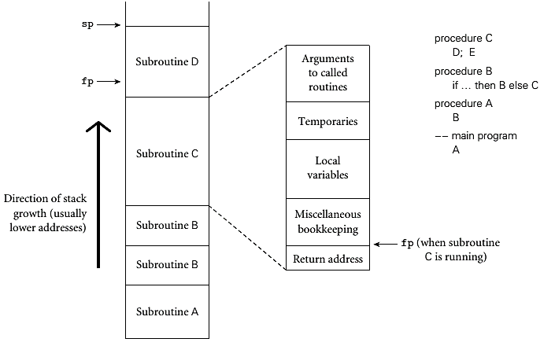
Stack-Based Allocation
A simplified picture of a typical stack

Slide 29
3.2.2 Stack-Based Allocation
Maintenance of stack is responsibility of calling sequence and subroutine prologue and epilogue of the subroutine itself
  calling sequence
    the code executed by the caller immediately before and after the call
    sometimes it refers to the combined operations of the caller, the prologue, and the epilogue
    will study in more detail 9.2
  prologue
    code executed at the beginning of the called subroutine
  epilogue
    code executed at the end of the called subroutine

Slide 30
Stack-Based Allocation
The location of a stack frame cannot be predicted at compile time
  But the offsets of objects within a frame usually can be statically determined
  Moreover, the compiler can arrange (in the calling sequence or prologue) for a particular register, known as the frame pointer to always point to a known location within the frame of the current subroutine
  Accessing a local variable within the current frame can be done by adding a predetermined offset to the value in the frame pointer

Slide 31
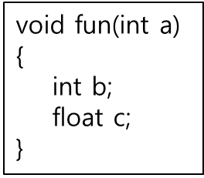
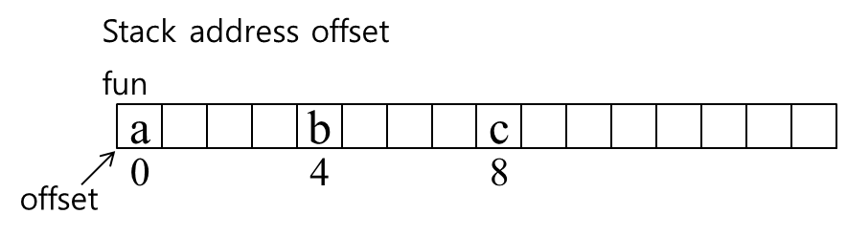
Stack-Based Allocation
  The stack grows "downward" toward lower addresses in most language implementations
  Local variables, temporaries, and booking information typically have negative offsets from the frame pointer
  Arguments and returns typically have positive offsets
    They reside in the caller's frame

Slide 32
Stack-Based Allocation
Even in a language without recursion, using a stack for local variables rather than allocating them statically can be advantageous
  In most programs, not all subroutines of the program to be active at the same time
  The total space needed for local variables of currently active subroutines is seldom as large as the total space across all subroutines, active or not
  A stack may require less memory at run time than would be required for static allocation

Slide 33
3.2.3 Heap-Based Allocation
heap
  a region of storage in which subblocks can be allocated and deallocated at arbitrary times
  are required for the dynamically allocated data structures and fully general character strings
Many possible strategies are available to manage space in a heap
  principal concerns are speed and space
Space concerns can be subdivided into issues of internal and external fragmentation
  Internal fragmentation
    allocates a block that is larger than required to hold a given object; the extra space is unused

Slide 34
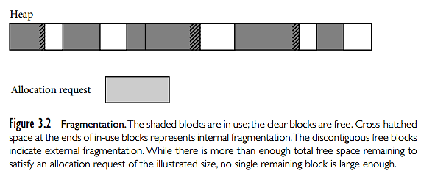
Heap-Based Allocation
  External fragmentation
    occurs when the blocks that have been assigned to active objects are scattered through the heap in such a way that the remaining, unused space is composed of multiple blocks; there may be quite a lot of free space, but no one piece of it may be large enough to satisfy some future request

Slide 35
Heap-Based Allocation
Many storage-management algorithms maintain a single linked list – the free list– of heap blocks not currently in use
  Initially the list consists of a single block comprising the entire heap
  At each allocation request the algorithm searches the list for a block of appropriate size
    First-fit
      Select the first block on the free list to find the smallest block that is large enough to satisfy the request
    Best-fit
      Search the entire the list to find the smallest block that is large enough to satisfy the request

Slide 36
Heap-Based Allocation
  If the chosen block is larger than required, it will be divided into two and return the unneeded portion to the free list
    If unneeded portion is below some minimum threshold in size, we may leave it in the allocated block as internal fragmentation
  When a block is deallocated and returned to the free list, we check to see whether either or both of the physically adjacent blocks are free; combine them
  One would expect a best fit algorithm to do a better job of reserving large blocks for large requests (maybe not)

Slide 37
Heap-Based Allocation
In any algorithm that maintains a single free list, the cost of allocation is O(n) where n is the number of free blocks
  To reduce this cost to a constant, some storage management algorithms maintain separate free lists for blocks of different sizes
  Some algorithms maintain separate free lists for blocks of different sizes
  Each request is rounded up to the next standard size (at the cost of internal fragmentation) and allocated from the appropriate list
  The heap is divided into "pools," one for each standard size
  Two common mechanism for dynamic pool adjustment are buddy system and Fibonacci heap

Slide 38
Heap-Based Allocation
Buddy system
  the standard block sizes are powers of two
  If a block of size 2^{k} is needed, but none is available, a block of size 2^{k+1} is split in two
  One of the halves is used to satisfy the request; the other is placed on the kth free list
  When a block is deallocated, it is coalesced with its "buddy"– the other half of the split that created it—if that buddy is free
Fibonacci heaps
  similar but use Fibonacci numbers for the standard sizes, instead of powers of two
  more complex but leads to slightly lower internal fragmentation because the Fibonacci sequence grows more slowly than 2^{k}

Slide 39
Heap-Based Allocation
The problem of external fragmentation
  The ability of the heap to satisfy requests may degrade over time
  It is always possible to devise a sequence of requests that cannot be satisfied, even though the total space required is less than the size of the heap
To eliminate external fragmentation, we must be prepared to compact the heap, by moving already-allocated blocks
  complicated by the need to find and update all outstanding references to a block that is being moved
  will be discussed in 8.5.3

Slide 40
3.2.4 Garbage Collection
Allocation of heap-based objects is always triggered by some specific operation in a program
  instantiating an object
  appending to the end of a list
  assigning a long value into a previously short string
  …
Deallocation is explicit in some languages (e.g., C, C++, and Rust)

Slide 41
Garbage Collection
Many languages specify that objects are to be deallocated implicitly when it is no longer possible to reach them from any program variable
  needs to provide garbage collection mechanism to identify and reclaim unreachable objects
  most functional and scripting languages require garbage collection, as do many more recent imperative languages, including Java and C#

Slide 42
Garbage Collection
Explicit deallocation
  Pros
    simple in implementation
    execution speed
    if the programmer can correctly identify the end of an object's lifetime, without too much run-time bookkeeping, the result is likely to be faster execution
  Cons
    manual deallocation errors are common and costly bugs in real-world programs
    if an object is deallocated too soon → dangling reference
    if an object is not deallocated at the end of its lifetime → "memory leak" → running out of heap space
    deallocation errors are difficult to identify and fix

Slide 43
Garbage Collection
Garbage collection
  Pros
    no manual deallocation errors
    garbage-collection algorithms have improved, reducing their run-time overhead
    leading-edge applications have become larger and more complex, making the benefits of automatic collection more compelling
  Cons
    add significant complexity to the implementation of a language with a rich type system
    the most sophisticated garbage collector can consume nontrivial amounts of time in certain programs

Slide 44
Garbage Collection
Over time, many language designers and programmers have come to consider automatic garbage collection an essential language feature
  Garbage-collection algorithms have improved
    reducing their run-time overhead
  Language implementations have become more complex in general
    reducing the marginal complexity of automatic collection
  Leading-edge applications have become larger and more complex, making the benefits of automatic collection ever more compelling

