Slide 1
Introduction to
Digital Design
상명대학교 컴퓨터과학과
2018년 1학기

Slide 2
Contents
Definition of Digital
Binary systems
Logic gates

Slide 3
What is the “Digital Design”
Design of digital electronics circuits that are within digital hardware in many digital devices, including computer
Circuits are often called Logics.
  Why?
What is Digital?

Slide 4
Definition of the “Digital”
Digit:
  A human finger or toe
  0, 1, 2, 3, … , 9 in Arabic number system
Digital:
  countable by human fingers
  We use the term “digital” synonymous to “discrete”.

Slide 5
Digital Signal
Signal : Data that changes over time
Analog signal: Data that changes over time—say, the temperature at a given location.
Digital signals: Discrete-time signal, with only discrete values
A discrete-time signal is a sampled version of an analog signal: the value of the data is noted at fixed intervals (for example, every microsecond) rather than continuously.

Slide 6
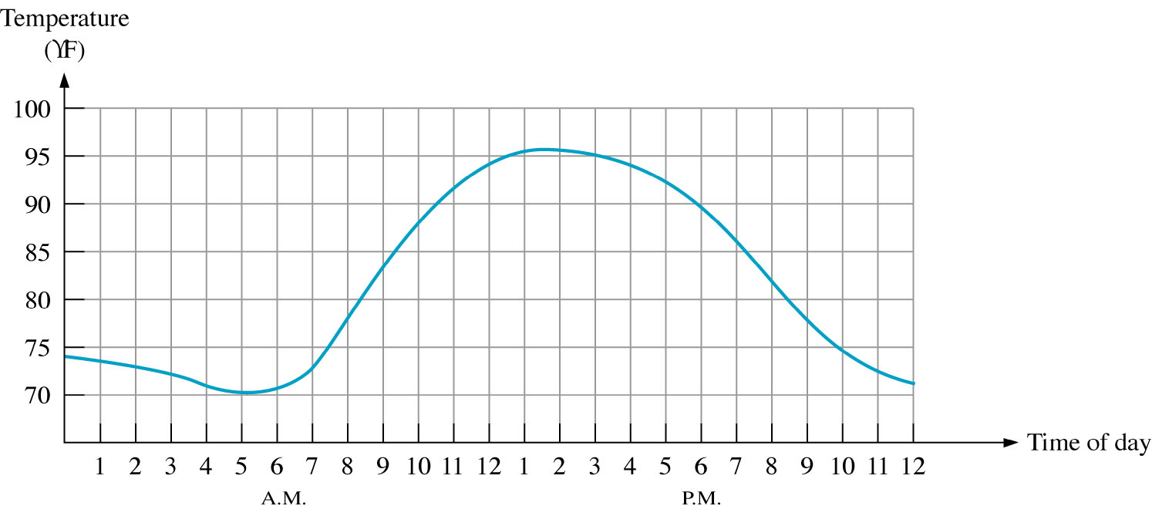
Analog signal
An analog signal has continuous values.
  e.g. sound, voice, video
Most things that can be measured in nature appear in analog;
  e.g. Temperature during a day
*e.g. = exempli gratia = for example

Slide 7
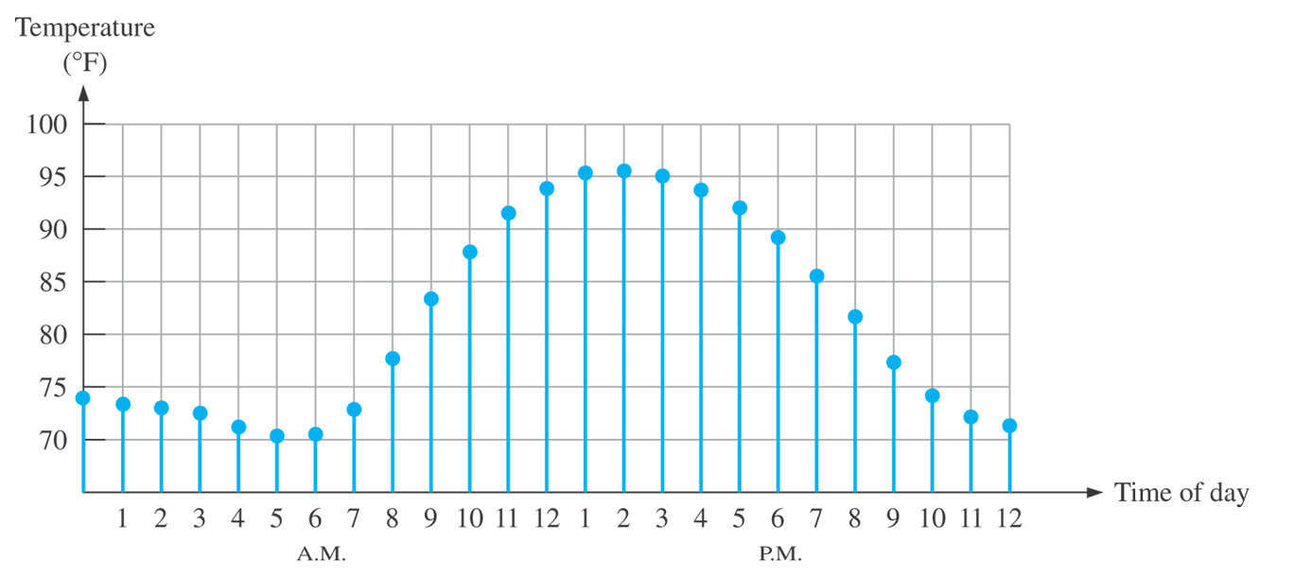
How to convert analog signal into digital signal
1st step: Sampling of an analog signal
  makes a discrete-time signal

Slide 8
How to convert analog signal into digital signal
2nd step: Quantizing sampled data
  Using a limited number of bits to describe the sampled data precision, a quantizing is a must
7.80
7.8
5.27
5.3
2.61
2.6
T
2T
3T
T
2T
3T

Slide 9
Analog to digital conversion
Sampling & Quantization
  Digital representation of an analog data is possible through sampling & quantization
Sampling
Quantizing
3, 4, 8, -4, 2, 0, …

Slide 10
Sampling theorem
The sampling theorem:
  If a data is sampled
    at regular intervals of time
    and at a rate higher than twice the highest data frequency,
  the samples contain all the information of the original data.
Example
  Human hearing: max frequency 20k Hertz
  If sampled more than 40k Hertz, then the sample has all the information.
  CD player: 44.1K Hertz sampling frequency.

Slide 11
Sampling theorem & Quantization Error
Sampling
Quantizing
3, 4, 8, -4, 2, 0, …
If sample frequently enough, a perfect restoration of original analog data from the sequence is possible
Perfect restoration of the original sequence is not possible because of Quantization error
CD: 44.1 kHz, 2 channels at 16 bits per channel or 2×16 bit per sample
(1411.2 k bits/sec)
MP3: 44.1 kHz, 128k bits per second, or 192k b/sec

Slide 12
Digital advantages
Advantages of digital representation
  Data Processing: more efficient
  Data Transmission: more reliable
  Data Storage: more compact
A copy can be exactly the same as the original → Information sharing
Digital, in our everyday life, is synonymous with “Sharing”
This is how life has evolved.

Slide 13
Contents
Definition of Digital
Binary digital systems
Logic gates

Slide 14
Digital Binary System
Two discrete values:
  yes, on, 5 volts, current flowing, “1”
  no, off, 0 volts, no current flowing, “0”
Advantage of binary systems:
  easy to implement
  rigorous mathematical foundation based on logic

Slide 15
Binary Bit and Group Definitions
Bit - a single binary digit
Nibble - a group of four bits
Byte - a group of eight bits
Word - depends on processor; 8, 16, 32, or 64 bits
LSB - Least Significant Bit (on the right)
MSB - Most Significant Bit (on the left)

Slide 16
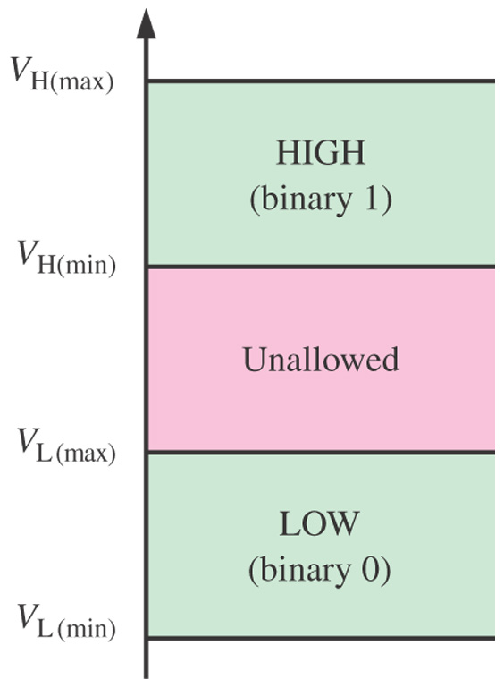
Logic level ranges of voltage
In digital circuits, the voltages used to represent a 1 and a 0 are called logic levels

Slide 17
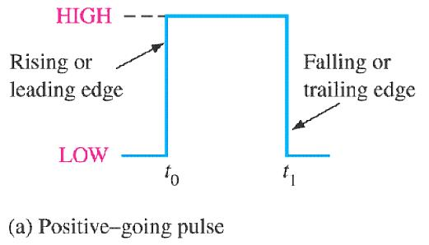
Digital waveform (Ideal)
A digital signal is represented as a “waveform”.

Slide 18
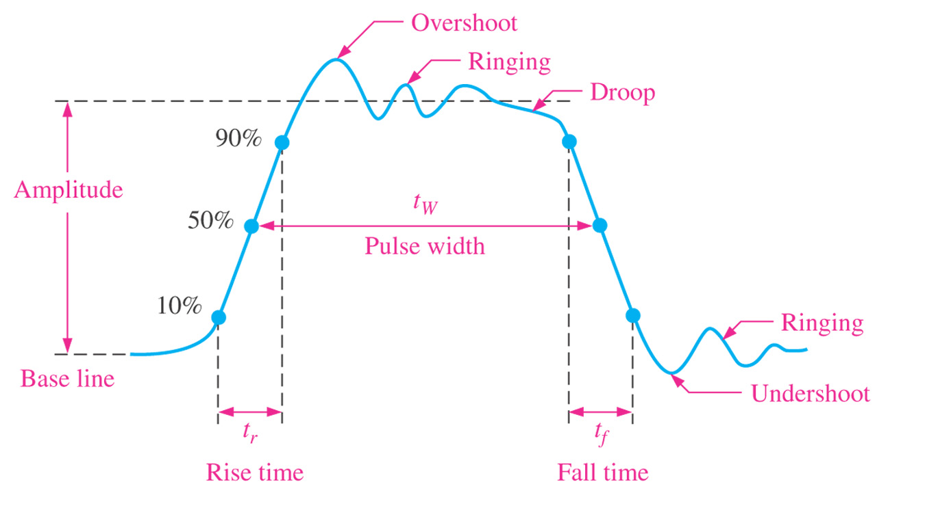
Non-ideal (real) pulse
In reality, all pulses exhibit some or all of the characteristics depicted in this figure.

Slide 19
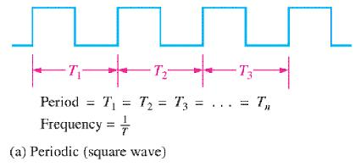
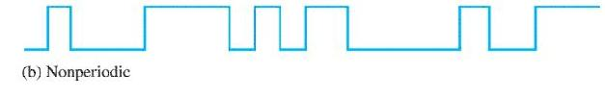
Periodic waveform
Frequency (f) is measured in cycles per second or Hertz (Hz)
Period (T) is measured in seconds
f = 1/T
T = 1/f

Slide 20
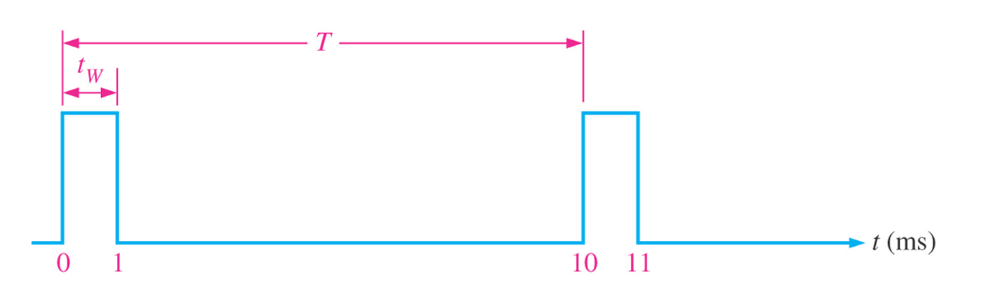
Duty cycle
Duty cycle = (t_{w}/T)100%

Slide 21
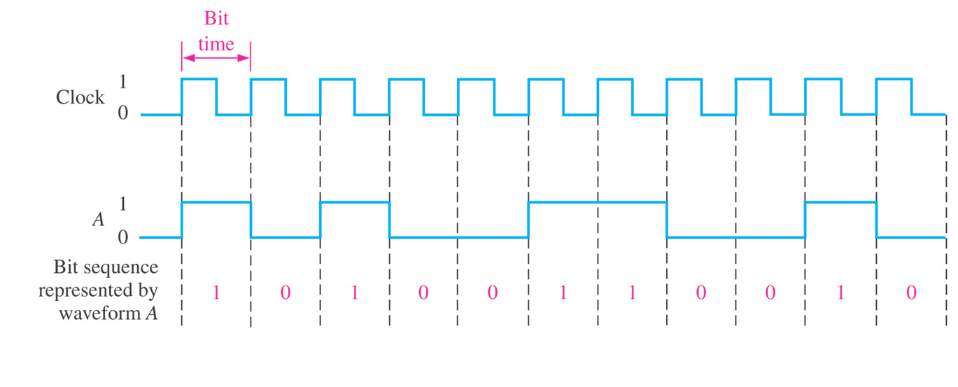
Clock
Used in a synchronous digital circuit.
A clock waveform synchronized with a waveform represents a sequence of bits.
Synchronized means a waveform switches to another logic level only at the rising (or falling) edge of the clock.

Slide 22
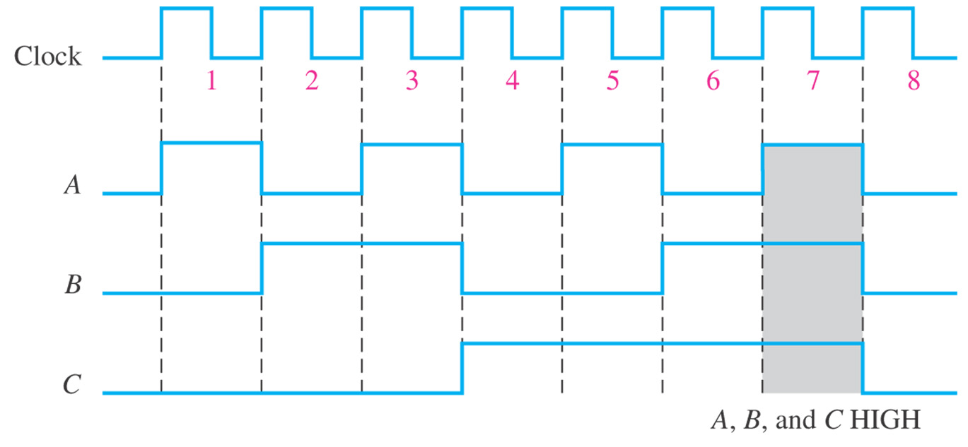
Timing diagram
A timing diagram is a graph of digital waveforms showing the actual relationship of two or more waveforms.

Slide 23
Contents
Definition of Digital
Binary digital systems
Logic gates

Slide 24
Recap: What is the “Digital Design”
Design of digital binary electronics circuits that are within digital hardware in many digital devices, including computer.
What is Digital?
Circuits are often called Logics.
  Why?

Slide 25
Logic
Logic is the reasoning that tells a certain proposition* is true if certain conditions are true.
Digital binary system fits well with logic.
*proposition: 명제, 주장, 진술

Slide 26
참고: 논리학의 기본 용어
명제(proposition): 하나의 진리값을 포함하는 문장이나 정보
  참(T), 거짓(F) 중 하나의 진리값만 갖는 문장
기본명제(primitive proposition, atom, atomic formula): 더 이상 분해할 수 없는 최소단위의 명제: P,Q, R등으로 표시
리터럴(literal) : 기본명제와 그 부정(~)
논리연산자
NOT( ~ ) : 논리부정
AND( ∧ ) : 논리곱
OR(∨ ) : 논리합
IMPLICATION( → ) : 함의, 조건명제
EQUIVALENCE( ↔ ) : 동치

Slide 27
Boolean algebra
In the 1850s, George Boole developed a mathematical system for formulating logic statements with symbols.
Logic problems can be written and solved like an ordinary algebra.

Slide 28
Boolean Constants and Variables
In Boolean algebra, there are only two constants.
  True and False
  1 and 0
Boolean variables are variables that store values that are Boolean constants.

Slide 29
Logic and Computers
The technology inside a digital machine is based on several simple logic operations:
  If … Then
  AND
  OR
  NOT
These logical operations are related to real world equivalents…

Slide 30
If … Then
If X then Y
  X & Y are propositions.
  A proposition can be either TRUE or FLASE.
If (the switch is ON) then (the light is turned on).
If (the input signal is 1) then (the output signal is 1).
Input
Output
The switch, which turns ON when the input signal is 1

Slide 31
AND
X AND Y.
  X & Y are propositions.
  A proposition can be either TRUE or FLASE.
(Today is Tuesday) AND (Today is sunny).

Slide 32
AND in Logic
AND may have many inputs.
AND produces the value TRUE if all the inputs are TRUE.
So, with the inputs: T AND T output is: T
T AND F output is: F
F AND T output is: F
F AND F output is: F
(Just like in the real world.)
TRUE = HIGH = ON = ‘1’

Slide 33

The AND Gate
The gate is a circuit that performs a basic logic operation.
Inputs are on the left, outputs are on the right of a logic symbol.
The AND gate has two or more inputs and a single output.
Output

Slide 34
The AND Gate
An AND gate produces a HIGH output only when all the inputs are HIGH.
A truth table is a convenient way to write down the definition of a logic operation.
Inputs |  | Output
A | B | X
0 | 0 | 0
0 | 1 | 0
1 | 0 | 0
1 | 1 | 1
Truth Table for a 2-input AND gate

Slide 35
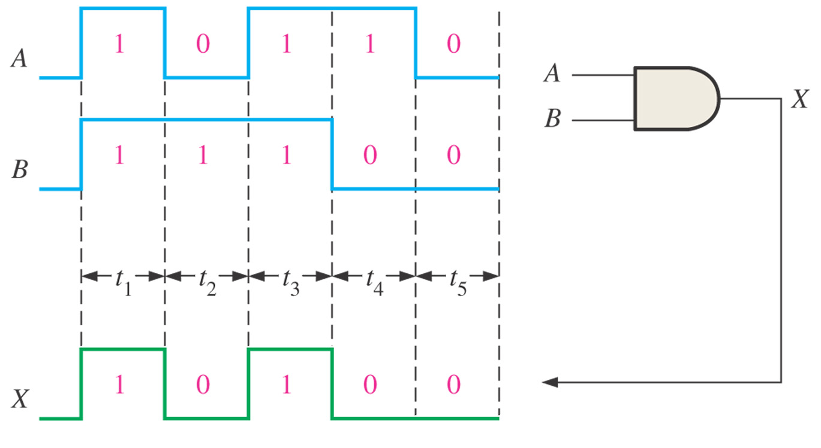
The AND Gate
Example of AND gate operation with a timing diagram showing input and output relationships

Slide 36
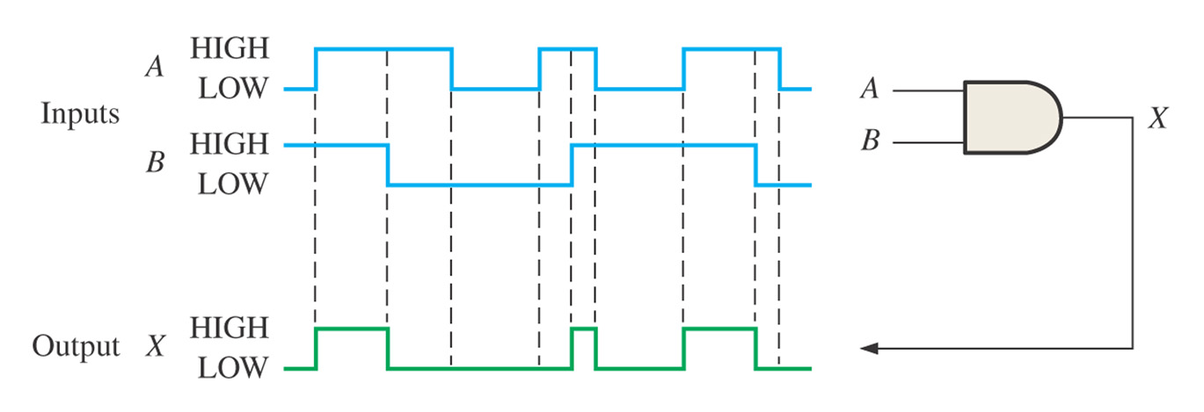
The AND Gate
AND gate operation with a timing diagram when inputs are asynchronous (or with a faster clock).

Slide 37
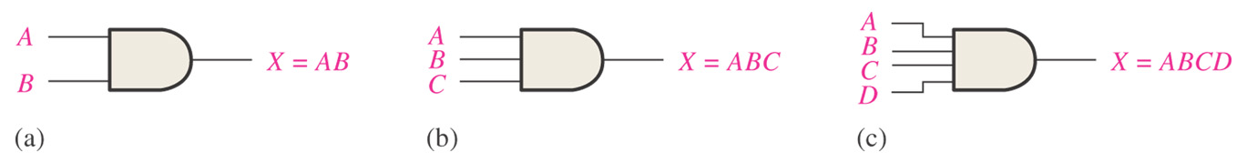
Logic gates and Boolean Algebra
Boolean algebra uses variables and operators to describe a logic circuit.
The logical AND function is equivalent to the multiplication in Boolean algebra.
If the input variable is A, B and the output variable is X, then, for an AND gate,
X = AB or X = A·B

Slide 38
The OR Gate
Input1
Output
Input2
Produces a HIGH on the output when any of the inputs is HIGH.

Slide 39
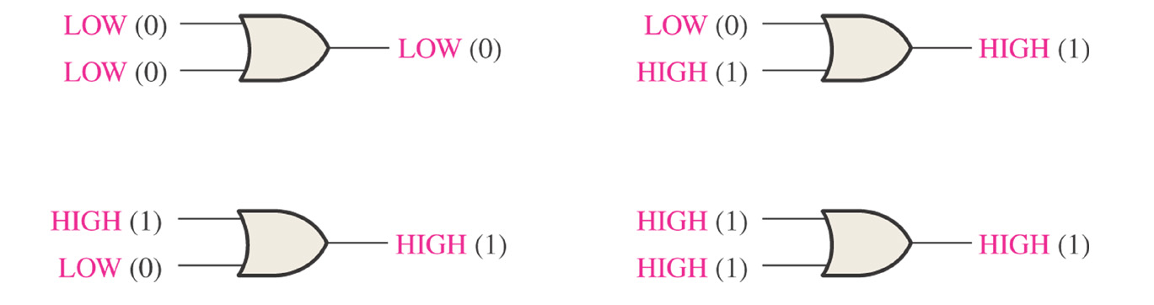
The OR Gate
Inputs |  | Output
A | B | X
0 | 0 | 0
0 | 1 | 1
1 | 0 | 1
1 | 1 | 1
Truth Table for a 2-input OR gate

Slide 40
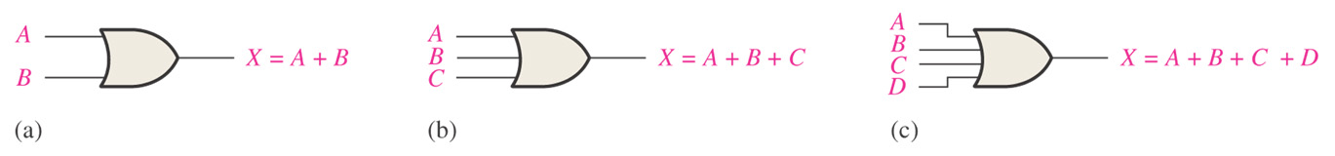
The OR Gate in Boolean algebra
The logical OR function is equivalent to the addition in Boolean algebra.
X = A+B

Slide 41
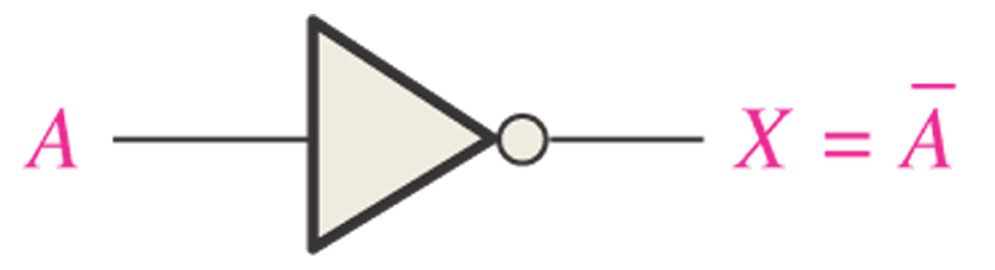
Inverter
In Boolean algebra, for an inverter,
X = A
X = A’
Can be read “Not A”, “A complement”, “A prime”, “A bar”

Slide 42
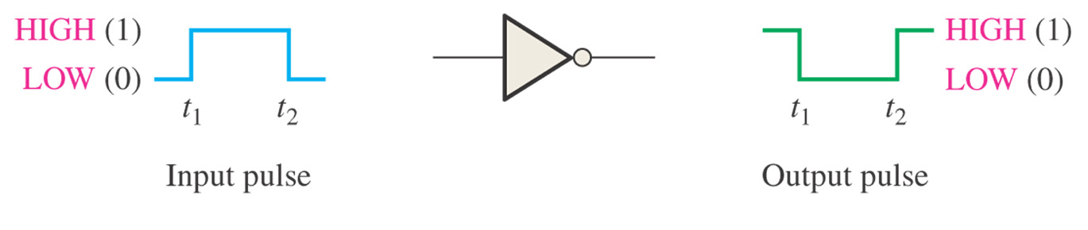
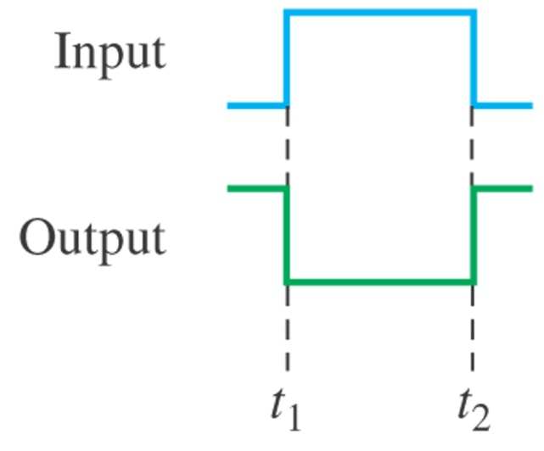
Inverter
Timing Diagram

Slide 43
Questions
What can we build from gates?
  The answer to this question will be addressed throughout the course.
How to make the “switches” in the circuit?
  Let’s focus on this question in the next lecture.

