Slide 1
Optimized Implementation of Logic Functions
Synthesis of logic functions
Analysis of logic circuits
Techniques for deriving minimum-cost implementation of logic functions
Graphical representation of logic functions in the form of Karnaugh maps

Slide 2




4.1 Karnaugh Map
Figure 4.1. The function f (x₁, x₂, x₃) = Σ m(0, 2, 4, 5, 6).

Slide 3
Two-Variable Map
x
1
x
2
x
x
1
0
0
m
2
0
1
0
0
1
m
0
m
m
1
0
2
1
0
m
2
1
m
m
1
1
m
1
3
3
(a) Truth table
(b) Karnaugh map
Figure 4.2. Location of two-variable minterms.

Slide 4
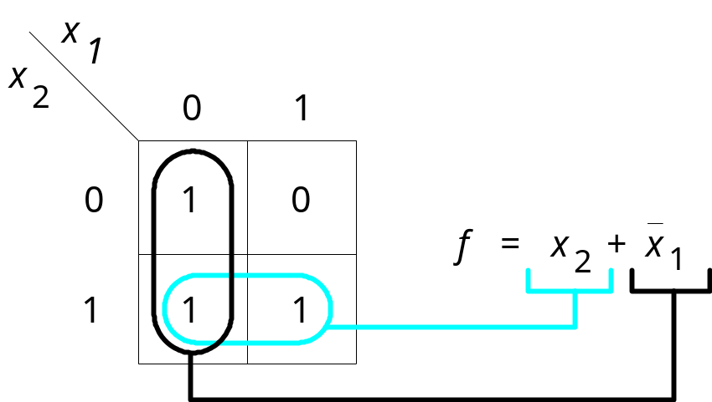
Two-Variable Map
1
Figure 4.3. The function of Figure 2.15.

Slide 5
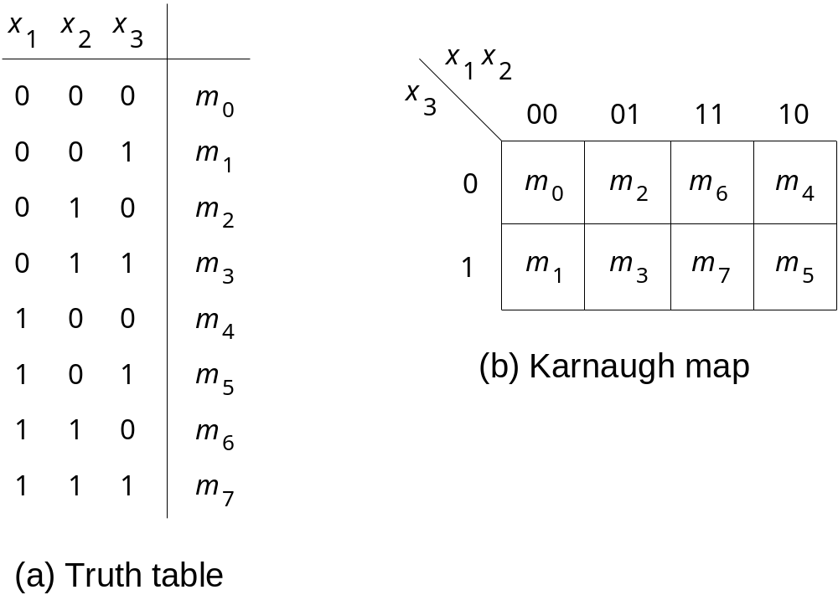
Three-Variables Map
Figure 4.4. Location of three-variable minterms.

Slide 6
x
1
x
2
x
3
00
01
11
10
0
0
0
1
1
f
=
x
1
x
3
+
x
2
x
3
1
1
0
0
1
(a) The function of Figure 2.18
x
1
x
2
x
3
00
01
11
10
0
1
1
1
1
f
=
x
3
+
x
1
x
2
1
0
0
0
1
(b) The function of Figure 4.1
Figure 4.5. Examples of three-variable Karnaugh maps.

Slide 7
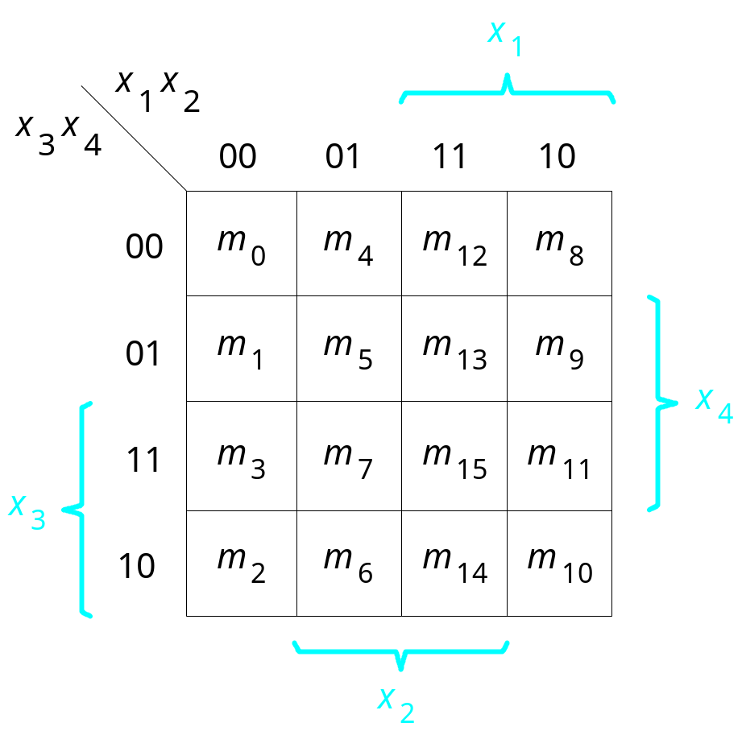
Four-Variables Map
Figure 4.6. A four-variable Karnaugh map.

Slide 8
x
1
x
2
x
1
x
2
x
3
x
4
00
01
11
10
x
3
x
4
00
01
11
10
00
0
0
0
0
00
0
0
0
0
01
0
0
1
1
01
0
0
1
1
11
1
0
0
1
11
1
1
1
1
10
1
0
0
1
10
1
1
1
1
f
1
=
x
2
x
3
+
x
1
x
3
x
4
f
2
=
x
3
+
x
1
x
4
x
1
x
2
x
1
x
2
x
3
x
4
00
01
11
10
x
3
x
4
00
01
11
10
00
1
0
0
1
00
1
1
1
0
01
0
0
0
0
01
1
1
1
0
11
1
1
1
0
11
0
0
1
1
10
1
1
0
1
10
0
0
1
1
x
1
x
2
f
3
=
x
2
x
4
+
x
1
x
3
+
x
2
x
3
x
4
f
4
=
x
1
x
3
+
x
1
x
3
+
or
x
2
x
3
Figure 4.7. Examples of four-variable Karnaugh maps.

Slide 9
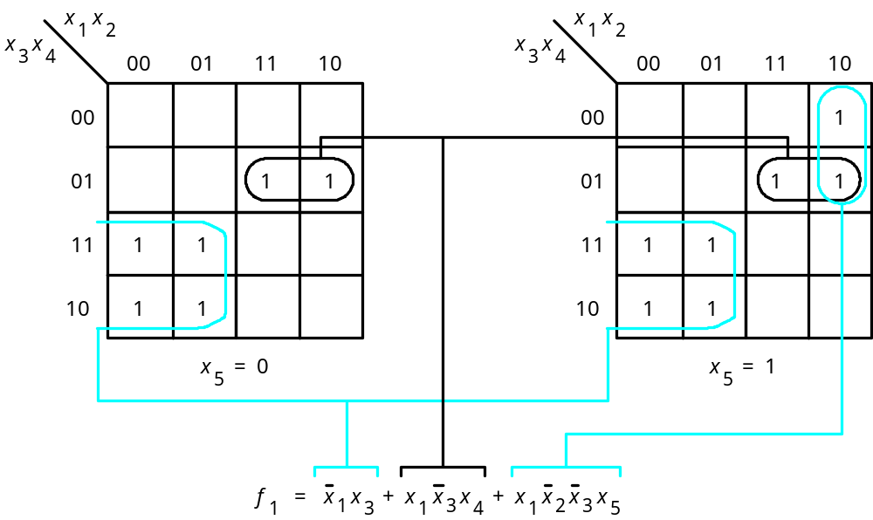
Five-Variables Map
Figure 4.8. A five-variable Karnaugh map.

Slide 10
Strategy for Minimization
Terminology
  Literal: Each appearance of a variables is called a literal
  Implicant: A product term that indicates the input valuation(s) for which a given function is equal to 1 is called an implicant of the function
  Prime implicant: An implicant is called a prime implicant if it cannot be combined into another implicant that has fewer literals
  Cover: A collection of implicants that accounts for all variations for which a given function is equal to 1 is called a cover for that function
  Cost: The number of gates + the total number of input to all gates

Slide 11
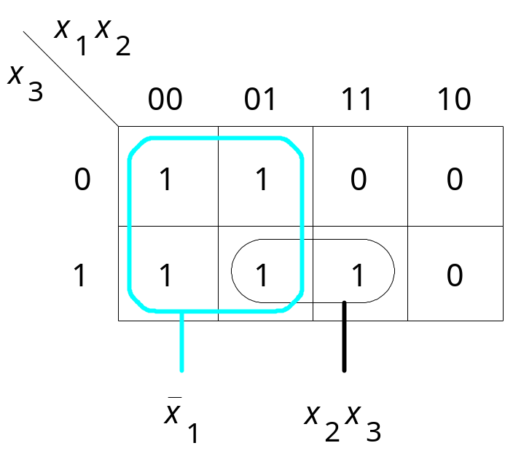
Figure 4.9. Three-variable function f (x₁, x₂, x₃) = Σ m(0, 1, 2, 3, 7).

Slide 12
Minimization Procedure
Generate all prime implicants for the given function f
Find the set of essential prime implicants
If the set of essential prime implicants covers all valuations for f = 1, then this set is the desired cover of f.

Slide 13
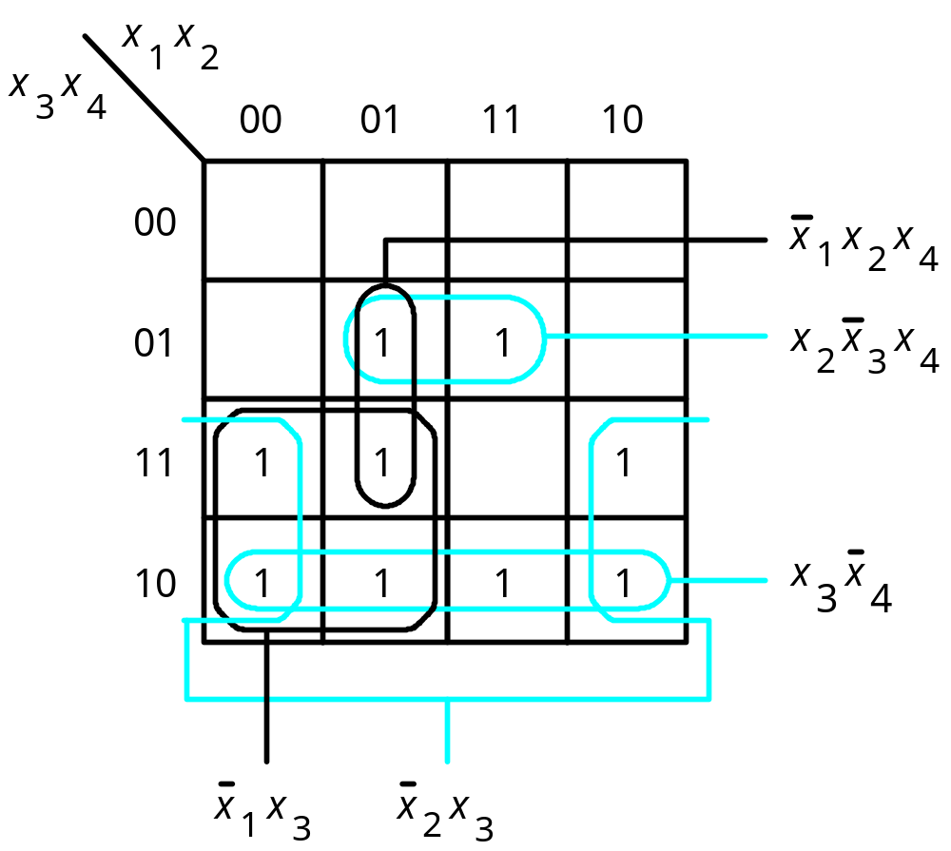
Figure 4.10. Four-variable function f ( x₁,…, x₄) =
Σ m(2, 3, 5, 6, 7, 10, 11, 13, 14).

Slide 14
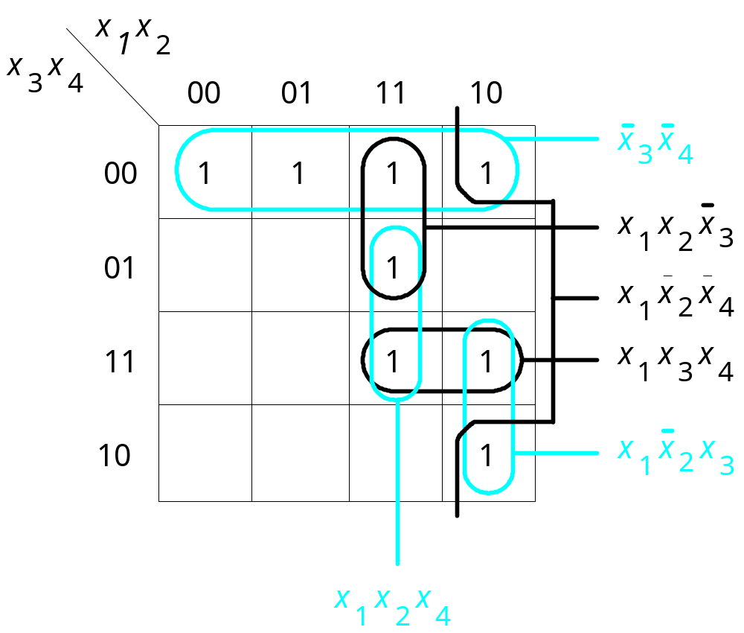
Figure 4.11. The function f ( x₁,…, x₄) =
Σ m(0, 4, 8, 10, 11, 12, 13, 15).

Slide 15
x
1
x
2
x
3
x
4
00
01
11
10
00
1
1
x
1
x
3
x
4
01
1
1
x
2
x
3
x
4
11
1
1
x
1
x
3
x
4
10
1
1
x
2
x
3
x
4
x
1
x
2
x
4
x
1
x
2
x
4
x
1
x
2
x
3
x
1
x
2
x
3
Figure 4.12. The function f ( x₁,…, x₄) =
Σ m(0, 2, 4, 5, 10, 11, 13, 15).

Slide 16
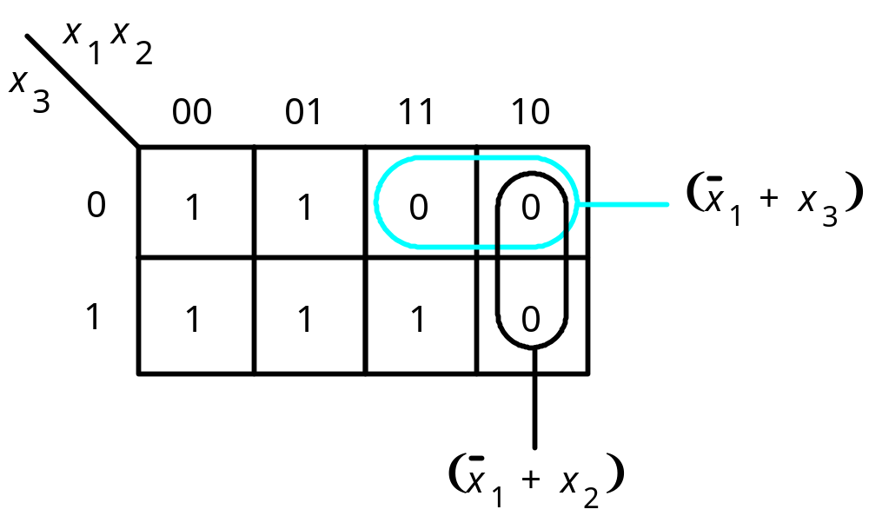
Figure 4.13. POS minimization of f (x₁, x₂, x₃) = Π M(4, 5, 6).

Slide 17
x
x
x
x
1
2
3
4
00
01
11
10
(
)
00
0
0
0
0
x
+
x
3
4
01
0
1
1
0
(
)
x
+
x
2
3
11
1
1
0
1
10
1
1
1
1
(
)
x
+
x
+
x
+
x
1
2
3
4
Figure 4.14. POS minimization of f ( x₁,…, x₄) =Π M(0, 1, 4, 8, 9, 12, 15).

Slide 18
x
x
x
1
x
2
x
x
1
2
x
x
3
4
00
01
11
10
3
4
00
01
11
10
(
)
x
2
+
x
3
00
0
1
d
0
00
0
1
d
0
x
2
x
3
01
0
1
d
0
01
0
1
d
0
(
)
11
0
0
d
0
11
0
0
d
0
x
3
+
x
4
10
1
1
d
1
x
3
x
4
10
1
1
d
1
(a) SOP implementation
(b) POS implementation
Figure 4.15. Two implementations of the function f ( x₁,…, x₄) =
Σ m(2, 4, 5, 6, 10) + D(12, 13, 14, 15).

Slide 19
x
1
x
2
x
3
x
4
00
01
11
10
00
1
1
x
2
01
1
1
1
x
3
11
1
1
x
4
f
1
10
1
1
x
1
x
3
x
(a) Function
f
1
x
2
1
x
3
x
4
00
01
11
10
x
1
x
3
00
1
1
f
x
2
2
01
1
1
x
3
11
1
1
1
x
4
10
1
1
(c) Combined circuit for
f
1
and
f
2
(b) Function
f
2
Figure 4.16. An example of multiple-output synthesis.

Slide 20
x
1
x
2
x
1
x
2
x
3
x
4
00
01
11
10
x
3
x
4
00
01
11
10
00
00
x
1
01
1
1
1
01
1
1
1
x
4
11
1
1
1
11
1
1
1
x
1
f
3
10
1
10
1
x
2
x
4
(a) Optimal realization of
f
3
(b) Optimal realization of
f
4
x
1
x
1
x
2
x
1
x
2
x
2
x
3
x
4
00
01
11
10
x
3
x
4
00
01
11
10
x
3
00
00
x
4
f
4
01
1
1
1
01
1
1
1
x
2
11
1
1
1
11
1
1
1
x
4
10
1
10
1
(d) Combined circuit for
f
3
and
f
4
(c) Optimal realization of
f
3
and
f
4
together
Figure 4.17. An example of multiple-output synthesis.

Slide 21
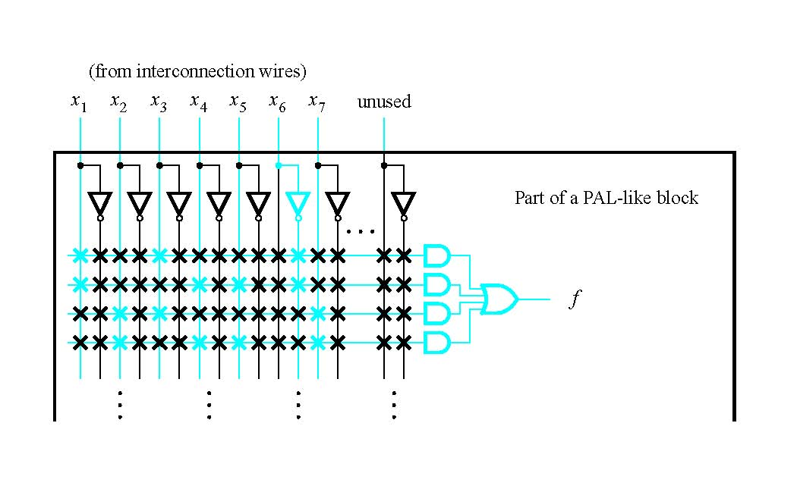
Figure 4.18. Implementation in a CPLD.

Slide 22
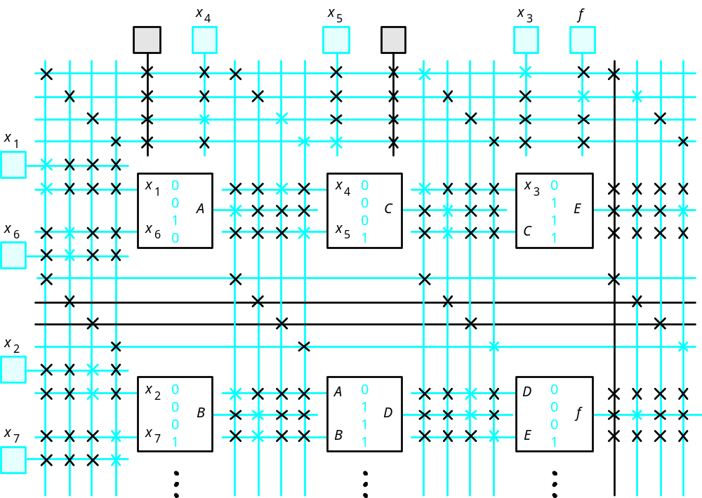
Figure 4.19. Implementation in an FPGA.

Slide 23

Factoring
2 3-input ANDs, 2 2input ANDs, 3 2-input ORs
4 2-input ANDs, 2 2-input ORs
7 inputs
Figure 4.20. Using four-input AND gates to realize a seven-input product term.

Slide 24

x
1
x
x
2
4
x
x
3
6
x
5
x
2
x
3
x
5
Figure 4.21. A factored circuit.

Slide 25
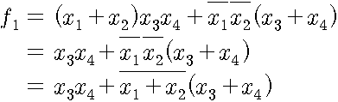

Example 4.5
For four input system, x1,x2,x3 and x3
f1 = 1 if at least one of x1 and x2 =1,
both x3 and x4 =1;
f1= 1 if x1=x2=0 and either x3 or x4=1
f2 = 1 in all cases except when both x1 and x2 = 0 or when both x3 and x4 = 0
Figure 4.22. Circuit for Example 4.5.

Slide 26
Example 4.5
x
1
x
2
f
1
x
f
3
2
x
4
Figure 4.22. Circuit for Example 4.5.

Slide 27

Functional Decomposition
Example 4.6
  Minimum cost SOP expression
    4 ANDs, 1 OR, 2 NOT gates

Slide 28

x
1
x
3
g
f
x
2
x
4
Figure 4.23. Logic circuit for Example 4.6.

Slide 29
x
1
x
3
g
f
x
2
x
4
x
1
x
g
2
x
h
f
3
x
4
Figure 4.24. The structure of decomposition in Example 4.6.

Slide 30



Example 4.7
x
1
x
2
x
1
x
2
x
3
x
4
x
3
x
4
00
01
11
10
00
01
11
10
00
1
00
01
1
1
1
01
1
1
1
1
11
1
11
10
1
1
1
10
1
1
1
1
x
5
=
0
x
5
=
1
(a) Karnaugh map for the function
f
Figure 4.25. Decomposition for Example 4.7.

Slide 31
Example 4.7
x
1
g
x
2
x
5
x
3
f
k
x
4
(b) Circuit obtained using decomposition
Figure 4.25. Decomposition for Example 4.7.

Slide 32
x
1
x
1
⊕
x
2
x
2
(a) Sum-of-products implementation
x
1
x
1
⊕
x
2
x
2
(b) NAND gate implementation
Figure 4.26. Implementation of XOR.

Slide 33
x
1
g
x
⊕
1
x
2
x
2
(c) Optimal NAND gate implementation
Figure 4.26. Implementation of XOR.

Slide 34
x
1
x
2
x
3
x
f
4
x
5
x
6
x
7
(a) Circuit with AND and OR gates
x
1
x
2
x
3
x
f
4
x
5
x
6
x
7
(b) Inversions needed to convert to NANDs
Figure 4.27. Conversion to a NAND-gate circuit.

Slide 35
x
1
x
2
x
3
x
f
4
x
5
x
6
x
7
(c) NAND-gate circuit
Figure 4.27. Conversion to a NAND-gate circuit.

Slide 36
x
1
x
2
x
3
x
f
4
x
5
x
6
x
7
(a) Inversions needed to convert to NORs
Figure 4.28. Conversion to a NOR-gate circuit.

Slide 37
x
1
x
2
x
3
f
x
4
x
5
x
6
x
7
(b) NOR-gate circuit
Figure 4.28. Conversion to a NOR-gate circuit.

Slide 38
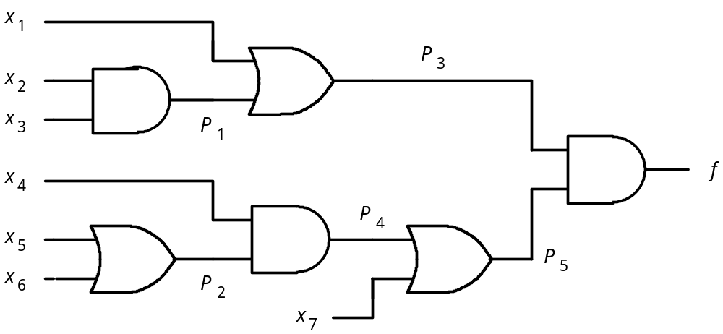
Figure 4.29. Circuit for Example 4.10.

