Slide 1
Number Representation and Arithmetic Circuits
Representation of numbers in computers
Circuits used to perform arithmetic operations
Performance issues in large circuit

Slide 2

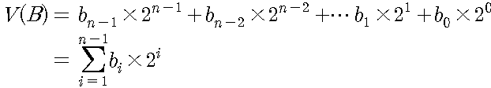


5.1 Number Representation in Digital System
Unsigned integers
Octal and Hexadecimal Representation

Slide 3
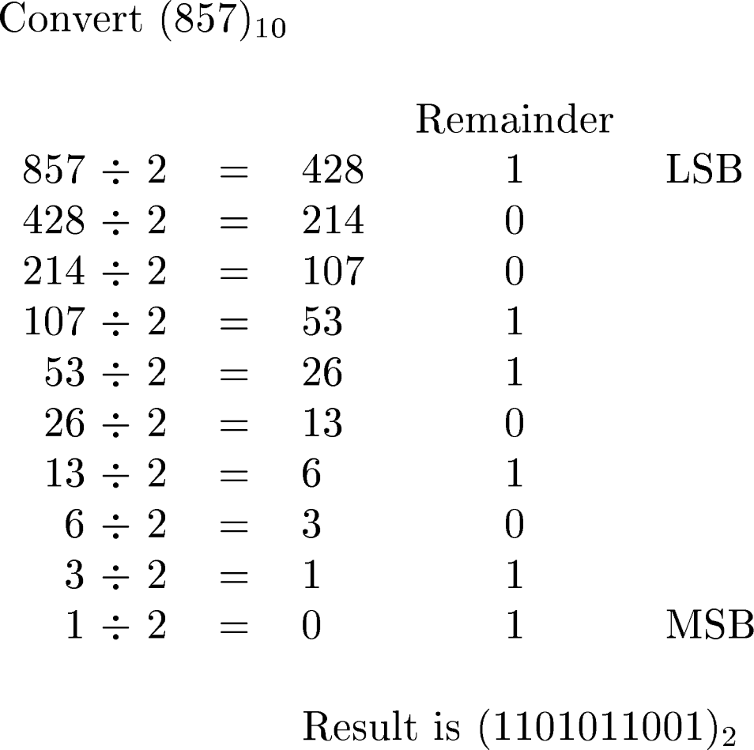
Conversion from decimal to binary
Figure 5.1. Conversion from decimal to binary.

Slide 4
Table 5.1. Numbers in different systems.

Slide 5
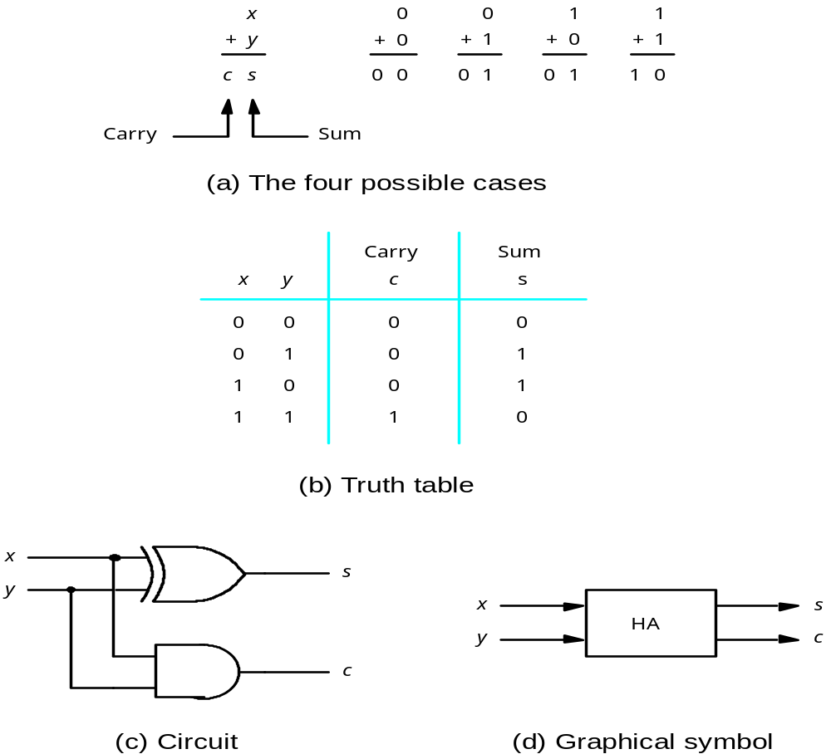
5.2 Addition of Unsigned Numbers
Figure 5.2. Half-adder.

Slide 6
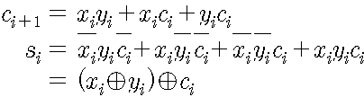
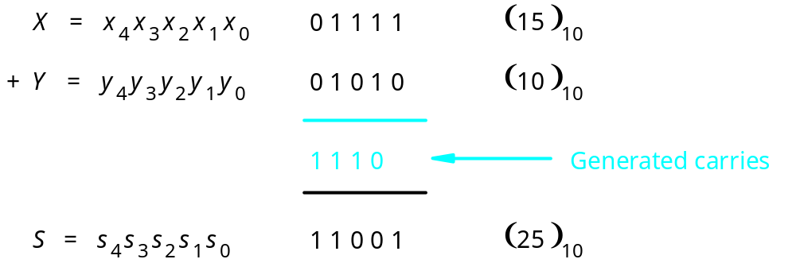
An example of addition
Figure 5.3. An example of addition.

Slide 7
x
y
c
i
i
i
00
01
11
10
c
x
y
c
s
0
1
1
i
i
i
i
+
1
i
1
1
1
0
0
0
0
0
0
0
1
0
1
s
=
x
⊕
y
⊕
c
0
1
0
0
1
i
i
i
i
0
1
1
1
0
x
y
1
0
0
0
1
c
i
i
1
0
1
1
0
i
00
01
11
10
1
1
0
1
0
0
1
1
1
1
1
1
1
1
1
1
(a) Truth table
c
=
x
y
+
x
c
+
y
c
i
+
1
i
i
i
i
i
i
(b) Karnaugh maps
x
i
y
s
i
i
c
i
c
i
+
1
Figure 5.4. Full-adder.
(c) Circuit

Slide 8
c
s
s
i
s
HA
c
i
x
i
HA
c
c
y
i
+
1
i
(a) Block diagram
c
i
s
i
x
i
y
i
c
i
+
1
(b) Detailed diagram
Figure 5.5. A decomposed implementation of the full-adder circuit.

Slide 9
Ripple Carry Adder
x
y
x
y
x
y
n –
1
n
–
1
1
1
0
0
c
c
c
c
1
c
n
FA
n
”
1
2
FA
FA
0
s
s
s
n
–
1
1
0
MSB position
LSB position
Figure 5.6. An n-bit ripple-carry adder.

Slide 10
Design Example
A
:
a
7
a
0
x
7
x
0
y
7
y
0
c
7
s
7
s
0
0
x
8
x
7
x
0
y
8
y
7
y
0
c
8
s
8
s
0
P
=
3
A
:
P
9
P
8
P
0
(a) Naive approach
Figure 5.7. Circuit that multiplies an eight-bit unsigned number by 3.

Slide 11
Design Example
A
:
a
7
a
0
0
0
x
8
x
1
x
0
y
8
y
7
y
0
c
8
s
8
s
0
P
=
3
A
:
P
9
P
8
P
0
(b) Efficient design
Figure 5.7. Circuit that multiplies an eight-bit unsigned number by 3.

Slide 12
5.3 Signed Numbers
b
n
–
1
b
1
b
0
Magnitude
MSB
(a) Unsigned number
b
n
–
1
b
n
–
2
b
1
b
0
Sign
Magnitude
0 denotes
+
1 denotes
–
MSB
(b) Signed number
Figure 5.8. Formats for representation of integers.

Slide 13
-
-
-
-
-
-
-
-
-
-
-
-
-
-
-
-
-
-
-
-
-
-
-
-
Table 5.2. Interpretation of four-bit signed integers.

Slide 14
(
+
5
)
0 1 0 1
(
–
5
)
1 0 1 0
+
(
+
2
)
+
0 0 1 0
+
(
+
2
)
+
0 0 1 0
(
+
7
)
0 1 1 1
(
-
3
)
1 1 0 0
(
+
5
)
0 1 0 1
(
–
5
)
1 0 1 0
+
(
–
2
)
+
1 1 0 1
+
(
–
2
)
+
1 1 0 1
(
+
3
)
1
0 0 1 0
(
–
7
)
1
0 1 1 1
1
1
0 0 1 1
1 0 0 0
Figure 5.9. Examples of 1’s complement addition.

Slide 15
(
+
5
)
0 1 0 1
(
–
5
)
1 0 1 1
+
(
+
2
)
+
0 0 1 0
+
(
+
2
)
+
0 0 1 0
(
+
7
)
0 1 1 1
(
–
3
)
1 1 0 1
(
+
5
)
0 1 0 1
(
–
5
)
1 0 1 1
+
(
–
2
)
+
1 1 1 0
+
(
–
2
)
+
1 1 1 0
(
+
3
)
1
0 0 1 1
(
–
7
)
1
1 0 0 1
ignore
ignore
Figure 5.10. Examples of 2’s complement addition.

Slide 16
(
+
5
)
0 1 0 1
0 1 0 1
–
(
+
2
)
–
0 0 1 0
+
1 1 1 0
(
+
3
)
1
0 0 1 1
ignore
(
)
1 0 1 1
1 0 1 1
–
5
–
(
+
2
)
–
0 0 1 0
+
1 1 1 0
(
)
1
1 0 0 1
–
7
ignore
(
+
5
)
0 1 0 1
0 1 0 1
–
(
)
–
+
–
2
1 1 1 0
0 0 1 0
(
+
7
)
0 1 1 1
(
)
1 0 1 1
1 0 1 1
–
5
–
(
)
–
+
–
2
1 1 1 0
0 0 1 0
(
)
1 1 0 1
–
3
Figure 5.11. Examples of 2’s complement subtraction.

Slide 17
0000
1111
0001
1110
0
0010
–
1
+
1
1101
–
2
+
2
0011
–
3
+
3
1100
–
4
+
4
0100
–
5
+
5
1011
0101
–
6
+
6
–
7
–
8
+
7
1010
0110
1001
0111
1000
Figure 5.12. Graphical interpretation of four-bit 2’s complement numbers.

Slide 18
y
y
y
n
–
1
1
0
Add
⁄
Sub
control
x
x
x
n
–
1
1
0
c
n
c
n
-bit adder
0
s
s
s
n
–
1
1
0
Figure 5.13. Adder/subtractor unit.

Slide 19

Arithmetic Overflow
Overflow =
(
+
7
)
0 1 1 1
(
–
7
)
1 0 0 1
+
(
+
2
)
+
0 0 1 0
+
(
+
2
)
+
0 0 1 0
(
+
9
)
1 0 0 1
(
–
5
)
1 0 1 1
c
4
=
0
c
4
=
0
c
3
=
1
c
3
=
0
(
+
7
)
0 1 1 1
(
–
7
)
1 0 0 1
+
(
–
2
)
+
1 1 1 0
+
(
–
2
)
+
1 1 1 0
(
+
5
)
1
0 1 0 1
(
–
9
)
1
0 1 1 1
c
4
=
1
c
4
=
1
c
3
=
1
c
3
=
0
Figure 5.14. Examples of determination of overflow.

Slide 20
x
y
x
y
1
1
0
0
g
p
g
p
1
1
0
0
c
1
c
2
c
0
Stage 1
Stage 0
s
s
1
0
Figure 5.15. A ripple-carry adder based on expression 5.3.

Slide 21
x
1
y
x
y
1
0
0
x
0
y
0
g
p
g
p
1
1
0
0
c
0
c
2
c
1
s
s
1
0
Figure 5.16. The first two stages of a carry-lookahead adder.

Slide 22
x
31
–
24
y
31
–
24
x
15
–
8
y
15
–
8
x
7
–
0
y
7
–
0
c
8
c
Block
c
c
Block
Block
c
32
3
24
16
1
0
0
s
31
–
24
s
15
–
8
s
7
–
0
Figure 5.17. A hierarchical carry-lookahead adder with ripple-carry between blocks

Slide 23
x
31
–
24
y
31
–
24
x
15
–
8
y
15
–
8
x
y
7
–
0
7
–
0
Block
Block
Block
c
3
c
1
0
0
24
G
3
P
3
G
1
P
1
G
0
P
0
s
s
s
31
–
24
15
–
8
7
–
0
c
32
c
c
16
8
Second-level lookahead
Figure 5.18. A hierarchical carry-lookahead adder.

Slide 24
x
1
y
1
x
y
0
0
g
p
g
p
1
1
0
0
c
0
c
2
c
1
s
s
1
0
Figure 5.19. An alternative design for a carry-lookahead adder.

Slide 25
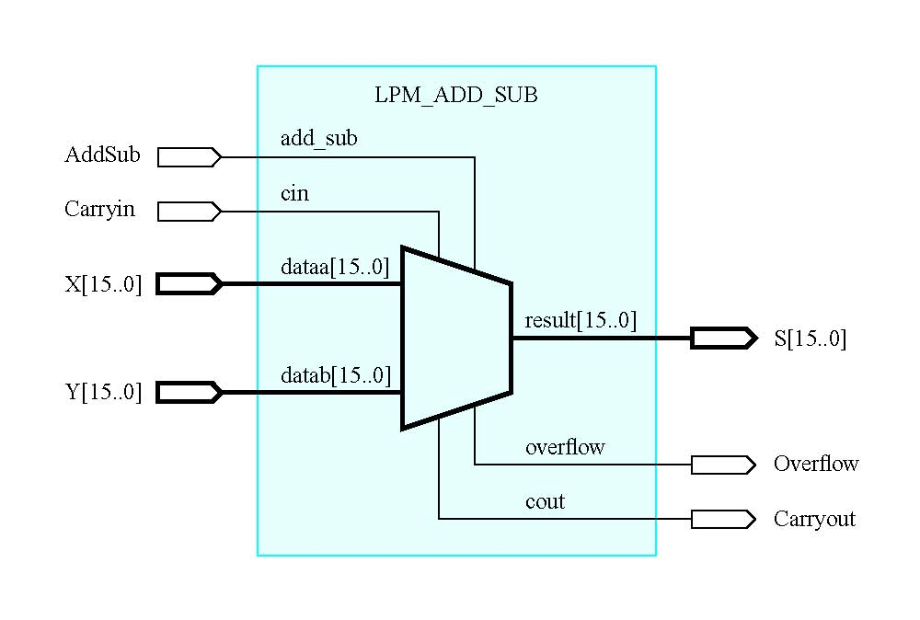
Figure 5.20. Schematic using an LPM adder/subtractor module.

Slide 26
Multiplication
Multiplicand M
(14)
1 1 1 0
x
Multiplier Q
(11)
×
1 0 1 1
1 1 1 0
1 1 1 0
0 0 0 0
1 1 1 0
Product P
(154)
1 0 0 1 1 0 1 0
(a) Multiplication by hand
Multiplicand M
(11)
1 1 1 0
x
Multiplier Q
(14)
×
1 0 1 1
Partial product 0
1 1 1 0
+
1 1 1 0
Partial product 1
1 0 1 0 1
+
0 0 0 0
Partial product 2
0 1 0 1 0
+
1 1 1 0
Product P
(154)
1 0 0 1 1 0 1 0
(b) Multiplication for implementation in hardware
Figure 5.31. Multiplication of unsigned numbers.

Slide 27
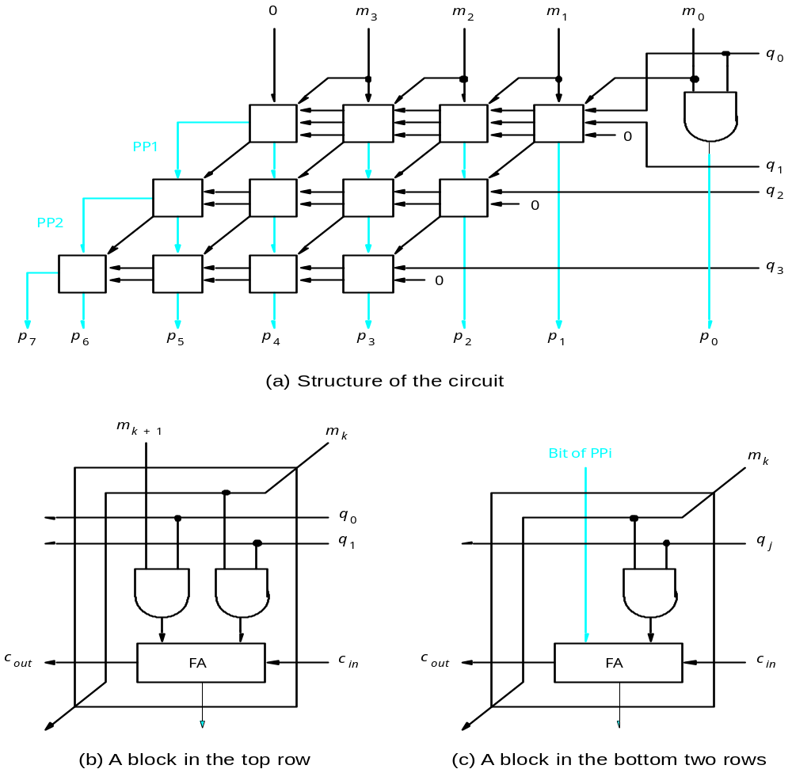
Figure 5.32. A 4 x 4 multiplier circuit.

Slide 28
Multiplicand M
(+14)
0 1 1 1 0
Multiplier Q
(+11)
x
0 1 0 1 1
Partial product 0
0 0
0 1 1 1 0
+
0
0 1 1 1 0
Partial product 1
0
0 1 0 1 0 1
+
0
0 0 0 0 0
Partial product 2
0
0 0 1 0 1 0
+
0
0 1 1 1 0
Partial product 3
0
0 1 0 0 1 1
+
0
0 0 0 0 0
Product P
(+154)
0 0 1 0 0 1 1 0 1 0
(a) Positive multiplicand
Multiplicand M
( 14)
–
1 0 0 1 0
Multiplier Q
(+11)
×
0 1 0 1 1
Partial product 0
1 1
1 0 0 1 0
+
1
1 0 0 1 0
Partial product 1
1
1 0 1 0 1 1
+
0
0 0 0 0 0
Partial product 2
1
1 1 0 1 0 1
+
1
1 0 0 1 0
Partial product 3
1
1 0 1 1 0 0
+
0
0 0 0 0 0
Product P
–
( 154)
1 1 0 1 1 0 0 1 1 0
(b) Negative multiplicand
Figure 5.33. Multiplication of signal numbers.

Slide 29
32 bits
S
E
M
Sign
0 denotes
+
8-bit
23 bits of mantissa
1 denotes
–
excess-127
exponent
(a) Single precision
64 bits
S
E
M
Sign
11-bit excess-1023
52 bits of mantissa
exponent
(c) Double precision
Figure 5.34. IEEE Standard floating-point formats.

Slide 30


Table 5.3. Binary-coded decimal digits.

Slide 31
X
0 1 1 1
7
+
Y
+
0 1 0 1
+
5
Z
1 1 0 0
12
+
0 1 1 0
carry
1 0 0 1 0
S = 2
X
1 0 0 0
8
+
Y
+
1 0 0 1
+
9
Z
1 0 0 0 1
17
+
0 1 1 0
carry
1 0 1 1 1
S = 7
Figure 5.35. Addition of BCD digits.

Slide 32
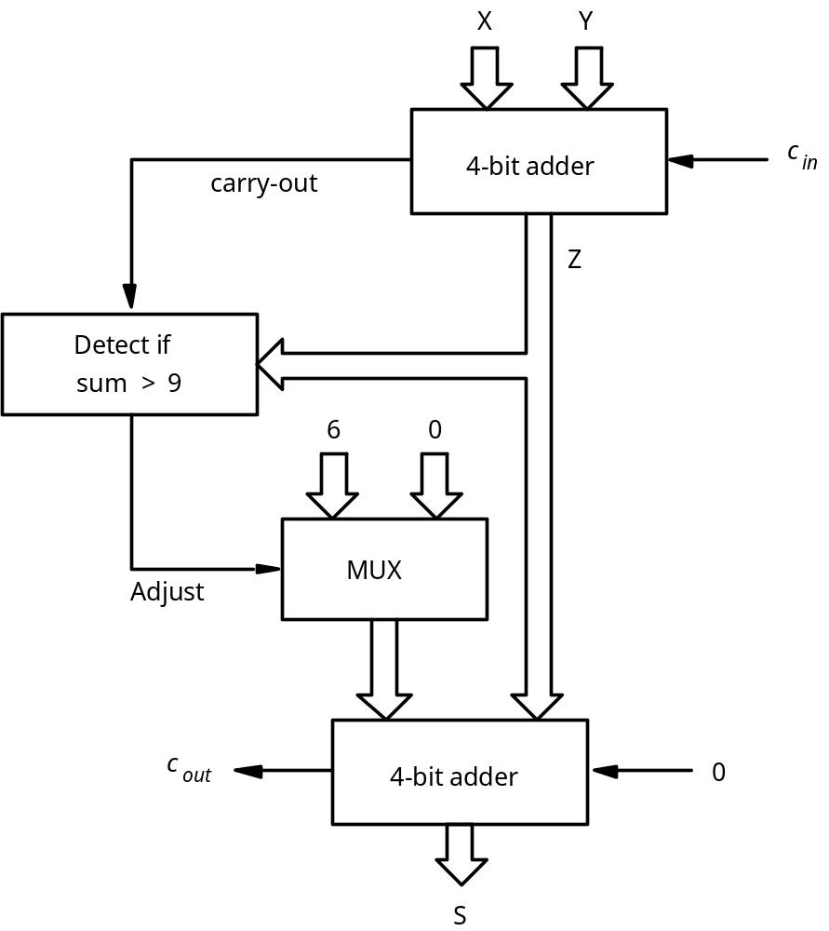
Figure 5.36. Block diagram for a one-digit BCD adder.

Slide 33
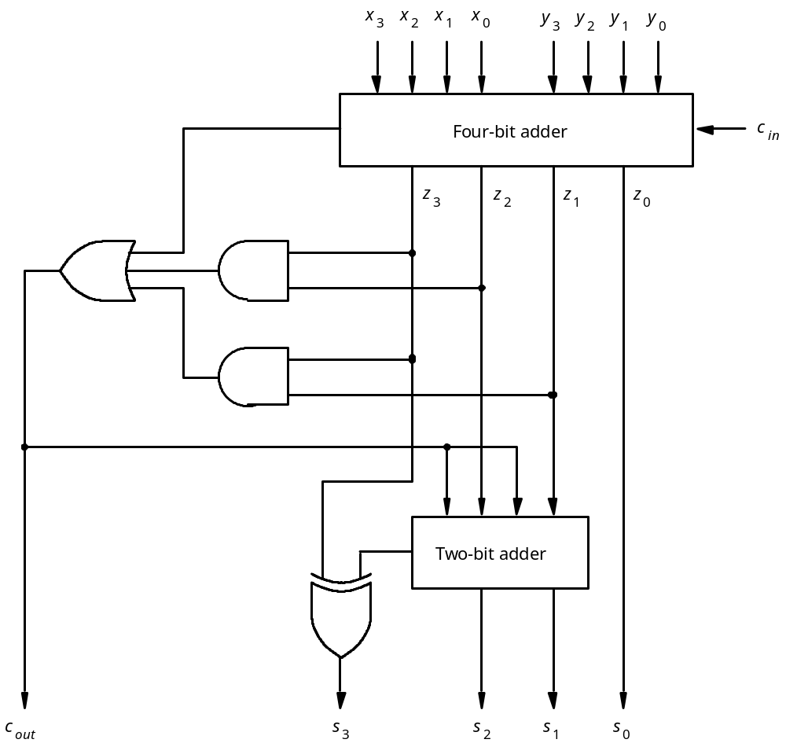
Figure 5.39. Circuit for a one-digit BCD adder.

Slide 34
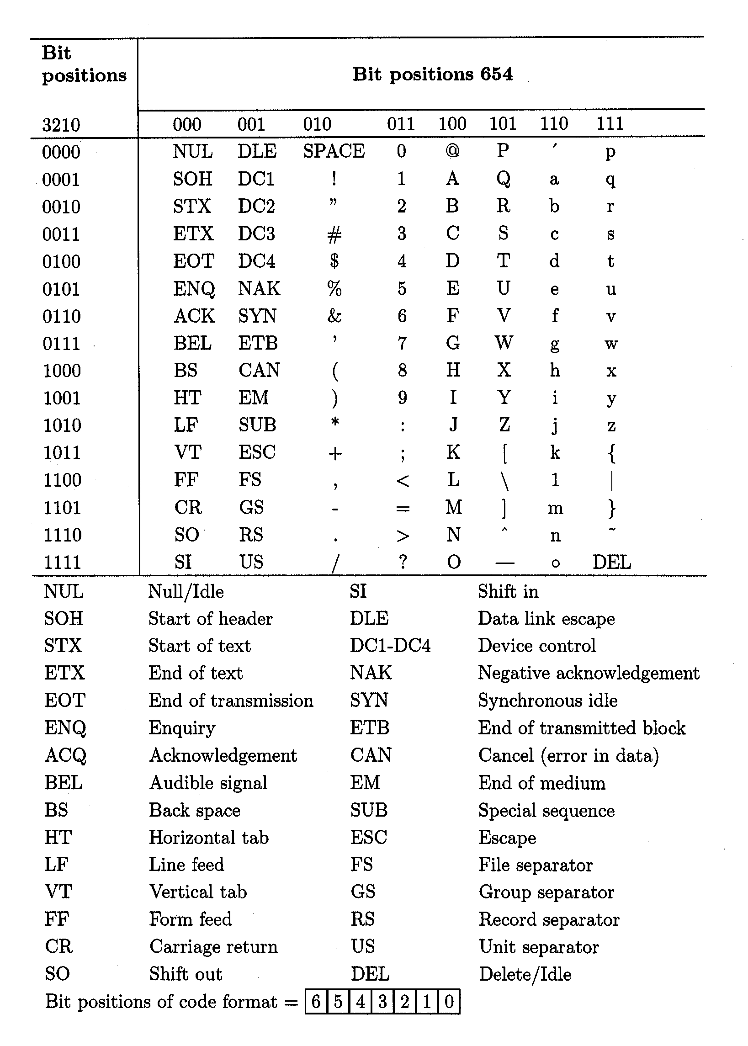
Table 5.4. The seven-bit ASCII code.

Slide 35
Convert (14959)₁₀
Remainder Hex digit
14959 ÷ 16 = 934 15 F LSB
934 ÷ 16 = 58 6 6
58 ÷ 16 = 3 10 A
3 ÷ 16 = 0 3 3 MSB
Result is (3A6F)₁₆
Figure 5.40. Conversion from decimal to hexadecimal.

Slide 36
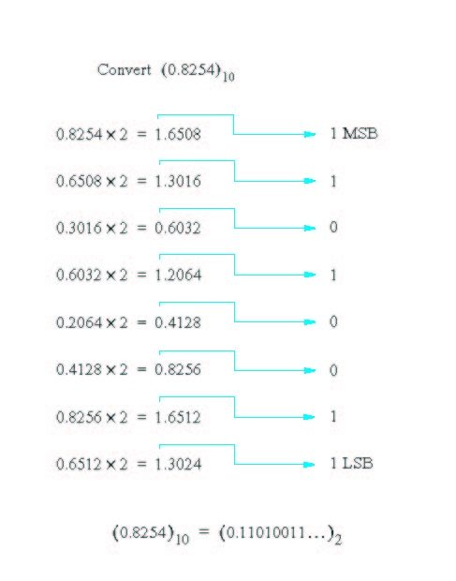
Figure 5.41. Conversion of fractions from decimal to binary.

Slide 37
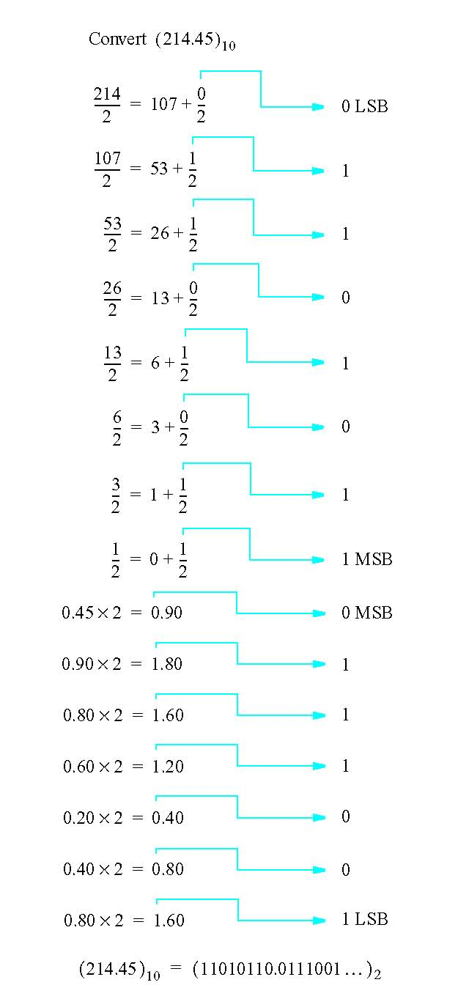
Figure 5.42. Conversion of fixed point numbers from decimal to binary.

Slide 38
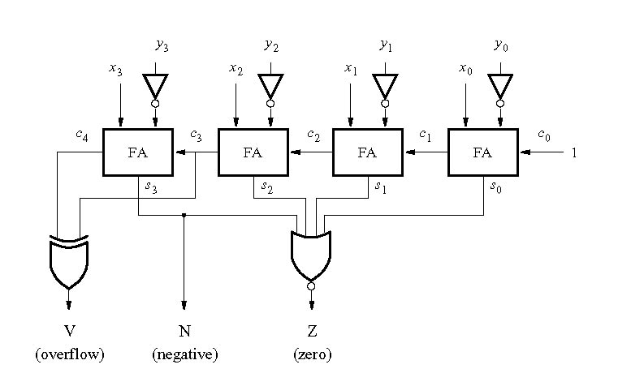
Figure 5.43. A comparator circuit.

