Slide 1
Combinational-Circuit Building Blocks
Commonly used combinational subcircuits
Multiplexers, which can be used for selection of signals and for implementation of general logic functions
Circuits used for encoding, decoding, and code conversion purposes

Slide 2
A 2-to-1 multiplexer
s
s
f
w
0
0
0
w
w
f
0
1
1
1
w
1
(a) Graphical symbol
(b) Truth table
w
w
0
0
s
f
s
w
1
w
f
1
(c) Sum-of-products circuit
(d) Circuit with transmission gates

Slide 3
A 4-to-1 multiplexer
s
0
s
1
s
1
s
0
f
w
0
00
0
0
w
0
w
1
01
f
0
1
w
1
w
2
10
1
0
w
w
3
11
w
2
1
1
3
(a) Graphic symbol
(b) Truth table
s
0
w
0
s
1
w
1
f
w
2
w
3
(c) Circuit

Slide 4
Using 2-to-1 multiplexers to build a 4-to-1 multiplexer
s
1
s
0
w
0
0
w
1
1
0
f
1
w
2
0
w
3
1

Slide 5
A 16-to-1 multiplexer
s
0
s
1
w
0
w
3
w
4
s
2
s
3
w
7
f
w
8
w
11
w
12
w
15

Slide 6
A practical application of multiplexers
s
x
1
y
1
x
2
y
2
(a) A 2x2 crossbar switch
x
1
0
y
1
1
s
x
2
0
y
2
1
(b) Implementation using multiplexers

Slide 7
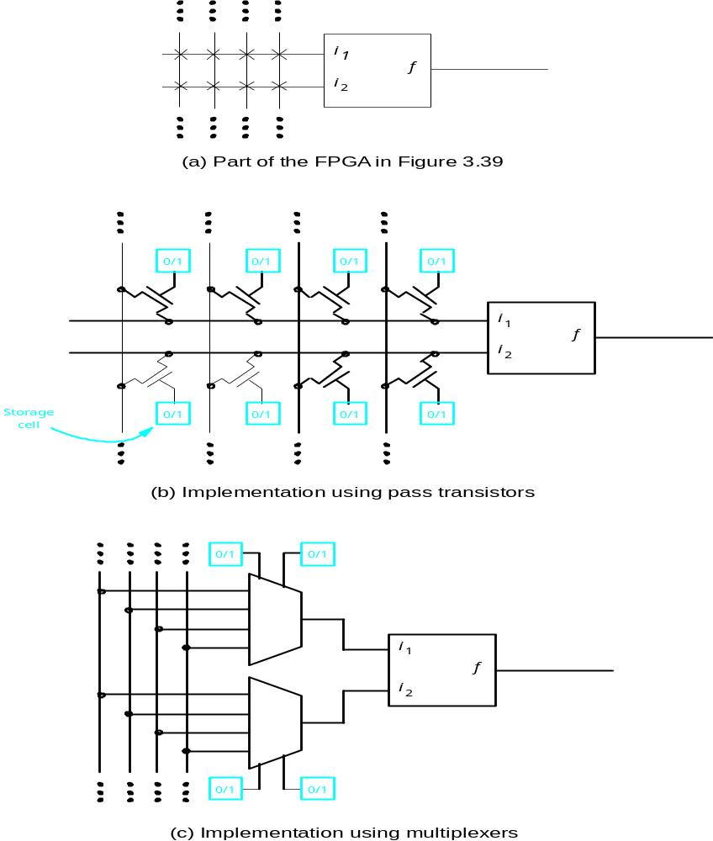
Implementing programmable switches in an FPGA

Slide 8
Synthesis of a logic function using multiplexers
w
w
f
w
2
1
2
w
1
0
0
0
0
0
1
1
1
1
0
1
1
f
1
1
0
0
(a) Implementation using a 4-to-1 multiplexer
w
1
w
2
f
w
f
1
w
0
0
0
w
1
0
2
0
1
1
w
w
1
2
2
1
0
1
f
1
1
0
(b) Modified truth table
(c) Circuit

Slide 9
Implementation of the three-input majority function using a 4-to-1 multiplexer
w
1
w
2
w
3
f
w
w
f
1
2
0
0
0
0
0
0
0
1
0
0
0
0
1
w
3
0
1
0
0
1
0
w
3
0
1
1
1
1
1
1
1
0
0
0
1
0
1
1
1
1
0
1
1
1
1
1
(a) Modified truth table
w
2
w
1
0
w
3
f
1
(b) Circuit

Slide 10
Three-input XOR implemented with 2-to-1 multiplexers
w
1
w
2
w
3
f
0
0
0
0
0
0
1
1
w
⊕
w
w
0
1
0
1
2
3
2
w
1
0
1
1
0
w
3
1
0
0
1
f
1
0
1
0
w
⊕
w
1
1
0
0
2
3
1
1
1
1
(a) Truth table
(b) Circuit

Slide 11
Three-input XOR function implemented with a 4-to-1 multiplexer
w
1
w
2
w
3
f
0
0
0
0
w
0
0
1
1
3
w
2
w
1
0
1
0
1
w
0
1
1
0
3
w
3
1
0
0
1
w
f
1
0
1
0
3
1
1
0
0
w
1
1
1
1
3
(a) Truth table
(b) Circuit

Slide 12

The three-input majority function implemented using a 2-to-1 multiplexer
w
1
w
2
w
3
f
0
0
0
0
w
1
f
0
0
1
0
0
w
w
0
1
0
0
2
3
1
w
2
+
w
3
0
1
1
1
1
0
0
0
1
0
1
1
1
1
0
1
1
1
1
1
(b) Truth table
w
w
1
2
w
3
f
(b) Circuit

Slide 13


Shannon’s Expansion Theorem
Cofactor of f with respect to

Slide 14
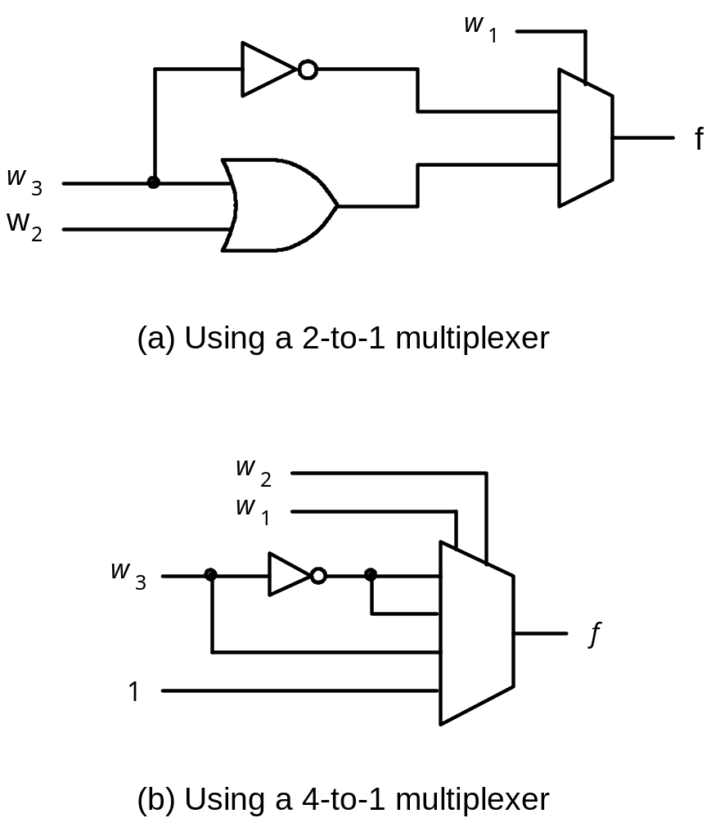


The circuits synthesized in Example 6.6

Slide 15

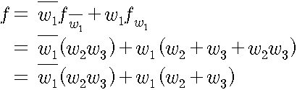


The circuit synthesized in Example 6.7
Three input majority function
w
w
2
1
0
w
3
f
1

Slide 16
Circuits synthesized in Example 6.8
x
w
1
1
x
2
0/1
0
f
w
w
1
f
0/1
2
w
3
0/1
0/1
f
f
w
1
0/1
w
4
0/1
0/1
(a) Using three 3-LUTs
0/1
x
w
3
2
0
w
f
f
1
w
w
2
3
w
4
(b) Using two 3-LUTs

Slide 17
An n-to-2^{n} binary decoder
w
y
0
0
n
inputs
2
n
w
outputs
n
–
1
Enable
y
2
n
–
1
En

Slide 18
En
w
w
y
y
y
y
1
0
0
1
2
3
w
y
1
0
0
1
0
0
0
0
0
w
y
1
0
1
0
1
0
0
1
1
y
1
1
0
0
0
1
0
2
En
y
1
1
1
0
0
0
1
3
0
x
x
0
0
0
0
(a) Truth table
(b) Graphical symbol
w
0
y
0
w
1
y
1
y
2
y
3
En
(c) Logic circuit
Figure 6.16. A 2-to-4 decoder.

Slide 19
w
w
y
y
0
0
0
0
w
w
y
y
1
1
1
1
y
2
y
2
w
y
2
En
y
3
3
En
w
y
y
4
0
0
w
y
y
5
1
1
y
2
y
6
En
y
3
y
7
Figure 6.17. A 3-to-8 decoder using two 2-to-4 decoders.

Slide 20
w
w
y
y
0
0
0
0
w
w
y
y
1
1
1
1
y
y
2
2
En
y
y
3
3
w
y
y
0
0
4
w
y
y
1
1
5
y
y
w
2
6
2
w
y
En
y
y
0
0
3
7
w
w
y
3
1
1
y
2
En
En
y
w
y
y
3
0
0
8
w
y
y
1
1
9
y
y
2
10
En
y
y
3
11
w
y
y
0
0
12
w
y
y
1
1
13
y
y
2
14
En
y
y
3
15
Figure 6.18. A 4-to-16 decoder built using a decoder tree.

Slide 21
w
0
w
1
s
0
w
y
0
0
s
1
w
y
f
1
1
y
2
w
2
1
En
y
3
w
3
Figure 6.19. A 4-to-1 multiplexer built using a decoder.

Slide 22
w
0
s
0
w
0
y
0
w
1
s
1
w
1
y
1
y
2
f
1
En
y
3
w
2
w
3
Figure 6.20. A 4-to-1 multiplexer built using a decoder and tri-state buffers.

Slide 23
Sel
0
0/1
0/1
0/1
Sel
1
0/1
0/1
0/1
a
0
Sel
2
decoder
0/1
0/1
0/1
a
1
Address
m
-to-2
a
m
–
1
m
Sel
2
m
–
1
0/1
0/1
0/1
Read
Data
d
n
–
1
d
n
–
2
d
0
Figure 6.21. A 2^{m} x n read-only memory (ROM) block.

Slide 24
w
0
y
0
2
n
n
inputs
outputs
y
n
–
1
w
2
n
–
1
Figure 6.22. A 2^{n}-to-n binary encoder.

Slide 25
w
w
w
w
y
y
3
2
1
0
1
0
0
0
0
1
0
0
0
0
1
0
0
1
0
1
0
0
1
0
1
0
0
0
1
1
(a) Truth table
w
0
w
1
y
0
w
2
w
y
1
3
(b) Circuit
Figure 6.23. A 4-to-2 binary encoder.

Slide 26
w
3
w
2
w
1
w
0
y
1
y
0
z
0
0
0
0
d
d
0
0
0
0
1
0
0
1
0
0
1
x
0
1
1
0
1
x
x
1
0
1
1
x
x
x
1
1
1
Figure 6.24. Truth table for a 4-to-2 priority encoder.

Slide 27
a
a
w
b
0
c
f
b
w
1
d
w
g
2
e
e
c
w
3
f
g
d
(a) Code converter
(b) 7-segment display
w
3
w
2
w
1
w
0
a
b
c
d
e
f
g
0
0
0
0
1
1
1
1
1
1
0
0
0
0
1
0
1
1
0
0
0
0
0
0
1
0
1
1
0
1
1
0
1
0
0
1
1
1
1
1
1
0
0
1
0
1
0
0
0
1
1
0
0
1
1
0
1
0
1
1
0
1
1
0
1
1
0
1
1
0
1
0
1
1
1
1
1
0
1
1
1
1
1
1
0
0
0
0
1
0
0
0
1
1
1
1
1
1
1
1
0
0
1
1
1
1
1
0
1
1
(c) Truth table
Figure 6.25. A BCD-to-7-segment display code converter.

Slide 28
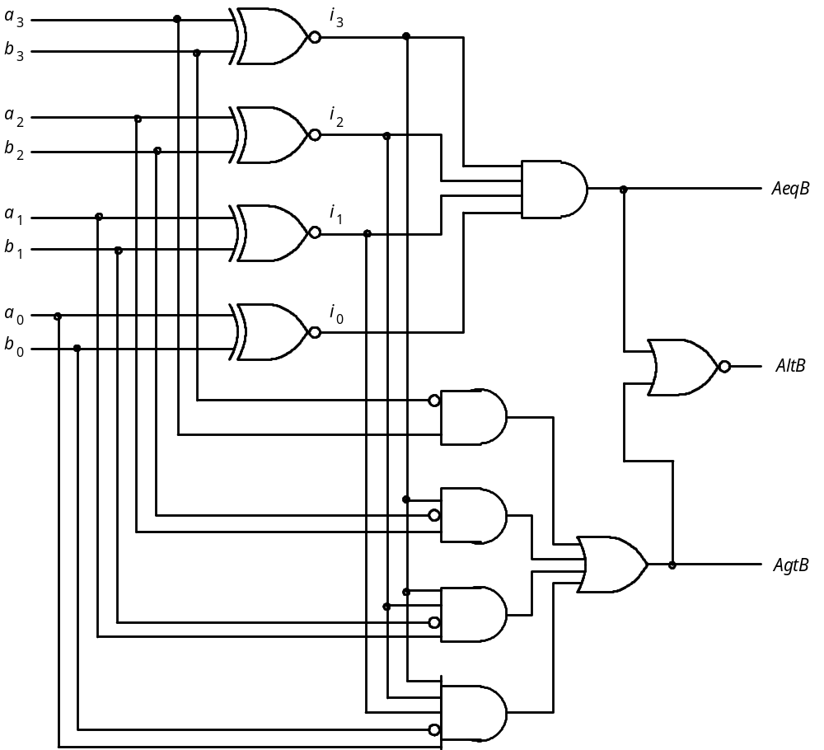
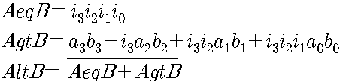

Figure 6.26. A four-bit comparator circuit.

