Slide 1
Flip-Flops, Registers, Counters, and a Simple Processor

Slide 2
Set
Sensor
On
⁄
Off
Memory
element
Alarm
Reset
Figure 7.1. Control of an alarm system.

Slide 3
A
B
Figure 7.2. A simple memory element.

Slide 4
Load
A
B
Data
Output
TG1
TG2
Figure 7.3. A controlled memory element.

Slide 5
Reset
Set
Q
Figure 7.4. A memory element with NOR gates.

Slide 6
R
S
R
Q
a
Q
b
Q
a
0
0
0/1 1/0
(no change)
0
1
0
1
1
0
1
0
Q
b
1
1
0
0
S
(a) Circuit
(b) Truth table
t
1
t
2
t
3
t
4
t
5
t
6
t
7
t
8
t
9
t
10
1
R
0
1
S
0
1
Q
a
?
0
1
Q
b
?
0
Time
(c) Timing diagram
Figure 7.5. A latch built with NOR gates.

Slide 7
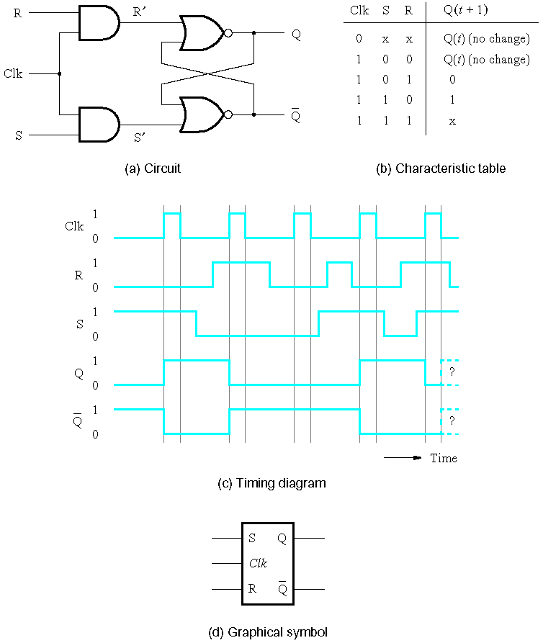
Figure 7.6. Gated SR latch.

Slide 8
S
Q
Clk
Q
R
Figure 7.7. Gated SR latch with NAND gates.

Slide 9
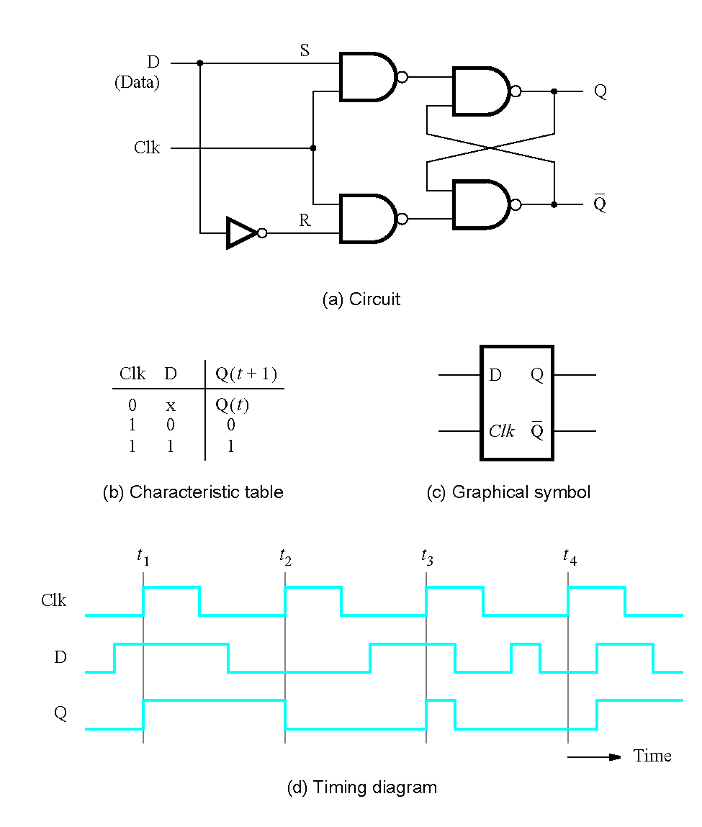
Figure 7.8. Gated D latch.

Slide 10
t
su
t
h
Clk
D
Q
Figure 7.9. Setup and hold times.

Slide 11
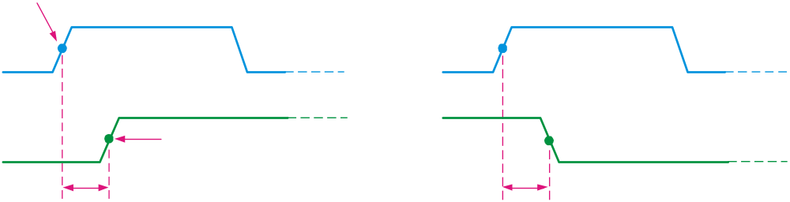
Flip-flop Characteristics
Propagation delay time is specified for the rising and falling outputs. It is measured between the 50% level of the clock to the 50% level of the output transition.
50% point on triggering edge
CLK
CLK
50% point
Q
50% point on LOW-to-HIGH transition of Q
Q
50% point on HIGH-to- LOW transition of Q
t_{PLH}
t_{PHL}
The typical propagation delay time for the 74AHC family (CMOS) is 4 ns. Even faster logic is available for specialized applications.

Slide 12
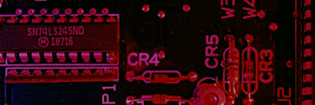
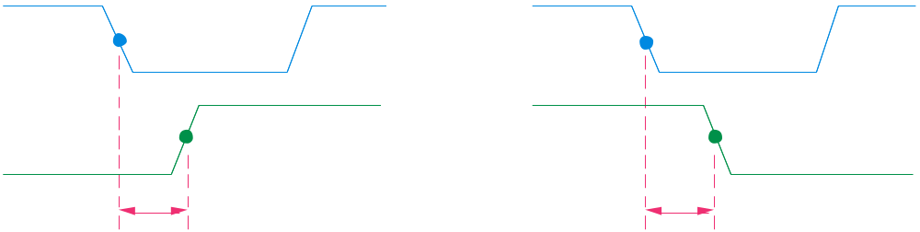
Summary
Flip-flop Characteristics
Another propagation delay time specification is the time required for an asynchronous input to cause a change in the output. Again it is measured from the 50% levels. The 74AHC family has specified delay times under 5 ns.
PRE
50% point
CLR
50% point
Q
50% point
Q
50% point
t_{PHL}
t_{PLH}

Slide 13
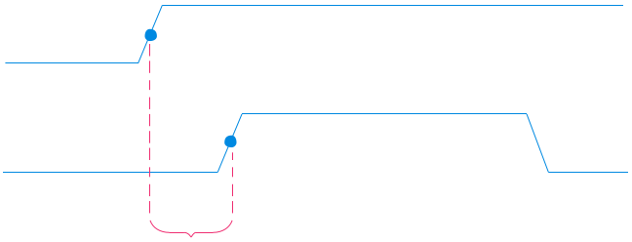
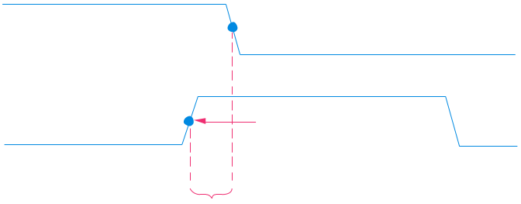
Summary
Flip-flop Characteristics
Set-up time and hold time are times required before and after the clock transition that data must be present to be reliably clocked into the flip-flop.
Setup time is the minimum time for the data to be present before the clock.
D
CLK
Set-up time, t_{s}
Hold time is the minimum time for the data to remain after the clock.
D
CLK
Hold time, t_{H}

Slide 14
Master
Slave
Q
m
Q
D
D
Q
D
Q
s
Q
Clock
Clk
Q
Clk
Q
Q
(a) Circuit
Clock
D
Q
m
Q
=
Q
s
(b) Timing diagram
D
Q
Q
(c) Graphical symbol
Figure 7.10. Master-slave D flip-flop.

Slide 15
1
P3
2
P1
5
Q
Clock
P2
6
Q
3
D
Q
4
P4
Clock
Q
D
(a) Circuit
(b) Graphical symbol
Figure 7.11. A positive-edge-triggered D flip-flop.

Slide 16
D
D
Q
Q
a
Clock
Clk
Q
Q
a
D
Q
Q
b
Q
Q
b
D
Q
Q
c
Q
Q
c
(a) Circuit
Clock
D
Q
a
Q
b
Q
c
(b) Timing diagram
Figure 7.12. Comparison of level-sensitive and edge-triggered D storage elements.

Slide 17
Preset
D
Q
Clock
Q
Clear
(a) Circuit
Preset
D
Q
Q
Clear
(b) Graphical symbol
Figure 7.13. Master-slave D flip-flop with Clear and Preset.

Slide 18
Preset
Q
Clock
Q
D
Clear
(a) Circuit
Preset
D
Q
Q
Clear
(b) Graphical symbol
Figure 7.14. Positive-edge-triggered D flip-flop with Clear and Preset.

Slide 19
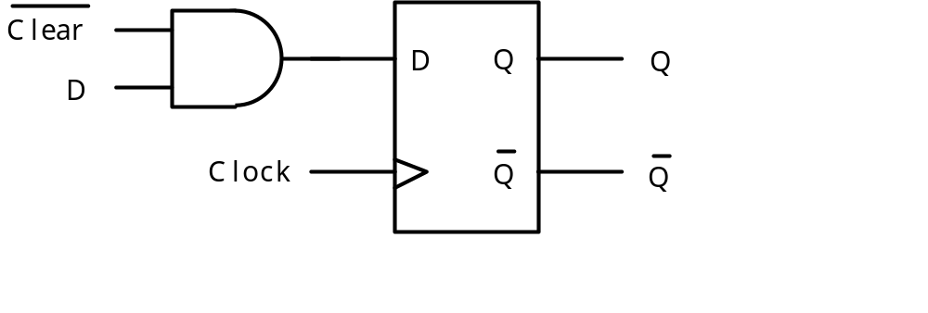
Figure 7.15. Synchronous reset for a D flip-flop.

Slide 20
D
Q
Q
T
Q
Q
Clock
(a) Circuit
Q
(
)
T
t
+
1
T
Q
0
Q
(
)
t
1
Q
(
)
t
Q
(b) Truth table
(c) Graphical symbol
Clock
T
Q
(d) Timing diagram
Figure 7.16. T flip-flop.

Slide 21
J
D
Q
Q
K
Q
Q
Clock
(a) Circuit
J
K
Q
(
t
+
1
)
0
0
Q
(
t
)
J
Q
0
1
0
1
0
1
K
Q
1
1
Q
(
t
)
(b) Truth table
(c) Graphical symbol
Figure 7.17. JK flip-flop.

Slide 22
Q
Q
Q
Q
In
D
Q
1
D
Q
2
D
Q
3
D
Q
4
Out
Clock
Q
Q
Q
Q
(a) Circuit
In
Q
Q
Q
Q
=
Out
1
2
3
4
t
1
0
0
0
0
0
t
0
1
0
0
0
1
t
1
0
1
0
0
2
t
1
1
0
1
0
3
t
1
1
1
0
1
4
t
0
1
1
1
0
5
t
0
0
1
1
1
6
t
0
0
0
1
1
7
(b) A sample sequence
Figure 7.18. A simple shift register.

Slide 23
Parallel output
Q
3
Q
2
Q
1
Q
0
D
Q
D
Q
D
Q
D
Q
Q
Q
Q
Q
Serial
Shift/Load
Clock
input
Parallel input
Figure 7.19. Parallel-access shift register.

Slide 24
1
T
Q
T
Q
T
Q
Clock
Q
Q
Q
Q
Q
Q
0
1
2
(a) Circuit
Clock
Q
0
Q
1
Q
2
Count
0
1
2
3
4
5
6
7
0
(b) Timing diagram
Figure 7.20. A three-bit up-counter.

Slide 25
1
T
Q
T
Q
T
Q
Clock
Q
Q
Q
Q
Q
Q
0
1
2
(a) Circuit
Clock
Q
0
Q
1
Q
2
Count
0
7
6
5
4
3
2
1
0
(b) Timing diagram
Figure 7.21. A three-bit down-counter.

Slide 26
Clock cycle
Q
2
Q
1
Q
0
Q
changes
0
0
0
0
1
Q
changes
1
0
0
1
2
2
0
1
0
3
0
1
1
4
1
0
0
5
1
0
1
6
1
1
0
7
1
1
1
8
0
0
0
Table 7.1. Derivation of the synchronous up-counter.

Slide 27
1
T
Q
T
Q
T
Q
T
Q
Q
0
Q
1
Q
2
Q
3
Clock
Q
Q
Q
Q
(a) Circuit
Clock
Q
0
Q
1
Q
2
Q
3
Count
0
1
2
3
4
5
6
7
8
9
10
11
12
13
14
15
0
1
(b) Timing diagram
Figure 7.22. A four-bit synchronous up-counter.

Slide 28
Enable
T
Q
T
Q
T
Q
T
Q
Clock
Q
Q
Q
Q
Clear
Figure 7.23. Inclusion of Enable and Clear capability.

Slide 29
Enable
D
Q
Q
0
Q
D
Q
Q
1
Q
D
Q
Q
2
Q
D
Q
Q
3
Q
Output
Clock
carry
Figure 7.24. A four-bit counter with D flip-flops.

Slide 30
Enable
0
D
Q
Q
D
1
0
0
Q
0
D
Q
Q
D
1
1
1
Q
0
D
Q
Q
D
2
1
2
Q
0
D
Q
Q
D
3
1
3
Q
Output
carry
Load
Clock
Figure 7.25. A counter with parallel-load capability.

Slide 31
1
Enable
0
D
Q
0
0
0
D
Q
1
1
0
D
Q
2
2
Load
Clock
Clock
(a) Circuit
Clock
Q
0
Q
1
Q
2
Count
0
1
2
3
4
5
0
1
(b) Timing diagram
Figure 7.26. A modulo-6 counter with synchronous reset.

Slide 32
1
T
Q
T
Q
T
Q
Q
0
Q
1
Q
2
Clock
Q
Q
Q
(a) Circuit
Clock
Q
0
Q
1
Q
2
Count
0
1
2
3
4
5
0
1
2
(b) Timing diagram
Figure 7.27. A modulo-6 counter with asynchronous reset.

Slide 33
1
Enable
0
D
0
Q
0
0
D
1
Q
1
0
D
Q
BCD
0
2
2
0
D
3
Q
3
Load
Clock
Clock
Clear
Enable
0
D
0
Q
0
0
D
1
Q
1
0
D
Q
BCD
1
2
2
0
D
3
Q
3
Load
Clock
Figure 7.28. A two-digit BCD counter.

Slide 34
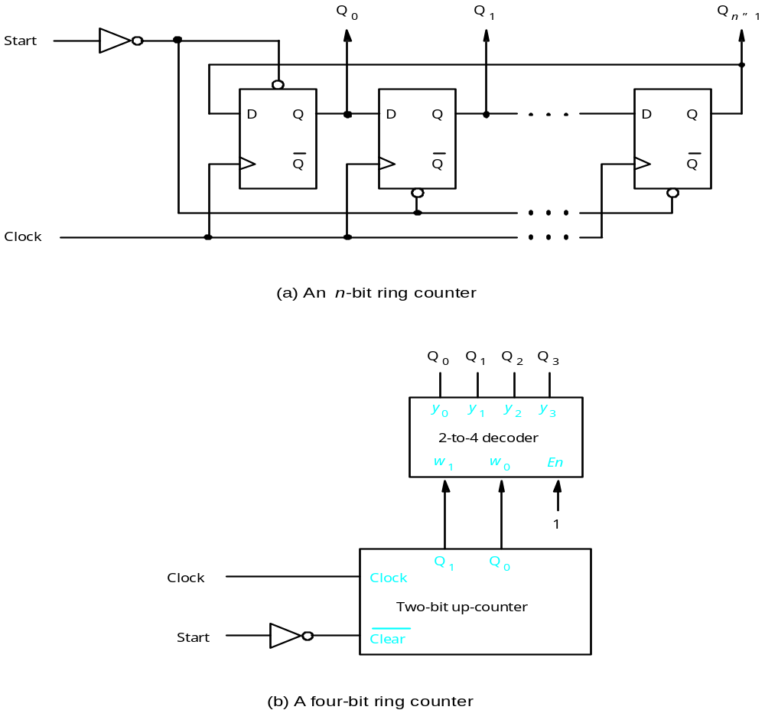
Figure 7.29. Ring counter.

Slide 35
Q
Q
Q
0
1
n
–
1
D
Q
D
Q
D
Q
Q
Q
Q
Reset
Clock
Figure 7.30. Johnson counter.

Slide 36
Figure 7.31. Three types of storage elements in a schematic.

Slide 37
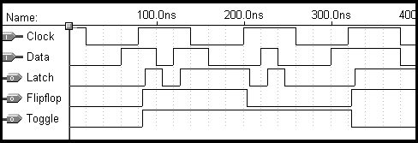
Figure 7.34. Timing simulation of storage elements in Figure 7.31.

