Slide 1
Synchronous Sequential Circuits

Slide 2
W
Combinational
Combinational
Flip-flops
circuit
Z
circuit
Q
Clock
Moore Type: Outputs depend only on the state of circuits
Mealy Type: Outputs depend on both the state and the inputs
Figure 8.1. The general form of a sequential circuit.

Slide 3
Basic Design Steps
Specification of sequence detector
  One input w, one output z
  All changes on the positive edge of a clock signal
  The output z is equal to 1 if during two immediately preceding clock cycles the input w was equal to 1. Otherwise, the value of z is equal to 0.

Slide 4
Sequences of input and output signals.
Clockcycle:
t
t
t
t
t
t
t
t
t
t
t
0
1
2
3
4
5
6
7
8
9
10
w
:
0
1
0
1
1
0
1
1
1
0
1
z
:
0
0
0
0
0
1
0
0
1
1
0
State diagram of a simple sequential circuit.
Reset
w
=
1
w
=
0
A
⁄
z
=
0
B
⁄
z
=
0
w
=
0
w
=
0
w
=
1
C
⁄
z
=
1
w
=
1

Slide 5
State Table
Present
Next state
Output
state
w
=
0
w
=
1
z
A
A
B
0
B
A
C
0
C
A
C
1
Figure 8.4. State table for the sequential circuit in Figure 8.3.

Slide 6
Y
1
y
1
w
Combinational
Combinational
z
circuit
circuit
Y
2
y
2
Clock
Figure 8.5. A general sequential circuit with input w, output z, and two state flip-flops.

Slide 7
State-Assigned Table
Next state
Present
w
=
0
w
=
1
Output
state
z
y
2
y
1
Y
2
Y
1
Y
2
Y
1
A
00
00
01
0
B
01
00
10
0
C
10
00
10
1
11
dd
dd
d
Figure 8.6. State-assigned table for the sequential circuit in Figure 8.4.

Slide 8
y
2
y
1
00
01
11
10
Ignoring don't cares
Using don't cares
w
0
0
0
d
0
Y
1
=
wy
1
y
2
Y
1
=
wy
1
y
2
1
1
0
d
0
y
2
y
1
w
00
01
11
10
0
0
0
d
0
Y
2
=
wy
1
y
2
+
wy
1
y
2
Y
2
=
wy
1
+
wy
2
1
0
1
d
1
=
w
(
y
1
+
y
2
)
y
1
y
2
0
1
0
0
0
z
=
y
1
y
2
z
=
y
2
1
1
d
Figure 8.7. Derivation of logic expressions for the sequential circuit in Figure 8.6.

Slide 9
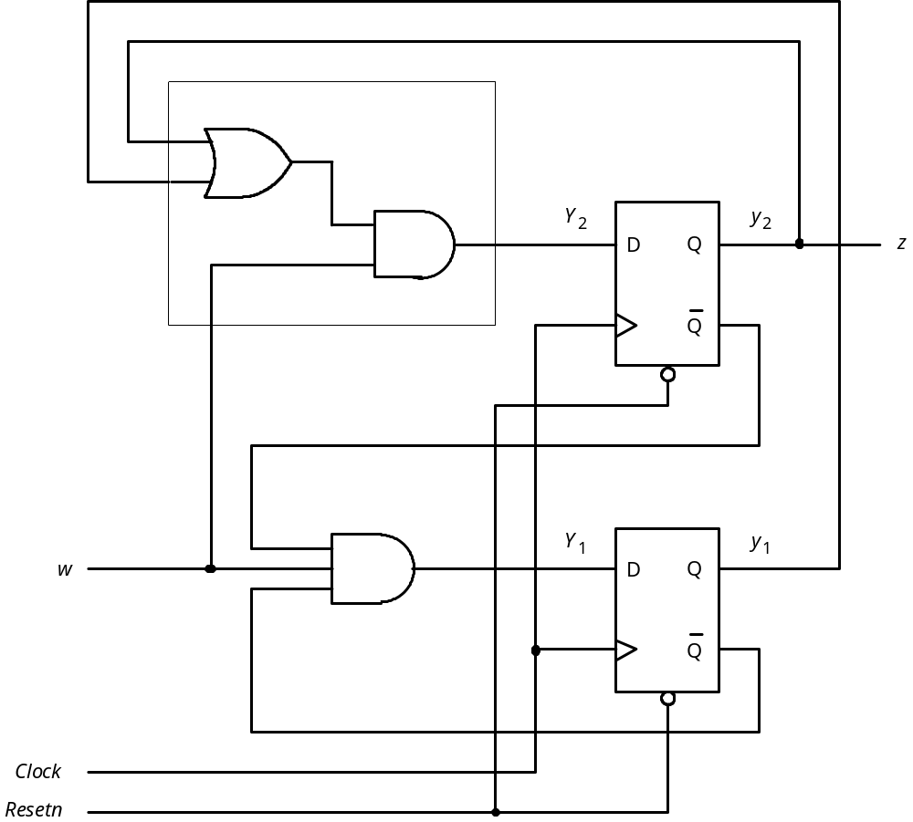
Figure 8.8. Final implementation of the sequential circuit derived in Figure 8.7.

Slide 10
t
t
t
t
t
t
t
t
t
t
t
0
1
2
3
4
5
6
7
8
9
10
1
Clock
0
1
w
0
1
y
1
0
1
y
2
0
1
z
0
Figure 8.9. Timing diagram for the circuit in Figure 8.8.

Slide 11
Example 8.1
The contents of R1 and R2 can be swapped using R3 as a temporary storage
  R2 ➔ R3
    Control signal R2out = 1 and R3in = 1
  R1 ➔ R2
    Control signal R1out = 1 and R2in = 1
  R3 ➔ R1
    Control signal R3out = 1 and R1in = 1
    Task is completed, Done = 1
  Swapping is performed in response to a pulse on an input signal called w

Slide 12
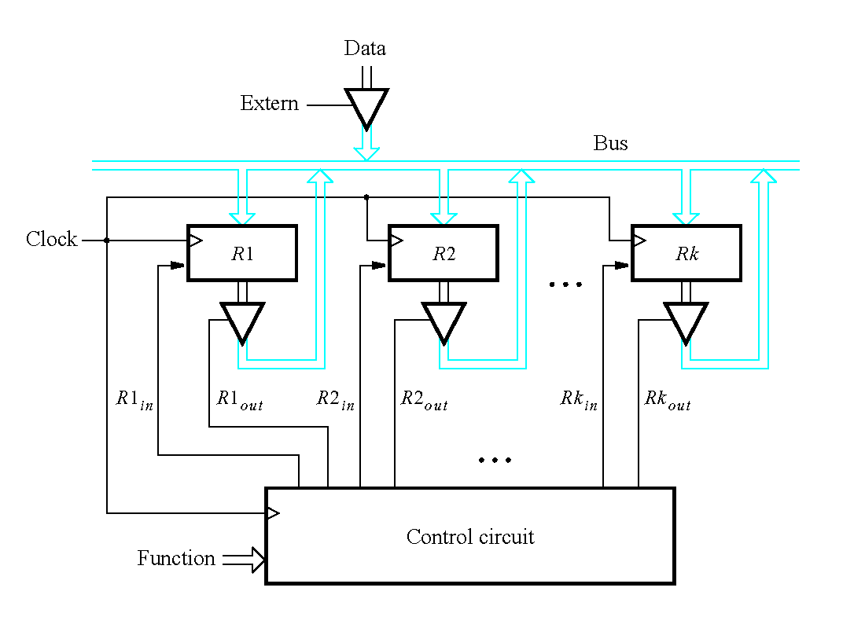

Slide 13
R
1
out
R
1
in
w
R
2
out
Control
circuit
R
2
in
R
3
out
Clock
R
3
in
Done
Figure 8.10. Signals needed in Example 8.1.

Slide 14
w
=
0
A
⁄
No
transfer
Reset
w
=
1
B
⁄
R
2
=
,
out
1
R
3
in
=
1
w
=
0
w
=
1
w
=
0
w
=
1
C
⁄
R
1
=
,
out
1
R
2
in
=
1
w
=
0
w
=
1
D
⁄
R
3
=
,
,
out
1
R
1
in
=
1
Done
=
1
Figure 8.11. State diagram for Example 8.1.

Slide 15


Present
Next state
Outputs
state
w = 0
w = 1
A
A
B
0
0
0
0
0
0
0
B
C
C
0
0
1
0
0
1
0
C
D
D
1
0
0
1
0
0
0
D
A
A
0
1
0
0
1
0
1
Figure 8.12. State table for Example 8.1.

Slide 16

Present
Next state
state
Outputs
A
00
00
0
1
0
0
0
0
0
0
0
B
01
10
1
0
0
0
1
0
0
1
0
C
10
11
1
1
1
0
0
1
0
0
0
D
11
00
0
0
0
1
0
0
1
0
1
Figure 8.13. State-assigned table for the sequential circuit in Figure 8.12.

Slide 17
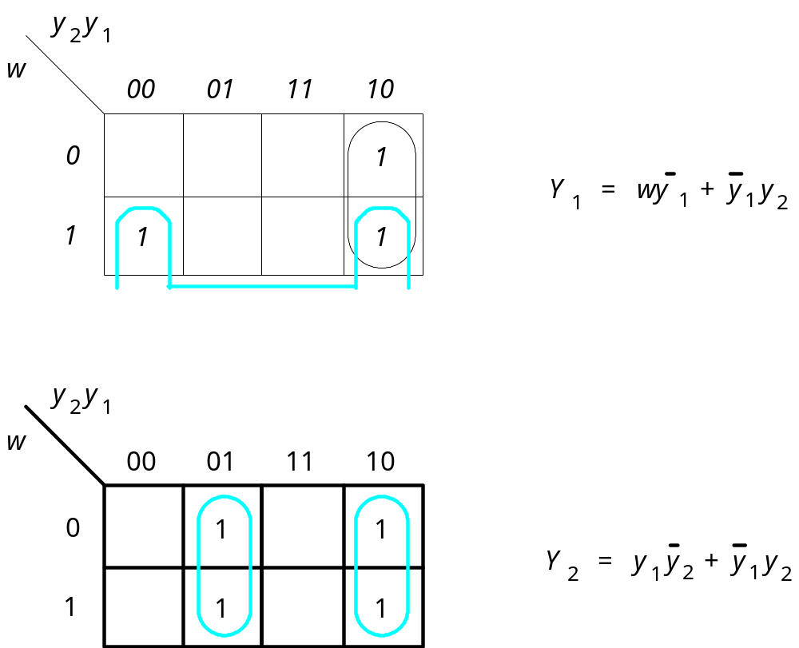
Figure 8.14. Derivation of next-state expressions for the
sequential circuit in Figure 8.13.

Slide 18
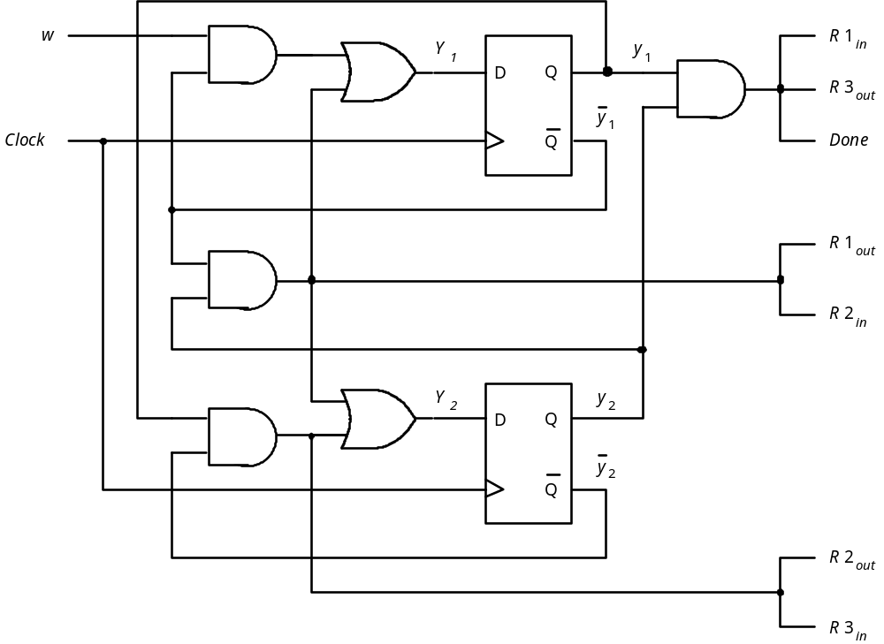
Figure 8.15. Final implementation of sequential circuit in Figure 8.13.

Slide 19
State-Assignment Problem
Next state
Present
state
w
=
0
w
=
1
Output
z
y
y
Y
Y
Y
Y
2
1
2
1
2
1
A
00
00
01
0
B
01
00
11
0
C
11
00
11
1
10
dd
dd
d
Figure 8.16. Improved state assignment for the sequential circuit in Figure 8.4.

Slide 20
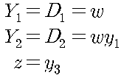
Y
2
y
2
D
Q
z
Q
Y
1
y
1
w
D
Q
Clock
Q
Resetn
Figure 8.17. Final circuit for the improved state assignment in Figure 8.16.

Slide 21
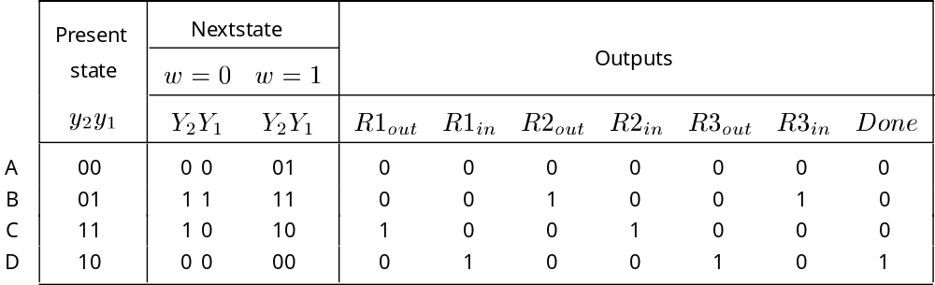
Figure 8.18. Improved state assignment for the sequential circuit in Figure 8.12.

Slide 22
y
2
y
1
w
00
01
11
10
0
1
Y
1
=
wy
2
+
y
1
y
2
1
1
1
y
2
y
1
w
00
01
11
10
0
1
1
Y
2
=
y
1
1
1
1
Figure 8.19. Derivation of next-state expressions for the sequential circuit in Figure 8.18.

Slide 23
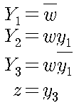
One-Shot Encoding
Present
Nextstate
state
w
=
0
w
=
1
Output
y
y
y
z
3
2
1
Y
3
Y
2
Y
1
Y
3
Y
2
Y
1
A
001
001
010
0
B
010
001
100
0
C
100
001
100
1
Figure 8.20. One-hot state assignment for the sequential circuit in Figure 8.4.

Slide 24
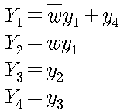
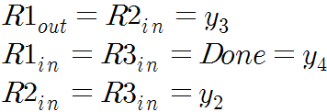
Present
Nextstate
state
Outputs
A
0
001
0001
0010
0
0
0
0
0
0
0
B
0
010
0100
0100
0
0
1
0
0
1
0
C
0
100
1000
1000
1
0
0
1
0
0
0
D
1
000
0001
0001
0
1
0
0
1
0
1
Figure 8.21. One-hot state assignment for the sequential circuit in Figure 8.12.

Slide 25
Mealy State Model
Clock cycle:
t
t
t
t
t
t
t
t
t
t
t
0
1
2
3
4
5
6
7
8
9
10
w
:
0
1
0
1
1
0
1
1
1
0
1
z
:
0
0
0
0
1
0
0
1
1
0
0
Figure 8.22. Sequences of input and output signals.

Slide 26
Reset
w
=
1
⁄
z
=
0
w
=
0
⁄
z
=
0
A
B
w
=
1
⁄
z
=
1
w
=
0
⁄
z
=
0
Figure 8.23. State diagram of an FSM that realizes the task in Figure 8.22.

Slide 27
Present
Next state
Output
z
state
w
=
0
w
=
1
w
=
0
w
=
1
A
A
B
0
0
B
A
B
0
1
Figure 8.24. State table for the FSM in Figure 8.23.

Slide 28

Present
Next state
Output
state
w
=
0
w
=
1
w
=
0
w
=
1
y
Y
Y
z
z
A
0
0
1
0
0
B
1
0
1
0
1
Figure 8.25. State-assigned table for the FSM in Figure 8.24.

Slide 29
z
w
D
Q
y
Clock
Q
Resetn
(a) Circuit
t
t
t
t
t
t
t
t
t
t
t
0
1
2
3
4
5
6
7
8
9
10
Clock
1
0
w
1
0
y
1
0
z
1
0
(b) Timing diagram
Figure 8.26. Implementation of FSM in Figure 8.25.

Slide 30
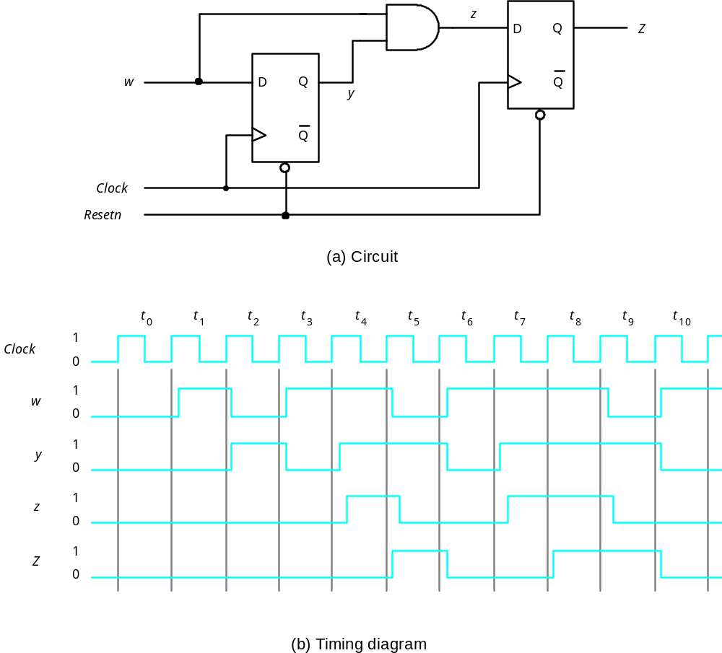
Figure 8.27. Circuit that implements the specification in Figure 8.2.

Slide 31
w
=
0
A
Reset
w
=
1
⁄
R
2
out
=
1
,
R
3
in
=
1
B
w
=
0
R
1
=
1
,
R
2
=
1
w
=
1
out
in
C
w
=
0
R
3
=
1
,
R
1
=
1
,
Done
=
1
w
=
1
out
in
Figure 8.28. State diagram for Example 8.4.

Slide 32
State Minimization
Example 8.5
  State Table in Figure 8.51
  To minimize the number of states
    Initial partition: P1=(ABCDEFG)
    New partition: P2=(ABD)(CEFG)
      Depends on the value of output z
    New partition: P3=(ABD)(CEG)(F)
      Depends on 0-successors and 1-successors
    New partition: P4=(AD)(B)(CEG)(F)
      Repeats the process on 0-successors and 1-successors

Slide 33
Present
Next state
Output
state
w
=
0
w
=
1
z
A
B
C
1
B
D
F
1
C
F
E
0
D
B
G
1
E
F
C
0
F
E
D
0
G
F
G
0
Figure 8.51. State table for Example 8.5.

Slide 34
Present
Nextstate
Output
state
w
=
0
w
=
1
z
A
B
C
1
B
A
F
1
C
F
C
0
F
C
A
0
Figure 8.52. Minimized state table for Example 8.5.

Slide 35
Example 8.6
Another example of minimization
A coin-operated vending machine
  The machine accepts nickels and dimes
  It takes 15 cents for a piece of candy
  It 20 cents is deposited, the machine will not return the change, but it will credit the buyer with 5 cents and wait for the buyer to make a second purchase.

Slide 36
Clock
sense
N
sense
D
N
D
(a) Timing diagram
N
sense
D
Q
D
Q
N
Clock
Q
Q
(b) Circuit that generates
N
Figure 8.53. Signals for the vending machine.

Slide 37
DN
Reset
DN
DN
S1
⁄
0
DN
DN
DN
D
N
S4
⁄
1
S2
⁄
0
S3
⁄
0
D
S7
⁄
1
N
D
N
DN
S5
⁄
1
S6
⁄
0
DN
DN
N
D
S8
⁄
1
S9
⁄
1
Figure 8.54. State diagram for Example 8.6.

Slide 38
Present
Next state
Output
state
DN
=00
01
10
11
z
S1
S1
S3
S2
–
0
S2
S2
S4
S5
–
0
S3
S3
S6
S7
–
0
S4
S1
–
–
–
1
S5
S3
–
–
–
1
S6
S6
S8
S9
–
0
S7
S1
–
–
–
1
S8
S1
–
–
–
1
S9
S3
–
–
–
1
Figure 8.55. State table for Example 8.6.

Slide 39
Present
Next state
Output
state
DN
=00
01
10
11
z
S1
S1
S3
S2
–
0
S2
S2
S4
S5
–
0
S3
S3
S2
S4
–
0
S4
S1
–
–
–
1
S5
S3
–
–
–
1
Figure 8.56. Minimized state table for Example 8.6.

Slide 40
DN
S1
⁄
0
N
DN
S3
⁄
0
D
DN
N
DN
DN
S2
⁄
0
D
S5
⁄
1
N
D
S4
⁄
1
Figure 8.57. Minimized state diagram for Example 8.6.

Slide 41
DN
⁄
0
S1
N
⁄
0
D
⁄
1
DN
⁄
0
N
⁄
1
S3
D
⁄
0
N
⁄
0
D
⁄
1
S2
DN
⁄
0
Figure 8.58. Mealy-type FSM for Example 8.6.

Slide 42
Incompletely Specified FSMs
Incompletely Specified FSMs: have don’t care terms in state table.
Present
Next state
Output
z
state
w
=
0
w
=
1
w
=
0
w
=
1
A
B
C
0
0
B
D
–
0
–
C
F
E
0
1
D
B
G
0
0
E
F
C
0
1
F
E
D
0
1
G
F
–
0
–
Figure 8.59. Incompletely specified state table for Example 8.7.

Slide 43
Example 8.7
Assuming the unspecified outputs have a value of 0
  P1=(ABCDEFG), P2=(ABDG)(CEF)
  P3=(AB)(D)(G)(CE)(F),P4=(A)(B)(D)(G)(CE)(F), P5=P4 ➔ 6 states
Assuming the unspecified outputs have a value of 1
  P1=(ABCDEFG), P2=(AD)(BCEFG)
  P3=(AD)(B)(CEFG),P4=(AD)(B)(CEG)(F), P5=P4 ➔ 4 states

Slide 44
Design of a Counter Using the Sequential Circuit Approach
w
=
0
w
=
0
w
=
0
w
=
0
w
=
1
w
=
1
w
=
1
A/0
B/1
C/2
D/3
w
=
1
w
=
1
H/7
G/6
F/5
E/4
w
=
1
w
=
1
w
=
1
w
=
0
w
=
0
w
=
0
w
=
0
Figure 8.60. State diagram for the counter.

Slide 45
Present
Next state
Output
state
w
=
0
w
=
1
A
A
B
0
B
B
C
1
C
C
D
2
D
D
E
3
E
E
F
4
F
F
G
5
G
G
H
6
H
H
A
7
Figure 8.61. State table for the counter.

Slide 46
Next state
Present
Count
state
w
=
0
w
=
1
y
2
y
1
y
0
z
2
z
1
z
0
Y
2
Y
1
Y
0
Y
2
Y
1
Y
0
A
000
000
001
000
B
001
001
010
001
C
010
010
011
010
D
011
011
100
011
E
100
100
101
100
F
101
101
110
101
G
110
110
111
110
H
111
111
000
111
Figure 8.62. State-assigned table for the counter.

Slide 47
y
1
y
0
y
1
y
0
wy
2
wy
2
00
01
11
10
00
01
11
10
00
0
1
1
0
00
0
0
1
1
01
0
1
1
0
01
0
0
1
1
11
1
0
0
1
11
0
1
0
1
10
1
0
0
1
10
0
1
0
1
Y
0
=
wy
0
+
wy
0
Y
1
=
wy
1
+
y
1
y
0
+
wy
0
y
1
y
1
y
0
wy
2
00
01
11
10
00
0
0
0
0
01
1
1
1
1
11
1
1
0
1
10
0
0
1
0
Y
2
=
wy
2
+
y
0
y
2
+
y
1
y
2
+
w
y
0
y
1
y
2
Figure 8.63. Karnaugh maps for D flip-flops for the counter.

Slide 48
w
Y
0
y
D
Q
0
Q
Y
1
D
Q
y
1
Q
Y
2
D
Q
y
2
Q
Clock
Resetn
Figure 8.64. Circuit diagram for the counter implemented with D flip-flops.

Slide 49
Present
Flip-flop inputs
state
w
=
0
w
=
1
Count
y
2
y
1
y
0
z
2
z
1
z
0
Y
2
Y
1
Y
0
J
2
K
2
J
1
K
1
J
0
K
0
Y
2
Y
1
Y
0
J
2
K
2
J
1
K
1
J
0
K
0
A
000
000
0d
0d
0d
001
0d
0d
1d
000
B
001
001
0d
0d
d0
010
0d
1d
d1
001
C
010
010
0d
d0
0d
011
0d
d0
1d
010
D
011
011
0d
d0
d0
100
1d
d1
d1
011
E
100
100
d0
0d
0d
101
d0
0d
1d
100
F
101
101
d0
0d
d0
110
d0
1d
d1
101
G
110
110
d0
d0
0d
111
d0
d0
1d
110
H
111
111
d0
d0
d0
000
d1
d1
d1
111
Figure 8.65. Excitation table for the counter with JK flip-flops.

Slide 50
y
1
y
0
y
1
y
0
wy
2
00
01
11
10
wy
2
00
01
11
10
00
0
d
d
0
00
d
0
0
d
01
0
d
d
0
01
d
0
0
d
11
1
d
d
1
11
d
1
1
d
10
1
d
d
1
10
d
1
1
d
J
0
=
w
K
0
=
w
y
1
y
0
y
1
y
0
wy
2
00
01
11
10
wy
2
00
01
11
10
00
0
0
d
d
00
d
d
0
0
01
0
0
d
d
01
d
d
0
0
11
0
1
d
d
11
d
d
1
0
10
0
1
d
d
10
d
d
1
0
J
1
=
wy
0
K
1
=
wy
0
y
1
y
0
y
1
y
0
wy
2
00
01
11
10
wy
2
00
01
11
10
00
0
0
0
0
00
d
d
d
d
01
d
d
d
d
01
0
0
0
0
11
d
d
d
d
11
0
0
1
0
10
0
0
1
0
10
d
d
d
d
J
2
=
wy
0
y
1
K
2
=
wy
0
y
1
Figure 8.66. Karnaugh maps for JK flip-flops in the counter.

Slide 51
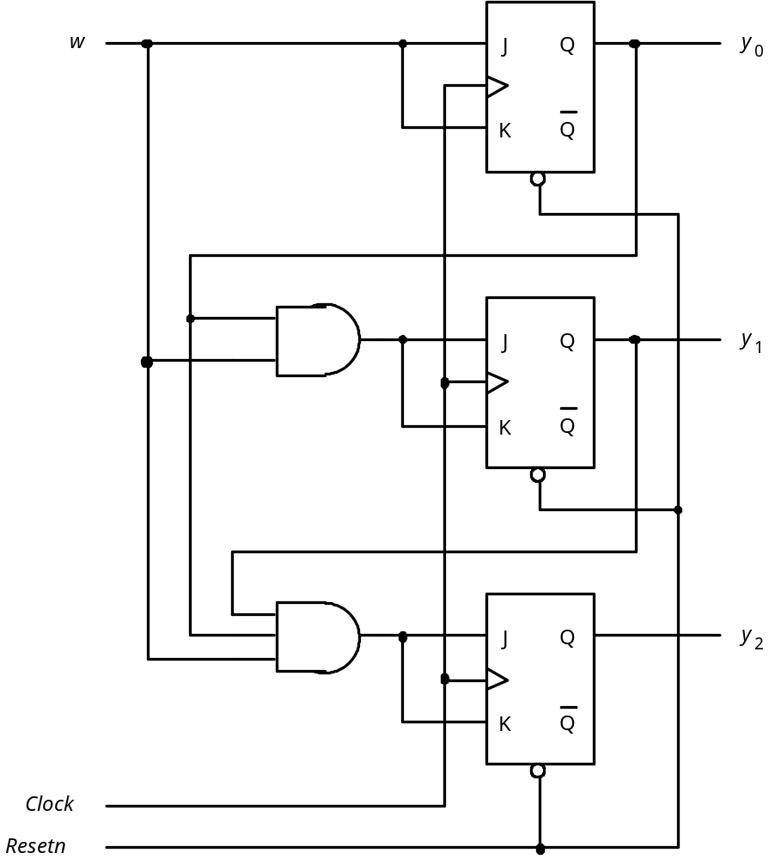
Figure 8.67. Circuit diagram using JK flip-flops.

Slide 52
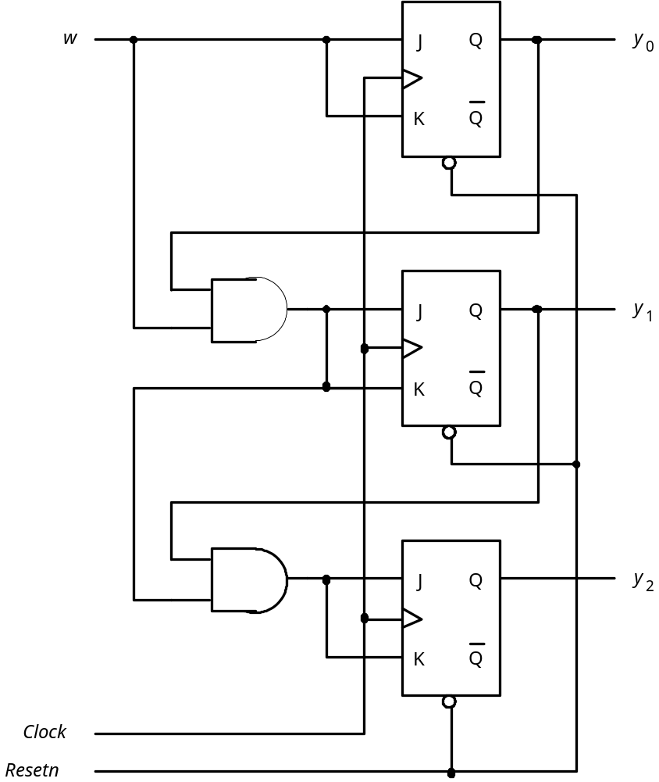

Figure 8.68. Factored-form implementation of the counter.

Slide 53
Example-A Different Counter
Present
Next
Output
state
state
z
2
z
1
z
0
A
B
000
B
C
100
C
D
010
D
E
110
E
F
001
F
G
101
G
H
011
H
A
111
Figure 8.69. State table for the counter like example.

Slide 54
Present
Next
Output
state
state
y
2
y
1
y
0
Y
2
Y
1
Y
0
z
2
z
1
z
0
000
1
00
0
00
100
0
10
1
00
010
1
10
0
10
110
0
01
1
10
001
1
01
0
01
101
0
11
1
01
011
1
11
0
11
111
0
00
1
11
Figure 8.70. State-assigned table for Figure 8.69.

Slide 55
D
Q
z
2
Q
D
Q
z
1
Q
D
Q
z
0
w
Q
Figure 8.71. Circuit for Figure 8.70.

