Slide 1
논리회로 실습 03
Adders using Carry Lookahead
상명대학교 컴퓨터과학과
2018년 1학기

Slide 2

Lab 03-1
Consider the 2-bit adder with ripple carry
Implement the full adder with AND, OR and XOR.
Cascade two FAs (full adders) for 2-bit adder.
  Capture BDF file
  Capture the RTL viewer.
  Verify with simulation. Capture the simulation.

Slide 3


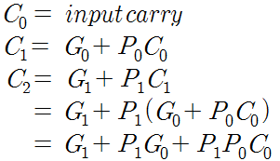
Lab 03-2
Consider the 2-bit adder with carry lookahead
Use the full adder obtained in Lab 03-1.
Implement 2-bit adder with carry lookahead.
  Capture BDF file
  Capture the RTL viewer.
  Verify with simulation. Capture the simulation.

