Slide 1
VAE
2020.07 하계방학
Variational Auto Encoder
20151739 공대현

Slide 2
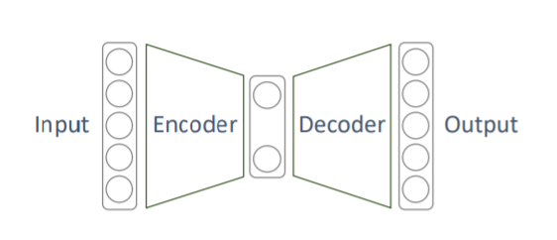
Prior Knowledge
Manifold learning
Prior Knowledge
배경 이론
설계 과정
AutoEncoder
설계 결과
VAE
Prior Knowledge
-Autoencoder
[Keyword]
Unsupervised learning
Representation learning = Efficient coding learning
Dimensionality reduction
Generative model learning

Slide 3
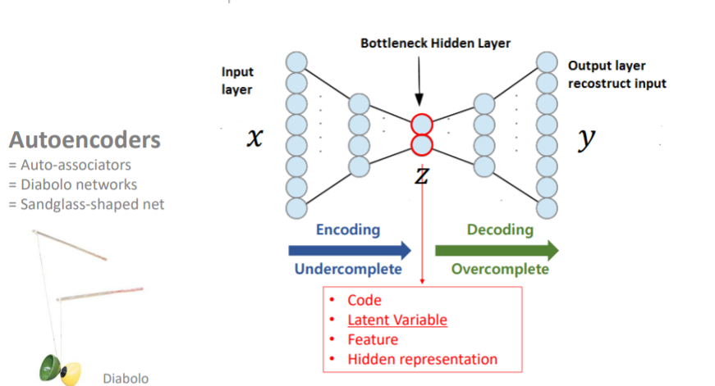
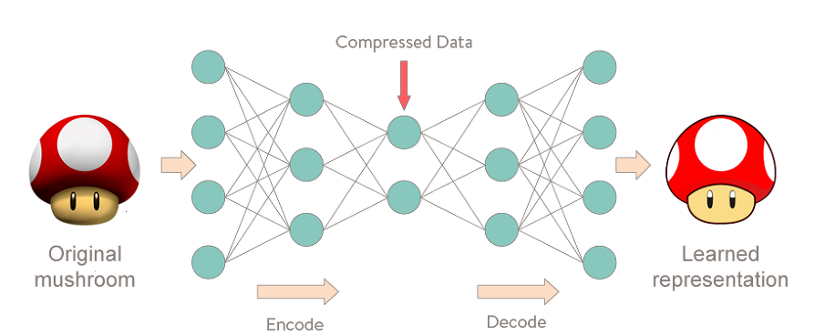
Prior Knowledge
Manifold learning
AutoEncoder
VAE
Prior Knowledge
Manifold learning
AutoEncoder
설계 결과
Auto Encoder

Slide 4
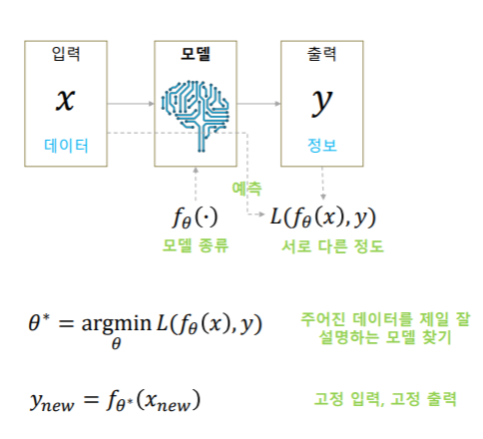
Prior Knowledge
Prior Knowledge
Manifold learning
배경 이론
설계 과정
AutoEncoder
설계 결과
VAE
Prior Knowledge
-Update parameter
$$θ :parameter set of Weight and Bias$$
$θ^{∗}:optimized parmeter set for loss fuction$

Slide 5
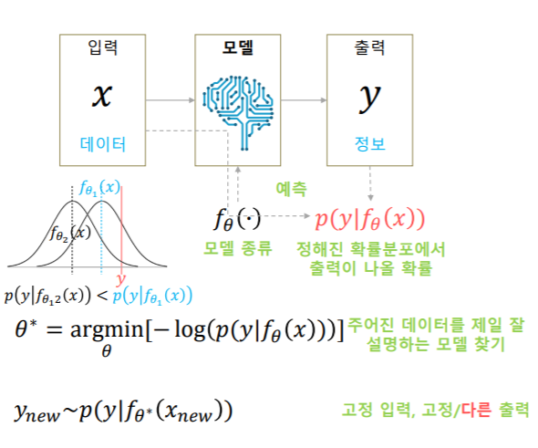
Prior Knowledge
Prior Knowledge
Manifold learning
배경 이론
설계 과정
AutoEncoder
설계 결과
VAE
Prior Knowledge
-Maximum likelihood ($P(A|B)$)
$f_{θ}$의 확률분포의 평균이 y에 가깝게 만듬

Slide 6
Prior Knowledge
Manifold learning
AutoEncoder
VAE
Prior Knowledge
Manifold learning
설계 과정
설계 결과
Manifold learning

Slide 7
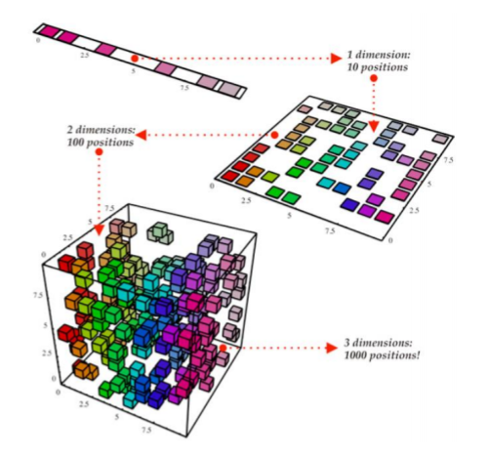
Prior Knowledge
Manifold learning
AutoEncoder
VAE
Prior Knowledge
Manifold learning
설계 과정
설계 결과
Manifold learning
-차원의 저주
데이터의 차원이 증가할수록 해당 공간의 크기(부피)가 기하급수적으로 증가
→ 동일한 개수의 데이터의 밀도는 차원이 증가할수록 급속도로 희박해짐
$∴$ 차원이 증가할수록 데이터의 분포 분석 또는 모델추정에 필요한 샘플 데이터의 개수가 기하급수적으로 증가

Slide 8
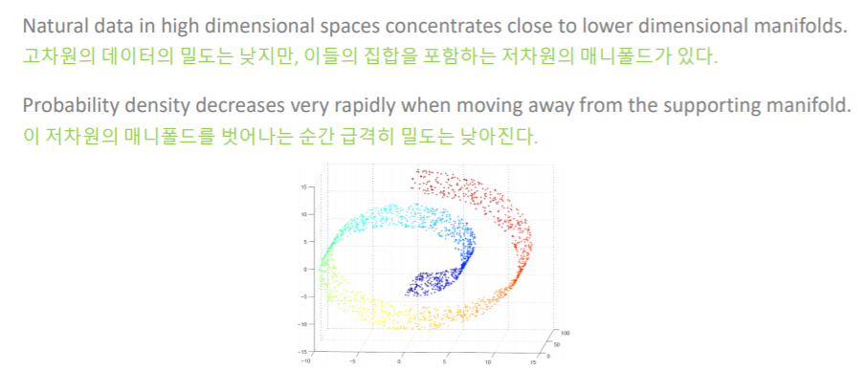
Prior Knowledge
Manifold learning
AutoEncoder
VAE
Prior Knowledge
Manifold learning
설계 과정
설계 결과
Manifold learning
-Manifold hypothesis (assumption)

Slide 9
Prior Knowledge
Manifold learning
AutoEncoder
VAE
Prior Knowledge
Manifold learning
설계 과정
설계 결과
Manifold learning

Slide 10
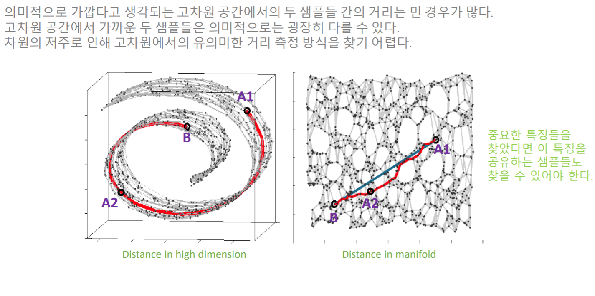
Prior Knowledge
Manifold learning
설계 과정
설계 결과
Prior Knowledge
Manifold learning
AutoEncoder
VAE
Manifold learning
-Reasonable distance metric

Slide 11
Prior Knowledge
Manifold learning
AutoEncoder
VAE
Prior Knowledge
Manifold learning
설계 과정
설계 결과
Manifold learning
-고차원데이터에서의 Euclidian distance

Slide 12
Prior Knowledge
Manifold learning
AutoEncoder
VAE
Prior Knowledge
Manifold learning
설계 과정
설계 결과
Manifold learning
-Reasonable distance metric

Slide 13
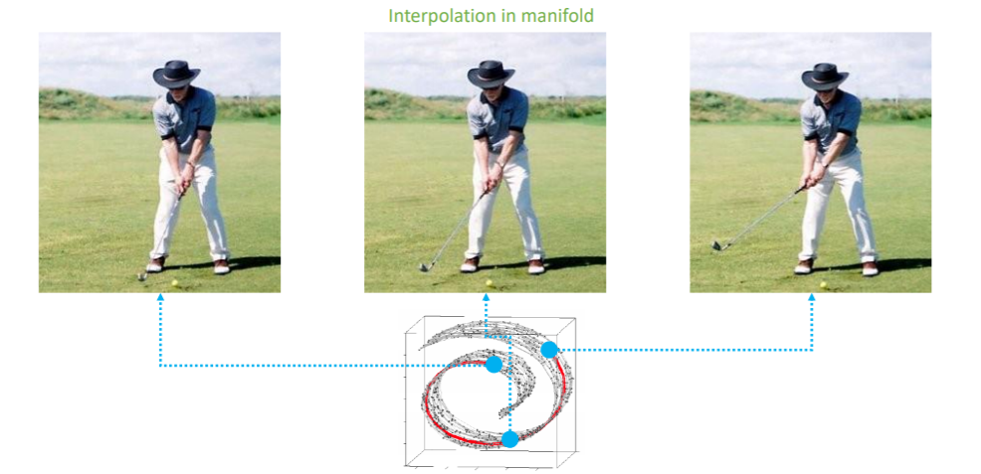
Prior Knowledge
Manifold learning
AutoEncoder
VAE
Prior Knowledge
Manifold learning
설계 과정
설계 결과
Manifold learning
-Reasonable distance metric

Slide 14
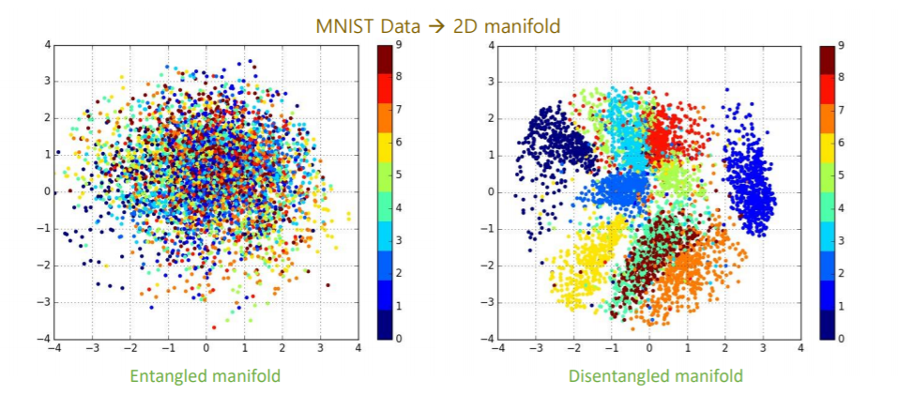
Prior Knowledge
Manifold learning
AutoEncoder
VAE
Prior Knowledge
Manifold learning
설계 과정
설계 결과
Manifold learning
-Disentangled manifold의 필요성
When a manifold is disentangled, it would be more interpretable and easier to apply to tasks

Slide 15
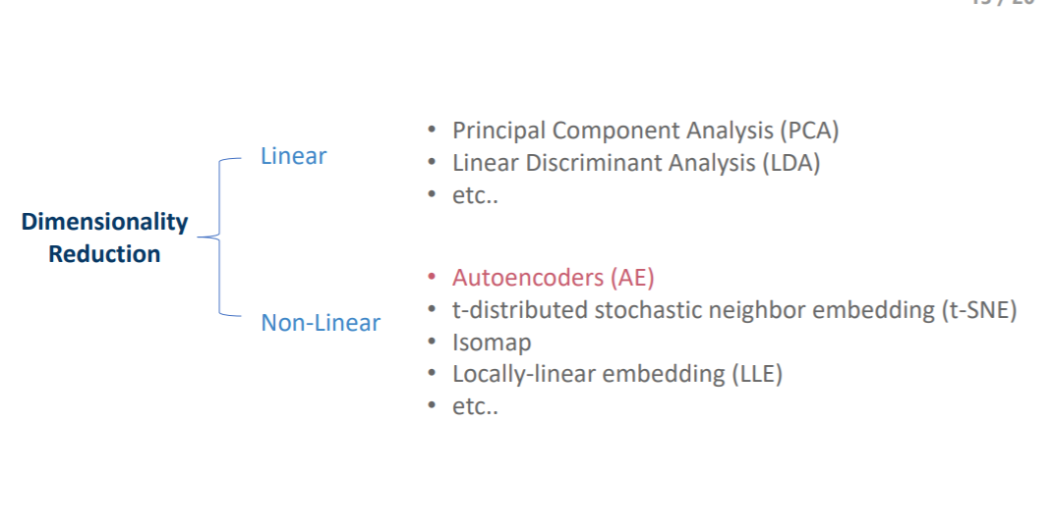
Prior Knowledge
Manifold learning
AutoEncoder
VAE
Prior Knowledge
Manifold learning
설계 과정
설계 결과
Manifold learning
-Ways of Reducting Dimension

Slide 16
Prior Knowledge
Manifold learning
AutoEncoder
VAE
Prior Knowledge
Manifold learning
AutoEncoder
설계 결과
Auto Encoder

Slide 17
Prior Knowledge
Manifold learning
AutoEncoder
VAE
Prior Knowledge
Manifold learning
AutoEncoder
설계 결과
Auto Encoder

Slide 18
Prior Knowledge
Manifold learning
AutoEncoder
VAE
Variational Auto Encoder

Slide 19
Prior Knowledge
Manifold learning
AutoEncoder
VAE
Variational Auto Encoder
- 그냥 z에서 sampling하면 안되는 이유

Slide 20
Prior Knowledge
Manifold learning
AutoEncoder
VAE
Variational Auto Encoder
- 해결책: sampling $z from p(z|x)$ by variance inference

Slide 21
Prior Knowledge
Manifold learning
AutoEncoder
VAE
Variational Auto Encoder
-Derivation

Slide 22
Prior Knowledge
Manifold learning
AutoEncoder
VAE
Variational Auto Encoder
-Derivation

Slide 23
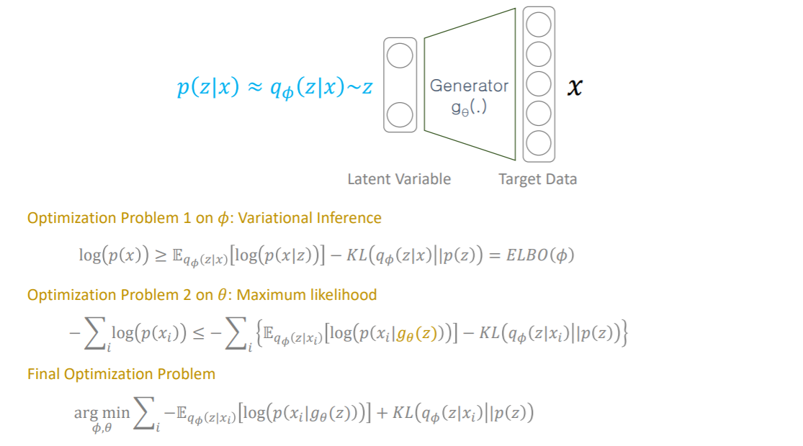
Prior Knowledge
Manifold learning
AutoEncoder
VAE
Variational Auto Encoder
-Derivation

Slide 24
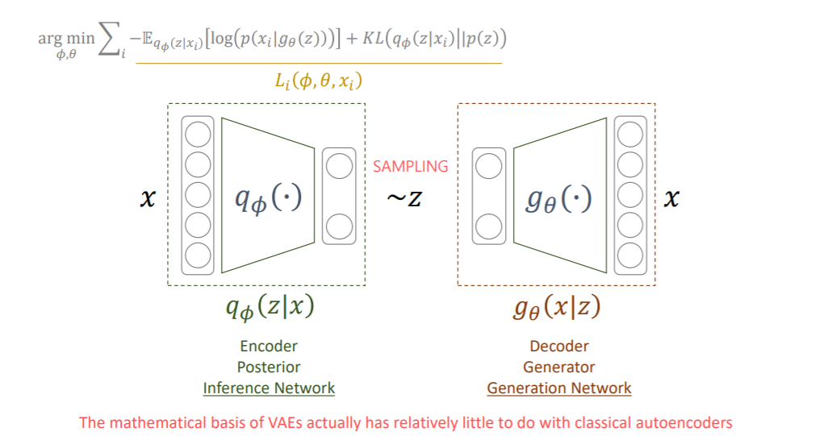
Prior Knowledge
Manifold learning
AutoEncoder
VAE
Variational Auto Encoder
-Derivation
Generation Network를 학습시키고 싶어서 Inference Network를 만들었더니 AutoEncoder와 모양이 비슷해진 꼴

Slide 25
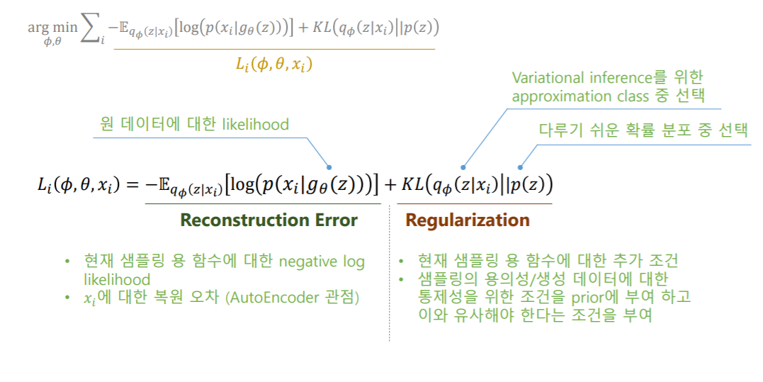
Prior Knowledge
Manifold learning
AutoEncoder
VAE
Variational Auto Encoder
-Loss Function

Slide 26
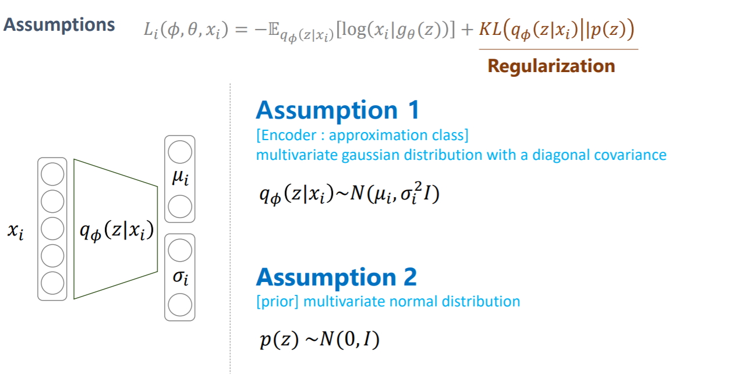
Prior Knowledge
Manifold learning
AutoEncoder
VAE
Variational Auto Encoder
-Regularization of Loss Function

Slide 27
Prior Knowledge
Manifold learning
AutoEncoder
VAE
Variational Auto Encoder
-Regularization of Loss Function

Slide 28
Prior Knowledge
Manifold learning
AutoEncoder
VAE
Variational Auto Encoder
-Reconstruction of Loss Function

Slide 29
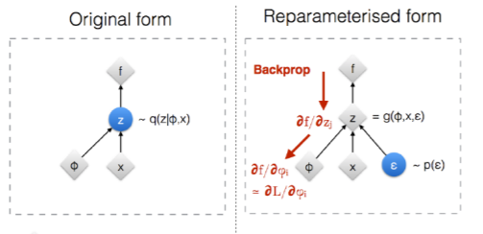
Prior Knowledge
Manifold learning
AutoEncoder
VAE
Variational Auto Encoder
-Reparametrization Trick
원래 z를 $q_{∅}$로부터 sample 하므로 random해서 미분불가 -> reparametrization tirck 이용
미분불가
미분가능

Slide 30
Prior Knowledge
Manifold learning
AutoEncoder
VAE
Variational Auto Encoder
-Reconstruction Error Assumption

Slide 31
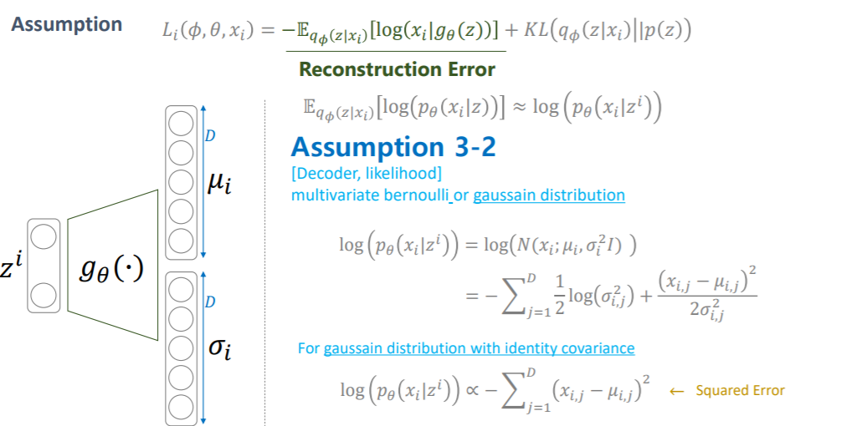
Prior Knowledge
Manifold learning
AutoEncoder
VAE
Variational Auto Encoder
-Reconstruction Error Assumption

Slide 32
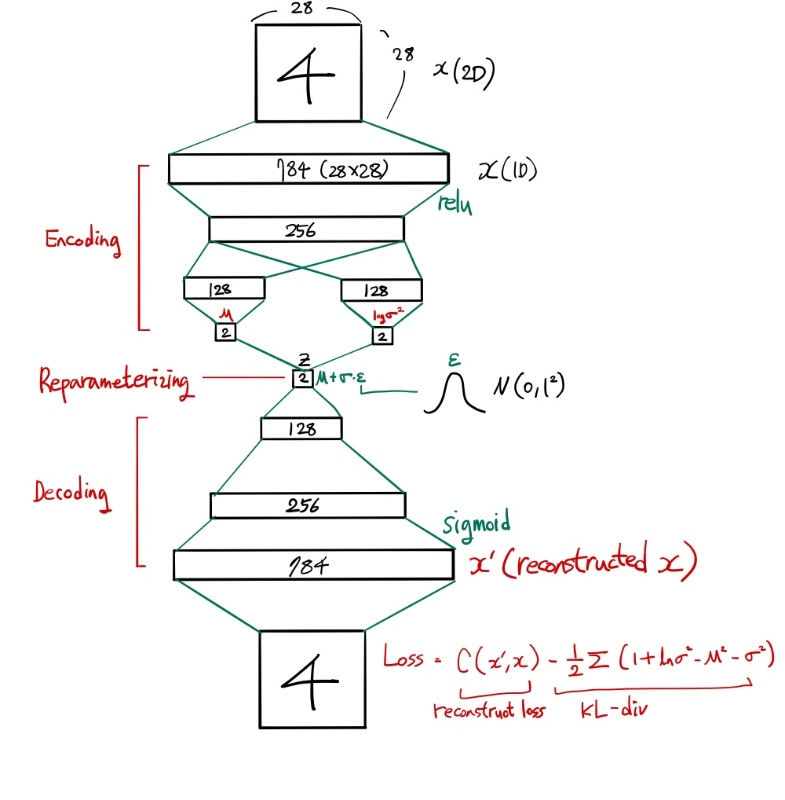
Prior Knowledge
Manifold learning
AutoEncoder
VAE
Architecture and Code
https://github.com/kdh4672/DH_Lab/blob/master/Deeplearning_Basic/VAE.ipynb

Slide 33
Reference
2020년도 1학기 인공지능종합설계I
https://www.youtube.com/watch?v=o_peo6U7IRM&t=0s

