Slide 1
OpenDSS Tutorial
Roger C. Dugan Sr. Technical Executive
PEPQA 2015, Bogota CO 2 June 2015

Slide 2
What is the OpenDSS?
Script-driven, frequency-domain electrical circuit simulation tool for dynamic distribution system modeling
Specific models for:
Supporting utility distribution system analysis
Designed for the unbalanced, multi-phase North American power distribution systems
Can also model European-style systems
These typically have a simpler structure

Slide 3
Typical North American Distribution System
Typical 4-wire multi-grounded neutral system
Unigrounded/Delta 3-wire also common on West Coast

Slide 4
Typical European Style System
3-wire unigrounded primary
Three-phase throughout,
including secondary (LV)

Slide 5
What is the OpenDSS? (cont’d)
Heritage of OpenDSS
Harmonics solvers rather than power flow
Gives OpenDSS extraordinary distribution system modeling capability
Simpler to solve the power flow problem with a harmonics solver than vice-versa
Supports all rms steady-state (i.e., frequency domain) analyses commonly performed for utility distribution system planning
And many new types of analyses
Original purpose in 1997: DG interconnection analysis

Slide 6
What is the OpenDSS? (cont’d)
NOT
An Electromagnetic transients solver (Time Domain)
It can solve Electromechanical transients
Frequency Domain => “Dynamics” mode
All solutions are in phasors (complex math)
..A “Power Flow” program
..A radial circuit solver
Does meshed networks with equal ease
..A distribution data management tool
It is a simulation engine designed to work with data extracted from one or more utility databases

Slide 7
What is the OpenDSS? (cont’d)
EPRI acquired the DSS software from Electrotek Concepts in 2004
It is EPRI’s primary tool for researching new methods in distribution system analysis
EPRI made the program open source in 2008 to collaborate with the industry to advance grid modernization efforts
Users have access to the latest versions that EPRI is using
Sourceforge.net is our source code repository

Slide 8
Why Dynamic Distribution Modeling?
You don’t get the right answer for many issues unless you simulate over a significant period of time
Disruptive technologies in distribution systems:
Integration of distributed generation and storage
Microgrids
Electric vehicles and other load changes
Evaluation of power delivery losses

Slide 9
Time- and Location-Dependent Benefits
Traditional distribution system analysis programs
Designed to study peak demand capacity
Capture mostly location-specific benefits
Ignores time; assumes the resource is available
This gets the wrong answer for many DG, energy efficiency, and Smart Grid analyses
Must do sequential-time analysis to get the right answer
Over a distribution planning area
Over a significant time period
Year, Month, or Week

Slide 10
What can OpenDSS be used for?
DG
Interconnection studies/screening
Value of service studies (risk based)
Solar PV voltage rise/fluctuation
Wind power variations impact
Hi-penetration solar PV impacts
Harmonic distortion simulation
Dynamics/islanding

Slide 11
What has OpenDSS be used for?
Hybrid simulation of communications and power networks
Geomagnetically-Induced Current (GIC) flow (solar storms)
Power delivery loss evaluations (EPRI Green circuits program - > 80 feeders)
Voltage optimization
PEV/PHEV impact simulations
Community energy storage (EPRI Smart Grid Demo)
High-frequency harmonic/interharmonic interference
Various unusual transformer configurations
Transformer frequency response analysis
Distribution automation control algorithm assessment
Impact of tankless electric water heaters
Wind farm collector simulations
Wind farm interaction with transmission
Wind generation impact on capacitor switching and regulator/LTC tapchanger operations
Protection system simulation
Open-conductor fault conditions
Circulating currents on transmission skywires
Ground voltage rise during faults on lines
Stray voltage simulations
Industrial load harmonics studies/filter design
Distribution feeder harmonics analysis, triplen harmonic filter design
And many more ….

Slide 12
Computing Annual Losses
Peak load losses are not necessarily indicative of annual losses

Slide 13
Solar PV Simulation – 1 h step size

Slide 14
1-s Solar Data – Cloud Transients
Impact on Feeder Voltage ??

Slide 15
Storage Modeling Simple Peak Shave Example

Slide 16
Program Files
For each of X86 and X64 versions:
OpenDSS.EXE Standalone EXE
OpenDSSEngine.DLL In-process COM server
KLUSolve.DLL Sparse matrix solver
DSSView.EXE is a separate program for processing graphics output

Slide 17
User Interfaces Currently Implemented
A stand-alone executable program that provides a text-based scripting interface (multiple windows)
Some graphical output is also provided.
No graphical input is provided.
An in-process COM server (for Windows) that supports driving the simulator from user-written programs.
32-bit and 64-bit

Slide 18
Why Scripting and COM?
More flexible than static forms
No two Smart Grid simulations alike
Not possible to predict what users will want to do
COM = Component Object Model
Supported by nearly all programming languages, Microsoft Office, MATLAB, Python, etc
Allows user to write their own algorithms
For things like DA controllers and DMS simulators
Co-simulation of power and communications
COM is not familiar to most power engineers but is powerful means of scripting

Slide 19
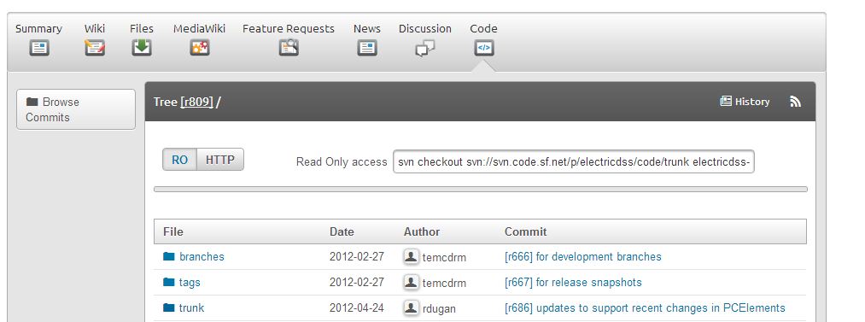
SourceForge.Net Links for OpenDSS
EPRI Links Page
http://smartgrid.epri.com/SimulationTool.aspx
OpenDSS Download Files:
http://sourceforge.net/projects/electricdss/files/
Top level of Main Repository

Slide 20
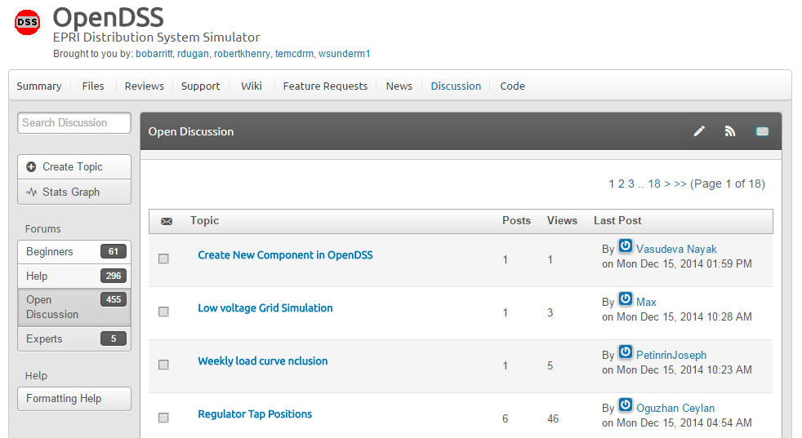
Discussion Forum & News for OpenDSS

Slide 21
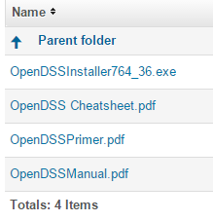
Installing
Download the Installer
http://sourceforge.net/projects/electricdss/files/
Get pdf Files, too (Also can be found in distrib/doc folder)

Slide 22
32-bit Vs 64-bit
On Windows 7 & 8 you can register both versions
They are in separate places in the registry
You will probably need to register both
MATLAB is often installed as 64-bit (x64)
MS Office is most often installed as 32-bit (x86)
Windows 7 will run the proper version depending on the type of program invoking the DSSEngine.
Magic!!

Slide 23
Questions So Far?

Slide 24
How OpenDSS Works

Slide 25
The Math …
Nearly everything results in a matrix or array
Nodal Admittance formulation
Circuit elements modeled by primitive admittance matrices
Y_{prim}
Primitive Y matrices used to build System Y matrix
OpenDSS Works In
Phase domain
Actual volts and amps
Symmetrical components and per units not used inside the program !! -- Input and output only!

Slide 26
Primitive Y Matrix
Simple Resistor

Slide 27
Primitive Y Matrix, cont’d
LINE model

Slide 28
What about 3-phase elements?
Simply let R, X, B, G, C, etc. represent 3x3 matrix
Notation stays the same
And it works!
I1, I2, V1, V2 etc become 3x1 vectors
This is basically how ALL the Circuit Element (CktElement) models in OpenDSS work.

Slide 29
The Network Model

Slide 30
Nodal Admittance Equations
V₁
V₂
…
V_{S}
…
V_{L1}
…
V_{L2}
…
V_{N}
I₁
I₂
…
I_{S}
…
I_{L1}
…
I_{L2}
…
I_{N}
Y_{SYSTEM}
=
N x N
(Sparse)
N = Number of NODES (not BUSES)

Slide 31
Solving the Power Flow Problem with a Harmonics Solver
Once the circuit model is connected properly the next step is to Solve the base power flow
It is easier to teach a harmonics solver how to solve the power flow than the other way
PC elements (i.e., Loads) are usually nonlinear
PC = Power Conversion
Loads are linearized to a Norton equivalent based on nominal 100% rated voltage.
Current source is “compensation current”
Compensates for the nonlinear characteristic

Slide 32
Solving the Power Flow
A fixed point iterative solution algorithm is employed for most solutions
This method allows for flexible load models and is robust for most distribution systems

Slide 33
Load (a PC Element)
General Concept
Added into Injection Current Vector
Goes into System Y Matrix
(One-Line Diagram)
Most Power Conversion (PC) Elements are Modeled Like This

Slide 34
Load - 3-phase Y connected
Phase 1
1
2
Phase 2
3
4 Conductors/Terminal
Phase 3
4

Slide 35
Load - 3-phase Delta connected
Phase 1
2
1
Phase 2
3
3 Conductors/Terminal
Phase 3

Slide 36
Load Models (Present version)
1:Standard constant P+jQ load. (Default)
2:Constant impedance load.
3:Const P, Quadratic Q (like a motor).
4:Nominal Linear P, Quadratic Q (feeder mix). Use this with CVRfactor.
5:Constant Current Magnitude
6:Const P, Fixed Q
7:Const P, Fixed Impedance Q
8: Special ZIP load model

Slide 37
Standard P + jQ (constant power) Load Model
When the voltage goes out of the normal range for a load the model reverts to a linear load model
This generally guarantees convergence
Even when a fault is applied
This script changes break points to +/- 10%:
Load.Load1.Vmaxpu=1.10
Load.Load1.Vminpu=0.90
Note: to solve some of the IEEE Radial Test feeders and match the published results, you have to set Vminpu to less than the lowest voltage published (usually about 0.80 per unit)

Slide 38
Standard P + jQ Load Model (Model=1)
Const Z
105%
(Defaults*)
95%
|I| = |S/V|
Const Z
New Method (2014)
* Change by setting Vminpu and Vmaxpu Properties

Slide 39
Power Flow Solution Algorithm
Initial Guess at Node Voltages, V
Compute all Injection (Compensation) Currents, I
For PC Elements
Solve for new guess at V
Repeat 2 and 3 until Converged
Convergence is based on change in per unit voltage magnitude
Default tolerance = 0.0001
Good enough for distribution systems

Slide 40
Putting it All Together
ALL Elements
Yprim 1
Yprim 2
Yprim 3
Yprim n
PC Elements Comp. Currents
I1
I2
Y
Node
Voltages
I_{inj}
=
V
Im
Iteration Loop

Slide 41
Putting it All Together
Th-Th-That's All Folks !
ALL Elements
Yprim 1
Yprim 2
Yprim 3
Yprim n
PC Elements Comp. Currents
I1
I2
Y
Node
Voltages
I_{inj}
=
V
Im
Iteration Loop

Slide 42
Solving the Power Flow …
This solution method requires that the first guess at the voltages be close to the final solution
Not a problem for daily or yearly simulations
Present solution is a good guess for next time step
First solution is often most difficult
The solution initialization routine in OpenDSS accomplishes this with ease in most cases
Method works well for arbitrary unbalances

Slide 43
Solution Speed
Distribution systems generally converge very well
Many transmission systems, also
The OpenDSS on par with faster commercial programs
Solution method is designed to run annual simulations
Our philosophy:
Err on the side of running more power flow simulations
Don’t worry about the solution time until it proves to be a problem
This reveals more information about the problem

Slide 44
OpenDSS Solution Loop with Controls

Slide 45
Circuit Modeling Basics
Some things that might be a bit different than other power system analysis tools you may have used.

Slide 46
DSS Bus Model (Bus ≠ Node)
Nodes
Bus
Referring to Buses and Nodes (A Bus has 1 or more Nodes)
Bus1=BusName.1.2.3.0
(This is the default for a 3-phase circuit element)
Shorthand notation for taking the default
Bus1=BusName
Note: Sometimes this can bite you (e.g. – Transformers, or capacitors with ungrounded neutrals)

Slide 47
DSS Terminal Definition
Conductors
Circuit Elements have one or more Terminals with 1..N conductors.
Conductors connect to Nodes at a Bus
Each Terminal connects to one and only one Bus

Slide 48
Power Delivery Elements
PD Elements are Generally Completely Described by [Yprim]

Slide 49
Power Conversion Elements
I_{Term}(t) = F(V_{Term}, [State], t)
Power Conversion (PC) elements are typically connected in “shunt” with the Power Delivery (PD) elements
PC Elements may be nonlinear
Described some function of V
May be linear
e.g., Vsource, Isource
May have more than one terminal, but typically one
Load, generator, storage, etc.

Slide 50
Specifying Bus Connections
Shorthand (implicit)
New Load.LOAD1 Bus1=LOADBUS
Assumes standard 3-phase connection by default
LOADBUS
6
5
4
3
LOAD
2
1
0

Slide 51
Specifying Bus Connections
Explicit
New Load.LOAD1 Bus1=LOADBUS.1.2.3.0
Explicitly defines which node
New Load.1-PHASELOAD Phases=1 Bus1=LOADBUS.2.0
Connects 1-phase load to Node 2 and ground
1-Phase Load Example

Slide 52
Specifying Bus Connections
Default Bus templates
Node connections assumed if not explicitly declared
Element declared Phases=1
… LOADBUS.1.0.0.0.0.0.0.0.0.0. …
Element declared Phases=2
… LOADBUS.1.2.0.0.0.0.0.0.0.0. …
Element declared Phases=3
… LOADBUS.1.2.3.0.0.0.0.0.0.0. …

Slide 53
Specifying Bus Connections
Ungrounded-Wye Specification
Bus1=LOADBUS.1.2.3.4 (or some other unused Node number)
Voltage at this Node is explicitly computed (just like any other Node)

Slide 54
Possible Gotcha: Specifying Two Ungrounded-Wye Capacitors on Same Bus
MyBus
… Bus1=MyBus.1.2.3 Bus2=MyBus.5.5.5
Neutrals are not connected to each other in this specification!
… Bus1=MyBus Bus2=MyBus.4.4.4

Slide 55
Circuit Element Conductors are Connected to the Nodes of Buses
MyBus
3
2
1
0
. . . Bus2 = MyBus.2.1.3.0 . . .
. . . Bus1 = MyBus . . .
(take the default)
(Explicitly define connections)
DSS Convention: A Terminal can be connected to only one Bus. You can have any number of Nodes at a bus.

Slide 56
Example: Connections for 1-Phase Residential Transformer Used in North America
! Line-to-Neutral Connected 1-phase Center-tapped transformer
New Transformer.Example_1-ph phases=1 Windings=3
! Typical impedances for small transformer with interlaced secondaries
~ Xhl=2.04 Xht=2.04 Xlt=1.36 %noloadloss=.2
! Winding Definitions
~ wdg=1 Bus=Bus1.1.0 kV=7.2 kVA=25 %R=0.6 Conn=wye
~ wdg=2 Bus=Bus2.1.0 kV=0.12 kVA=25 %R=1.2 Conn=wye
~ Wdg=3 Bus=Bus2.0.2 kV=0.12 kVA=25 %R=1.2 Conn=wye
Note: You may use XfmrCode to define a library of transformer definitions that are used repeatedly (like LineCode for Line elements)

Slide 57
All Terminals of a Circuit Element Have Same Number of Conductors
3-Phase Transformer

Slide 58
Scripting Basics
Syntax and how to build circuit models.
Simple Model

Slide 59
Scripting Recommendation
A good text editor is recommended
Notepad is OK but others may be better for you:
EditPlus
TextPad
Notepad++
Must be capable of saving a file in plain ANSI text
Not Unicode
Not RTF (Write)
Not Doc (Word)

Slide 60
Scripting
OpenDSS is a scriptable solution engine
Scripts
Series of commands
From text files
From edit forms in OpenDSS.EXE
From another program through COM interface
e. g., This is how you would do looping
Scripts define circuits
Scripts control solution of circuits
Scripts specify output, etc.

Slide 61
Command Syntax
Command parm1, parm2 parm3 parm 4 ….
Parameters may be positional or named (tagged).
If named, an "=" sign is expected.
Name=value (this is the named form)
Value (value alone in positional form)
For example, the following two commands are equivalent:
New Object="Line.First Line" Bus1=b1240 Bus2=32 LineCode=336ACSR, …
New “Line.First Line”, b1240 32 336ACSR, …
Comma or white space

Slide 62
Delimiters
Array or string delimiter pairs: [ ] , { },( ),“ “,‘ ‘
Matrix row delimiter: |
Value delimiters: , (comma) any white space (tab or space)
Class, Object, Bus, or Node delimiter: . (period)
Keyword / value separator: =
Continuation of previous line: ~ (More)
Comment line: //
In-line comment: !
Query a property: ?

Slide 63
Array and Matrix Parameters
Array
kvs = [115, 6.6, 22]
kvas=[20000 16000 16000]
Matrix
(3x3 matrix)
Xmatrix=[1.2 .3 .3 | .3 1.2 3 | .3 .3 1.2]
(3x3 matrix – lower triangle)
Xmatrix=[ 1.2 | .3 1.2 | .3 .3 1.2 ]

Slide 64
An Example

Slide 65
A Basic Script (Class Exercise)
New Circuit.Simple ! Creates voltage source (Vsource.Source)
Edit Vsource.Source BasekV=115 pu=1.05 ISC3=3000 ISC1=2500 !Define source V and Z
~ bus1=sourcebus.1.2.3 bus2=Sourcebus.10.10.10
New Reactor.Rneutral phases=1 bus1=Sourcebus.10 Bus2=Sourcebus.0 R=.01 X=0
New Transformer.TR1 Buses=[SourceBus, Sub_Bus] Conns=[Delta Wye] kVs= [115 12.47]
~ kVAs=[20000 20000] XHL=10
New Linecode.336ACSR R1=0.058 X1=.1206 R0=.1784 X0=.4047 C1=3.4 C0=1.6 Units=kft
New Line.LINE1 Bus1=Sub_Bus Bus2=LoadBus Linecode=336ACSR Length=1 Units=Mi
New Load.LOAD1 Bus1=LoadBus kV=12.47 kW=1000 PF=.95
Solve
Show Voltages
Show Currents
Show Powers kVA elements

Slide 66
Detailed Distribution Circuit Modeling
How to organize scripts for larger problems
Examination of how the IEEE 8500-Node Test Feeder model is organized

Slide 67
Scripting Large Circuits
For small circuits, often put all the scripts in one file
Some IEEE test feeder examples are mostly in one file
When you have large amounts of data, a more disciplined approach is recommended using multiple files:
Redirect Command
Redirects the input to another file
Returns to home directory
Compile Command
Same as Redirect except repositions home directory

Slide 68
Organizing Your Main Screen
OpenDSS.exe saves all windows on the main screen
They appear where you left them when you shut down
The next time you start up, you can resume your work
Values are saved in the Windows Registry
Come up with a way you are comfortable with

Slide 69
A Common Sense Structuring of Script Files
Run_The_Master.DSS
“Compile” the Master file from here
Master.DSS
LineCodes.DSS
WireData.DSS
LineGeometry.DSS
Libraries
Put a “Clear” in here
Spectrum.DSS
LoadShape.DSS
Transformers.DSS
Lines.DSS
Circuit Definition
Make a separate folder for each circuit
Loads.DSS
Etc.

Slide 70
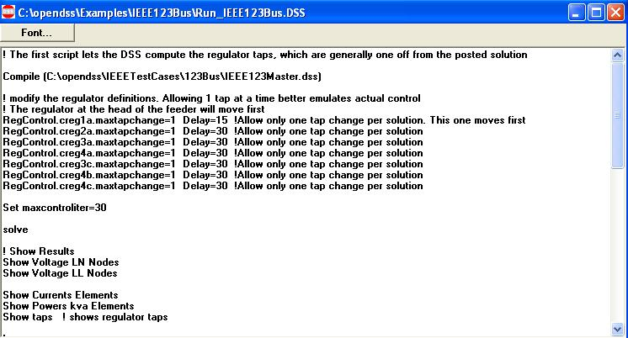
Organizing Run Scripts
Based on 123-bus Test Feeder
Compiles the Circuit Description
Override Some Property Settings and/or Define Some Additional Circuit Element
Change an option
Solve Snapshot Power Flow
Selected Results Display

Slide 71
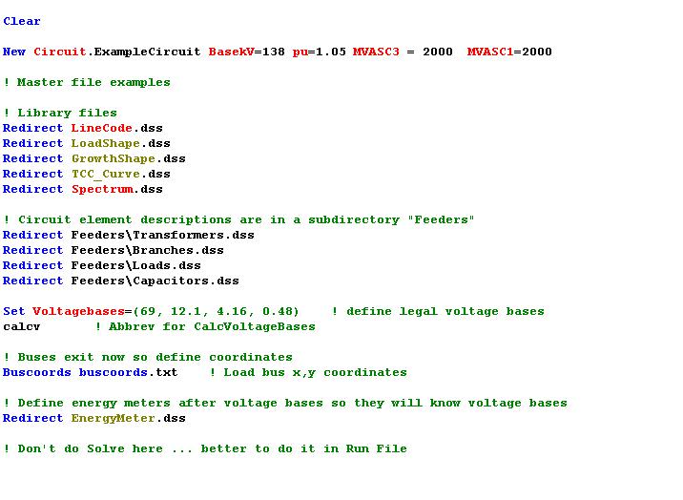
Organizing Your Master File
So Compile Doesn’t Fail
General Library Data
Circuit Elements for this Model
Let OpenDSS Define the Voltage Bases
(You can do this explicitly with SetkVBase command)

Slide 72
Example: IEEE 8500-Node Test Feeder

Slide 73
OpenDSS COM Interface
Programming via the COM interface

Slide 74
Review: Two Implementations of OpenDSS
Stand-alone EXE
32-bit
64-bit
Use this to develop text scripts to study problems
In-Process COM Server
32-bit
64-bit
Use this to link OpenDSS to other programs
Automate the program
Execute complex algorithms

Slide 75
DSS Structure
Text
Scripts
Main Simulation Engine
COM Interface
User-Written DLLs
Scripts, Results

Slide 76
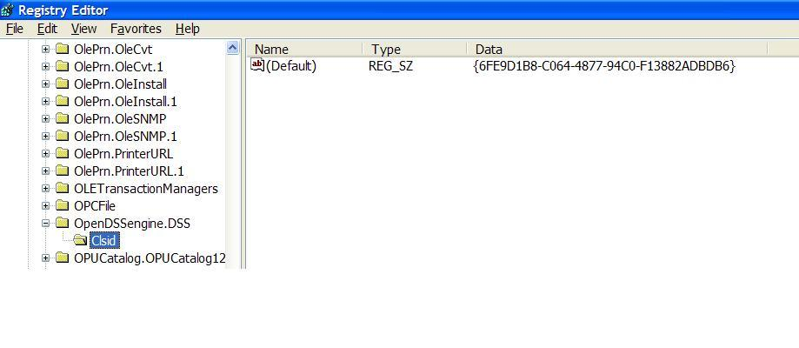
OpenDSSEngine.DSS is Registered
Windows Registry Entry
GUID
The Server shows up as “OpenDSSEngine.DSS” in the Windows Registry
The OpenDSS is now available to any program on the computer

Slide 77
Linking Your Program to the COM Server
Examples of accessing the COM server in various languages
In MATLAB:
DSSobj = actxserver(‘OpenDSSEngine.DSS’);
In VBA:
Public DSSobj As OpenDSSEngine.DSS Set DSSobj = New OpenDSSEngine.DSS
In Dephi
{Import Type Library}
Type DSSObj : IDSS;
…
DSSObj := coDSS.Create;

Slide 78
Linking Your Program to the COM Server, 2
In PYTHON:
Import win32com.client
Class DSS:
self.engine = win32com.client.Dispatch("OpenDSSEngine.DSS")
In C#:
(Project >Add Reference … select OpenDSSEngine)
Using OpenDSSEngine;
Public DSS DSSObj;
DSSObj = new DSS();

Slide 79
OpenDSS COM Interfaces
There are many interfaces supplied by the COM server
There is one registered In-Process COM interface:
OpenDSSEngine.DSS
The DSS interface is the one your program instantiates
The DSS interface then creates all the others.
This is for simplicity for users who are not necessarily familiar with COM programming

Slide 80
“Active objects” concept
.The interfaces generally act on the ACTIVE object
Active circuit,
Active circuit element,
Active bus, etc.
The interfaces generally point to the active object
To work with another object, change the active object
There are methods for selecting objects
You may also use script commands

Slide 81
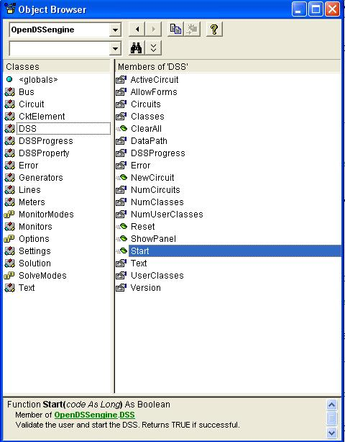
DSS Interface
This is the main interface. It is instantiated upon loading OpenDSSEngine.DSS and then instantiates all other interfaces internally
Call the Start(0) method to initialize the DSS
DSS Class Functions (methods) and Properties

Slide 82
Together... Shaping the Future of Electricity
(The End)

