Slide 1
Advanced Modeling for Distribution Planning Workshop with OpenDSS
Instructors
Roger C. Dugan Matt Rylander
Sponsored by CenterPoint Energy At Texas A&M University April 19, 20, 21

Slide 2

Instructor
Roger C. Dugan, Life Fellow, IEEE
Roger is a Sr. Technical Executive with EPRI in Knoxville, Tennessee USA. He has over 45 years of combined experience in distribution engineering with EPRI, Electrotek Concepts, and Cooper Power Systems. He holds the BSEE degree from Ohio University and the Master of Engineering in Electric Power Engineering degree from Rensselaer Polytechnic Institute, Troy, NY. Roger has worked on many diverse aspects of power engineering over his career because of his interests in applying computer methods to power system simulation. Beginning with a student internship with Columbus and Southern Ohio Electric Co, his work has been focused on Distribution Engineering. He was elected a Fellow of the IEEE for his contributions in harmonics and transients analysis. Recently, he has been very active in distributed generation, particularly as it applies to utility distribution systems and distribution system analysis. He was the 2005 recipient of the IEEE Excellence in Distribution Engineering Award. He is coauthor of Electrical Power Systems Quality published by McGraw-Hill, now in its 3rd edition. He serves on the IEEE PES Distribution System Analysis Subcommittee and is active in the Distribution Test Feeders WG.

Slide 3
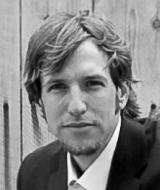
Instructor
Matthew Rylander Technical Leader Power Systems Studies Power Delivery and Utilization mrylander@epri.com (512) 351-9938
Matthew Rylander is a Technical Lead Engineer at the Electric Power Research Institute. His current research activities focus on transmission and distribution system issues such as analyzing operational strategies to improve system operation and evaluating the impact of distributed resources. Before joining EPRI, Matthew received his Doctorate from the University of Texas at Austin in 2008 and worked at the Electric Reliability Council of Texas.
Area of Responsibility – Distribution System Analysis and the Integration of Distributed Energy Resources
The past 5 years have been spent in detailed distributed energy resource (DER) analysis to the distribution system. The detailed analysis have examined DER impact methods from screening, clustering, and more streamlined techniques. Those analyses have also led to the impacts considering hosting capacity, operational flexibility, smart inverter settings, power quality aspects, and the values of DER.
Recent Publications & Research Results
Integration of Hosting Capacity Analysis into Distribution Planning Tools. EPRI, Palo Alto, CA: 2015. 3002005793.
Analysis to Inform CA Grid Integration: Methods and Default Settings to Effectively Use Advanced Inverter Functions in the Distribution System. EPRI, Palo Alto, CA: 2015. 3002007139.
Alternatives to the 15% Rule: Modified Screens and Validation. EPRI, Palo Alto, CA: 2015. 3002005791.

Slide 4
Introduction to Distribution Systems

Slide 5
Typical North American Distribution System
Typical 4-wire multi-grounded neutral system
Unigrounded/Delta 3-wire also common on West Coast

Slide 6
Typical European Style System
3-wire unigrounded primary
Three-phase throughout,
including secondary (LV)

Slide 7
Comparisons of Systems
European-Style System
MV
LV
North American System
MV (ALL)

Slide 8
Comparison of Distribution Systems
North American System
Primary (MV) system is extensive, complex
Secondary (LV) is short
4-5 houses per distribution transformer
120/240 V single-phase (“split phase”) service
1 Industrial customer per distribution transformer
Or multiple transformers per customer
Extended by adding transformer + wire
European Style System
MV System has simpler structure
LV System (400 V) is extensive
Perhaps 100 residences on MV/LV transformer
230/400 V 3-phase
Extended by adding wire
Fewer transformers

Slide 9
Urban Low-Voltage Network Systems

Slide 10
Urban LV Network Systems – Another View
SUBSTATION
PRIMARY FEEDERS
TRANSMISSION
SYSTEM
FEEDER BREAKER
OR RECLOSER
LOW-VOLTAGE NETWORK
NETWORK
PROTECTOR

Slide 11
Urban LV Network Systems
Used in downtown areas (e.g., Manhattan) requiring extraordinary reliability
In a number of major cities
New York
Seattle
Chicago
Reliability is on the order of 100 times better than radial
Much more costly to build
Use devices not found on other distribution systems
Network transformer and network protectors
Most distribution systems in the world are radial

Slide 12
Why are most distribution systems radial?

Slide 13
Utility Fault-Clearing Practices
This explains why most systems are radial
Important to understand this for DER application on the “Integrated Grid”
Lower-cost protection for the inevitable short circuit
This is where many of the operating conflicts arise !!
DER response during faults can
Affect utility practices, fault clearing
Be damaged by fault clearing practices

Slide 14
The Fuse Characteristic Dictates Utility Fault Protection Practices On Distribution

Slide 15
Fuse Characteristic, cont’d
A fuse is a one-shot device
Operates faster for higher currents
To coordinate with this:
Upstream devices have same basic shape
Devices closer to substation act slower
Except for “fast” or “instantaneous” tripping where we try once or twice to save the fuse

Slide 16
Radial Distribution Fault Protection
Series Overcurrent Devices
(current is expected from only one source)
Only one device operates to clear fault

Slide 17
Transmission Fault Protection
Multiple Sources
Two Devices Must Operate to Clear Fault

Slide 18
Radial Circuit Economics
Most distribution systems are radially configured because the protection system is
Simpler to operate
Less expensive to build
Smart, or “Integrated”, Grid with multiple sources in changing that
Current flows in more than one direction
Overcurrent relaying/fuses inadequate on microgrids

Slide 19
Radial System Protection Principles
Radial Distribution Systems are employed because protection is economical
DER provides multiple sources for faults
System must revert to radial configuration for the fault clearing to proceed when using conventional radial system overcurrent protection.

Slide 20
LV Network Systems

Slide 21
LV Network Protection Principles
Designed for higher reliability than a radial system
Can withstand more failures (2 or more)
Network protectors open very quickly on reverse power
Assumption: The only time the power will reverse is for a fault
Have to shut off all sources of fault current
This makes it very difficult to accommodate much DER on urban LV networks

Slide 22

Reclosing on Radial Circuits
Most faults on primary distribution are temporary
Lightning
Trees blow into lines
Reclosing allows for prompt restoration of service
Interrupt current and allow arc to disperse
Automatically reclose to restore service
Very common on North American distribution systems

Slide 23
Typical Reclosing Sequences
DG may prevent faults from clearing
DG may be damaged by reclose
DG must disconnect here

Slide 24
Summary: Distribution Systems
Structure and operations are dictated by the economics of the protection system and desired Reliability
It will be too costly to modify the protection system just to accommodate DER devices
DER must disconnect for fault clearing on same feeder or LV network
The greater value for DER is generally on the end-user side or to subtransmission feed to distribution
DER can economically defer investments in distribution infrastructure under some circumstances

Slide 25
Introduction to the OpenDSS Program

Slide 26
What is the OpenDSS?
Many of the examples in this course will be taught using the EPRI OpenDSS computer program
The program is freely available and is updated regularly
You may find it on www.Sourceforge.net
Also, bookmark the EPRI link site:
http://smartgrid.epri.com/SimulationTool.aspx

Slide 27
What is the OpenDSS?
Script-driven, frequency-domain electrical circuit simulation tool
Specific models for:
Supporting utility distribution system analysis
Designed for the unbalanced, multi-phase North American power distribution systems
As well as European-style systems
These typically have a simpler structure

Slide 28
What can OpenDSS be used for?
Simple power flow (unbalanced, n-phase)
Daily loading simulations
Yearly loading simulations
Duty cycle simulations
Impulse loads
Rock crushers
Car crushers
Renewable generation
DG
Interconnection studies/screening
Value of service studies (risk based)
Solar PV voltage rise/fluctuation
Wind power variations impact
Hi-penetration solar PV impacts
Harmonic distortion
Dynamics/islanding

Slide 29
What can OpenDSS be used for? (cont’d)
Hybrid simulation of communications and power networks
Geomagnetically-Induced Current (GIC) flow (solar storms)
Power delivery loss evaluations (EPRI Green circuits program - > 80 feeders)
Voltage optimization
PEV/PHEV impact simulations
Community energy storage (EPRI Smart Grid Demo)
High-frequency harmonic/interharmonic interference
Various unusual transformer configurations
Transformer frequency response analysis
Distribution automation control algorithm assessment
Impact of tankless electric water heaters
Wind farm collector simulations
Wind farm interaction with transmission
Wind generation impact on capacitor switching and regulator/LTC tapchanger operations
Protection system simulation
Open-conductor fault conditions
Circulating currents on transmission skywires
Ground voltage rise during faults on lines
Stray voltage simulations
Industrial load harmonics studies/filter design
Distribution feeder harmonics analysis, triplen harmonic filter design
And many more ….

Slide 30
Some Examples

Slide 31
Computing Annual Losses
Peak load losses are not necessarily indicative of annual losses

Slide 32
Using DSS to Determine Incremental Capacity of DG
“Needle” Peaking System
“How much more power can be served at the same risk of unserved energy?”
Broad Summer Peaking System

Slide 33
DG Dispatch

Slide 34
Solar PV Simulation

Slide 35
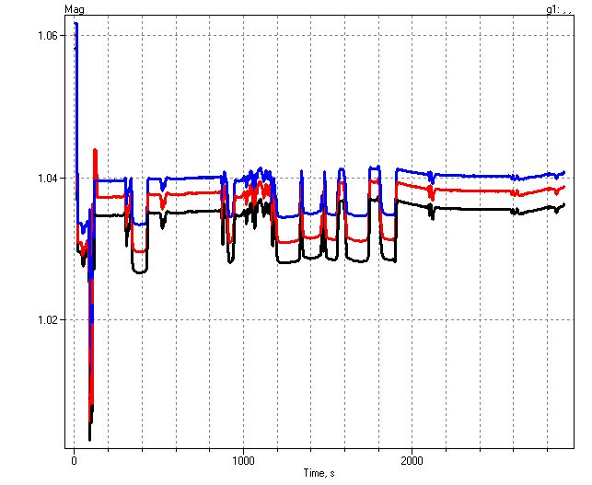
1-sec Solar Data – Cloud Transients
Impact on Feeder Voltage

Slide 36
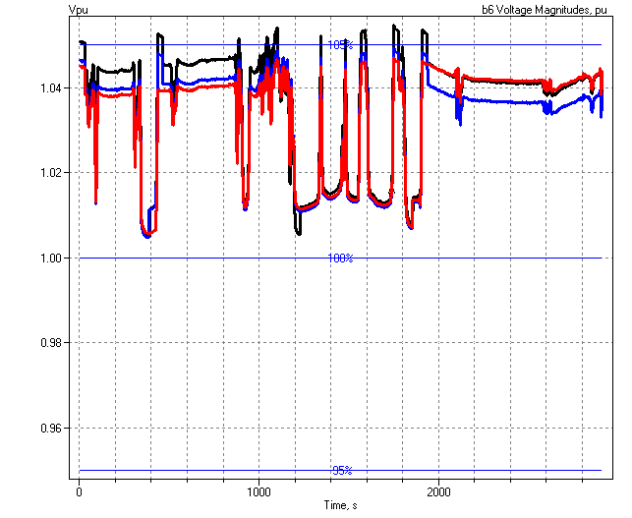
1-sec Solar PV Simulation Shows Voltage Regulation Issues
Regulator Operations

Slide 37
Power Distribution Efficiency
Light Load Week
Peak Load Week

Slide 38
Wind Plant 1-s Simulation
Notes:
The plot you see to the right is a sample case study we did where a developer wanted to install 3 750kW turbines at the end of a 10-mile distribution feeder. Along the feeder was a voltage regulator and large intermittent load. The concern we had was the impact the turbine output fluctuations would have on the flicker, regulator action, as well as the voltage profile along the feeder. Utilizing software that Electrotek had developed, specifically the Distribution System Simulator, or DSS,, minor modifications were made that allowed us to simulate the wind plant fluctuation impact over time, thus giving us the ability to address the concerns at hand.
The plot you see to the right is simulation output from the DSS, over a time horizon of ~ 4 minutes. The three turbines were modeled explicitly, along with the 5-step switched capacitor banks connected to each turbine as well as the voltage regulator upline from the wind plant. This software allows us to make recommendations to the utility and/or wind plant developer regarding modifications necessary, if any, to allow for the wind plant to have minimal impact on the distribution feeder and surrounding customers, or perhaps even improve feeder performance.
We also utilize this software for estimating flicker according the IEC standard 1400-21. The software, along with data specific to the turbine being considered allows one to estimate the flicker impact BEFORE the turbine is installed.

Slide 39
Broadband Driving Point Admittance
0.035
0.03
0.025
0.02
Siemens
|Y|
0.015
0.01
0.005
0
0
100000
200000
300000
400000
500000
Frequency, Hz

Slide 40
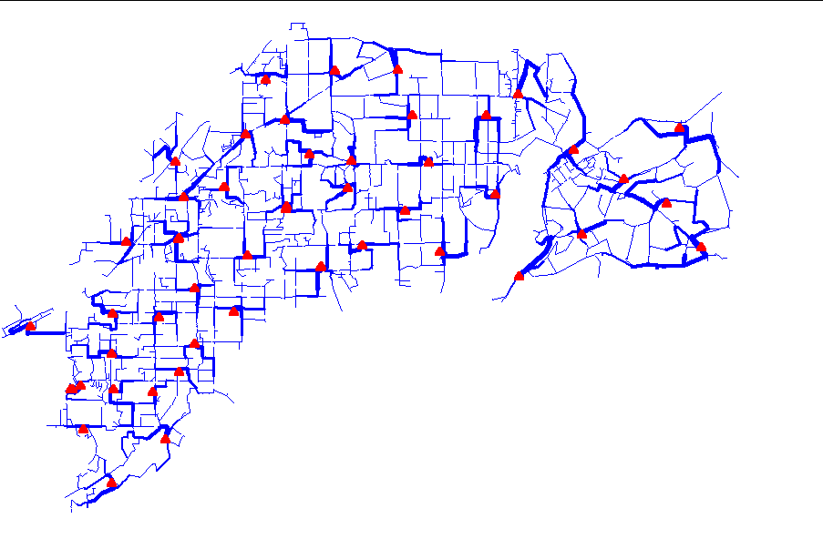
Power Flow Visualization

Slide 41
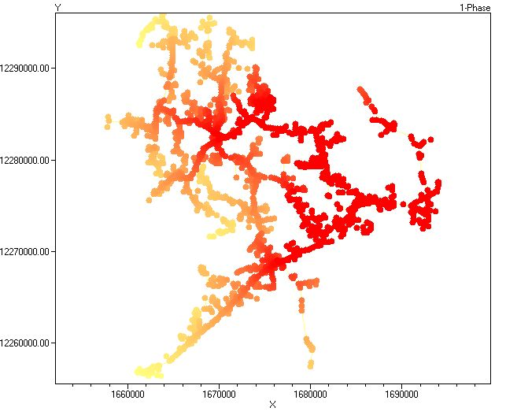
Special Displays
Fault Current Magnitudes

Slide 42
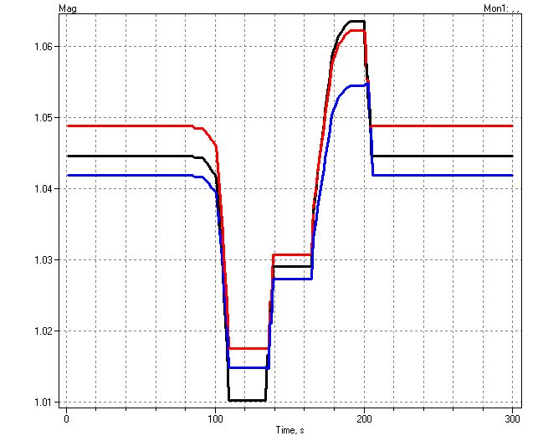
Example of an Expected DG Problem
Voltage overshoots as power output ramps up
Regulator taps up to compensate for voltage drop

Slide 43
Root of Problem
p.u. Voltage
Voltage Profile w/ DG
1.10
Distribution Systems designed for voltage DROP, not voltage RISE.
High Voltages
1.05
1.00
0.95
0.90
0.0
2.0
4.0
6.0
Distance from Substation (km)

Slide 44
What is the OpenDSS? (cont’d)
Heritage
Harmonics solvers rather than power flow
Gives OpenDSS extraordinary distribution system modeling capability
Simpler to solve power flow problem with a harmonics solver than vice-versa
Supports all rms steady-state (i.e., frequency domain) analyses commonly performed for utility distribution system planning
And many new types of analyses
Original purpose: DG interconnection analysis

Slide 45
What is the OpenDSS? (cont’d)
What it Isn’t
An Electromagnetic transients solver (Time Domain)
It can solve Electromechanical transients
Frequency Domain => “Dynamics”
All solutions are in phasors (complex math)
Not a Power Flow program
Not a radial circuit solver
Does meshed networks just as easily
Not a distribution data management tool
It is a simulation engine designed to work with data extracted from one or more utility databases

Slide 46
Time- and Location-Dependent Benefits
The OpenDSS was designed to capture both
Time-specific benefits and
Location-specific benefits
Needed for
DG analysis
Renewable generation
Energy efficiency analysis
PHEV and EV impacts
Other proposed capacity enhancements that don’t follow typical loadshapes

Slide 47
Time- and Location-Dependent Benefits
Traditional distribution system analysis programs
Designed to study peak loading conditions
Capture mostly location-specific benefits
Ignores time; Assumes resource is available
This gets the wrong answer for many DG, energy efficiency, and Smart Grid analyses
Must do time sequence analysis to get the right answer
Over distribution planning area

Slide 48
What are the Key Features?
See Documentation for more details
http://svn.code.sf.net/p/electricdss/code/trunk/Distrib/Doc/
Designed to allow expansion indefinitely
Impossible to anticipate everything users will want to do
Scripting language and COM interface allows easier customization

Slide 49
Built-in Solution Modes
Snapshot (static) Power Flow
Direct (non-iterative)
Daily mode (default: 24 1-hr increments)
Yearly mode (default 8760 1-hr increments)
Duty cycle (1 to 5s increments)
Dynamics (electromechanical transients)
Fault study
Monte carlo fault study
Harmonic
Custom user-defined solutions

Slide 50
Controls
A key feature is that controls are modeled separately from the devices being controlled
Capacitors
Regulators/tapchangers
Control Modes
Static
Power flows with large time steps
Time
Control queue employed to delay actions
Control acts when time is reached
Event

Slide 51
Overall Model Concept

Slide 52
User Interfaces Currently Implemented
A stand-alone executable program that provides a text-based interface (multiple windows)
Some graphical output is also provided.
No graphical input is provided.
An in-process COM server (for Windows) that supports driving the simulator from user-written programs.
(An out-of-process COM server is under development to support execution from 64-bit programs.)
A direct DLL interface that mimics the COM interface
For non-Windows platforms, such as HPCs
For programming languages that do not support COM or are not efficient at supporting COM

Slide 53
Validation of OpenDSS
EPRI routinely checks OpenDSS power flow results against CYME, Synergi, and WindMil programs after converting data sets for various projects.
The OpenDSS program has been benchmarked against all the IEEE Test Feeders (OpenDSS versions installed with the program)
(http://ewh.ieee.org/soc/pes/dsacom/testfeeders/).
OpenDSS was used to develop the NEV test feeder and the 8500-node test feeder.
Used to develop the DG Protection test feeder and the YDY test case
For the EPRI Green Circuits project, computed load characteristics were calibrated against measured data.
Calibrated against measurements on feeders with 100% AMI

Slide 54
Needs Envisioned by EPRI for the Smart Grid (2007)
Sequential time simulation (QSTS)
Meshed network solution capability
Better modeling of Smart Grid controllers
Advanced load and generation modeling
High phase order modeling ( >3 phases)
Stray voltage (NEV), crowded ROWs, etc.
Integrated harmonics
NEV requires 1st and 3rd
User-defined (scriptable) behavior
Dynamics for DG evaluations
= Original Capabilities in 1997

Slide 55
EPRI’s Vision
Distribution planning and distribution management systems (DMS) will converge
Into a unified set of analysis tools.
Real-time analysis and planning analysis will merge into common tools.
Distribution system analysis tools will continue to play an important role,
Although they might appear in a much different form than today.

Slide 56
Plan for Future Work/Enhancements
We plan to exploit high performance desktop computing to make it feasible to study distribution systems of at least 100,000 nodes and perhaps as many as 1,000,000 nodes.
OpenDSS-PM (for Parallel Machine) developed in 2016 to perform parallel processing for faster QSTS simulations
Can solve different time periods in parallel
Employs Diakoptics to solve very large networks
Still under development with US DOE (Sandia & NREL) contract (since 2016)
Improved distribution state estimation functions
Improved microgrid simulations (Dynamics mode)
Improved Distribution Management Systems (DMS) functions
Existing EPRI research project

Slide 57
What’s Next?
Other Advanced Distribution System Analysis problems
Microgrids
Advanced inverters
Probabilistic planning
DMS and DA
Communications and control latency
Masking of load growth by PV and other DG
Recloser siting
Training next generation distribution engineer for the “Integrated Grid”

Slide 58
Getting Started: Installation and Basic Usage

Slide 59
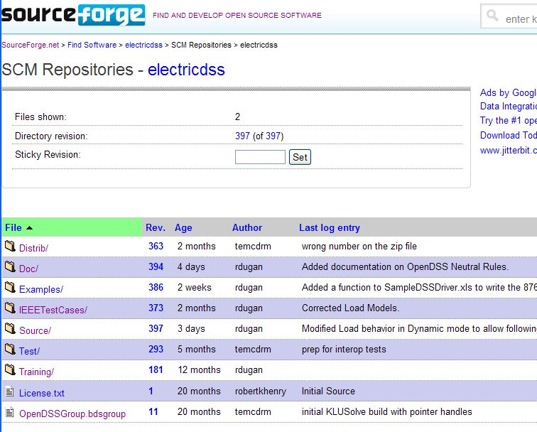
Repository on SourceForge.Net

Slide 60
Accessing the SourceForge.Net Source Code Repository with TortoiseSVN
Install a TortoiseSVN client from Tortoisesvn.net/downloads.
Recommendation:
Then, to grab the files from SourceForge by: 1 - create a clean directory such as "c:\opendss" 2 - right-click on it and choose "SVN Checkout..." from the menu 3 - the repository URL is
http://electricdss.svn.sourceforge.net/svnroot/electricdss
(Change the checkout directory if it points somewhere other than what you want.)
Thereafter, to update a folder or file, right-click on the folder or file and select SVN Update

Slide 61
Program Installation

Slide 62
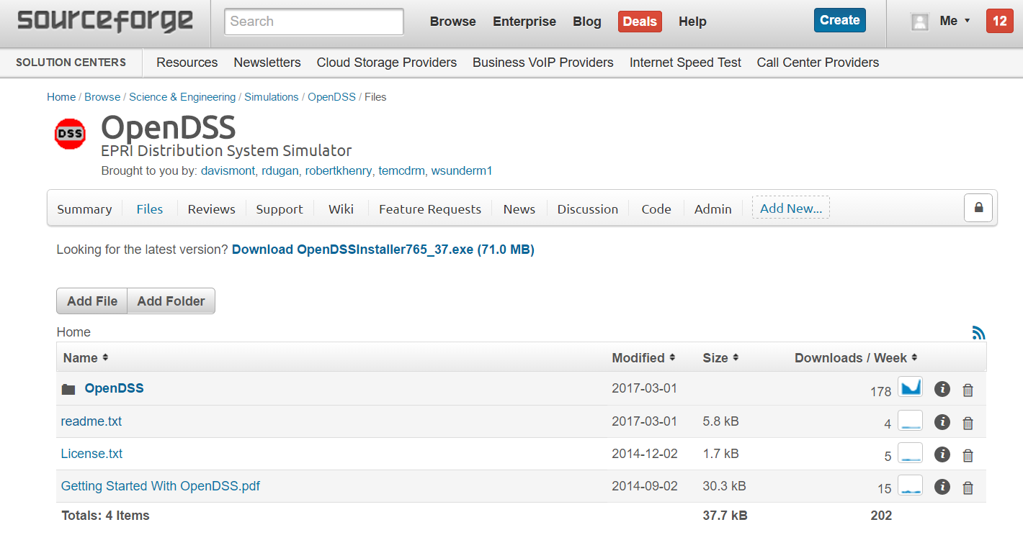
Download the Installer Files

Slide 63
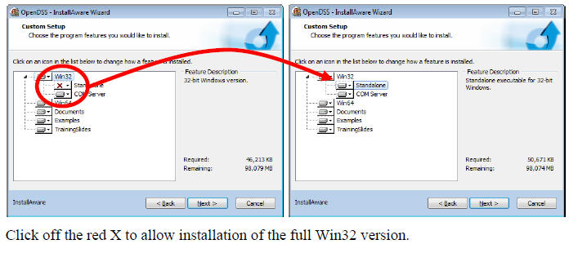
Install Both 32-bit and 64-bit Versions of OpenDSS
DG Screener and Excel typically use 32-bit OpenDSS, but both versions must be installed to get 32-bit server fully installed. Windows will figure out which one needs to be executed. Magic!!

Slide 64
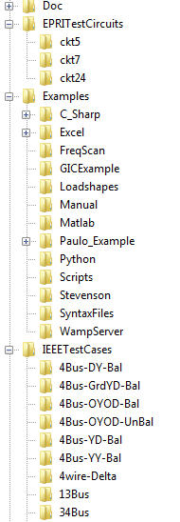
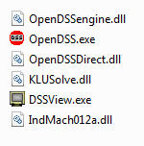
OpenDSS Files Installed
Main Program Files

Slide 65
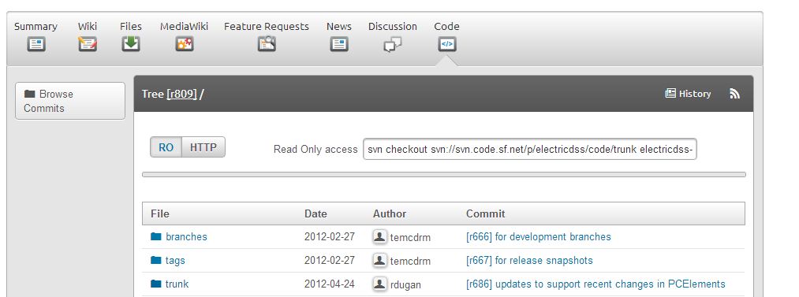
SourceForge.Net Links for OpenDSS
EPRI Links Page
http://smartgrid.epri.com/SimulationTool.aspx
OpenDSS Download Files:
http://sourceforge.net/projects/electricdss/files/
Top level of Main Repository

Slide 66
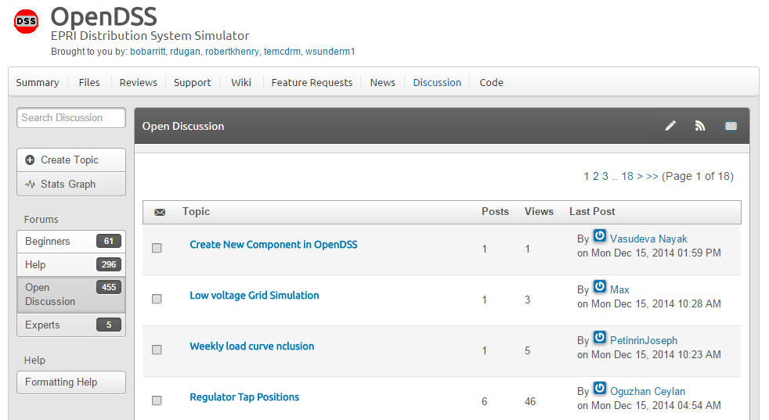
Discussion Forum & News for OpenDSS

Slide 67
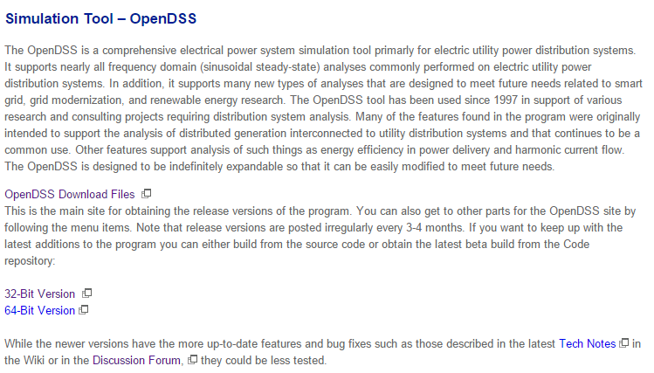
EPRI OpenDSS Link Page
http://smartgrid.epri.com/SimulationTool.aspx

Slide 68
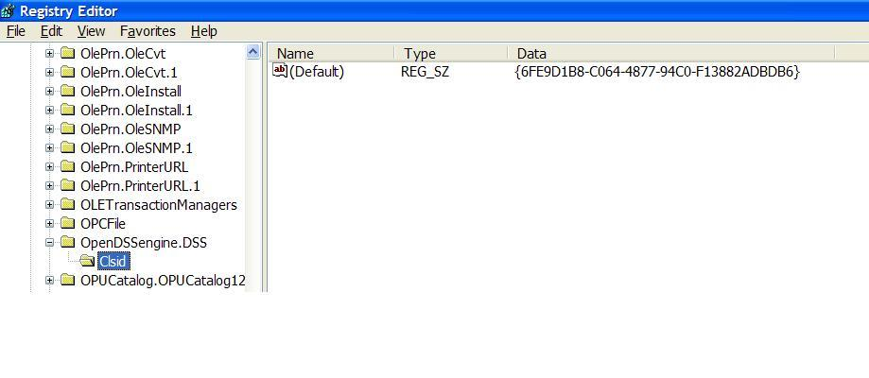
Registering the COM server
Windows Registry Entry
GUID
The Server shows up as “OpenDSSEngine.DSS” in the Windows Registry
The OpenDSS is now available to any program on the computer

Slide 69
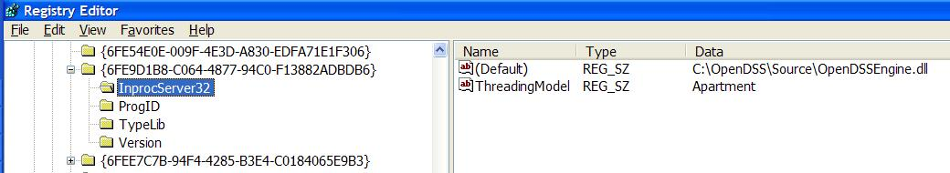
The GUID References the DLL File ….
If you look up the GUID in RegEdit
Points to OpenDSSEngine.DLL (In-process server, Apartment Threading model)

Slide 70
Questions So Far?

Slide 71
OpenDSS Architecture and Circuit Modeling Basics
.

Slide 72
DSS Structure
Scripts
Main Simulation Engine
COM Interface
User-Written DLLs
Scripts, Results

Slide 73
DSS Object Structure
DSS Executive
Commands
Options
Circuit
Solution
V
[Y]
I
PDElement
PCElement
Controls
Meters
General
Line Transformer Capacitor Reactor
Load Generator Vsource Isource Storage
RegControl CapControl Relay Reclose Fuse
Monitor EnergyMeter Sensor
LineCode LineGeometry WireData LoadShape GrowthShape Spectrum TCCcurve XfmrCode

Slide 74
DSS Class Structure
Instances of Objects of this class
Class
Object 1
Property Definitions
Property Values
Methods
Class Property Editor
Yprim
Collection Manager
States
Object n
Property Values
Methods
Yprim
States

Slide 75
Models Currently Implemented (April 2017)
POWER DELIVERY ELEMENTS
CAPACITOR (Series and shunt capacitors; filter banks)
LINE (All types of lines, cables)
REACTOR (Series and shunt reactors)
TRANSFORMER (multi-phase, multi-winding transformer models)
POWER CONVERSION ELEMENTS
GENERATOR (General generator models)
LOAD (General load models)
PVSYSTEM (Solar PV system with panel and inverter)
STORAGE (Generic storage element models)
INDMACH012 (Induction Machine Model in Symmetrical Components)
CONTROL ELEMENTS
CAPCONTROL (Capacitor bank control; various types)
FUSE (Controls a switch, modeling fuse TCC behavior)
GENDISPATCHER (A specialized controller for dispatching DG)
RECLOSER (Controls a switch, modeling recloser behavior)
REGCONTROL (Standard 32-step regulator/LTC control)
RELAY (Controls a switch, modeling various relay behaviors)
STORAGECONTROLLER (Implementation of AEP’s hub controller)
SWTCONTROL (one way to control switches during simulations)
INVCONTROL (Inverter control for VVO, etc)

Slide 76
Models Currently Implemented (April 2017)
GENERAL DATA
CNDATA (Concentric neutral cable data)
GROWTHSHAPE (Growth vs year)
LINECODE (Line and cable impedances, matrices or symmetrical components)
LINEGEOMETRY (Line geometry data)
LINESPACING (spacing data for LINEGEOMETRY)
LOADSHAPE (Load shape data)
PRICESHAPE (Price shape data)
SPECTRUM (Harmonic spectra)
TCC_CURVE (TCC curves)
TSDATA (Tape shield cable data)
TSHAPE (Temperature shape data)
WIREDATA (Wire parameters, GMR, etc.)
XFMRCODE (Transformer type definitions)
XYCURVE (Generic x-y curves)
METERS
ENERGYMETER (Captures energy quantities and losses)
MONITOR (Captures selected quantities at a point in the circuit)
SENSOR (Simple monitor used for state estimation)
OTHER
FAULT (1 or more faults can be placed anywhere in the circuit)
ISOURCE (Multi-phase current source)
VSOURCE (2-terminal multiphase voltage source, thevinen equivalent)

Slide 77
Built-in Solution Modes
Snapshot (static) Power Flow
Direct (non-iterative solution of I=YV )
Daily mode (default: 24 1-hr increments)
Yearly mode (default 8760 1-hr increments)
Duty cycle (1 to 5s increments)
Dynamics (electromechanical transients)
Fault study
Monte carlo fault study
Harmonic
Custom user-defined solutions

Slide 78
Input Data Requirements
OpenDSS is a Script-driven circuit solution engine
The OpenDSS was designed in a research or consulting environment where input data might come from a variety of sources.
The program can accept many common forms of data for describing impedances, loading, and topology of distribution systems for planning analysis.
The OpenDSS scripting language is designed to require minimal translation from other formats of distribution data.
The program can accept more detailed data for lines, transformers, etc. than the typical data for distribution system analysis when they are available.

Slide 79
Input Data Requirements
OpenDSS Circuit elements have many properties
Nearly all have reasonable default values
Users only need to specify the property values that are
Different than the default values
Used in the circuit simulation
Throughout OpenDSS, property values remain at the value most recently set until they are subsequently changed
They generally do NOT reset to original values unless you explicitly change them

Slide 80
Advanced Types of Data in OpenDSS
Harmonic spectra for harmonic analysis,
Various curves as a function of time for sequential time simulations:
Load shapes (e.g., AMI P, Q data),
Price shapes,
Temperature shapes,
Storage dispatch curves,
Growth curves.
Efficiency curves for PV inverters,
Voltage dependency exponents for loads,
Capacitor control settings,
Regulator control settings,
TCC Curves and other data for Fuse, Relay, and Recloser objects
Machine data.

Slide 81
How Does OpenDSS Work?

Slide 82
The Math …
Nearly everything results in a matrix or array
Nodal Admittance formulation
Circuit elements modeled by primitive admittance matrices
Y_{prim}
Primitive Y matrices used to build System Y matrix
OpenDSS Works In
Phase domain
Actual volts and amps
Symmetrical components and per units not used inside the program !! -- Input and output only!

Slide 83
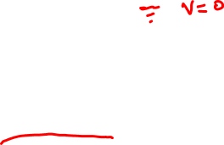
Primitive Y Matrix
Simple Resistor

Slide 84
Primitive Y Matrix, cont’d
LINE model

Slide 85
What about 3-phase elements?
Simply let R, X, B, G, C, etc. represent 3x3 matrix
Notation stays the same
And it works!
I1, I2, V1, V2 etc become 3x1 vectors
This is basically how all the Circuit Element (CktElement) models in OpenDSS work.

Slide 86
The Network Model

Slide 87
Nodal Admittance Equations
V₁
V₂
…
V_{S}
…
V_{L1}
…
V_{L2}
…
V_{N}
I₁
I₂
…
I_{S}
…
I_{L1}
…
I_{L2}
…
I_{N}
Y_{SYSTEM}
=
N x N
(Sparse)
N = Number of NODES (not BUSES)

Slide 88
Solving the Power Flow
Once the circuit model is connected properly the next step is to Solve the base power flow
PC elements (i.e., Loads) are usually nonlinear
Loads are linearized to a Norton equivalent based on nominal 100% rated voltage.
Current source is “compensation current”
Compensates for the nonlinear characteristic
A fixed point iterative solution algorithm is employed for most solutions
This method allows for flexible load models and is robust for most distribution systems

Slide 89
Load (a PC Element)
General Concept
Added into Injection Current Vector
Goes into System Y Matrix
(One-Line Diagram)
Most Power Conversion (PC) Elements are Modeled Like This

Slide 90
Load - 3-phase Y connected
Phase 1
1
2
Phase 2
3
4 Conductors/Terminal
Phase 3
4

Slide 91
Load - 3-phase Delta connected
Phase 1
2
1
Phase 2
3
3 Conductors/Terminal
Phase 3

Slide 92
Load Models (Present version)
1:Standard constant P+jQ load. (Default)
2:Constant impedance load.
3:Const P, Quadratic Q (like a motor).
4:Nominal Linear P, Quadratic Q (feeder mix). Use this with CVRfactor.
5:Constant Current Magnitude
6:Const P, Fixed Q
7:Const P, Fixed Impedance Q
8: Special ZIP load model

Slide 93
Standard P + jQ (constant power) Load Model
When the voltage goes out of the normal range for a load the model reverts to a linear load model
This generally guarantees convergence
Even when a fault is applied
This script changes break points to +/- 10%:
Load.Load1.Vmaxpu=1.10
Load.Load1.Vminpu=0.90
Note: to solve some of the IEEE Radial Test feeders and match the published results, you have to set Vminpu to less than the lowest voltage published (usually about 0.80 per unit)

Slide 94
Standard P + jQ Load Model (Model=1)
Const Z
105%
(Defaults*)
95%
|I| = |S/V|
Const Z
New Method (2014)
* Change by setting Vminpu and Vmaxpu Properties

Slide 95
Power Flow Solution Algorithm
Initial Guess at Node Voltages, V
Compute all Injection (Compensation) Currents, I
For PC Elements
Solve for new guess at V
Repeat 2 and 3 until Converged
Convergence is based on change in per unit voltage magnitude
Default tolerance = 0.0001
Good enough for distribution systems

Slide 96
Putting it All Together
ALL Elements
Yprim 1
Yprim 2
Yprim 3
Yprim n
PC Elements Comp. Currents
I1
I2
Y
Node
Voltages
I_{inj}
=
V
Im
Iteration Loop

Slide 97
Putting it All Together
Th-Th-That's All Folks !
ALL Elements
Yprim 1
Yprim 2
Yprim 3
Yprim n
PC Elements Comp. Currents
I1
I2
Y
Node
Voltages
I_{inj}
=
V
Im
Iteration Loop

Slide 98
A More Concise Form …
Fixed-point solution form for normal solution
V_{n+1} = [Y_{system}]⁻¹ I_{PC}(V_{n}) n = 0, 1, 2, … until converged
I_{PC}(V) = compensation currents from Power Conversion (PC) elements in the circuit as a function of voltage

Slide 99
Solving the Power Flow …
This solution method requires that the first guess at the voltages be close to the final solution
Not a problem for daily or yearly simulations
Present solution is a good initial guess at next time step
First solution is often most difficult
The solution initialization routine in OpenDSS accomplishes this with ease in most cases
Method works well for arbitrary unbalances
For conditions that are sensitive, a Newton method is provided that is more robust, but slower.
Not to be confused with “Newton-Raphson Power Flow”

Slide 100
Circuit Modeling Basics

Slide 101
DSS Bus Model (Bus ≠ Node)
Nodes
Bus
Referring to Buses and Nodes (A Bus has 1 or more Nodes)
Bus1=BusName.1.2.3.0
(This is the default for a 3-phase circuit element)
Shorthand notation for taking the default:
Bus1=BusName
Note: Sometimes this can bite you (e.g. – Transformers, or capacitors with ungrounded neutrals)

Slide 102
Node Numbers
Bus
The voltage at Node 0 = 0 (always)
The other Node numbers are arbitrary
By convention, Nodes 1, 2, 3 correspond to phase ABC
But they don’t have to
You can have a very large number of nodes at a Bus
They do not have to be pre-declared

Slide 103
DSS Terminal Definition
Conductors
Circuit Elements have one or more Terminals with 1..N conductors.
Conductors connect to Nodes at a Bus
Each Terminal connects to one and only one Bus

Slide 104
Power Delivery Elements
PD Elements are Generally Completely Described by [Yprim]

Slide 105
Power Conversion Elements
I_{Term}(t) = F(V_{Term}, [State], t)
Power Conversion (PC) elements are typically connected in “shunt” with the Power Delivery (PD) elements
PC Elements may be nonlinear
Described some function of V
May be linear
e.g., Vsource, Isource
May have more than one terminal, but typically one
Load, generator, storage, etc.

Slide 106
Specifying Bus Connections
Shorthand (implicit)
New Load.LOAD1 Bus1=LOADBUS
Assumes standard 3-phase connection by default
LOADBUS
6
5
4
3
3-ph
grounded-
Wye
LOAD
2
1
0

Slide 107
Specifying Bus Connections
Explicit
New Load.LOAD1 Bus1=LOADBUS.1.2.3.0
Explicitly defines which node
New Load.1-PHASELOAD Phases=1 Bus1=LOADBUS.2.0
Connects 1-phase load between Node 2 and ground
Note: 1-phase Load has 2 conductors
1-Phase Load Example

Slide 108
Specifying Bus Connections
Default Bus templates
Node connections assumed if not explicitly declared
Element declared Phases=1
… LOADBUS.1.0.0.0.0.0.0.0.0.0. …
Element declared Phases=2
… LOADBUS.1.2.0.0.0.0.0.0.0.0. …
Element declared Phases=3
… LOADBUS.1.2.3.0.0.0.0.0.0.0. …

Slide 109
Specifying Bus Connections
Ungrounded-Wye Specification
Bus1=LOADBUS.1.2.3.4 (or some other unused Node number)
Voltage at this Node explicitly computed (just like any other Node)

Slide 110
Possible Gotcha: Specifying Two Ungrounded-Wye Capacitors on Same Bus
MyBus
… Bus1=MyBus.1.2.3 Bus2=MyBus.5.5.5
Neutrals are not connected to each other in this specification!
… Bus1=MyBus Bus2=MyBus.4.4.4

Slide 111
Capacitor Object
The Capacitor object is a basic 2-terminal branch that may be connected in different ways.
If defined with only one Bus, it is assumed to be a shunt capacitor
Same rules apply to Reactor and Fault objects

Slide 112
Circuit Element Conductors are Connected to the Nodes of Buses
MyBus
3
2
1
0
. . . Bus2 = MyBus.2.1.3.0 . . .
. . . Bus1 = MyBus . . .
(take the default)
(Explicitly define connections)
DSS Convention: A Terminal can be connected to only one Bus. You can have any number of Nodes at a bus.

Slide 113
Example: Connections for 1-Phase Residential Transformer Used in North America
! Line-to-Neutral Connected 1-phase Center-tapped transformer
New Transformer.Example_1-ph phases=1 Windings=3
! Typical impedances for small transformer with interlaced secondaries
~ Xhl=2.04 Xht=2.04 Xlt=1.36 %noloadloss=.2
! Winding Definitions
~ wdg=1 Bus=Bus1.1.0 kV=7.2 kVA=25 %R=0.6 Conn=wye
~ wdg=2 Bus=Bus2.1.0 kV=0.12 kVA=25 %R=1.2 Conn=wye
~ Wdg=3 Bus=Bus2.0.2 kV=0.12 kVA=25 %R=1.2 Conn=wye
Note: You may use the XfmrCode object to define a library of transformer definitions that are used repeatedly (like LineCode for Line elements)

Slide 114
All Terminals of a Circuit Element Have Same Number of Conductors
3-Phase Transformer

Slide 115
Scripting Basics

Slide 116
Scripting
OpenDSS is a scriptable solution engine
Scripts
Series of commands
From text files
From edit forms in OpenDSS.EXE
From another program through COM interface
e. g., This is how you would do looping
Scripts define circuits
Scripts control solution of circuits
Scripts specify output, etc.

Slide 117
Command Syntax
Command parm1, parm2 parm3 parm 4 ….
Parameters may be positional or named (tagged).
If named, an "=" sign is expected.
Name=value (this is the named form)
Value (value alone in positional form)
For example, the following two commands are equivalent:
New Object="Line.First Line" Bus1=b1240 Bus2=32 LineCode=336ACSR, …
New “Line.First Line”, b1240 32 336ACSR, …
Comma or white space

Slide 118
Delimiters
Array or string delimiter pairs: [ ] , { },( ),“ “,‘ ‘
Matrix row delimiter: |
Value delimiters: , (comma) any white space (tab or space)
Class, Object, Bus, or Node delimiter: . (period)
Keyword / value separator: =
Continuation of previous line: ~ (More)
Comment line: //
In-line comment: !
Query a property: ?

Slide 119
Array and Matrix Parameters
Array
kvs = [115, 6.6, 22]
kvas=[20000 16000 16000]
Matrix
(3x3 matrix)
Xmatrix=[1.2 .3 .3 | .3 1.2 3 | .3 .3 1.2]
(3x3 matrix – lower triangle)
Xmatrix=[ 1.2 | .3 1.2 | .3 .3 1.2 ]

Slide 120
A Simple Example

Slide 121
A Basic Script (Class Exercise)
Clear
New Circuit.Simple ! Creates voltage source (Vsource.Source)
Edit Vsource.Source BasekV=115 pu=1.05 ISC3=3000 ISC1=2500 !Define source V and Z
New Transformer.TR1 Buses=[SourceBus, Sub_Bus] Conns=[Delta Wye] kVs= [115 12.47]
~ kVAs=[20000 20000] XHL=10
New Linecode.336ACSR R1=0.058 X1=.1206 R0=.1784 X0=.4047 C1=3.4 C0=1.6 Units=kft
New Line.LINE1 Bus1=Sub_Bus Bus2=LoadBus Linecode=336ACSR Length=1 Units=Mi
New Load.LOAD1 Bus1=LoadBus kV=12.47 kW=1000 PF=.95
Solve
Show Voltages LN Nodes
Show Currents Element
Show Powers kVA Elements

Slide 122
20 MVA Substation Transformer
SourceBus
TR
1
Sub_Bus
Defining Using Arrays
Defining Winding by Winding
New Transformer.TR1 Phases=3 Windings=2
~ Buses=[SourceBus, Sub_Bus]
~ Conns=[Delta Wye]
~ kVs= [115 12.47]
~ kVAs=[20000 20000]
~ XHL=10
New Transformer.TR1 Phases=3 Windings=2 XHL=10
~ wdg=1 bus=SourceBus Conn=Delta kV=115 kVA=20000
~ wdg=2 bus= Sub_Bus Conn=wye kV=12.47 kVA=20000

Slide 123
The Line
Sub_Bus
LoadBus
LINE
1
1
Mile
,
336
New Linecode.336ACSR R1=0.058 X1=.1206 R0=.1784 X0=.4047 C1=3.4 C0=1.6 Units=kft
New Line.LINE1 Bus1=Sub_Bus Bus2=LoadBus Linecode=336ACSR Length=1 Units=Mi
Line objects may also be defined by Geometry or matrix properties.
(Rmatrix=… Xmatrix=… Cmatrix=…)

Slide 124
The Load
Loadbus
LOAD
1
1000
kW
0
.
95
PF
New Load.LOAD1 Bus1=LoadBus kV=12.47 kW=1000 PF=.95
For 3-phase loads, use L-L kV and total kW
For 1-phase loads, typically use L-N kV and total kW unless L-L-connected; Then use L-L kV.

Slide 125
Add a 500-kW Generator Object to LoadBus
DG
… (continue from existing Script)
New Generator.DG1 Bus1=LoadBus kV=12.47 kW=500 PF=1.0
// solve again and observe results
Solve ! Starts with previous solution
Show Voltages LN Nodes
Show Currents Element
Show Powers kVA Elements

Slide 126
Scripting Large Circuits
For small circuits, it is often sufficient to put all the scripts in a single file
Many of the IEEE test feeder examples are mostly in a single file
When you have large amounts of data, a more disciplined approach is recommended
Redirect Command
Redirects the input to another file
Returns to home directory
Compile Command
Same as Redirect except repositions home directory

Slide 127
Organizing Your Main Screen
OpenDSS.exe saves all windows on the main screen
They appear where you left them when you shut down
The next time you start up, you can resume your work
Values are saved to the Windows Registry

Slide 128
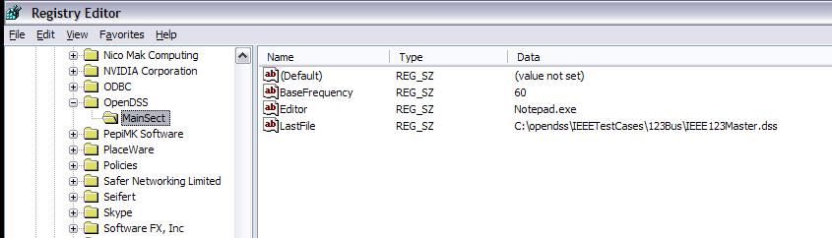
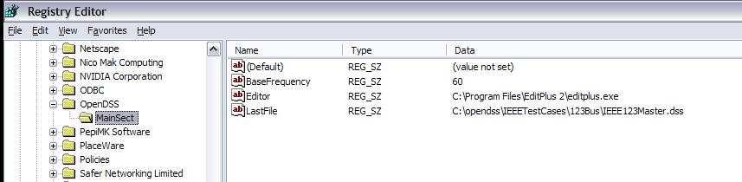
OpenDSS Registry Entries
Certain persistent values are saved to the Windows Registry upon exiting the program
Default Editor Setting
After Redefining

Slide 129
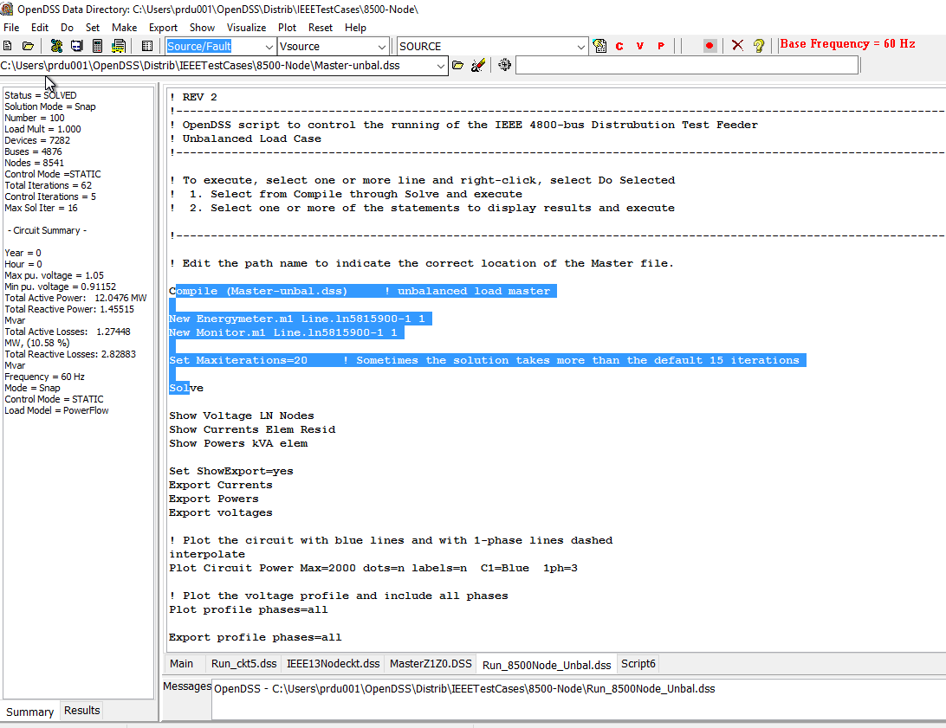
OpenDSS Main Screen
Results Text Box
Solution Summary and Results
Selection to execute
Main Script Tab never goes away. Put some frequently-used commands here.
Active Script file
Tabs for script files

Slide 130
A Common Sense Structuring of Script Files
Run_The_Master.DSS
“Compile” the Master file from here
Master.DSS
LineCodes.DSS
WireData.DSS
LineGeometry.DSS
Libraries
Put a “Clear” in here
Spectrum.DSS
LoadShape.DSS
Transformers.DSS
Lines.DSS
Circuit Definition
Make a separate folder for each circuit
Loads.DSS
Etc.

Slide 131
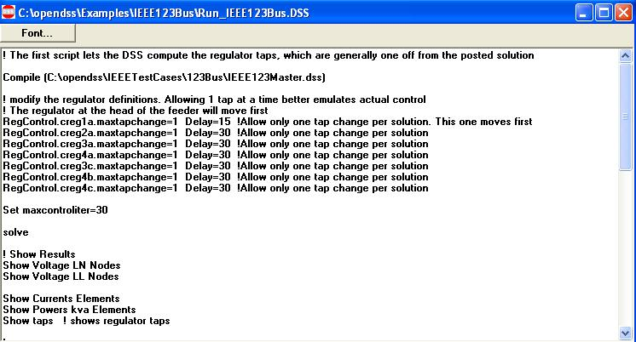
Organizing Run Scripts
Based on 123-bus Test Feeder
Compiles the Circuit Description
Override Some Property Settings and/or Define Some Additional Circuit Element
Change an option
Solve Snapshot Power Flow
Selected Results Display

Slide 132
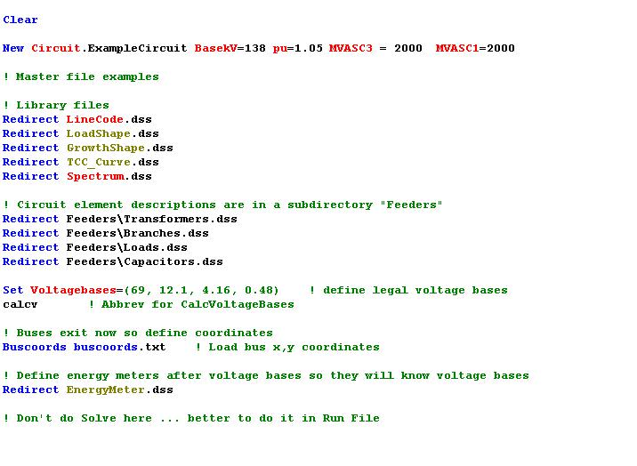
Organizing Your Master File
So Compile Doesn’t Fail
General Library Data
Circuit Elements for this Model
Let OpenDSS Define the Voltage Bases
(You can do this explicitly with SetkVBase command)

Slide 133
Example: IEEE 8500-Node Test Feeder
Load and exercise the IEEE 8500-Node Test Feeder Circuit – an example of a large circuit

Slide 134
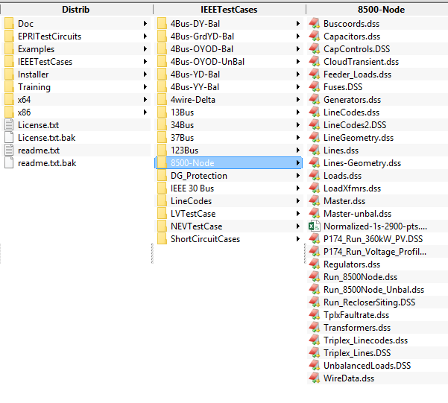
Location of the IEEE 8500-Node Test Feeder Files

Slide 135
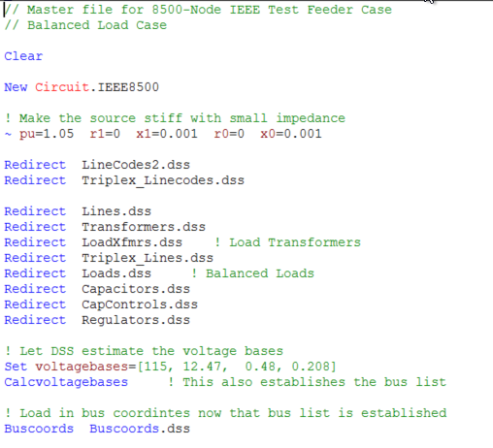
Master File for 8500-Node Test Case

Slide 136
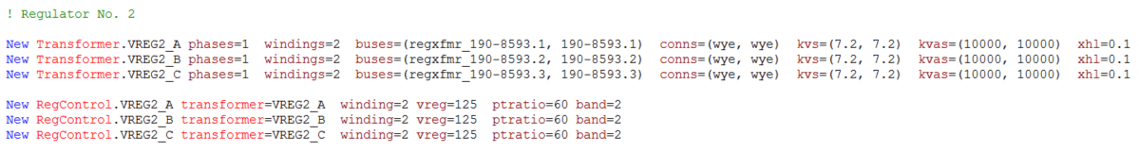
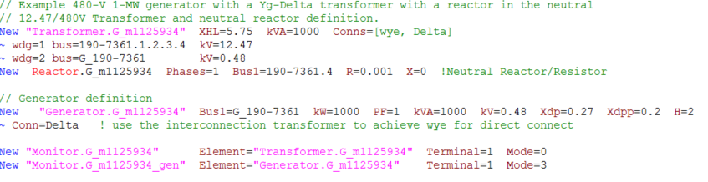
Snippets of Circuit Script Files

Slide 137
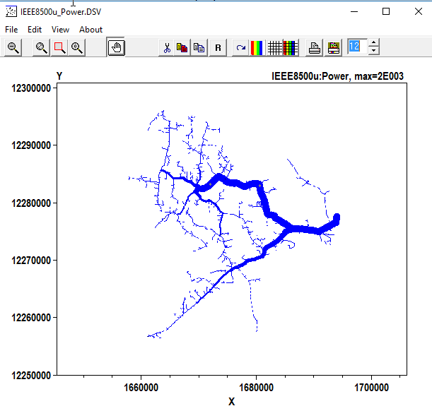
Circuit Plot
Plot Circuit Power Max=2000 dots=n labels=n C1=Blue 1ph=3

Slide 138
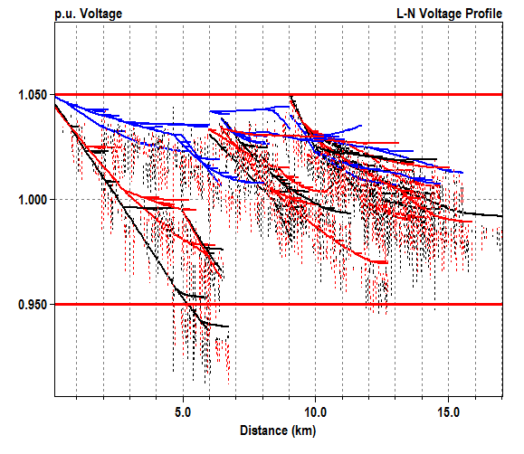
Voltage Profile Plot
Plot profile phases=all

Slide 139
Application Programming Interfaces (API)

Slide 140
Why You Might Want to Write Some Code …
There is no looping in the DSS scripting language
To implement an algorithm not in OpenDSS
For optimizing device siting …
Generators
Capacitors
Reclosers
To automate some repetitive analysis task
To develop a new device model or control
Using the COM interface
Writing a Dynamic-Linked Library (DLL)

Slide 141
Ways to Write Code to Do Innovative Things with OpenDSS
COM Interface
Microsoft standard: Windows only
Well supported in MS Office
DirectDLL Interface
Standard function call library
Separate program to generate DSS scripting code

Slide 142
What Languages Can You use for Code?
Excel VBA
VB.net
C#
C/C++
Delphi, Free Pascal
MATLAB
Python
Java
LabView
R
Fortran (for DLLs, with DirectDLL)
Julia (with DirectDLL)

Slide 143
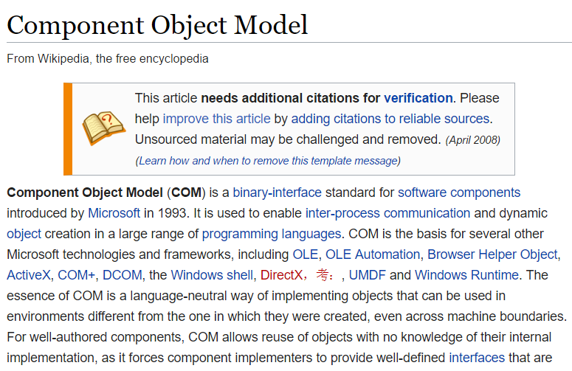
COM Interface

Slide 144
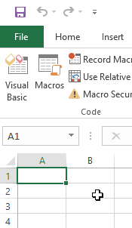
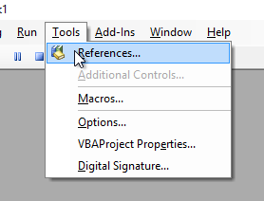
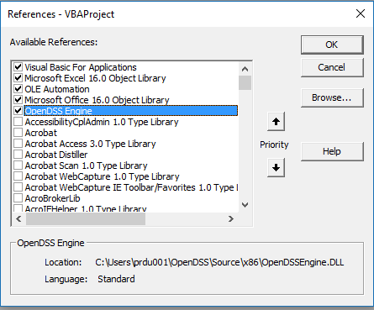
Finding COM Servers on Your Computer
Excel VBA

Slide 145
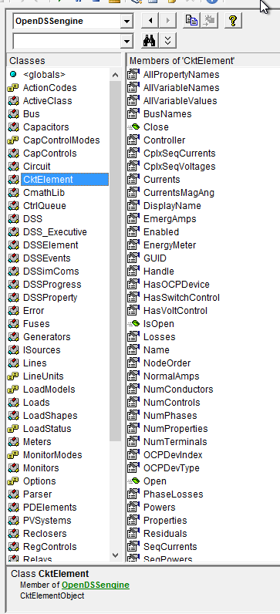
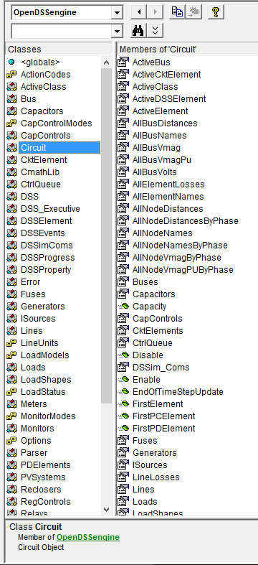
Object Browser in VBA for OpenDSSEngine
The Object Browser in MS Office VBA is a good way to learn what is available through the OpenDSS COM Interface

Slide 146
DSS Structure
Scripts
Main Simulation Engine
COM Interface
User-Written DLLs
Scripts, Results

Slide 147
Demonstration of Using the COM Interface

Slide 148
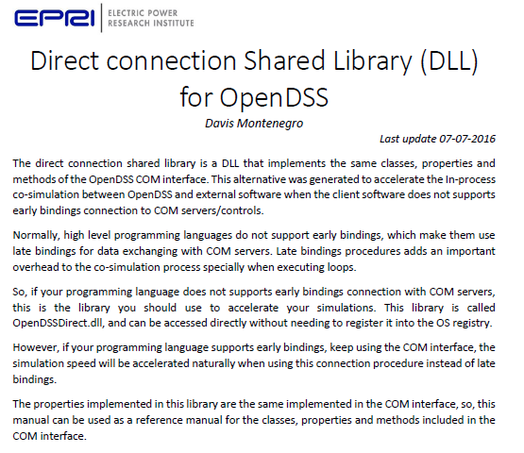

Slide 149
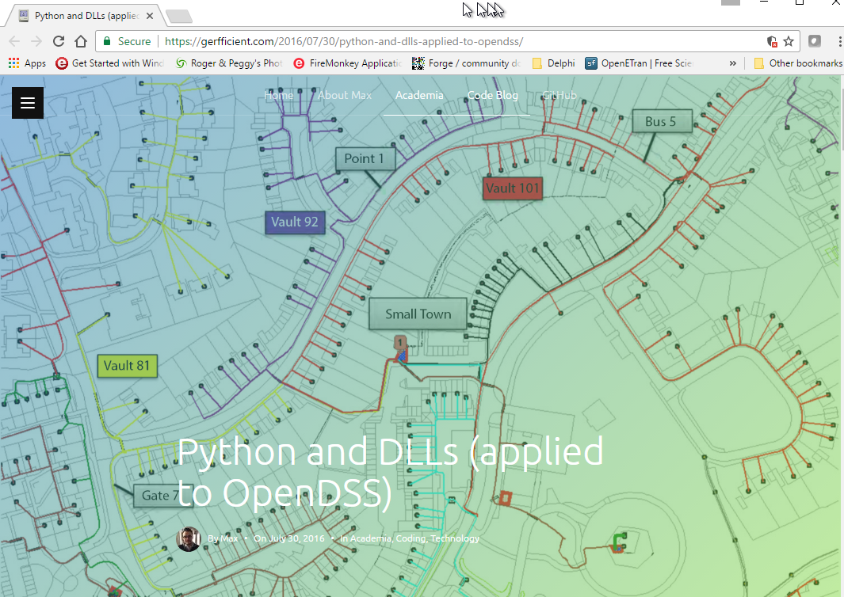
An Interesting Link Using the Direct DLL interface

