Slide 1
Advanced Modeling for Distribution Planning Workshop with OpenDSS
Instructors
Roger C. Dugan Matt Rylander
Sponsored by CenterPoint Energy At Texas A&M University April 19, 20, 21

Slide 2
Day 1 Review

Slide 3
Introduction to OpenDSS
What is OpenDSS and what can it be used for?
User Interfaces Provided
Installation and startup
Models Implemented in OpenDSS
Advanced Data Types
How Does OpenDSS Work?
Basic equations
Power Flow Solution Algorithm
Basic Load models
Circuit Modeling Basics
Scripting Basics
Simple circuit
Larger circuits
IEEE 8500-Node Test Feeder Example
Application Programming Interfaces (API)
COM Interface
Direct DLL interface
COM Interface Example
Questions?

Slide 4
Agenda Day 2
Simulations
Loadshapes, QSTS, etc.
Models of Circuit Elements for Advanced Distribution System Analysis
Distribution Power Flow, Per units, etc.
Use Cases/Examples
Modeling Distributed Generation for Dist. Planning and Protection
Including Storage in Distribution Planning
Dynamics Analysis for Distribution Planning

Slide 5
Simulations

Slide 6
Loadshapes and Quasi-Static Time-Series Simulation

Slide 7
Loadshapes
Key feature of OpenDSS
Sequential time simulation is required for many Smart Grid analyses
Basic time-varying modes that use Loadshape objects
Daily (nominally 24 h, 1 h steps)
Yearly (nominally 8760 h, 1 h steps)
Dutycycle (nominal step size 1 s .. 5 m)
(used for wind and solar)
Learning to work with Loadshapes is essential skill for OpenDSS users

Slide 8
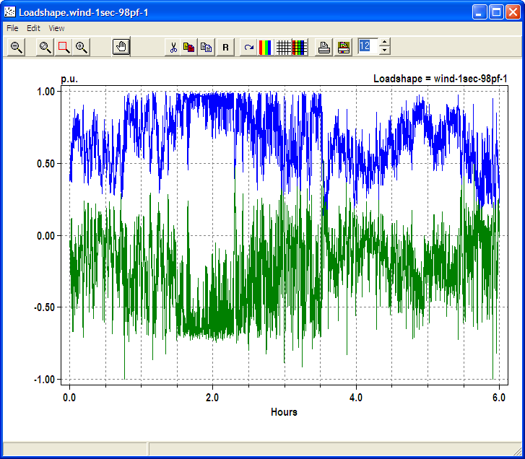
Example Loadshape for Wind Turbine Output
Watts
Vars

Slide 9
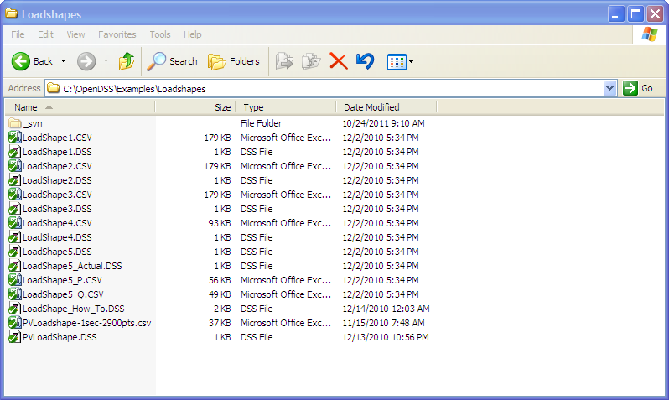
Example Loadshapes Provided in Examples Folder

Slide 10
How to Define
Clear
! Example scripts for loading and plotting loadshapes out of the loadshape library
! You have to have a circuit defined to load in loadshapes.
New Circuit.LoadshapeExamples
! directly ...
New "LoadShape.LoadShape1a" npts=8760 interval=1.0 mult=(File=LoadShape1.csv)
Plot Loadshape Object=Loadshape1a ! execute this to prove you got it
! or using Redirect
Redirect Loadshape1.DSS ! Load in Loadshape 1
Plot Loadshape Object=Loadshape1

Slide 11
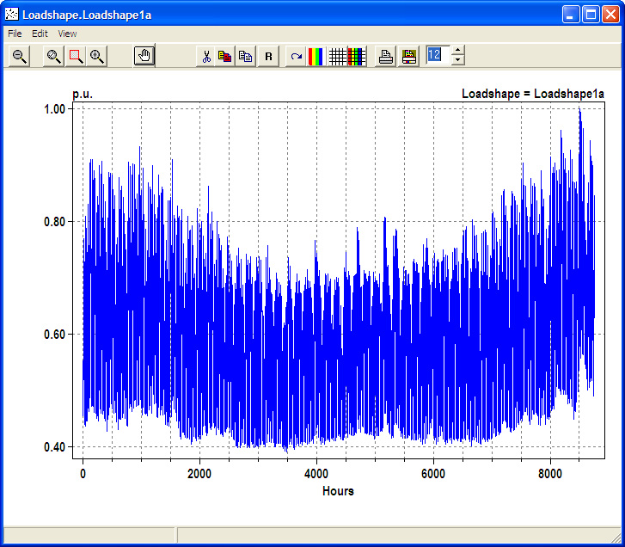
Example Yearly LoadShape

Slide 12
Loadshape Interpolation
The OpenDSS LOADSHAPE class uses two different types of interpolation depending on it is defined
Fixed interval data.
Default. INTERVAL property defaults to 1 hour.
You can set it to another value or to 0.
The SINTERVAL and MINTERVAL properties facilitate defining intervals in second or minutes.
INTERVAL > 0: fixed interval data
CSV files --one numeric value per line.
Interpolation algorithm assumes the value REMAINS CONSTANT over the entire interval
The HOUR array property is ignored

Slide 13
Loadshape Interpolation, Cont’d
For LINEAR INTERPOLATION between the points, define INTERVAL=0.
Then both the time and multiplier values for the loadshape using the HOUR, MULT, and QMULT array properties.
Alternatively, you may use the CSVFILE, DBLFILE, or SNGFILE properties.
Enter both the time in hours and the multiplier values.
A CSV file would have two values per line separated by a comma or whitespace.
The variable interval interpolation could be a little bit slower than the fixed interval data because there is more work to do to compute the factor.

Slide 14
Importing Packed Binary Files
For simulations, such as AMI, required large volumes of Loadshapes to be imported, using packed binary files can save time
Standard CSV or TXT file
Mult=[file=myfile.txt]
File of doubles
Mult=[dblfile=myfile.dbl]
File of singles
Mult=[sngfile=myfile.sng]

Slide 15
Defining Array Properties Using CSV files
Syntax:
mult=[File=myMultiColumnFile.CSV, Column=n, Header=Yes/No]
Allows use of multicolumn CSV files with a single header row.
Example:
New Loadshape.Ramp2 npts=4000 sInterval=1 mult=(file=MultiChannelTest.csv, column=3, header=yes)
Imports the 3rd column from the file, skipping the header row

Slide 16
Built-in Simulation Modes

Slide 17
Built-in Solution Modes
Snapshot (static) Power Flow
Direct (non-iterative)
Daily mode (default: 24 1-hr increments)
Yearly mode (default 8760 1-hr increments)
Duty cycle (1-s to 5-s increments)
Dynamics (electromechanical transients)
Fault study
Monte carlo fault study
Harmonic
HarmonicT
Custom user-defined solutions

Slide 18
Snapshot Mode
This is the default solution mode after creating a new circuit model
The basic power flow solution mode for the OpenDSS
Performs a single solution each time Solve is issued
Control mode defaults to “Static”
Defaults to iterative power flow solution
Load model is “Powerflow”

Slide 19
Direct Mode
Performs a non-iterative solution of the present system admittance equation
Loads and Generators represented by constant impedance
Value in their Norton equivalents
This is a useful mode when convergence is difficult, but needed to perform Harmonic, Dynamic, or Faultstudy mode solution.
Will nearly always give a reasonable starting point for these solution modes

Slide 20
Daily Mode
Defaults
Stepsize = 1.0 h
Controlmode = static
Number = 24
Designed for simulations of a load profile for one day for distribution planning studies, losses, other energy studies
Time step of 0.25 h to 1.0 h typically
One or more days (change “Number” property)
Set the Daily= property of Load and Generator to follow a loadshape
Similar functionality to Yearly mode

Slide 21
Yearly Mode
Defaults
Stepsize = 1.0 h
Controlmode = static
Number = 8760
Designed for annual simulations for distribution planning studies, losses, other energy studies
Time step of 0.25 .. 1.0 h typically
All or part of year
Set the Yearly= property of Load and Generator to follow a loadshape

Slide 22
DutyCycle Mode
Defaults
Stepsize = 1.0 s
Controlmode = time
Number = 100
Designed for simulations of wind turbine output, solar PV output, stone crushers, and other impulse loads
Time step of 1 – 10 s
Duration of a few minutes up to 1 day
Some are now using this for long periods for solar PV generation
Set the Duty= property of Load and Generator to follow a loadshape

Slide 23
Dynamics Mode
Defaults
Stepsize = 0.001 s
Controlmode = time
Number = 100
Electromechanical transients simulations
Generator state variables integrated
Predictor-corrector
Intended for simulations of a few seconds duration

Slide 24
FaultStudy Mode
Defaults to dynamic model so machine contributions to faults are included
Requires a power flow solution to start
Solve causes short circuit equivalents to be computed for each bus
Follow immediately by “Show Faultstudy” report
Computes fault currents
Typical sequence:
Solve
Solve mode=Faultstudy
Show Faultstudy

Slide 25
Monte Carlo Fault Study Mode
A special kind of fault study useful for some reliability or power quality studies
The circuit model is first populated by a selected number of Fault objects.
Example: SLG faults at all buses
User can distribute faults in any manner
This solution mode activates the faults one at a time and computes a Snapshot solution with loads modeled as admittances
Be sure to place Monitors around the circuit where you want to see voltage sag magnitudes, fault currents, etc.
Answers will come fast!

Slide 26
Harmonic Mode
Defaults
Controlmode = OFF
Loadmodel = Admittance
Performs a direct solution at each frequency presently defined in the problem by Spectrum objects.
See Harmonics option
Requires a power flow solution
Typical sequence
Solve
Solve mode=harmonics
Be sure you have Monitor objects defined!

Slide 27
Control Modes
Control models are a key feature of OpenDSS and it is important to understand how they work in different solution modes.
Key Modes
OFF
Controls are disabled; controlled parameters stay the same as last value
TIME
Controls operate when solution reaches a specified time. For time steps smaller than control delay
STATIC
For time steps larger than control delay. Controls operate in sequence of time delay values.
Shortest delay operates first
Default for Snapshot, Daily, Yearly modes

Slide 28
Using the COM Interface

Slide 29
Three Implementations of OpenDSS
Stand-alone EXE
32-bit
64-bit
Use this to develop text scripts to study problems
In-Process COM Server
32-bit
64-bit
Use this to link OpenDSS to other programs
Automate the program
Execute complex algorithms
DirectDLL API
Use this to link OpenDSS to other programs on platforms/languages that do not support COM

Slide 30
DSS Structure
Text
Scripts
Main Simulation Engine
COM Interface
User-Written DLLs
Scripts, Results

Slide 31
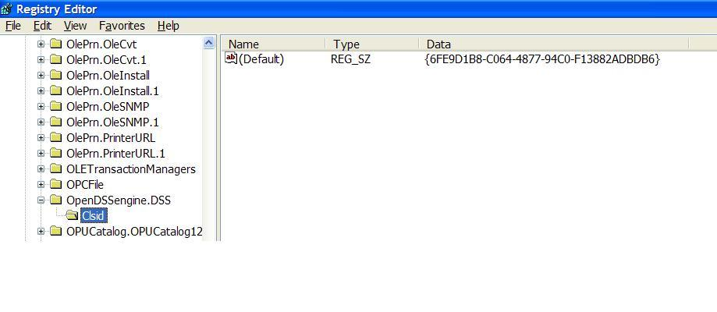
OpenDSSEngine.DSS is Registered
Windows Registry Entry
GUID
The Server shows up as “OpenDSSEngine.DSS” in the Windows Registry
The OpenDSS is now available to any program on the computer

Slide 32
Linking Your Program to the COM Server
Examples of accessing the COM server in various languages
In MATLAB:
DSSobj = actxserver(‘OpenDSSEngine.DSS’);
In VBA: (Early binding)
Public DSSobj As OpenDSSEngine.DSS Set DSSobj = New OpenDSSEngine.DSS
In Dephi
{Import Type Library}
DSSObj := coDSS.Create;
In PYTHON:
self.engine = win32com.client.Dispatch("OpenDSSEngine.DSS")

Slide 33
OpenDSS COM Interfaces
There are many interfaces supplied by the COM server
There is one registered In-Process COM interface:
OpenDSSEngine.DSS
The DSS interface is the one your program instantiates
The DSS interface then creates all the others.
This is for simplicity for users who are not necessarily familiar with COM programming

Slide 34
“Active objects” concept
.The interfaces generally act on the ACTIVE object
Active circuit,
Active circuit element,
Active bus, etc.
The interfaces generally point to the active object
To work with another object, change the active object
There are methods for selecting objects
You may also use script commands

Slide 35
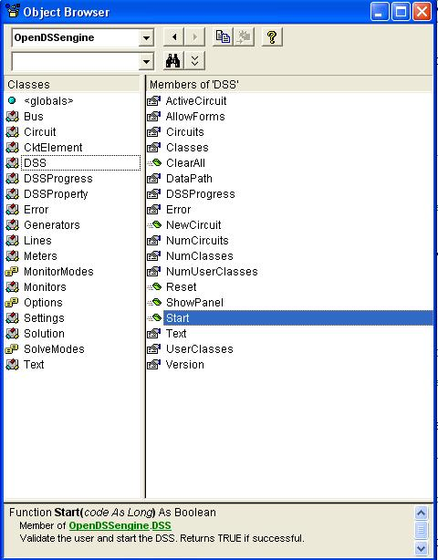
DSS Interface
This is the main interface. It is instantiated upon loading OpenDSSEngine.DSS and then instantiates all other interfaces internally
Call the Start(0) method to initialize the DSS
DSS Class Functions (methods) and Properties

Slide 36
COM with a Simple VBA Macro (Class Exercise)
To run the IEEE 123-bus Test Feeder and plot the voltage profile

Slide 37
Option Explicit
Public MyOpenDSS As OpenDSSengine.DSS
Public MyText As OpenDSSengine.Text
Public MyCircuit As OpenDSSengine.Circuit
Public Sub MyMacro()
Set MyOpenDSS = New OpenDSSengine.DSS
MyOpenDSS.Start (0)
Set MyText = MyOpenDSS.Text
Set MyCircuit = MyOpenDSS.ActiveCircuit
MyText.Command = "Compile (C:\OpenDSS\IEEETestCases\123Bus\IEEE123Master.dss)"
MyText.Command = "New Energymeter.M1 element=Line.L115 terminal=1"
MyText.Command = "Solve"
Dim MyVoltages As Variant
Dim MyNames As Variant
Dim Mydistances As Variant
MyVoltages = MyCircuit.AllBusVmagPu
MyNames = MyCircuit.AllNodeNames
Mydistances = MyCircuit.AllNodeDistances
Dim i As Integer, irow As Integer
irow = 1
For i = LBound(MyVoltages) To UBound(MyVoltages)
ActiveSheet.Cells(irow, 1).Value = MyNames(i)
ActiveSheet.Cells(irow, 2).Value = Mydistances(i)
ActiveSheet.Cells(irow, 3).Value = MyVoltages(i)
irow = irow + 1
Next I
Set MyOpenDSS = Nothing
End Sub

Slide 38
Steps Require to Do This
Register OpenDSSEngine.DLL (32-bit if your Excel is 32-bit)
Start Microsoft Excel
Type alt-F11 to open VBA editor
Or Tools>Macro …
Select OpenDSS Engine under Tools>References
Insert>Module
Enter the VBA code into blank module
Use correct path name for your computer
Execute the macro “MyMacro”

Slide 39
Resulting Chart in Excel

Slide 40
Custom Simulations
(with Python, Matlab, etc.)

Slide 41
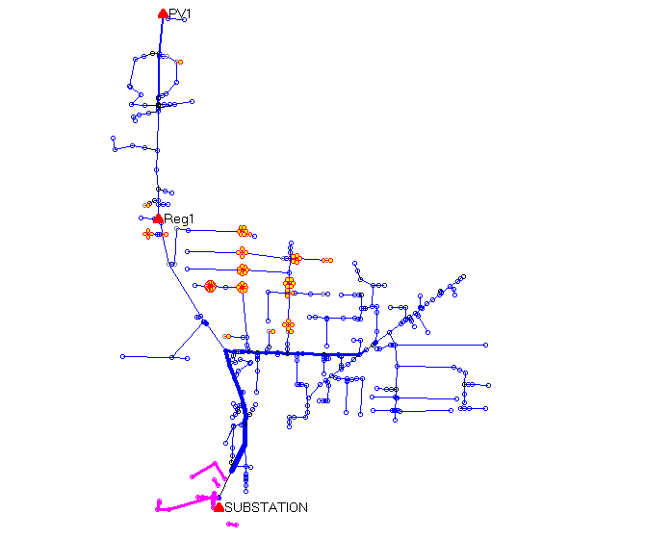
A Co-simulation Example (A Hypothetical Case)
PV Location (2.5 MW)
Voltage regulator
Clusters of
Storage Units
Ref: EPRI/AEP Smart Grid Demo
Community Energy Storage Concept

Slide 42
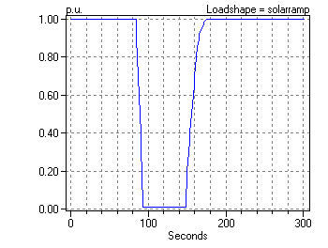
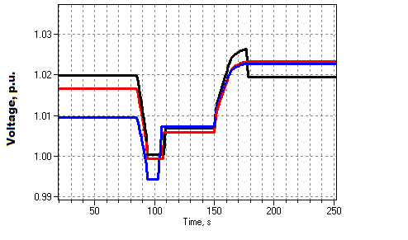
Solar Ramp Rate Issue
Assumed Solar Ramping Function
Result

Slide 43
The Question
Can you dispatch the 84 CES units fast enough to compensate for the sudden loss of PV generation on a “Cloud Transient” ?
Why it might not work:
Communications latency
CES not in right location or insufficient capacity
Calls for a “Hybrid” simulation
Communications network (NS2)
Distribution network (OpenDSS)

Slide 44
How We Did It

Slide 45
OpenDSS Script (Snippet)
Set sec=20
Solve ! Init steady state at t=20
Sample
! Start the ramp down at 1 sec
Set sec=21
Generator.PV1.kW=(2500 250 -) ! Decrement 10%
Solve
Sample
Set sec=22
Generator.PV1.kW=(2500 500 -) ! Decrement another 10%
Solve
Sample
Set sec = 22.020834372 ! Unit 1 message arrives
storage.jo0235001304.state=discharging %discharge=11.9
Solve
Sample
Set sec = 22.022028115 ! Unit 2 message arrives
storage.jo0235000257.state=discharging %discharge=11.9
Solve
Sample
Etc.

Slide 46
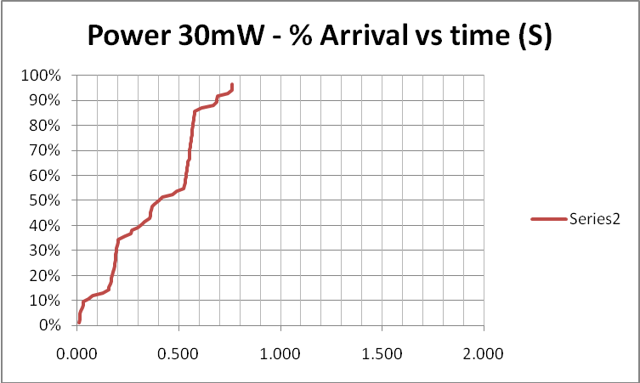
Results (for down ramp only)
Comm Simulation

Slide 47
Comm and Power Co-simulation
New and active research area
Working to more tightly link ns-2 and OpenDSS
Or other comm simulators
Communications latency is an important issue with Smart Grid
Power engineers tend to assume communications will happen
But there are limits

Slide 48
Custom Simulation Scripting in Snapshot Mode
This is the default solution mode
Attempts one solution for each “solve”
Solves the circuit “as is”
If you want something done, you have to specifically tell it
Set Load and Generator kW, etc.
Load.MyLoad.kW=125
Loadshapes are not used in this mode!
Sample Monitors and meters
Solve
Sample

Slide 49
Custom Simulation Scripting in “Time” Mode
Similar to Snapshot mode EXCEPT:
Loads, Generators can follow a selected Loadshape
Duty, Daily, or Yearly
Monitors are automatically sampled
But not Energymeters; do that explicitly if desired
Time is automatically incremented AFTER solve

Slide 50
Snapshot Mode Scripting Example
Set Gen kW explicitly each time step
! Start the ramp down at 1 sec
Set sec=1
Generator.PV1.kW=(2500 250 -)
Solve
Sample
Set sec=2
Generator.PV1.kW=(2500 500 -)
Solve
Sample
Set sec = 2.020834372 ! Unit 1
storage.jo0235001304.state=discharging %discharge=11.9
Solve
Sample
Set sec = 2.022028115 ! Unit 2
storage.jo0235000257.state=discharging %discharge=11.9
Solve
Sample
Set sec = 2.023158858 ! Unit 3
storage.jo0235000265.state=discharging %discharge=11.9
Solve
Sample
Set sec = 2.024604602 ! Unit 4
storage.jo0235000268_1.state=discharging %discharge=11.9
Solve
Sample
Set sec = 2.025738325 ! Unit 5
storage.jo0235000268_2.dispmode=discharging %discharge=11.9
Solve
Sample
Etc.
Solve and Sample explicitly at each step
Set each Storage unit discharge rate explicitly each time step
(time is used for recording purposes only)

Slide 51
Time Mode Scripting Example
All Loads, Generators will follow assigned Duty cycle loadshape
! Start the ramp down at 1 sec
Set mode=time loadshapeclass=duty
set stepsize=1s
Solve ! Base case t=0
Solve ! t=t+1 = 2
Solve ! t=2 second solution; t=t+1 = 3
Set sec = 2.020834372 ! Unit 1 (reset t)
storage.jo0235001304.state=discharging %discharge=11.9
Solve
Set sec = 2.022028115 ! Unit 2
storage.jo0235000257.state=discharging %discharge=11.9
Solve
Set sec = 2.023158858 ! Unit 3
storage.jo0235000265.state=discharging %discharge=11.9
Solve
Set sec = 2.024604602 ! Unit 4
storage.jo0235000268_1.state=discharging %discharge=11.9
Solve
Set sec = 2.025738325 ! Unit 5
storage.jo0235000268_2.dispmode=discharging %discharge=11.9
Solve
Etc.
Set sec=3
Solve ! t=3 solution; t=t+1 = 4
….

Slide 52
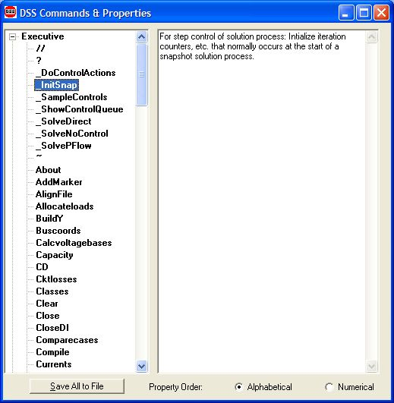
Custom Simulation Scripting: Rolling Your Own Solution Algorithm
These commands allow step-by-step control of the solution process

Slide 53
Custom Simulation Scripting: Rolling Your Own Solution Algorithm
The basic Snapshot solution process:
Initialize Snapshot (_InitSnap)
Repeat until converged:
Solve Circuit (_SolveNoControl)
Sample control devices (_SampleControls)
Do control actions, if any (_DoControlActions)
You may wish, for example, to interject custom control actions after the _SolveNoControl step

Slide 54
Co-simulation and OpenDSS
Simulation of power system and communications networks simultaneously
An important area of smart grid research
Will messages be able to get to targets in time to perform Smart Grid functions?
What will be the effect of communications latency?
Much work needs to be done developing appropriate tools

Slide 55
Custom Simulation Scripting, cont’d
Via COM interface
Whatever you want (if you can write code)
See Examples Folder on Sourceforge site
Excel: SampleDSSDriver.xls
Matlab:
VoltageProfileExample.m
DSSMonteCarlo.m

Slide 56
For More Information …
See OpenDSS Custom Scripting.Doc
(Sourceforge site, “Doc” Folder)

Slide 57
Models of Circuit Elements for Advanced Distribution System Analysis

Slide 58
Introduction to Power Flow Analysis in Distribution Systems

Slide 59
Types of Power Flow
If you were to ask most engineers in the electric power industry to list the different types of power flow programs, you will probably get these answers:
Gauss-Seidel
Newton-Raphson
Fast Decoupled
These are three different kinds of general numerical methods for solving sets of nonlinear equations.
Fast Decoupled algorithms take advantage of certain peculiarities of the power system,
The other two methods are used in many different sciences.
The basic equations solved by these methods are nearly the same (found in most basic power system texts).

Slide 60
On These Power Flow Methods …
These methods have been developed for power flow calculations for Transmission (HV) systems.
Generally for positive-sequence models only
Also adequate for capacity planning of 3-phase systems
DG and other issues demand more detailed model
Formulation influenced heavily by P-V generation bus
Not needed in most distribution analysis
They are not necessarily the best methods to use for Distribution (MV and LV) systems
Other numerical methods that are more appropriate,
Better ways to write the equations describing the system.

Slide 61
The Unbalanced Distribution System
This takes more than a positive-sequence model !!

Slide 62
On These Power Flow Methods …
Transmission:
Balanced
per units
MW
100 MVA Base
Distribution:
unbalanced
ohms,
kV,
A,
kW,
kvar
There are probably dozens of ways to write a distribution power flow application. We will examine at a couple that are adequate for most situations.

Slide 63
The Typical Power Flow Problem
Three different kinds of buses
Swing
Generator
Load
Power delivery network usually represented by positive-sequence only
Assumes balance between phases

Slide 64
Buses in Power Flow Problem
Swing Bus
Voltage magnitude and angle specified
i.e. - a voltage source
Power "swings" to compensate for mismatches at other sources
Load Bus
Active and Reactive Power specified
S = p + j q = vi* (* denotes complex conjugate)

Slide 65
Buses in Power Flow Problem cont’d
Generator Bus
Power and voltage magnitude specified
P = Re{VI*}
|V| = Constant
Determined by optimal dispatch
Built into modern power flow program
Network
Generally described by Admittance matrix, Y
I = YV

Slide 66
The power flow problem is frequently stated in terms of mismatch in the complex power, S, at each bus.
Mismatch, m, at j-th bus
m_{j} = - v_{j}i_{j}* + s_{j}
s_{j} is the specified power at a load bus
i_{j} is j-th element of the system I vector:
I = Y V
Boldface type denotes a complex number
* denotes complex conjugate
Lower-case letters:Individual bus quantities
Upper case letters: System quantities
The objective of a solution technique is to minimize this mismatch.

Slide 67
Methods of Solving
Gauss-Seidel
Basic formulation
v_{k} = [(s_{k})/v_{k}* - Σy_{jk}v_{j}] ( sum j≠k)
Iterate until mismatch criteria met
A straight Gauss method would use two separate vectors for the left- and right-hand sides of this equation.
In a Gauss-Seidel, you just keep one vector and always use the latest estimate in your calculations.
References
G.T. Heydt, Computer Analysis methods for Power Systems, MacMillan, 1986, Chapter 4, Section 2.

Slide 68
Methods of Solving
Newton-Raphson
Extension of basic Newton method to systems of nonlinear equations
Where we are attempting to solve
g(x_{n}) = 0

Slide 69
Methods of Solving
Newton-Raphson
Split the mismatch equations into real and imaginary parts (P + jQ) and try to force to zero
Unknowns are voltage magnitude and angle

Slide 70
Methods of Solving
Newton-Raphson
Jacobian
(Use J in solution equations:)

Slide 71
Methods of Solving
Fast Decoupled
Based on Newton-Raphson formulation
Coupling in Jacobian is neglected.

Slide 72
Methods of Solving
Fast Decoupled
Takes advantage of:
Newton methods frequently converge if pointed in the right direction even if Jacobian is not precisely correct
Reactance dominates the resistance (X/R is high) in many parts of the power system
Number of calculations is much reduced
Very popular today
Reference
B. Stott and O. Alsac, ”Fast Decoupled Load Flow," IEEE Transactions on Power Apparatus and Systems, Vol PAS-93, May-June 1974, pp. 859-869.

Slide 73
Some Observations Relevant to Distribution System Analysis
Formulation of the power flow equations is different than an electrical circuit simulation require for some types of DER
For example, there is no electrical device that is a P-V bus;
Need generator and exciter control model
It can be difficult to formulate the Jacobian in a Newton-Raphson method for unbalanced distribution systems with different Load models and voltage control devices.
This paper derives one method:
P. Garcia, J. L. Pereira, et. al. , “Three-phase power flow calculations using the current injection method,” IEEE T-PWRS, Vol 15, No. 2, May 2000.
Fast decoupled approach reportedly does not work well on radial distribution systems where X/R is low
Needs dominant X

Slide 74
Radial Circuit Power Flow Calculations

Slide 75
Problem Definition

Slide 76
Problem Definition, Continued
Only one source
Substation transformer may have a tap changer for voltage regulation
Many different kinds of loads, e.g.:
P + jQ (traditional power flow model)
Constant impedance (Z)
Motor: Constant P, Q varies quadratically
Mixed: Linear P, quadratic Q
Some Rectifiers: Constant P, constant |I|
Many others …

Slide 77
The Current Injection Model is a Common Way to Model a Distribution System
Many diverse kinds of load models
Represent the loads as current sources that are a function of voltage

Slide 78
Radial Circuit Solution Techniques

Slide 79
Forward-Backward Sweep is a Popular Method
(See Kersting’s excellent text book on Distribution System Modeling for details of this method)
Similar methods were used in hand calculations
Often, just one sweep due to time-consuming labor
The FB Sweep method by computer was implemented at least by the late 1960’s
The McGraw-Edison RCAP program used full nonlinear F-B sweep in 1971
And was not the first to use it

Slide 80
The Process …

Slide 81
The Forward Sweep
Compute voltage drops
where,
Bus k is immediately downline from Bus j
Z_{jk} = Impedance of branch between Buses j and k
I_{jk} = Current in branch between Buses j and k
Start at the source and work toward ends of feeders
This requires an algorithm for ordering the branches in the circuit model

Slide 82
The Backward Sweep
Estimate the load currents given guess at voltages
Accumulate currents in branches
Start at ends of feeders and work toward source
There is only one path from each load bus to the source
(there could be multiple forward paths from a node)

Slide 83
Iteration Algorithm for FB Sweep Method
Assume loads currents are zero and all branch currents are zero
Do Forward Sweep
Compute new guess at load currents and do backward sweep
Repeat Forward and Backward Sweep (steps 2 and 3) until converged

Slide 84
Notes on the FB Sweep Method
Will work for multiphase as well as single-phase models
Is simple to program and fairly fast (no big matrices to factor)
(Modern sparse matrix methods appear to be faster)
When implementing, programmers usually keep an array or stack that keeps track of the sweep sequence.
This is done one time so that the program doesn't have to search for branches on each sweep.
Naturally represents the effect of time delay on line voltage regulators
(ones closest to substation change first)
Load model can be just about anything where the current can be written in the form I=f(V)

Slide 85
Convergence of FB Sweep Method
Converges easily on practical systems - 3 to 10 iterations.
1 or 2 iterations if previous solution is close
Advantageous for daily, monthly, yearly simulations
Valuable for capacitor optimization searches, etc.
A relative of "fixed point" iteration.
The derivative, f'(V), must be <1.
Translation: Equivalent shunt impedance must be greater than short circuit impedance at all buses.
This is generally easily the case for most distribution systems
Constant P, Q load model (traditional power flow model) causes convergence problems when voltage begins to sag to about 70%
Fix: linearize load model outside ±10% voltage deviation
Voltage convergence is usually satisfactory: Typical |ΔV| < 0.01%

Slide 86
Units for Quantities

Slide 87
Per Units or Actual values?
Distribution system analysis is more commonly done using actual volts, amps, ohms
Traditional from when engineers did voltage drop calculations “by hand”
Computer programs developed by distribution engineers retain this approach
Computer programs derived from transmission system power flows generally use per unit system

Slide 88
Per Units or Actual values?
The Per-Unit system was developed to avoid explicit modeling of transformer winding ratios and different voltage levels to simplify hand calculations
With many distribution power flow problems with distributed resources having a detailed transformer model is an advantage

Slide 89
Per Units or Actual values?
Per unit system not necessarily needed
OpenDSS program doesn’t use it
To computers, numbers are numbers
Modern solvers can do their own normalization
Some distribution problems can’t easily be solved in per unit system – easier in actual ohms

Slide 90
Example: Residential Service Transformer
What’s the voltage base for the LV side that would allow removing the explicit transformer?

Slide 91
Per Units or Actual values?
Distribution analysis problems that require explicit modeling of transformer winding connections
The common 120/240 V center-tapped residential service transformer
Harmonics
Electromagnetic transients
Many Distributed Generation applications
Some fault studies (e.g., HV falling on MV)
EPRI recommends designing distribution system analysis tools to work in actual volt, amps, and ohms

Slide 92
Quantities Required for Distribution Models

Slide 93
Approaches to Line Impedance Models
Positive-sequence only
Like transmission programs
Positive- and zero-sequence ohms
Commonly available data
Fits short circuit current formulae
Does NOT represent unbalance in line
Have to “trick” the solution for 1- and 2-phase sections
Full impedance matrix in ohms
Most accurate for all analyses and line constructions

Slide 94
Approaches to Line Impedance Models
Technically, there is no such thing as the sequence impedance of a 1-phase, 2-phase or unbalanced 3-phase line.
An underlying assumption for symmetrical component currents is balanced lines

Slide 95
Some Handy Relationships for Symmetrical Components
If given the Z Matrix
If given Z₁ and Z₀

Slide 96
Equivalent 4-wire model use on TNA
TNA= Transient Network Analyzer
Line Model:
You can also use this in digital computer models

Slide 97
Modeling Transformers

Slide 98
Compute Short Circuit Matrix, ZB
Follow McWhirter’s method of building Yprim directly from short-circuit measurements on the transformer
As opposed to computing the Inductance matrix from FEA field calculations
Compute short circuit matrix on 1-volt basis
Perform reference frame change to compute Y on a 1-V base
Apply turns ratios/voltage ratios to get actual siemens
Apply winding connections

Slide 99
Compute Short Circuit Matrix, ZB
Take n(n-1)/2 short circuit measurements
Between each pair of windings
For 3-winding: 3 measurements
Usually found on nameplate or Test Report in %
Z_{SC}1,2; Z_{SC}1,3; Z_{SC}2,3
Convert to pu
Diagonal Elements of Z_{B}
z_{Bii} = z_{SC 1, i+1} × z_{base} for i = 1 to n-1
Off-diagonal Elements of Z_{B}:
z_{Bij} = 0.5[z_{Bii} + z_{Bjj} - z_{Scj+1,i+1} × z_{base}] i≠ j

Slide 100
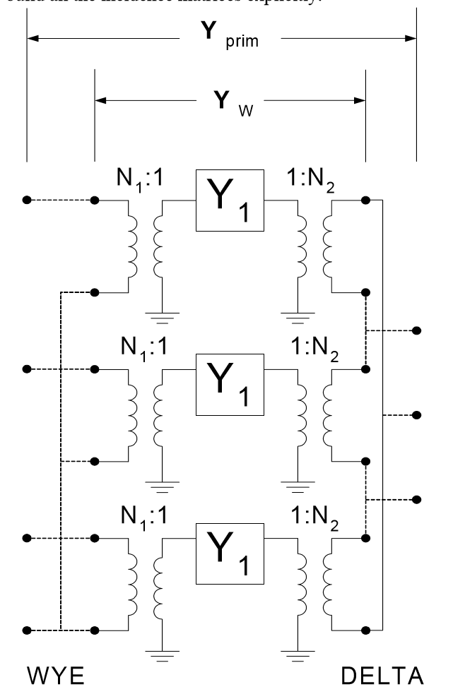
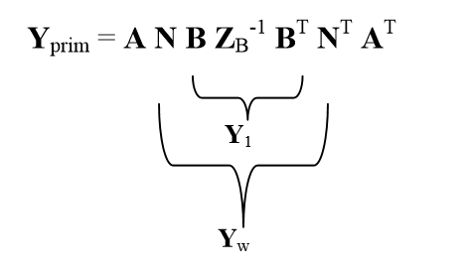
Transforming to Yprim

Slide 101
YDY Transformer

Slide 102
Effect of Core Configuration
3-Leg Core Offers Low Impedance Path to Zero Sequence

Slide 103
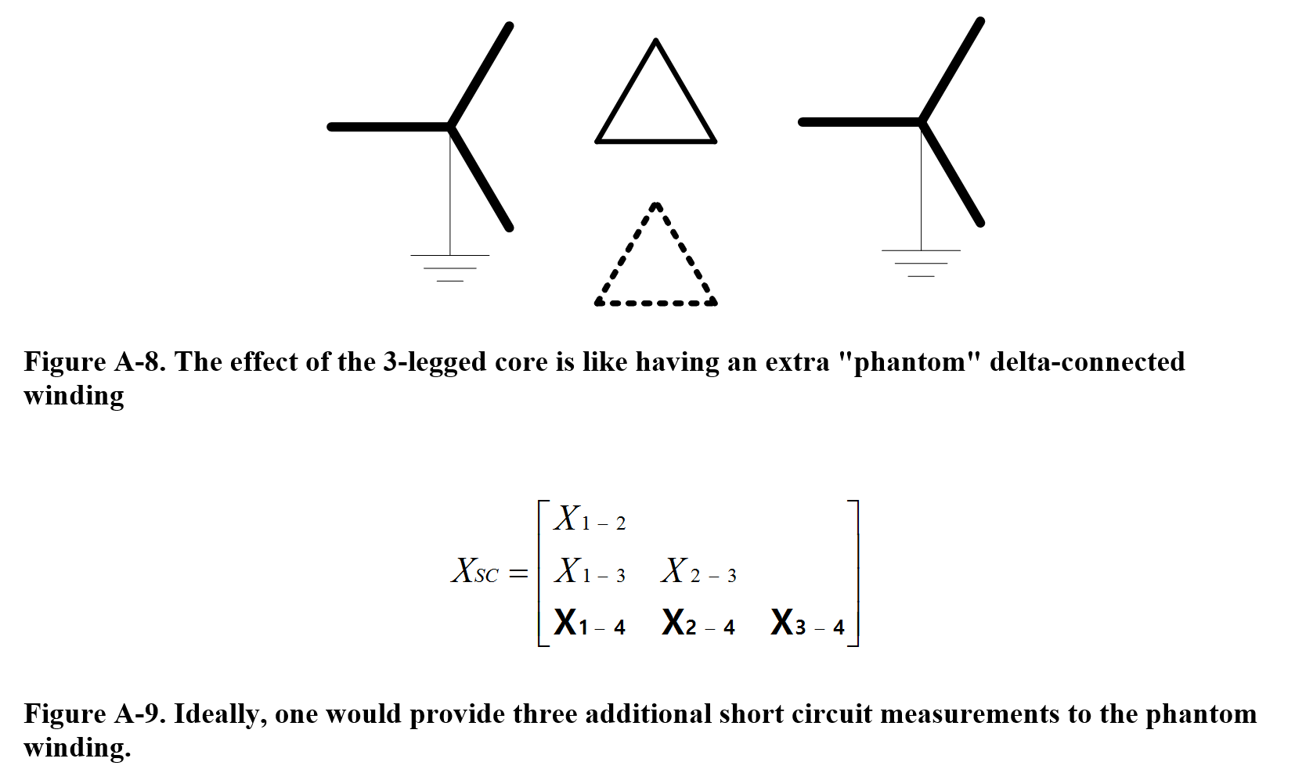
Adding The Phantom Winding

Slide 104
Transformer Data Required
Base MVA or kVA
Rated voltage: kV L-L for 3-phase transformers
Leakage Z =R+jX… usually in %
R may come from nameplate losses at rated load
Then compute X from total Z
Or, both numbers may be available in test report
Need leakage or Short Circuit Z between every pair of windings

Slide 105
Transformer Data Required
Some distribution analysis program require L-N voltage
Winding Connections
Some programs require specification of phase shift
Others compute phase shift from winding connections
E.g., Delta-wye = 30 degrees
For difficult problems in general, explicit modeling of transformer winding connections works best
Zig-zag
Open-Delta
Scott T

Slide 106
Load Models

Slide 107
Load Data Required
For Distribution: kVA instead of MVA (as in Transmission)
Typical ways to define a base load value:
kW, PF
kW, kvar
kVA, PF
Nominal rated voltage, kV L-N or L-L
For QSTS, base kW + Loadshape (in pu)
Or actual AMI data (kW in 10-,15-, or 30-min intervals)
How load varies with voltage magnitude
ZIP model, etc.

Slide 108
OpenDSS Load Models (P, Q as function of voltage)
Model 1: Constant P, Q
Model 2: Constant Z
Model 3: Const P, quadratic Q
Model 4: Nominal Linear P, Quadratic Q (feeder mix).
Use this with CVRfactor.
Model 5: Constant Current (I)
Model 6: Const P, Fixed Q
Model 7: Const P, Fixed Impedance Q
Model 8: ZIP Model

Slide 109
OpenDSS Generator Models for Power Flow (P, Q as function of voltage)
Model 1: Constant P, Q
Model 2: Constant Z
Model 3: Constant P, constant |V|
Model 4: Constant P, Fixed Q (Q never varies)
Model 5: Constant P, Fixed Q (as a constant reactance)
Model 6: Compute current injection from User-written Model. (see usage of Xd, Xdp)
Model 7: Constant P, Q, but current-limited below Vminpu.
Approximates a simple inverter.
Balanced property:
Force balanced current only for 3-phase generators.
Force zero- and negative-sequence to zero.

Slide 110
Transmission Source Equivalent
Short circuit (Thevinen) equivalent
L-L kV
Per-unit voltage
Phase angle, degrees
Any of
3-phase and 1-phase short circuit currents, amps
3-phase and 1-phase short circuit MVA
Z1 and Z0 in pu on 100 MVA
Z1 and Z0 in ohms
Sometimes, Z2, if different from Z1
Near a generator

Slide 111
Capacitors and Regulators
Control devices

Slide 112
OpenDSS Solution Loop with Controls
Controls are sampled and executed after a converged power flow solution
Power Flow Solution

Slide 113
Shunt Capacitors
The kvar rating
The kV rating
L-L for 3-phase bank in OpenDSS
Rating of can for 1-phase capacitors
Switching criteria
None (fixed)
Voltage
Current
kvar (plus Voltage Override, Delay, etc)
PF
Time

Slide 114
Shunt Capacitors - CapControl
The control is modeled separately from the Capacitor
Type
{Current | voltage | kvar | PF | time }
PT ratio
CT ratio
Time Delay, Delay OFF, Dead time
Voltage override
User model (optional)

Slide 115
Voltage Regulator/OLTC
Voltage target
Bandwidth
Time Delay
PT ratio
CT primary rating (regulator rating)
Line-drop compensator (forward and reverse)
R (in Volts!)
X
Remote bus to control

