Slide 1
Advanced Modeling for Distribution Planning Workshop with OpenDSS
Instructors
Roger C. Dugan Matt Rylander
Sponsored by CenterPoint Energy At Texas A&M University April 19, 20, 21

Slide 2
Use Cases/Examples

Slide 3
Modeling Solar PV

Slide 4
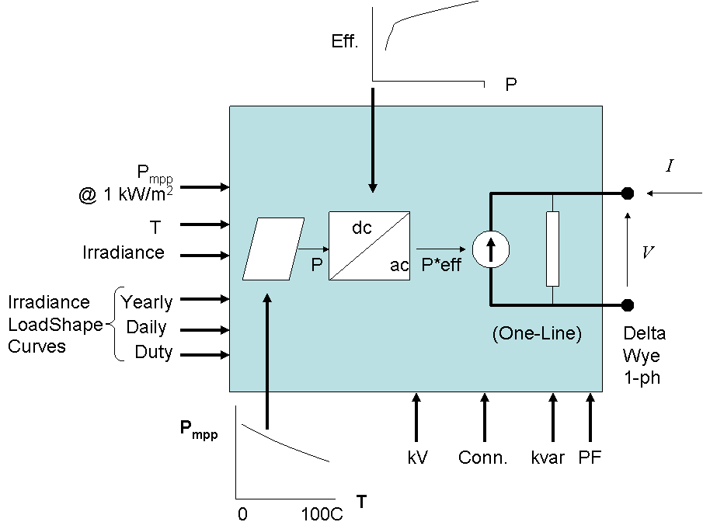
PVSystem in the OpenDSS
The PVSystem model combines a model of the PV array and the PV inverter into one convenient model to use for distribution system impacts studies

Slide 5
Example Script
This example defines a PV system with a panel Pmpp of 500 kW at 1 kW/m² irradiance and a panel temperature of 25°C. The inverter is rated at 500 kVA. A PF of 1.0 is assumed for this example.
Can also be used with the InvControl control object that implements advanced (‘smart’) inverter functions such as volt-var, volt-watt, and dynamic reactive current.
InvControl usage to be covered later today

Slide 6
Example Script
clear
New Circuit.PVSystem basekv=12.47 Isc3=1000 Isc1=900
// P-T curve is per unit of rated Pmpp vs temperature
// This one is for a Pmpp stated at 25 deg
New XYCurve.MyPvsT npts=4 xarray=[0 25 75 100] yarray=[1.2 1.0 0.8 0.6]
// efficiency curve is per unit eff vs per unit power
New XYCurve.MyEff npts=4 xarray=[.1 .2 .4 1.0] yarray=[.86 .9 .93 .97]
// per unit irradiance curve (per unit if "irradiance" property)
New Loadshape.MyIrrad npts=24 interval=1 mult=[0 0 0 0 0 0 .1 .2 .3 .5 .8 .9 1.0 1.0 .99 .9 .7 .4 .1 0 0 0 0 0]
// 24-hr temp shape curve
New Tshape.MyTemp npts=24 interval=1 temp=[25, 25, 25, 25, 25, 25, 25, 25, 35, 40, 45, 50 60 60 55 40 35 30 25 25 25 25 25 25]
// **** plot tshape object=mytemp
// take the default line
New Line.line1 Bus1=sourcebus bus2=PVbus Length=2

Slide 7
Example Script (cont’d)
! PV definition
New PVSystem.PV phases=3 bus1=PVbus kV=12.47 kVA=500 irrad=0.8 Pmpp=500
~ temperature=25 PF=1 effcurve=Myeff P-TCurve=MyPvsT
~ Daily=MyIrrad TDaily=MyTemp
set voltagebases=[12.47]
calcv
solve ! solves at the specified irradiance and temperature
new monitor.m1 PVSystem.PV 1 mode=1 ppolar=no
new monitor.m2 PVSystem.PV 1
solve
solve mode=daily
show mon m1
show mon m2

Slide 8
Example Script (cont’d)
Export monitors m1
Plot monitor object= m1 channels=(1 )
Export monitors m2
Plot monitor object= m2 channels=(1 ) base=[7200]
Export monitors m2
Plot monitor object= m2 channels=(9 )

Slide 9
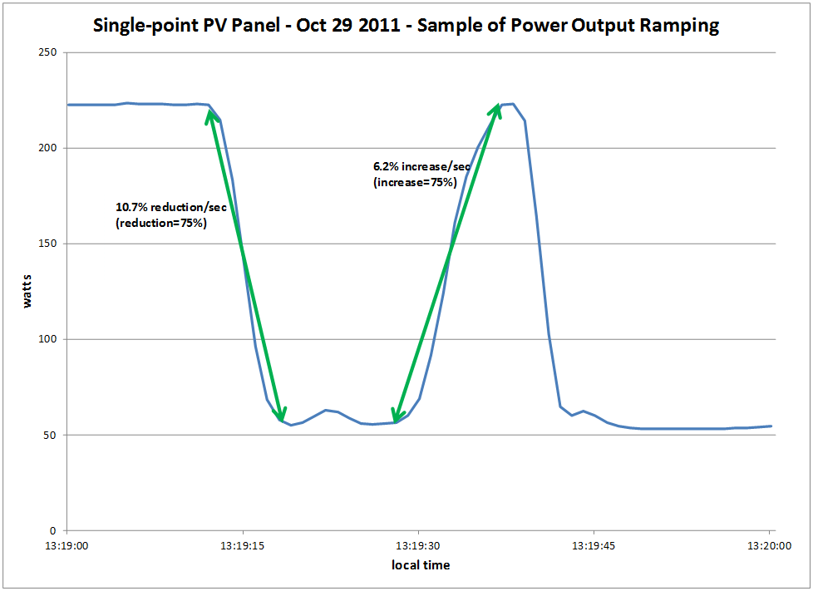
Modeling PV Systems – Variability/Ramping – Single-Panel

Slide 10
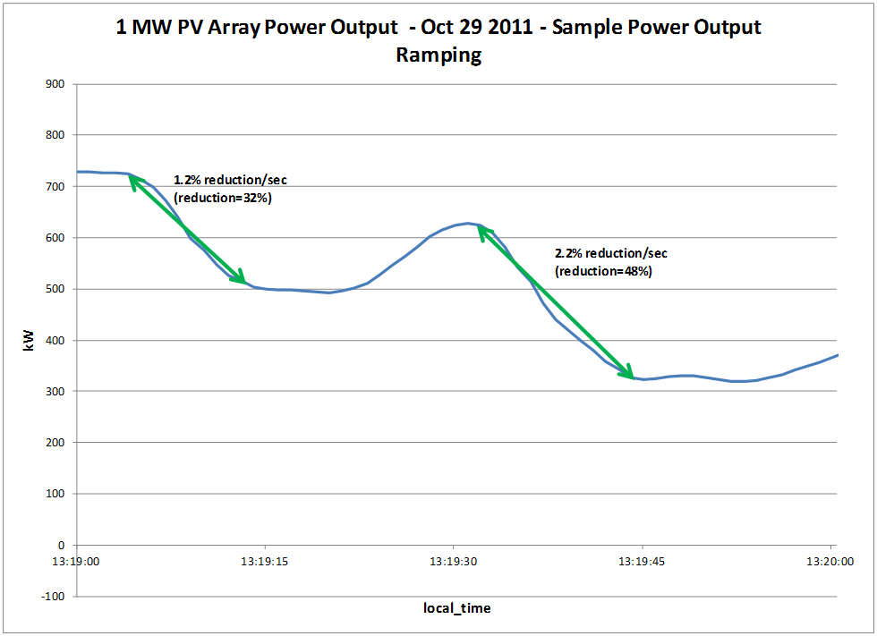
Modeling PV Systems – Variability/Ramping – 1 MW PV Array (same location as Single-Panel)

Slide 11
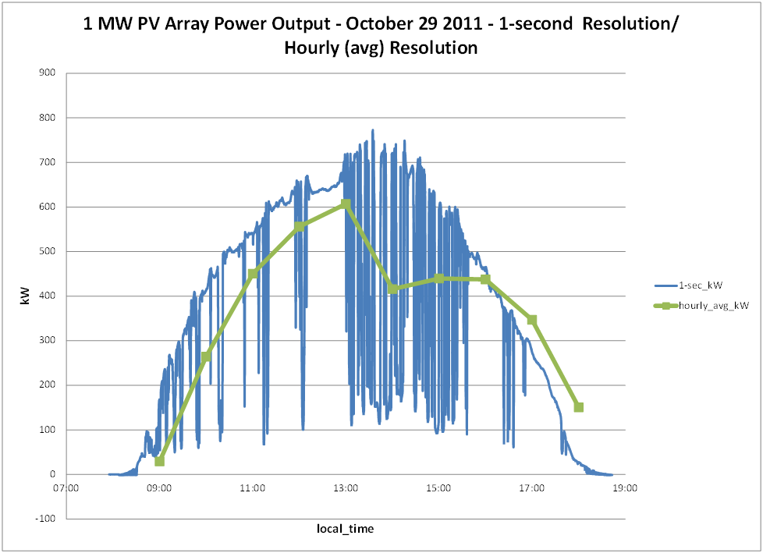
Modeling PV Systems – Variability/Ramping – Significance of Solar Irradiance Resolution

Slide 12
Modeling PV Systems for Distribution System Impact Assessment – Fault Response
Fault current contribution
Conservative Rule-of-thumb: 2 x Full Output Rating of Inverter for 1 cycle (three-phase fault)
Other testing has been performed by Southern California Edison, NREL, PV inverter manufacturers, etc
Inverters generally shut down at 1.2 pu of rated current
May be 3-4 times pre-fault current
Irregular behavior on voltage sags
Tries to hold constant power (current increases)
May become discontinuous

Slide 13
Sample Open-Circuit Events – in per unit
Summarizing short circuit events: they to follow similar patterns, the event begins with a transient overcurrent, followed by a sustained current that increases (possibly an attempt to maintain output level), before the inverter trips due to voltage loss. The sustained current lasts between one and ten cycles depending on the inverter, power output level, and the triggered point-on-wave. The transient overcurrents ranged from 1.47 pu to 7.53 pu while the sustained overcurrents ranged from 0.00 pu to 1.91 pu.
Source: EPRI Protecting the Modern Distribution Grid, Program 180, 2016

Slide 14
Sample Voltage Sag Events – Single Phase Inverters
90% Retained Voltage
70% Retained Voltage
60% Retained Voltage
*Dashed lines indicate the start and end of the 12 cycles sag duration
14
Source: EPRI Protecting the Modern Distribution Grid, Program 180, 2016

Slide 15
‘Smart’ Inverter Control in the OpenDSS

Slide 16
InvControl Control Object
Works in conjunction with PVSystem object(s) to control the PVSystem(s) output according to ‘smart’ inverter functions
Three modes currently available:
Volt-var
Follows a voltage versus reactive power curve and changes the reactive power generation (capacitive) or reactive power absorption (inductive) according to the terminal voltage at each PVSystem
Volt-watt
Follows a voltage versus active power curve and changes the active power output according to the terminal voltage at each PVSystem (within the limits of the present irradiance)
Dynamic Reactive Current (DRC)
Has several settings that change the reactive power generation or absorption in response to fast changes in terminal voltage (e.g., during a sag or swell)

Slide 17
Volt-var Control Mode – Example Volt-var Curve

Slide 18
InvControl in Volt-var Mode – Script
New PVSystem.3P_ExistingSite4 phases=3 bus1=B51854_sec kV=0.4157 kVA=523 ~ irradiance=1 Pmpp=475 pf=1 %cutin=0.1 %cutout=0.1 yearly=PV_ls
New PVSystem.3P_ExistingSite1 phases=3 bus1=X_5865228330A kV=0.4157 kVA=314 ~ irradiance=1 Pmpp=285 pf=1 %cutin=0.1 %cutout=0.1 yearly=PV_ls
New PVSystem.3P_ExistingSite3 phases=3 bus1=X_5891328219_Cust1 kV=0.4157 ~ kVA=836 irradiance=1 Pmpp=760 pf=1 %cutin=0.1 %cutout=0.1 yearly=PV_ls
New PVSystem.3P_ExistingSite2 phases=3 bus1=B4832_sec kV=0.4157 kVA=209 ~ irradiance=1 Pmpp=190 pf=1 %cutin=0.1 %cutout=0.1 yearly=PV_ls
New XYCurve.vv_curve npts=4 Yarray=(1.0,1.0,-1.0,-1.0) ~ XArray=(0.5,0.95,1.05,1.5)
New InvControl.InvPVCtrl mode=VOLTVAR voltage_curvex_ref=rated ~ vvc_curve1=vv_curve EventLog=yes

Slide 19
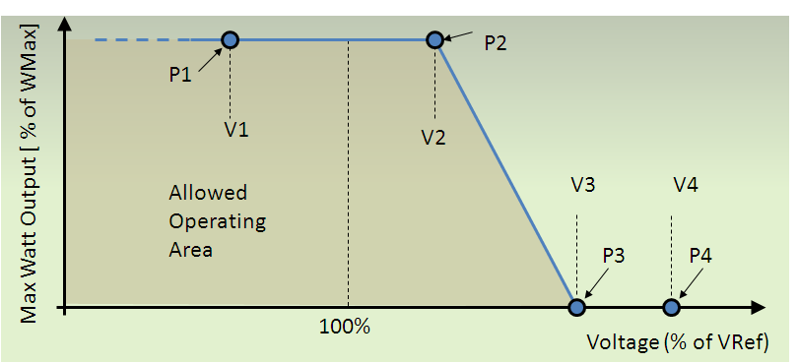
Volt-watt Control Mode – Example Volt-watt Curve

Slide 20
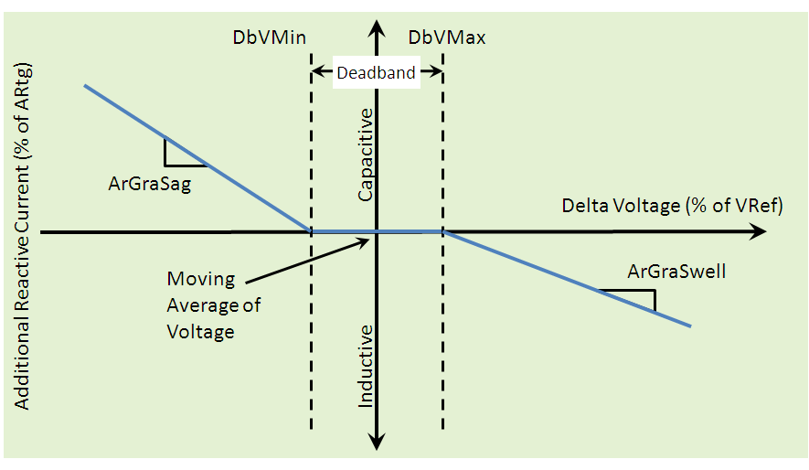
DRC Control Mode – Settings Curve

Slide 21
Including Storage in Distribution Planning
OpenDSS STORAGE and STORAGECONTROLLER objects

Slide 22
Introduction
Storage is the frequently-proposed solution to renewable generation issues
States and provinces are requiring large amounts of storage
(Cal: 1.3 GW by 2020; 425 MW on distribution)
Significant amounts expected on Distribution systems controlled for benefit of Transmission

Slide 23
Introduction, cont’d
Distribution planners are accustomed to static power flow calculations
Accurate analysis of storage required sequential-time simulation (“QSTS”)
Summary of EPRI research into modeling energy storage for planning …

Slide 24
Applications of Storage on Distribution
Smoothing solar PV power output
Extending solar PV output into the evening
Support of the Transmission grid
Extending capacity of existing assets
Supporting alternate feeds during reconfig.
Controlling frequency of a microgrid
Increasing short circuit strength of a microgrid

Slide 25
Planning Issues Introduced by Storage
Overvoltages while discharging
Low voltages while charging
Voltage regulation while compensating for transmission grid support
Interference with overcurrent protection scheme
Insufficient short-circuit capacity in microgrid

Slide 26
Sequential-Time Simulation
All DER disrupt the normal load shape
A single static power flow does not give a good answer
Have to simulate over a significant time period
Sequential-time power flow is now accepted practice in advanced distribution planning

Slide 27
The Planning Problem with Storage is More than Capacity to meet Demand
Storage is a variable resource but it is also Limited
Planning tools must account for energy stored
Has a limited ramp rate
Has to be recharged at some other time
Has losses
Charge-discharge cycle (~15-20%)
Idling losses (temperature dependent)

Slide 28
6 Simulation Modes Have Been Identified and Implemented in OpenDSS Program
Static (charge or discharge at specific rate)
Time (charge or discharge at specific time)
Peak Shave
Load Following
Loadshape Following (define a loadshape)
Dynamics (i.e., electromechanical transients)

Slide 29
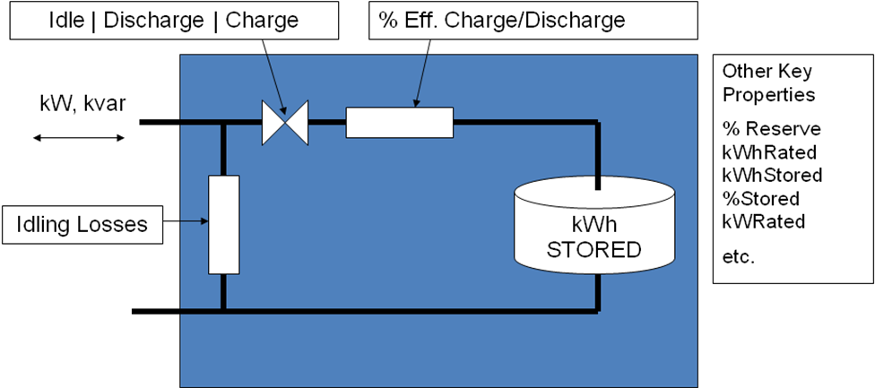
EPRI’s OpenDSS Employs a Generic Energy Storage Element

Slide 30
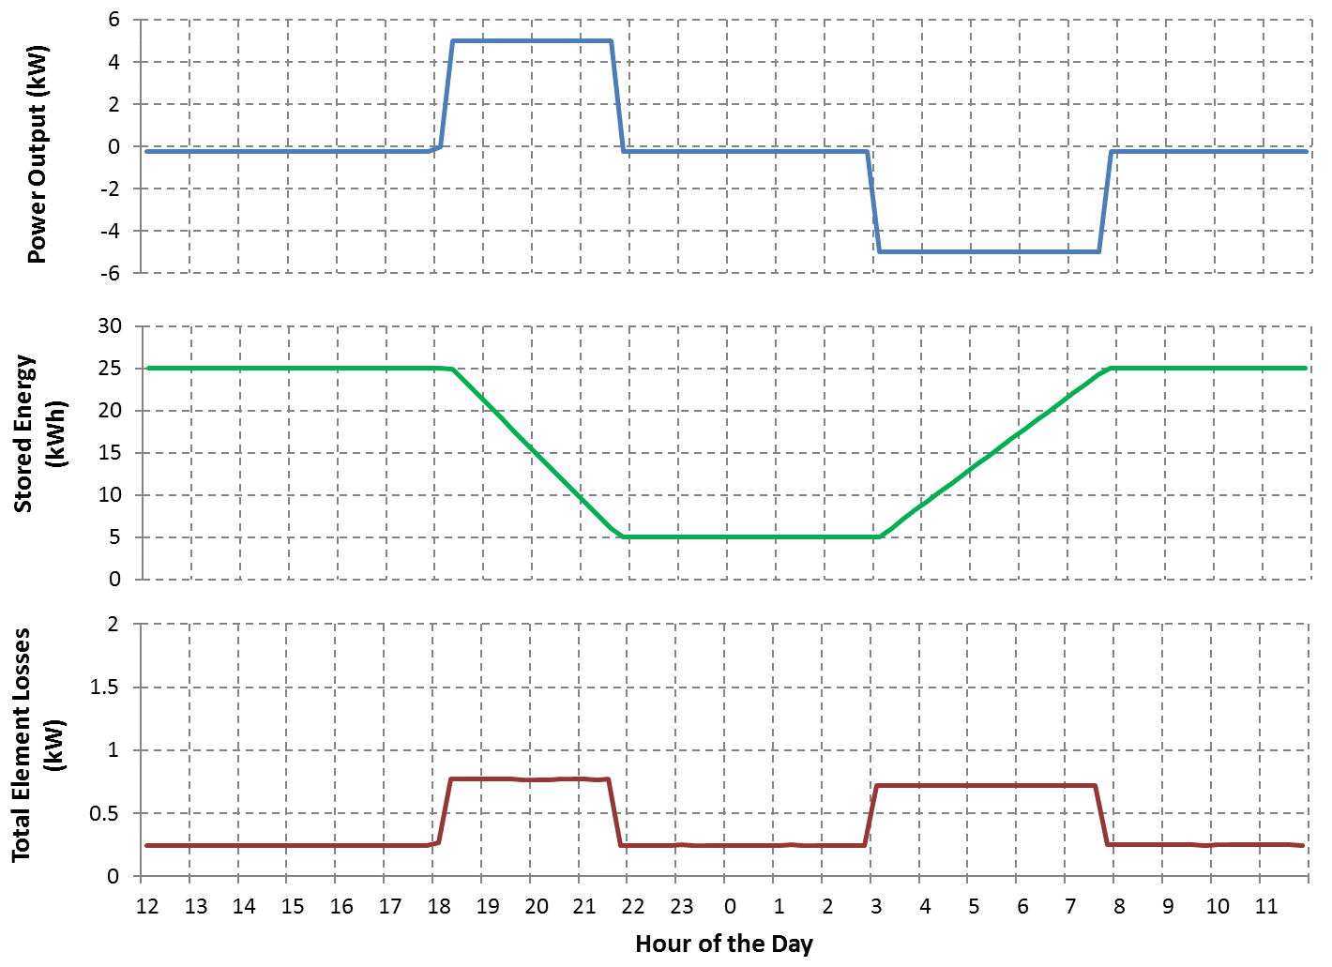
Storage Element Operation

Slide 31
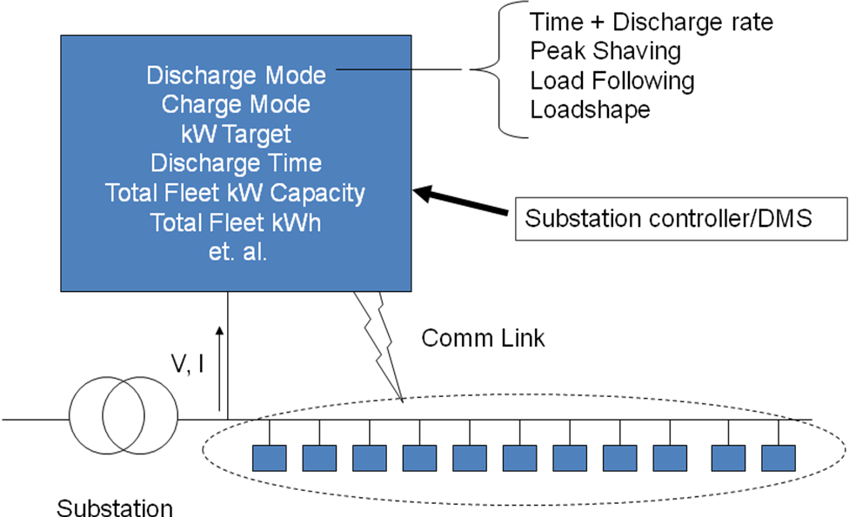
Storage Controller Model
Fleet of Distributed Energy Storage Elements

Slide 32
Peak Shaving Applications
Time step size: 15-60 min

Slide 33
Compensating for Renewable Generation
Extend solar PV output into evening peak.

Slide 34
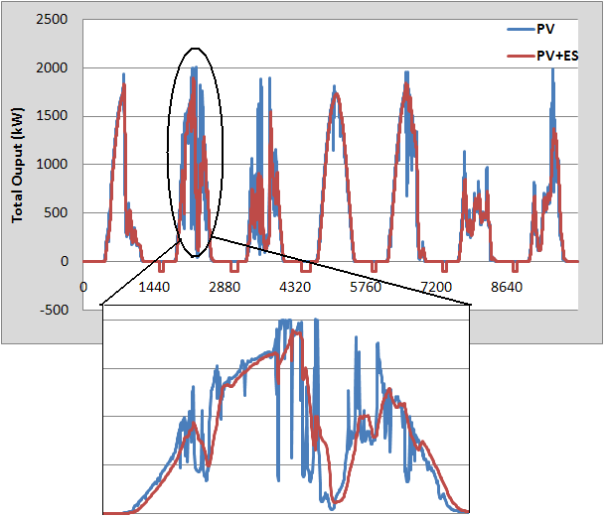
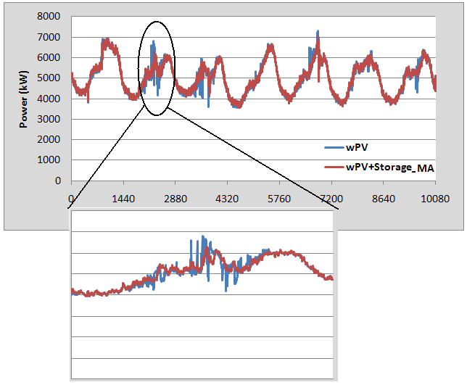
Intermittent Generation Smoothing
Network Response
PV Output

Slide 35
Storage Power Output for Smoothing

Slide 36
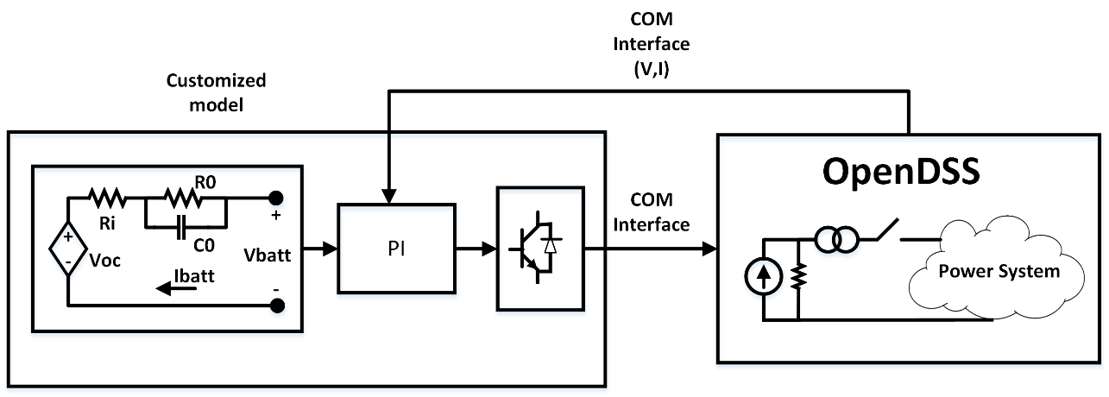
A Dynamics Example (Black start of a Microgrid)
Model may require more than 30 parameters.

Slide 37
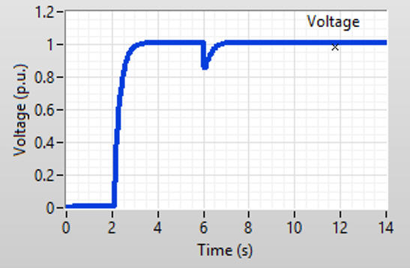
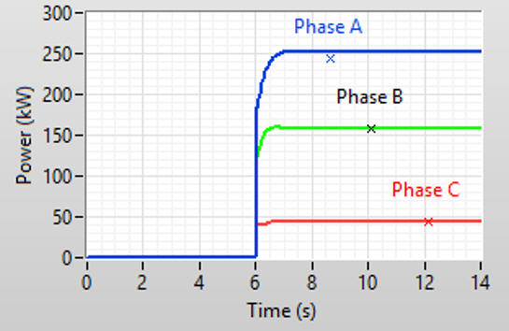
Results from the Model

Slide 38
How to Support Vendor-Supplied Models for Complex Storage System Models
Establish common software interface (DLL?)
Variants for QSTS, Dynamics, and EMT
Windows dominant platform in US for distribution
DSA vendors will have to support
Storage system vendors will want protection

Slide 39
Simplified Distribution Planning
System Performance Considerations
Overvoltages while discharging
Low voltages when charging
Voltage regulation interaction (bulk system dispatch)
Interference with overcurrent protection
Short circuit capacity when islanded
At least two accommodation screens:
Max output / min load
Max charge / max load

Slide 40
The Versatile REACTOR Model
A Model to represent many impedance characteristics

Slide 41
Specify R and X or Z1, Z2, Z0
Basic series R-X model
With option parallel Rp that can represent no-load losses or produce lower X/R at higher frequencies
1.. N phases
If Z2 <> Z1 then Yprim is asymmetric
Good for modeling induction machine

Slide 42
Specify Rmatrix and Xmatrix
Can specify series (default) or parallel
Significantly different frequency response will result for parallel model
Can represent some very creative, somewhat arbitrary R-L networks.
Restricted to symmetrical at 7.6.3

Slide 43
Dynamics Solution

Slide 44
Dynamics Mode
Dynamics mode is used for
Fault current calculations including Generator contributions
Single time-step solution
Machine transients
Inverter transients
Typical time step: 0.2 – 1 ms
Depends on time constants in model
A converged power flow is required to initialize the model.

Slide 45
Basic Algorithm (From SolutionAlgs.Pas)
Increment_time;
{Predictor}
IterationFlag := 0;
IntegratePCStates;
SolveSnap;
{Corrector}
IterationFlag := 1;
IntegratePCStates;
SolveSnap;

Slide 46
Entering Dynamics Mode
Initialize state variables in all PC Elements
For example, in a Generator object currently:
Compute voltage, E₁, behind Xd‘ and Initialize the phase angle, θ, to match power flow (approximately)
Set derivatives of the state variables to zero
For the Generator: Speed (relative to synch frequency), Angle
Set controlmode=time
When running in time steps of a few seconds or less, controls that depend on the control queue for instructions on delayed actions will be automatically sequenced when the solution time reaches the designated time for an action to occur.

Slide 47
3-Phase Generator Model in Dynamics Mode
E∠θ

Slide 48
Differential Equations for Default Generator (1-Mass)
Derivative Calculation:
Integration
Trapezoidal integration formula for θ, for example:

Slide 49
User-Written DLLs
More complex behaviors can be modeled using Dynamic-Linked Libraries
Requires more sophisticated programming skills
Certain PCElements provide interfaces
Generator, Storage
Some Control elements, too (CapControl)
IndMach012a.DLL is an example supplied with the program
A symmetrical component based induction machine model for the Generator class element
(2017: now built in as a base model)

Slide 50
Supplemental Material

Slide 51
Harmonic Solution

Slide 52
Solving for Harmonic Flows
The OpenDSS solution algorithm heritage
McGraw-Edison Steady-State Analysis Program (MESSAP) 1977-78
McGraw-Edison Harmonic Analysis Program (MEHAP) 1979-1982
McGraw/Cooper V-Harm® program (1984)
Electrotek Concepts SuperHarm® program (1990-92)
Electrotek DSS (1997)
Harmonic solution has been an integral part of the program since its inception

Slide 53
Harmonic Solution
All Load elements have ‘Spectrum=default’
The default spectrum is a typical 3-phase ASD spectrum
Re-define Spectrum.Default if you want something else
Edit spectrum.default …
Or create a new Spectrum and assign Loads to it
Harmonic solution requires a converged power flow solution to initialize all the harmonic sources
Do “Solve mode=direct” if convergence is difficult to achieve

Slide 54
Typical Harmonic Solution Script
Typical script for Harmonics Solution
Solve ! Snapshot power flow
Solve mode=harmonics
This will solve for all frequencies defined in the problem
Make sure you have Monitors where you want to see results because results will come fast!
Post process Monitor data in Excel, Matlab, etc. to compute THD, etc.

Slide 55
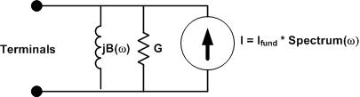
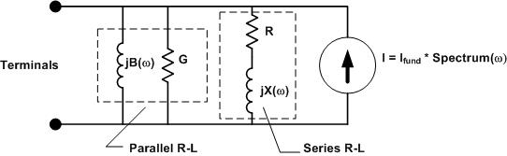
Load Modeling for Harmonics Studies
Original Model
Present Model

Slide 56
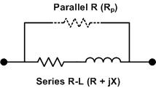
Transformer Modeling
There is now (as of 7.6.3.14) an option to hold X/R Constant
More appropriate for substation transformer
Distribution transformers have lower X/R
Modeling with Reactor
Frequency dependence is coming …

Slide 57
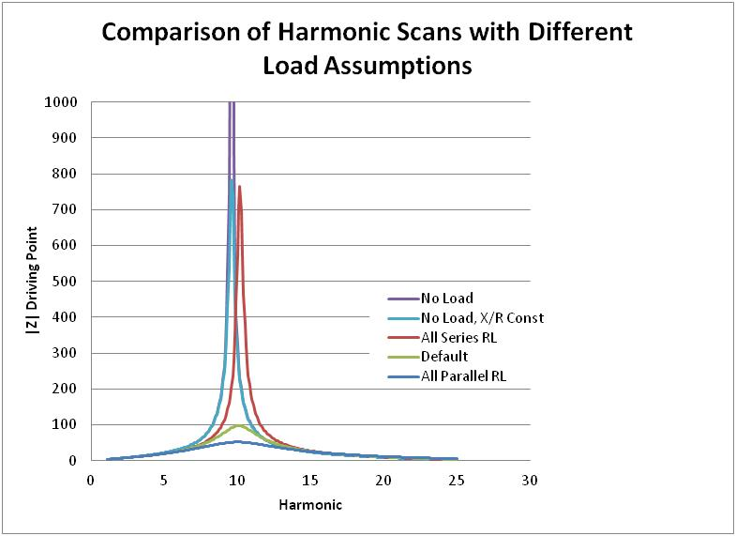
What Difference Does it Make?

Slide 58
Harmonic Solution Mode
Solve the power flow (fundamental frequency)
Harmonic current sources in LOAD models are initialized to match the fundamental frequency solution
Generators converted to Thevenin voltage behind Xd”
“Solve Mode=Harmonics”
Program solves at each frequency that is defined
Non-iterative (direct solution)
Harmonic currents assumed invariant
Y matrix is rebuilt for each frequency
Need MONITOR objects to capture results

Slide 59
Harmonic Solution Mode, Cont’d
Frequency Scans
Define a scan spectrum at a small frequency increment
Assign it to an ISOURCE or VSOURCE
You probably want do disable LOAD and GENERATOR harmonic spectra, e.g.:
Spectrum.DefaultLoad.NumHarm=1
Otherwise, LOAD objects will inject a current at integer harmonic frequencies yielding a really weird solution
Scans can be performed for (see ScanType property)
Positive sequence
Zero sequence
No sequence
Example Frequency Scan
…\Distrib\Examples\FreqScan folder

Slide 60
Frequency Scan Example Script
// THIS SCRIPT WILL RUN A FREQUENCY SCAN ON THE IEEE 123 BUS TEST CASE
Spectrum.DefaultLoad.NumHarm=1 ! This effectively gets rid of LOAD harmonics
// Define a spectrum for the scan source
New spectrum.Scanspec numharm=1000 csvfile=ScanSpectrum.csv
// Put a Monitor to capture the results
New Monitor.Mscan Line.l84 1
// Define a positive-sequence (the default) 1-A, 3-ph current source
New Isource.scansource bus1=83 amps=1 spectrum=scanspec
solve ! solve the power flow at fundamental
solve mode=harmonics ! do the harmonic solutions
show mon mscan ! show the results
Export monitors mscan
// You can plot the Monitor, but Excel or Matlab might be better
Plot monitor object= mscan channels=(1 3 5 )

Slide 61
What Does the Scan Spectrum Look Like?
1.083333333 100 0
1.166666667 100 0
1.25 100 0
1.333333333 100 0
1.416666667 100 0
1.5 100 0
1.583333333 100 0
1.666666667 100 0
1.75 100 0
1.833333333 100 0
1.916666667 100 0
2 100 0
2.083333333 100 0
2.166666667 100 0
2.25 100 0
2.333333333 100 0
2.416666667 100 0
2.5 100 0
2.583333333 100 0
… etc …
% Magnitude
(All 100%)
Harmonic
For 60 Hz base frequency, this gives a 5 Hz scan
Phase Angle
(All 0)
This is typically associated with a 1-A current source, so that the resulting voltages represent driving-point Z, transfer Z, etc.

Slide 62
Putting it All Together - Harmonics
ALL Elements, each frequency
Yprim 1
Yprim 2
Yprim 3
Yprim n
PC Elements Harmonic injection Currents
I1
I2
Y
Node
Voltages
(each Frequency)
I_{inj}
=
V
Im

