Slide 1

Introduction to OpenDSS
Roger C. Dugan, LFIEEE
Sr. Technical Executive
and
Davis Montenegro, Ph.D. Engineer Scientist II
UTK Presentation, Sept 15, 2016

Slide 2
What is the OpenDSS?
Script-driven, frequency-domain electrical circuit simulation tool
Specific models for:
Supporting utility distribution system analysis
Designed for the unbalanced, multi-phase North American power distribution systems
As well as European-style systems
These typically have a simpler structure

Slide 3
What can OpenDSS be used for?
Simple power flow (unbalanced, n-phase)
Daily loading simulations
Yearly loading simulations
Duty cycle simulations
Impulse loads
Rock crushers
Car crushers
Renewable generation
DG
Interconnection studies/screening
Value of service studies (risk based)
Solar PV voltage rise/fluctuation
Wind power variations impact
Hi-penetration solar PV impacts
Harmonic distortion
Dynamics/islanding

Slide 4
What can OpenDSS be used for? (cont’d)
Hybrid simulation of communications and power networks
Geomagnetically-Induced Current (GIC) flow (solar storms)
Power delivery loss evaluations (EPRI Green circuits program - > 80 feeders)
Voltage optimization
PEV/PHEV impact simulations
Community energy storage (EPRI Smart Grid Demo)
High-frequency harmonic/interharmonic interference
Various unusual transformer configurations
Transformer frequency response analysis
Distribution automation control algorithm assessment
Impact of tankless electric water heaters
Wind farm collector simulations
Wind farm interaction with transmission
Wind generation impact on capacitor switching and regulator/LTC tapchanger operations
Protection system simulation
Open-conductor fault conditions
Circulating currents on transmission skywires
Ground voltage rise during faults on lines
Stray voltage simulations
Industrial load harmonics studies/filter design
Distribution feeder harmonics analysis, triplen harmonic filter design
And many more ….

Slide 5
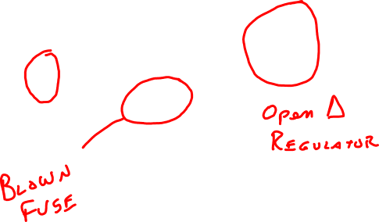
The Unbalanced Distribution System
This takes more than a positive-sequence model !!

Slide 6
Typical North American Distribution System
Typical 4-wire multi-grounded neutral system
Unigrounded/Delta 3-wire also common on West Coast

Slide 7
Typical European Style System
3-wire unigrounded primary
Three-phase throughout,
including secondary (LV)

Slide 8
Urban Low-Voltage Network Systems

Slide 9
Computing Annual Losses
Peak load losses are not necessarily indicative of annual losses

Slide 10
Using DSS to Determine Incremental Capacity of DG
“Needle” Peaking System
“How much more power can be served at the same risk of unserved energy?”
Broad Summer Peaking System

Slide 11
DG Dispatch

Slide 12
Solar PV Simulation

Slide 13
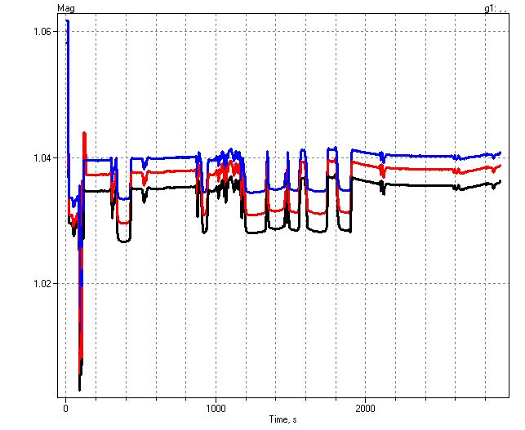
1-sec Solar Data – Cloud Transients
Impact on Feeder Voltage

Slide 14
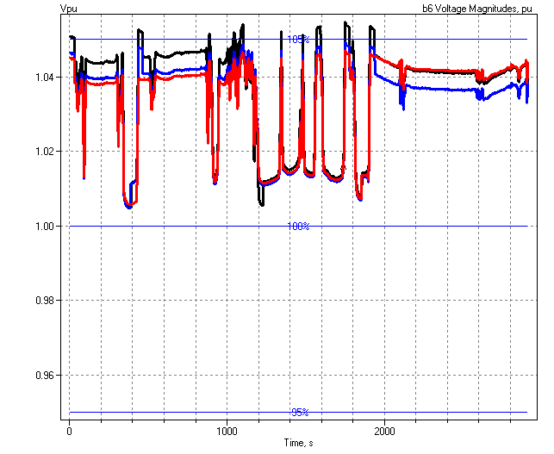
1-sec Solar Data (2010)
Regulator Operations

Slide 15
Power Distribution Efficiency
Peak Load Week
Light Load Week

Slide 16

Wind Plant 1-s Simulation
Notes:
The plot you see to the right is a sample case study we did where a developer wanted to install 3 750kW turbines at the end of a 10-mile distribution feeder. Along the feeder was a voltage regulator and large intermittent load. The concern we had was the impact the turbine output fluctuations would have on the flicker, regulator action, as well as the voltage profile along the feeder. Utilizing software that Electrotek had developed, specifically the Distribution System Simulator, or DSS,, minor modifications were made that allowed us to simulate the wind plant fluctuation impact over time, thus giving us the ability to address the concerns at hand.
The plot you see to the right is simulation output from the DSS, over a time horizon of ~ 4 minutes. The three turbines were modeled explicitly, along with the 5-step switched capacitor banks connected to each turbine as well as the voltage regulator upline from the wind plant. This software allows us to make recommendations to the utility and/or wind plant developer regarding modifications necessary, if any, to allow for the wind plant to have minimal impact on the distribution feeder and surrounding customers, or perhaps even improve feeder performance.
We also utilize this software for estimating flicker according the IEC standard 1400-21. The software, along with data specific to the turbine being considered allows one to estimate the flicker impact BEFORE the turbine is installed.

Slide 17
Broadband Driving Point Admittance
0.035
0.03
0.025
0.02
Siemens
|Y|
0.015
0.01
0.005
0
0
100000
200000
300000
400000
500000
Frequency, Hz

Slide 18
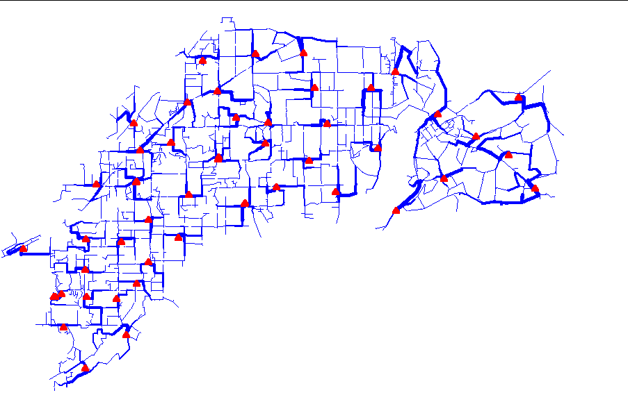
Power Flow Visualization

Slide 19
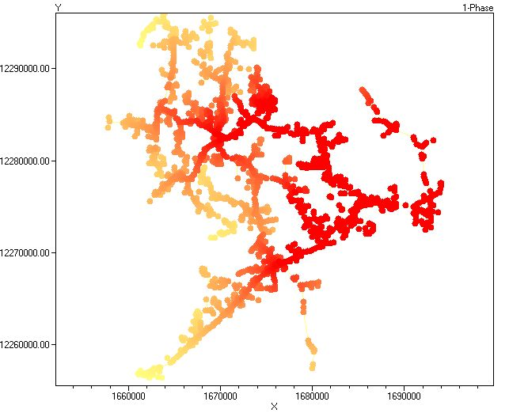
Special Displays
Fault Current Magnitudes

Slide 20
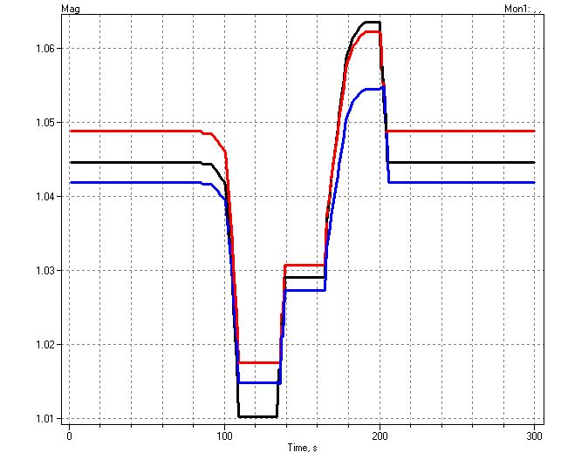
Example of an Expected DG Problem
Voltage overshoots as power output ramps up
Regulator taps up to compensate for voltage drop

Slide 21
Root of Problem
p.u. Voltage
Voltage Profile w/ DG
1.10
Distribution Systems designed for voltage DROP, not voltage RISE.
High Voltages
1.05
1.00
0.95
0.90
0.0
2.0
4.0
6.0
Distance from Substation (km)

Slide 22
What is the OpenDSS? (cont’d)
Heritage
Harmonics solvers rather than power flow
Gives OpenDSS extraordinary distribution system modeling capability
Simpler to solve power flow problem with a harmonics solver than vice-versa
Supports all rms steady-state (i.e., frequency domain) analyses commonly performed for utility distribution system planning
And many new types of analyses
Original purpose: DG interconnection analysis

Slide 23
What is the OpenDSS? (cont’d)
What it Isn’t
An Electromagnetic transients solver (Time Domain)
It can solve Electromechanical transients
Frequency Domain => “Dynamics”
All solutions are in phasors (complex math)
Not a Power Flow program
Not a radial circuit solver
Does meshed networks just as easily
Not a distribution data management tool
It is a simulation engine designed to work with data extracted from one or more utility databases

Slide 24
Time- and Location-Dependent Benefits
The OpenDSS was designed to capture both
Time-specific benefits and
Location-specific benefits
Needed for
DG analysis
Renewable generation
Energy efficiency analysis
PHEV and EV impacts
Other proposed capacity enhancements that don’t follow typical loadshapes

Slide 25
Time- and Location-Dependent Benefits
Traditional distribution system analysis programs
Designed to study peak loading conditions
Capture mostly location-specific benefits
Ignores time; Assumes resource is available
This gets the wrong answer for many DG, energy efficiency, and Smart Grid analyses
Must do time sequence analysis to get the right answer
Over distribution planning area

Slide 26
What are the Key Features?
See Documentation for more details
http://svn.code.sf.net/p/electricdss/code/trunk/Distrib/Doc/
Designed to allow expansion indefinitely
Impossible to anticipate everything users will want to do
COM interface allows easier customization

Slide 27
Built-in Solution Modes
Snapshot (static) Power Flow
Direct (non-iterative)
Daily mode (default: 24 1-hr increments)
Yearly mode (default 8760 1-hr increments)
Duty cycle (1 to 5s increments)
Dynamics (electromechanical transients)
Fault study
Monte carlo fault study
Harmonic
Custom user-defined solutions

Slide 28
Controls
A key feature is that controls are modeled separately from the devices being controlled
Capacitors
Regulators/tapchangers
Control Modes
Static
Power flows with large time steps
Time
Control queue employed to delay actions
Control acts when time is reached
Event

Slide 29
Overall Model Concept

Slide 30
User Interfaces Currently Implemented
A stand-alone executable program that provides a text-based interface (multiple windows)
Some graphical output is also provided.
No graphical input is provided.
An in-process COM server (for Windows) that supports driving the simulator from user-written programs.
Direct DLL (standard Windows DLL)
Mimics COM interfaces

Slide 31
Validation of OpenDSS
EPRI routinely checks OpenDSS power flow results against CYMDIST, SYNERGEE, and WindMil programs after converting data sets for various projects.
The OpenDSS program has been benchmarked against all the IEEE Test Feeders
(http://ewh.ieee.org/soc/pes/dsacom/testfeeders/).
OpenDSS was used to develop the NEV test feeder and the 8500-node test feeder.
Being used to develop the DG Protection test feeder and the large urban network test feeder.
For the EPRI Green Circuits project, computed load characteristics were calibrated against measured data.
Recently, the new PVSystem model was compared to actual measurements with excellent results.

Slide 32
Needs Envisioned by EPRI for the Smart Grid
Sequential time simulation
Meshed network solution capability
Better modeling of Smart Grid controllers
Advanced load and generation modeling
High phase order modeling ( >3 phases)
Stray voltage (NEV), crowded ROWs, etc.
Integrated harmonics
NEV requires 1st and 3rd
User-defined (scriptable) behavior
Dynamics for DG evaluations

Slide 33
EPRI’s Vision
Distribution planning and distribution management systems (DMS) will converge
Into a unified set of analysis tools.
Real-time analysis and planning analysis will merge into common tools.
Distribution system analysis tools will continue to play an important role,
Although they might appear in a much different form than today.

Slide 34
Plan for Future Work/Enhancements
There is a continuing effort to promote interfacing to the Common Information Model (CIM).
The CIM is the common data interchange mechanism
We plan to exploit high performance desktop computing to make it feasible to study distribution systems of at least 100,000 nodes and perhaps as many as 1,000,000 nodes.
This will involve revamping algorithms within the program to enable the application of parallel processing (multiple CPUs) to planning problems.
e.g., Diakoptics
Improved distribution state estimation functions
Improved Distribution Management Systems (DMS) functions

Slide 35
What’s Next?
It’s time to address other Distribution System Analysis problems
Microgrids
Advanced inverters
Probabilistic planning
DMS and DA
Communications and control latency
Masking of load growth by PV and other DG
Recloser siting
Training next generation distribution engineer for the “Integrated Grid”

Slide 36
Getting Started: Installation and Basic Usage

Slide 37
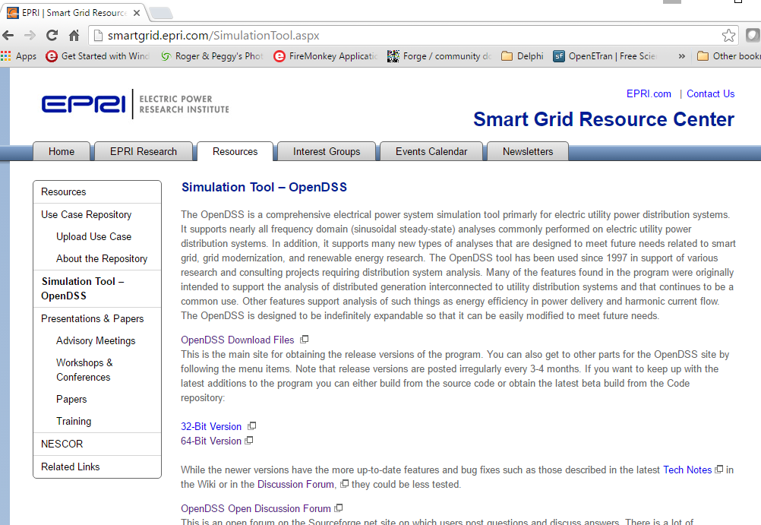

Slide 38
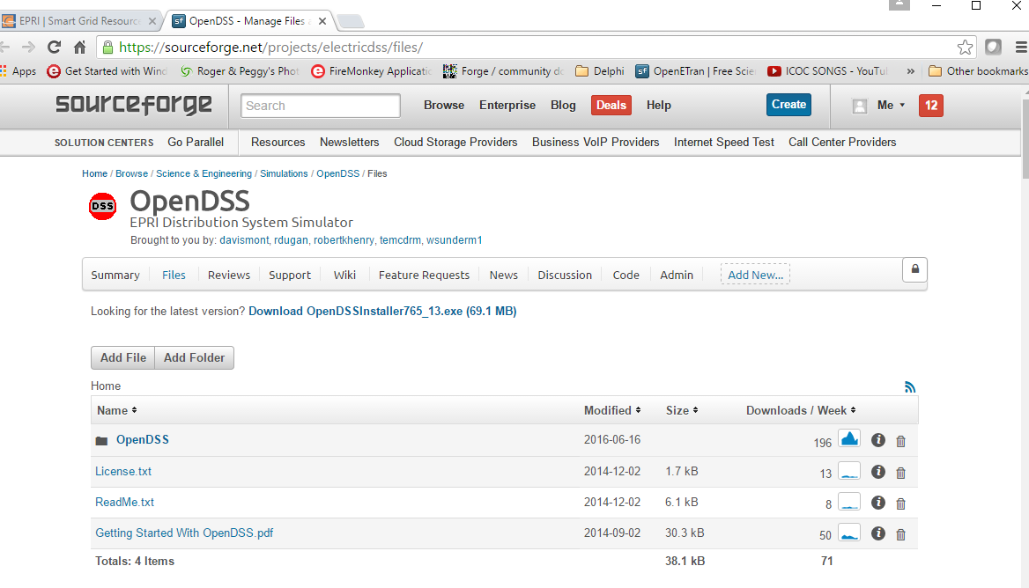
Main Download Page

Slide 39
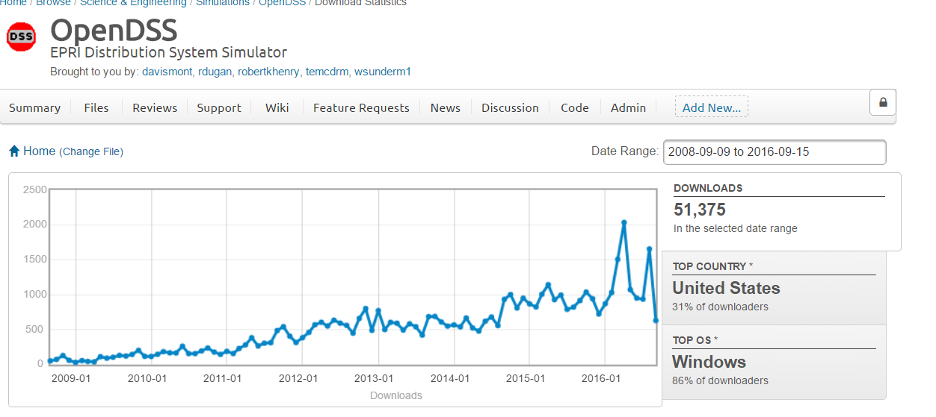
OpenDSS downloads
Downloads Continue to Accelerate
Estimate: ~ 2000 active users World-Wide at any time
More and more profs assigning projects each year

Slide 40
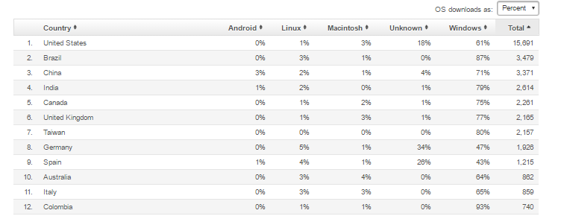
OpenDSS downloads - Countries

Slide 41
How Does OpenDSS Work?

Slide 42
The Math …
Nearly everything results in a matrix or array
Nodal Admittance formulation
Circuit elements modeled by primitive admittance matrices
Y_{prim}
Primitive Y matrices used to build System Y matrix
OpenDSS Works In
Phase domain
Actual volts and amps
Symmetrical components and per units not used inside the program !! -- Input and output only!

Slide 43
Primitive Y Matrix
Simple Resistor

Slide 44
Primitive Y Matrix, cont’d
LINE model

Slide 45
What about 3-phase elements?
Simply let R, X, B, G, C, etc. represent 3x3 matrix
Notation stays the same
And it works!
I1, I2, V1, V2 etc become 3x1 vectors
This is basically how all the Circuit Element (CktElement) models in OpenDSS work.

Slide 46
The Network Model

Slide 47
Nodal Admittance Equations
V₁
V₂
…
V_{S}
…
V_{L1}
…
V_{L2}
…
V_{N}
I₁
I₂
…
I_{S}
…
I_{L1}
…
I_{L2}
…
I_{N}
Y_{SYSTEM}
=
N x N
(Sparse)
N = Number of NODES (not BUSES)

Slide 48
Solving the Power Flow
Once the circuit model is connected properly the next step is to Solve the base power flow
PC elements (i.e., Loads) are usually nonlinear
Loads are linearized to a Norton equivalent based on nominal 100% rated voltage.
Current source is “compensation current”
Compensates for the nonlinear characteristic
A fixed point iterative solution algorithm is employed for most solutions
This method allows for flexible load models and is robust for most distribution systems

Slide 49
Load (a PC Element)
General Concept
Added into Injection Current Vector
Goes into System Y Matrix
(One-Line Diagram)
Most Power Conversion (PC) Elements are Modeled Like This

Slide 50
Load Models (Present version)
1:Standard constant P+jQ load. (Default)
2:Constant impedance load.
3:Const P, Quadratic Q (like a motor).
4:Nominal Linear P, Quadratic Q (feeder mix). Use this with CVRfactor.
5:Constant Current Magnitude
6:Const P, Fixed Q
7:Const P, Fixed Impedance Q
8: Special ZIP load model

Slide 51
Power Flow Solution Algorithm
Initial Guess at Node Voltages, V
Compute all Injection (Compensation) Currents, I
For PC Elements
Solve for new guess at V
Repeat 2 and 3 until Converged
Convergence is based on change in per unit voltage magnitude
Default tolerance = 0.0001
Good enough for distribution systems

Slide 52
Putting it All Together
ALL Elements
Yprim 1
Yprim 2
Yprim 3
Yprim n
PC Elements Comp. Currents
I1
I2
Y
Node
Voltages
I_{inj}
=
V
Im
Iteration Loop

Slide 53
Putting it All Together
Th-Th-That's All Folks !
ALL Elements
Yprim 1
Yprim 2
Yprim 3
Yprim n
PC Elements Comp. Currents
I1
I2
Y
Node
Voltages
I_{inj}
=
V
Im
Iteration Loop

Slide 54
Together…Shaping the Future of Electricity

