Slide 1
Intro to OpenDSS Workshop
Roger Dugan Sr. Technical Exec. EPRI
Milsoft User’s Conference Orlando, FL June 9, 2016

Slide 2
OpenDSS
DSS was developed in 1997 to enable analysis of disruptive technologies such as DER
DSS acquired by EPRI in 2004
Made open source and renamed OpenDSS in 2008
To speed industry advancements in grid modernization
Over 35,000 downloads since 2008
> 170 countries
US, China, Canada, and UK lead in downloads
47,000
Brazil and India

Slide 3
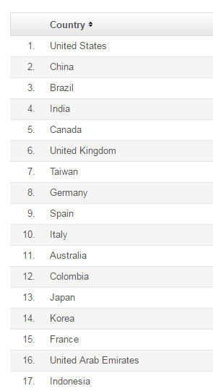
Country List …

Slide 4
What Can You Do with OpenDSS?

Slide 5
What can OpenDSS be used for?
Simple power flow (unbalanced, n-phase)
Daily loading simulations
Yearly loading simulations
Duty cycle simulations
Impulse loads
Rock crushers
Car crushers
Renewable generation

Slide 6
What has OpenDSS be used for?
Hybrid simulation of communications and power networks
Geomagnetically-Induced Current (GIC) flow (solar storms)
Power delivery loss evaluations (EPRI Green circuits program - > 80 feeders)
Voltage optimization
PEV/PHEV impact simulations
Community energy storage (EPRI Smart Grid Demo)
High-frequency harmonic/interharmonic interference
Various unusual transformer configurations
Transformer frequency response analysis
Distribution automation control algorithm assessment
Impact of tankless electric water heaters
Wind farm collector simulations
Wind farm interaction with transmission
Wind generation impact on capacitor switching and regulator/LTC tapchanger operations
Protection system simulation
Open-conductor fault conditions
Circulating currents on transmission skywires
Ground voltage rise during faults on lines
Stray voltage simulations
Industrial load harmonics studies/filter design
Distribution feeder harmonics analysis, triplen harmonic filter design
And many more ….

Slide 7
What’s Next?
It’s time to address other Distribution System Analysis problems
Microgrids
Advanced inverters
Probabilistic planning
DMS and DA
Communications and control latency
Masking of load growth by PV and other DG
Recloser siting
Training next generation distribution engineer for the “Integrated Grid”

Slide 8
EPRI’s Vision
Distribution planning and distribution management systems (DMS) will converge
Into a unified set of analysis tools.
Real-time analysis and planning analysis will merge into common tools.
Distribution system analysis tools will continue to play an important role,
Although they might appear in a much different form than today.

Slide 9
Computing Annual Losses
Peak load losses are not necessarily indicative of annual losses

Slide 10
Using DSS to Determine Incremental Capacity of DG
“Needle” Peaking System
“How much more power can be served at the same risk of unserved energy?”
Broad Summer Peaking System

Slide 11
DG Dispatch

Slide 12
Solar PV Simulation – 1 h step size

Slide 13
1-s Solar Data – Cloud Transients
Impact on Feeder Voltage ??

Slide 14
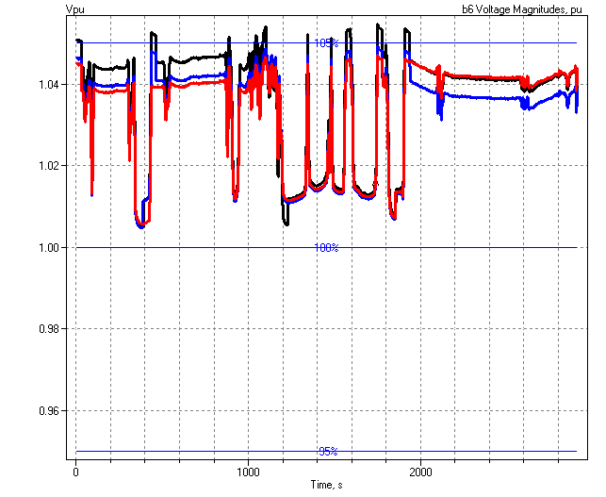
1-sec Solar Data (2010)
Regulator Operations

Slide 15
Root of Problem
p.u. Voltage
Voltage Profile w/ DG
1.10
Distribution Systems designed for voltage DROP, not voltage RISE.
High Voltages
1.05
1.00
0.95
0.90
0.0
2.0
4.0
6.0
Distance from Substation (km)

Slide 16
Power Distribution Efficiency
Peak Load Week
Light Load Week

Slide 17
Wind Plant 1-s Simulation
Notes:
The plot you see to the right is a sample case study we did where a developer wanted to install 3 750kW turbines at the end of a 10-mile distribution feeder. Along the feeder was a voltage regulator and large intermittent load. The concern we had was the impact the turbine output fluctuations would have on the flicker, regulator action, as well as the voltage profile along the feeder. Utilizing software that Electrotek had developed, specifically the Distribution System Simulator, or DSS,, minor modifications were made that allowed us to simulate the wind plant fluctuation impact over time, thus giving us the ability to address the concerns at hand.
The plot you see to the right is simulation output from the DSS, over a time horizon of ~ 4 minutes. The three turbines were modeled explicitly, along with the 5-step switched capacitor banks connected to each turbine as well as the voltage regulator upline from the wind plant. This software allows us to make recommendations to the utility and/or wind plant developer regarding modifications necessary, if any, to allow for the wind plant to have minimal impact on the distribution feeder and surrounding customers, or perhaps even improve feeder performance.
We also utilize this software for estimating flicker according the IEC standard 1400-21. The software, along with data specific to the turbine being considered allows one to estimate the flicker impact BEFORE the turbine is installed.

Slide 18
Storage Modeling Simple Peak Shave Example

Slide 19
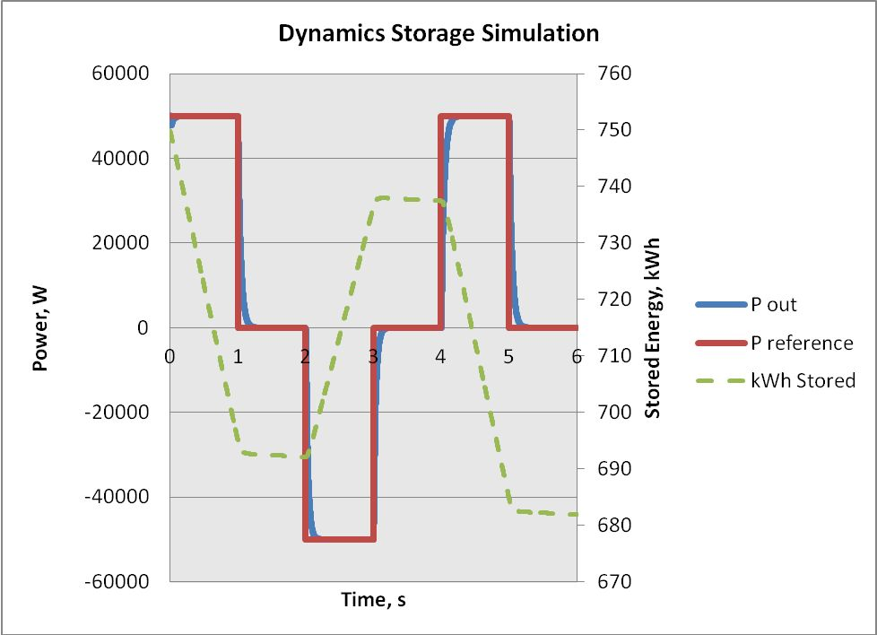
Dynamics Storage Simulation
(Requires separately-licensed DLL)

Slide 20
Getting Started

Slide 21
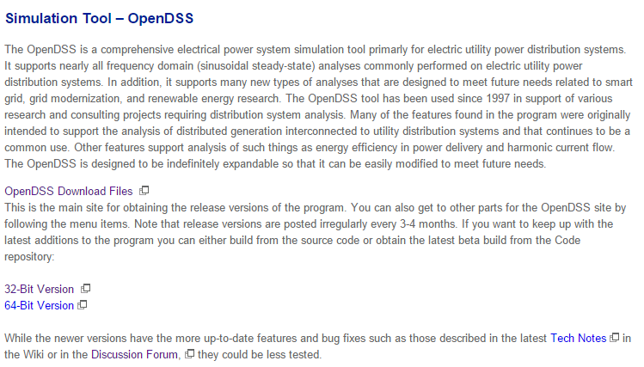
Installing
EPRI Link Page
http://smartgrid.epri.com/SimulationTool.aspx

Slide 22
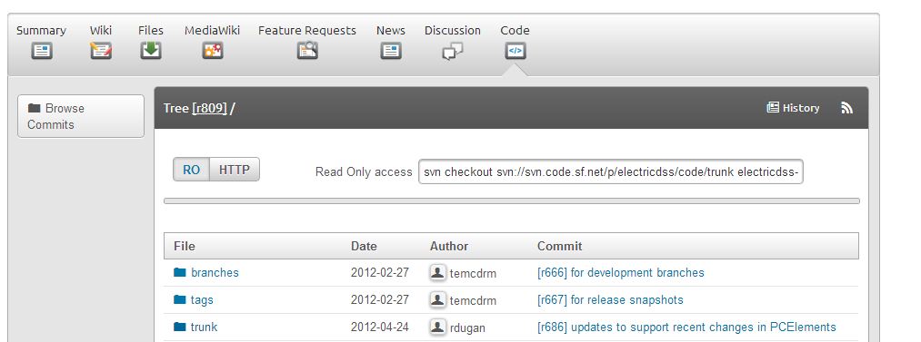
SourceForge.Net Links for OpenDSS
EPRI Links Page
http://smartgrid.epri.com/SimulationTool.aspx
OpenDSS Download Files:
http://sourceforge.net/projects/electricdss/files/
Top level of Main Repository

Slide 23
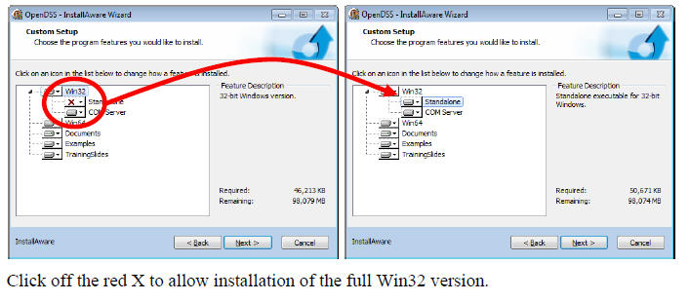
Install Both 32-bit and 64-bit Versions of OpenDSS
DG Screener and Excel typically use 32-bit OpenDSS, but both versions must be installed to get 32-bit server fully installed. Windows will figure out which one needs to be executed. Magic!!

Slide 24
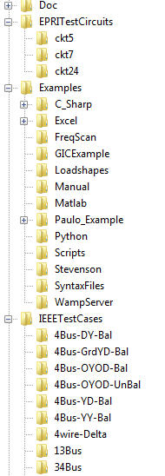
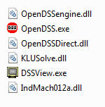
OpenDSS Files Installed
Main Program Files

Slide 25
Key Files in Doc Folder
Getting Started With OpenDSS.pdf
OpenDSSPrimer.pdf
OpenDSSManual.pdf
OpenDSS Cheatsheet.pdf

Slide 26
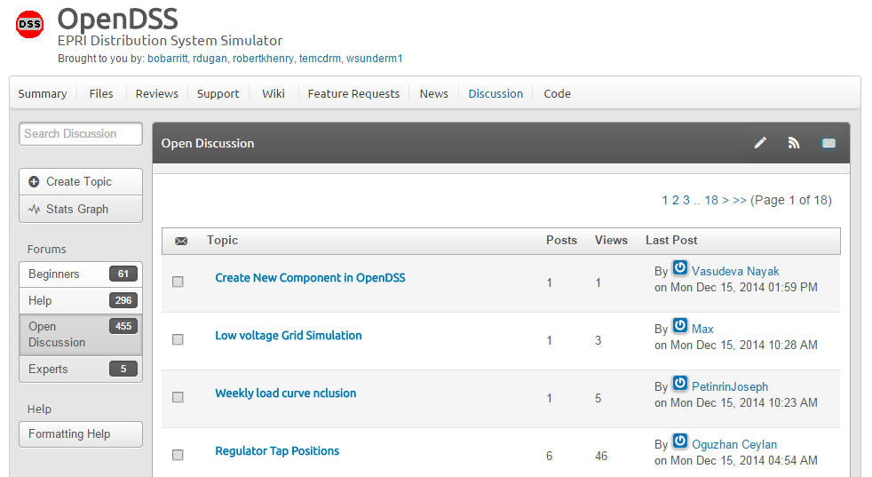
Discussion Forum & News for OpenDSS

Slide 27
Introduction to Distribution Systems and Modeling

Slide 28
Validation of OpenDSS
EPRI routinely checks OpenDSS power flow results against CYME, Synergi, WindMil, and other programs after converting data sets for various projects.
The OpenDSS program has been benchmarked against all the IEEE Test Feeders
(http://ewh.ieee.org/soc/pes/dsacom/testfeeders/).
OpenDSS was used to develop the NEV test feeder and the 8500-node test feeder.
Being used to develop the DG Protection test feeder
For the EPRI Green Circuits project, computed load characteristics were calibrated against measured data.

Slide 29
OpenDSS is Basically a Nodal Admittance Solver
OpenDSS is a script-driven, frequency-domain electrical circuit simulation tool
It uses a basic nodal admittance circuit model that could be used for a wide variety of ac circuit analysis applications
OpenDSS has specific models for:
Supporting utility distribution system analysis
Initially designed for the unbalanced, multi-phase North American power distribution systems
Can also model European-style systems
These typically have a simpler structure

Slide 30
Typical North American Distribution System
Typical 4-wire multi-grounded neutral system
Unigrounded/Delta 3-wire also common on West Coast

Slide 31
Typical European Style System
3-wire unigrounded primary
Three-phase throughout,
including secondary (LV)

Slide 32
Comparisons of Systems
European-Style System
MV
LV
North American System
MV (ALL)

Slide 33
Comparison of Distribution Systems
North American System
Primary (MV) system is extensive, complex
Secondary (LV) is short
4-5 houses per distribution transformer
120/240 V single-phase (“split phase”) service
1 Industrial customer per distribution transformer
Or multiple transformers per customer
Extended by adding transformer + wire
European Style System
MV System has simpler structure
LV System (400 V) is extensive
Perhaps 100 residences on MV/LV transformer
230/400 V 3-phase
Extended by adding wire
Fewer transformers

Slide 34
What is the OpenDSS?
Heritage of OpenDSS
Harmonics solvers rather than power flow
Gives OpenDSS extraordinary distribution system modeling capability
Simpler to solve the power flow problem with a harmonics solver than vice-versa
Supports all rms steady-state (i.e., frequency domain) analyses commonly performed for utility distribution system planning
And many new types of analyses
Original purpose in 1997: DG interconnection analysis

Slide 35
What is the OpenDSS? (cont’d)
What it is NOT
An Electromagnetic transients solver (Time Domain)
It can solve Electromechanical transients
Frequency Domain => “Dynamics” mode
All solutions are in phasors (complex math)
Not a “Power Flow” program
Not a radial circuit solver
Does meshed networks with equal ease
Not a distribution data management tool
It is a simulation engine designed to work with data extracted from one or more utility databases

Slide 36
Built-in Solution Modes
Snapshot (static) Power Flow
Direct (non-iterative)
Daily mode (default: 24 1-hr increments)
Yearly mode (default 8760 1-hr increments)
Duty cycle (1 to 5s increments)
Dynamics (electromechanical transients)
Fault study
Monte carlo fault study
Harmonics
Custom user-defined solutions

Slide 37
Controls
A key feature is that controls are modeled separately from the devices being controlled
Capacitors
Regulators/tapchangers
Storage controllers
Inverter control
Switch control
Relays, Reclosers, and Fuses are controls

Slide 38
Overall Model Concept (1997)

Slide 39
Control Modes
Static
Power flows with large time steps
Time
Control queue employed to delay actions
Control acts when time is reached
Event

Slide 40
User Interfaces Currently Implemented
A stand-alone executable program that provides a text-based interface (multiple windows)
Some graphical output is also provided.
No graphical input is provided.
An in-process COM server (for Windows) that supports driving the simulator from user-written programs.
32-bit and 64-bit (New in 2012)
A Direct DLL interface for user-written programs on HPCs and servers
EPRI Program 174 funders have access to DGScreener, an interface to OpenDSS

Slide 41
Why Scripting and COM?
More flexible than static dialog forms
No two Smart Grid simulations alike
Not possible to predict what users will want to do
COM = Component Object Model
Supported by nearly all programming languages, Microsoft Office, MATLAB, Python, etc that run on Windows
Allows user to write their own algorithms
For things like DA controllers and DMS simulators
Co-simulation of power and communications
COM is not familiar to most power engineers but is powerful means of scripting

Slide 42
What is COM?
COM = Component Object Model
A binary-interface standard for software components introduced by Microsoft in 1993
Related technologies
OLE, OLE Automation, ActiveX, COM+, DCOM
A language-neutral way of implementing objects that can be used in environments different from the one in which they were created
Microsoft Office tools like Excel and Work can be Automated via COM
And VBA supports automating other apps via COM

Slide 43
How Does OpenDSS Work?

Slide 44
The Math …
Nearly everything results in a matrix or array
Nodal Admittance formulation
Circuit elements modeled by primitive admittance matrices
Y_{prim}
Primitive Y matrices used to build System Y matrix
OpenDSS Works In
Phase domain
Actual volts and amps
Symmetrical components and per units not used inside the program !! -- Input and output only!

Slide 45
Primitive Y Matrix
Simple Resistor

Slide 46
Primitive Y Matrix, cont’d
LINE model

Slide 47
What about 3-phase elements?
Simply let R, X, B, G, C, etc. represent 3x3 matrix
Notation stays the same
And it works!
I1, I2, V1, V2 etc become 3x1 vectors
This is basically how all the Circuit Element (CktElement) models in OpenDSS work.

Slide 48
The Network Model

Slide 49
Nodal Admittance Equations
V₁
V₂
…
V_{S}
…
V_{L1}
…
V_{L2}
…
V_{N}
I₁
I₂
…
I_{S}
…
I_{L1}
…
I_{L2}
…
I_{N}
Y_{SYSTEM}
=
N x N
(Sparse)
N = Number of NODES (not BUSES)

Slide 50
Solving the Power Flow
Once the circuit model is connected properly the next step is to Solve the base power flow
PC elements (i.e., Loads) are usually nonlinear
Loads are linearized to a Norton equivalent based on nominal 100% rated voltage.
Current source is “compensation current”
Compensates for the nonlinear characteristic
A fixed point iterative solution algorithm is employed for most solutions
This method allows for flexible load models and is robust for most distribution systems

Slide 51
Load (a PC Element)
General Concept
Added into Injection Current Vector
Goes into System Y Matrix
(One-Line Diagram)
Most Power Conversion (PC) Elements are Modeled Like This

Slide 52
Load - 3-phase Y connected
Phase 1
1
2
Phase 2
3
4 Conductors/Terminal
Phase 3
4

Slide 53
Load - 3-phase Delta connected
Phase 1
2
1
Phase 2
3
3 Conductors/Terminal
Phase 3

Slide 54
Load Models (Present version)
1:Standard constant P+jQ load. (Default)
2:Constant impedance load.
3:Const P, Quadratic Q (like a motor).
4:Nominal Linear P, Quadratic Q (feeder mix). Use this with CVRfactor.
5:Constant Current Magnitude
6:Const P, Fixed Q
7:Const P, Fixed Impedance Q
8: Special ZIP load model

Slide 55
Standard P + jQ (constant power) Load Model
When the voltage goes out of the normal range for a load the model reverts to a linear load model
This generally guarantees convergence
Even when a fault is applied
This script changes break points to +/- 10%:
Load.Load1.Vmaxpu=1.10
Load.Load1.Vminpu=0.90
Note: to solve some of the IEEE Radial Test feeders and match the published results, you have to set Vminpu to less than the lowest voltage published (usually about 0.80 per unit)

Slide 56
Standard P + jQ Load Model (Model=1)
Const Z
105%
(Defaults*)
95%
|I| = |S/V|
Const Z
New Method (2014)
* Change by setting Vminpu and Vmaxpu Properties

Slide 57
Power Flow Solution Algorithm
Initial Guess at Node Voltages, V
Compute all Injection (Compensation) Currents, I
For PC Elements
Solve for new guess at V
Repeat 2 and 3 until Converged
Convergence is based on change in per unit voltage magnitude
Default tolerance = 0.0001
Good enough for distribution systems

Slide 58
Putting it All Together
ALL Elements
Yprim 1
Yprim 2
Yprim 3
Yprim n
PC Elements Comp. Currents
I1
I2
Y
Node
Voltages
I_{inj}
=
V
Im
Iteration Loop

Slide 59
Putting it All Together
Th-Th-That's All Folks !
ALL Elements
Yprim 1
Yprim 2
Yprim 3
Yprim n
PC Elements Comp. Currents
I1
I2
Y
Node
Voltages
I_{inj}
=
V
Im
Iteration Loop

Slide 60
Circuit Modeling Basics in OpenDSS

Slide 61
DSS Bus Model (Bus ≠ Node)
Nodes
Bus
Referring to Buses and Nodes (A Bus has 1 or more Nodes)
Bus1=BusName.1.2.3.0
(This is the default for a 3-phase circuit element)
Shorthand notation for taking the default
Bus1=BusName
Note: Sometimes this can bite you (e.g. – Transformers, or capacitors with ungrounded neutrals)

Slide 62
DSS Terminal Definition
Conductors
Circuit Elements have one or more Terminals with 1..N conductors.
Conductors connect to Nodes at a Bus
Each Terminal connects to one and only one Bus

Slide 63
Power Delivery Elements
PD Elements are Generally Completely Described by [Yprim]

Slide 64
Power Conversion Elements
I_{Term}(t) = F(V_{Term}, [State], t)
Power Conversion (PC) elements are typically connected in “shunt” with the Power Delivery (PD) elements
PC Elements may be nonlinear
Described some function of V
May be linear
e.g., Vsource, Isource
May have more than one terminal, but typically one
Load, generator, storage, etc.

Slide 65
Specifying Bus Connections
Shorthand (implicit)
New Load.LOAD1 Bus1=LOADBUS
Assumes standard 3-phase connection by default
LOADBUS
6
5
4
3
LOAD
2
1
0

Slide 66
Specifying Bus Connections
Explicit
New Load.LOAD1 Bus1=LOADBUS.1.2.3.0
Explicitly defines which node
New Load.1-PHASELOAD Phases=1 Bus1=LOADBUS.2.0
Connects 1-phase load to Node 2 and ground
1-Phase Load Example

Slide 67
Specifying Bus Connections
Default Bus templates
Node connections assumed if not explicitly declared
Element declared Phases=1
… LOADBUS.1.0.0.0.0.0.0.0.0.0. …
Element declared Phases=2
… LOADBUS.1.2.0.0.0.0.0.0.0.0. …
Element declared Phases=3
… LOADBUS.1.2.3.0.0.0.0.0.0.0. …

Slide 68
Specifying Bus Connections
Ungrounded-Wye Specification
Bus1=LOADBUS.1.2.3.4 (or some other unused Node number)
Voltage at this Node is explicitly computed (just like any other Node)

Slide 69
Possible Gotcha: Specifying Two Ungrounded-Wye Capacitors on Same Bus
MyBus
… Bus1=MyBus.1.2.3 Bus2=MyBus.5.5.5
Neutrals are not connected to each other in this specification!
… Bus1=MyBus Bus2=MyBus.4.4.4

Slide 70
Circuit Element Conductors are Connected to the Nodes of Buses
MyBus
3
2
1
0
. . . Bus2 = MyBus.2.1.3.0 . . .
. . . Bus1 = MyBus . . .
(take the default)
(Explicitly define connections)
DSS Convention: A Terminal can be connected to only one Bus. You can have any number of Nodes at a bus.

Slide 71
Example: Connections for 1-Phase Residential Transformer Used in North America
! Line-to-Neutral Connected 1-phase Center-tapped transformer
New Transformer.Example_1-ph phases=1 Windings=3
! Typical impedances for small transformer with interlaced secondaries
~ Xhl=2.04 Xht=2.04 Xlt=1.36 %noloadloss=.2
! Winding Definitions
~ wdg=1 Bus=Bus1.1.0 kV=7.2 kVA=25 %R=0.6 Conn=wye
~ wdg=2 Bus=Bus2.1.0 kV=0.12 kVA=25 %R=1.2 Conn=wye
~ Wdg=3 Bus=Bus2.0.2 kV=0.12 kVA=25 %R=1.2 Conn=wye
Note: You may use XfmrCode to define a library of transformer definitions that are used repeatedly (like LineCode for Line elements)

Slide 72
All Terminals of a Circuit Element Have Same Number of Conductors
3-Phase Transformer

Slide 73
OpenDSS Scripting Basics
Example Circuit

Slide 74
A Basic Script
Clear
New Circuit.Simple ! Creates voltage source (Vsource.Source)
Edit Vsource.Source BasekV=115 pu=1.05 ISC3=3000 ISC1=2500 !Define source V and Z
Var @MV1=12.47
New Transformer.TR1 Buses=[SourceBus, Sub_Bus] Conns=[Delta Wye] kVs= [115 @MV1]
~ kVAs=[20000 20000] XHL=10
New Linecode.336ACSR R1=0.058 X1=.1206 R0=.1784 X0=.4047 C1=3.4 C0=1.6 Units=kft
New Line.LINE1 Bus1=Sub_Bus Bus2=LoadBus Linecode=336ACSR Length=1 Units=Mi
New Load.LOAD1 Bus1=LoadBus kV=12.47 kW=1000 PF=.95
set voltagebases=[115 @MV1]
Calcvoltagebases
Solve

Slide 75
Scripting for Larger Circuits
How to organize scripts for larger problems
Examination of how the IEEE 8500-Node Test Feeder model is organized

Slide 76
Scripting Large Circuits
For small circuits, often put all the scripts in one file
Some IEEE test feeder examples are mostly in one file
When you have large amounts of data, a more disciplined approach is recommended using multiple files:
Redirect Command
Redirects the input to another file
Returns to home directory
Compile Command
Same as Redirect except repositions home directory

Slide 77
Organizing Your Main Screen
OpenDSS.exe saves all windows on the main screen
They appear where you left them when you shut down
The next time you start up, you can resume your work
Values are saved in the Windows Registry
Come up with a way you are comfortable with

Slide 78
A Common Sense Structuring of Script Files
Run_The_Master.DSS
“Compile” the Master file from here
Master.DSS
LineCodes.DSS
WireData.DSS
LineGeometry.DSS
Libraries
Put a “Clear” in here
Spectrum.DSS
LoadShape.DSS
Transformers.DSS
Lines.DSS
Circuit Definition
Make a separate folder for each circuit
Loads.DSS
Etc.

Slide 79
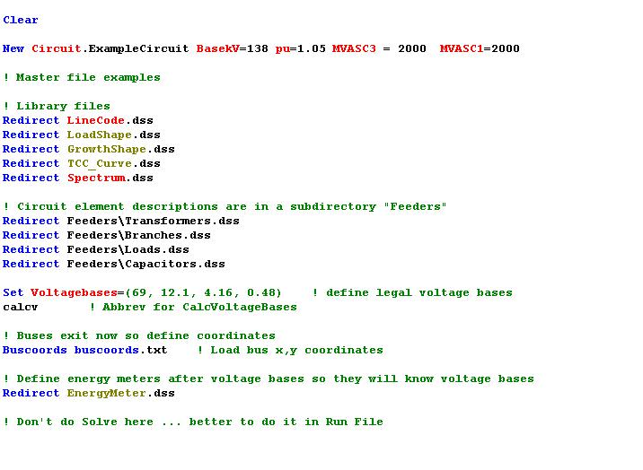
Organizing Your Master File
So Compile Doesn’t Fail
General Library Data
Circuit Elements for this Model
Let OpenDSS Define the Voltage Bases
(You can do this explicitly with SetkVBase command)

Slide 80
Example: IEEE 8500-Node Test Feeder

Slide 81
Main Part of “Run” File
Compile base circuit description
Add an energymeter not in base description
Change an option
Solve
Compile (C:\DSSdata\IEEETest\8500Node\Master-unbal.dss)
! Put an Energymeter at the head of the feeder New Energymeter.m1 Line.ln5815900-1 1
! Sometimes the solution takes more than the default 15 iterations Set Maxiterations=20
Solve

Slide 82
The Master File
Clear
New Circuit.IEEE8500u
! Make the source stiff with small impedance
~ pu=1.05 r1=0 x1=0.001 r0=0 x0=0.001
Redirect LineCodes2.dss
Redirect Triplex_Linecodes.dss
Redirect Lines.dss
Redirect Transformers.dss
Redirect LoadXfmrs.dss ! Load Transformers
Redirect Triplex_Lines.dss
Redirect UnbalancedLoads.dss
Redirect Capacitors.dss
Redirect CapControls.dss
Redirect Regulators.dss
! Let DSS estimate the voltage bases
Set voltagebases=[115, 12.47, 0.48, 0.208]
Calcvoltagebases ! This also establishes the bus list
! Load in bus coordintes now that bus list is established
Buscoords Buscoords.dss

Slide 83
DGScreener Connection to OpenDSS
An Example of COM Interface Driver

Slide 84
DG Screener Structure
DG Screener
DSS Scripts
(Text)
OpenDSS COM Interface
OpenDSS
Circuit Templates and Case Files
General OpenDSS Files

Slide 85
OpenDSS COM Interface

Slide 86
Two Implementations of OpenDSS
Stand-alone EXE
32-bit
64-bit
Use this to develop text scripts to study problems
In-Process COM Server
32-bit
64-bit
Use this to link OpenDSS to other programs
Automate the program
Execute complex algorithms

Slide 87
DSS Structure
Text
Scripts
Main Simulation Engine
COM Interface
User-Written DLLs
Scripts, Results

Slide 88
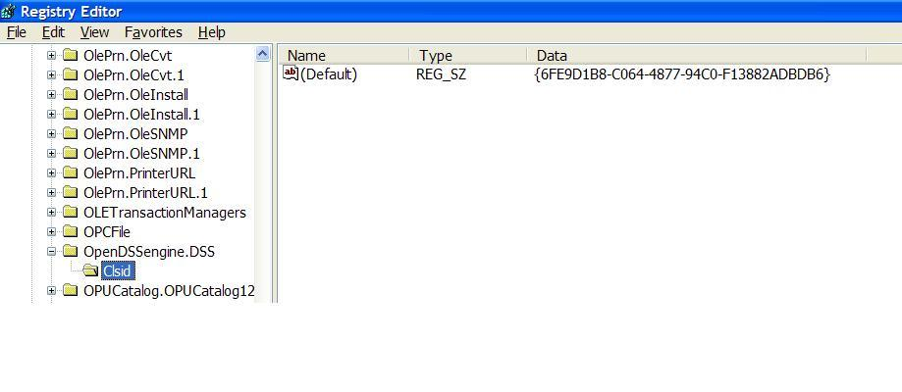
OpenDSSEngine.DSS is Registered
Windows Registry Entry
GUID
The Server shows up as “OpenDSSEngine.DSS” in the Windows Registry
The OpenDSS is now available to any program on the computer

Slide 89
Linking Your Program to the COM Server
Examples of accessing the COM server in various languages
In MATLAB:
DSSobj = actxserver(‘OpenDSSEngine.DSS’);
In VBA:
Public DSSobj As OpenDSSEngine.DSS Set DSSobj = New OpenDSSEngine.DSS
In Dephi
{Import Type Library}
Type DSSObj : IDSS; ⬅ This is how DG Screener does it!
…
DSSObj := coDSS.Create;

Slide 90
Linking Your Program to the COM Server, 2
In PYTHON:
Import win32com.client
Class DSS:
self.engine = win32com.client.Dispatch("OpenDSSEngine.DSS")
In C#:
(Project >Add Reference … select OpenDSSEngine)
Using OpenDSSEngine;
Public DSS DSSObj;
DSSObj = new DSS();

Slide 91
OpenDSS COM Interfaces
There are many interfaces supplied by the COM server
There is one registered In-Process COM interface:
OpenDSSEngine.DSS
The DSS interface is the one your program instantiates
The DSS interface then creates all the others.
This is for simplicity for users who are not necessarily familiar with COM programming

Slide 92
“Active objects” concept
.The interfaces generally act on the ACTIVE object
Active circuit,
Active circuit element,
Active bus, etc.
The interfaces generally point to the active object
To work with another object, change the active object
There are methods for selecting objects
You may also use script commands

Slide 93
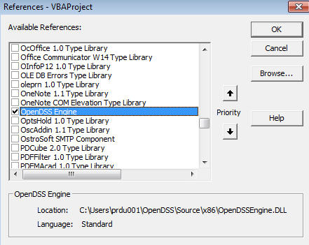
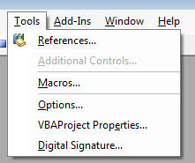
Viewing the COM Interface
The easiest way for most users to view the OpenDSS COM interface is to use Microsoft Excel
Procedure
Start Excel
Alt-F11 to open VBA Editor
Connect to OpenDSS Engine via Tools>References

Slide 94
Loadshapes and Smart Grid Simulation: The Key to Dynamic Modeling

Slide 95
Modeling Solar PV

Slide 96
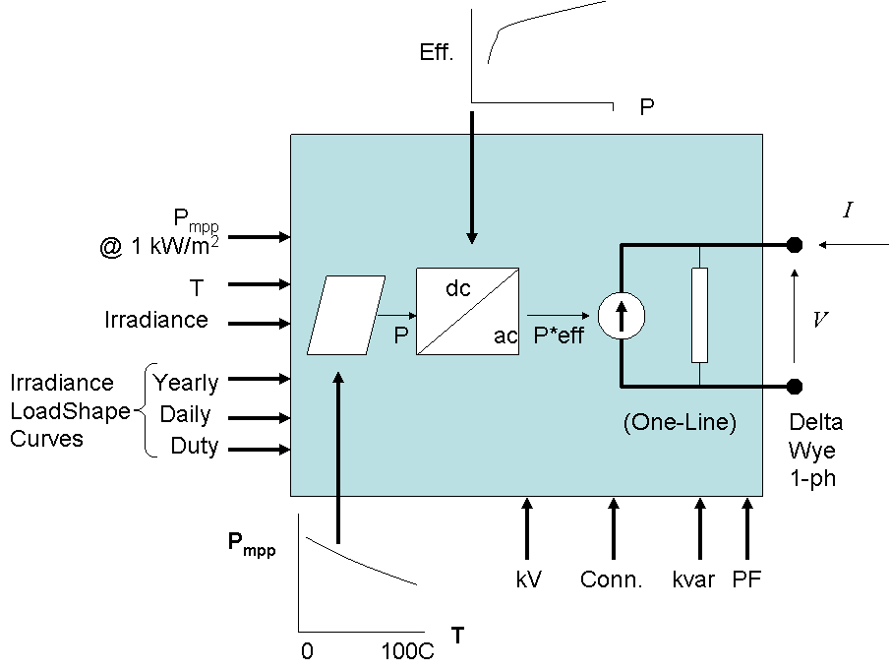
PVSystem in the OpenDSS
The PVSystem model combines a model of the PV array and the PV inverter into one convenient model to use for distribution system impacts studies

Slide 97
Example Script
This example defines a PV system with a panel Pmpp of 500 kW at 1 kW/m² irradiance and a panel temperature of 25°C. The inverter is rated at 500 kVA. A PF of 1.0 is assumed for this example.
Can also be used with the InvControl control object that implements advanced (‘smart’) inverter functions such as volt-var, volt-watt, and dynamic reactive current.
InvControl usage to be covered later today

Slide 98
Example Script
clear
New Circuit.PVSystem basekv=12.47 Isc3=1000 Isc1=900
// P-T curve is per unit of rated Pmpp vs temperature
// This one is for a Pmpp stated at 25 deg
New XYCurve.MyPvsT npts=4 xarray=[0 25 75 100] yarray=[1.2 1.0 0.8 0.6]
// efficiency curve is per unit eff vs per unit power
New XYCurve.MyEff npts=4 xarray=[.1 .2 .4 1.0] yarray=[.86 .9 .93 .97]
// per unit irradiance curve (per unit if "irradiance" property)
New Loadshape.MyIrrad npts=24 interval=1 mult=[0 0 0 0 0 0 .1 .2 .3 .5 .8 .9 1.0 1.0 .99 .9 .7 .4 .1 0 0 0 0 0]
// 24-hr temp shape curve
New Tshape.MyTemp npts=24 interval=1 temp=[25, 25, 25, 25, 25, 25, 25, 25, 35, 40, 45, 50 60 60 55 40 35 30 25 25 25 25 25 25]
// **** plot tshape object=mytemp
// take the default line
New Line.line1 Bus1=sourcebus bus2=PVbus Length=2

Slide 99
Example Script (cont’d)
! PV definition
New PVSystem.PV phases=3 bus1=PVbus kV=12.47 kVA=500 irrad=0.8 Pmpp=500
~ temperature=25 PF=1 effcurve=Myeff P-TCurve=MyPvsT
~ Daily=MyIrrad TDaily=MyTemp
set voltagebases=[12.47]
calcv
solve ! solves at the specified irradiance and temperature
new monitor.m1 PVSystem.PV 1 mode=1 ppolar=no
new monitor.m2 PVSystem.PV 1
solve
solve mode=daily
show mon m1
show mon m2

Slide 100
Example Script (cont’d)
Export monitors m1
Plot monitor object= m1 channels=(1 )
Export monitors m2
Plot monitor object= m2 channels=(1 ) base=[7200]
Export monitors m2
Plot monitor object= m2 channels=(9 )

Slide 101
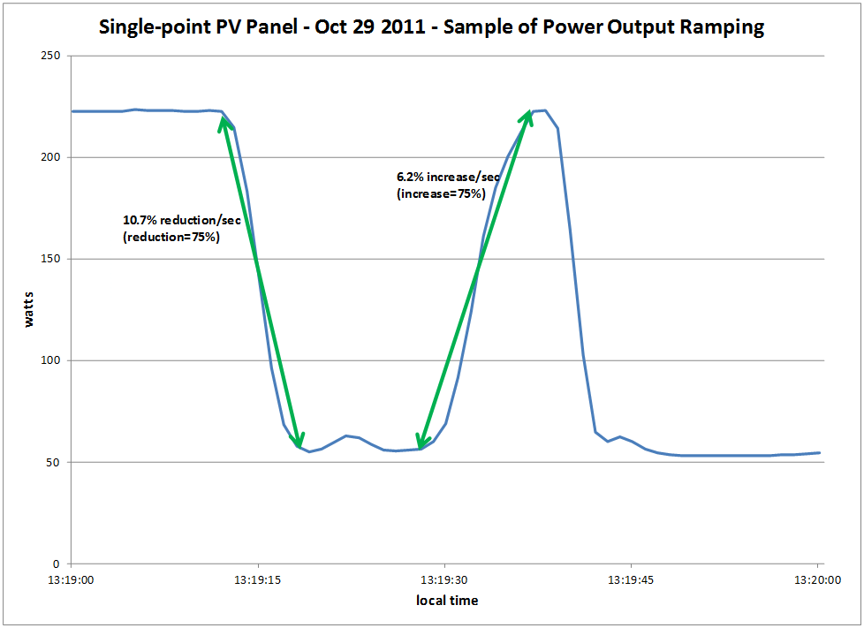
Modeling PV Systems – Variability/Ramping – Single-Panel

Slide 102
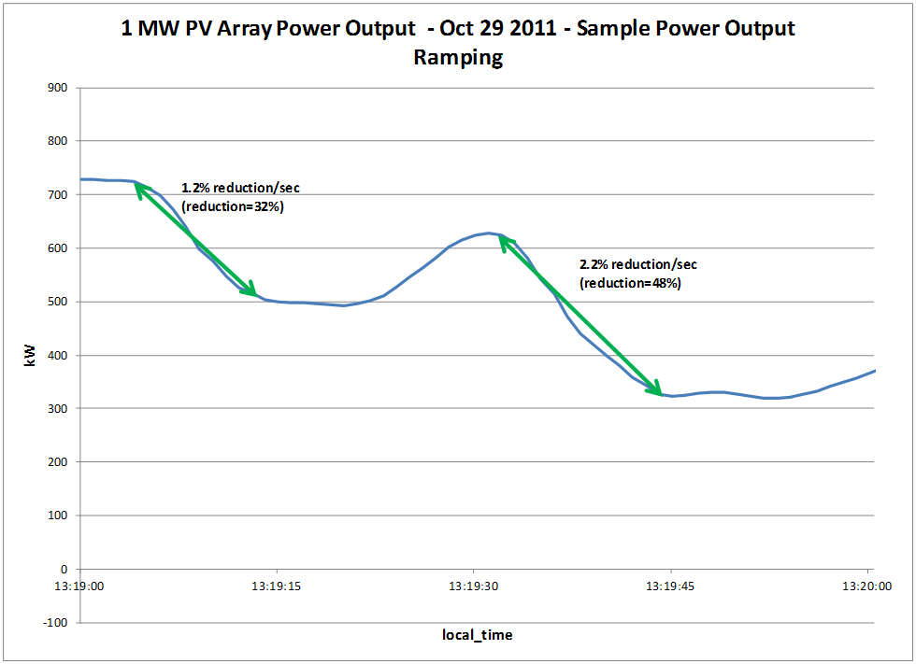
Modeling PV Systems – Variability/Ramping – 1 MW PV Array (same location as Single-Panel)

Slide 103
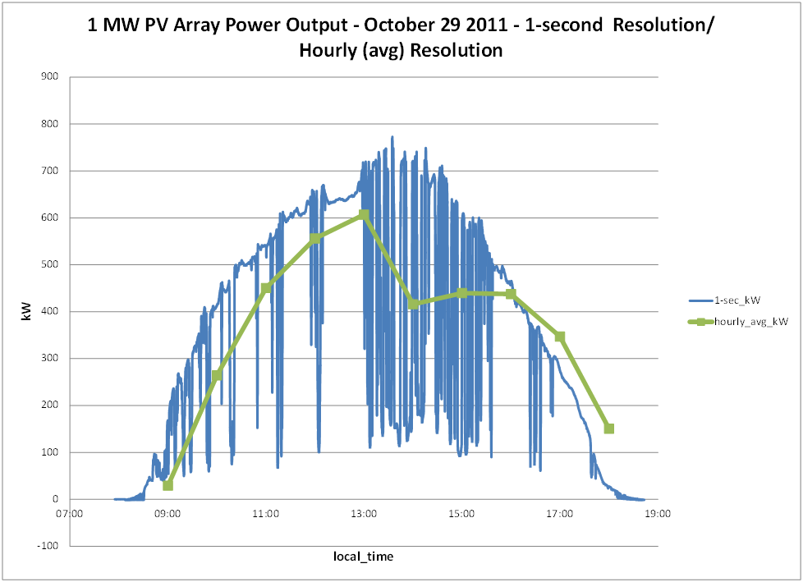
Modeling PV Systems – Variability/Ramping – Significance of Solar Irradiance Resolution

Slide 104
Modeling PV Systems for Distribution System Impact Assessment – Fault Response
Fault current contribution
‘Rule-of-thumb’: 2 x Full Output Rating of Inverter for 1 cycle (three-phase fault)
Other testing has been performed by Southern California Edison, NREL, PV inverter manufacturers, etc
NREL
1 kW inverter: 4 x pre-fault output current for 1.6 ms
PV Inverter Manufacturer (un-named)
500 kva grid-tied: 2 – 3 times pre-fault output current for up to 4.25 ms

Slide 105
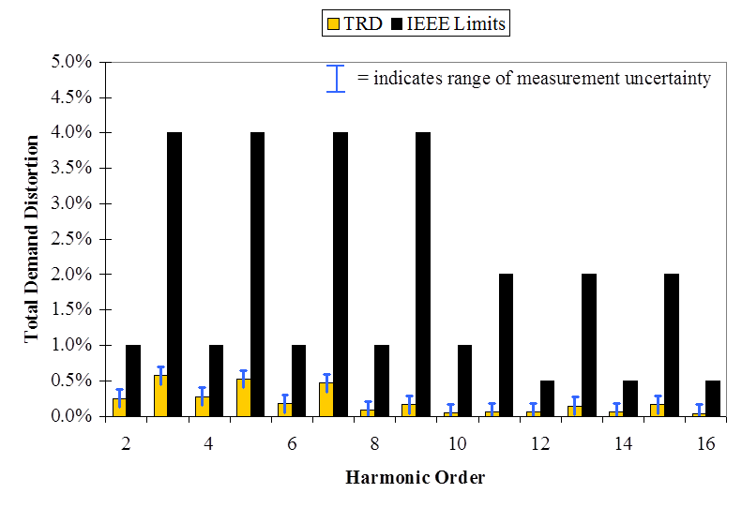
Modeling PV Systems for Distribution System Impact Assessment – Harmonic Response
Single units – Model as current sources
Typically below IEEE 519-1992 current injection limits for generation equipment, especially at low harmonic orders
Multiple units – Model as current sources with cancellation at higher order harmonics

Slide 106
Modeling PV Systems for Distribution System Impact Assessment – Anti-Islanding
Difficult to model without explicit knowledge of the anti-islanding scheme implementation details for the PV System
Implementation details for the PV Systems are usually ‘trade secrets’ and therefore not publicly available for use
See, for more information on approaches: “Evaluation of Islanding Detection Methods for Photovoltaic Utility Interactive Power Systems”, International Energy Agency, March 2002.
Precise re-creation of events in EMTP-like programs, from ‘in-the-field’ system event recordings will likely be difficult with generic models of anti-islanding approaches

Slide 107
‘Smart’ Inverter Control in the OpenDSS
InvControl

Slide 108
InvControl Control Object
Works in conjunction with PVSystem object(s) to control the PVSystem(s) output according to ‘smart’ inverter functions
Three modes currently available:
Volt-var
Follows a voltage versus reactive power curve and changes the reactive power generation (capacitive) or reactive power absorption (inductive) according to the terminal voltage at each PVSystem
Volt-watt
Follows a voltage versus active power curve and changes the active power output according to the terminal voltage at each PVSystem (within the limits of the present irradiance)
Dynamic Reactive Current (DRC)
Has several settings that change the reactive power generation or absorption in response to fast changes in terminal voltage (e.g., during a sag or swell)

Slide 109
Volt-var Control Mode – Example Volt-var Curve

Slide 110
InvControl in Volt-var Mode – Script
New PVSystem.3P_ExistingSite4 phases=3 bus1=B51854_sec kV=0.4157 kVA=523 ~ irradiance=1 Pmpp=475 pf=1 %cutin=0.1 %cutout=0.1 yearly=PV_ls
New PVSystem.3P_ExistingSite1 phases=3 bus1=X_5865228330A kV=0.4157 kVA=314 ~ irradiance=1 Pmpp=285 pf=1 %cutin=0.1 %cutout=0.1 yearly=PV_ls
New PVSystem.3P_ExistingSite3 phases=3 bus1=X_5891328219_Cust1 kV=0.4157 ~ kVA=836 irradiance=1 Pmpp=760 pf=1 %cutin=0.1 %cutout=0.1 yearly=PV_ls
New PVSystem.3P_ExistingSite2 phases=3 bus1=B4832_sec kV=0.4157 kVA=209 ~ irradiance=1 Pmpp=190 pf=1 %cutin=0.1 %cutout=0.1 yearly=PV_ls
New XYCurve.vv_curve npts=4 Yarray=(1.0,1.0,-1.0,-1.0) ~ XArray=(0.5,0.95,1.05,1.5)
New InvControl.InvPVCtrl mode=VOLTVAR voltage_curvex_ref=rated ~ vvc_curve1=vv_curve EventLog=yes

Slide 111
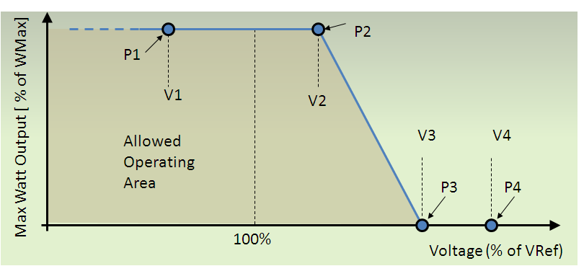
Volt-watt Control Mode – Example Volt-watt Curve

Slide 112
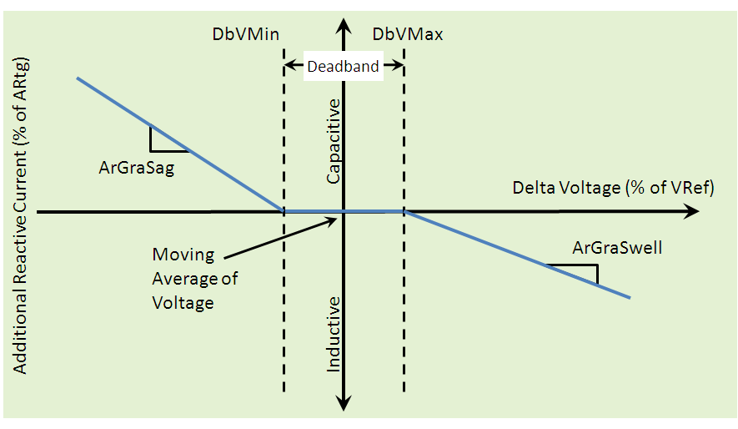
DRC Control Mode – Settings Curve

Slide 113
Scripting Storage Models
See “OpenDSS STORAGE Element.PDF” in Distrib\DOC folder

Slide 114
Storage Element Model in EPRI’s OpenDSS
Idle | Discharge | Charge
% Eff. Charge/Discharge
Other Key Properties
% Reserve kWhRated kWhStored %Stored kWRated
etc.
kW, kvar
Idling Losses
kWh STORED

Slide 115
StorageController Element in OpenDSS
Time + Discharge rate Peak Shaving Load Following Loadshape
Discharge Mode Charge Mode kW Target Discharge Time Total Fleet kW Capacity Total Fleet kWh
et. al.
Comm Link
V, I
Substation
Storage “Fleet”

Slide 116
Simple Peak Shave Example with 3-Hour Storage
From EPRI
Smart Grid Demo - AEP
Community Energy Storage

Slide 117
Detail on Peak Shaving Application

Slide 119
“Ran Out of Gas”

Slide 121
12:00 is too early
Load declines after 12:00

Slide 122
Using Storage to Extend Solar PV
Source: EPRI, 2012, Analysis of Distribution System Effects of Energy Storage Through Simulation and Modeling, Palo Alto, CA, US. 1024285

Slide 123
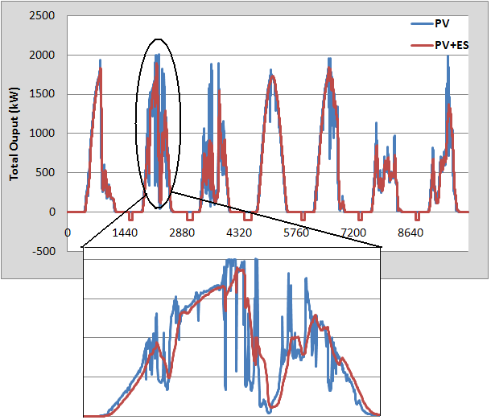
Using Storage for Smoothing PV

Slide 124
Storage with Controller
Clear
New Circuit.TestStorage
~ BasekV=12.47
New Line.Line1 Bus1=Sourcebus LoadBus ! default line
New Loadshape.DailyShape npts=96 minterval=15 mult=[file=storagetestshape.csv]
New Storage.Battery phases=3 Bus1=loadbus kV=12.47 kW=250 kWrated=250 kWhrated=1000
~ dispmode=follow daily=dailyshape
set voltagebase=[12.47]
calcv
new monitor.PQ storage.battery 1 ppolar=no mode=1
new monitor.Vars storage.battery 1 mode=3
solve
solve mode=daily step=15m number=(2 96 *)
show mon PQ
show mon vars

Slide 125
The Loadshape

Slide 126
Result …

Slide 127
Storage with DynaDLL
clear
New Circuit.SimpleStore ! Creates voltage source (Vsource.Source)
Edit Vsource.Source BasekV=115 pu=1.02 ISC3=30000 ISC1=25000 !Define source V and Z
New Transformer.TR1 XHL=10
~ Buses=[SourceBus, Sub_Bus]
~ Conns=[Delta Wye]
~ kVs= [115 12.47]
~ kVAs=[200000 200000]
New Linecode.336ACSR R1=0.058 X1=.1206 R0=.1784 X0=.4047 C1=3.4 C0=1.6 Units=kft
New Line.LINE1 Bus1=Sub_Bus Bus2=LoadBus Linecode=336ACSR Length=0.011 Units=Mi
New Transformer.MVLV XHL = 5
~ Buses=[LoadBus LVBus]
~ Conns=[Delta Wye]
~ kVs= [12.47 .400]
~ kVAs=[300 300]
New Storage.Store1 phases=3 Bus1=LVBus kV=0.400 conn=Delta kVA=60
~ kWrated=60 kWHrated= 0.20833 %reserve=50 // 750 kW-s (kJ)
~ state=discharge
~ kW=50 PF=1
~ DynaDLL="C:\Users\prdu001\OpenDSS\Source\DESS1\Dess1.DLL"
! ~ DynaData=(help)
~ DynaData=(file=DESSModel_Test.TxT)
// New Load.LOAD1 Bus1=LoadBus kV=12.47 kW=1000 PF=.95 model=4 cvrwatts=1.2
Solve

Slide 128
Storage with Controller
new Storage.battery phases=3 bus1=loadbus kv=12.47
~ kwrated=250 kwhrated=1000
new StorageController.battery element=line.Line1
~ %Reserve=20.0
~ ModeCharge=Loadshape
~ ModeDischarge=Loadshape
~ Yearly=ls_bat_cntrl
~ EventLog=Yes

Slide 129
Model for Direct-Connect Y-connected DG to avoid convergence issue
Insert a Yn-D Transformer in Series with delta-connected DG to achieve Y direct to avoid numerical problems in OpenDSS. Set Transformer XHL = DG’s %X₀

Slide 130
Monte Carlo Fault Example

Slide 131
Concept: One-Line Diagram

