Slide 1
Statistical Analysis of Craft Beers and Breweries in the United States
Willis A. Jones
wajones@smu.edu
Kristin Henderson
hendersonk@smu.edu
Notes:
Hi…….…Thank you for the opportunity to present our findings to you today. My name is Willis Jones and this is Kristin Henderson….and this is our Statistical Analysis of Craft Beers & Breweries in the United States.
As you know, you all gave us a dataset containing information on breweries and craft beers in the US and asked us to answer a handful of questions for you about the data. We will answer each of those questions during this presentation.

Slide 2
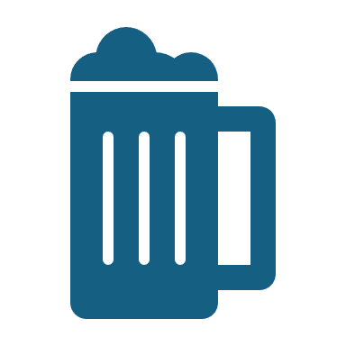
Overview
Breweries per state
Craft beer alcohol content and bitterness
Statistical relationships between craft beer measurements
Notes:
To summarize some key takeaways:
The most breweries are found in Colorado and Texas, on the West Coast, and near the Great Lakes.
Beers with the highest ABV and IBU are made in Colorado and Oregon, respectively.
Lastly, we found evidence of a strong correlation between ABV and IBU.

Slide 3
Client Question: How many breweries are present in each state?
Notes:
Here is an overview of what we will cover during this presentation. As you know, you all gave us a dataset containing information on breweries and craft beers in the US and asked us to answer a handful of questions for you about the data. We will answer each of those questions during this presentation.
The first question we will address is how many breweries are present in each state.

Slide 4
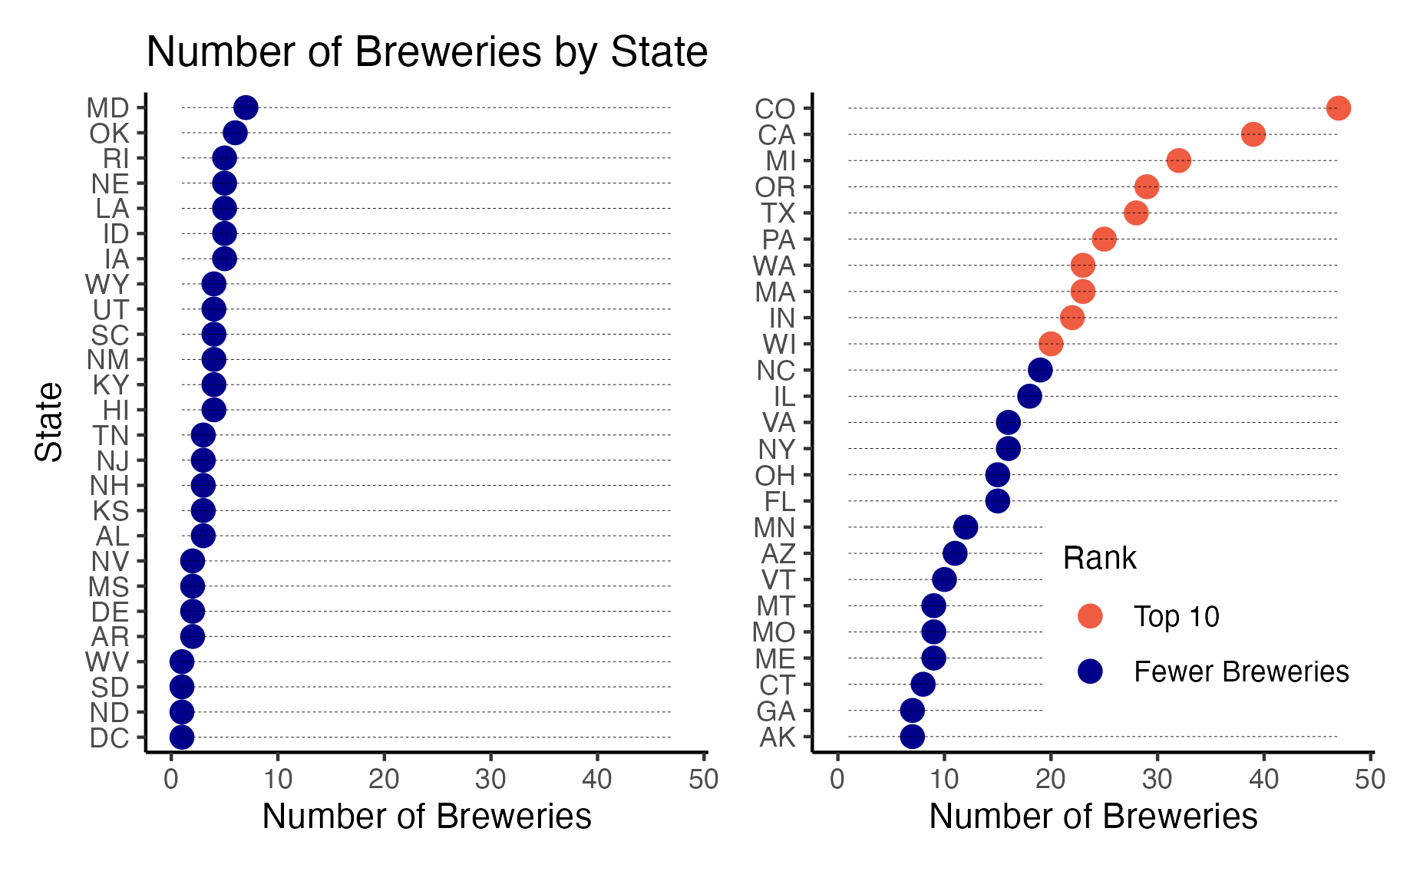
Notes:
This chart shows a ranking of states from lowest number of breweries to the highest.
The top 10 states are in red.
Washington, DC, North and South Dakota and West Virginia each only have 1 brewery. Colorado is highest with 47 breweries.

Slide 5
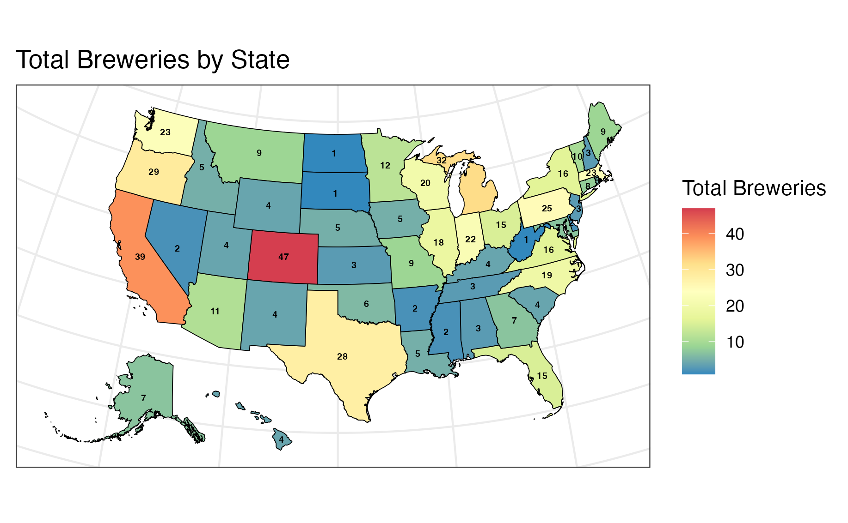
Notes:
Here we can see get a better look at what regions tend to have the highest and lowest number of breweries.
Colorado, the West Coast, Texas, and the states near the Great Lakes top the list.

Slide 6
Client Question: How much missing data were in the dataset provided?
Notes:
The next question you all asked about was the missing data

Slide 7
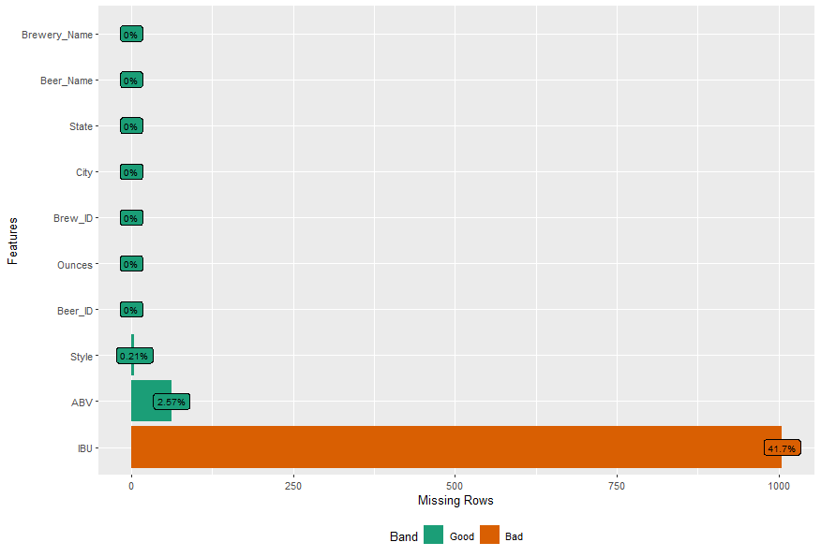
Notes:
And as you can see from this graphic, the dataset was pretty complete. For most variables, very little data were missing. The one exception was International bitterness units. 42% of the craft beer observations did not have a measure of international bitterness units.

Slide 8
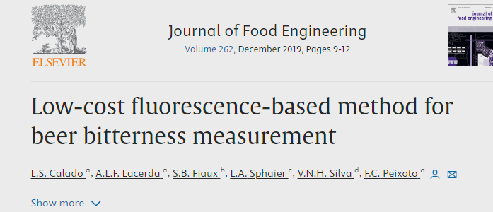
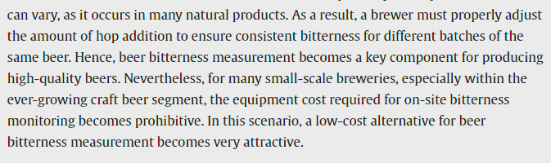


Notes:
Some of this missing might be due to the high cost of measuring international bitterness….we found an article in the Journal of Food Engineering that noted that the cost of equimpemnt might prevent small craft brewers from measuring international bitterness
This missing did will important later when we look at the relationships between beer measurements

Slide 9
Client Question: What is the median alcohol content and international bitterness units for beers in each state?
Notes:
We next wanted to find the median alcohol content and international bitterness units for beers in each state.

Slide 10
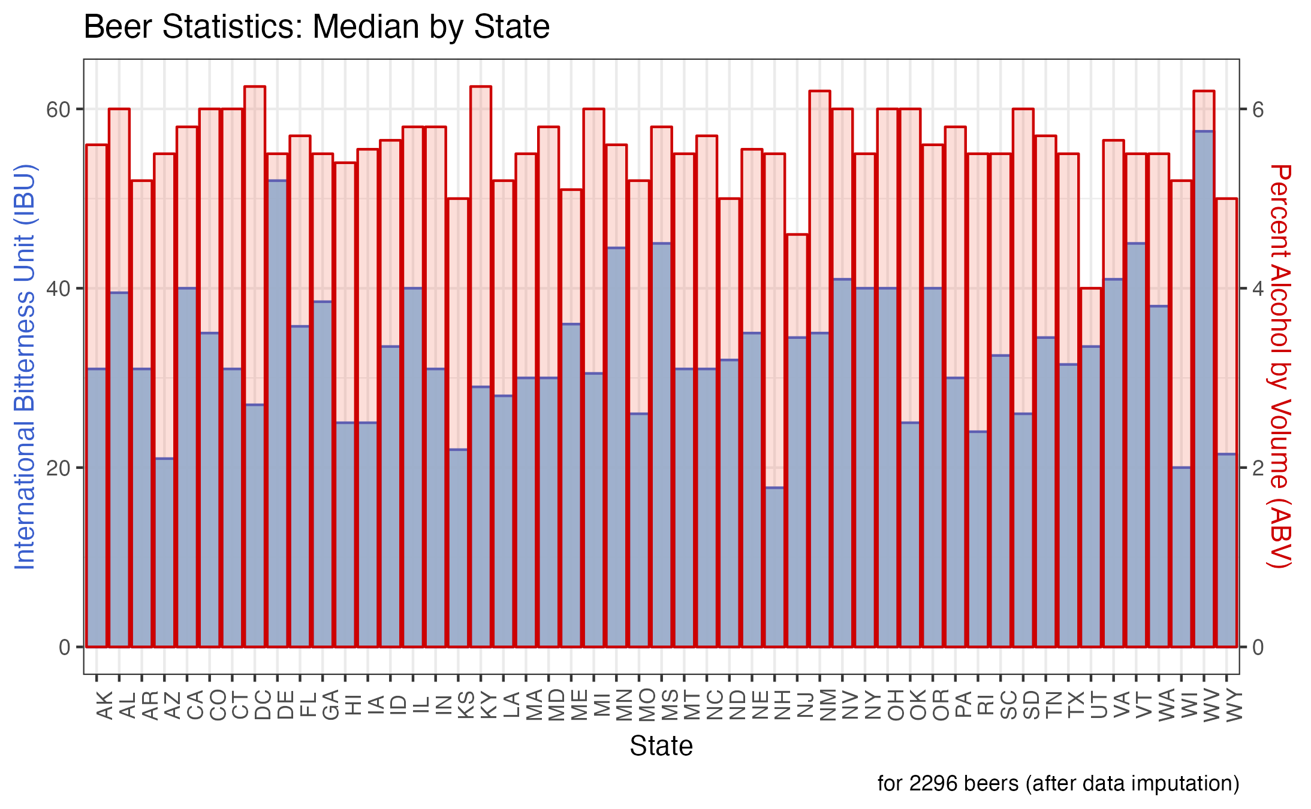
Notes:
For each state, we overlaid the median international bitterness units in blue and the median percent alcohol in red.
DC and KY have the highest median ABV, while UT is the lowest.
WV has highest median IBU and NH the lowest.

Slide 11
Client Question: Which state has the beer with the maximum alcohol by volume and highest international bitterness units?
Notes:
Next questions you asked was which state had the beer with the maximum alcohol and maximum bitterness

Slide 12
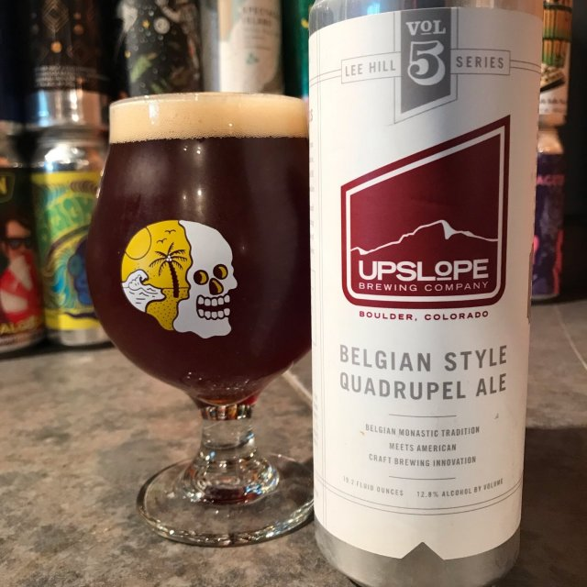
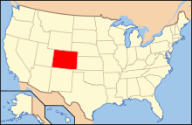
Highest alcohol by volume beer
ABV = .128
Lee Hill Series Vol. 5 - Belgian Style Quadrupel Ale
Notes:
Alcohol by volume

Slide 13
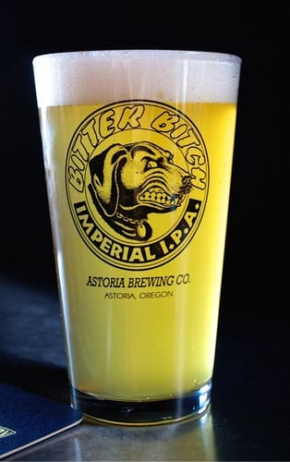
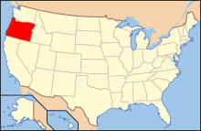
Most Bitter Beer
IBU = 138
Bitter Bitch Imperial IPA
Notes:
International bitterness unit of 138 units

Slide 14
Client Question: What are descriptive statistics for craft beer alcohol by volume (ABV)?
Notes:
Next, we will give an overview of the descriptive statistics for craft beer alcohol by volume.

Slide 15
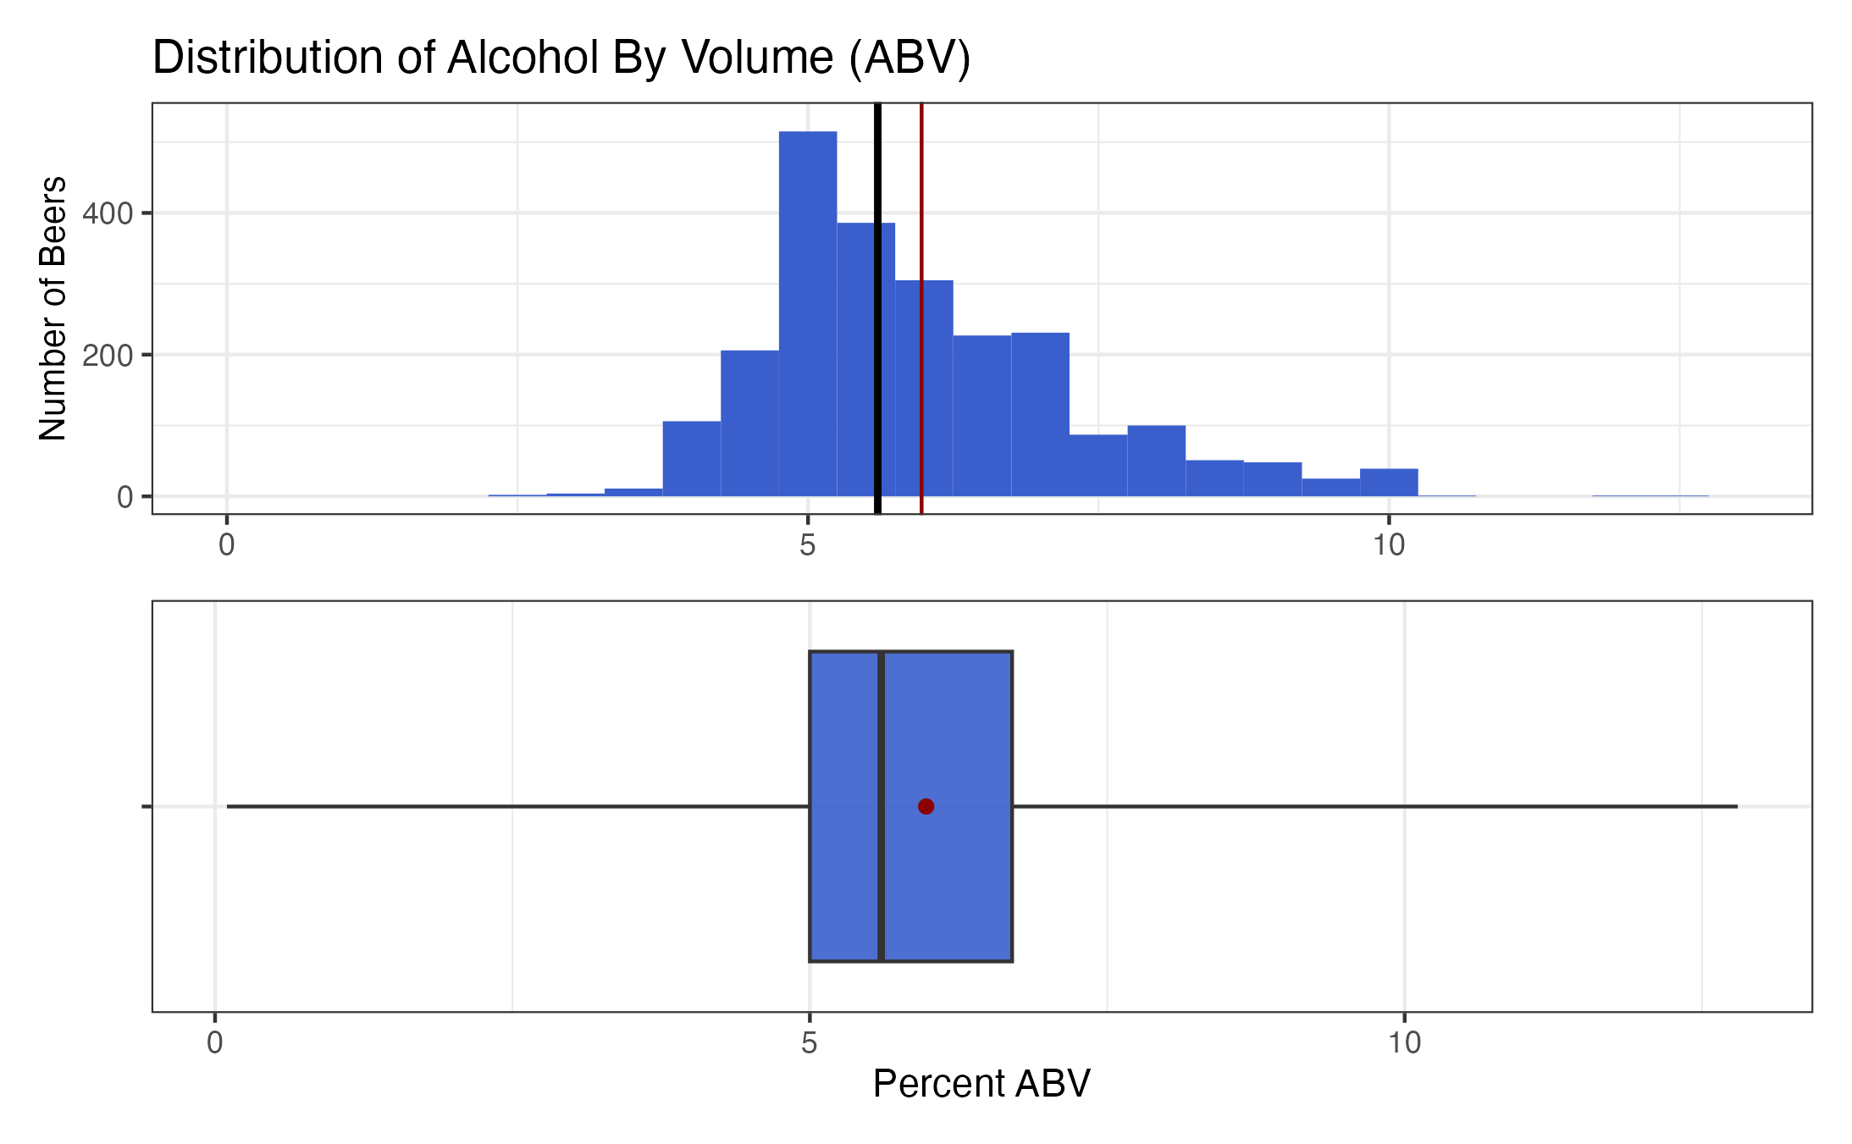
Statistic
Mean
Median
Range: nearly 0% to almost 13%
Median: 5.6%
Half: between 5.0% and 6.7%
Notes:
Here is a histogram and boxplot showing the distribution of percent alcohol across all the craft beers.
The distribution is mostly normal though a bit skewed to the higher percentages.
The beers range from having nearly no alcohol to almost 13% alcohol.
The median is 5.6% with the mean being slightly greater at 6.0%.
Lastly, half of the beers fall in the 5.0 - 6.7 percent alcohol range.

Slide 16
Client Question: What is the relationship between beer bitterness and alcoholic content?
Notes:
Final questions you all asked was which state had the beer with the maximum alcohol and maximum bitterness

Slide 17
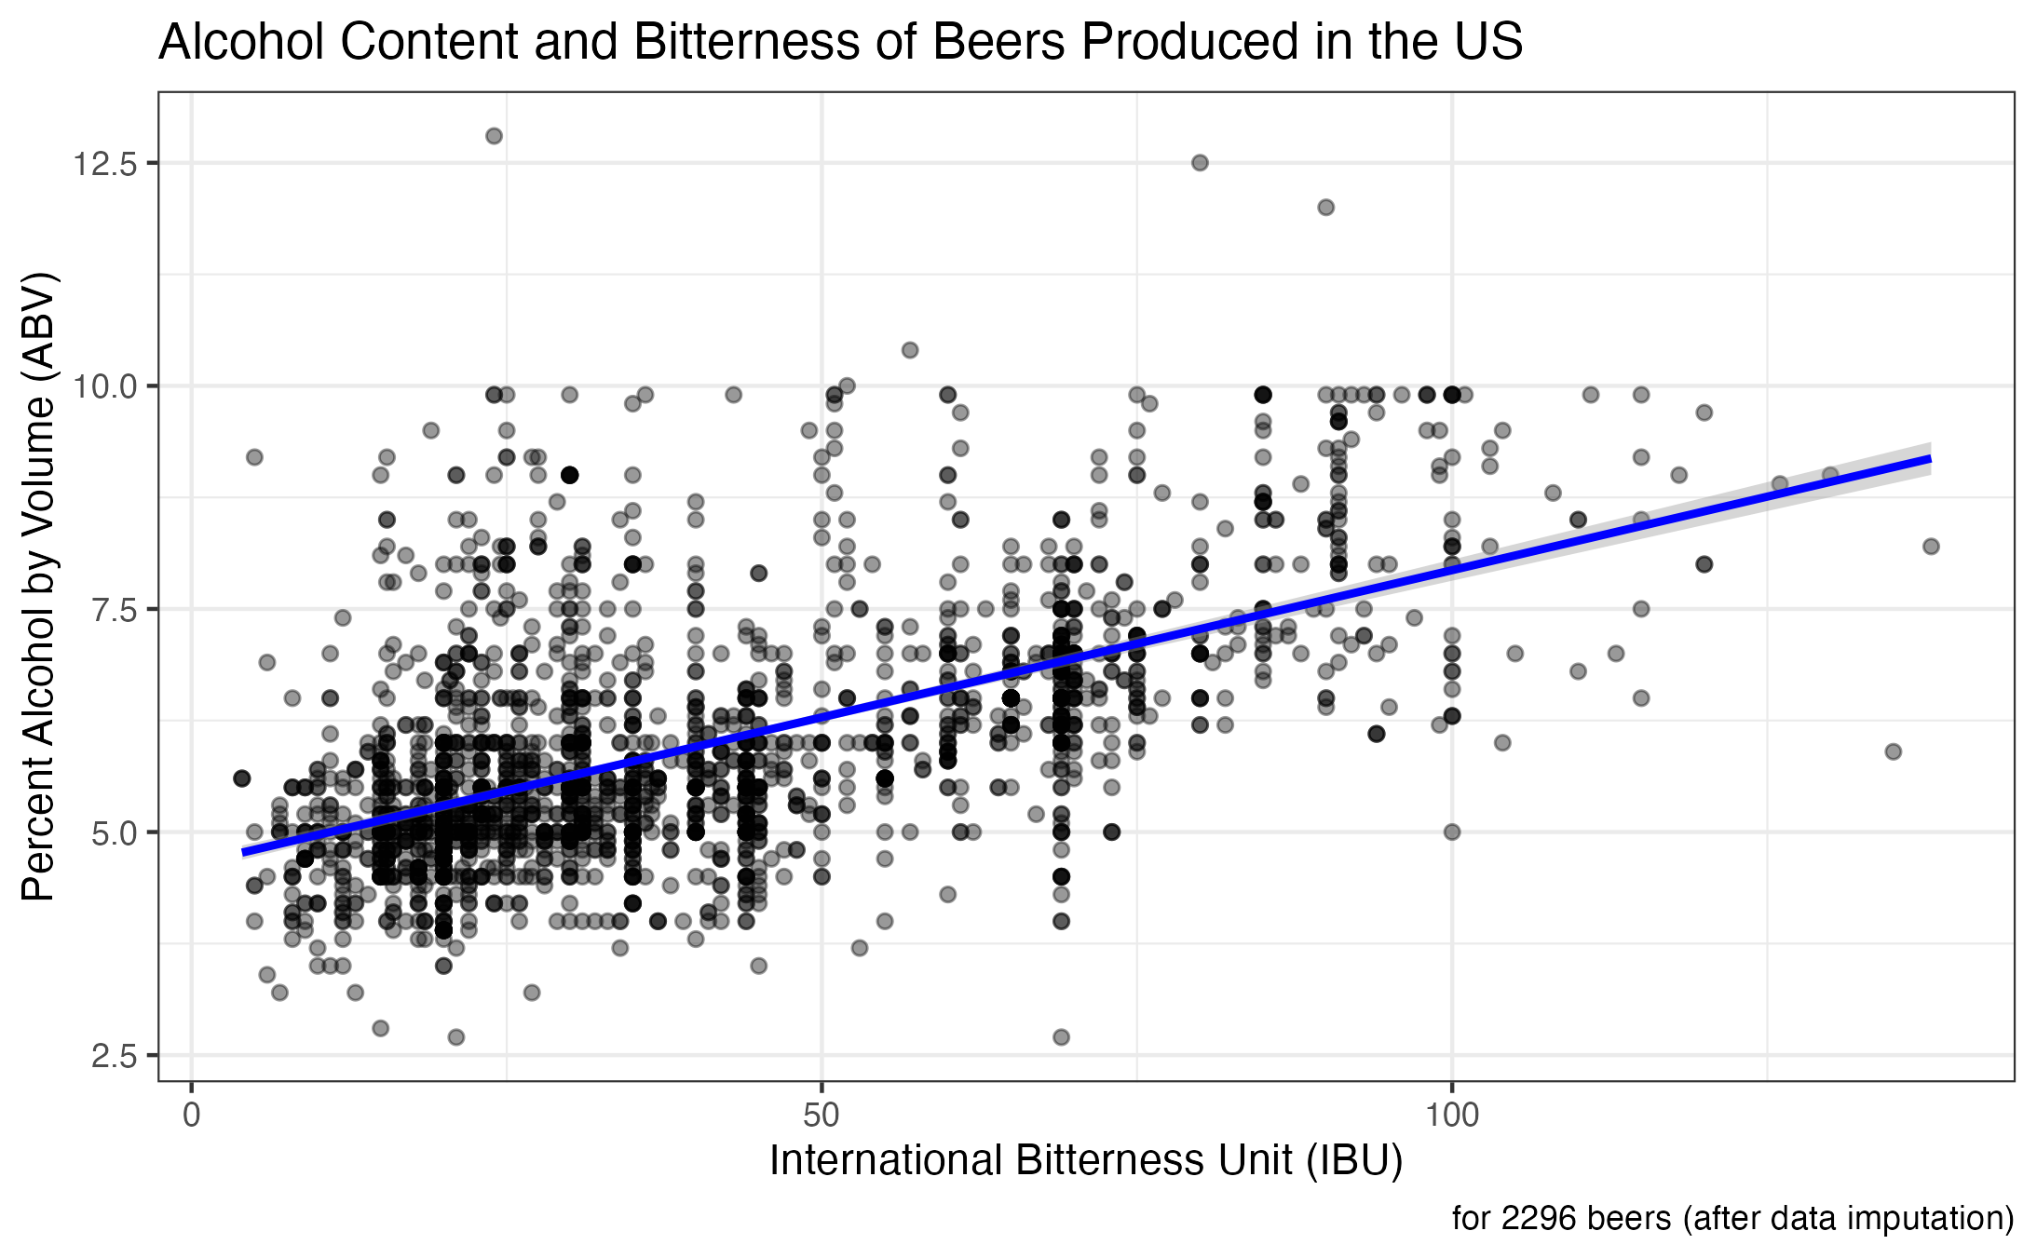
Correlation Coefficient = .59
95% Confidence Interval = .56, .62
N = 2296
Notes:
To measure, we created a scatter plot and ran a Pearson's r correlation between the variables……The correlation coefficient was 0.59 with a 95% confidence interval of 0.56 to 0.62.
This shows a Strong correlation between Alcohol and Bitterness.

Slide 18
Summary
The most breweries are found in Colorado and Texas, on the West Coast, and near the Great Lakes.
Beers with the highest ABV and IBU are made in Colorado and Oregon.
There is evidence of a strong correlation between ABV and IBU.
Notes:
To summarize some key takeaways:
The most breweries are found in Colorado and Texas, on the West Coast, and near the Great Lakes.
Beers with the highest ABV and IBU are made in Colorado and Oregon, respectively.
Lastly, we found evidence of a strong correlation between ABV and IBU.

Slide 19
Thank You!
For additional information:
Willis A. Jones
wajones@smu.edu
Kristin Henderson
hendersonk@smu.edu
Notes:
Thank you very much.
If you would like further analysis of these data, we can certainly follow up with you.
Here is our contact information.
And we are happy to take any questions that you may have.

