Slide 1
Which Brands Will Make It?
A Framework for Scoring Emerging Brands
Kristin Henderson
Advisor: Bivin Sadler
hendersonk@smu.edu
Master of Science in Data Science
Southern Methodist University

Slide 2
The Problem
Distributors, brokers, and retailers must decide which emerging brands to invest in.
Some will grow rapidly. Some will fail. Most sit in between.
How do you tell them apart early?
Emerging Brand
Limited history
Uncertain trajectory
Decision Framework
Multi-criteria scoring
+ statistical benchmarks
Opportunity Tiers
Growing | Stable
Decline | Discontinued
Prior work: Focused on demand forecasting
Our approach: Evaluate brands on multiple performance signals, not just sales predictions

Slide 3
The Data
Weekly retail sales data from a brokerage agency
5 years of data (2021-2026), ~260 weeks
22,500 brands
Primary Variables:
Sales (Case and Dollar)
%ACV (All Commodity Volume)
What is %ACV?
Product in 4 of 16 stores, but those 4 represent
35% of total market volume = 35% ACV

Slide 4
Building the Truth Set
The dataset has no outcome labels. We had to create them.
BUILD THE POOL
PLOT AND LABEL
RESULT
Started with a large single category
Plotted trajectories and classified each brand
112 labeled brands, roughly balanced across all four tiers
29
30
28
25
Discontinued
Decline
Stable
Growing

Slide 5
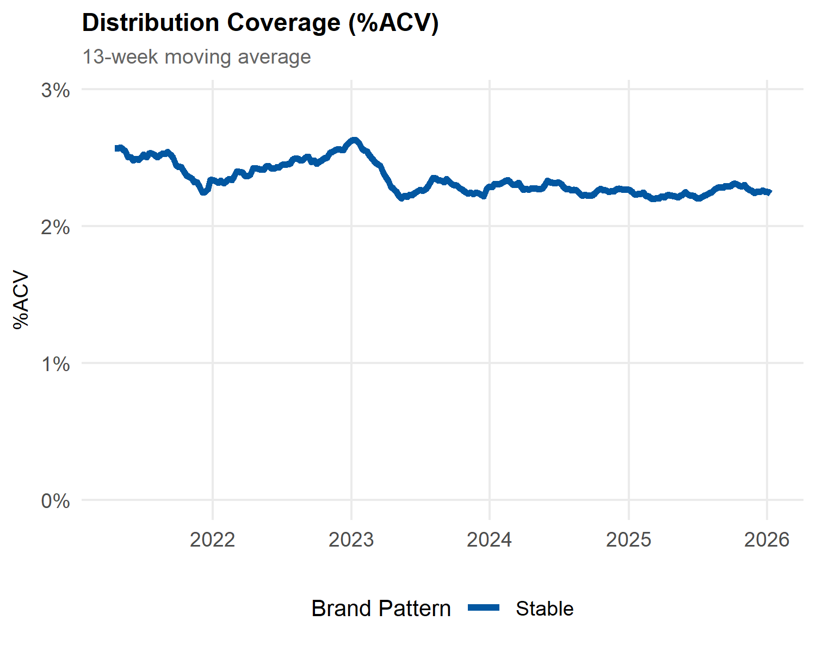
What Does Brand Performance Look Like?

Slide 6
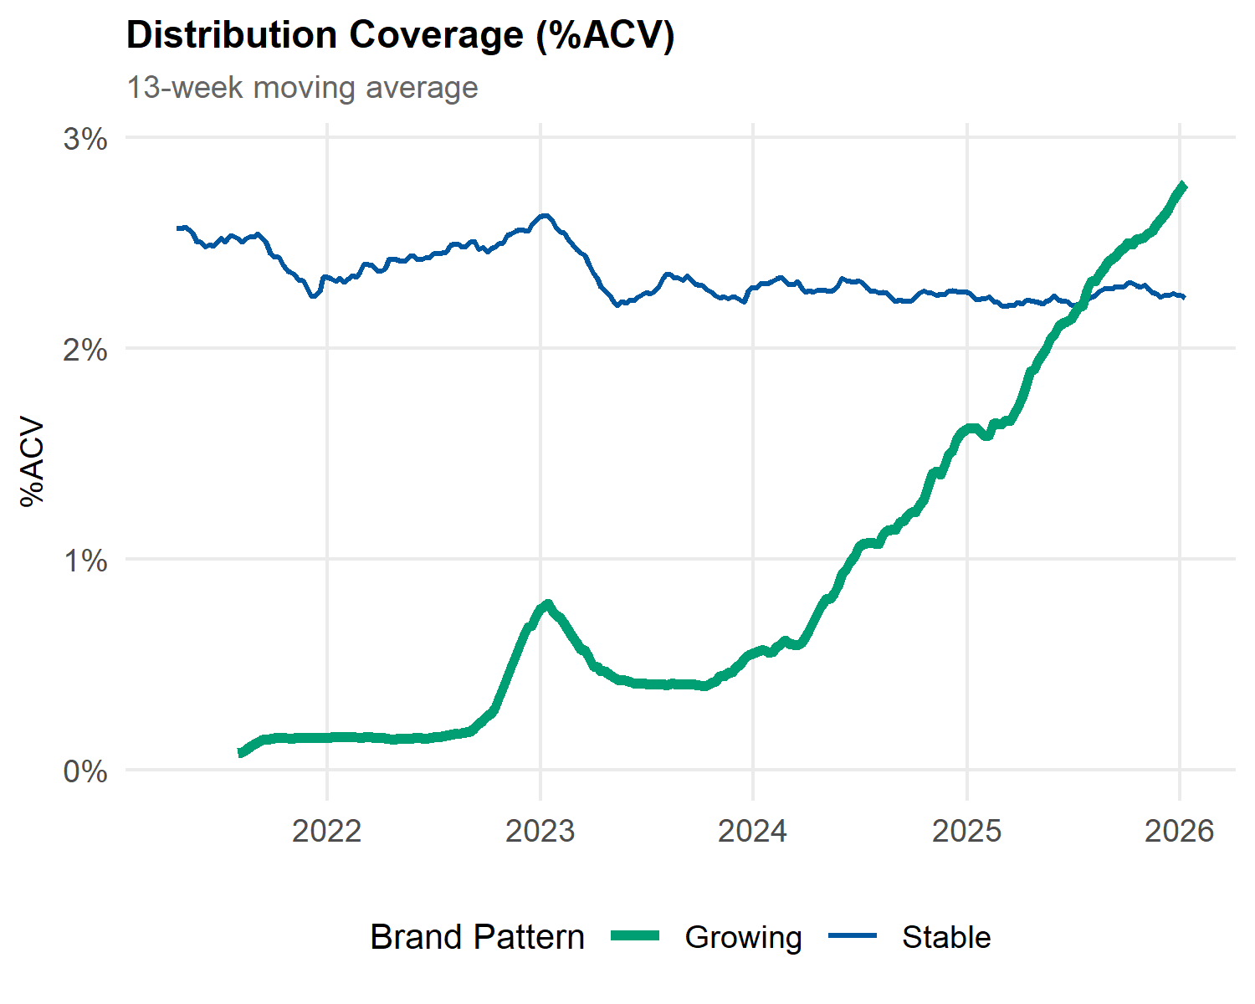
What Does Brand Performance Look Like?

Slide 7
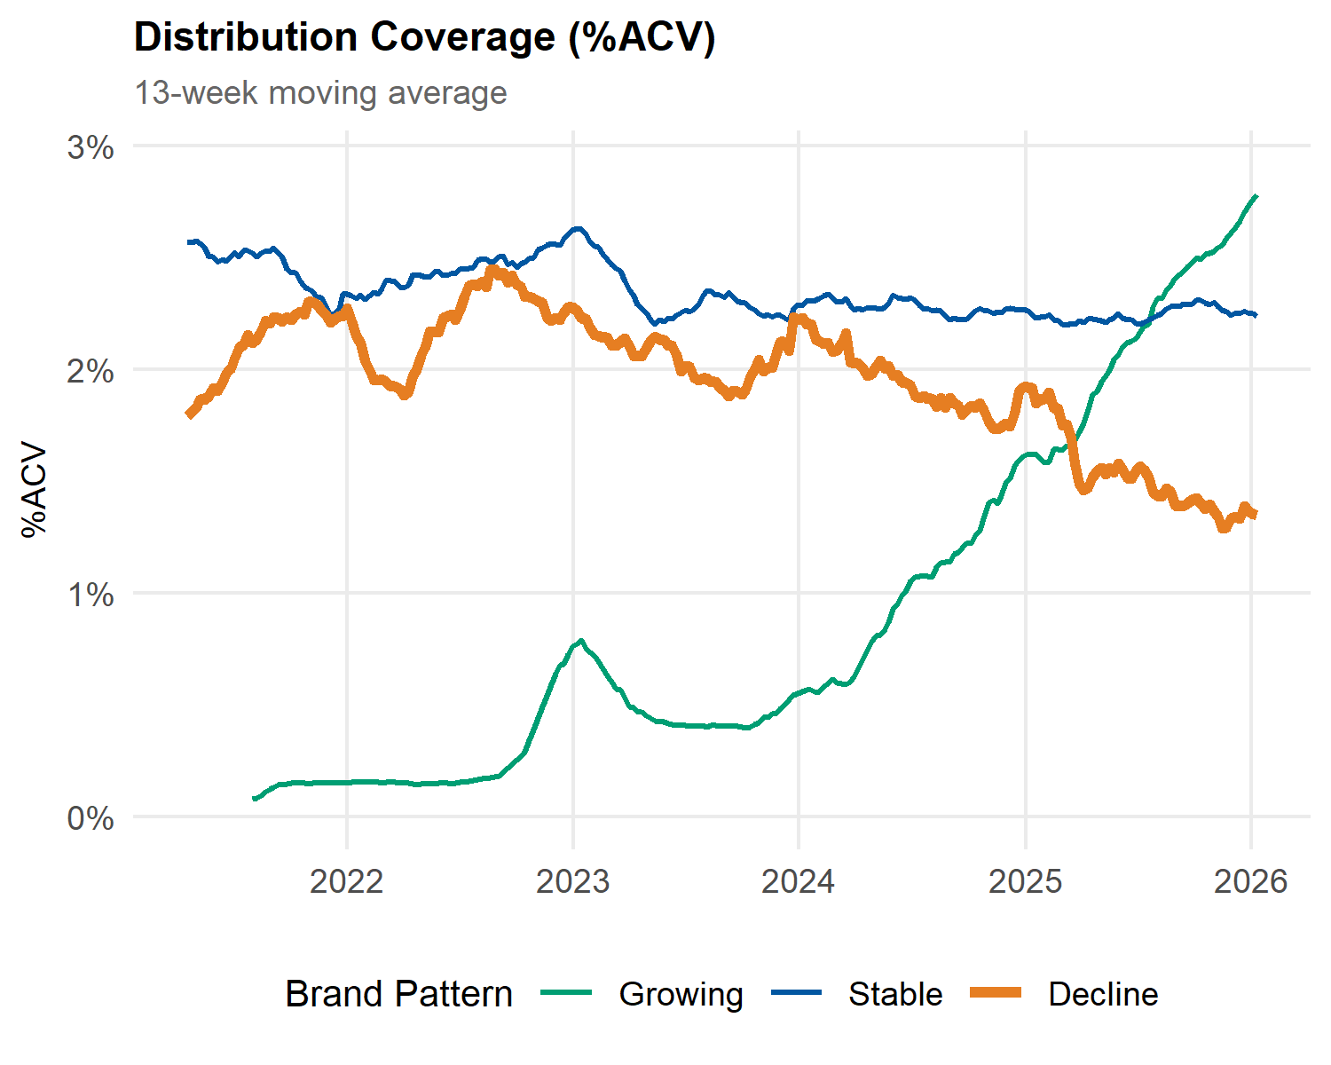
What Does Brand Performance Look Like?

Slide 8
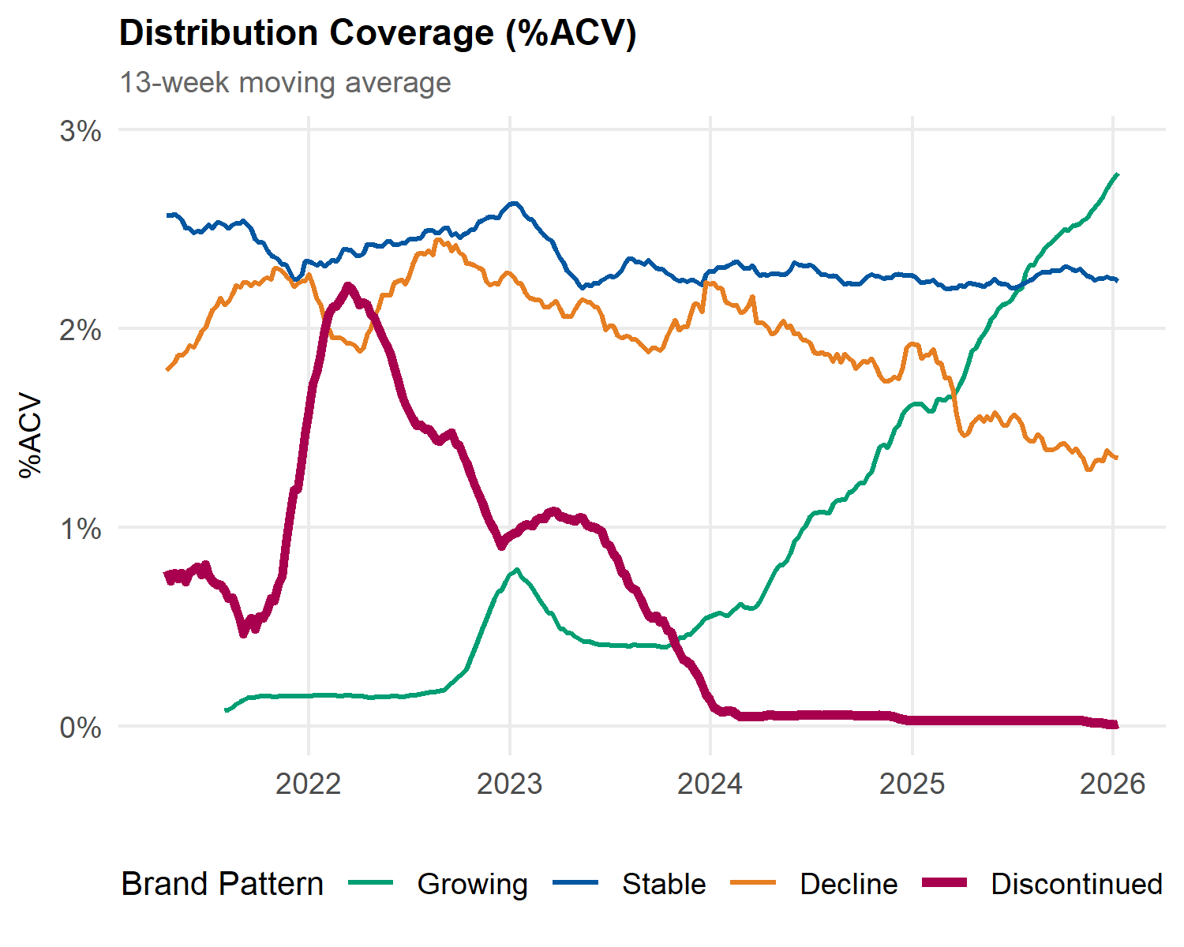
What Does Brand Performance Look Like?

Slide 9
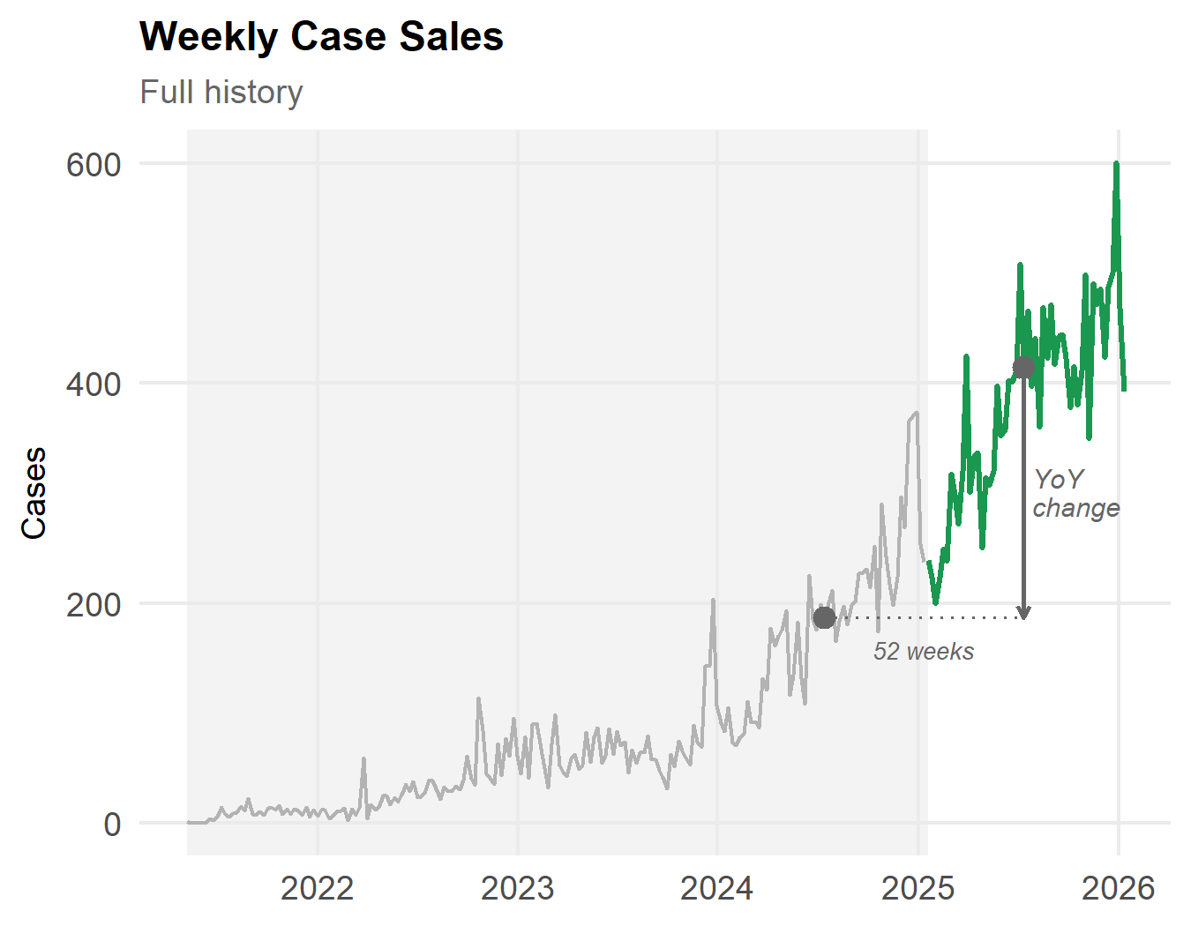
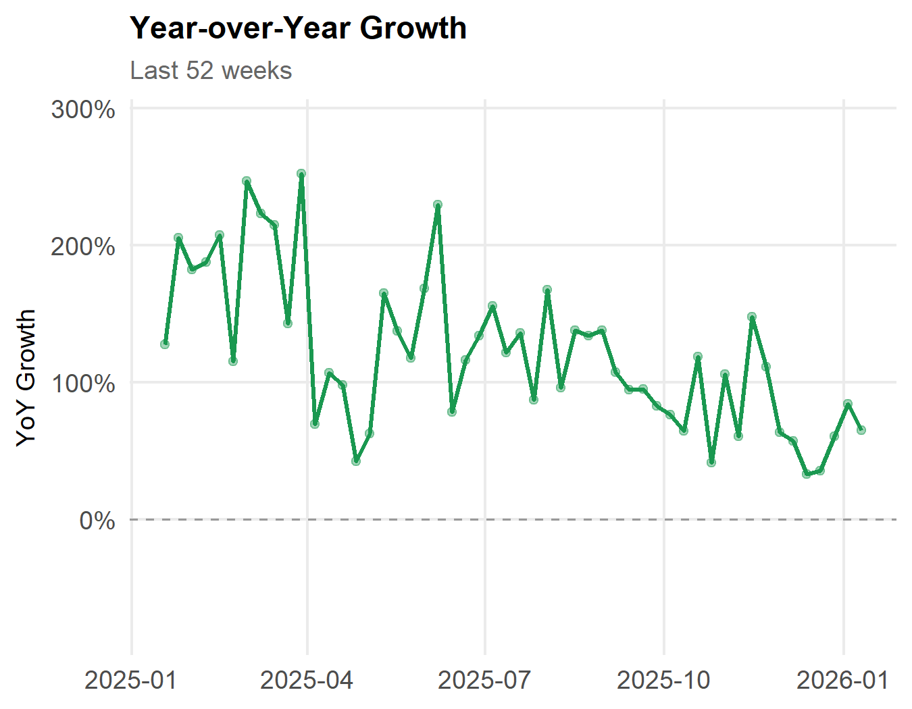
From Raw Sales to Demand Features

Slide 10
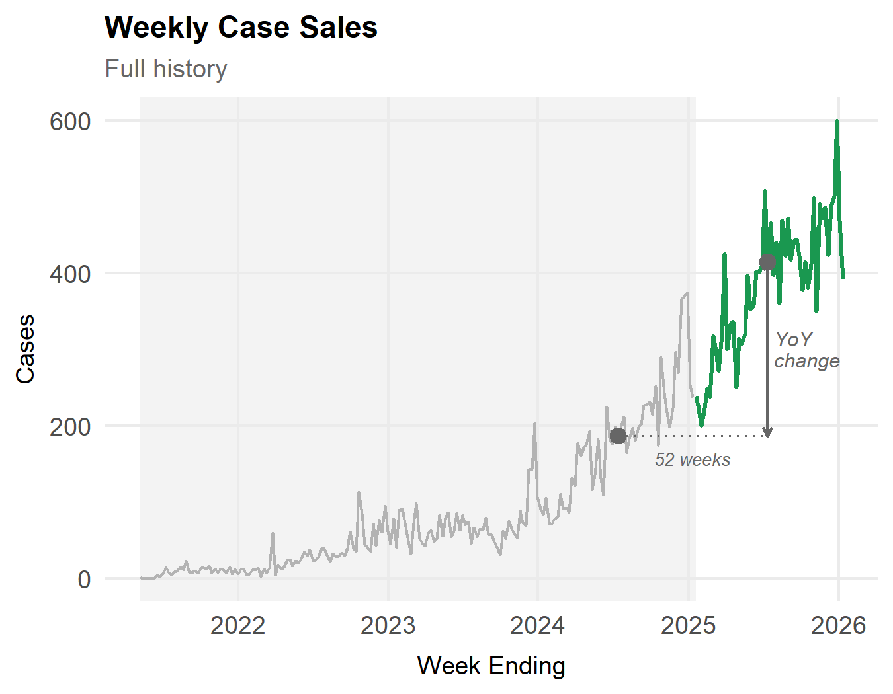
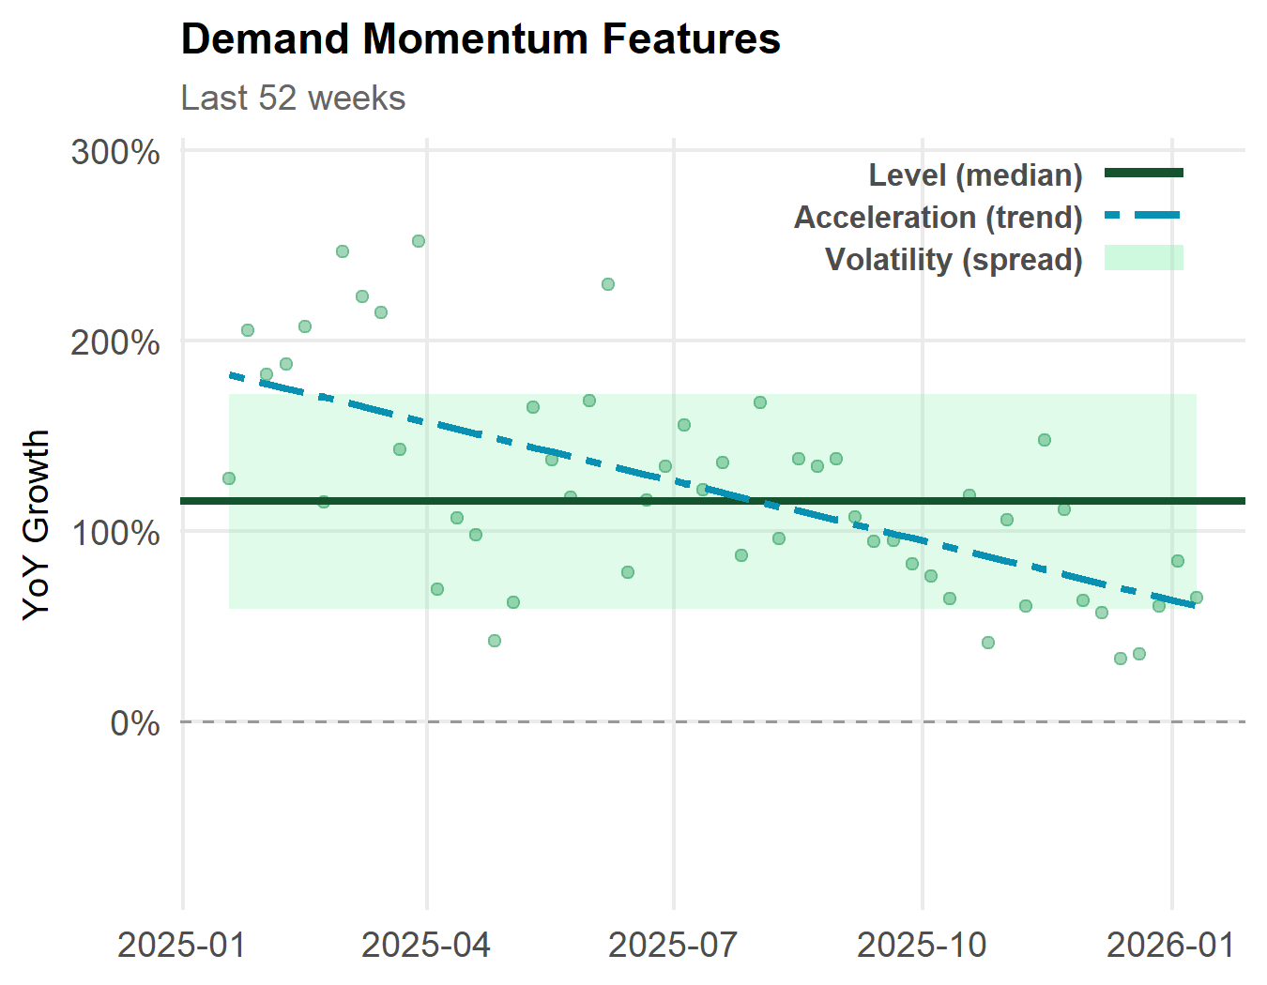
From Raw Sales to Demand Features

Slide 11
A Scoring Framework Built for This Decision
Multi-Criteria Decision Analysis (MCDA) evaluates brands across multiple criteria using a weighted sum:
$$\text{Opportunity} \text{Score}=w_{1}\left(\text{Demand} \text{Moment}um\right)+w_{2}\left(\text{Distribution}\right)+w_{3}\left(\text{Promotion}\right)+w_{4}\left(\text{Category}\right)$$
$$\text{Opportunity} \text{Score}=w_{1}\left(\text{Demand} \text{Momentum}\right)+w_{2}\left(\text{Distribution}\right)+w_{3}\left(\text{Promotion}\right)+w_{4}\left(\text{Category}\right)$$
Level
Median YoY growth
How fast is the brand growing?
Acceleration
Trend of YoY growth
Is growth speeding up or slowing down?
Volatility
Spread of YoY growth
How consistent is the growth?
Demand Momentum
Weighted combination of level, acceleration, and volatility

Slide 12



Which Feature Configuration Best Separates Tiers?
Separation = difference in mean MCDA score between adjacent tiers. Larger gap = better separation.
0.15
Tier boundary:
0.133
Growing vs Stable
0.115
Stable vs Decline
0.099
Decline vs Discontinued
0.10
Separation within
Dot
0.05
0.042
0.043
0.041
0.035
0.032
0.024
→
+0.018 gain vs L
0.00
L
LV
LVA
L
LV
LVA
L
LV
LVA
Level
(100%)
Level + Volatility
(90/10)
Level + Vol. + Accel.
(80/10/10)
LV is the most balanced config: gains at the bottom tier without much loss at the top.

Slide 13
Two Models, Two Levels of Detail
Each model addresses a different decision a broker faces
Is this brand worth investing in?
Which tier is it in?
Logistic Regression
Ordinal Logistic Regression
Low-performing (disc + decline) vs. Viable (stable + growing)
Discontinued < Decline < Stable < Growing
Best config: Level + Volatility
Level p < 0.001 *** | Volatility p = 0.038 *
Best config: Level only
Level p < 0.001 ***
83%
Balanced Accuracy
83% Macro F1
58%
Balanced Accuracy
92% Adjacent Accuracy | 59% Macro F1
Metrics from leave-one-out cross-validation (n = 112).

Slide 14
Models Get It Close
Low-Performing vs. Viable
Ordinal: 4-Tier
 | Truth: Low-Perf | Truth: Viable
Pred: Low-Perf | 47 | 7
Pred: Viable | 12 | 46
 | Discontinued | Decline | Stable | Growing
Discontinued | 18 | 9 | 0 | 0
Decline | 2 | 14 | 5 | 0
Stable | 8 | 7 | 18 | 10
Growing | 1 | 0 | 5 | 15
83% balanced accuracy
7 false positives | 12 false negatives
92% adjacent accuracy
Discontinued is hardest tier (47% recall)
Rows = predicted, Columns = truth. LOOCV (n = 112).
Green = correct Yellow = off by one Red = off by 2+

Slide 15
Can We Predict Outcomes in Advance?
Balanced accuracy with data truncated 6, 12, and 18 months before the end of the observation window.
Approach | Task | Full Data | 6 mo | 12 mo | 18 mo
MCDA Score LV | Low-Perf. vs. Viable | 83% | 82% | 79% | 72%

Slide 16
Can We Predict Outcomes in Advance?
Balanced accuracy with data truncated 6, 12, and 18 months before the end of the observation window.
Approach | Task | Full Data | 6 mo | 12 mo | 18 mo
MCDA Score LV | Low-Perf. vs. Viable | 83% | 82% | 79% | 72%
Logistic | Low-Perf. vs. Viable | 83% | 83% | 83% | 82%

Slide 17
Can We Predict Outcomes in Advance?
Balanced accuracy with data truncated 6, 12, and 18 months before the end of the observation window.
Approach | Task | Full Data | 6 mo | 12 mo | 18 mo
MCDA Score LV | Low-Perf. vs. Viable | 83% | 82% | 79% | 72%
Logistic | Low-Perf. vs. Viable | 83% | 83% | 83% | 82%
Ordinal | 4-Tier (balanced) | 58% | 57% | 56% | 55%
Ordinal | 4-Tier (adjacent) | 92% | 93% | 91% | 91%
Binary logistic model is the most stable. It barely degrades even 18 months out.

Slide 18
Validation: Hand-Labeled Brands
Sample of 10 hand-labeled brands with 6-month forecast predictions, sorted by MCDA score
Extension
Truth
MCDA Score (6mo)
Logistic (6mo)
Ordinal (6mo)
Brand A
Growing
0.411
Viable
Growing
Brand B
Growing
0.369
Viable
Growing
Brand C
Growing
0.268
Viable
Growing
Brand D
Stable
0.198
Viable
Stable
Brand E
Stable
0.195
Viable
Stable
Brand F
Decline
0.159
Low Performance
Decline
Brand G
Low Performance
Decline
Stable
0.144
Brand H
Discontinued
Decline
0.101
Low Performance
Brand I
Discontinued
0.088
Low Performance
Discontinued
Brand J
Discontinued
0.045
Low Performance
Discontinued

Slide 19
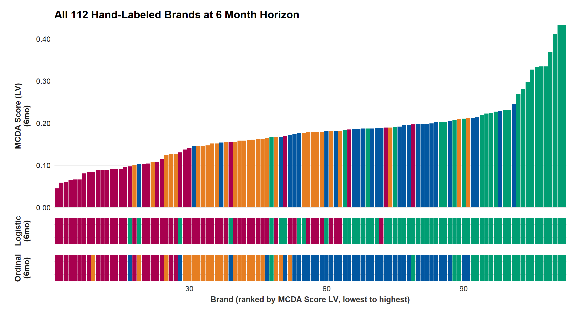
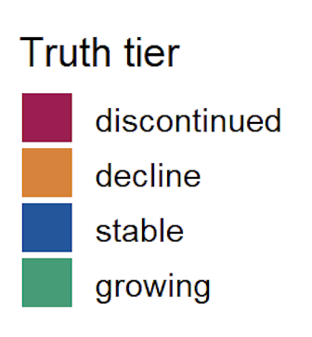
Validation: Full Hand-Labeled Set
highest scores
match growing
some mixing
in between
lowest scores
match discontinued

Slide 20
Validation: Full Hand-Labeled Set
mostly aligns with red & orange above
mostly aligns with blue & green above

Slide 21
Validation: Full Hand-Labeled Set
ordinal predictions
mostly match
truth labels

Slide 22
Takeaways
WHAT: A simple demand feature separates brand tiers.
Median year-over-year case growth distinguishes low-performing from viable brands.
WHEN: The framework works as a forward-looking signal.
Prediction accuracy is stable even when computed up to 18 months before the present.
WHY: This is a proof of concept designed to grow.
The framework is validated by statistical models and is designed to expand as new criteria are tested.

Slide 23

Connect with me on LinkedIn
Thank You
Questions?
Kristin Henderson
hendersonk@smu.edu
kdhenderson.github.io

Slide 24
Appendix

Slide 25
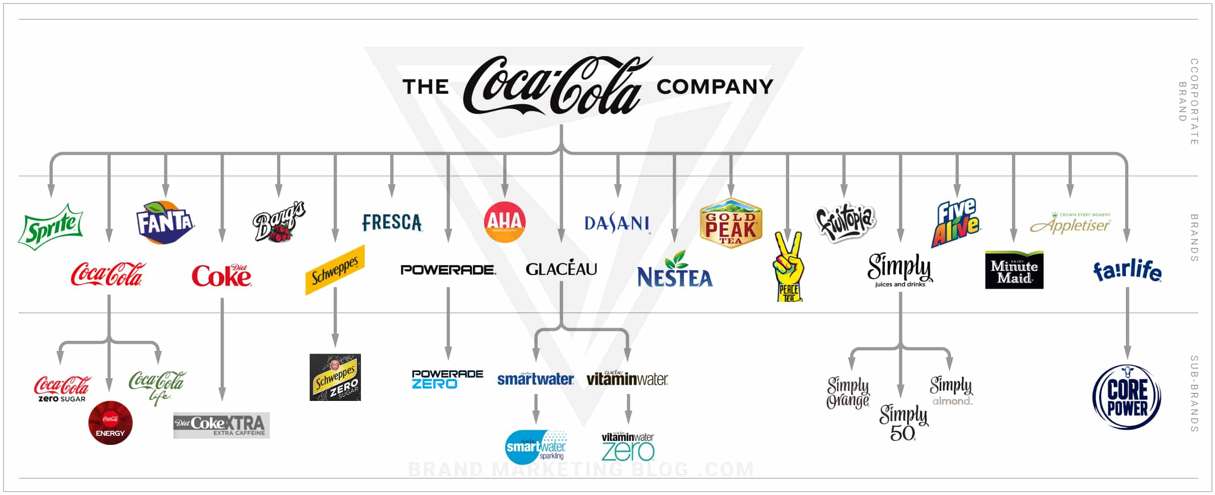
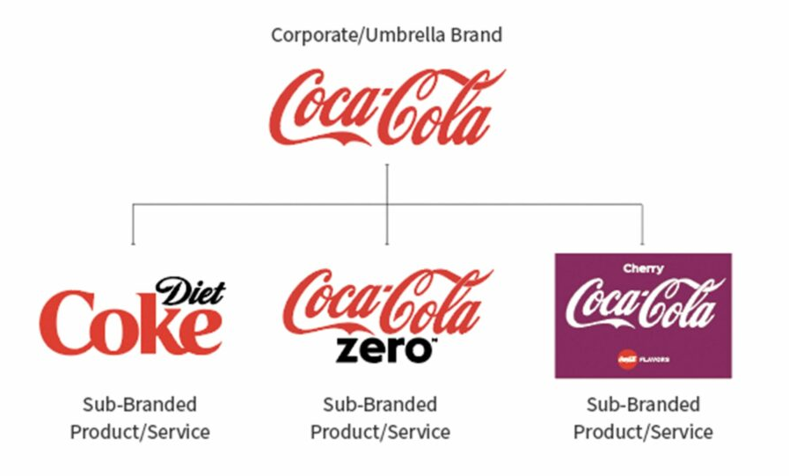

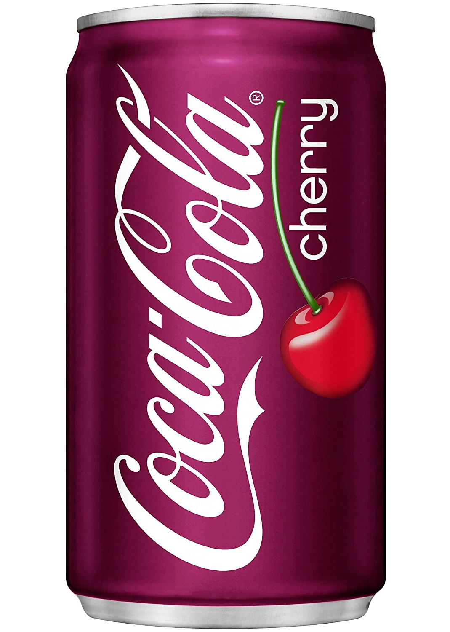
Brand Hierarchy
Each brand is identified at four levels. Analysis is conducted at the extension level.
Brand Owner
Coca-Cola Corporation
Brand Family
Brand Extension
UPC
Coca-Cola
Cherry Coke
12 oz can
Analysis
level

Slide 26
Why Case Sales?
Case sales standardize packaging units, making product movement comparable across formats.
Unit Sales
Case Sales
1 case of 2L bottles = 6 units
1 case of 2L bottles = 1 case
1 case of 12oz cans = 24 units
1 case of 12oz cans = 1 case
Not comparable across formats:
Different container sizes → unit counts are misleading
Comparable across formats: Both represent a standard package sold
Case sales are a standardized packaging metric.
Dollar sales are also available but are more sensitive to price promotions. Both are informative. Divergence suggests pricing/promotional effects.

Slide 27
Market and Category Context
Market-level trends and example category trends. Category context is planned as the next framework feature.

Slide 28
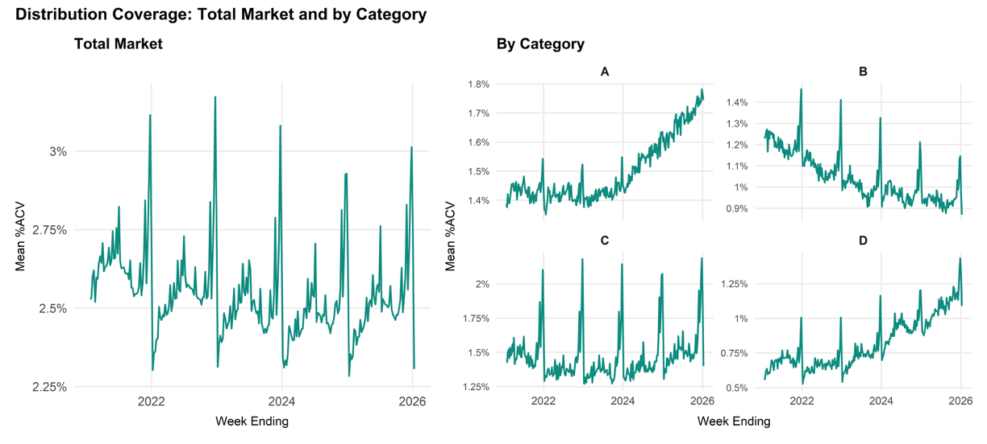
Market and Category Context
Market-level trends and example category trends. Category context is planned as the next framework feature.

Slide 29
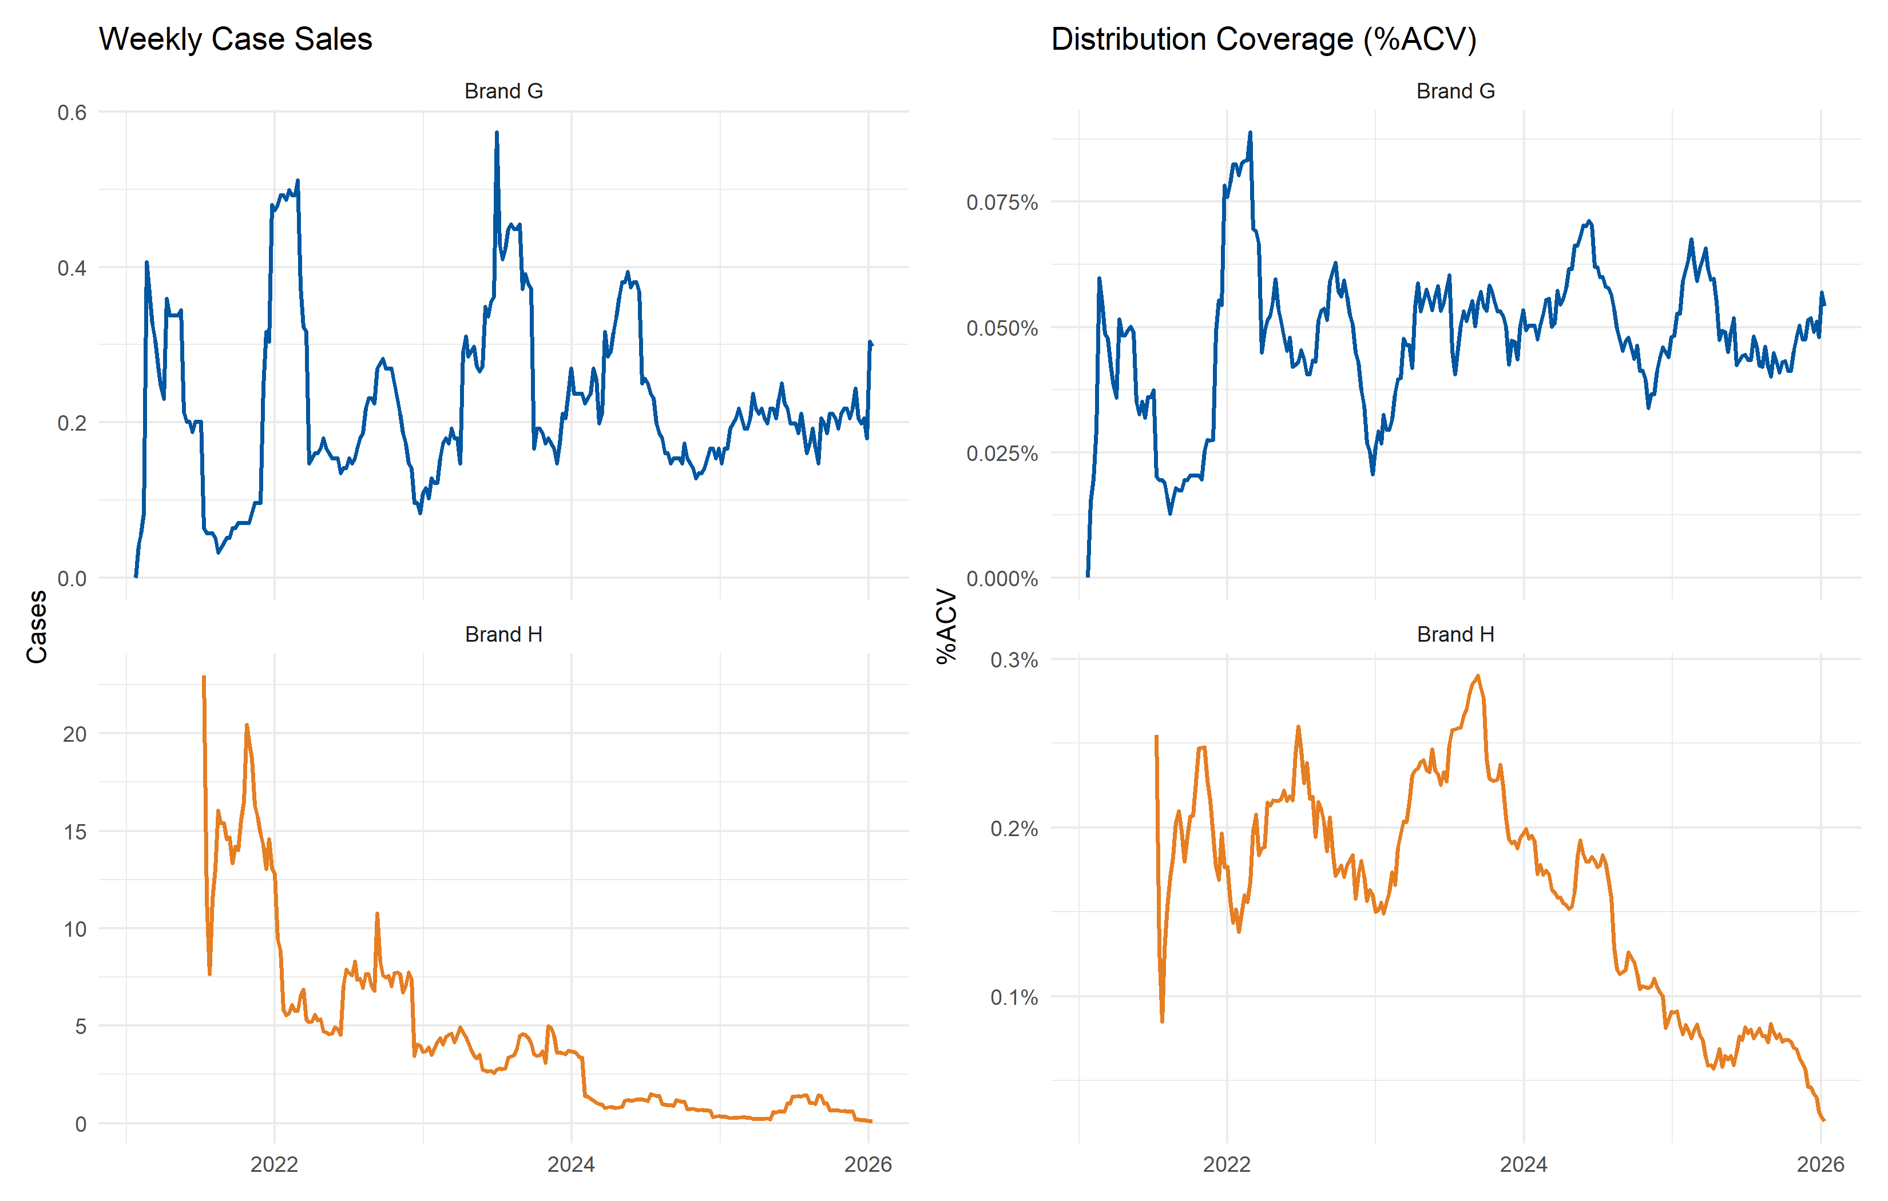
What’s Going on with Brand G & H?

Slide 30
Validation: Stakeholder Truth Set
18 stakeholder families (10 bankrupt, 8 acquired). Features computed 6 months prior to event date.
Family
Outcome
MCDA Score
Logistic
Ordinal
Brand A
Acquired
0.300
Viable
Growing
Brand B
Acquired
0.270
Viable
Growing
Brand C
Acquired
0.203
Viable
Stable
Brand D
Acquired
0.190
Viable
Stable
Brand E
Acquired
0.190
Viable
Stable
Brand F
Bankrupt
0.190
Viable
Stable
Brand G
Bankrupt
0.189
Viable
Stable
Brand H
Bankrupt
0.187
Viable
Stable
Brand I
Bankrupt
0.183
Viable
Stable
Brand J
Acquired
0.172
Low Performance
Decline
Brand K
Bankrupt
0.170
Viable
Stable
Brand L
Acquired
0.158
Viable
Stable
Brand M
Bankrupt
0.141
Low Performance
Decline
Brand N
Bankrupt
0.137
Low Performance
Discontinued
Brand O
Bankrupt
0.135
Low Performance
Decline
Brand P
Acquired
0.133
Low Performance
Decline
Brand Q
Bankrupt
0.130
Low Performance
Decline
Brand R
Bankrupt
0.108
Low Performance
Discontinued

