Slide 1


IXDS710_Winter2026_Final
Prof. Priya Rajasagi
Smart Research
Figma Link
Present by Zhaolin Hu

Slide 2
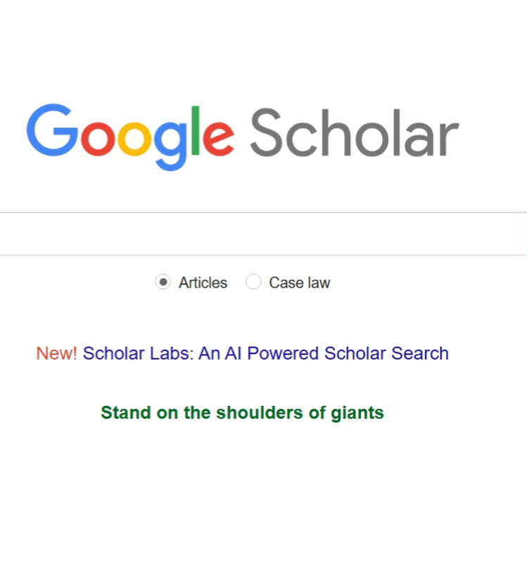
IXDS710_Winter2026_Final
Problem
students and early-stage researchers struggle to quickly and confidently judge whether a search result is relevant to their research goal after running an academic search.

Slide 3

IXDS710_Winter2026_Final
Persona
Name: Mellisa
Age: 21
Role: Interdisciplinary undergraduate student
Focus: Interaction Design + Public Health/Psychology
Device: Laptop
Skill level: Moderate
Mellisa is writing a course research paper on how smartphone use affects sleep and whether a digital intervention could help. She needs papers from both HCI/design and health/psychology, but the fields use different terms and evidence standards.

Slide 4
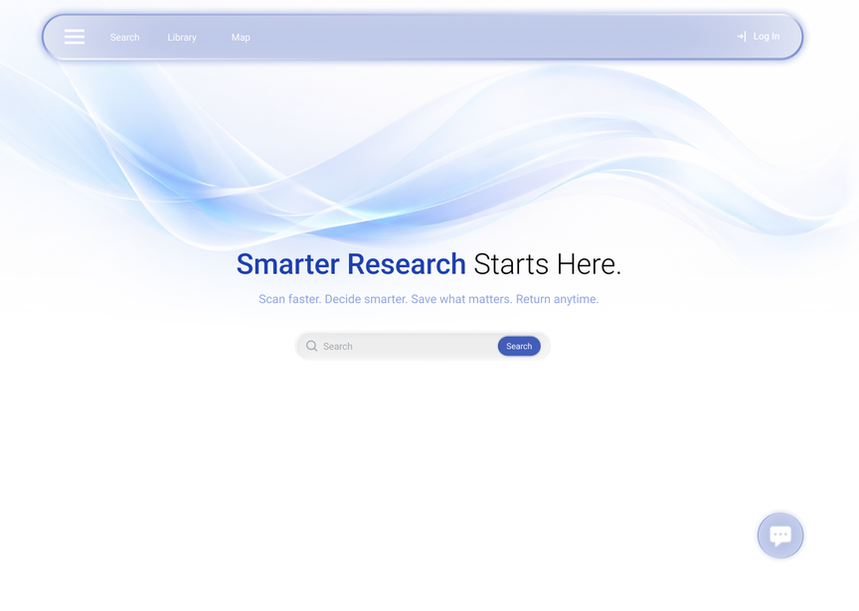
IXDS710_Winter2026_Final
Solution
Search
Tags
Bring AI to help user research, also turn dense papers into scannable, structured cards so users can assess relevance faster without opening multiple PDFs.
Let users tag and group saved papers into lightweight collections, making key sources easy to recall and reuse later.
3 main features
Map
Visualize the user’s research path by linking queries, saved papers, and “related articles,” so they can backtrack, resume, and see connections across their exploration.

Slide 5

IXDS710_Winter2026_Final
Search
Auto complete
Forecast user intention research result. Simplify the research flow

Slide 6
IXDS710_Winter2026_Final
Search
Cards
Turn dense papers into scannable, structured cards that reduce browsing effort.

Slide 7
IXDS710_Winter2026_Final
Search
Quick View
Provide a slide-out side panel that lets users access content without leaving the current page, reducing unnecessary clicks.

Slide 8
IXDS710_Winter2026_Final
Search
Open PDF
Enable users to open the chosen PDF after quickly filtering and scanning papers.

Slide 9
IXDS710_Winter2026_Final
Search
Filter

Slide 10
IXDS710_Winter2026_Final
Tags
The tagging system helps users categorize papers based on their own research logic rather than relying only on predefined filters. By attaching tags to papers during exploration, users can quickly group related content and revisit it later. This reduces repeated searching and supports a more personalized and flexible research workflow.

Slide 11
IXDS710_Winter2026_Final
Map
The research map turns the search process into a visual exploration path, allowing users to see connections between queries, papers, and related articles while easily backtracking or resuming their research.

Slide 12
IXDS710_Winter2026_Final
User Flow

Slide 13
Rimberio
June 13, 2038
AI Feature Integration
In my project, the AI works as a research assistant chatbot that helps users discover high quality academic papers that are both free to access and widely recognized. Instead of only returning standard search results, the AI focuses on recommending papers that are available as free PDFs and are considered popular or highly valued within the research community. The goal is to save users time and reduce frustration caused by paywalls or low-relevance results.

Slide 14
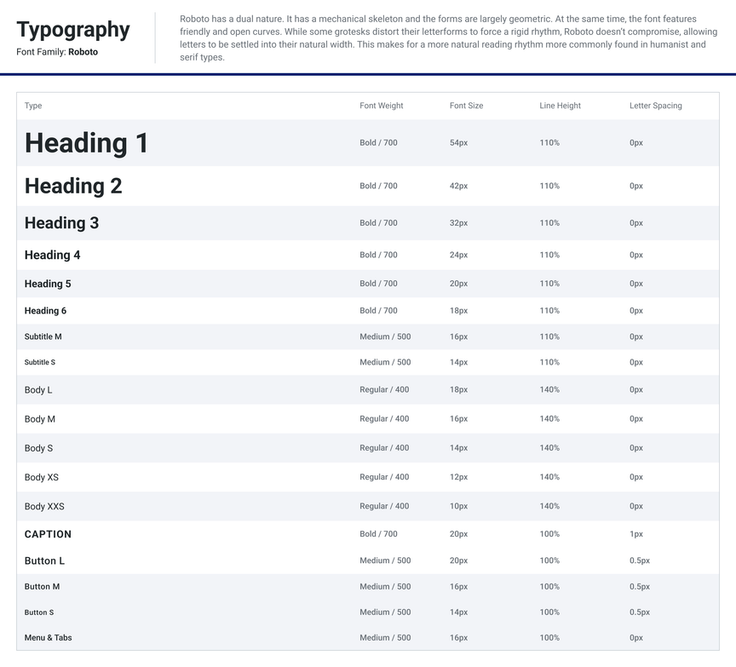
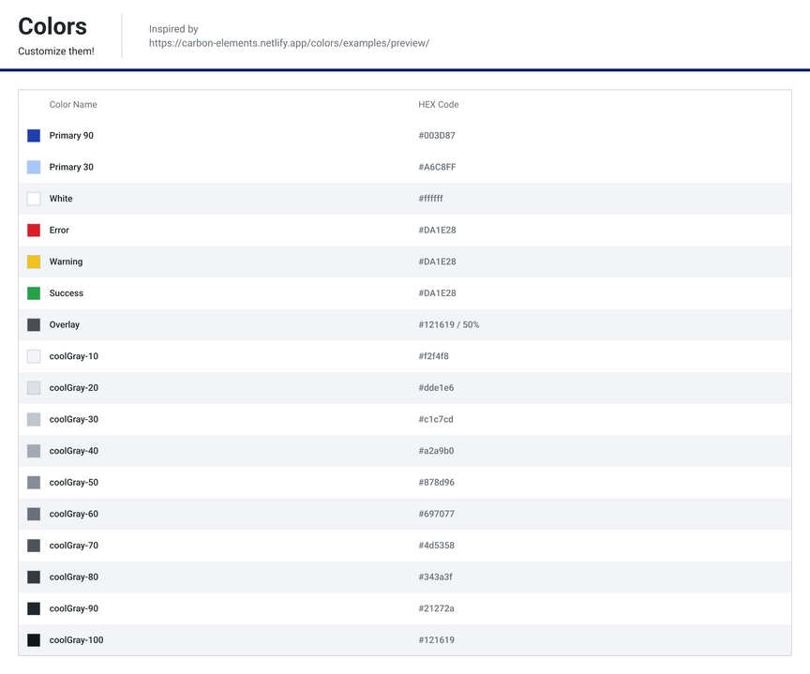
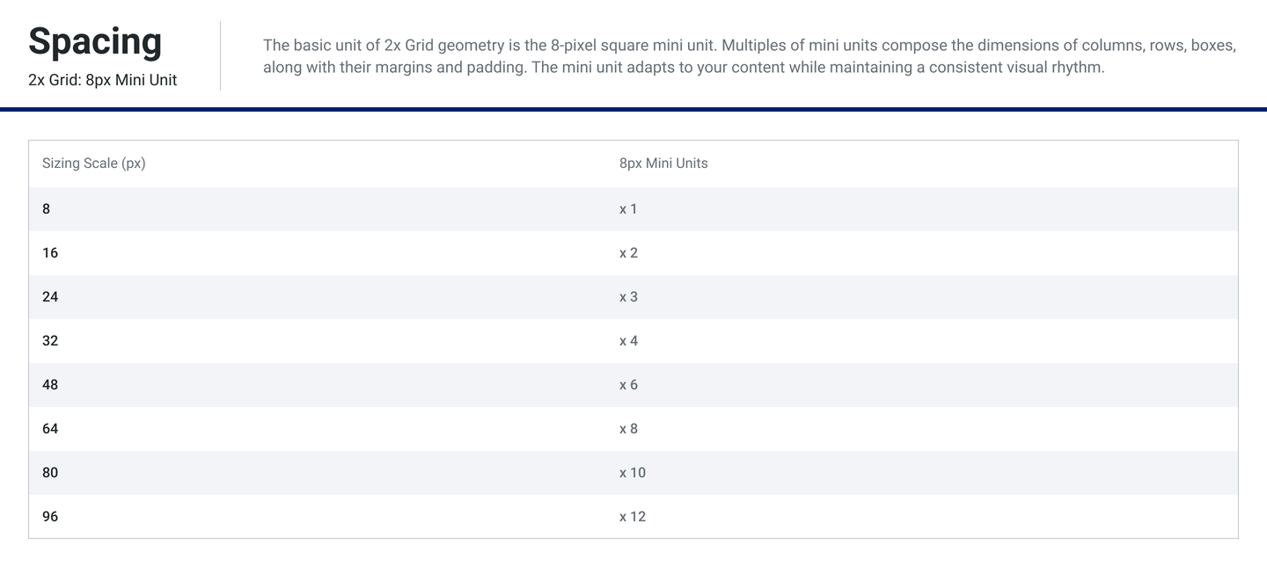
IXDS710_Winter2026_Final
Design System v3
Design Tokens
To keep the product consistent and scalable, I built a design system with Material 3–inspired tokens for typography, spacing, and color. The system focuses on readability and low distraction because this is an information-dense research tool. The core reusable components are the search input, paper result cards, and the Quick View drawer with consistent states like loading, success, low confidence, and missing data.

Slide 15
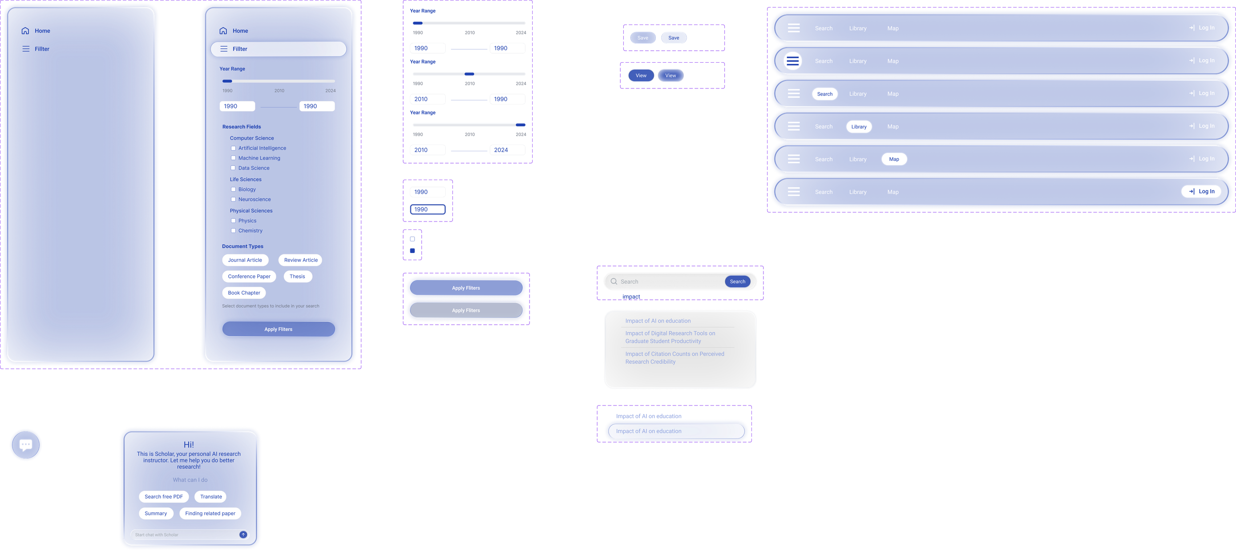
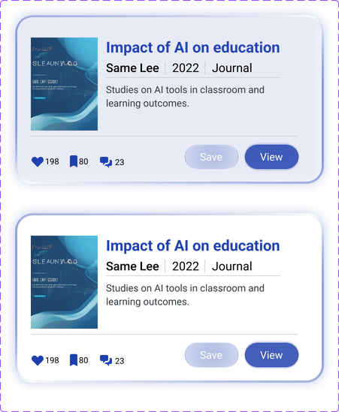
IXDS710_Winter2026_Final
Design System v3
reusable UI components

Slide 16
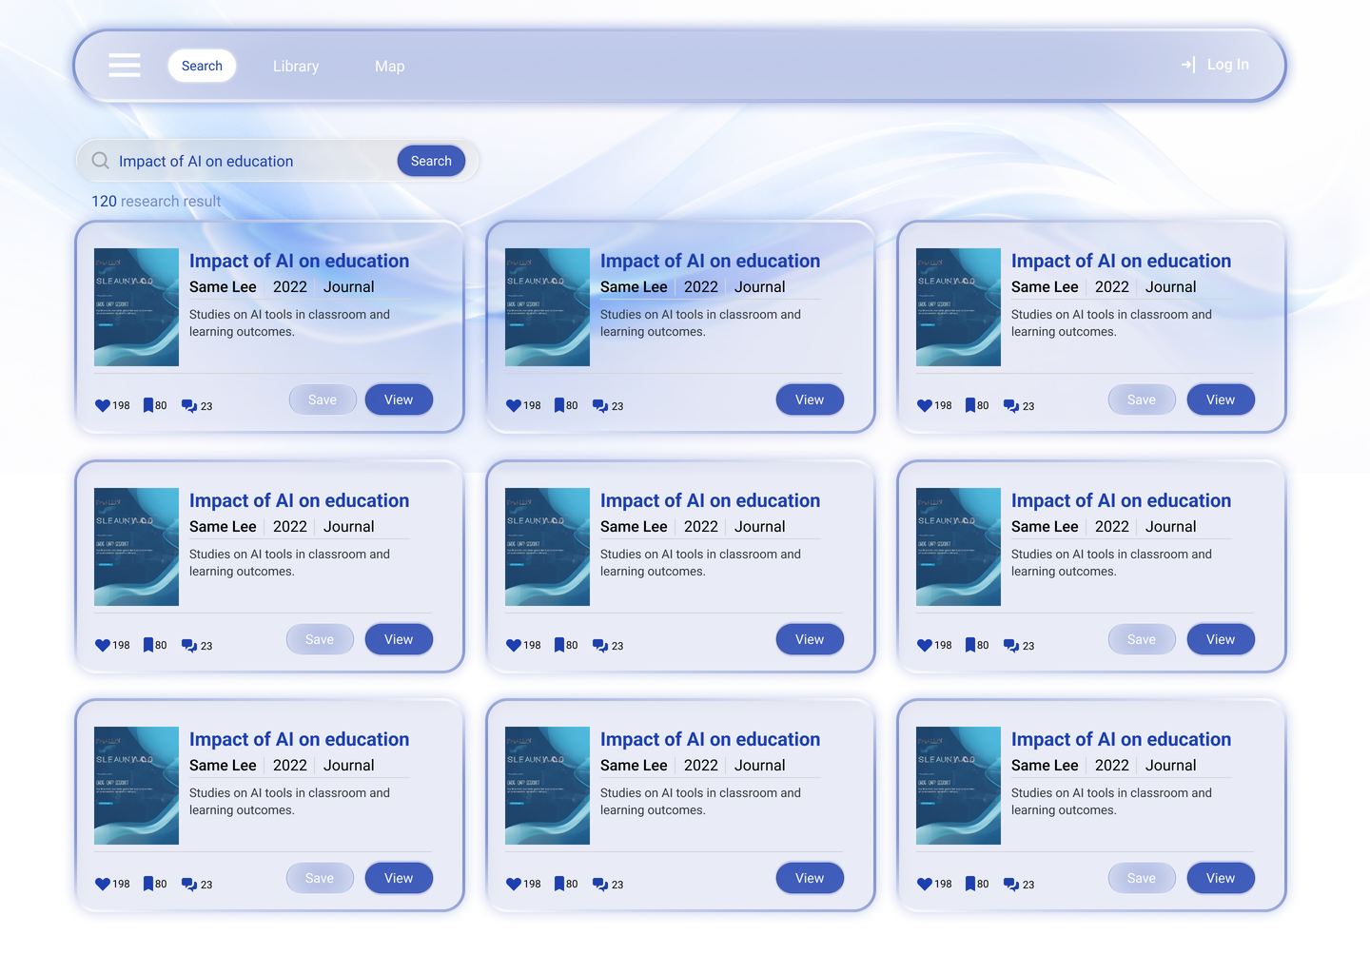
IXDS710_Winter2026_Final
Usability testing insights
User number
2
Structured research cards help experienced users scan papers quickly, but less experienced users still rely heavily on titles and abstracts.

Slide 17
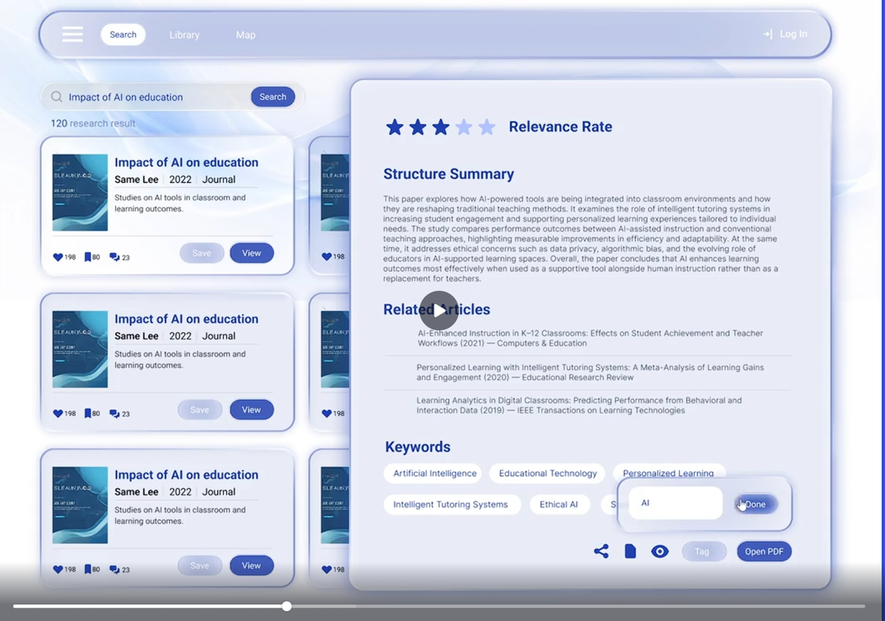
IXDS710_Winter2026_Final
Usability testing insights
User number
2
The structured summary effectively reduces reading time, but some users may still want slightly more context about the paper’s contribution.

Slide 18
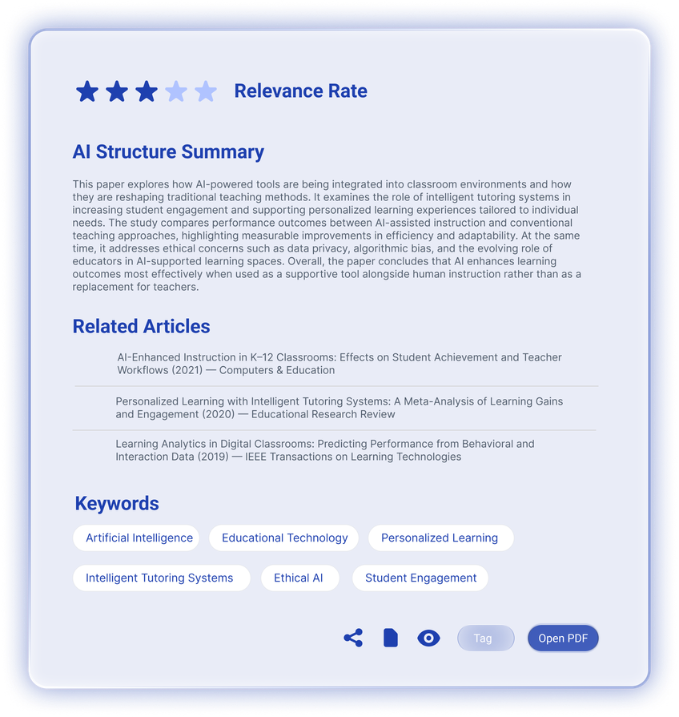
IXDS710_Winter2026_Final
Improvements
Making refinement more discoverable

Slide 19
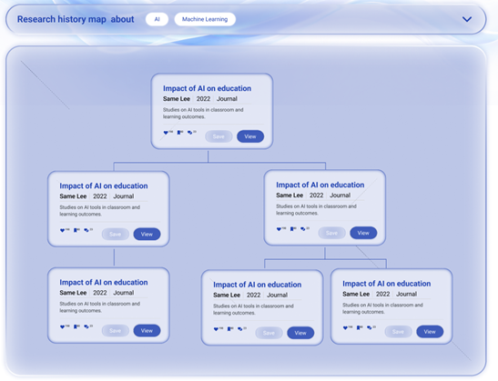
IXDS710_Winter2026_Final
Improvements
Clearer Research Map Explanation

Slide 20
IXDS710_Winter2026_Final
Thank You
Present by Zhaolin Hu

