Slide 1
ALIGNING INCENTIVES
IN THE NBA DRAFT
A Multi-Agent Mechanism Design Study
"Every NBA draft reform since 1985 has failed
to stop teams from losing on purpose"
Grant Valentine · Kartik Dhinakaran · Mechanism Design · May 2026

Slide 2
NBA background, draft system background, introduce the incentives

Slide 3
ACT I · THE PROBLEM
This isn't a calibration problem — it's mathematically unavoidable under any standings-based system
What the NBA tried | What happened
Equal odds lottery (1985) | Conspiracy theories; Patrick Ewing to New York
Weighted odds (1990) | Tanking spiked to 2.2× the expected loss rate
Flattened top-3 odds (2019) | Race to the bottom became a race to 4th–7th
Banchio & Munro (2020) — Theorem 1: Any non-flat, standings-based allocation will give some team an incentive to tank.
This is provable. Not a calibration problem. Not a PR problem. Any standings-based system fails by design.
3 / 15

Slide 4
Add table of these to appendix
ACT I · THE PROBLEM
Five proposals claim to fix this but none have been tested against adaptive, strategic agents
← Status quo
Most radical →
NBA
2019
NBA
3-2-1
Weighted
Loss
Bilevel
COLA
Current system
Flatter odds
Reward close losses
Breakpoint date
Multi-year guarantee
Our contribution: prior work uses fixed-rule agents. We use adaptive ones — mechanisms must survive agents who learn and respond to incentives in real time.
4 / 15

Slide 5
ACT II · OUR APPROACH
We built a simulation where 30 AI-powered teams develop strategy endogenously with no hardcoded rules
30 Teams
Agent
Effort
Decision
Game
Outcome
Draft &
Update
NBA skill distribution
Rational or LLM
Tank or compete?
Win probability model
Lottery → next season
↺ Repeat for 50 simulated seasons · Seed fixed for reproducibility
Rational Agent
LLM Agent (Claude Haiku)
Maximizes expected utility analytically at each checkpoint. Computes E[D(k)] for each effort level and selects the dominant best response given opponent strategies.
Receives game state + payoff structure in natural language. Returns effort level plus chain-of-thought reasoning. No hardcoded strategy — behavior emerges from incentives.
More demanding than prior work because mechanisms must survive agents who learn and adapt in real time
5 / 15

Slide 6
ACT II · OUR APPROACH
Teams trade off a known playoff value against lottery odds that vary by mechanism
Win Probability
Draft Pick Values D(k)
p(eᵢ | e₋ᵢ) = (eᵢ + δ) / Σⱼ (eⱼ + δ)
Pick | Value D(k)
#1 | 100
#2 | 73
#3 | 54
#5 | 31
#8 | 14
#14 | 3
eᵢ = effort of team i · δ = 0.3 (effort floor — cannot fully throw a game)
Team Utility
Uᵢ = V · 𝟙[playoff] + E[D(kᵢ)] · 𝟙[lottery]
V = playoff value (baseline V = 50) · D(k) = draft pick value for pick k
Explain exactly what playoff and draft value are
Playoff appearance value = 50 (baseline)
6 / 15

Slide 7
Slide on the model - How are things initialized
How do things progress through season and season to season

Slide 8
ACT II · OUR APPROACH
Seven conditions isolate the effect of each mechanism against rational agents, with an honest baseline throughout
Cond. | Agent + Mechanism | Purpose
A | Rational agents, no lottery mechanism (full competition) | Baseline — pure effort equilibrium
B | Honest agents, NBA 2019 lottery | Honest benchmark
C | Rational agents, NBA 2019 lottery | Status quo with strategic teams ← key comparison
D | Rational agents, NBA 3-2-1 mechanism | Reform candidate 1
E | Rational agents, Weighted Loss mechanism | Reform candidate 2
F | Rational agents, Bilevel mechanism | Reform candidate 3 ★ recommended
G | Rational agents, COLA mechanism | Reform candidate 4
Blue = reform mechanisms · Amber = status quo strategic baseline · 50 seasons per condition
7 / 15

Slide 9
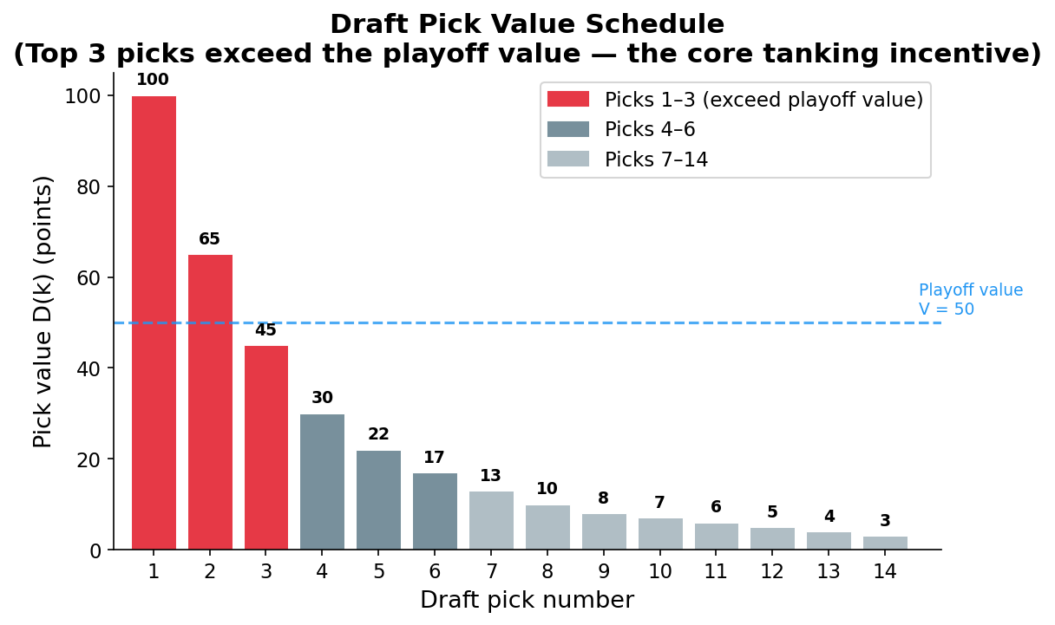
ACT I · THE PROBLEM
The NBA's reverse-order draft was designed to help weak teams — but it punishes winning
Chart of the the relationship between draft and playoff value
Lottery value
← Kink
Playoff value
"The Rockets deliberately lost in 1983 to draft Hakeem Olajuwon. Forty years later, teams are still doing it."
Expected
Value
Add callout boxes
← Tank zone
Team Rank (Worst → Best)
2 / 15

Slide 10
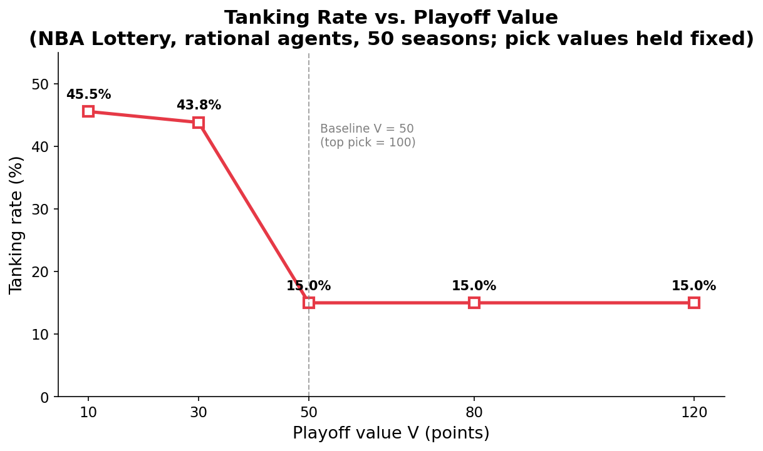
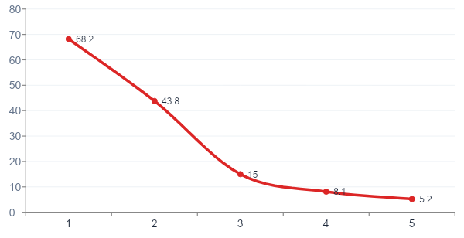
ACT III · RESULTS
Tanking spikes when playoff value falls below ~50 — teams near the bubble defect to the lottery
Sharp drop between V=30 (43.8%) and V=50 (15.0%). When playoff value is low, even bubble teams prefer the lottery over competing.
Above V=50, only clearly out-of-contention teams tank. Below it, bubble teams defect too — compounding the problem.
11 / 15

Slide 11
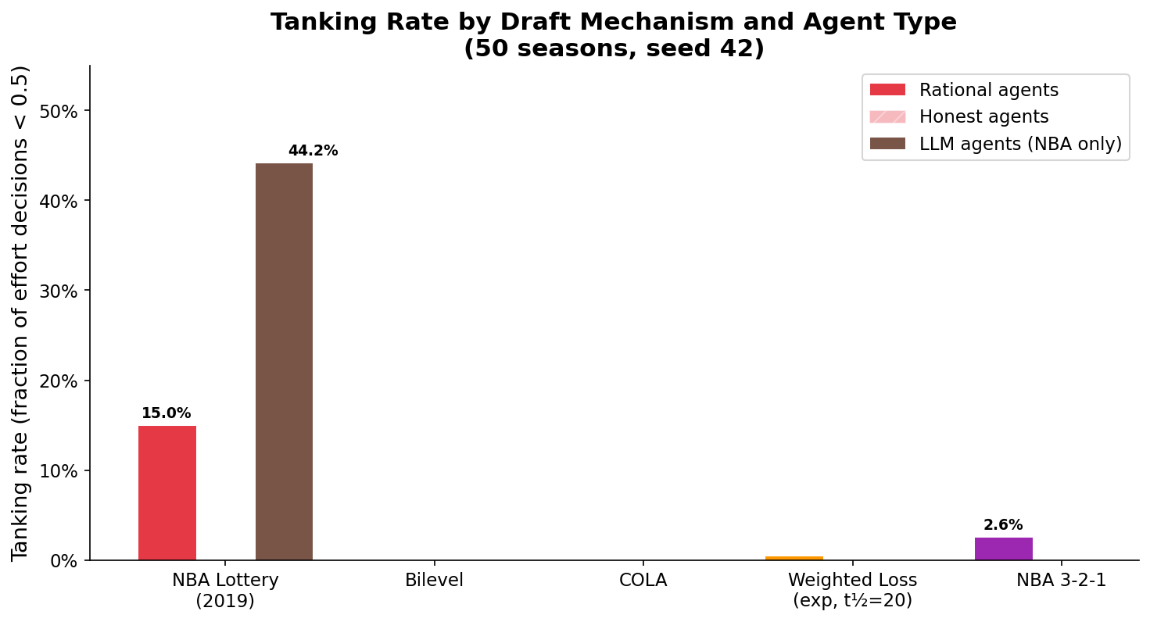
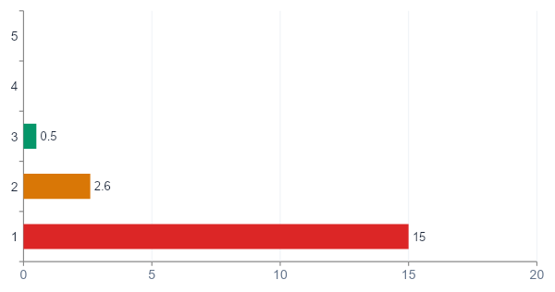
ACT III · RESULTS
The current NBA lottery produces 15% tanking — three reforms near-eliminate it
Bilevel and COLA eliminate tanking entirely against adaptive rational agents (0.0%)
NBA 2019 status quo: 15% of all game decisions are deliberate losses. This is the benchmark to beat.
NBA 3-2-1 reduces tanking to 2.6% — meaningful improvement but tanking still present at equilibrium.
8 / 15

Slide 12
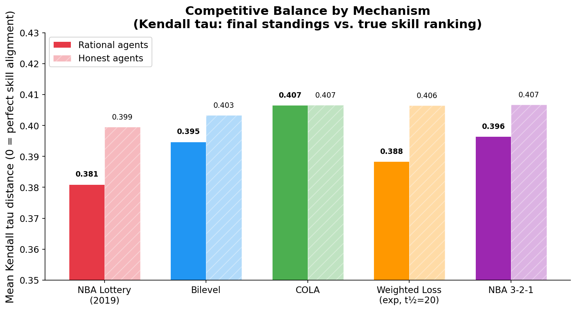
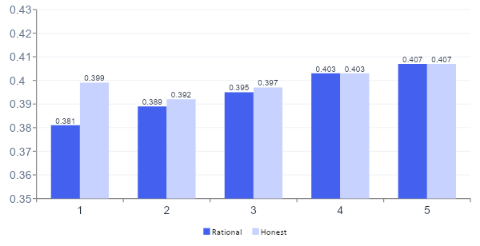
ACT III · RESULTS
Tanking under the NBA lottery actually improves competitive balance — the mechanism is working as designed
NBA 2019 rational (0.381) is LOWER than honest (0.399). Lower Kendall-τ = better balance. Tanking sends picks to genuinely weak franchises.
COLA: rational = honest (0.407). Mechanism fully decoupled from effort — identical outcomes regardless of strategy.
Kendall-τ distance (lower = better competitive balance — records align with true team strength)
9 / 15

Slide 13
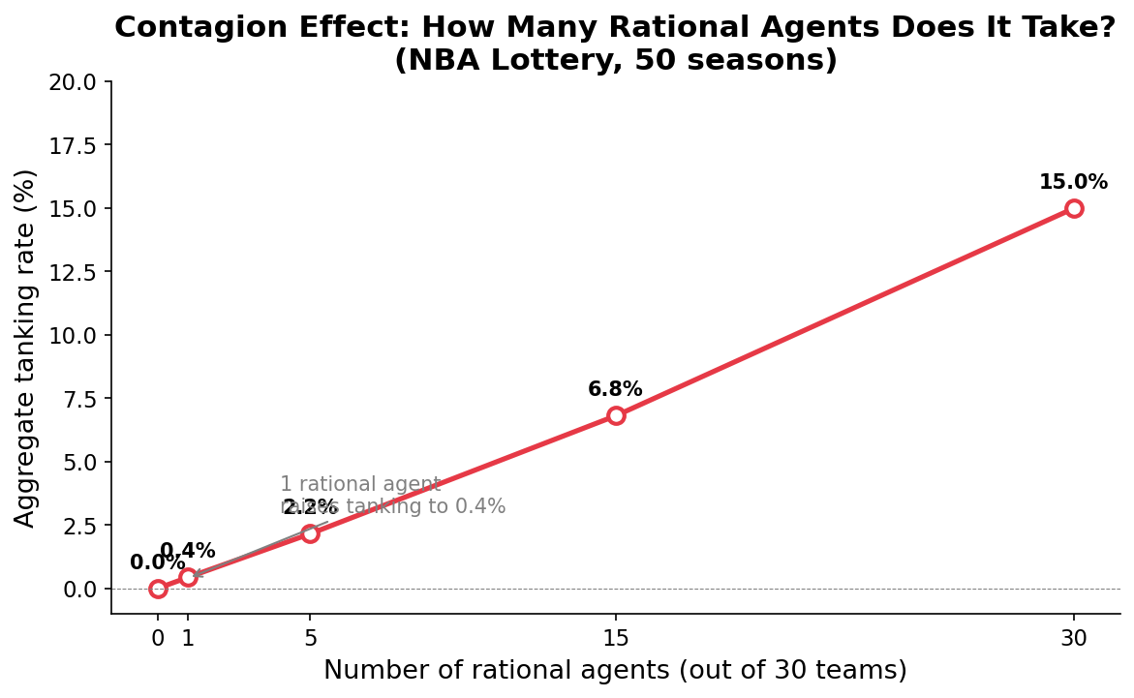
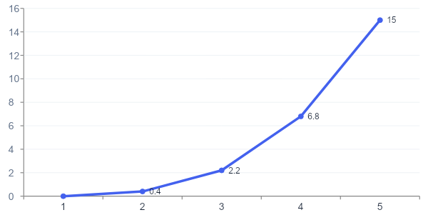
ACT III · RESULTS
One rational agent raises aggregate tanking from 0% to 0.4% — and the effect scales linearly
1 rational agent in an otherwise honest 30-team league still causes measurable tanking (0.4%). The honest equilibrium is not self-enforcing.
Any team willing to optimize against the incentive structure extracts value at the expense of its competitors.
10 / 15

Slide 14
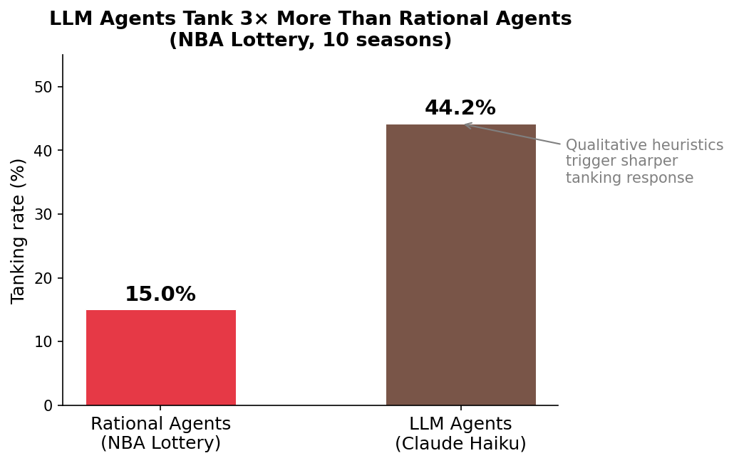
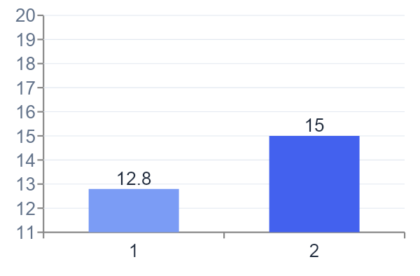
ACT III · RESULTS
Claude Haiku spontaneously tanks under the NBA lottery — without being told to
Sample LLM Reasoning (Tanking Decision)
Tanking Rate: LLM vs. Rational
"At 14–18 we’re firmly out of playoff contention with 50 games left; minimizing effort maximizes losing to secure top-3 lottery odds. that competing at full effort only marginally improves our playoff odds. Given pick #1 is worth 100 versus a playoff appearance worth 50, the expected value of reducing effort to the floor (δ = 0.3) exceeds full effort by approximately 12 utility units.
The optimal strategy is to reduce effort and maximize lottery position."
Strategic tanking emerges from pure incentive reasoning — not hardcoded rules. LLM and rational agents converge on the same behavior.
12 / 15

Slide 15
ACT IV · SO WHAT?
No single mechanism dominates, the right choice depends on what the NBA values most
Mechanism
Tanking
Eliminated
Draft
Efficiency
Implementation
Simplicity
Transparency
NBA 2019 (status quo)
Bilevel ★
COLA
Weighted Loss
NBA 3-2-1
Strong / Eliminates
Partial / Mixed
Weak / Fails
13 / 15

Slide 16
ACT IV · SO WHAT?
The bilevel mechanism offers the best combination of tanking elimination, draft efficiency, and practical feasibility
Recommendation: Adopt the bilevel mechanism
Tanking Eliminated
Draft Efficiency
Practical Feasibility
0.0% tanking rate against adaptive rational agents — the only mechanism that fully survives strategic optimization.
Best pick quality for the weakest skill quartile: avg pick 6.99 vs. 7.58 under the current NBA system (+8% improvement).
Requires only a publicly announced breakpoint date. No multi-year CBA renegotiation or new infrastructure required.
Honest caveat: COLA provides a stronger theoretical incentive-compatibility guarantee — but requires multi-year adoption the NBA has historically resisted.
14 / 15

Slide 17
ACT IV · SO WHAT?
Mechanism design can fix tanking — but the Banchio impossibility means there is a tradeoff between information completeness and tanking
Explain that the theorem shows nobody can have a tanking free draft while running the whole season.
Conclusion and follow up questions
What We Found
What It Means
Open Questions
— Tanking drops from 15% → 0% under bilevel and COLA against adaptive agents
— Reform is achievable — even against agents who learn and adapt
— Does this hold in generational draft years with outlier talent?
— Tau paradox: strategic tanking actually improves competitive balance
— Redistribution and competitive incentives can be aligned simultaneously
— What is the socially optimal tanking level, if not zero?
— Just 1 rational agent is sufficient to start the cascade
— Self-enforcement requires structural change, not just rule adjustments
— Can LLM agents model team social dynamics and front-office politics?
Grant Valentine · Kartik Dhinakaran · Mechanism Design · May 2026
15 / 15

