Slide 1
Aligning Incentives in the NBA Draft
A Multi-Agent Simulation of Mechanism Design
Grant Valentine & Kartik Dhinakaran
Topics in Algorithmic Game Theory | May 2026
30
82
50
5
Teams
Games
Seasons
Mechanisms

Slide 2
SECTION 1
What Is Tanking?
The incentive problem and its history

Slide 3
What Is Tanking?
The Incentive
The Expected-Utility Tradeoff
▸ Tanking = deliberately losing games to improve future draft position
▸ NBA Draft Lottery: worse record → more ping-pong balls → better odds
▸ A team faces a binary season: compete for playoffs, or lose for picks
– When playoff odds fall below a threshold, tanking becomes individually rational
▸ Not a moral failing — a structural game-theory problem
𝔼[U] = p_playoff · V + (1 − p_playoff) · 𝔼[D(k)]
▸ V = value of a playoff berth (revenue, prestige, competitive stature)
▸ D(k) = value of draft pick #k (k=1 → $100 pts, falls to 3 pts at k=14)
▸ Tanking is rational when:
– ΔE[D(k)] from extra losses > V · Δp_playoff lost
▸ This tradeoff exists for SOME team under ANY weighted lottery (Banchio & Munro 2020)

Slide 4
A Brief History of Tanking
The incentive has been present since the first draft lottery
1983
Houston Rockets
Deliberately underperform late-season to secure #1 pick (Ralph Sampson). NBA notices.
1985
NBA introduces the lottery
Equal odds for all non-playoff teams. Conspiracy: 'frozen envelope' lets Knicks land Patrick Ewing.
1990
Weighted lottery introduced
Worst team gets 16.7% odds. Taylor & Trogdon (2002): eliminated teams lose 2.2× more than expected.
2013–16
Sam Hinkie's 'The Process'
76ers stockpile picks across 3 seasons. Hinkie forced out. League-wide imitation follows.
2019
NBA flattens top-3 odds to 14% each
Intended to reduce tanking. Instead: displaces incentive to picks #4–7. Tanking continues.

Slide 5
NBA Lottery Reforms: A Cycle of Displacement
Each reform reduces tanking in one place and creates it somewhere else
1985 Equal odds
1990 Weighted odds
1994 More weighting
2019 Flattened top
2026 3-2-1 proposal
All 7 non-playoff teams have identical odds. Eliminates race-to-bottom, creates race to non-playoffs.
Worst team: 16.7% at #1 pick. Reintroduces tanking incentive, now concentrated at absolute bottom.
Worst team: 25% at #1 pick. Tanking value even higher for the very worst team.
Top-3 teams each get 14% at #1 pick. Displaces incentive to positions 4–7. Tanking persists.
Bottom 3 get fewer balls than teams ranked 4–14. Our research tests whether this inverts the incentive.

Slide 6
Why Reforms Keep Failing: The Banchio Impossibility
Banchio & Munro (2020), Theorem 1
Theorem 1 (Banchio & Munro 2020)
Any draft mechanism that (a) allocates picks based solely on end-of-season standings and (b) does not treat all non-playoff teams identically, will give some team an incentive to lose in some possible season history.
▸ Proof by contradiction:
– If mechanism favors worse records and isn't flat, ∃ a rank where one more loss improves lottery odds by more than it costs in playoff probability
– No parameter choice fixes this — it is structural, not parametric
▸ Implication:
– No tweak to the current odds table can eliminate tanking
– The only escape routes: (1) lock in standings mid-season, or (2) equal odds (destroys redistribution), or (3) break the standings → lottery link entirely

Slide 7
SECTION 2
The Formal Model & Proposals
Five mechanisms + the math behind agent decisions

Slide 8
Formal Model: League Setup
▸ Teams & Skills
– n = 30 teams, each with true skill αᵢ ~ LogNormal(0, 0.3)
– Skills evolve: mean reversion + draft pick quality boost
▸ Season Structure
– G = 82 games per team (balanced round-robin schedule)
– Top P = 16 teams by wins → playoffs
– Bottom L = 14 teams → draft lottery
▸ Win Probability (Bradley–Terry with effort floor)
– P(A beats B) = (αA · effA) / (αA · effA + αB · effB)
– eff = 0.3 + 0.7 · e → even at e = 0, team plays at 30% strength
– Floor δ = 0.3: teams cannot perfectly throw a game
▸ Agent Decisions
– Effort e ∈ {0, 0.25, 0.5, 0.75, 1.0} (discrete grid)
– Decision at 8 checkpoints per season (every 10 games)
– e < 0.5 = tanking decision
▸ Utility Function
– U = V if team makes playoffs
– U = E[D(k)] otherwise (expected pick value from lottery)
▸ Payoff Calibration
– V = 200 (playoff >> any single lottery pick)
– D(1)=100, D(2)=65, D(3)=45, ... D(14)=3 pts
– Calibration: consistent with u(playoffs) >> u(picks) (Kazachkov 2020)

Slide 9
When Is Tanking Individually Rational?
Expected utility comparison (at a checkpoint):
𝔼[U | compete] = p_playoff(e=1) · V + (1−p_playoff(e=1)) · 𝔼[D(k) | rank_compete] 𝔼[U | tank] = p_playoff(e=0) · V + (1−p_playoff(e=0)) · 𝔼[D(k) | rank_tank]
▸ Rational agent tanks when:
– The playoff probability with e=1 is negligibly small (team is out of contention)
– AND the lottery rank improvement from e=0 meaningfully raises E[D(k)]
– This is NOT a binary threshold — we compute the normal-approximation p_playoff continuously
▸ Key calibration insight:
– With V = 200: E[D(k)] across all lottery slots averages ~24 pts
– Even pick #1 (100 pts at 14% odds) has expected value ≈ 14 pts < < 200
– Tanking is only rational when p_playoff is truly negligible (< ~5%)
▸ Concentration of tanking decisions (our simulation):
– 76% of tanking decisions: team ranked 21st or worse (deep lottery)
– 16% of tanking decisions: team ranked 13–20 (near bubble but behind)
– Teams in playoff position essentially never tank

Slide 10
Five Mechanisms Under Study
Mechanism
Lottery Basis
How It Addresses Tanking
Theoretical Guarantee
NBA Lottery (2019) [baseline]
End-of-season standings, flattened top-3 at 14%
Doesn't — deliberately loses to improve lottery rank is rational
None (Banchio theorem applies)
Bilevel (Kazachkov 2020)
Standings at game 70 (~85% through season)
Locks draft position before tanking becomes rational
No post-lock-point incentive; residual pre-lock tanking
COLA (Highley et al. 2026)
Multi-season accumulated tickets (equal/season)
Removes within-season link between record and lottery odds
Near-full IC: within-season effort does not affect lottery odds
Weighted Loss (this paper)
Cumulative loss score; early losses worth more
Decaying reward for tanking; no hard cutoff to game
Continuous suppression; no strategic discontinuity
NBA 3-2-1 (proposed 2026)
Tier A (worst 3): 2 balls; Tier B (4–14): 3 balls
Inverts incentive: being in bottom 3 is now WORSE
Reduces, does not eliminate; Tier A guaranteed ≤ pick #12

Slide 11
Bilevel Ranking (Kazachkov & Vardi 2020)
Lock in draft positions before tanking becomes individually rational
▸ How it works:
– Standings are observed at a preset mid-season breakpoint
– Our calibration: game 70 of 82 (≈ 85% through the season)
– Draft lottery order for non-playoff teams = standings at the lock point
– Post-lock games count for playoff seeding only — not draft order
▸ Why it works:
– No team can improve its lottery position after game 70
– Rational agents never tank post-lock: no benefit
– Residual tanking (3.0%) = rational pre-lock positioning
▸ Key result (Kazachkov):
– 57–72% reduction in tanked games vs. NBA lottery
– Can also IMPROVE competitive balance:
– Late-season tanking distorts standings → bilevel corrects this
▸ Tradeoffs & Critiques:
– Breakpoint must be chosen in advance — no principled formula
– Pre-breakpoint tanking incentives remain (teams can game the lock point)
– Teams whose position is locked may rest healthy players (no incentive to compete)
– Fan engagement: confusing when draft order 'freezes' mid-season
▸ In our simulation:
– Tanking rate: 3.0% (vs. 6.9% for NBA lottery)
– Tau distance: 0.398 (honest: 0.403)
– Draft efficiency (weakest quartile): 6.85
– Pre-lock tanking observed: rational agents see value in early-season positioning before the lock point

Slide 12
COLA: Carry-Over Lottery Allocation (Highley et al. 2026)
Full incentive compatibility by breaking the standings → lottery link
▸ How it works:
– Every non-playoff team receives the same fixed number of tickets each season
– Record does not matter for ticket allocation within a season
– Tickets accumulate across seasons; playoff success / draft wins reduce stockpile
– Lottery draw from cumulative ticket pool
▸ Why it works:
– Within any season: effort has no effect on lottery odds
– Rational agent has no incentive to tank
– Long-run: chronically weak teams accumulate tickets → better picks over time
▸ Incentive-compatibility proof:
– Diet COLA variant: formally proved IC under assumption that
– making playoffs is always preferred to lottery access
– Classic COLA: simulated IC, not formally proved
▸ Tradeoffs & Critiques:
– Multi-season ticket carryover requires complex accounting
– Transition from current system: how to initialize stockpiles fairly?
– IC proof depends on all teams always preferring playoffs
– 'Strong draft year' extension uses Bayesian Truth Serum — itself manipulable
▸ In our simulation:
– Tanking rate: 0.5% (near-zero; consistent with IC)
– Tau distance: 0.408 (honest: 0.407 — nearly identical)
– Draft efficiency (weakest quartile): 7.21
– Residual tanking: edge cases where accumulated ticket differentials
– create ambiguous ranking near the lottery threshold

Slide 13
Weighted Loss & NBA 3-2-1 (Two Anti-Tanking Designs)
Weighted Loss Mechanism
NBA 3-2-1 Proposal
▸ Lottery position = total weighted losses, not final standings
▸ Weight function: w(g) = 0.5^(g / 20) (half-life = 20 games)
▸ Early-season loss worth ~4× a late-season loss
▸ Key property:
– No hard cutoff — tanking value decays smoothly all season
– Harder for teams to strategically 'time' their tanking window
▸ Simulation results:
– Tanking rate: 2.3%
– Residual: rational agents still tank early when decay is slow
– Draft efficiency: 6.92 (solid redistributive performance)
▸ Tier A (worst 3 teams): 2 lottery balls each → 5.9% odds at #1
▸ Tier B (teams 4–14): 3 lottery balls each → 8.8% odds at #1
▸ Worst teams guaranteed no worse than pick #12
▸ Key property (inverted incentive):
– Being in the bottom 3 is now WORSE than being in positions 4–14
– Rational strategy: avoid the absolute bottom, not target it
▸ Simulation results:
– Tanking rate: 0.9% (strong reduction)
– Draft efficiency: 6.57 — BEST of all mechanisms for weakest teams
– Surprising: fewer balls for worst teams → better outcomes on average
– Fewer extreme lottery misses; value more evenly spread

Slide 14
SECTION 3
Simulation Structure
What we ran, why, and how agents make decisions

Slide 15
Experimental Conditions
7 conditions × 50 seasons each, all agents decide endogenously
Cond.
Mechanism
Agent Population
Purpose
A
Current NBA (2019)
All honest (e = 1 always)
Baseline: competitive balance under zero strategic play
B
Current NBA (2019)
1 rational + 29 honest
Does a single strategic team unravel the honest equilibrium?
C
Current NBA (2019)
All 30 rational
Equilibrium tanking level under the current system
D
Bilevel (lock: game 70)
All 30 rational
Does the bilevel guarantee hold against adaptive agents?
E
COLA
All 30 rational
Does COLA's incentive compatibility survive strategic agents?
F
Weighted Loss (exp, t½=20)
All 30 rational
Does continuous decay suppress tanking vs. hard cutoff?
G
NBA 3-2-1
All 30 rational
Does inverting Tier A odds alter the tanking equilibrium?
Additional sweeps (50 seasons each):
★
Mixed-population sweep
n_rational ∈ {0, 1, 5, 15, 30}
How does tanking scale with rational-agent share?
★
Playoff-value sweep (V)
V ∈ {50, 100, 150, 200, 300}
When do playoff incentives dominate lottery incentives?
★
LLM agents (10 seasons)
All 30 = Claude Haiku
Do LLMs spontaneously discover the tanking incentive?

Slide 16
Agent Design: Rational vs. LLM
No hard-coded strategies — behavior emerges from incentives
Rational Agent (analytical EU maximizer)
LLM Agent (Claude Haiku-4-5 via Anthropic API)
▸ At each checkpoint: evaluates EU over effort grid {0, 0.25, 0.5, 0.75, 1.0}
▸ Playoff probability: normal approximation (σ² = n·p·(1−p))
▸ Lottery EV: pre-computed Monte Carlo table (5,000 simulations per lottery structure)
▸ Picks effort with max EU; deterministic given game state
▸ Advantage: reproducible, fast, analytically grounded
▸ Advantage: can isolate mechanism effects without LLM noise
▸ Limitation: perfect rationality — not how real GMs reason
▸ Limitation: no learning across seasons (stateless Bayesian agent)
▸ Receives structured natural-language prompt at each checkpoint:
– Current record, rank, standings (top 5 / bottom 5)
– Games remaining, playoff gap, lottery tickets
– Mechanism description + full D(k) payoff schedule
▸ Returns JSON: {"effort": float, "reasoning": string}
▸ System prompt cached per agent instance (reduces API cost ~80%)
▸ No hard-coded tanking rule — behavior fully emergent
▸ Advantage: behavioral realism — reasons like a front office
▸ Advantage: spontaneous discovery of game-theoretic incentives
▸ Limitation: expensive (10 seasons of 30 teams × 8 decisions)

Slide 17
SECTION 4
Results & Findings
50 seasons × 5 mechanisms × rational + honest baselines

Slide 18
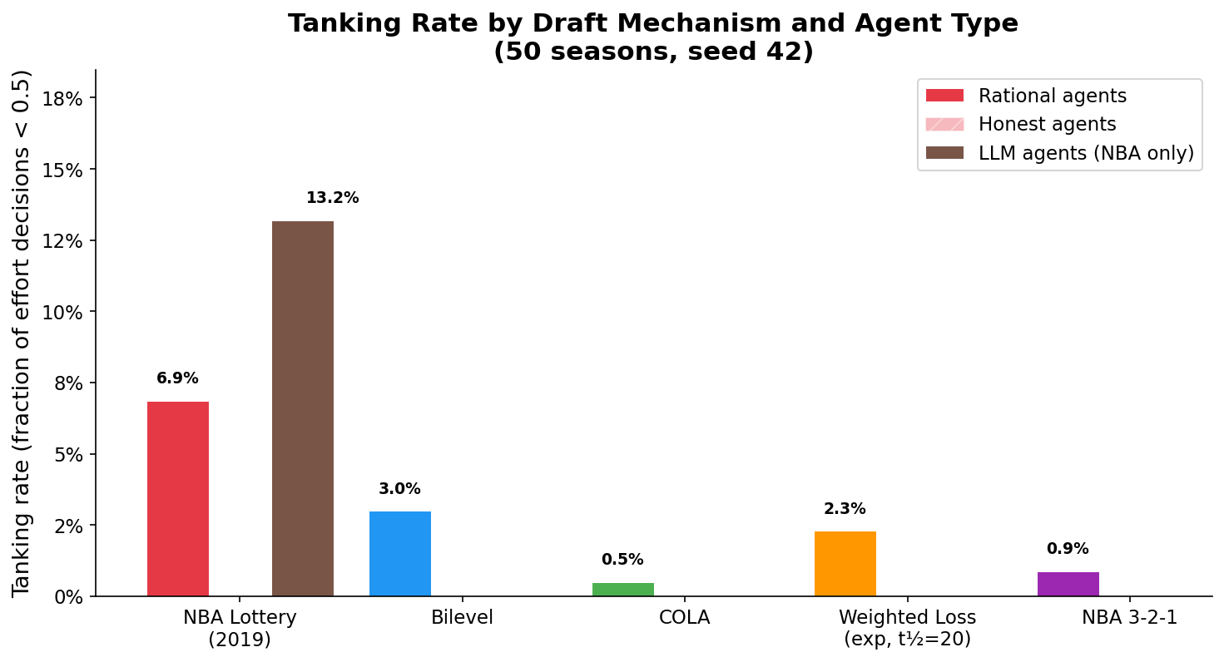
Result 1: Tanking Rate by Mechanism
All reforms reduce tanking — but by different amounts and mechanisms
▸ Key numbers (rational agents, 50 seasons):
▸ NBA 2019 baseline: 6.9% ← ceiling
▸ Bilevel (lock g=70): 3.0% ← pre-lock tanking remains
▸ Weighted loss: 2.3% ← early-season incentive
▸ NBA 3-2-1: 0.9% ← inverted incentive
▸ COLA: 0.5% ← near-zero (near-IC)
▸ Honest agents: 0.0% across all mechanisms
▸ Takeaways:
▸ All four reforms outperform status quo
▸ No single mechanism perfectly eliminates tanking
▸ COLA and 3-2-1 achieve strongest suppression
▸ Bilevel retains pre-breakpoint incentive

Slide 19
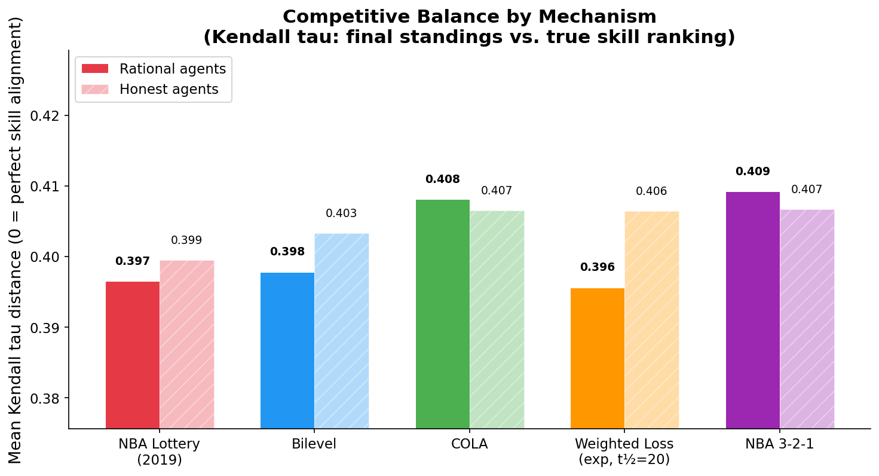
Result 2: Competitive Balance (Kendall Tau Distance)
τ = 0: standings perfectly reflect skill | τ = 1: fully reversed
▸ Tau distance (rational / honest):
▸ NBA 2019: 0.397 / 0.399 (≈ same)
▸ Bilevel: 0.398 / 0.403
▸ COLA: 0.408 / 0.407 (identical!)
▸ Wt. Loss: 0.396 / 0.406
▸ NBA 3-2-1: 0.409 / 0.407
▸ Surprising finding:
▸ With V = 200, rational agents barely change tau vs. honest
▸ Only 6.9% tanking → standings still mostly reflect skill
▸ Draft efficiency (avg pick, weakest quartile):
▸ 3-2-1: 6.57 ← best!
▸ Bilevel: 6.85
▸ Wt. Loss: 6.92
▸ COLA: 7.21
▸ NBA 2019: 7.52 ← worst

Slide 20
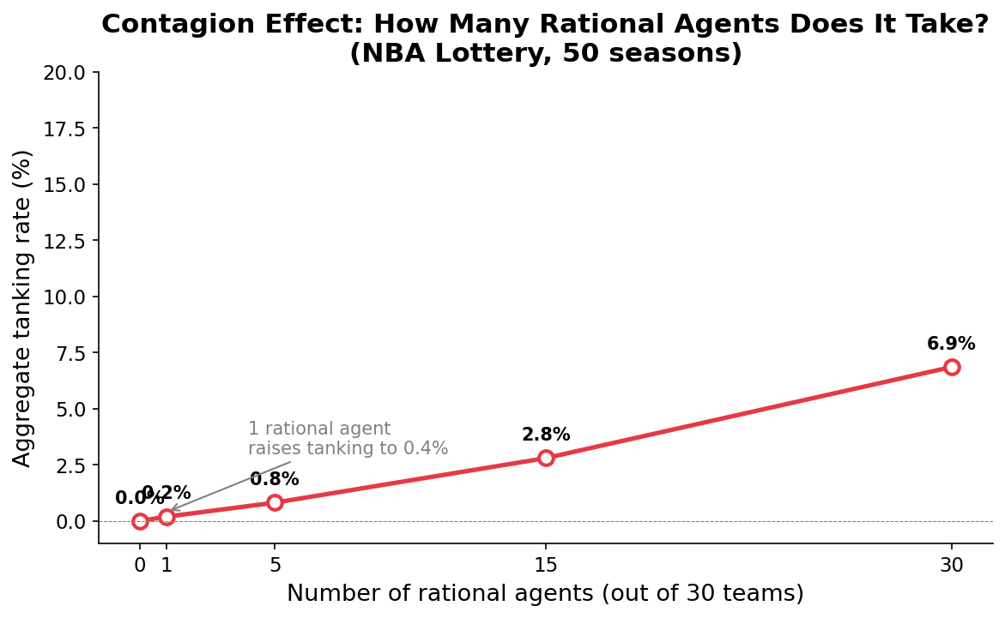
Result 3: Mixed-Population Sweep
How does tanking scale as the fraction of rational agents grows?
▸ Tanking rate by # rational agents:
– 0 rational: 0.0%
– 1 rational: 0.2%
– 5 rational: 0.8%
▸ 15 rational: 2.8%
▸ 30 rational: 6.9%
▸ Finding: linear scaling, no cascade
▸ Each added rational team ≈ +0.2 pp tanking
▸ Honest equilibrium is NOT fragile at first defection
▸ But unstable over the long run: any front office that
▸ optimizes against the incentive structure gains value
▸ Real NBA implication: even if most teams play honestly,
▸ a small number of analytical front offices can rationally tank
▸ without triggering league-wide contagion

Slide 21
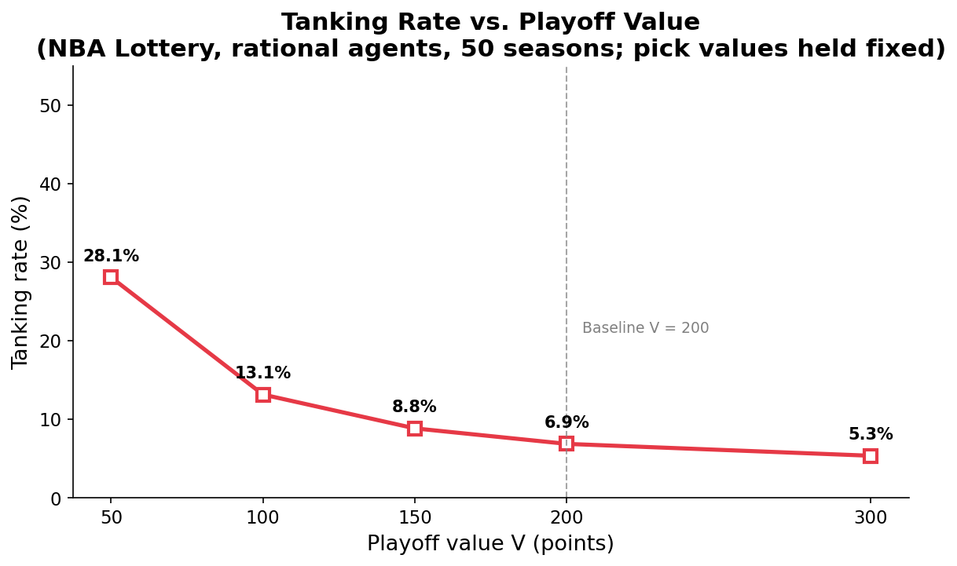
Result 4: Playoff Value Sensitivity
How does calibrating V (playoff value) change rational tanking?
▸ Tanking rate by playoff value V:
▸ V = 50: 28.1% ← high tanking when V is low
▸ V = 100: 13.1%
▸ V = 150: 8.8%
▸ V = 200: 6.9% ← our baseline
▸ V = 300: 5.3%
▸ Finding: monotone decline, no sharp threshold
▸ Old binary EU model: cliff at V ≈ 50
▸ Probabilistic model: smooth continuous decline
▸ Why this matters:
▸ Calibration of V matters enormously for predictions
▸ V = 200 (>> pick value) is consistent with the paper's
▸ core assumption that u(playoffs) >> u(picks)
▸ Real NBA teams likely have V >> 200 in revenue terms

Slide 22
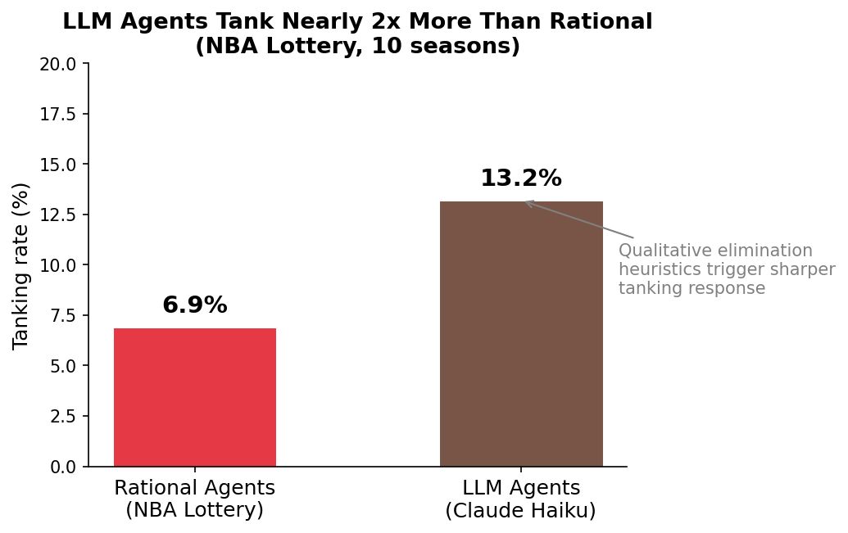
Result 5: LLM Agents (Claude Haiku-4-5, 10 seasons)
Does the tanking incentive emerge spontaneously from language model reasoning?
▸ LLM: 13.2% vs. Rational: 6.9% (≈ 2×)
▸ LLM reasoning patterns:
▸ "At 8-22, playoff probability is negligible (<5%),
– lottery upside exceeds any realistic playoff path"
– → effort = 0.0 (tanking)
▸ "playoff probability is high and 200-pt bonus vastly
– exceeds any lottery pick expected value; compete"
– → effort = 1.0 (competing)
▸ Why LLMs tank more than rational agents:
▸ Qualitative elimination heuristics are sharper than
▸ continuous probability-weighted EU calculation
▸ LLMs apply a binary 'out of contention' threshold;
▸ rational agents use a gradient
▸ Behavioral finding: real GMs (qualitative reasoners)
▸ may tank closer to LLM rate than rational-agent rate

Slide 23
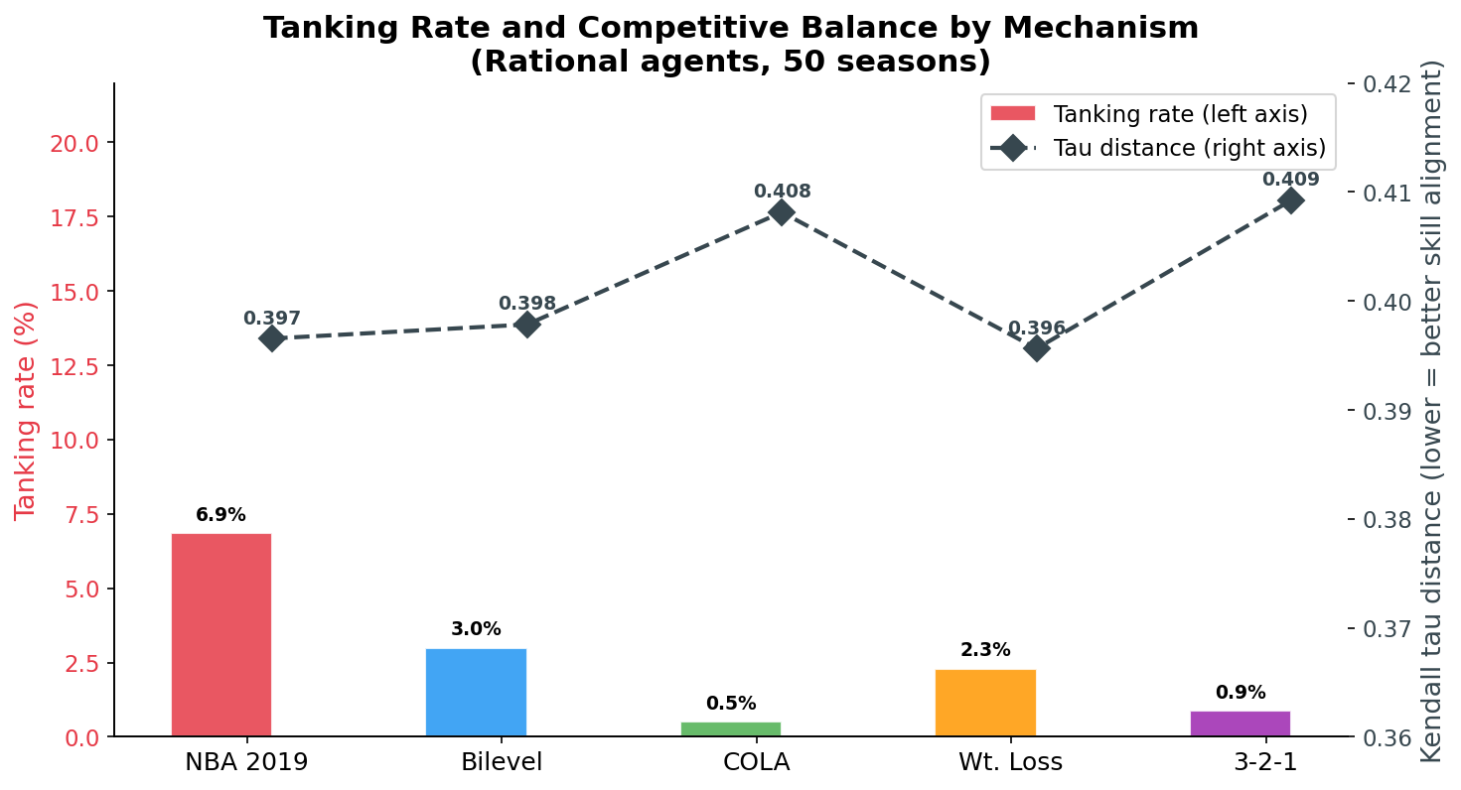
Result 6: Summary — Tanking vs. Competitive Balance
No mechanism Pareto-dominates; all involve explicit design tradeoffs
▸ The tradeoff is real:
▸ Mechanisms that suppress tanking most (COLA, 3-2-1)
▸ produce slightly higher tau distance — less tanking means
▸ luck dominates more, so standings reflect skill less
▸ But the effect is small:
▸ Tau range across all mechanisms: 0.396 – 0.409
▸ Much smaller than the honest–rational gap in old calibration
▸ V = 200 means most teams compete → standings mostly correct
▸ Policy-relevant insight:
▸ There is no free lunch — but the cost is modest
▸ All four reforms substantially reduce tanking
▸ with only marginal impact on competitive balance

Slide 24
SECTION 5
Conclusion
Mechanism comparison, policy recommendations, and open questions

Slide 25
Mechanism Comparison
Across implementation simplicity, transparency, tanking elimination, and draft efficiency
Mechanism
Simplicity (implement)
Transparency (teams/fans)
Tanking Reduction
Draft Efficiency (weakest quartile)
Theory
NBA 2019 (baseline)
★★★★★
★★★★★
✗ 6.9%
7.52 (worst)
Impossibility applies
Bilevel (Kazachkov)
★★★☆☆
★★★☆☆
✓ 3.0%
6.85
Eliminates post-lock tanking
COLA (Highley)
★★☆☆☆
★★★☆☆
✓✓ 0.5%
7.21
Near-full IC proof (Diet COLA)
Weighted Loss (ours)
★★★☆☆
★★☆☆☆
✓ 2.3%
6.92
Continuous decay, no cutoff
NBA 3-2-1 (proposed)
★★★★★
★★★★☆
✓✓ 0.9%
6.57 (BEST ★)
Inverts Tier A incentive
★ NBA 3-2-1 achieves the best tanking reduction + draft efficiency combination with highest implementation simplicity

Slide 26
What Should the NBA Do?
Our simulation-based policy recommendations
Near-term: NBA 3-2-1
Medium-term: Bilevel
Long-term: COLA
▸ Easiest to implement — just rebalance balls
▸ Highest transparency — rule is intuitive
▸ 0.9% tanking + 6.57 draft efficiency
▸ No multi-year ramp-up required
▸ Already under serious consideration by NBA
▸ Limitation: does not fully eliminate tanking;
▸ restructures rather than removes the incentive
▸ Lock standings at game 70 (public, pre-announced)
▸ 3.0% tanking — meaningful reduction
▸ Strong theoretical basis (Kazachkov 2020)
▸ No infrastructure overhaul required
▸ Limitation: pre-breakpoint incentives remain;
▸ fans need education on why standings 'freeze'
▸ Theoretically strongest IC guarantee
▸ 0.5% tanking — near-zero
▸ Chronically weak teams accumulate tickets
▸ Formally proved (Diet COLA variant)
▸ Limitation: multi-year accounting complexity;
▸ requires transition plan for existing teams;
▸ NBA historically reluctant to restructure
Regardless of mechanism: the Banchio impossibility means we manage, not eliminate, tanking incentives. The goal is a regime where the cost of tanking is higher than the benefit for most teams, most of the time.

Slide 27
Key Findings & Open Questions
What We Found
Open Questions
▸ 1. All four reforms reduce tanking from the 6.9% NBA baseline
– COLA (0.5%) and NBA 3-2-1 (0.9%) achieve strongest suppression
▸ 2. Tanking is concentrated far from the playoff bubble
– 76% of decisions: team ranked 21st or worse
– High V = 200 keeps bubble teams competing
▸ 3. Honest equilibrium is stable but not robust
– 1 rational team → 0.2% aggregate tanking (not contagious)
– But scales linearly: each rational agent adds ~0.2 pp
▸ 4. LLM agents tank nearly 2× more than rational agents
– Qualitative elimination heuristics are sharper than gradient EU
– Behavioral realism matters for mechanism design predictions
▸ 5. NBA 3-2-1 has surprisingly strong draft efficiency
– Inverted Tier A incentive improves outcomes for weakest teams
▸ Draft class strength
▸ We hold D(k) fixed across seasons
▸ In a 'generational draft year', D(1) >> 100 pts
▸ Would mechanisms hold under variable draft quality?
▸ Full 30-team LLM simulation
▸ We ran 10 seasons, 1 mechanism
▸ Full 50-season sweep across all mechanisms:
▸ Do LLMs discover mechanism-specific strategies?
▸ Is some tanking actually optimal?
▸ Tau paradox: tanking can IMPROVE standings-skill alignment
▸ If weak teams intentionally lose, draft redistribution works better
▸ Is there a socially optimal tanking rate > 0?
▸ Adversarial robustness
▸ What if teams learn each other's strategies over time?
▸ Multi-agent RL rather than static EU maximization

Slide 28
Thank You
Grant Valentine & Kartik Dhinakaran
Questions?
6.9% → 0.5%
2×
6.57
50 seasons
Tanking range (NBA → COLA)
LLM tanks more than rational
Best draft efficiency (NBA 3-2-1)
Simulated per mechanism
Code: github.com/[repo] | Data: tanking_sim.db | Contact: grantsvalentine@gmail.com

