Slide 1

Job Recommendation System Using Hybrid Approach
Presented By:
Sushmita Khadka, 23280/076
Suman Gole, 23274/076
Suman Shrestha , 23276/076
Supervised By:
Sushant Paudel
Department of CSIT
Bhaktapur Multiple Campus

Slide 2
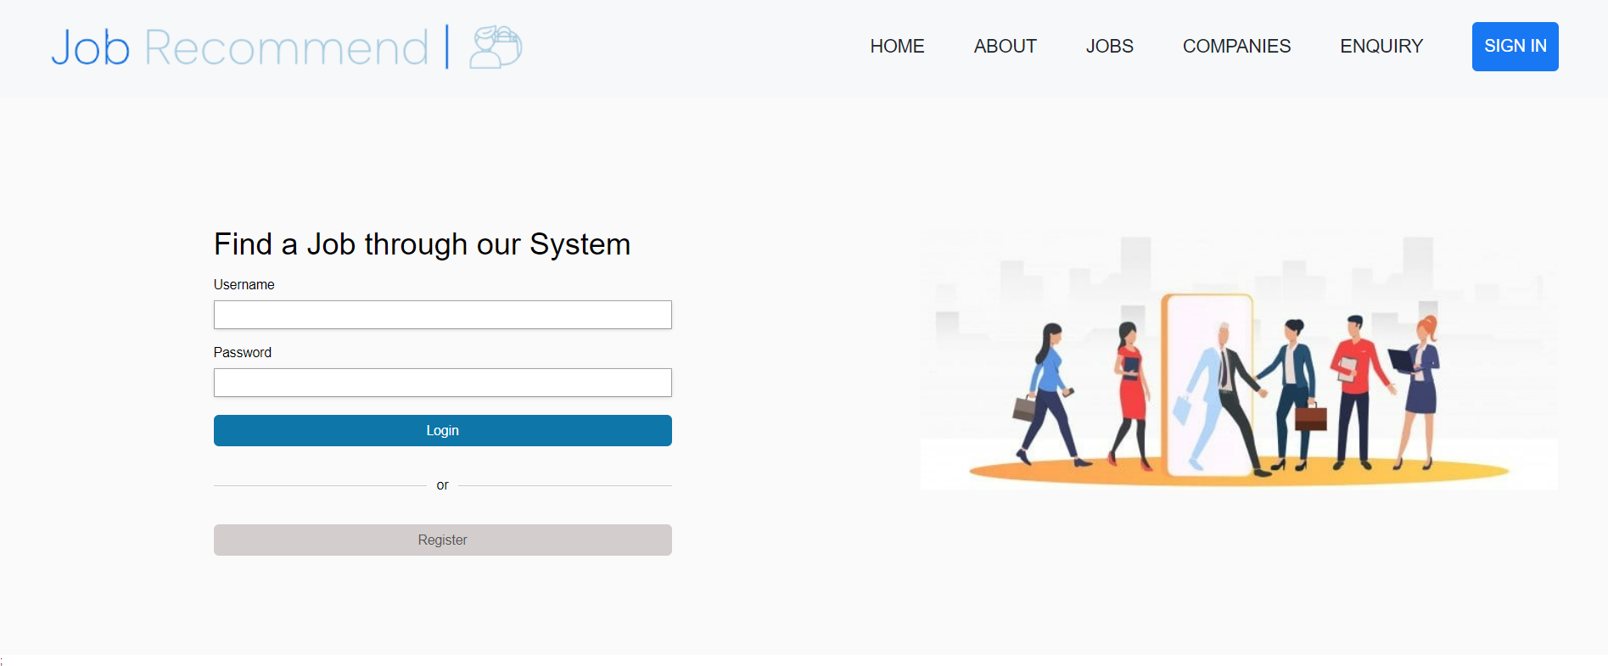
Introduction
Job Recommendation system with Hybrid Approach
Uses user profile details as well as user interactions to recommend

Slide 3

Prevalent Problems
Confusing and complex UI design
Lack of relevant job suggestion
Lack of transparency of candidate selection
Lack of Responsiveness from the companies

Slide 4
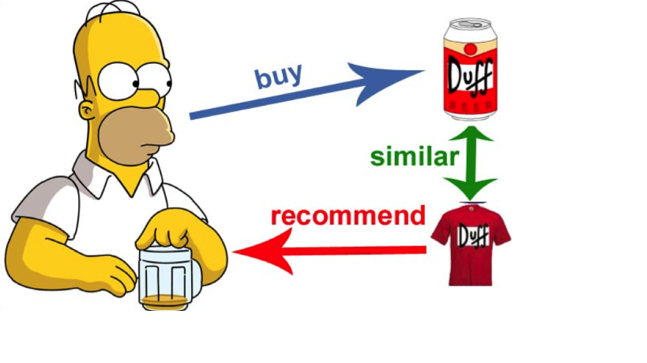
Why Recommendation System?
To understand the candidates expectations while searching job and given them ideas to explore their interest
To analyze user interactivities to recommend jobs that aligns with candidates expectation and experience.

Slide 5
How does Job Recommendation System work?
• By recommending the suitable job to the job seeker as per their skills and preferred industry using the Hybrid method including Cosine similarity and Pearson correlation.
• By enhancing the user experience while searching for the job through easy navigation using a simple yet robust user interface through style components

Slide 6





Tools Used
JavaScript
React Python
Django
Styled Components

Slide 7
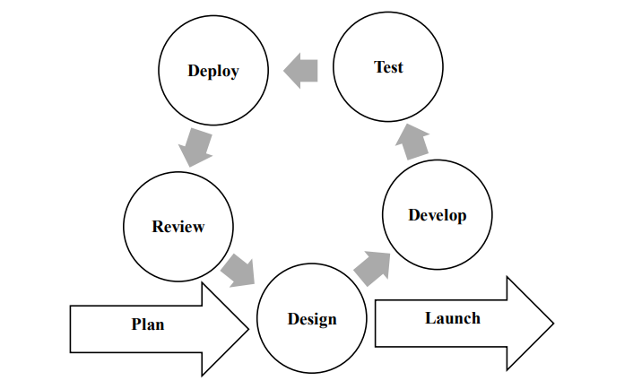
Development Methodology
Fig - Agile Methodology

Slide 8
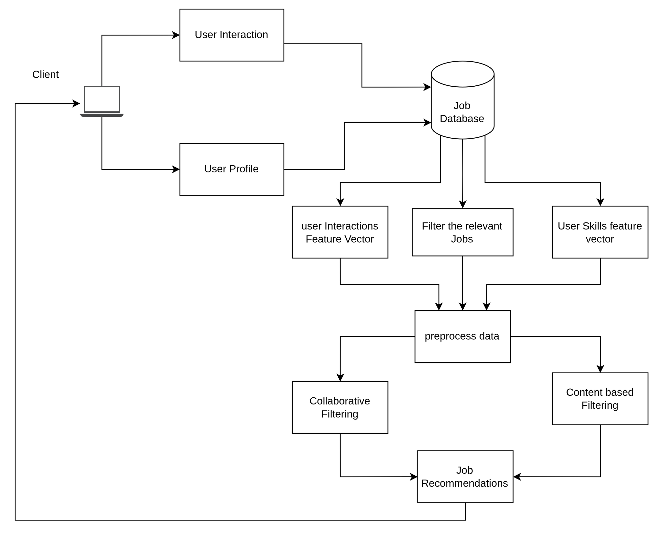
System Design

Slide 9
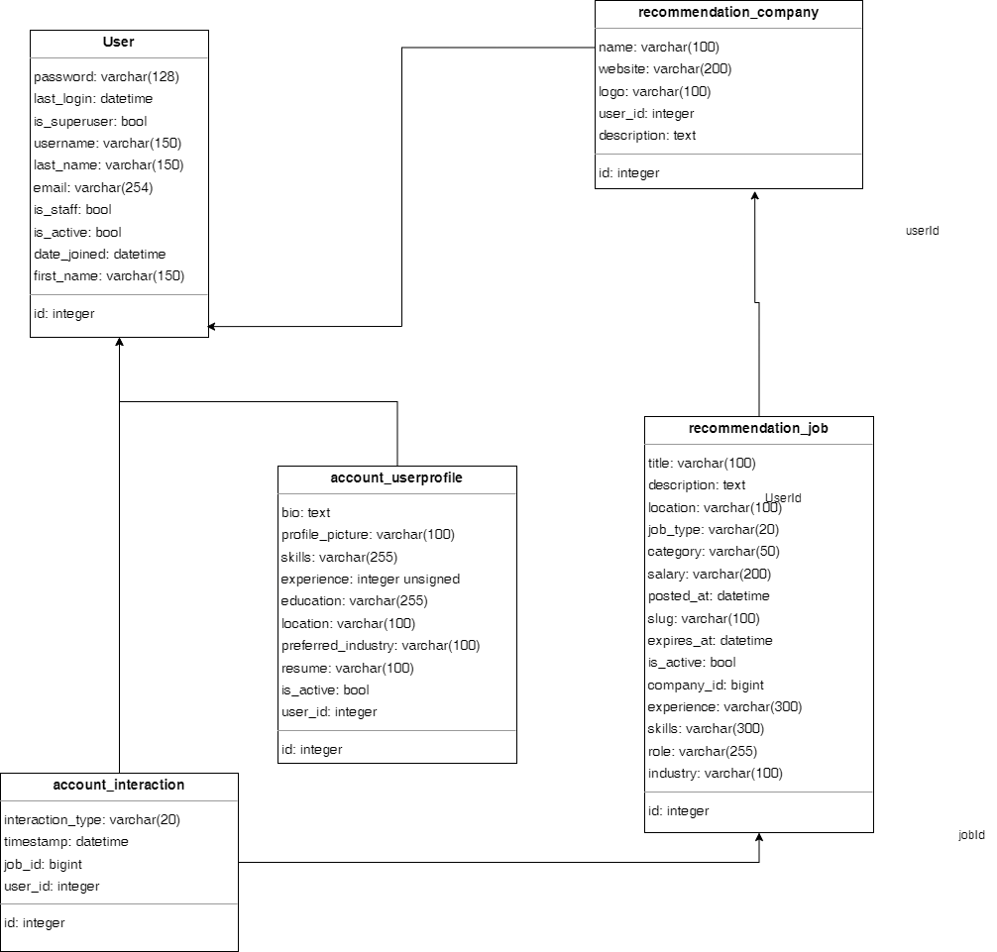
Database Design

Slide 10
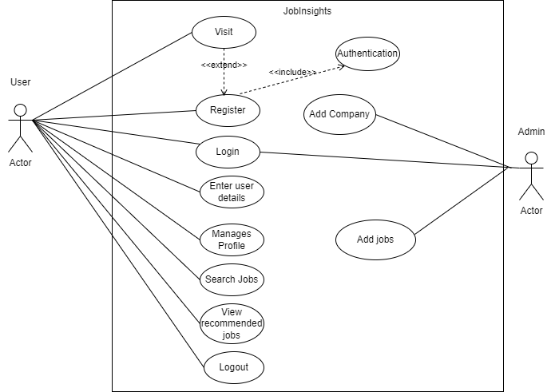
Use case

Slide 11
Algorithms
TF-IDF
Cosine Similarity
Pearson correlation
Merge Sort

Slide 12
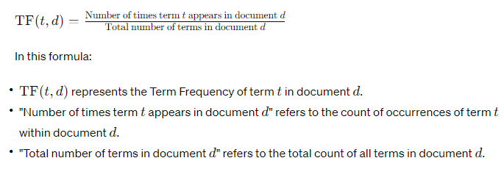
TF(Term-Frequency)
It is a numerical representation that can be used for frequency counting of term in a document.

Slide 13
TF(Term-Frequency) in Job Recommendation System
Job Detail1 Title: "HTML, CSS, JavaScript, React”
Job Detail2 Title: "Java, Spring, Hibernate, SQL”
User Skills: "HTML,CSS, JavaScript, Python”
Job Detail1 Title :
TF(HTML) = ¼
TF(CSS) = ¼
TF(JavaScript) = ¼
TF(React) = ¼
Job Detail2 Title :
TF(Java) = ¼
TF(Spring) = ¼
TF(Hibernate) = ¼
TF(SQL) = ¼
User Skills :
TF(HTML) = ¼
TF(CSS) = ¼
TF(JavaScript) = ¼
TF(React) = ¼

Slide 14
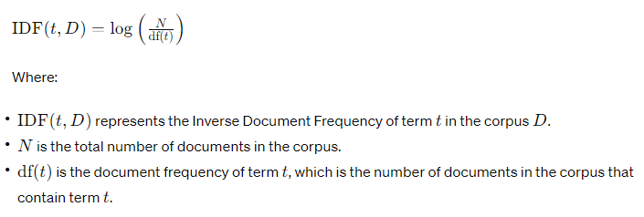
IDF(Inverse Document Frequency)
It is a numerical representation that can be used for determining how rare a term is within entire document collection.

Slide 15
IDF(Inverse Document Frequency) in Job Recommendation
Job Detail1 Title: "HTML, CSS, JavaScript, React”
Job Detail2 Title: "Java, Spring, Hibernate, SQL”
User Skills: "HTML,CSS, JavaScript, Python”
Job Detail1 Title :
IDF(HTML) = log⁡(3/2​) IDF(CSS) = log⁡(3/2​) IDF(JavaScript) = log⁡(3/2​) IDF(React) = log⁡(3/1)
Job Detail2 Title :
IDF(Java) = log⁡(3/1​) IDF(Spring) = log⁡(3/1​) IDF(Hibernate) = log⁡(3/1​) IDF(SQL) = log⁡(3/1)
User Skills :
IDF(HTML) = log⁡(3/2​)
IDF(Spring) = log⁡(3/1​) IDF(Hibernate) = log⁡(3/1​) IDF(SQL) = log⁡(3/1)

Slide 16
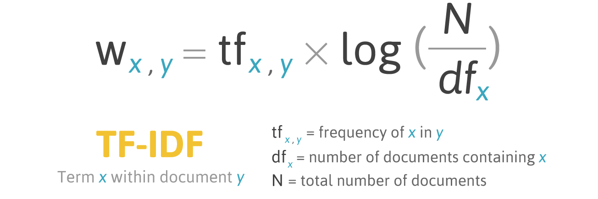
TF-IDF
It combines TF and IDF to give higher weight to the term that is frequent within document and rare across the entire collection.

Slide 17
TF-IDF in Job Recommendation System
Job Detail1 Title: "HTML, CSS, JavaScript, React”
Job Detail2 Title: "Java, Spring, Hibernate, SQL”
User Skills: "HTML,CSS, JavaScript, Python”
Job Detail1 Title :
TF-IDF(HTML) = 0.146
TF-IDF(CSS) 0.146)
TF-IDF(JavaScript) = 0.146 TF-IDF(React) = 0.275
Job Detail2 Title :
TF-IDF(HTML)=0.146
TF-IDF(CSS)= 0.146
TF-IDF(JavaScript) = 0.146 TF- IDF(Python) = 0.275
User Skills :
TF-IDF(Java) = 0.275
TF-IDF(Spring) = 0.275
TF-IDF(Hibernate) = 0.275 TF-IDF(SQL) = 0.275
[0.146,0.146,0.146,0.275]
[0.146,0.146,0.146,0.275]
[0.275,0.275,0.275,0.275]

Slide 18
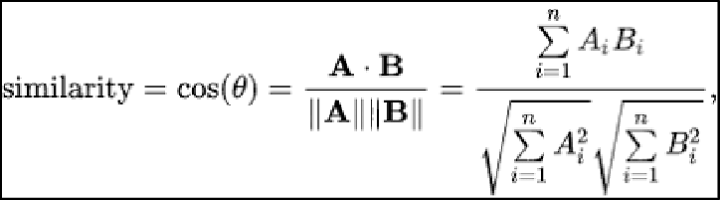
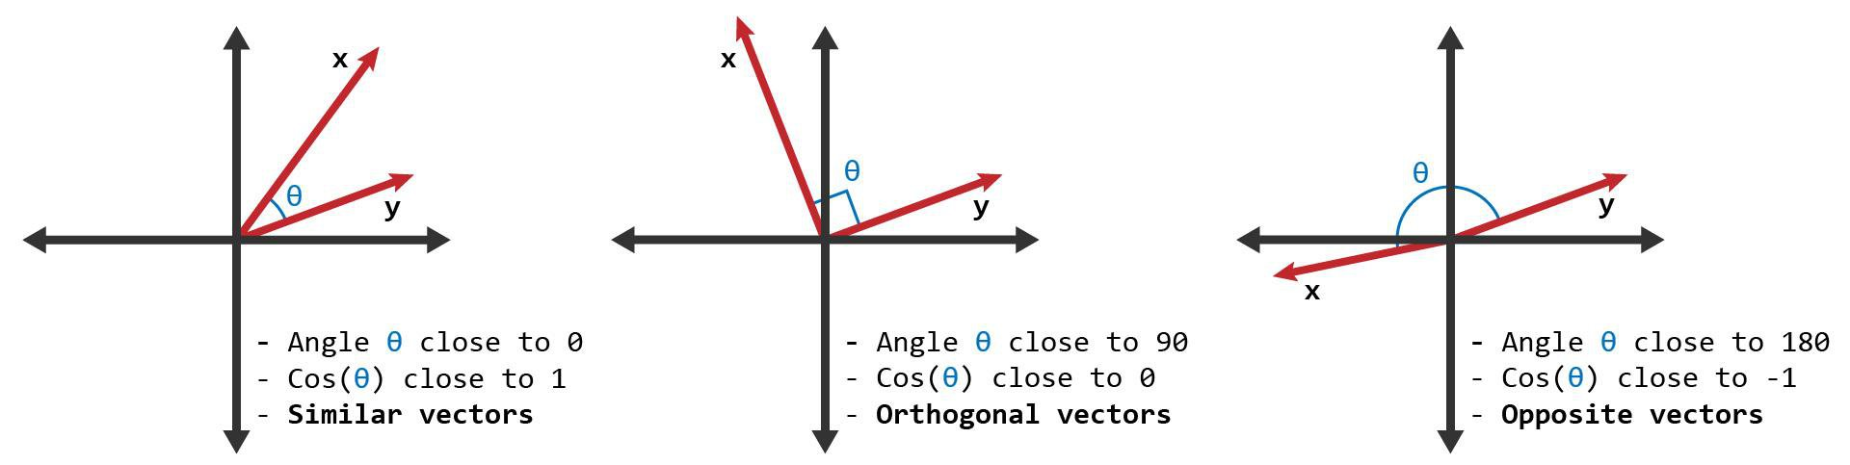
Cosine Similarity
It is used to measure similarity between 2 vectors.
1
0
-1

Slide 19
Cosine Similarity in Job Recommendation System
Job Detail1 Title: "HTML, CSS, JavaScript, React”
User Skills: "HTML,CSS, JavaScript, Python”
Cosine Similarity(Job Detail1 Title, User Skills) = (
[0.146,0.146,0.146,0.275]
[0.146,0.146,0.146,0.275]
Dot Product=(0.146×0.146)+(0.146×0.146)+(0.146×0.146)+(0.275×0.275)=0.139573
Magnitude of Job1 Vector=​ 0.3739
Magnitude of User Skills Vector= 0.3739
Cosine Similarity(Job Detail1 Title, User Skills)
(0.139573)/(0.3739×0.3739) =0.988

Slide 20
Cosine Similarity(Job1, User Skills) 0.988
Cosine Similarity(Job2, User Skills)0.953
Recommendation Order
Job1
Job2

Slide 21
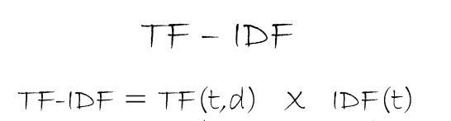
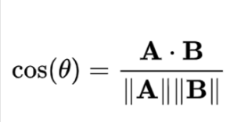
Recommendation below Single Job’s Details Page (Content Based)
Vector 2
Jobs after Filtering DB Job’s
Title
Description with
Single Job Details’s title
Vector 1
Single Job Detail’s Title
Content Based

Slide 22
Home Page Recommendation customized for User (Content Based)
Vector 2
Jobs after Filtering DB Job’s
Title
Description with
User’s Skills from Registration
Vector 1
User’s Skills from Registration
Content Based
Similar Job’s
Title
Description
Similar Job

Slide 23

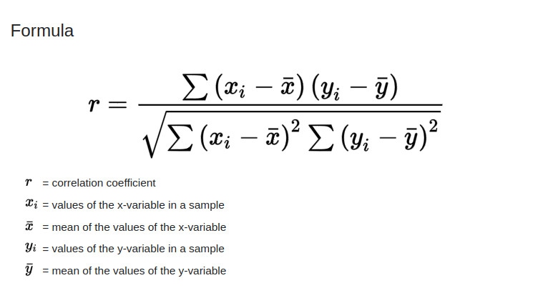
Pearson Correlation
It is a part of the collaborative filtering approach to provide recommendations.
To calculate the similarity between 2 vectors job documents and user interactions.

Slide 24
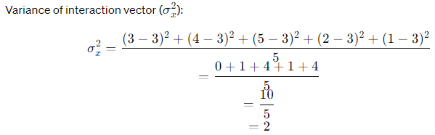

Pearson Correlation For Job Recommendation
.
Interaction Vector:[3, 4, 5, 2, 1]
Job Document Vector:[4, 5, 3, 1, 2]

Slide 25
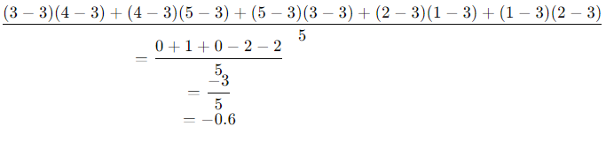
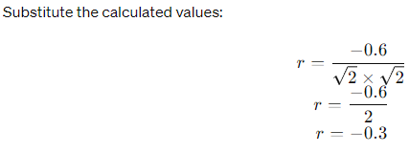
Pearson Correlation For Job Recommendation
Covariance

Slide 26
Home Page Recommendation customized for User (Collaborative Filtering)
Vector 2:
Jobs after Filtering DB Job’s
Title with Interactions
Interacted Job’s Title
Vector 1:
Recently Interacted Jobs
Title
Description
Hybrid(Switching Type)
Similar Job
Similar Job’s
Title
Description

Slide 27
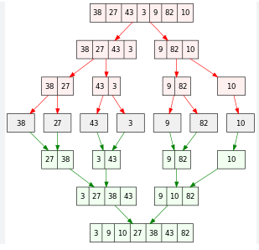
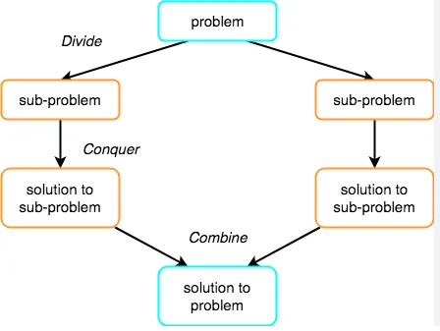
Merge Sort

Slide 28
Challenges
Keyword Extraction which are relevant for the job recommendation
Data sparsity
Content representation
Feature Engineering
Bias and Fairness

Slide 29
Future Recommendations
Predict salary based on user skills and experience
Recommend users with courses

Slide 30
Thank you !

