Slide 1
APCS: Intro to Ruby
Brian Chang
Kevin Huang
Credit: Ruby for Java Programmers by Armando Fox

Slide 2

Ruby 101
© 2012 Armando Fox & David Patterson
Licensed under Creative Commons Attribution-NonCommercial-ShareAlike 3.0 Unported License

Slide 3
Ruby is...
Interpreted
Object-oriented
  Everything is an object
  Every operation is a method call on some object
Dynamically typed: objects have types, but variables don’t
Dynamic
  add, modify code at runtime (metaprogramming)
  ask objects about themselves (reflection)
  in a sense all programming is metaprogramming
Notes:
relfection and metaprogramming often used together
it's always runtime, so ALL programming is metaprogramming – even loading a class causes code to be executed.

Slide 4
Naming conventions
ClassNames use UpperCamelCase
  class FriendFinder ... end
methods & variables use snake_case
  def learn_conventions ... end
  def faculty_member? ... end
  def charge_credit_card! ... end
CONSTANTS (scoped) & $GLOBALS (not scoped)
  TEST_MODE = true $TEST_MODE = true
Notes:
Symbols usually connote "specialness". One use is like an Enum in Java.

Slide 5
Variables, Arrays, Hashes
There are no declarations!
  local variables must be assigned before use
  instance & class variables ==nil until assigned
OK: x = 3; x = 'foo'
Wrong: Integer x=3
Array: x = [1,'two',:three]
x[1] == 'two' ; x.length==3
Hash: w = {'a'=>1, :b=>[2, 3]}
w[:b][0] == 2
w.keys == ['a', :b]
Notes:
Note, Array and hash elts can be anyting, including other arrays/hashes, and don't all have to be same type. As in python and perl, hashes are the swiss army chainsaw of building data structures.

Slide 6
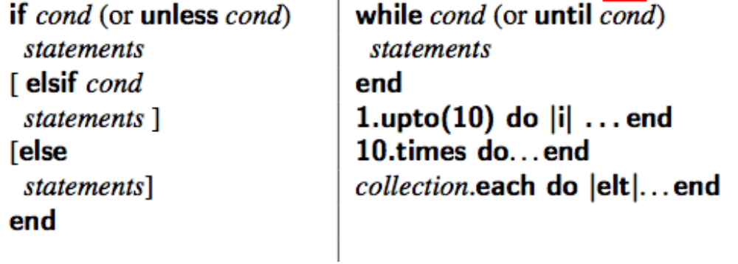
Basic Constructs
Statements end with ';' or newline, but can span line if parsing is unambiguous
Basic Comparisons & Booleans:
== != < > =~ !~ true false nil
The usual control flow constructs

Slide 7
Everything is an object,
Every operation is a method call
© 2012 Armando Fox & David Patterson
Licensed under Creative Commons Attribution-NonCommercial-ShareAlike 3.0 Unported License

Slide 8
Everything is an object; (almost) everything is a method call
Even lowly integers and nil are true objects:
  57.methods
  57.heinz_varieties
  nil.respond_to?(:to_s)
Rewrite each of these as calls to send:
  Example: my_str.length => my_str.send(:length)
  1 + 2
  my_array[4]
  my_array[3] = "foo"
  if (x == 3) ....
  my_func(z)
in particular, things like “implicit conversion” on comparison is not in the type system, but in the instance methods
1.send(:+, 2)
my_array.send(:[], 4)
my_array.send(:[]=, 3,"foo")
if (x.send(:==, 3)) ...
self.send(:my_func, z)

Slide 9
Ruby OOP
© 2012 Armando Fox & David Patterson
Licensed under Creative Commons Attribution-NonCommercial-ShareAlike 3.0 Unported License

Slide 10
Classes & inheritance
class SavingsAccount < Account # inheritance
# constructor used when SavingsAccount.new(...) called
def initialize(starting_balance=0) # optional argument
@balance = starting_balance
end
def balance # instance method
@balance # instance var: visible only to this object
end
def balance=(new_amount) # note method name: like setter
@balance = new_amount
end
def deposit(amount)
@balance += amount
end
@@bank_name = "MyBank.com" # class (static) variable
# A class method
def self.bank_name # note difference in method def
@@bank_name
end
# or: def SavingsAccount.bank_name ; @@bank_name ; end
end
http://pastebin.com/m2d3myyP

Slide 11
Instance variables: shortcut
class SavingsAccount < Account
def initialize(starting_balance)
@balance = starting_balance
end
def balance
@balance
end
def balance=(new_amount)
@balance = new_amount
end
end

Slide 12
Instance variables: shortcut
class SavingsAccount < Account
def initialize(starting_balance)
@balance = starting_balance
end
attr_accessor :balance
end
attr_accessor is just a plain old method that uses metaprogramming...not part of the language!
Notes:
Note we still need to initialize the value in constructor.

Slide 13
Review: Ruby’s Distinguishing Features (So Far)
Object-oriented with no multiple-inheritance
  everything is an object, even simple things like integers
  class,instance variables invisible outside class
Everything is a method call
  usually, only care if receiver responds to method
  most “operators" (like +, ==) actually instance methods
  Dynamically typed: objects have types; variables don’t

Slide 14
Blocks, Iterators, Functional Idioms
© 2012 Armando Fox & David Patterson
Licensed under Creative Commons Attribution-NonCommercial-ShareAlike 3.0 Unported License

Slide 15
Loops—but don’t think of them that way
["apple", "banana", "cherry"].each do |string|
puts string
end
for i in (1..10) do
puts i
end
1.upto 10 do |num|
puts num
end
3.times { print "Rah, " }

Slide 16
If you’re iterating with an index, you’re probably doing it wrong
Iterators let objects manage their own traversal
(1..10).each do |x| ... end
(1..10).each { |x| ... }
1.upto(10) do |x| ... end
=> range traversal
my_array.each do |elt| ... end
=> array traversal
hsh.each_key do |key| ... end
hsh.each_pair do |key,val| ... end
=> hash traversal
10.times {...} # => iterator of arity zero
10.times do ... end
Notes:
These look different but are all examples of a common mechanism. Understand the mchanism and you won't hav to worry about memorizing different-looking forms!

Slide 17
Rails from Zero to CRUD
© 2012 Armando Fox & David Patterson
Licensed under Creative Commons Attribution-NonCommercial-ShareAlike 3.0 Unported License

Slide 18


Rails as an MVC Framework
Model, View, Controller
Relational
Database
Persistence: mysql or
sqlite3
tables
Subclasses of ActiveRecord::Base, an object-relational mapping layer
models/*.rb
your app
Logic: your code &
Rack appserver
views/*.html.haml
controllers/*.rb
Rails rendering
Rails routing
Presentation:
WEBrick,
Apache, etc.
Subclasses of ActionView
Subclasses of ApplicationController
Client: Firefox

Slide 19
MVC responsibilities
Model: methods to get/manipulate data
  Movie.where(...), Movie.find(...)
Controller: get data from Model, make available to View
  def show
  @movie = Movie.find(params[:id])
  end
View: display data, allow user interaction
  Show details of a movie (description, rating)
But…
  What else can user do from this page?
  How does user get to this page?
Instance variables set in Controller available in View
Absent other info, Rails will look for app/views/movies/show.html.haml
http://pastebin.com/kZCB3uNj

Slide 20
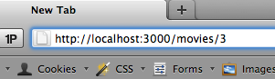
A trip through a Rails app
Routes (in routes.rb) map incoming URL’s to controller actions and extract any optional parameters
  Route’s “wildcard” parameters (eg :id), plus any stuff after “?” in URL, are put into params[] hash accessible in controller actions
Controller actions set instance variables, visible to views
  Subdirs and filenames of views/ match controllers & action names
Controller action eventually renders a view
app/controllers/movies_controller.rb
app/views/movies/show.html.haml
def show
id = params[:id]
@mv=Movie.find(id)
end
%li
Rating:
= @mv.rating
config/routes.rb
GET /movies/:id {:action=>'show',:controller=>'movies'}

Slide 21
Databases & Migrations
© 2012 Armando Fox & David Patterson
Licensed under Creative Commons Attribution-NonCommercial-ShareAlike 3.0 Unported License

Slide 22
The Database is Golden
Contains valuable customer data—don’t want to test your app on that!
Rails solution: development, production and test environments each have own DB
  Different DB types appropriate for each
How to make changes to DB, since will have to repeat changes on production DB?
Rails solution: migration—script describing changes, portable across DB types

Slide 23

Migration Advantages
Can identify each migration, and know which one(s) applied and when
  Many migrations can be created to be reversible
Can manage with version control
Automated == reliably repeatable
  Compare: use Bundler vs. manually
  install libraries/gems
Theme: don’t do it—automate it
  specify what to do, create tools to automate

Slide 24

Meet a Code Generator
rails generate migration CreateMovies
Note, this just creates the
migration. We haven’t applied it.
Apply migration to development:
rake db:migrate
Apply migration to production:
heroku rake db:migrate
Applying migration also records in DB itself which migrations have been applied
http://pastebin.com/VYwbc5fq

Slide 25


Rails Cookery #1
Augmenting app functionality ==
adding models, views, controller actions
To add a new model to a Rails app:
  (or change/add attributes of an existing model)
Create a migration describing the changes:
  rails generate migration (gives you boilerplate)
Apply the migration: rake db:migrate
If new model, create model file
app/models/model.rb
Update test DB schema: rake db:test:prepare

Slide 26
ActiveRecord Basics
© 2012 Armando Fox & David Patterson
Licensed under Creative Commons Attribution-NonCommercial-ShareAlike 3.0 Unported License

Slide 27
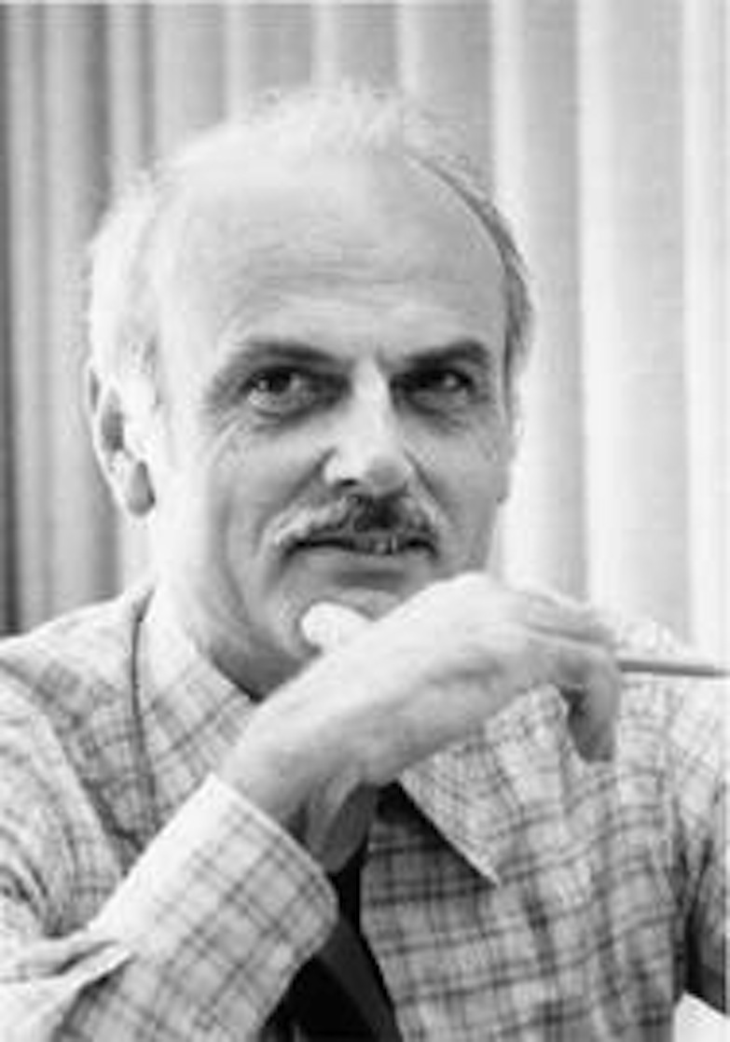
CRUD in SQL
“Ted” Codd
Structured Query Language (SQL) is the
query language used by RDBMS’s
Rails generates SQL statements at
runtime, based on your Ruby code
4 basic operations on a table row:
Create, Read, Update attributes, Delete
INSERT INTO users
(username, email, birthdate)
VALUES ("fox", "Fox@cs.berkeley.edu", "1968-05-12"),
"patterson", "pattrsn@cs.berkeley.edu", "????")
SELECT * FROM users
WHERE (birthdate BETWEEN "1987-01-01" AND “2000-01-01”)
UPDATE users
SET email = "armandofox@gmail.com"
WHERE username="fox"
DELETE FROM users WHERE id=1

Slide 28

The Ruby side of a model
Subclassing from ActiveRecord::Base
  “connects” a model to the database
  provides CRUD operations on the model
Database table name derived from
model’s name: Movie➔movies
Database table column names are getters & setters for model attributes
Observe: the getters and setters do not simply modify instance variables!
http://pastebin.com/ruu5y0D8

Slide 29
Creating: new ≠ save
Must call save or save! on an AR model instance to actually save changes to DB
  '!' version is “dangerous”: throws exception if operation fails
  create just combines new and save
Once created, object acquires a primary key (id column in every AR model table)
  if x.id is nil or x.new_record? is true, x has never been saved
  These behaviors inherited from ActiveRecord::
  Base—not true of Ruby objects in general
Notes:
Use 'rails console' to illustrate

Slide 30
Read: finding things in DB
class method where selects objects based on attributes
Movie.where("rating='PG'")
Movie.where('release_date < :cutoff and
rating = :rating',
:rating => 'PG', :cutoff => 1.year.ago)
Movie.where("rating=#{rating}") # BAD IDEA!
Can be chained together efficiently
kiddie = Movie.where("rating='G'")
old_kids_films =
kiddie.where "release_date < ?", 30.years.ago

Slide 31
Read: find_*
find by id:
Movie.find(3) #exception if not found
Movie.find_by_id(3) # nil if not found
dynamic attribute-based finders using method_missing:
Movie.find_all_by_rating('PG')
Movie.find_by_rating('PG')
Movie.find_by_rating!('PG')

Slide 32
Update: 2 ways
Modify attributes, then save object
m=Movie.find_by_title('The Help')
m.release_date='2011-Aug-10'
m.save!
Update attributes on existing object
Movie.find_by_title('The Help').
update_attributes!(
:release_date => '2011-Aug-10'
)
Transactional: either all attributes are updated, or none are

Slide 33
Deleting is straightforward
Note! destroy is an instance method
m = Movie.find_by_name('The Help')
m.destroy
There’s also delete, which doesn’t trigger lifecycle callbacks we’ll discuss later (so, avoid it)
Once an AR object is destroyed, you can access but not modify in-memory object
m.title = 'Help' # FAILS

Slide 34
Summary: ActiveRecord intro
Subclassing from ActiveRecord::Base “connects” a model to database
  C (save/create), R (where, find), U (update_attributes), D (destroy)
Convention over configuration maps
  model name to DB table name
  getters/setters to DB table columns
Object in memory ≠ row in database!
  save must be used to persist
  destroy doesn’t destroy in-memory copy

Slide 35
Controllers & Views
© 2012 Armando Fox & David Patterson
Licensed under Creative Commons Attribution-NonCommercial-ShareAlike 3.0 Unported License

Slide 36
Rails Cookery #2
To add a new action to a Rails app
Create route in config/routes.rb if needed
Add the action (method) in the appropriate app/controllers/*_controller.rb
Ensure there is something for the action to render in app/views/model/action.html.ham

Slide 37
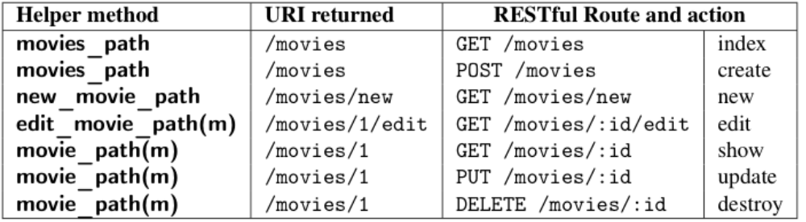
How we got here: URI helpers
link_to movie_path(3)
  def show
  @movie =
  Movie.find(params[:id])
  end
index.
html.
haml
<a href="/movies/3">...</a>
GET /movies/:id {:action=>"show", :controller=>"movies"}
params[:id]⬅3

Slide 38
What else can we do?
How about letting user return to movie list?
RESTful URI helper to the rescue again:
movies_path with no arguments links to Index action
  =link_to 'Back to List', movies_path
ELLS, Fig. 3.13

Slide 39
RASP
Debugging is a fact of life.
Read the error message. Really read it.
Ask a colleague an informed question.
Search using StackOverflow, a search engine, etc.
  Especially for errors involving specific versions of gems, OS, etc.
Post on StackOverflow, class forums, etc.
  Others are as busy as you. Help them help you by providing minimal but complete information

Slide 40
Search: Use the Internet to answer questions
Google it
  “How do I format a date in Ruby?”
  “How do I add Rails routes beyond CRUD?”
Check the documentation
  api.rubyonrails.org, complete searchable Rails docs
  ruby-doc.org, complete searchable Ruby docs (including standard libraries)
Check StackOverflow

Slide 41
Use rails console
Like irb, but loads Rails + your app code
But context is still not quite right for “peeking into” controllers and views
  Controllers rely on environment prepared by presentation tier
  Views rely on context set up by controllers
Big guns: ruby-debug (demo shortly)
Notes:
talk about type casting on date

Slide 42
Forms
© 2012 Armando Fox & David Patterson
Licensed under Creative Commons Attribution-NonCommercial-ShareAlike 3.0 Unported License

Slide 43
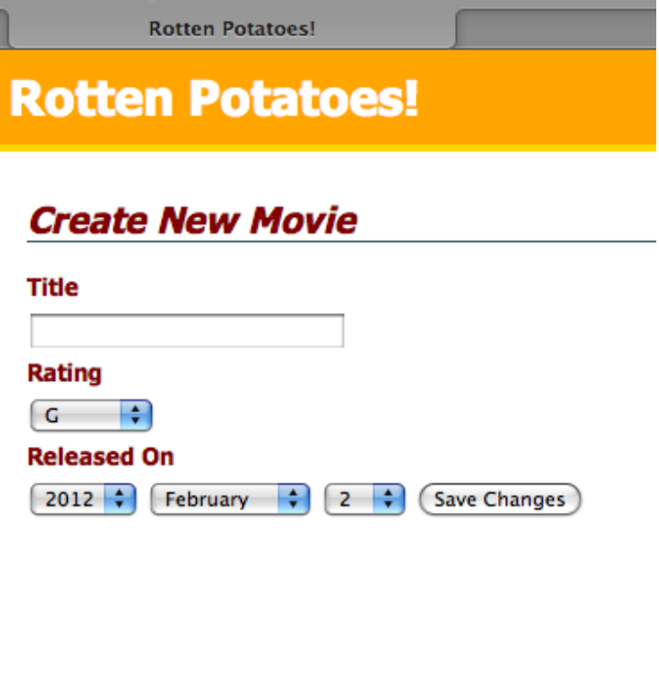
Dealing with forms
Creating a resource usually takes 2 interactions
  new: Retrieve blank form
  create: Submit filled form
How to generate/display?
How to get values filled in by user?
What to “return” (render)?

Slide 44
Rails Cookery #3
To create a new submittable form:
Identify the action that gets the form itself
Identify the action that receives submission
Create routes, actions, views for each
In form view, form element name attributes control how values will appear in params[]
Helpers provided for many common elements

Slide 45
Creating the Form
Anatomy of a form in HTML
  the action and method attributes (i.e., the route)
  only named form inputs will be submitted
Generating the form in Rails
  often can use URI helper for action, since it’s just the URI part of a route (still need method)
  form field helpers (see api.rubyonrails.org) generate conveniently-named form inputs
http://pastebin.com/k8Y49EhE
http://pastebin.com/3dGWsSq8
Notes:
- how the form helpers are used to create a form
- naming form fields as "movie[title]", "movie[rating]", etc means you end up with params[:movies] as a hash ready to pass to create or update_attributes

Slide 46
Fallacies, pitfalls, and perspectives on SaaS-on-Rails
© 2012 Armando Fox & David Patterson
Licensed under Creative Commons Attribution-NonCommercial-ShareAlike 3.0 Unported License

Slide 47
Fat controllers & views
Really easy to fall into “fat controllers” trap
  Controller is first place touched in your code
  Temptation: start coding in controller method
Fat views
  “All I need is this for-loop.”
  “....and this extra code to sort the list of movies differently.”
  “...and this conditional, in case user is not logged in.”
No! Let controller & model do the work.

Slide 48
Summary
Rails encourages you to put real code in models, keep controllers/views thin
  Reward: easier SOA integration
Rails encourages convention over configuration and DRY
  Reward: less code ➔ fewer bugs
Debugging can be tricky for SaaS
  Use logging, interactive debugger, printf
  Soon: Test-driven Development to help reduce bugs in the first place

Slide 49
Application
https://kdhuang@github.com/kdhuang/APCS-Blog-New.git
Download tar
cd /Download/
tar -xvf __filename__
mv __filename__ blog
cd into the directory

Slide 50
Application
bundle install
rails server (browser: 0.0.0.0:3000)
rails generate controller home index
rm public/index.html
rails generate scaffold Post name:string title:string content:text
rake db:migrate

Slide 51
Application
Index.html.haml
  Change to:
    %h2 Hello, Rails
    = link_to “My_Blog”, posts_path
rails console

