Slide 1
Structured and Unstructured Data Collection, Storage, Cleaning and Preprocessing
Péter Molnár, Institute for Insight, Robinson, GSU

Slide 2
Overview
Section 1:
Collecting and extracting data from website using Scrapy, BeautifulSoup and other relevant Python packages
Section 2:
Preprocessing data formats like JSON, CSV, HTML/XML to repair corrupt files, extract and filter relevant information, or de-duplicate records
Session 3:
Data cleaning and manipulation using packages Pandas, NumPy and other relevant Python packages, data visualization and visual inspection with Python
Session 4:
Practices and techniques to handle missing values in structured data

Slide 3
Session 1
Collecting and extracting data from website using Scrapy, BeautifulSoup and other relevant Python packages
Hands-on: build a web crawler to harvest data from websites

Slide 4

1989 first web-server at CERN

Slide 5
Hyper Text Transfer Protocol HTTP
https://en.wikipedia.org/wiki/Hypertext_Transfer_Protocol

Slide 6
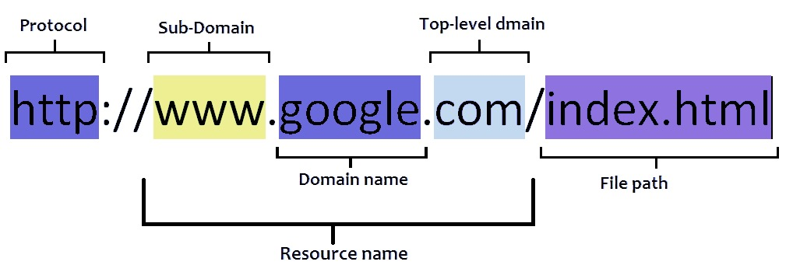
URL (Universal Resource Location)

Slide 7
CSS
https://developer.mozilla.org/en-US/docs/Learn/CSS/Introduction_to_CSS/How_CSS_works

Slide 8
Can we do this?
https://benbernardblog.com/web-scraping-and-crawling-are-perfectly-legal-right/
Web scraping and crawling aren't illegal by themselves. They might become problematic when you play on somebody else's turf, on your own terms, without obtaining their prior permission. The same is true in real life as well, when you think about it.
There are a lot of grey areas in law around this topic, so the outcome is pretty unpredictable. Before getting into trouble, make sure that what you're doing respects the rules.
And finally, the relevant question isn't "Is this legal?". Instead, you should ask yourself "Am I doing something that might upset someone? And am I willing to take the (financial) risk of their response?".

Slide 9
Rules
Use an API if one is provided, instead of scraping data.
Respect the Terms of Service (ToS).
Respect the rules of robots.txt.
Use a reasonable crawl rate. Respect the crawl-delay setting provided in robots.txt; if there's none, use a conservative crawl rate (e.g. 1 request per 10-15 seconds).
Identify your web scraper or crawler with a legitimate user agent string. Create a page that explains what you're doing and why, and link back to the page in your user agent string (e.g. 'MY-BOT (+https://yoursite.com/mybot.html)')
If ToS or robots.txt prevent you from crawling or scraping, ask a written permission to the owner of the site, prior to doing anything else.
Don't republish your crawled or scraped data or any derivative dataset without verifying the license of the data, or without obtaining a written permission from the copyright holder.
If you doubt on the legality of what you're doing, don't do it. Or seek the advice of a lawyer.
Don't base your whole business on data scraping. The website(s) that you scrape may eventually block you, just like what happened in Craigslist Inc. v. 3Taps Inc..

Slide 10
Let's jump to the notebooks…
https://github.com/kingmolnar/Structured-Unstructured-Data-Collection-Storage-Cleaning-Preprocessing

Slide 11
Session 2
Preprocessing data formats like JSON, CSV, HTML/XML to repair corrupt files, extract and filter relevant information, or de-duplicate records
Hands-on: repairing several text files so that they comply the standard formats, extract data points using text processing tools (prior to loading them into Pandas, etc.)

Slide 12
Session 3
Data cleaning and manipulation using packages Pandas, NumPy and other relevant Python packages, data visualization and visual inspection with Python
Hands-on: finding outliers, invalid values, coverage, calculate distributions of values and correct by scaling and normalization, visually inspect data sets.

Slide 13
Session 4
Practices and techniques to handle missing values in structured data;
Hands-on: impute values for data set with missing data, using nearest neighbors, probability distribution, etc.

