Slide 1

“Grok” Git
Fundamentals and Functionality
Madison Swain-Bowden
Notes:
Mention the different experience levels

Slide 2
Purpose
Radical approach to git’s innards
Workflow tips & tricks

Slide 3
Outline
Git in 30 seconds
How the heck does git work
Collaboration with git
Commit messages
PRs
GitKraken showcase
Github’s CLI

Slide 4
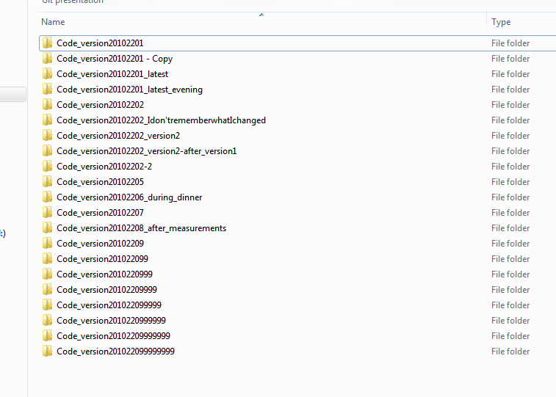
Version Control
System that tracks changes of files (generally text) over time
Many different kinds of VC
New folders for each version
Zipped backups
Email backups
Git - common VCS

Slide 5


Git
Version control software developed in 2005
Captures “changes” across time
Allows multiple developers to work on the same codebase simultaneously
Not synonymous with Github!
Git is the software used locally
Github is a website/service used to host git

Slide 6
How the heck does git work??
Directed Acyclic Graph
Each repository is a set of “steps” (commits)
Steps can only go forward
Commit - set of changes applied from the previous snapshot (delta)
Very (very) short workflow summary:
Make some changes
Tell Git which changes to keep
Commit those changes to the timeline (history)

Slide 7
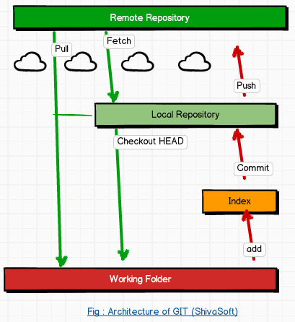
Git - Local & Remote
Can (and usually do) have two copies of a repository - Local and Remote
Local - where all operations are done
Remote - where history is “synced”
One more level - Index (or Stage)
Changes for a commit
Seems unnecessary, but is extremely useful
Notes:
By default, *no* changes are tracked. We have to be VERY specific about what changes we want to commit

Slide 8
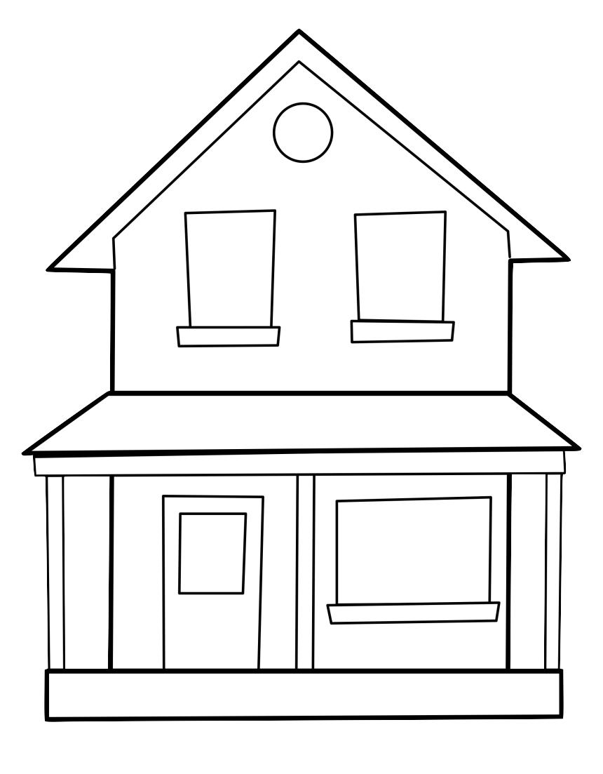


It’s a git…house
(Local Only)
Repository
(1) Make all changes (2) git add .
(3) git commit -m “Paint and roof house”
Notes:
I’m going to try something extremely radical…
What if we wanted to split these changes up, here’s how we’d do that individually

Slide 9



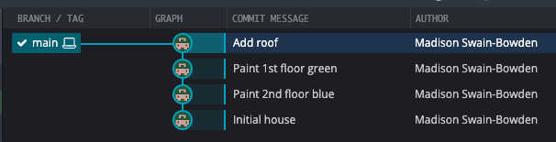
Committing
(Local Only)
(1) Paint 2nd floor blue
(2) git add 2nd-floor
(3) git commit -m “Paint 2nd floor blue”
(1) Paint 1st floor green
(2) git add 1st-floor
(3) git commit -m “Paint 1st floor green”
(1) Add roof
(2) git add roof
(3) git commit -m “Add roof”
Notes:
This shows what the set of commit changes looks like, but not how to actually get it to look like that

Slide 10
Local stuff
Very (very) short workflow summary:
Make some changes
Tell Git which changes to keep
Commit those changes to the timeline (history)
Notes:
I want to bring up this workflow again

Slide 11
Local stuff
Very (very) short workflow summary:
Make some changes
Tell Git which changes to keep
Commit those changes to the timeline (history)
Notes:
By default, *no* changes are tracked. We have to be VERY specific about what changes we want to commit

Slide 12
Committing
(Local Only)
Local Repository
(1) Make all changes
(2) git add 2nd-floor
(3) git commit -m “Paint 2nd floor blue”
(1) Make all changes
(1) Paint 1st floor green
(2) git add 1st-floor
(3) git commit -m “Paint 1st floor green”
(1) Add roof
(2) git add roof
(3) git commit -m “Add roof”
2nd floor
1st floor
Roof
Working Folder
Notes:
This takes into account how things look locally. What about remote?

Slide 13
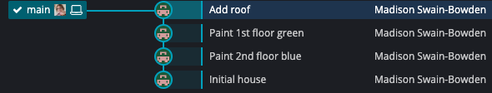
Pushing
Remote Repository
(Main only)
Local Repository
git push
Notes:
This shows changes all on one branch. What is a branch and how do we use them?

Slide 14

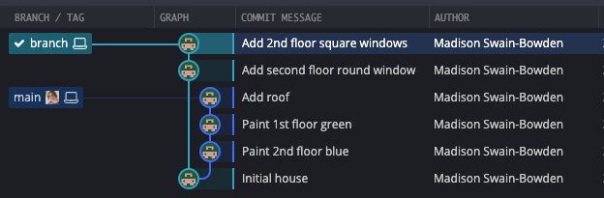
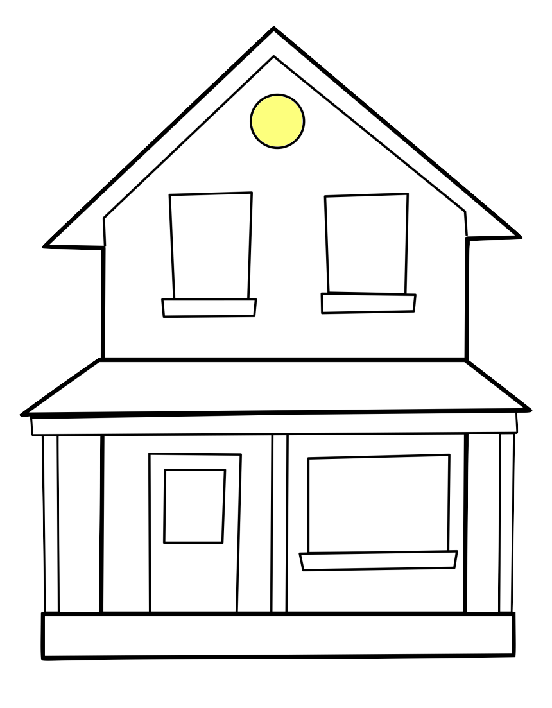

Branches
Main Branch
?
Feature branch
?
?
(1) git checkout -b <branch>
(2) Commit like normal
(3) git push -u origin <branch>
What next??
Notes:
Great now we have a branch with the work that we want done on it, how do we get it back into the main one?

Slide 15
Combining Branches
Madison’s Preference
Merge commit
Rebase
Squash and rebase
Squash and rebase
Rebase
Merge commit

Slide 16
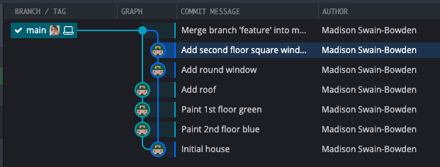
Merge commit
Main Branch
Feature branch
(1) Pull Request
(2) Select “merge commit”

Slide 17

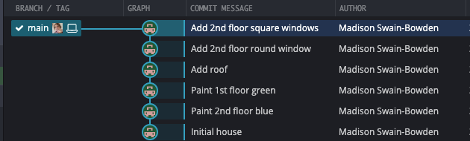
Rebase
Main Branch
Feature branch

Slide 18
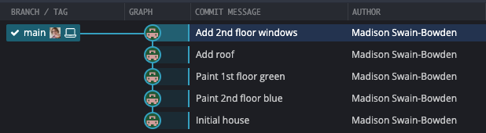
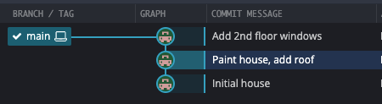
Squash and Rebase
Main Branch
Feature branch

Slide 19

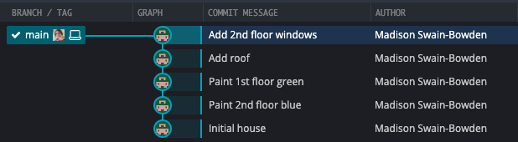
Integrating Code: A Comparison
Merge commit
Rebase
Squash & Rebase

Slide 20

Special Case - Cherry Pick
Main Branch
cc6a03
Feature branch
(1) git checkout <branch-to-alter>
(2) git cherry-pick <commit>
(1) git checkout main
(2) git cherry-pick cc6a03
0c2ab8
cc6a03
Notes:
Let’s say that for some reason, you needed a specific change from another branch. That’s what cherry pick is for!
(good time to mention commit hashes)

Slide 21

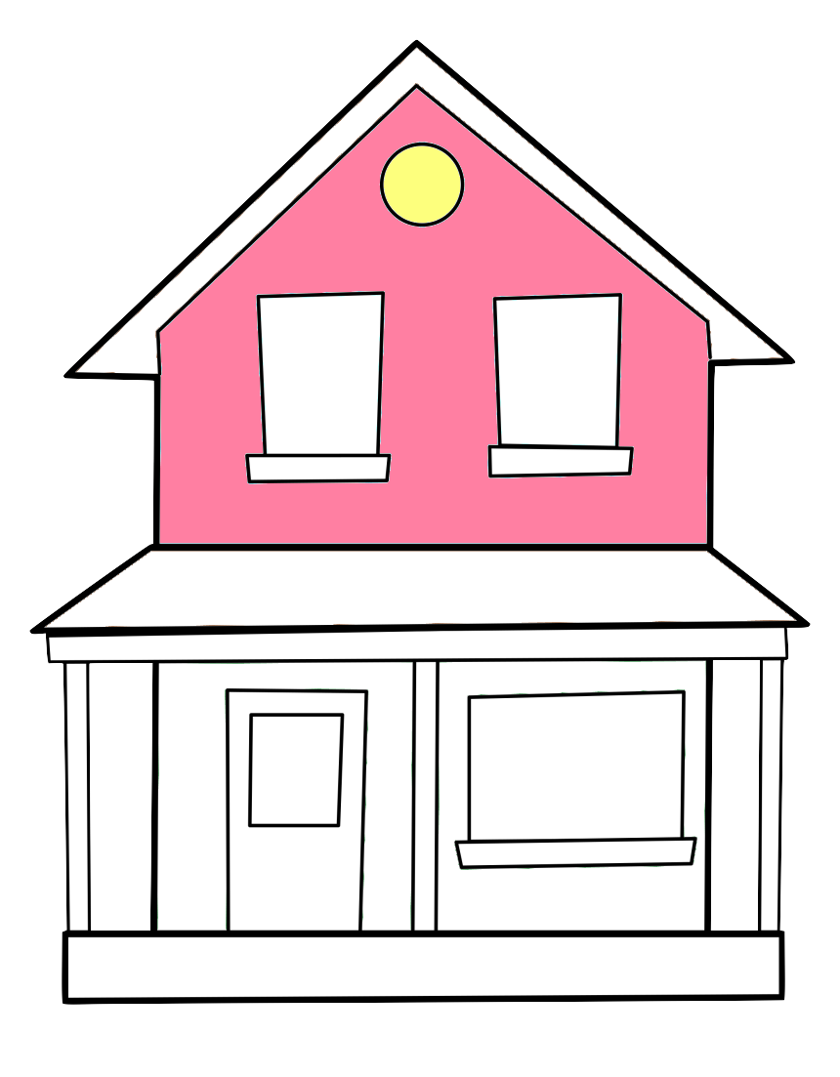
Special Case - Conflict Resolution
Main Branch
Feature branch
Resolve the conflict locally
(usually through a UI)

Slide 22
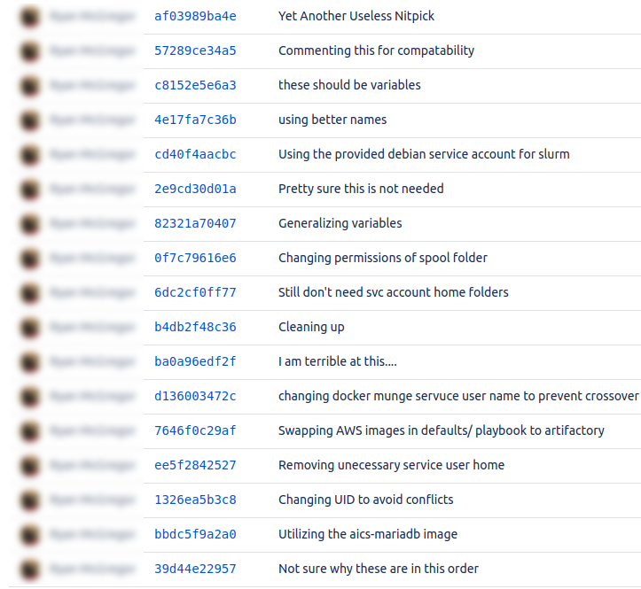
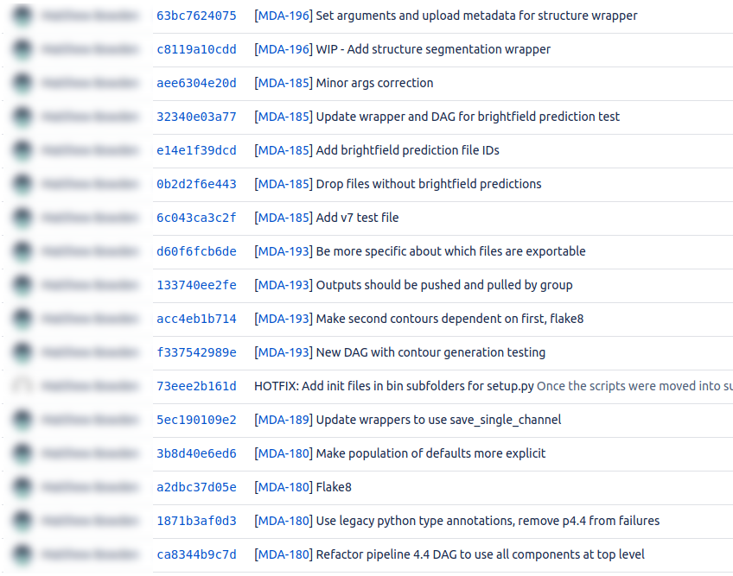
Collaboration: Commit Messages

Slide 23
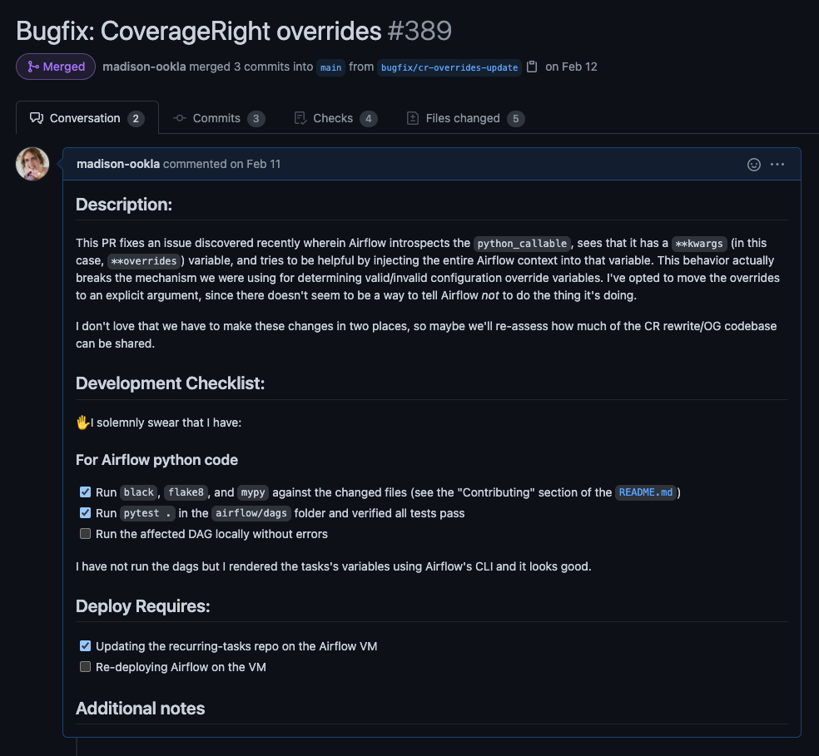
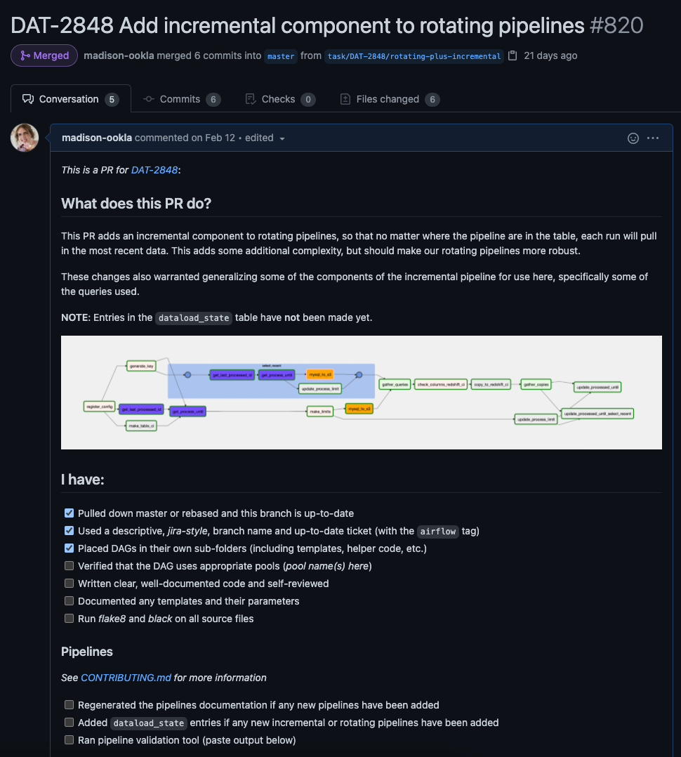
Collaboration: Pull Requests
Notes:
PRs should primarily be a form of communication to the team/those interacting with the codebase.
PRs should contain a succinct summary of the change, and ideally a link to any relevant JIRA ticket
Screenshots are always welcome!
Include the JIRA ticket in the title
Choose the “squash and merge” option

Slide 24
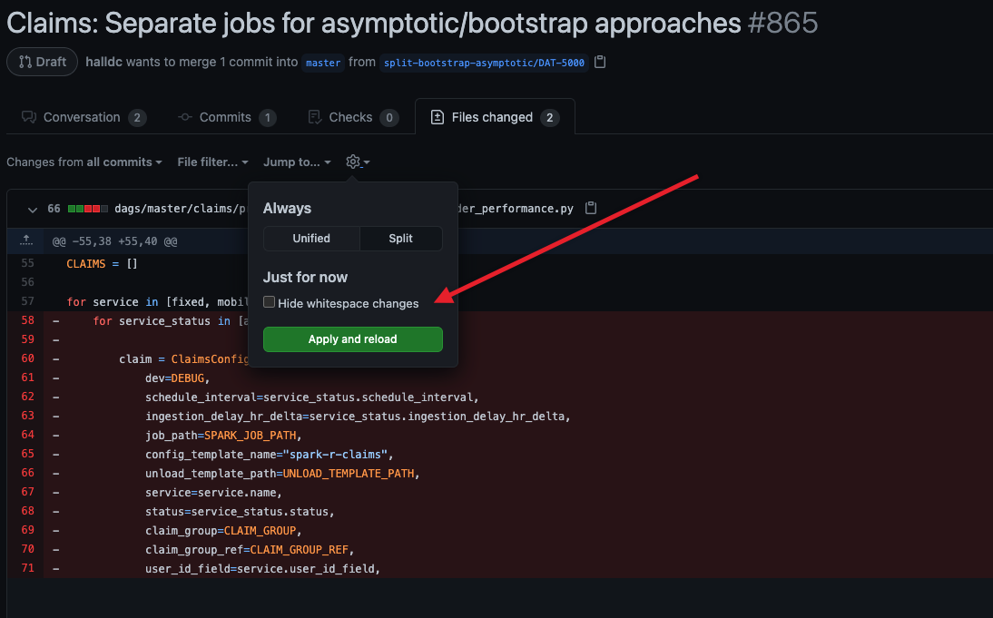
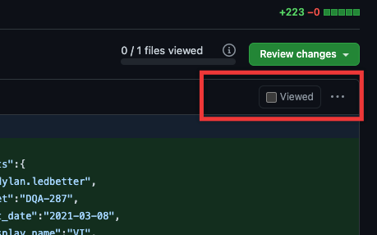
Collaboration: PR tips

Slide 25
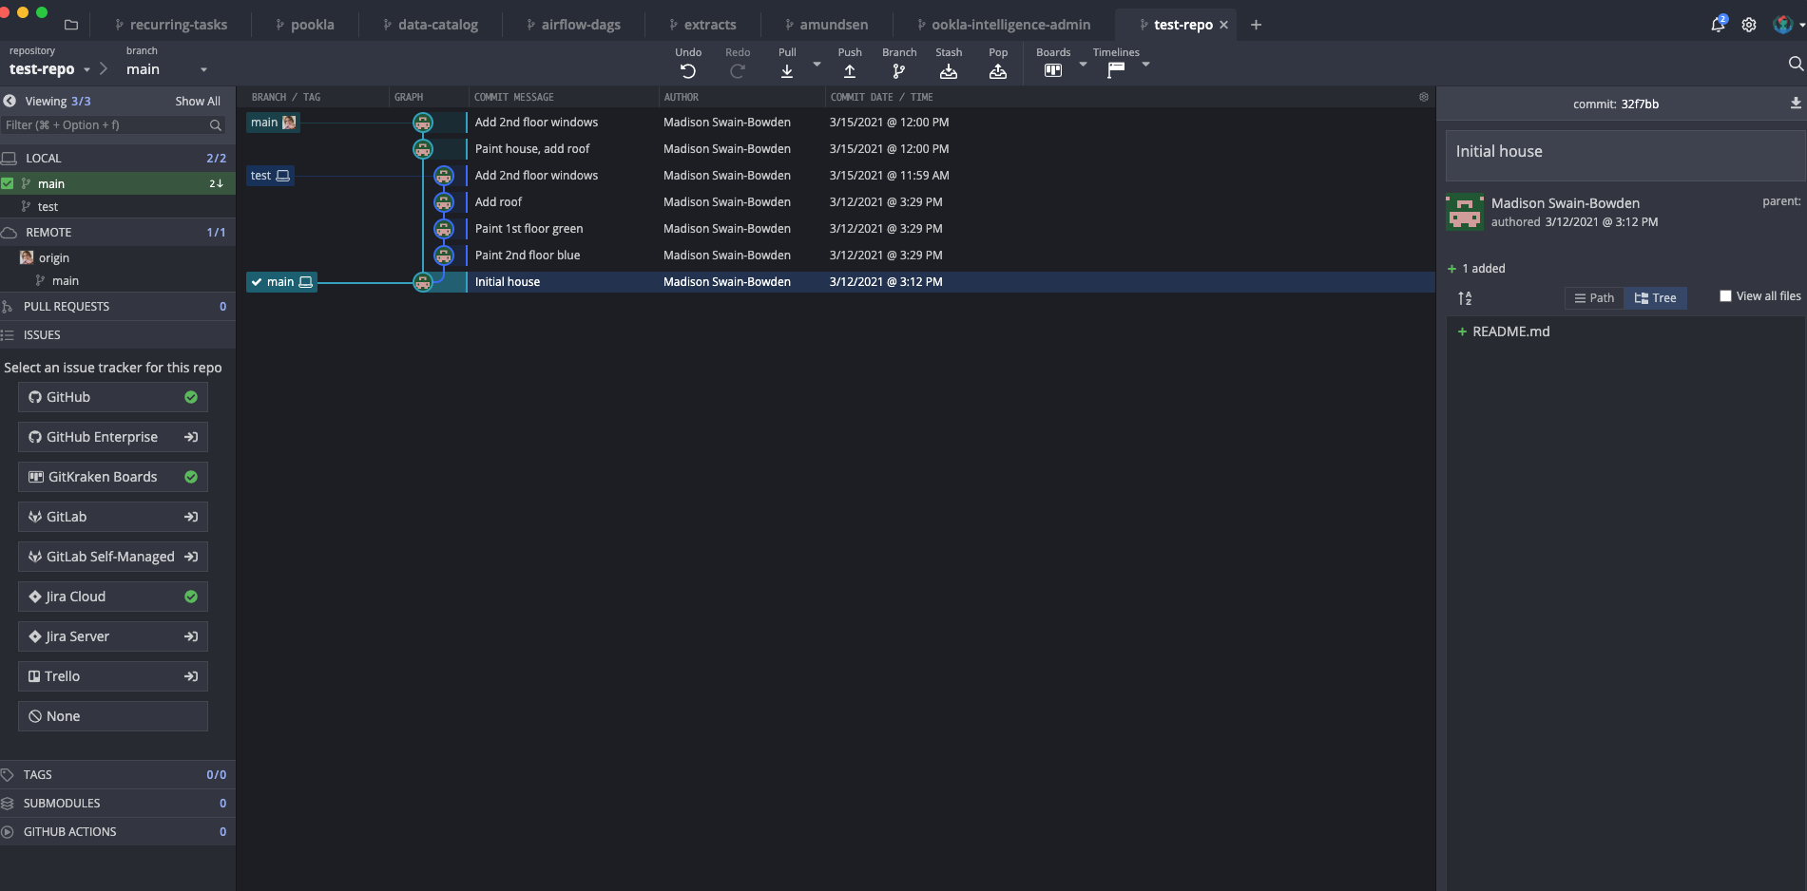
GitKraken Showcase
Notes:
Things to show:
Git commit graph
Index vs local vs remote
Hide/solo branches
Reset branch
Rebase by drag & drop
Conflict resolution
Amend
Refresh main via pull

Slide 26
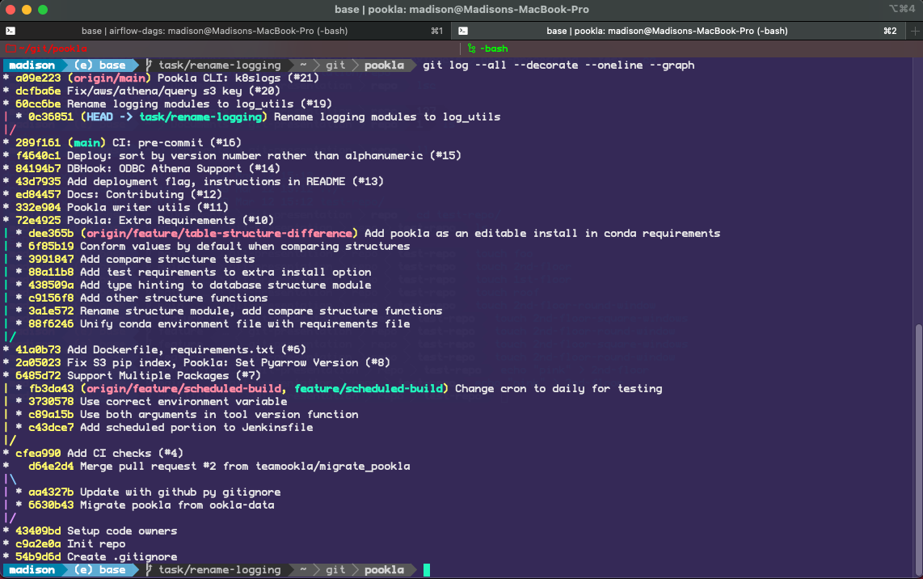
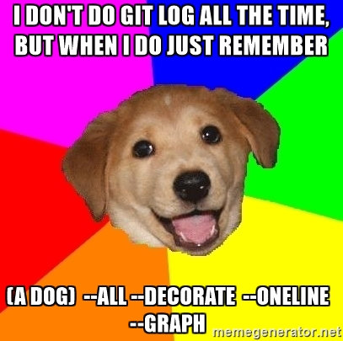
GitKraken Showcase (note for CLI users)

Slide 27
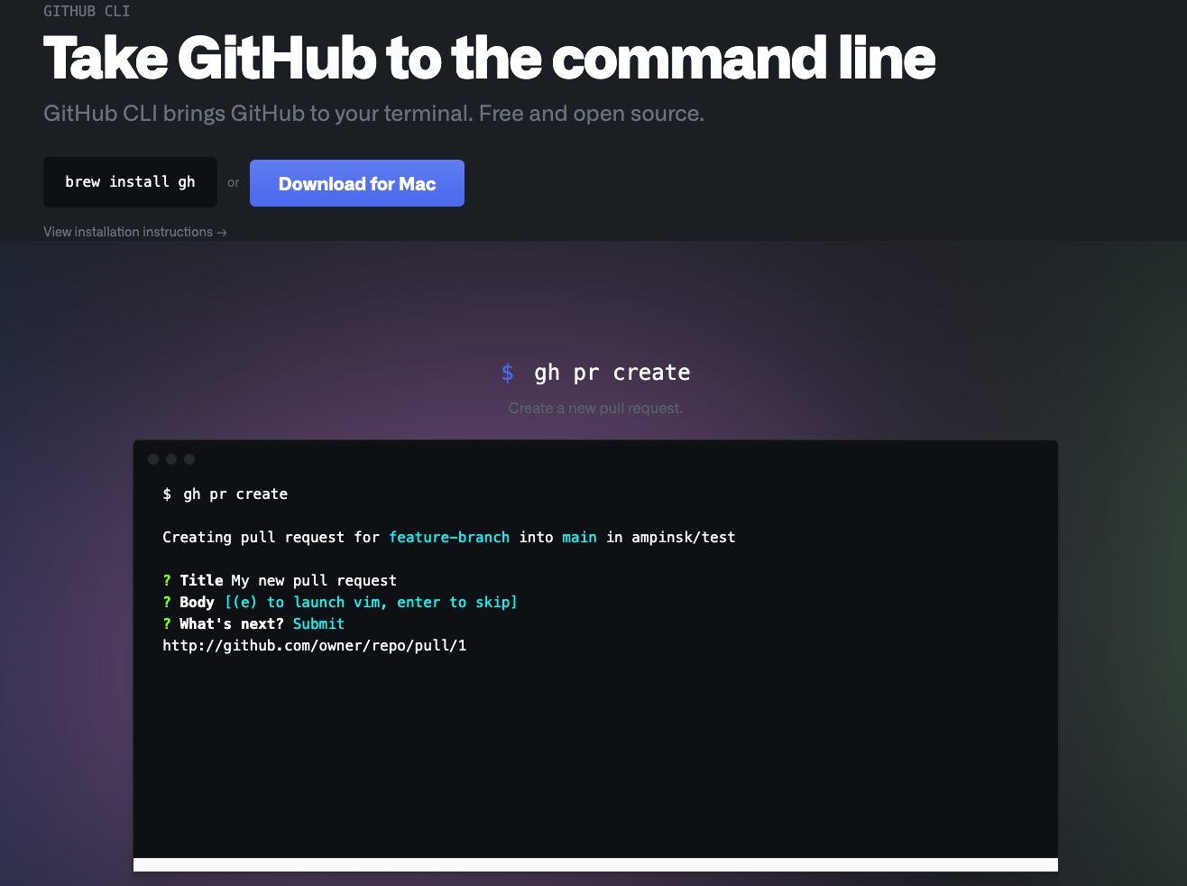
GitHub CLI Showcase
Notes:
Things to show:
gh pr create
edit with vim
continue in browser

Slide 28
Takeaways
Git records changes to files
You have great power over which changes to report and how to report them
Git is a tool for collaboration
Try to make things easy and approachable for others (or even your future self!)
Always be aware of “where” you are in the git commit graph
If you run into a bad “gituation” - ask Madison!
Special thanks to Larisa for that nomenclature

Slide 29
Thank you!

