Slide 1

GitHub Desktop GUI
Kim Dill-McFarland, PhD
April 16, 2021

Slide 2
Collaborate with yourself
git on your local computer

Slide 3
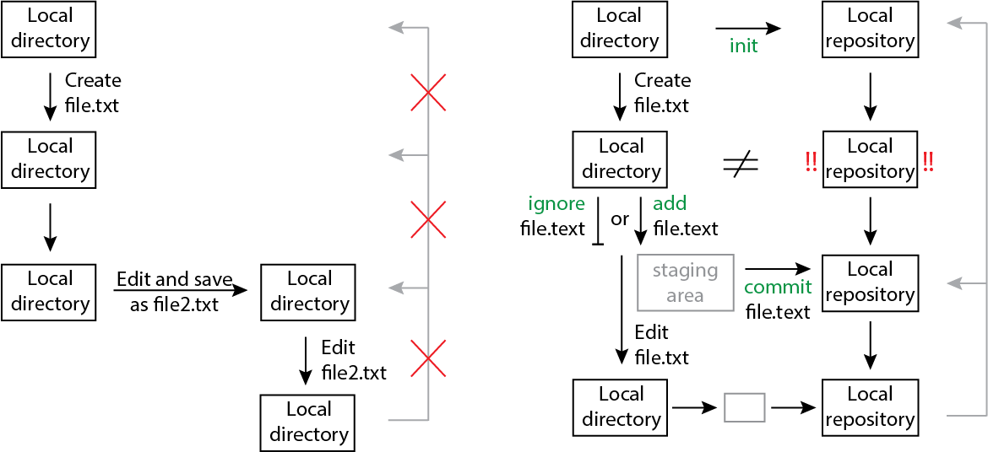
“Standard” workflow

Slide 4
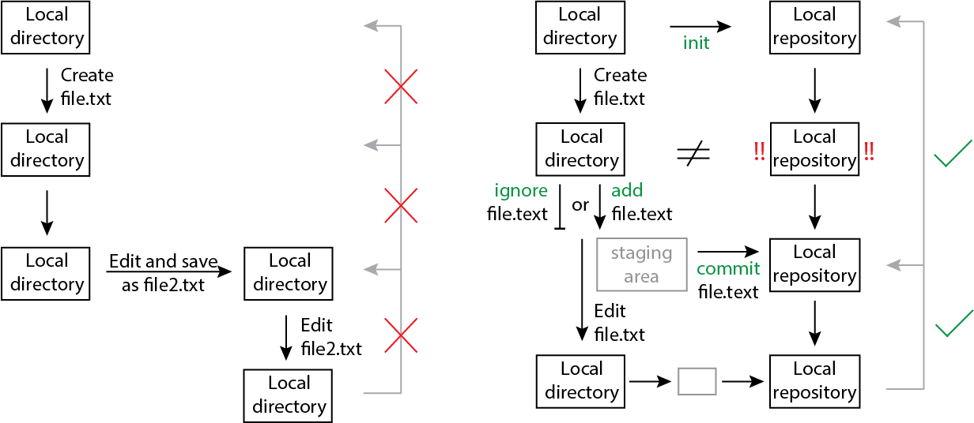
git workflow

Slide 5
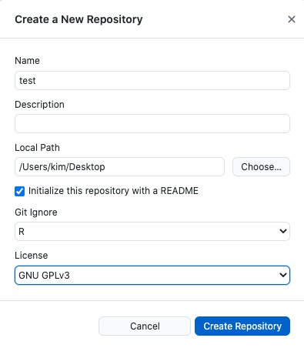
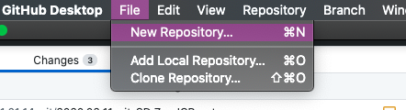
Create a new repository
Always have a README
Optionally auto generate common ignored files for different programs
Add license so others can use your code if made public

Slide 6
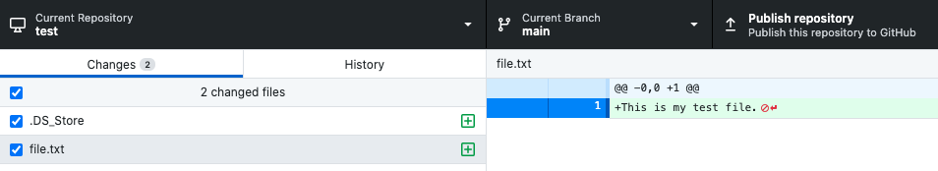
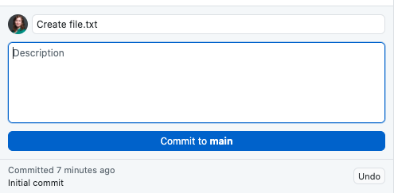
Add and commit a file
If it is a text-based file, see line specific changes since last commit
Select file(s) to add
Must have a main commit message
Optional additional details
Most recent commit message

Slide 7
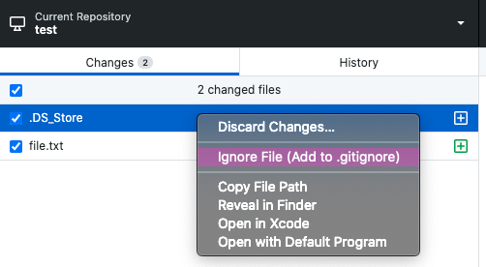
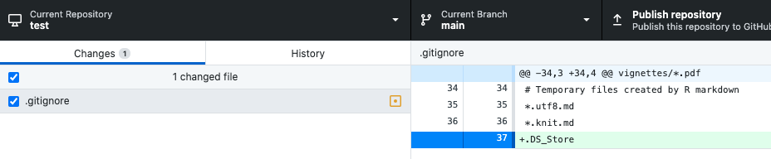
Ignore a file
Right-click

Slide 8
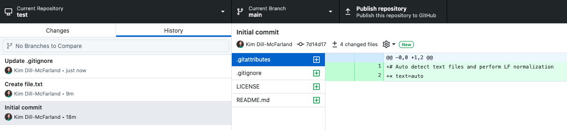
View complete history
kadm@uw.edu @kdillmcfarland Slides https://tinyurl.com/4zsqs2rd

Slide 9
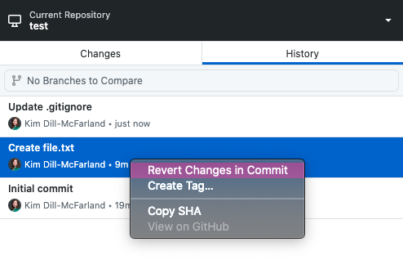
Revert back to old versions
Right-click

Slide 10
Collaborate with others
GitHub

Slide 11
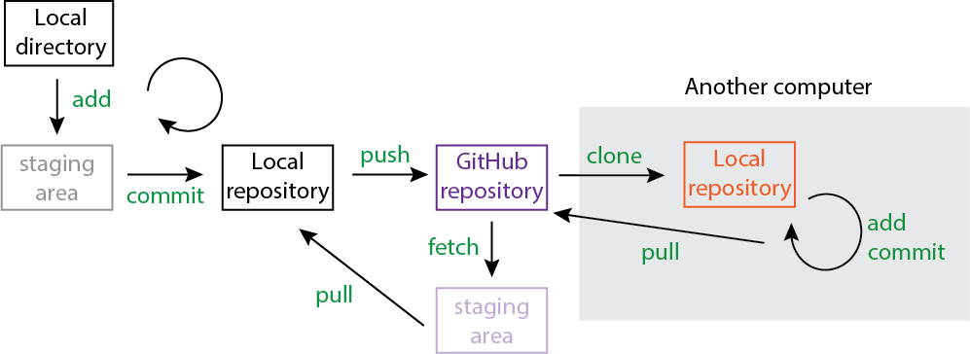

GitHub workflow

Slide 12
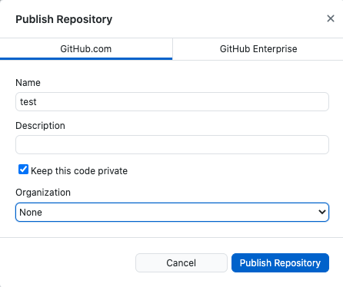
Publish to GitHub
Public vs private. Not all accounts have this option
If you’re part of an organization

Slide 13
Working with GitHub
Check if local and GitHub match
Local copy does not match GitHub.
Click to update GitHub
Local copy does not match GitHub.
Click to update local

Slide 14
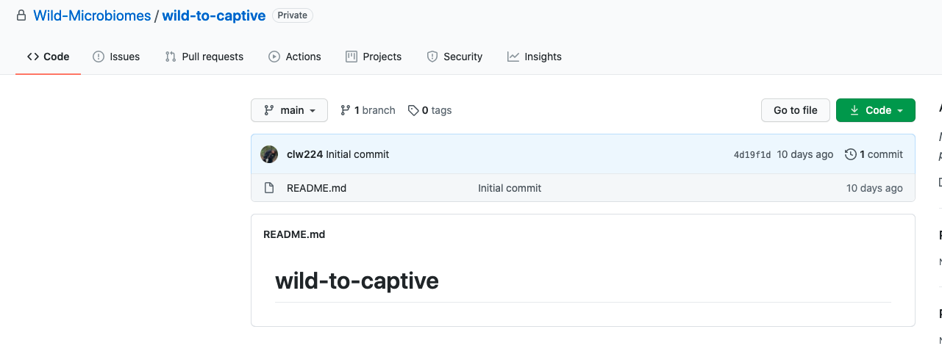
GitHub repos
Let others know about errors, requested features, etc in their repo
Requests to merge in someone else’s code
Files in repo
Automatically renders README

Slide 15
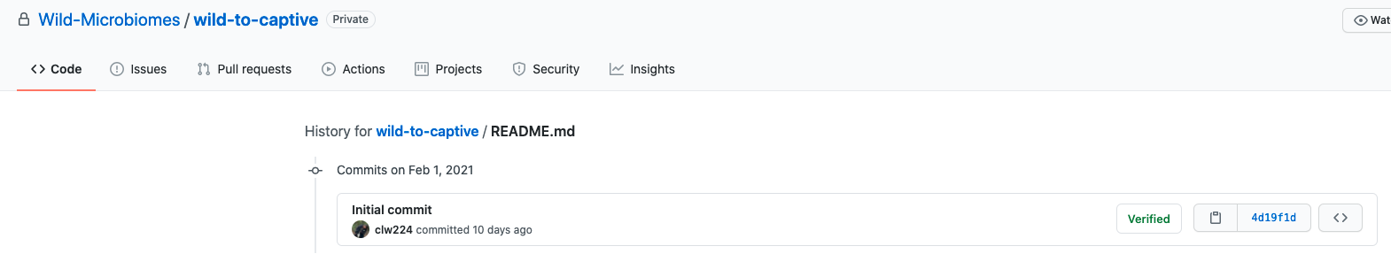
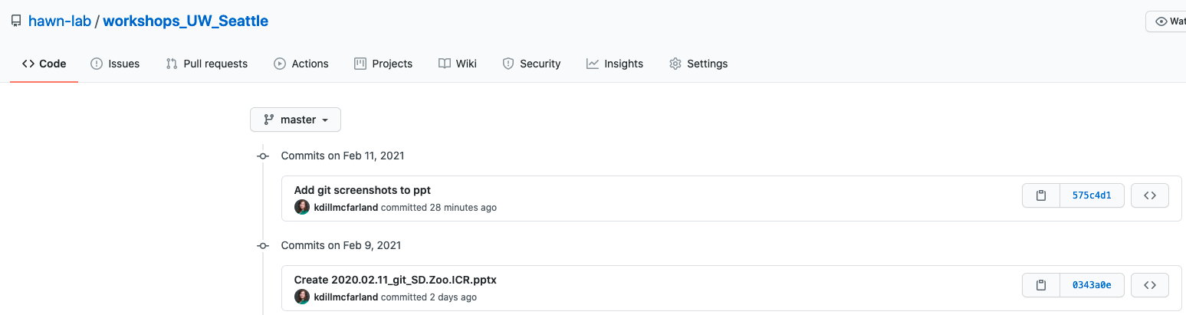
GitHub history
Select a file and view its commit history
Or view an entire repo’s history

Slide 16
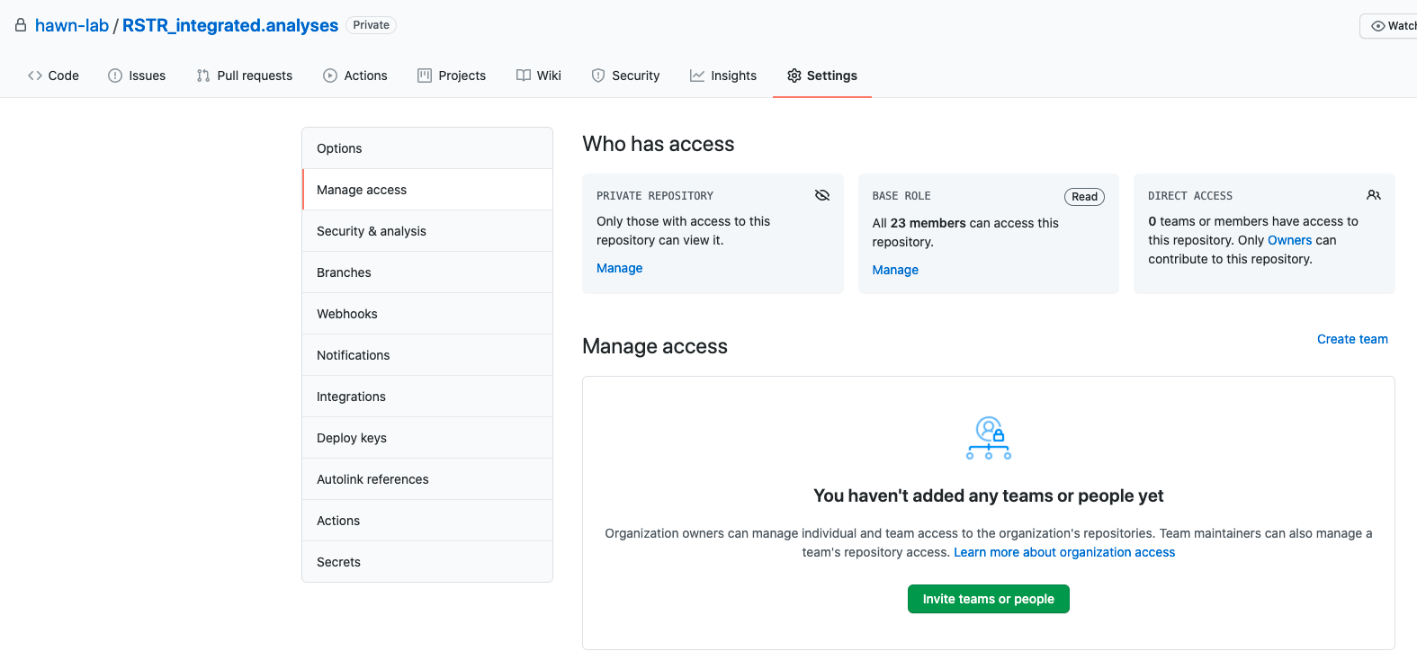
GitHub permissions

