Slide 1
git through April: command line git
Instructor: Monica Gerber (she/her)
Helpers: Kim Dill-McFarland (she/her)
Lauren Wolfe (they/them)
Before we begin:
Install git git-scm.com/downloads
Make a GitHub account github.com
Take the pre-survey (optional but much appreciated!) https://carpentries.typeform.com/to/wi32rS?slug=2021-04-02-r-ladies-seattle-online
Find today’s notes bit.ly/Rladies-git

Slide 2
Overview
Sign-up for each event separately at
https://www.meetup.com/rladies-seattle/events/
02: Command line git
09: GitHub
16: GitHub GUI and RStudio
23: Collaborating in GitHub

Slide 3
Code of conduct
R-Ladies is dedicated to providing a harassment-free experience for everyone. We do not tolerate harassment of participants in any form.
This code of conduct applies to all R-Ladies spaces, including meetups, Twitter, Slack, mailing lists, both online and offline. Anyone who violates this code of conduct may be sanctioned or expelled from these spaces at the discretion of the Global Leadership Team.
If you are being harassed by a member/guest/participant of/at R-Ladies, notice that someone else is being harassed, or have any other concerns, please contact the Global Leadership Team via reporting@rladies.org
For more information https://rladies.org/code-of-conduct/

Slide 4

Attendees
Notes and slides
bit.ly/Rladies-git
.md and .pdf render in your browser, no need to download
Questions
Raise Hand Once an instructor/helper calls on you, you can use voice and/or video to ask a question
Or type it in the chat at any time
You are welcome to have your video on or off as you are comfortable
If we are hacked, the session will end, and you will be emailed a new Zoom link shortly

Slide 5
Instructors / helpers
Add your role and pronouns to your Zoom name
Feel free to interrupt instructor with questions from raised hands or chat
Also let instructor know if there are too many questions to keep up with and we need to pause
If using breakout rooms, try to pre-assign attendees at the beginning to avoid a delay later on

Slide 6
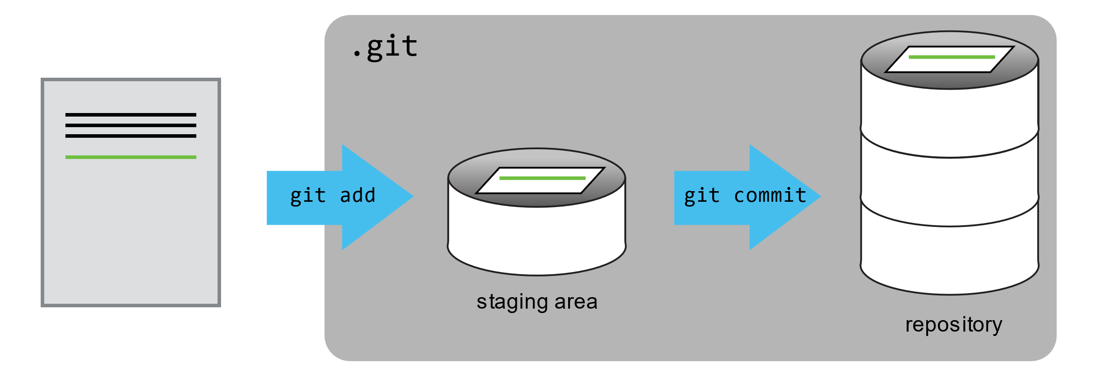

Slide 7
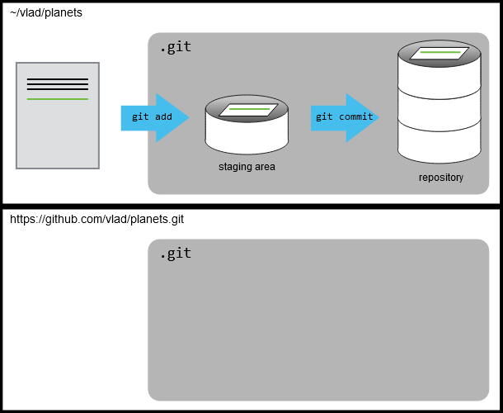

Slide 8
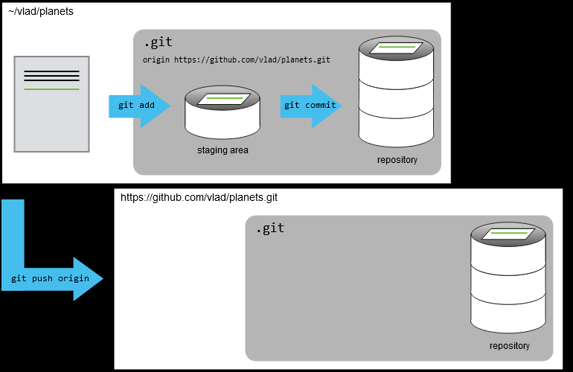

Slide 9
git vocabularly
Nouns
repository/repo
remote
branch
staging area

Slide 10
git vocabularly
Nouns
Verbs
repository/repo
remote
branch
staging area
commit
add
init
push
pull

Slide 11
git vocabularly
Nouns
Verbs
repository/repo
remote (origin)
branch (main or master)
staging area
commit
add
init
push
pull

